Slide 1
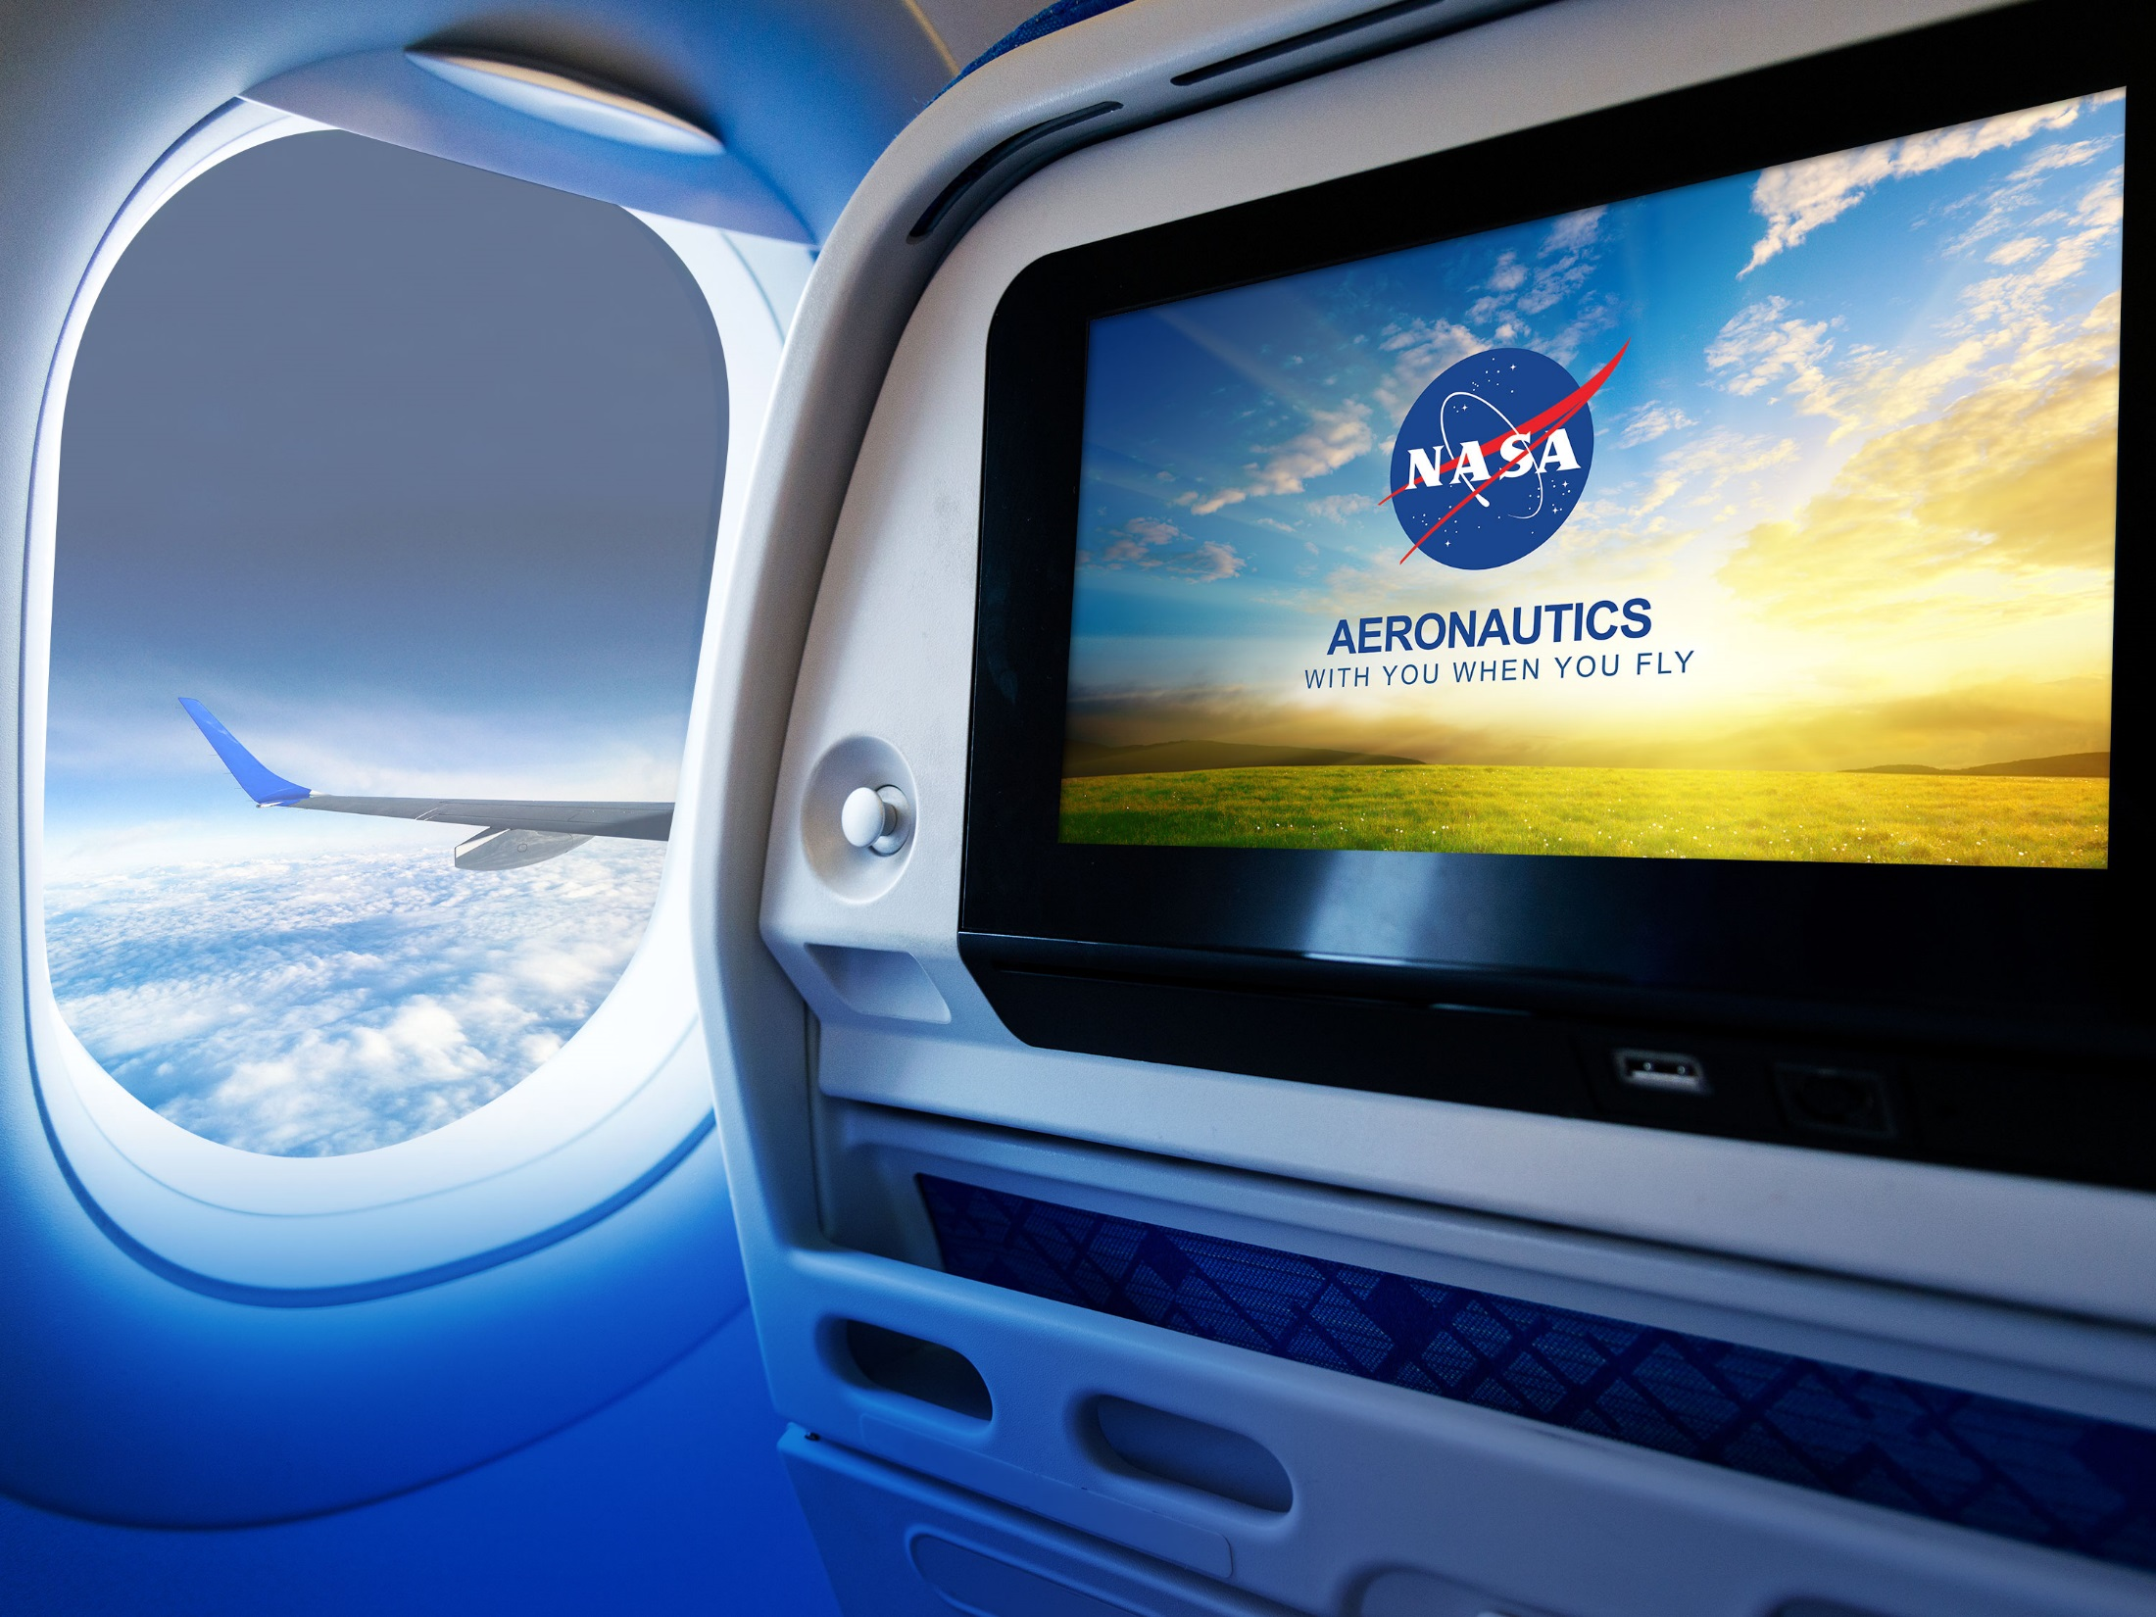
NASA Aeronautics Update
E&E REDAC Subcommittee
Aeronautics Research Mission Directorate
April 5, 2016

Slide 2
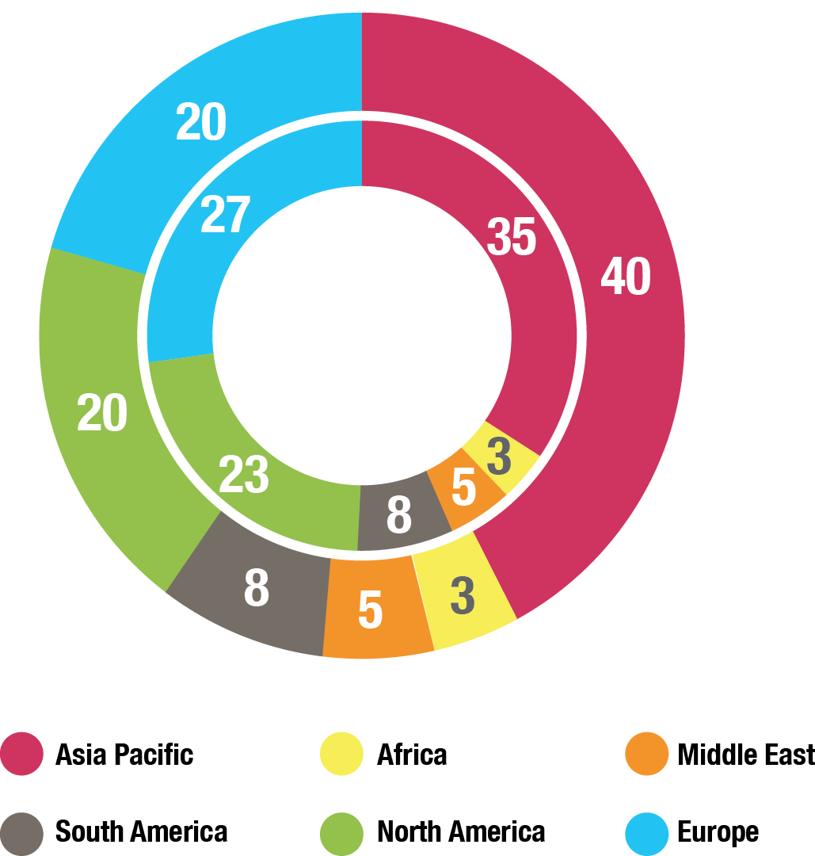
Global Growth in Aviation: Opportunities and Challenges
Global Air Passengers by Region (% of Total)
2014
Global Aviation
Industry
3.3B Passenger Trips
North America and Europe combined is half of all Passenger Trips
58M Jobs
$2.4T GDP
2034
Global Aviation
Industry, est.
7B Passenger Trips
Asia-Pacific Passenger
Trips equal to
North America and
Europe combined
105M Jobs
$6T GDP
Over 36,000 New Aircraft required (replacement and growth) over the
20 year period
($4-$5T value)
Sources: International Air Transport Association, Air Transport Action Group, Boeing
Major Opportunities / Growing Challenges
Competitiveness—New state backed entrants, e.g., COMAC (China); Growing global R&D
Environment—Very ambitious industry sustainability goals; Large technology advances needed
Mobility—More speed to connect the worlds’ major cities; Opportunity for commercial supersonic flight
U.S. Technological Leadership Required!

Slide 3
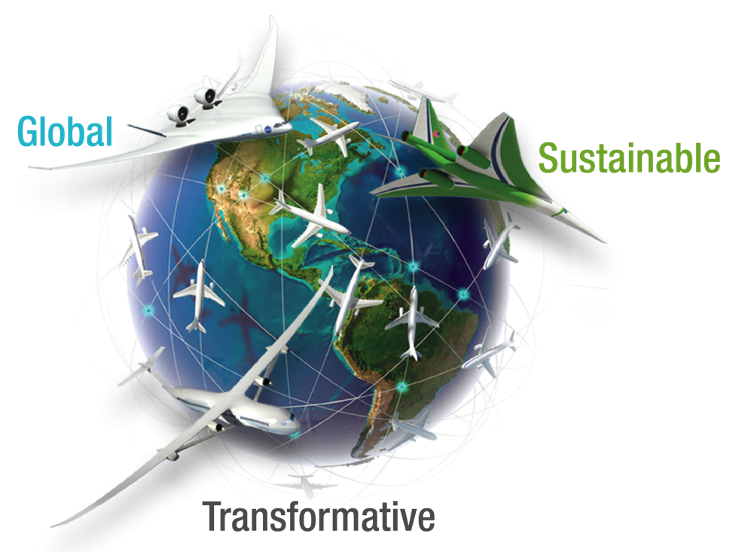
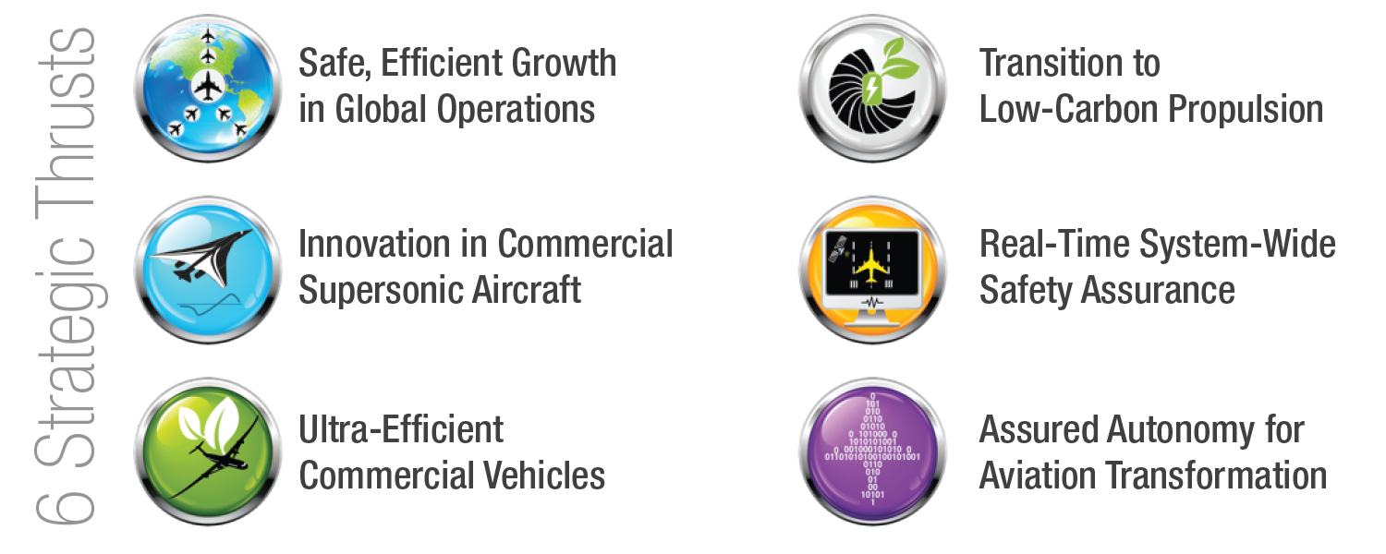
NASA Aeronautics
NASA Aeronautics Vision for Aviation in the 21st Century
U.S. leadership for a new era of flight

Slide 4


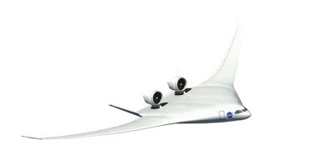



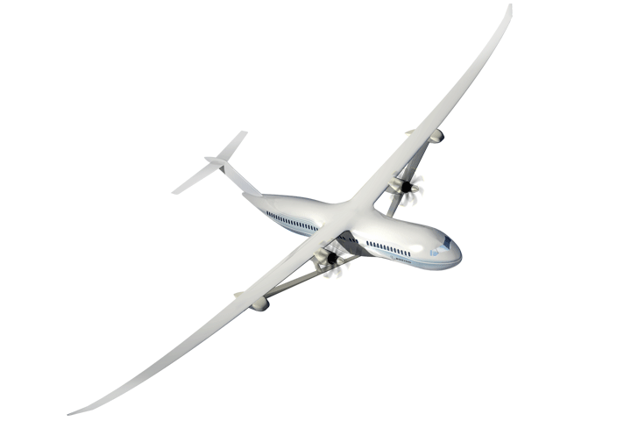
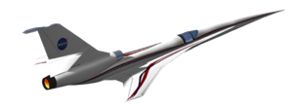



NASA Aeronautics Ready for Flight
Accomplishments and Planning
NASA Aero Vision and Strategy Established
Roadmaps Completed
2008-2013
2014/15
2016/17
2018-2026
N+3 Subsonic & Supersonic Concept/Technology Studies
Ground Testing of N+3 configurations and technologies
LBFD PDR
Completed
UEST PDR
Completed
N+2 Environmentally Responsible Aviation (ERA) Project Initiated
8 Integrated Tech Demos Completed, Tech transitioned to industry. HWB ready for Flight Dem/Val.
Ready for X-Plane Integration & Demonstration
NASA FAA NextGen Research Transition Teams (RTTs) Initiated
Technology Transitions to FAA: MSP, EDA, PDRC, TSAS
ATD-1 Completed and transferred to FAA
ATD-2, 3 Completed
& Transferred to FAA
Ready for NextGen TBO Integration & Demonstration

Slide 5

Ten Year Investment Plan—FY 2017 Budget Accelerates Key Components of NASA Aeronautics Plan
Fund the Next Major Steps to Efficient, Clean and Fast Air Transportation Mobility
New Aviation Horizons
Enabling Tools & Technologies
Revolutionizing
Operational Efficiency
Fostering Advanced Concepts & Future Workforce
UAS
Major series of ground experiments to ready key technologies for flight
Research and ground demonstration for an advanced small engine core for very high bypass engines and as a hybrid-electric propulsion enabler
Development of next generation physics-based models needed to design advanced configurations
Accelerate demonstration of full gate-to-gate Trajectory Based Operations
Strong continued research leadership in enabling UAS integration into the National Airspace. Extending the UAS in the NAS project for an additional 4 years
Start a continuing series of experimental aircraft to demonstrate and validate high impact concepts and technologies. Five major demonstrations over the next 10+ years in the areas of
Ultra-Efficiency,
Hybrid-Electric Propulsion, and Low Noise Supersonic Flight
Increased investment in new innovation through the NASA workforce and Universities
Leverage
Non-Traditional Technology Advances
Hypersonics
Pursue challenge prizes in areas such as energy storage, high power electric motors, advanced networking and autonomy
Increased investment to ensure a strong National fundamental research capability
Major New Initiative within IASP
Increases to AAVP and TACP
Increase to AOSP
Increase to TACP
Increases to IASP and AAVP
Build off of major current developments and accomplishments
Continue to incentivize
new innovation

Slide 6
FY 2017 Budget
$ Millions | FY 2015 | Enacted FY 2016 | FY 2017 | FY 2018 | FY 2019 | FY 2020 | FY 2021 | FY 2022 | FY 2023 | FY 2024 | FY 2025 | FY 2026
Aeronautics | $642.0 | $640.0 | $790.4 | $846.4 | $1,060.1 | $1,173.3 | $1,286.9 | $1,294.2 | $1,307.6 | $1,218.1 | $829.7 | $839.5
Airspace Operations and Safety | 154.0 |  | 159.4 | 159.2 | 176.2 | 189.1 | 221.5 | 198.7 | 200.9 | 193.2 | 175.5 | 167.8
Advanced Air Vehicles | 240.6 |  | 298.6 | 277.4 | 308.8 | 311.6 | 312.6 | 321.3 | 315.0 | 318.9 | 317.7 | 326.7
Integrated Aviation Systems | 150.0 |  | 210.0 | 255.4 | 381.4 | 493.0 | 556.7 | 591.5 | 612.2 | 525.0 | 203.8 | 210.6
Transformative Aeronautics Concepts | 97.4 |  | 122.3 | 154.4 | 193.8 | 179.7 | 196.2 | 182.8 | 179.4 | 181.0 | 132.7 | 134.4
Aeronautics budget includes paid-for 10-year mandatory funding from the Administration’s 21st Century Clean Transportation Plan. See appendix for additional detail.
Mandatory Budget Authority $ Millions | FY 2017 | FY 2018 | FY 2019 | FY 2020 | FY 2021 | Outyears
21st Century Clean Transportation Plan | 100 | 200 | 400 | 500 | 600 | 1900
Airspace Operations and Safety | 18 | 20 | 35 | 45 | 75 | 170
Advanced Air Vehicles | 30 | 41 | 79 | 80 | 65 | 305
Integrated Aviation Systems | 37 | 84 | 196 | 300 | 370 | 1170
Transformative Aeronautics Concepts | 15 | 55 | 90 | 75 | 90 | 255
Low Boom Flight Demonstrator | 56
Integrated Aviation Systems | 56

Slide 7
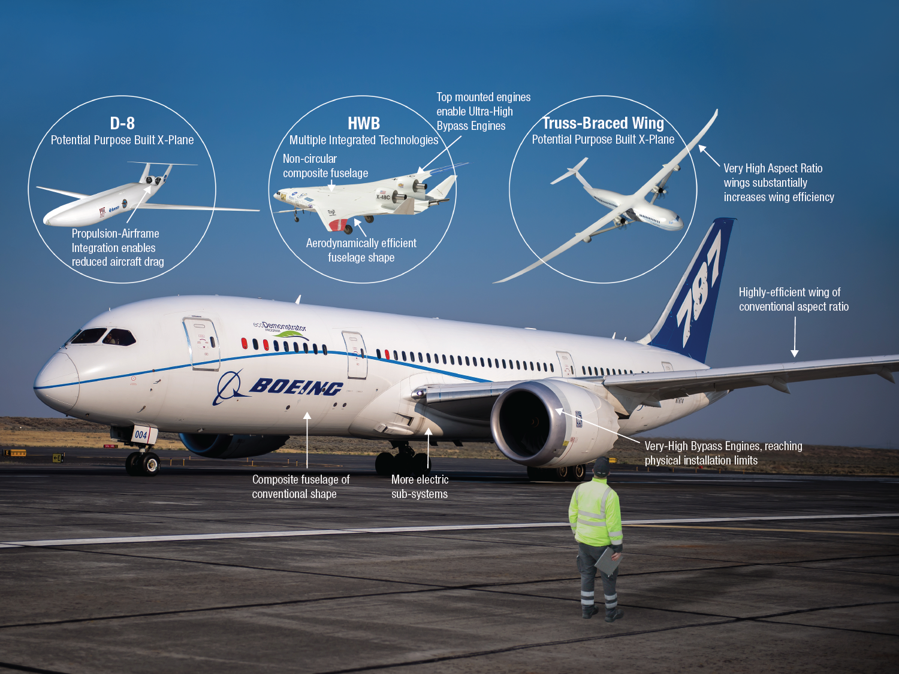
Ultra-Efficient Subsonic Demonstrators
787 image credit: Boeing

Slide 8
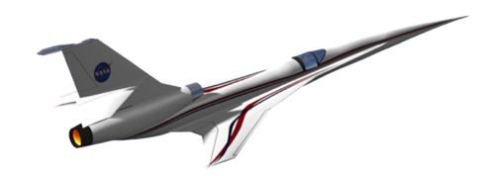
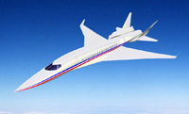

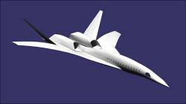
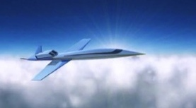
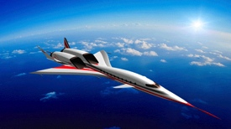
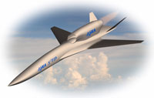
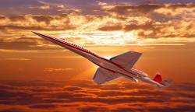
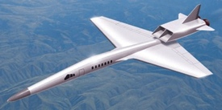
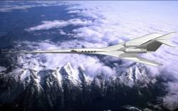
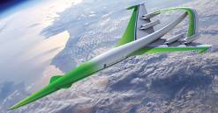
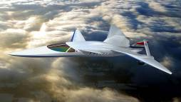
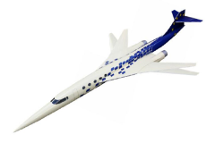

Low Noise Supersonic Flight
First Step to Unlocking a Global Market
JAXA
Hypermach
Dassault
Boeing
Spike Aerospace
S³TD
Aerion
Sukhoi/TsAGI
Gulfstream
Lockheed Martin
Supersonic Aerospace Int’l
Alenia Aeronautica
Low Boom Flight Demonstrator
Demonstrate that noise from sonic boom can be reduced to a level acceptable to the population residing under future supersonic flight paths.
Create a community response database that supports an International effort to develop a noise based rule for supersonic overflight.
Establish U.S. Leadership for this New Global Market
Supersonic Low Boom Flight Demonstration Concept

Slide 9
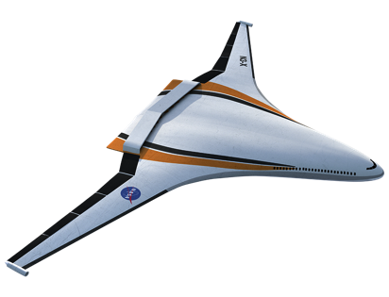
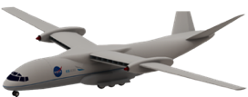



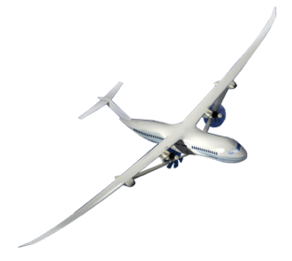
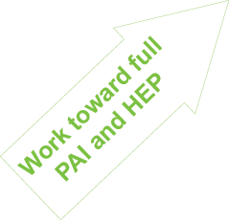

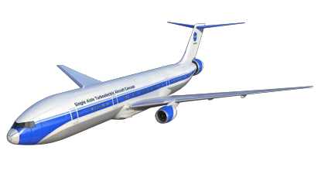
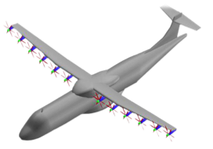
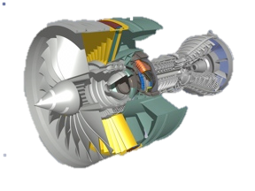
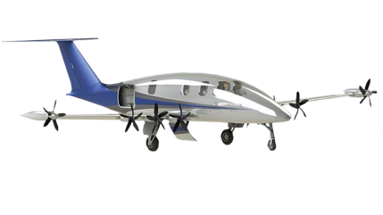
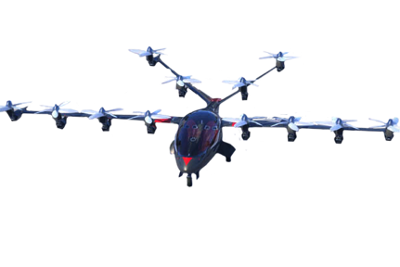
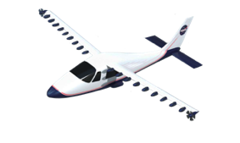

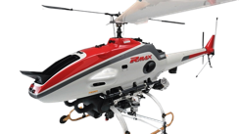
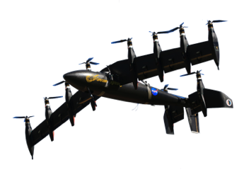
Hybrid Electric Propulsion
Prove Out Transformational Potential
+
Single Aisle Transport
Explore and demonstrate vehicle integration synergies enabled by hybrid electric propulsion
2040
Increasingly electric aircraft propulsion with minimal change to aircraft outer mold lines
2030
Environmental Benefit
Image Credit: Joby
Modeling
2020
Explore Architectures
Image Credit: Yamaha
Test Beds
Small Aircraft
Component Improvements
Gain experience through integration and demonstration on progressively larger platforms
+
Knowledge through Integration & Demonstration
Notes:
We will add the proper links to the sonic boom noises when I get back. If they are desired

Slide 10
New Era For NASA Aeronautics
Investing In Our Future - Investments in NASA’s cutting edge aeronautics research today are investments in a cleaner, safer, quieter and faster tomorrow for American aviation:
A future where Americans are working in stable, well-paying jobs.
A future where we fly on aircraft that consume half as much fuel and generate only one quarter of current emissions.
A future where flight is fueled by greener energy sources.
A future where our air transportation system is able to absorb nearly four billion more passengers over the next 20 years without compromising the safety of our skies.
A future where our airports are better neighbors because aircraft noise is contained well within the airport boundary.
A future where people can travel to most cities in the world in six hours or less in an airplane that can fly faster than the speed of sound on bio-fuels.

