Slide 1
FAA Alternative Jet Fuels - Analysis, Testing and Coordination Update
To: FAA E&E REDAC
By: Nate Brown, Mohan Gupta,
and Jim Hileman
Date: April 5, 2016
Notes:
Overview of the program
Alternative jet fuels are a key component of U.S. strategy for meeting aviation environmental goals
FAA efforts are directed to overcoming key challenges via testing, analysis and coordination
Multiple programs and activities focus on different aspects of the challenge
Partnerships across technical areas, and with partners with very different expertise across the supply chain are a key focus
Strong domestic and international coordination necessary for success
FAA Alternative Jet Fuel principles:
must be drop in, have equivalent safety and better environmental performance than petroleum Jet fuel
Enable all possible fuels that meet criteria
Government role to address key barriers
Work through Public-Private Partnerships
Address the whole supply chain
Leverage expertise and resources of other government agencies and other countries
Aviation should be a lead user of alternative fuels

Slide 2



FAA Alternative Jet Fuel Activities
Testing
  Support Cert/Qual testing
  Improve Cert/Qual process (NJFCP)
  Emissions measurements
Analysis
  Environmental sustainability
  Techno-economic analysis
  Future supply
Coordination
  Interagency
  Public-Private
  State & Regional
  International
2

Slide 3
FAA Alternative Jet Fuel Activities
CLEEN Testing and Research Report Review
Volpe BAA Testing
A31 Alternative Jet Fuel Test & Evaluation
A33 Alternative Jet Fuel Test Data Library
SEMRS Jet Fuel Data Tracking
A25-30, 34 National Jet Fuels Combustion Program
Testing
  Support Cert/Qual testing
  Improve Cert/Qual process (NJFCP)
  Emissions measurements
Analysis
  Environmental sustainability
  Techno-economic analysis
  Future supply
Coordination
  Interagency
  Public-Private
  State & Regional
  International
A01 Alternative Jet Fuel Supply Chain Analysis
A13 ACCESS 2 Micro Physical Modeling with NASA
A24 Emissions Data Analysis for CLEEN, ACCESS, and Other Recent Tests
A32 Worldwide Life Cycle Analysis (LCA) of Greenhouse Gas (GHG) Emissions from Petroleum Jet Fuel
SEMRS Analysis
Volpe Alternative Fuels Transportation Optimization Tool (AFTOT)
Impacts of removing naphthalene from jet fuel (ASCENT - New)
CAAFI
Farm to Fly 2.0
Federal Alternative Jet Fuel Strategy
International agreements
3

Slide 4
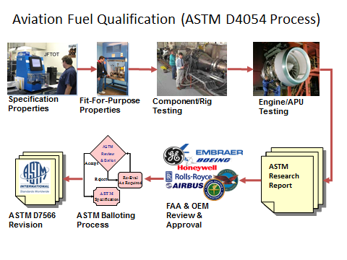
Alternative Jet Fuel Testing
Support ASTM Intl evaluation of alternative jet fuels
Support ASTM D4054 testing activities to develop data for approvals
(CLEEN; Volpe BAA; SEMRS; ASCENT A31; CLEEN II)
Research Report Review
(CLEEN; A31)
Data Gathering
(ASCENT A33, SEMRS)
Streamline approval process via the National Jet Fuels Combustion Program (ASCENT A25-30, 34)
Notes:
1) Near term effort to Support ASTM D4054 testing activities to enable development of data for approvals
BAA/SEMRS/CLEEN
Honeywell APU testing of 7 fuels underway
ASCENT Project 31
TBD fuels tested
2) Support for Research Report Review & Coordination
Via CLEEN
Support organized approach to fuels in ASTM pipeline
Boeing, GE, Honeywell, P&W, RR and SWRi
3) Data Gathering
Alternative Jet Fuel Test Data Library (ASCENT A33) -- focus on creating a library to catalogue the test data that has and will be collected from previous, current and future alternative fuels testing. Plan to establish a framework for the database, as well as host a web-portal that will make the data collected accessible to the general public.
Worldwide Jet Fuel Data (SEMRS) – Metron & A4A project gathering fuel specification data of conventional jet fuel at airports throughout the US and the world. Track the spec properties at the various airports over time to give insight to the variation of properties in conventional jet fuel, and substantiate a tolerance level for spec properties in alternative fuels. Conventional jet fuel property data at multiple areas can be useful in aircraft emissions modeling and future alternative fuel blending efforts.
4) Mid term effort to streamline ASTM International jet fuels approval process
Develop generic fuel composition/chemistry evaluation methodology
Standardized rig/lab tests
Chemical kinetic/combustion modeling
Collaborative OEM/university/federal effort

Slide 5
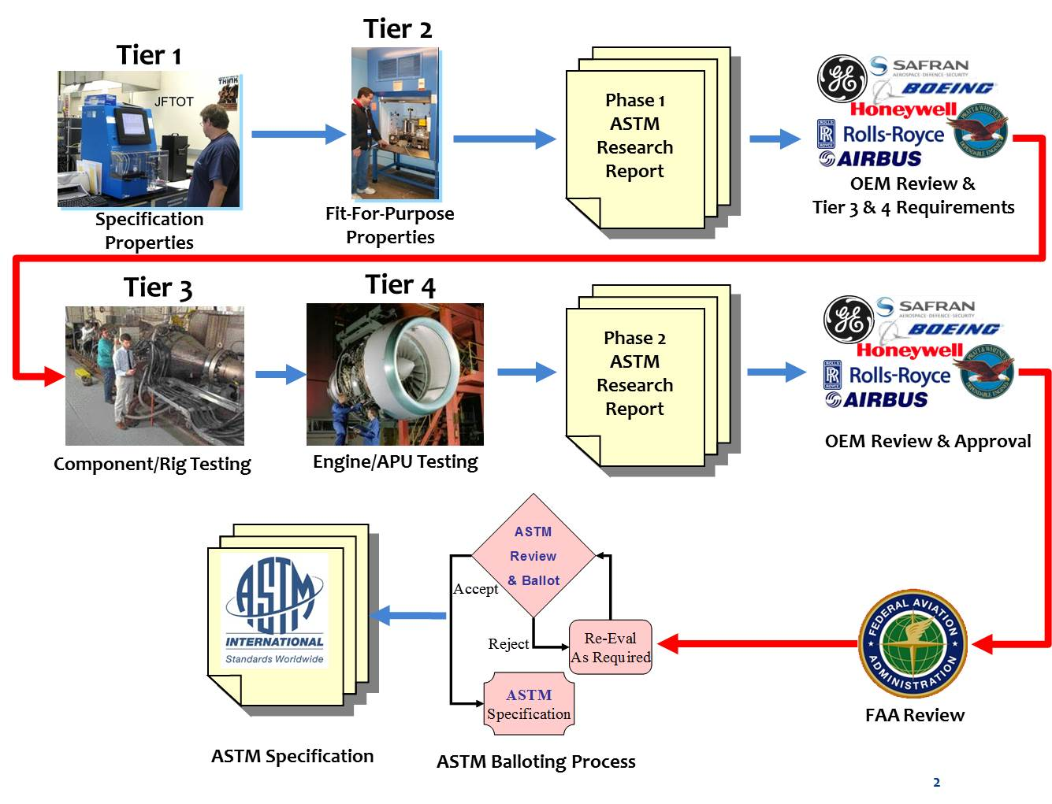
Modified D4054 Fuels Qualification Process

Slide 6






Status of Alternative Jet Fuels
OEM Screening & Reqts
OEM Engineering Review
OEM Review Process Step
1
2
3 4 5 6 7 8 9
Awaiting Honeywell Combustor Rig test results before defining Tier 3 & 4 test req’ts
On-hold waiting for Virent SK to advance
Addressing SNECMA and Airbus negatives
Notes:
OEM Approval Process & Status of Alternative Jet Fuels 1-9

Slide 7
Alternative Jet Fuels Testing
CLEEN Program
  Honeywell performed atomizer spray, combustor rig, and APU altitude cold start with Virent SK and Green Diesel (cooperative testing with Navy, USAF also covers ARA)
  Supporting ASTM Review at Rolls Royce, GE, Pratt & Whitney, Boeing, Honeywell, SWRi,
  Support USAF funded APU testing by Pratt & Whitney of Lanzatech/Swedish biofuels ATJ.
CLEEN II
  GE will perform combustor rig testing on advanced designed combustors
  Rolls Royce will perform atomizer spray and combustor rig
ASCENT 31
  Perform laboratory testing and support ASTM research report review

Slide 8
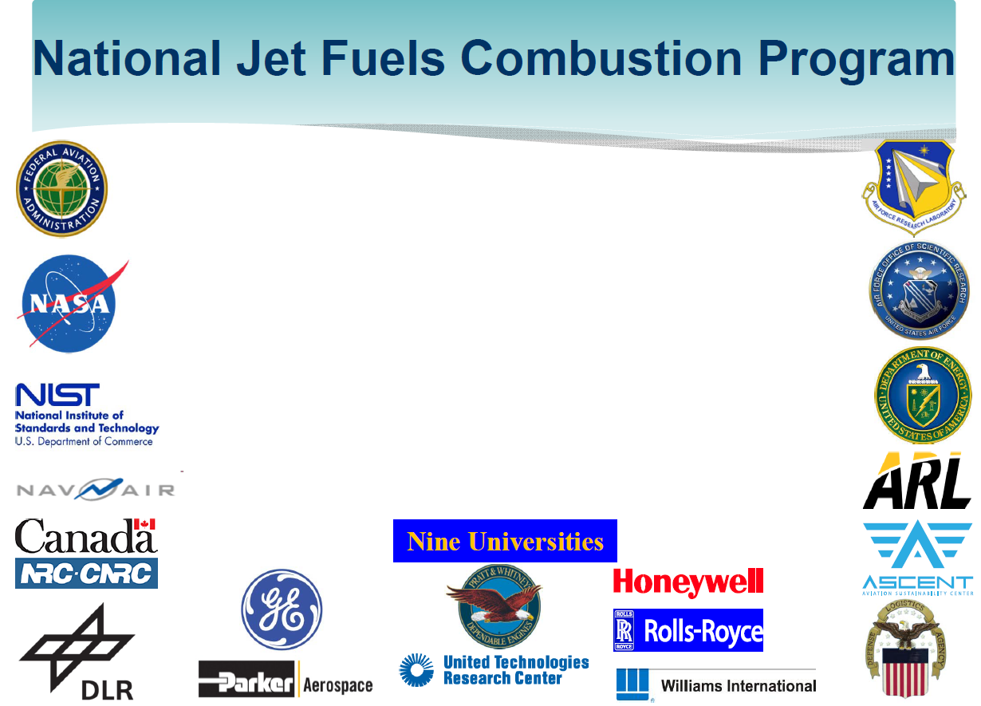
Wide ranging participation from 35 entities worldwide
Program is directly funded by FAA, AFRL, NavAir, and DLA Energy
NASA is directly funding all NJFCP modeling areas
AFOSR is supporting some NJFCP areas through its combustion program (4 universities are involved)
Program is supported by in-house funded activities – NASA, NRC Canada, DLR (Germany), Army Research Lab, Univ. Sheffield (UK) and Univ. Toronto (Canada)

Slide 9
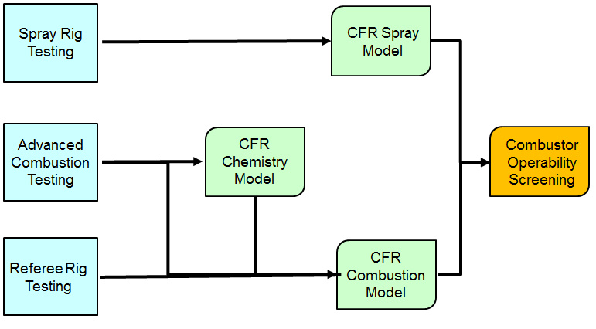
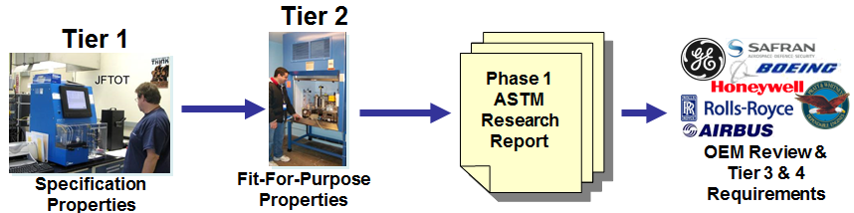
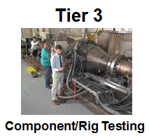
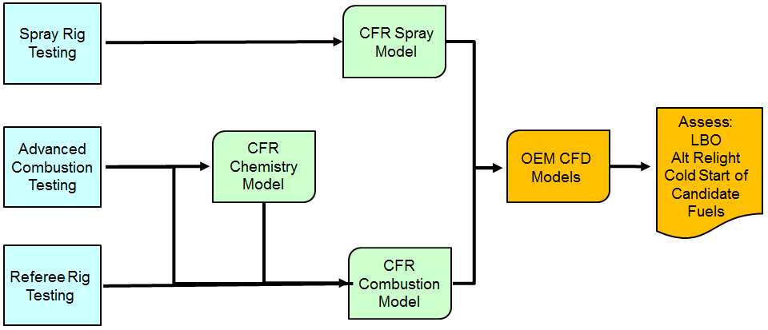
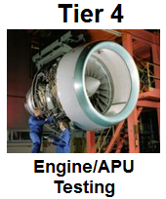
Improved OEM Screening of Jet Fuels following Integration of Successful NJFCP Outcomes
Redesign/Reengineer Fuel Development Pathway
NJFCP: Initial Fuel Screening at a representative operating condition using OEM designed 1-Cup Rig linking fuel to the FOM
Scope of Tier 3/4 Testing Determined by NJFCP Results
Expand & Employ Gained Knowledge Base
Acceptable Combustor Operability?
No
Yes
3 Figures of Merit (FOM):
Lean blowout
Cold Start
High Altitude Ignition
NJFCP: Detailed Fuel Testing & Combustion Modeling at an extended range of conditions using OEM designed 1-Cup Rig to study FOM
Benefits: Early fuel screening, targeted Tier 3 and 4 tests, and increased OEM confidence

Slide 10
NJFCP: Take-Aways/Key Points
NJFCP program is targeted to improve and streamline current ASTM fuel approval process
Year 1 Accomplishment Summary:
  Experimentally screened fuels, demonstrated fuel effects, and performed detailed measurements for model comparisons
  Modeling teams have simulated detailed fundamental experiments and multi-dimensional multi-phase experiments.
Excellent coordination amongst Government, OEMs, and universities
Community-wide national and international participation
  Leveraging interagency and international support
Year 2 – Develop additional testing capabilities, iterate on modeling methodology and develop Fuel-X Approach for blend and neat fuels

Slide 11
Program Success Criteria for the First Year
Demonstrate that one or more tests have sensitivity to a test fuel over a range of conditions that offer the potential of their being used as part of a methodology for simplifying the alternative fuel certification process
Demonstrate that a validated surrogate chemistry model can be developed that has the potential of being used to predict fuel-sensitive test results over a suitable range of conditions
Demonstrate a combustion modeling approach that can be integrated into an OEM’s procedures that offers the potential of being used to predict fuel effects on combustor operability and simplify the alternative fuel certification process

Slide 12
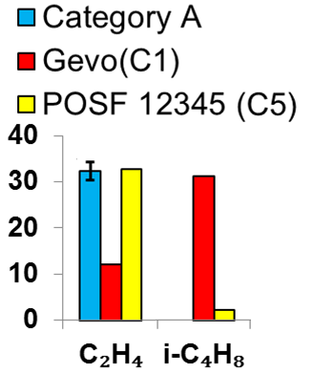
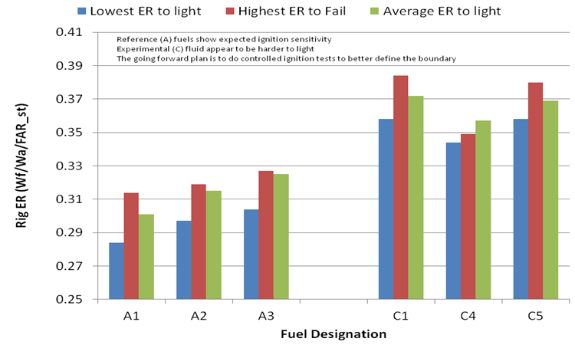
Year 1 Success Criteria 1
Demonstrate that one or more tests have sensitivity to a test fuel over a range of conditions that offer the potential of their being used as part of a methodology for simplifying the alternative fuel certification process
Complete – All rigs have shown fuel sensitivity.
Area 1 – Shock tube and flow reactor
Area 3 – High sheer, forced ignition, and turbulent flame speed rigs
Area 5 – Atmospheric spray rig
Area 6 – Referee rig lean blow out and ignition tests
Area 3
✓
Area 1 Flow Reactor
C1
C5
Ignition sensitivity
Area 6
Speciation sensitivity
A-3

Slide 13
Year 1 Success Criteria 2
Demonstrate that a validated surrogate chemistry model can be developed that has the potential of being used to predict fuel-sensitive test results over a suitable range of conditions
A1
Complete
Chemical Kinetics (Complete): Area 2 sensitivity modeled for two fuels in shock tube and flow reactor studies.
Sprays (Progressing): Area 4/5 is completing its study shortly. Nader Risk (contractor) has modeled fuel effects and shown fuel sensitivity for Area 5 spray rig.
Combustion Rigs (Progressing): Areas 4 and 4/5 are processing and finishing results for Areas 3 and 6 advanced combustion testing.
✓
Area 2
C1

Slide 14
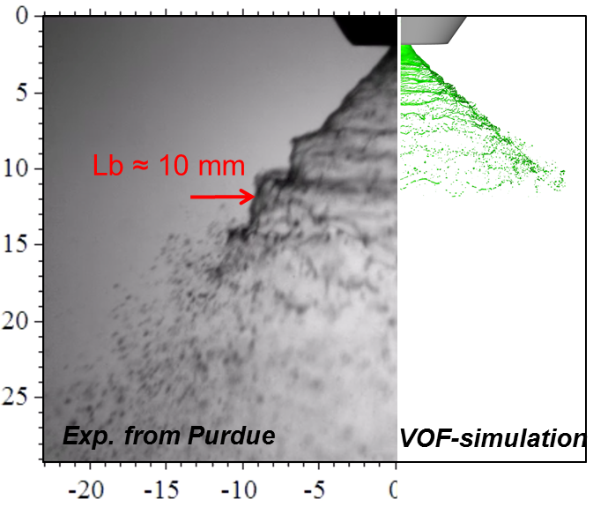
Year 1 Success Criteria 3
Demonstrate a combustion modeling approach that can be integrated into an OEM’s procedures that offers the potential of being used to predict fuel effects on combustor operability and simplify the alternative fuel certification process
Complete
✓
Demonstrated approach to LBO
Drafted plan for integration of computational approach into OEM Common Formate Routines (CFR); revisions underway.
15 December: final draft accepted by OEMs
Path to deliver NJFCP modeling approaches for use by OEMs in certification is undergoing review.
Test capabilities being developed to test conditions near cold start and altitude ignition conditions FOMs.

Slide 15
Summary of OEM Year 1 Assessment (Oct, 2015)
Progress was very positive and overall the year 1 success criteria has been met
All the tests are up and running, repeatability has been established, many of the fuels were tested, and fuel effects were demonstrated
Area 4 modelers are being paced by and eager to receive Area 5 spray measurements and derived spray correlations
A plan for Fuel X modeling has not been presented, CFD modeling efforts have started but have not demonstrated fuel effects, and the transition plan for models/tools to OEMs is still unclear
This page contains no technical data subject to the EAR or the ITAR

Slide 16
Year-2 Success Criteria
COLD FUEL AND AIR TESTS: Demonstrate capability and data collection with cold fuel and (cold) air under one or more NJFCP Test areas targeting one or more of the FOMs, and, where possible, at sub-atmospheric conditions (as low as 0.5 atm)
SEMI-QUANTITIVE COMBUSTION SIMULATIONS: Demonstrate manageable size and applicable kinetic/combustion models that show right order-of-magnitude effects against collected data
ADVANCED FUEL-DEPENDENT ENGINEERING MODELS: Demonstrate physics-based fuel-dependent engineering models of spray break-up, filming, and evaporation at realistic conditions for use in CFD simulations

Slide 17
Year-2 / Year-3 Work Plan
  Demonstrate fuel effects during ignition in a fundamental rig and in aeroengine rigs under altitude (relight) and cold fuel conditions
  Examine fuel effects on LBO at sub-atmospheric and cooled fuel conditions
  Generate approaches and partially validate modeling methods for generic jet fuels (Fuel-X) based on laboratory tests (e.g. Tier 1 & 2)
  Develop and demonstrate fuel-dependent spray models for CFD
  Validate fuel-dependent (engineering-based) CFD models and demonstrate reduction for LBO
  Integrate efforts by allied partners into development plans
This plan is consistent with OEM Expectations for Year-2.

Slide 18
Years 1-3 Budget Details
Year 1 Funding ($K)
Funding Area | FAA | AFRL$ | DLA Energy | Navy
OEMs | 500 | 500
NJFCP Testing (ASCENT) | 1,150 | 1,300 | 250
NJFCP Modeling (ASCENT) | 750 | ------
NJFCP Integration (ASCENT) | 100
Other Testing & Contract Support | ------ | 171 | 500 | 200
Sub Total | 2,500 | 1,971 | 750 | 200
Grand Total | 5,421
Besides FAA, many other federal agencies and international partners are significant contributors to the program.
$AFRL spends additional funds (that are not included here) to procure fuels and rig development and maintenance for the program.
Additional Contributions
AFOSR (consistently investing in the fundamental-DOD 6.1 combustion and fuel research through its core: ~$1.4M/yr. in areas directly related to NJFCP on leveraged bases, in addition to STTR listed in tables left)
ARL (in-house activities, $550K)
DOE (in-house activities at National Labs and possible support to secure fuels for testing)
NASA (in-house activities)
NIST (in-house activities)
NRC (in-house activities, $500K)
DLR (In-house activities funded by EU ECLIF program)
Univ. Sheffield (in-house activities)
Year 2 Resources ($K)
Agency Contributions
FAA (Testing and analysis areas: 1, 3, 5 and 7) | 1,353
AFRL (Testing area 6 + misc.) | 1,650
NASA (All modeling areas: 2, 4 and 5) | 1,103
DLA (misc.) | 500
AFOSR (STTR, tech transition to area 4) | 375
Navy (misc.) | 200
Grand Total | 5,191
Year 3: FAA Funds: $2M

Slide 19
NJFCP: Future Plans (Beyond Dec 2017)
NJFCP is initially designed as a 3-year program
  Year 3 funding (FY16) will last through Nov. 2017.
Assess the program success and deficiency at the end of Nov 2016 to decide need for FY17 funding
Mature plans for transition of NJFCP capabilities for ASTM Fuel Approval Process
NARP 2018 Milestone:
Advance approval methodology for alternative jet fuels

Slide 20


FAA Alternative Jet Fuel Activities
Testing
  Support Cert/Qual testing
  Improve Cert/Qual process (NJFCP)
  Emissions measurements
Analysis
  Environmental sustainability
  Techno-economic analysis
  Future scenarios
Coordination
  Interagency
  Public-Private
  State & Regional
  International
20
Notes:
2. Analysis on impacts, economics and availability to:
Improve understanding of environmental and economic sustainability of alternative jet fuel pathways
Improve understanding of the potential availability of alternative jet fuels

Slide 21
Alternative Jet Fuel Analysis
A01 Alternative Jet Fuel Supply Chain Analysis
A13 ACCESS 2 Micro Physical Modeling with NASA
A24 Emissions Data Analysis for CLEEN, ACCESS, and Other Recent Tests
A32 Worldwide Life Cycle Analysis (LCA) of Greenhouse Gas (GHG) Emissions from Petroleum Jet Fuel
Volpe Alternative Fuels Transportation Optimization Tool (AFTOT)
Metron Jet Fuel Data Tracking
(New in FY16) Impacts of removing naphthalene from jet fuel

Slide 22
ASCENT Project 01 Overview
Examine the opportunity/barriers to the large scale production of alternative jet fuels via the full range of pathways being considered for ASTM approval
Considering the entire supply chain
  feedstock production, transportation, and conversion
  jet fuel and co-products,
  blending and jet fuel use by aviation
  quantify competition for resources along the supply-chain by other sectors
Considering Project Contributions
  Aimed at a holistic evaluation of pathways and resources
  Incorporate social, economic, and environmental considerations

Slide 23
ASCENT 01 Objectives
Develop information on regional supply chains
  Scenarios of future alternative jet fuel production
  Outputs will be used as inputs to a regional supply chain analysis tool (AFTOT) being developed by the Volpe Center
Identify the key barriers in regional supply chains that must be overcome
  to produce 1 billion gallons of alternative jet fuel by 2018 and
  an order of magnitude larger production in the longer term
Estimate supply potential
Support International Civil Aviation Organization (ICAO Committee on Aviation Environmental Protection (CAEP) Alternative Fuel Task Force (AFTF)
Complement deployment efforts (Farm to Fly 2.0)

Slide 24
ASCENT 01 Research Team
ASCENT Universities:
  Washington State (M. Wolcott)
  Penn State (P. Smith)
  U. Illinois (J. Endres)
  U. Tennessee (T. Rials)
  Penn State (T. Richard)
  MIT (R. Malina)
  Purdue (W. Tyner)
  U. Hawaii (S. Turn)
National Labs:
  Volpe, ANL, NREL (heavily involved)
  INL, ORNL, PNNL (discussions)
Cost share support:
  Biofuel Net Canada (TC funded effort)
  ITAKA (CLH Aviation, EC funded effort)
  Delta Airlines
  Byogy
  Monsanto
Universities represented:
  USDA AFRI Coordinated Agricultural Projects
    Northwest Advanced Renewables Alliance (NARA via WSU)
    Southeast Partnership for Integrated Biomass Supply Systems (IBSS via U. Tennessee)
    Northeast Woody/Warm-season Biomass Consortium (NEWBio via PSU)
  Sun Grant Partnership
  Bioenergy Science Center (via U. Illinois)

Slide 25
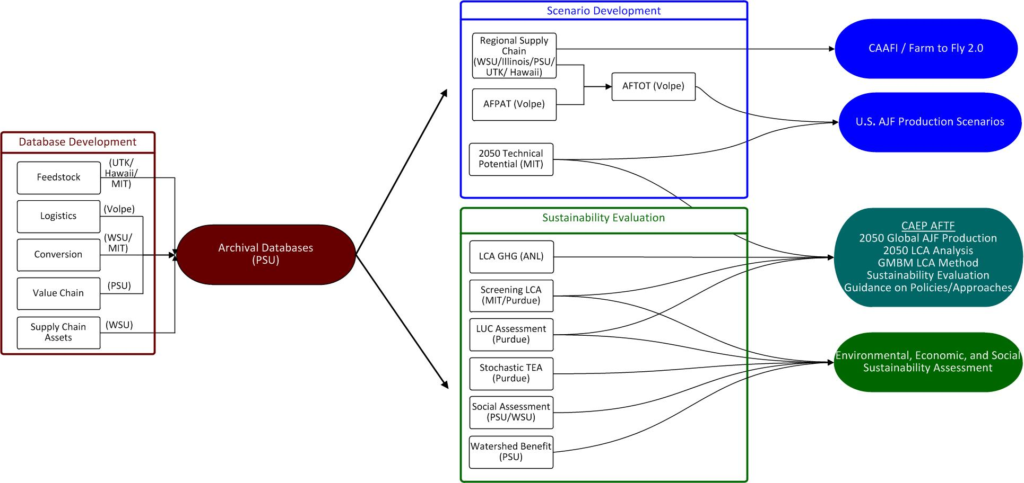
ASCENT 01 Supply Chain Analysis
Database Development
and Archive
Scenario and Sustainability Analysis
Project Outputs
25
Notes:
Project includes 3 components (colored boxes)
Database development and archive
Scenario Development
Sustainability Evaluation
Project includes 5 outputs (colored bubbles)
Archive/Database to store and share key data and information among the team members on feedstocks, feedstock logistics, conversion etchnologies, economics and existing infrastructure assets – PSU is the lead
Develop scenarios of future alternative jet fuel production in the U.S. using gathered data on feedstock, transportation, conversion, and regional supply chains, and the AFTOT modeling tool. These holistic evaluation will also leverage CAAFI/F2F2 activities and knowledge. (Volpe)
Evaluate sustainability from environmental, economic and societal perspectives to:
Support International Civil Aviation Organization (ICAO Committee on Aviation Environmental Protection (CAEP) Alternative Fuel Task Force (AFTF) (MIT, Purdue, ANL)
Provide Environmental, Economic, and Social sustainability assessment. (multiple U’s)
Investigate the potential use of and AJF Product Category Rule (PCR) and Environmental Product Declaration – means of fuel users guaranteeing/certifying product they use meets environmental and social sustainability standards. (UIUC)

Slide 26
ASCENT 01 Shifting Direction
Focus has been on developing information on regional supply chains and creating a national viewpoint on alt fuel production
Shifting focus to incubate supply chain ideas for development through CAAFI / Farm-to-Fly 2.0 State Initiatives
Will continue to develop databases and support ICAO CAEP efforts

Slide 27
ICAO CAEP Alternative Fuels Task Force
2050 Global AJF Production Potential Analysis
  Effort is complete – used for CAEP Trends Assessment
  MIT conducted fuel production analysis
  MIT/ANL compiled life cycle GHG emissions factors
LCA Methodology for the Global MBM
  MIT/Purdue/ANL/Volpe all instrumental to method development
  MIT will compile core LCA default values
  Purdue will calculate induced land use change emissions
Sustainability Criteria for AJF recognition under Global MBM
Guidance on Potential Policies and Coordinated Approaches for Sustainable AJF Deployment
Feasibility of ICAO Climate Goals / Carbon Budget

Slide 28
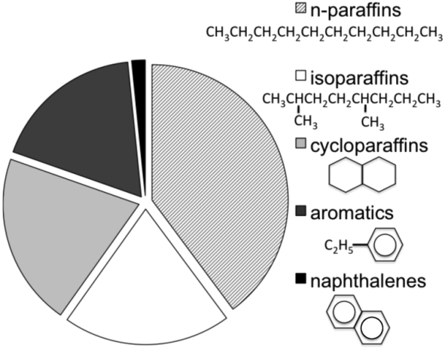
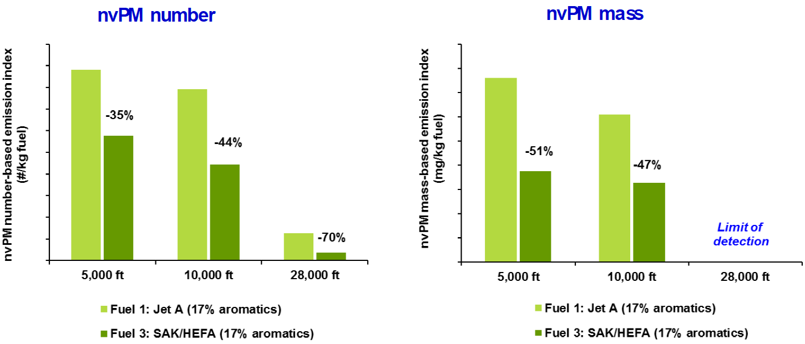
Naphthalene Removal Evaluation – New Project
Recent tests show zero napthalene fuels result in substantial black carbon reduction
Examine costs and benefits of removing naphthalene from jet fuel over two years
Examine refinery changes to reduce naphthalene content
Estimate reduction in black carbon emissions that would result from naphthalene reduction in jet fuel
Calculate changes in air quality and climate impacts due to reduced black carbon emissions
Data from recent Shell/Virent/NRC Canada/MS&T test

Slide 29
FAA Alternative Jet Fuel Activities
Testing
  Support Cert/Qual testing
  Improve Cert/Qual process
  Emissions measurements
Analysis
  Environmental sustainability
  Techno-economic analysis
  Future scenarios
Coordination
  Interagency
  Public-Private
  State & Regional
  International
29
Notes:
3. Coordination and Leveraging efforts across…interagency, public-private, regional level and with international partners
Complement and leverage work of other U.S. agencies
Complement and leverage work of private sector
Support deployment through state/regional supply chain development
Complement and leverage work of international partners
Our means of conducting the work on the right side

Slide 30








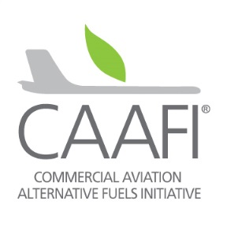
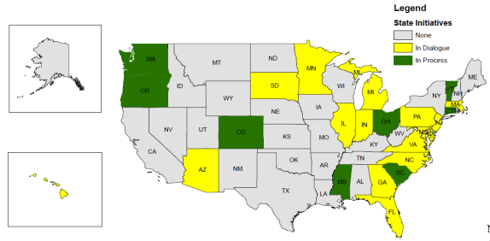











Alternative Jet Fuel Coordination
Interagency coordination across supply chain & Federal Alternative Jet Fuel R&D Strategy
Commercial Aviation Alternative Fuel
Initiative (CAAFI)
Farm to Fly 2.0 & CAAFI State Activities
International cooperation
Notes:
FAA efforts are part of a broader government and private sector effort that requires coordination across supply chain.
We are depending on the programs, policies and expertise of 8 different agencies.
NAJFS - To identify opportunities and strategically address challenges associated with Research, Development, Demonstration, and Deployment (RD3) along the development path of alternative jet fuels.
An undertaking by Aeronautical Science and Technology Subcommittee of the OSTP/NSTC with input from stakeholder community.
Interagency working group of 8 participating Departments & Agencies: USDA, DOC, DOD, NASA, FAA, DOE, EPA, NSF, DOS
CAAFI
Public – private partnership – coordination, information exchange, direction and support
F2F2
Farm to Fly 2.0 is an agreement to cooperate to develop the supply of alternative jet fuel in the United States.
Signatories: USDA, FAA, DOE and Industry associations Airlines for America (A4A), Aerospace Industries Assoc. (AIA), Airports Council International-North America (ACI-NA), General Aviation Manufacturers Association (GAMA) and the National Business Aviation Association (NBAA) = Entire civil jet-aviation enterprise now represented and engaged
Purpose:
To focus government and aviation industry resources towards jet fuel supply chain development.
Endorsed and adopted FAA goal of 1 billion gallons by 2018.
Supporting feasability studies for fuel production in various U.S. states.
CAAFI state & regional deployment
Supporting “grassroots” supply chain development and fuel production.
Identifying local lead organizations/POCs/stakeholders in states and regions.
Provide context, advice, strategy, benchmarking
Facilitate networks & links between stakeholders (e.g. airlines/airports w/ state bioenergy authorities)
Rural Bioenergy Enterprise Grants (RBEG) and Value Added Producer Grants (VAPG)

Slide 31
Federal Alternative Jet Fuels R&D Strategy: The Latest Status
Overarching Purpose
This strategy sets out prioritized Federal R&D goals and objectives to address key scientific and technical challenges that inhibit the development, production, and use of economically viable alternative jet fuels that would provide environmental and social benefits relative to conventional fuels while enhancing U.S. energy security.
Development since the last update to REDAC E&E Subcommittee
All COT/NSTC members have reviewed the Federal Alternative Jet Fuels R&D Strategy
Current Status
Waiting for the OMB review/approval of the Strategy
Next Steps
Secure official approval of the Strategy from the COT/NSTC/OSTP
Work with OSTP and STPI for release of the Federal Alternative Jet Fuels R&D Strategy

Slide 32





Farm to Fly 2.0 Cooperation
Enable commercially viable, sustainable bio-Jet Fuel supply chains in the U.S.
State & local stakeholder coordination
(FAA/CAAFI)
State & local feasibility assessments
(USDA Rural Development)
Feedstock availability and readiness
(USDA, DOT Volpe, FAA/Ascent)
Analysis on existing Infrastructure, transportation, techno economics
(FAA/ASCENT, DOT Volpe, DOE)
Coordination with end users
(FAA/CAAFI, Airlines, Navy)

Slide 33
Coordination Outputs in 2016
Interagency
Federal Activities Report on the Bioeconomy
Billion Ton Study 2016
Federal Alternative Jet Fuel R&D Strategy
Coordination ASCENT/Volpe/DOE/NREL on modeling
Advance Market Commitments Working group
Private Sector
CAAFI Biennial General Meeting (CBGM) – October 25-27, 2016
International
CAAFI/EU CoreJet Fuel meeting – April 28, 2016
Indonesia agreement and visitor exchange

Slide 34

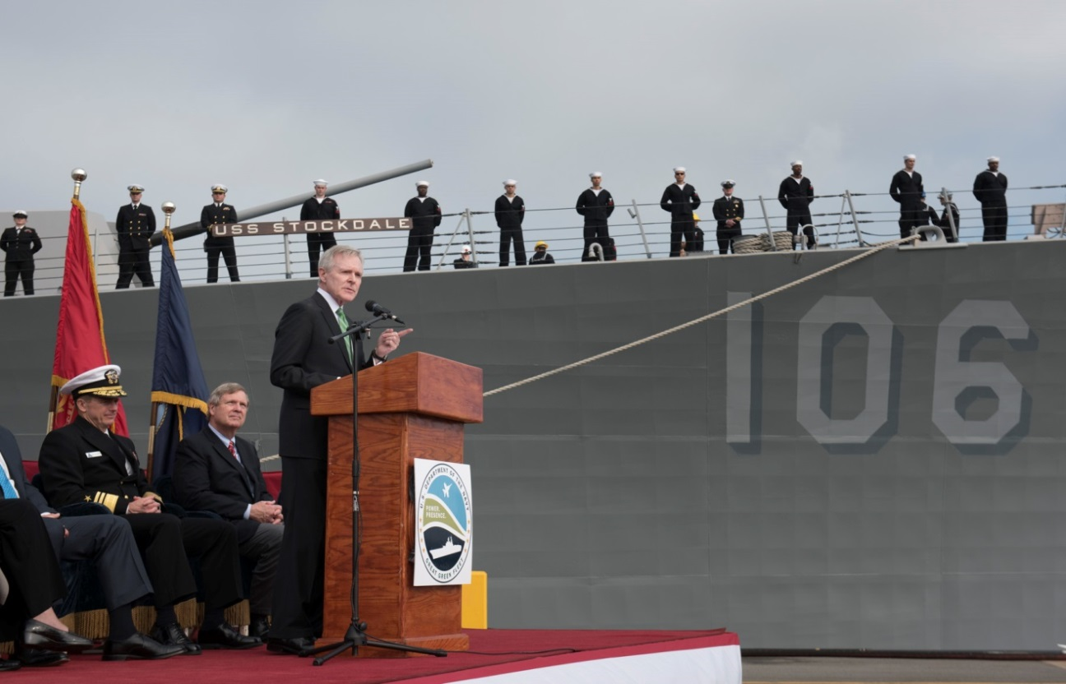
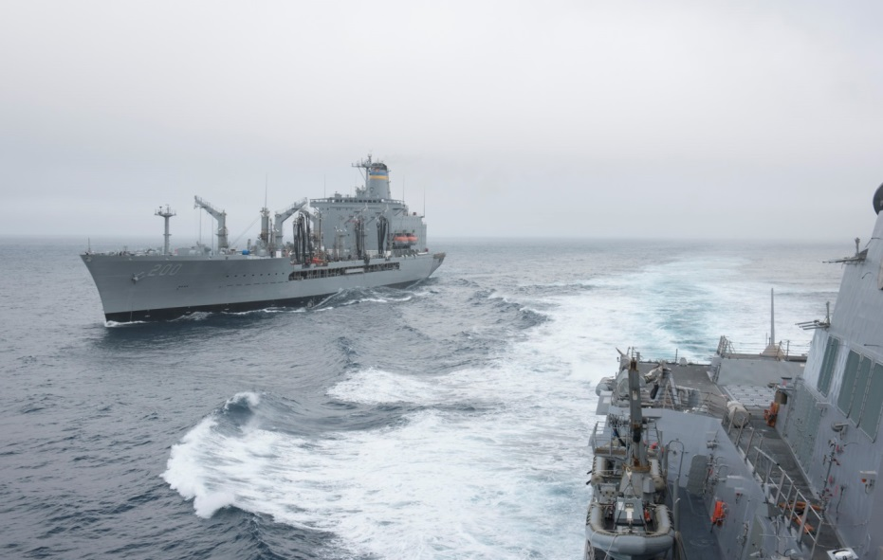
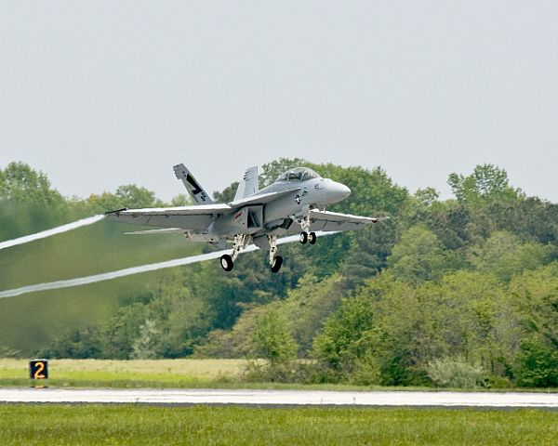
Navy’s Great Green Fleet 2016
Launched in January w/ 77M gallon purchase of Altair F76 blend (10%)
$2.05/gallon
2nd Green Hornet flight 100% in April
International exercises June, July, August

Slide 35
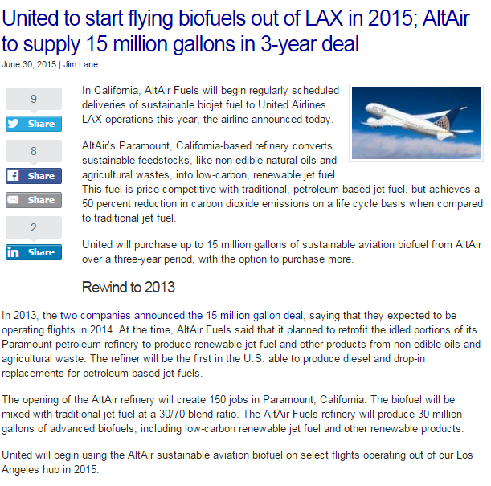
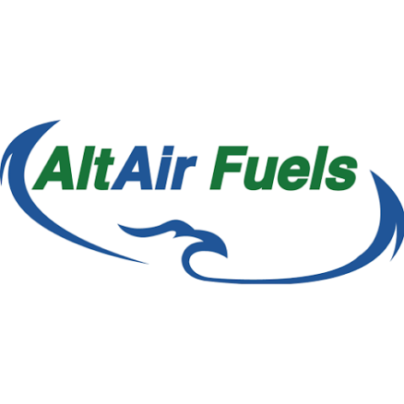


United first commercial scale airline purchase
Feb 18th first deliveries to LAX
March 11th kickoff of flights
60% GHG reduction
Blend into LAX fuel supply
Notes:
Recall from our last presentation that there were a number of commercial announcements last year – united and altair
The start was delayed, but is now happening!
2/18 first deliveries to LAX were announced at ABLC by United
3/11 kickoff of flights is planned
60% GHG reduction
Begin with 2 weeks of 30% blend, after that will be put into the fuel supply (low blend level).
Currently trucking, but hope to a
Fuel production at a repurposed idled refinery, RFS and LCFS credits support production = cost competitive.
Remaining challenge – shared by United and Altair – CA Low carbon fuel standard creating an imbalance in the subsidy for diesel v. jet – being worked by United, Altair, A4A – hope for creation of analogous situation to RFS where jet can generate credits in system but not a mandate.

Slide 36

Nate Brown, Mohan Gupta & Jim Hileman
Federal Aviation Administration
Office of Environment and Energy
Email: nathan.brown@faa.gov
mohan.l.gupta@faa.gov
james.hileman@faa.gov

