Slide 1
Emissions Roadmap Update
Office of Environment & Energy

Slide 2
Contents
Emissions Research Overview
CAEP/10 Aircraft CO₂ Emissions Standard
CAEP/10 Engine nvPM Emissions Standard

Slide 3
Emissions Research Overview
ASCENT Project | Description | Emissions Roadmap
2 | nvPM Emissions Engine Measurements
13 | Microphysical Modeling of NASA’s ACCESS2 Data
18 | Health Effects of Aviation Emissions
19 | Global Aviation AQ Model Development (Adjoint)
20 | CMAQ-based Aviation AQ Model Development
21 | Updates to APMT-I Climate
24 | Emissions effects of fuel components
!new! | Climate and AQ Impacts from Naphthalene
!new! | Engine nvPM Emissions Standard Setting Support
Health Impacts Research
Emissions Tools Development
Emissions Source Characterization
Climate Impacts Research
Certification and Regulations
Aviation Emissions Modeling

Slide 4
Contents
Emissions Research Overview
CAEP/10 Aircraft CO₂ Emissions Standard
CAEP/10 Engine nvPM Emissions Standard

Slide 5
ICAO/CAEP Aeroplane CO₂ Emissions Standard
Agreed applicability dates and regulatory limits:
“New Type” standard
Applicable to new aeroplane types which apply for certification on or after 1 January 2020, except those aeroplane types with a passenger seat capacity of less than or equal to 19 which have an applicability date of 1 January 2023.
“In-Production” standard
Applicable to newly produced in-production aeroplanes initially via a change criteria on or after 1 January 2023 and followed by a production cut-off from 1 January 2028.
Applies to airplanes weighing greater than Maximum Take Off Mass (MTOM):
Subsonic jets… 5.7 metric tonnes (12,566 pounds)
Propeller-driven… 8.6 metric tonnes (19k pounds)
Exemptions criteria agreed to provide flexibility for low volume production aeroplane types in exceptional circumstances.
CAEP/11 includes a future work item on an aeroplane fuel burn technology review.
FAA to host public ICAO CO₂ Certification Database

Slide 6
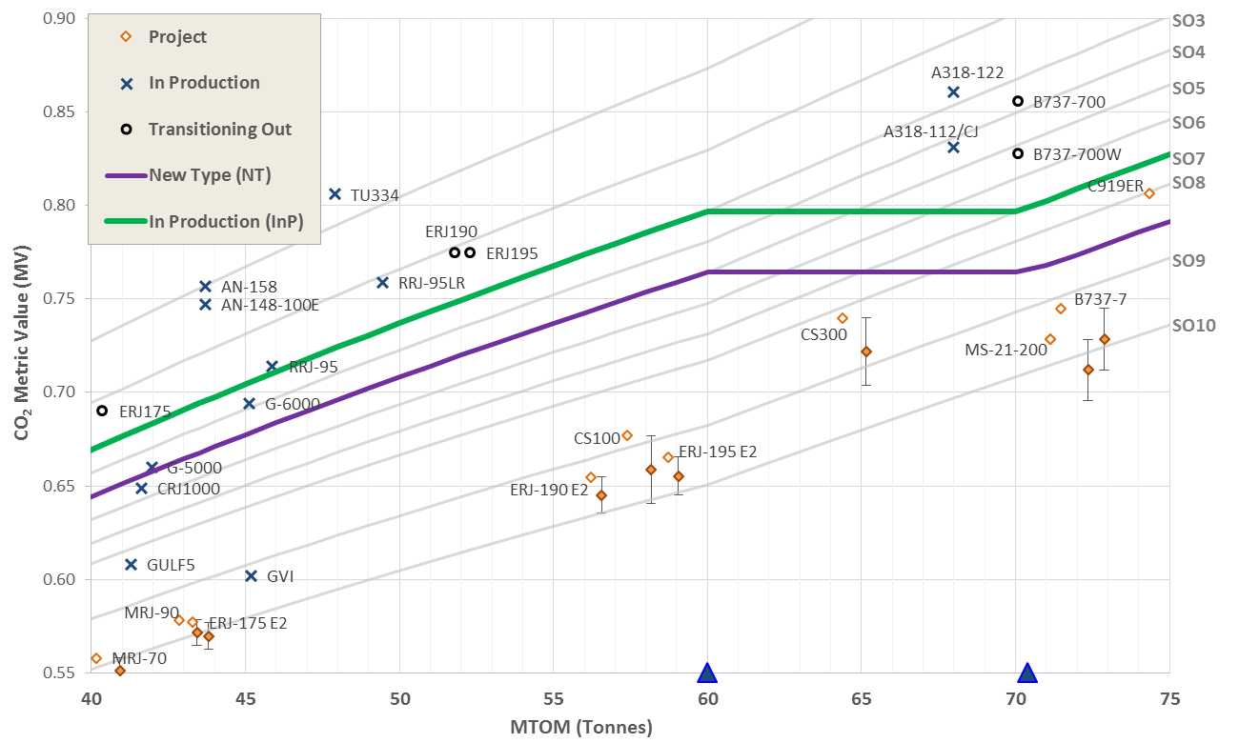
ICAO/CAEP Aeroplane CO₂ Emissions Standard (40-75t)

Slide 7
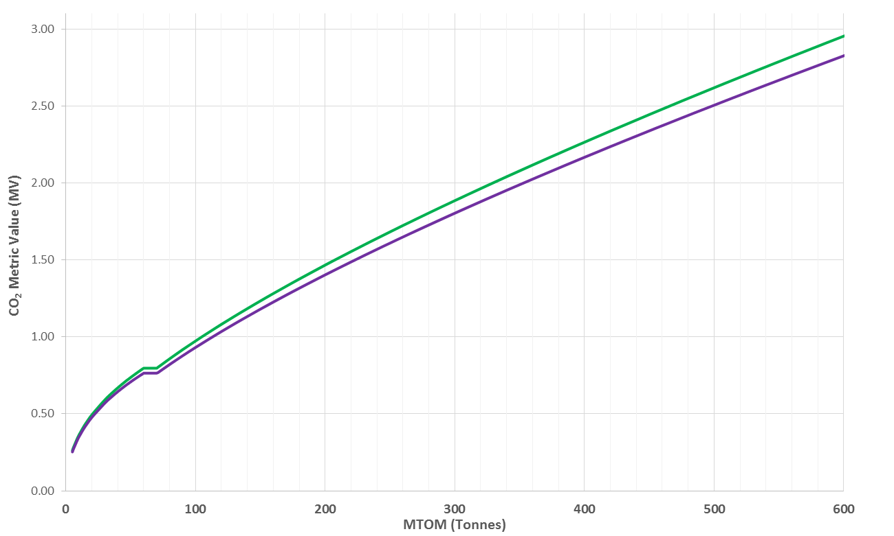
ICAO/CAEP Aeroplane CO₂ Emissions Standard
In Production (InP) CAEP/10
New Type (NT) CAEP/10
Better

Slide 8
Contents
Emissions Research Overview
CAEP/10 Aircraft CO₂ Emissions Standard
CAEP/10 Engine nvPM Emissions Standard

Slide 9
ICAO/CAEP Engine nvPM Emissions Standard
CAEP/10 agreed to the inaugural engine nvPM Certification Requirement and nvPM Emissions Standard
CAEP/10 Certification Requirement
Standardized nvPM Measurement System
New Appendix 7 to Annex 16 Vol. II
Engine nvPM Emissions Standard
CAEP/10 Standard based on smoke visibility limit
New Chapter 4 to Annex 16 Vol. II
Notes:
It is well known that there is no PM standard for aircraft engines. The first order approximation is used to estimate PM mass concentrations from certification smoke number measurements. It should be noted that the smoke number standard was developed originally as a visibility standard.

Slide 10
The CAEP/10 nvPM Standard
The CAEP/10 nvPM standard enables:
Reporting of certified LTO nvPM mass and number Emission Indices (EIs) for all in-production engines of >26.7 kN rated thrust
Establishment of a regulatory level for the nvPM mass concentration equivalent to smoke number regulatory level. Sets the stage for:
Health and climate relevant nvPM standards
Expected removal of the Smoke Number standard for engines of rated thrust >26.7 kN
Use of standardized nvPM measurement system
Designed for use with existing probe/rake systems and simultaneous operation with gaseous measurement system.
Comparison of engine technology and engine types for nvPM emissions

Slide 11
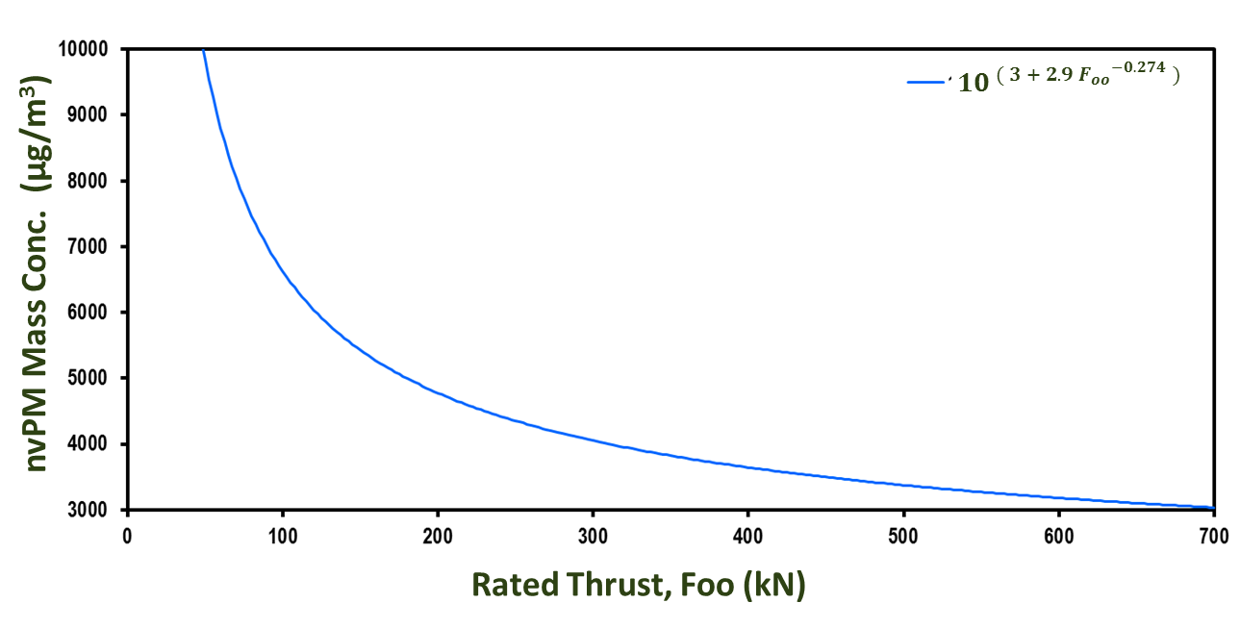
The CAEP/10 nvPM Standard Regulatory Level
Visible Exhaust Plume
Invisible Exhaust Plume
$$Regulatory limit concentration of {nvPM}_{mass}= {10}^{ ( 3 + 2.9{ F_{oo}}^{−0.274} )}$$

Slide 12
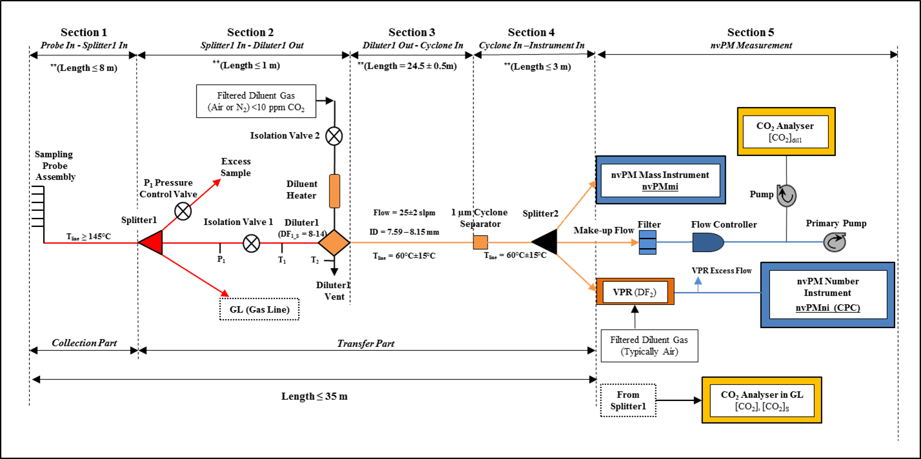
Standardized nvPM Measurement System – Appendix 7
Notes:
While research grade PM sampling systems have been used to acquire nvPM mass and number concentrations, a conceptual non-volatile PM sampling system was developed by January 2011 by SAE E31. The probe is on the left with FS1 indicating the first splitter. Until the first splitter, the particle or gas transfer system remains identical to that of the Annex 16 gaseous sampling system. At the first splitter, there is a 1:3 split with one line continuing on to the Annex 16 system. A PM line connects to an eductor where the PM sample is diluted with Nitrogen to prevent volatile PM from forming. The sample is then taken downstream through a standard length of line through a cyclone in to the mass and number concentration measuring instruments.

Slide 13
nvPM Measurement Systems: Reference and OEM systems
= Reference Systems
FOCA Empa ETH
U.S. Air Force, Arnold Engineering Development Complex

Slide 14
CAEP/11 nvPM Remits
Provide representative engine data for assessing the nvPM emissions standard for mass and number regarding turbofan/turbojet engines ≥26.7kN by February 2017.
Provide recommendations on technology responses, stringency options and applicability to CAEP Steering Group 2017.
Develop an aircraft engine based LTO nvPM mass and number standard for turbofan/turbojet engines ≥26.7kN.
Investigation the possible replacement of the smoke number standard for engine categories ≥26.7kN and other engine categories <26.7kN.
Develop improved nvPM model inputs to both local air quality models

Slide 15
CAEP/11 LTO Based nvPM Mass and Number Standard Tasks
Full Standard Setting Process in CAEP/11:
Develop metric system
Develop stringency options
Develop technology response
Conduct cost effectiveness analyses
Determine LTO-based nvPM mass and number regulatory levels
Refine and finalize corrections for ambient conditions, fuel sensitivity and engine-to-engine variability
Refine steps to replace SN standard with nvPM mass and number standard based on CAEP/10 nvPM standard

Slide 16
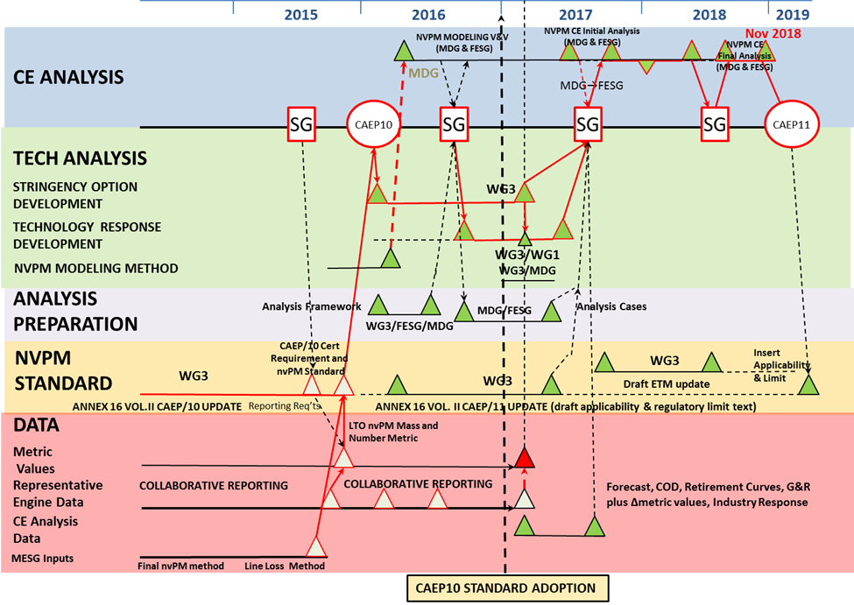
CAEP/11 Schedule: LTO-based nvPM standard development

Slide 17
Data from 25 Representative Engines
Engine Tests
10 of the 25 representative engines have been tested
Plans in place for 11 additional engines types
Provided Funding for 6 US engines
Multiple Engine Tests on 7 engine types
Negotiations on-going for 4 (2 Canada + 1 France + 1 RR) unfunded engines
Data to be made available to CAEP in agreed upon format

Slide 18
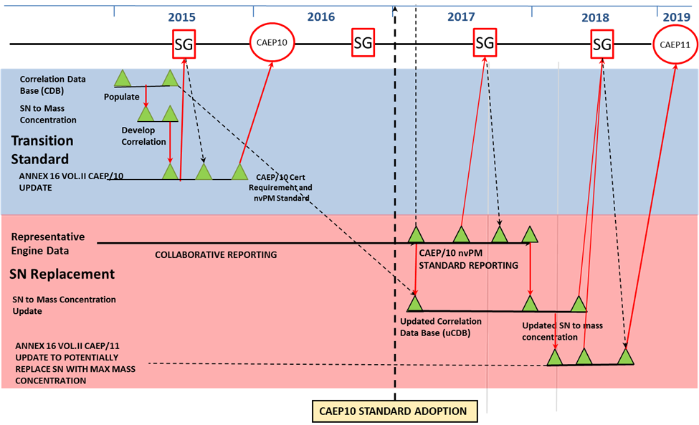
CAEP/11 Schedule: Replacement of SN for Engines > 26.7 kN

Slide 19
Summary
Major Milestone: Visibility-based nvPM standard and certification requirement agreed to at CAEP10 meeting.
Engine/ Combustor Rig Tests toward development of corrections for ambient conditions sensitivity and fuel specifications and engine to engine variability
FOCA Fuel Sensitivity Test – First Test Complete. A follow on test is planned
NASA Rig Test (Ambient Conditions and/ or Fuel Sensitivity) – May 2016
GE Ambient Conditions Testing – Q2/ Q3 2016
Opportunities to Quantify Engine to Engine Variability being Explored

