Slide 1
FAA Office of Environment and Energy (AEE) Research Overview
Presented to: E&E REDAC Subcommittee
By: Dr. Jim Hileman
Chief Scientific & Technical Advisor for Environment and Energy
Office of Environment and Energy
Federal Aviation Administration
Date: August 1, 2017

Slide 2
Outline
AEE Research
  Overview of strategy and five pillar approach
  Science and Tools
  CLEEN Program
  Alternative Fuels
  Operations
  Policy
ASCENT COE Update
Airport Technology Research
Budget summary
Summary

Slide 3
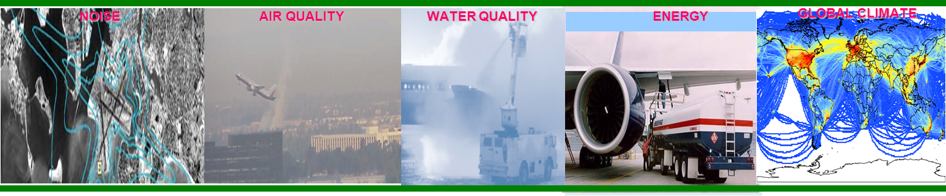
Aviation Environmental Challenges
NOISE AIR QUALITY WATER QUALITY ENERGY GLOBAL CLIMATE
Aviation impacts community noise, air quality, water quality, energy usage, and climate change
Environmental impacts from aviation could pose a critical constraint on capacity growth
FAA are pursuing aircraft technology, alternative jet fuels, operations, and policy measures to address the environmental challenges facing aviation

Slide 4




Environmental Protection that Allows Sustained Aviation Growth
ENVIRONMENT AND ENERGY GOALS
NOISE
Reduce the number of people exposed to significant noise around U.S. airports
AIR QUALITY
Reduce significant
air quality impacts attributable to aviation
CLIMATE
Achieve carbon neutral growth by 2020 relative to a 2005 baseline
ENERGY
Develop and deploy sustainable alternative aviation fuels

Slide 5





Environmental & Energy Strategy
PLAN
Environment and energy policy statement ¹
Aviation Emissions Reduction Plan ²
Research roadmaps ³
FAA VISION
Reach the next level of safety, efficiency, environmental responsibility and global leadership
GOALS
Noise
Air Quality
Climate
Energy
ADVANCE SCIENCE AND INTEGRATED MODELING
IMPROVE
Adapt roadmaps
Fill research pipeline
Source characterization
Propagation and dispersion
EVALUATE
Progress toward goals
Mitigation opportunities
Health and welfare impacts
Aviation Environmental Tool Suite
IMPLEMENT
Technology
Alternative Fuels
Operations
Policy
Notes:
Aviation E&E Policy Statement (Federal Register 77-141, 2012): http://www.faa.gov/about/office_org/headquarters_offices/apl/environ_policy_guidance/policy/media/FAA_EE_Policy_Statement.pdf
U.S. Aviation GHG Emissions Reduction Plan: http://www.icao.int/environmental-protection/Pages/ClimateChange_ActionPlan.aspx
Environment and Energy Website: http://www.faa.gov/go/environment

Slide 6





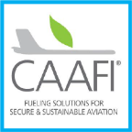




The Five Pillar Approach
Science and Tools
Technology
Alternative Fuels
PILLAR 1: Improved Scientific Knowledge and Integrated Modeling
Decision-making based on solid scientific understanding
Work with research community through the Aviation Sustainability Center (ASCENT)
Understand public health and welfare impacts
Incorporate this knowledge within the Aviation Environmental Tool Suite
PILLAR 2: New Aircraft Technologies
Offer the greatest opportunity to reduce environmental impacts
Partner with industry, research community, NASA, and Department of Defense
Mature new engine and airframe technologies through the Continuous Lower Energy, Emissions and Noise (CLEEN) Program
PILLAR 3: Sustainable Alternative Aviation Fuels
Reduce environmental impacts, enhance energy security, and provide economic benefits
Collaborate with stakeholders through the Commercial Aviation Alternative Fuels Initiative (CAAFI)
Test alternative jet fuels to ensure they are safe for use through ASCENT and CLEEN
Analyze their potential for reducing the environmental impacts of aviation
Operations
Policy
PILLAR 4: Air Traffic Management Modernization and Operational Improvements
Increase efficiency of aircraft operations through the Next Generation Air Transportation System (NextGen)
Engage with industry, research community, NASA, and Department of Defense
Develop advanced operational procedures to optimize gate-to-gate operations
Integrate infrastructure enhancements to the National Airspace System (NAS), improving environmental performance
PILLAR 5: Policies, Environmental Standards, and Market Based Measures
Implement domestic policies, programs, and mechanisms to support technology and operational innovation
Develop and implement aircraft emissions and noise standards
Work within the International Civil Aviation Organization (ICAO) to pursue a basket of measures to address emissions that affect climate, including a global market based measure as a gap filler
Seek international partners to further our environmental and energy strategy
http://www.faa.gov/nextgen
http://www.caafi.org
http://www.faa.gov/go/cleen
http://ascent.aero

Slide 7



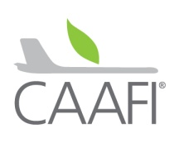

Research Programs
ASCENT Center of Excellence (COE)
COE for Alternative Jet Fuel and Environment
Cost share research with universities
Continuous Lower Energy, Emissions and Noise (CLEEN)
Reduce aircraft fuel burn, emissions and noise through technology & advance alternative jet fuels
Cost share partnership with industry
Additional Efforts
Commercial Aviation Alternative Fuels Initiative (CAAFI)
Contract mechanisms (e.g., SEMRS, PEARS, PEARS-II)
Volpe Transportation Center
Notes:
COE Technical Areas – Alt Jet Fuels
Feedstock Development, Processing and Conversion Research
Regional Supply and Refining Infrastructure
Environmental Benefits Analysis
Aircraft Component Deterioration and Wear Assessment
Fuel Performance Testing
Technical Areas – Environment
Aircraft Noise and Impacts
Aviation Emissions and Impacts
Aviation Modeling and Analysis
Aircraft Technology Assessment
Environmentally and Energy Efficient Gate-to-Gate Aircraft Operations

Slide 8
Addressing the Aircraft Noise Challenge
Understanding Impact of Noise
  Noise impacts: annoyance, sleep, cardiovascular health and children’s learning
  Improving modeling capabilities
  Evaluating current aircraft, helicopters, commercial supersonic aircraft, unmanned aerial systems, and commercial space vehicles
Outreach
  Increase public understanding
  Community outreach
Mitigation
  Land use planning and related measures
  Vehicle operations
  Airframe and engine technology
  Aircraft architecture
In-Depth Briefings – later today and tomorrow:
Impacts, helicopters and outreach
Land use planning and related measures
Commercial Supersonic aircraft

Slide 9
Noise Technology Workshops
FAA have been working with Institute of Noise Control Engineering of the USA, National Academy of Engineering, NASA and Volpe Center
Held workshop to highlight issues of commercial aviation noise and opportunities if new technologies were developed to address it
October 2016 - Engineering Technology Transfer: Research and Development for Engineering a Quieter America
May 2017 - Technology for a Quieter America: Commercial Aviation, A New Era
Currently developing the Meeting Report

Slide 10
Addressing Aircraft Emissions
Understanding Impacts
  Particulate Matter (PM) measurements and modeling
  Improving air quality and climate modeling capabilities
  Evaluating current aircraft, commercial supersonic aircraft, unmanned aerial systems, and commercial space vehicles
Mitigation
  Vehicle operations
  Alternative fuels
  Airframe and engine technology
  Aircraft architecture
  Engine standard (CAEP PM standard)
  Policy measures (CORSIA)
In-Depth Briefings – later today and tomorrow:
PM measurements and modeling
Analytical effort to quantify future fuel use
and CO2 emissions under varied scenarios
Commercial Supersonic aircraft

Slide 11
Improved Scientific Knowledge for Solution Development
P1: Science and Tools
Note: Briefings provided on Noise and PM
Aspect | Key Research Questions | Research Programs
Noise | How do we define significance in regards to aircraft noise? What are the public health and welfare impacts of aircraft noise? | ASCENT COE Tech Center Volpe Center
Air Quality | How do we define significance in regards to aircraft emissions that degrade air quality? | ASCENT COE Volpe Center
Energy | How do we characterize annual variations in system-wide fuel efficiency? How do we define sustainability of alternative jet fuels? | ASCENT COE CAAFI CLEEN Program Volpe Center
Climate | What is the incremental impact of non-CO2 aircraft emissions on global and regional climate? | ASCENT COE
1. Aviation E&E Policy Statement (Federal Register 77-141, 2012): http://www.faa.gov/about/office_org/headquarters_offices/apl/environ_policy_guidance/policy/media/FAA_EE_Policy_Statement.pdf

Slide 12
Aviation Environmental Tool Suite
P1: Science and Tools
Note: Briefing on Aircraft Technology Assessment Efforts
Modeling range of solutions and their consequences on fuel use, noise and emissions (basket of measures for CO₂ and balanced approach for noise)
Policy and Scenarios
Including outputs from other tools and analyses as appropriate
Rapid Fleet-Wide Environmental Assessment
Aviation Environmental Design Tool (AEDT)
Aviation Environmental Impacts Analysis (APMT-I)
Alternative Fuels
Source and Composition
Single
Flight/Airport
Regional
Global
Studies
Integrated
Noise,
Emissions,
and
Fuel Burn
Analyses
Emissions
& Noise
Aircraft Design
Existing Aircraft, New
Aircraft, and/or Generic Fleet
Emissions
Climate
Impacts
Operations
Air Quality Impacts
Emissions
Noise
Impacts
Fleet Evolution, Economics Estimation & Evaluation
(FOM, APMT-E, FLEET-Builder)
Noise
Collected Costs
Emissions,
Noise, & Fuel Burn
Monetized
Impacts
Cost Benefit Analysis
12

Slide 13
Front Line Staff Training
P1: Science and Tools
Action: FAA should develop appropriate training programs on AEDT to ensure FAA front line staff fully understands the model.
Organized AEDT training session at Volpe targeted to needs of front line staff
AEDT Session – Volpe led
  AEDT overview: legacy tools, system requirements, system structure, data sources (internal and external), aircraft performance, GIS
  Study basics: workflow, airport hierarchy, tracks annualization and operations, receptors, metric results, study hierarchy, noise workflow, emissions workflow, interface, help system
  Interactive exercise session: troubleshooting and technical support, emissions dispersion, high fidelity weather, creating user defined aircraft via ASIF, administrative file
  Optional features: airport designer, operating configuration, delay and sequencing, operational profiles, study dabase maintenance
Application and best practices Session – AEE led
  AEDT technical session recap: take-aways and Q&A session
  Best practices session: best practices and project types, AEDT versioning, NEPA work support, environmental justice capabilities
  Breakout sessions: (1) database system, ASIF, and SQL introduction, (2) environmental justice demonstration, (3) advanced data manipulation with SQL
  FAA Feedback and input on AEDT and policies

Slide 14
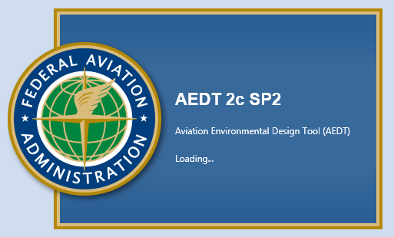
Tools Update (1 of 2)
P1: Science and Tools
AEDT Current Status
Public release of AEDT2c SP2 on March13, 2017
AEDT 2c SP2 B4 with BADA4 and MERRA data
support was released to internal users on June 30th
  It leverages work done by AEE on Sensor Path Filtering and Smoothing (developed as an external preprocessor for flexibility)
  ANG-B7 has been provided with a copy of the software and documentation to begin assessing new features for their work
AEDT Development Plan (emphasis on noise)
Current version of tool, AEDT2c, was designed to model DNL 65
Developing AEDT3 with release in 2018
  Improving takeoff weight and thrust modeling
  Improving aircraft performance module
Laying ground work to incorporate airframe noise more explicitly
For more information on AEDT or to download it, please visit: https://aedt.faa.gov/

Slide 15
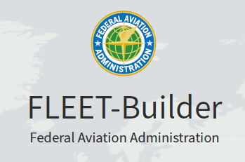
Tools Update (2 of 2)
P1: Science and Tools
Fleet Builder
  Fleet-Builder v0.1 was delivered to FAA on
  schedule in mid June for initial field-deployment
  testing
  Further capabilities testing and development is under way
APMT-Impacts
  Air quality tool development continues – focus on global model
  Climate tool development continues – focus on incorporating latest knowledge, alt fuel considerations, and improving contrail modeling
  Noise tool currently based on willingness to pay to calculate monetary impacts – focus on advancing underlying science of sleep and health

Slide 16
In-House Modeling Update
P1: Science and Tools
AEDT Internal Testing: DCA Emissions Dispersion Study
  Analysis work completed
  Report writing under way and scheduled for completion at end of summer
Annual U.S. inventory review
  Work has began on the detailed internal review of the annual US inventory fleet and operations data
  Work leverages SEL energy and emissions data developed for Single Event Methodology Tool (SEM Tool)
  Review work is being conducted using underlying AEDT database infrastructure capabilities (MS SQL Server)
  A by-product of this analysis will be complete set of scripts that will represent a SQL-based implementation of Single Event Methodology Tool

Slide 17

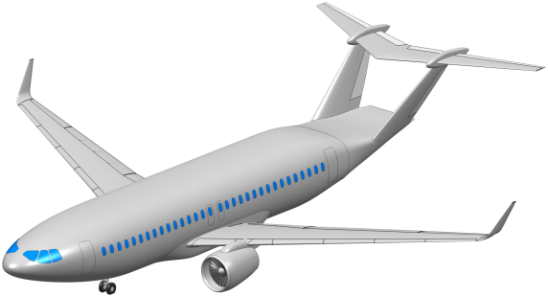
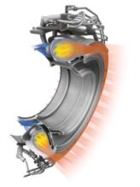
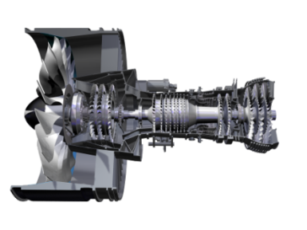
Continuous Lower Energy, Emissions & Noise (CLEEN)
P2: Technology
Note: No CLEEN Briefing this Meeting
FAA led public-private partnership with 50-50 cost share from industry
Reducing fuel burn, emissions and noise via aircraft and engine technologies and alternative jet fuels
Conducting ground and/or flight test demonstrations to accelerate maturation of certifiable aircraft and engine technologies
 | CLEEN I | CLEEN II
Time Frame | 2010-2015 | 2016-2020
FAA Budget | ~$125M | ~$100M
Noise Reduction Goal | 32 dB cumulative noise reduction | 32 dB cumulative noise reduction
NO_{X} Emissions Reduction Goal | 60% landing/take-off NO_{X} emissions | 75% landing/take-off NO_{X} emissions
Fuel Burn Goal | 33% reduction | 40% reduction
Entry into Service | 2018 | 2026
For more information: http://www.faa.gov/go/cleen
Notes:
The CLEEN Program is a public-private partnership between the FAA and industry that is accelerating that introduction of new aircraft technologies into the fleet to reduce fuel burn, emissions and noise.
Following the success of the initial CLEEN Program, initiated in 2010, the FAA launched CLEEN II in 2015. The program is expected to run through 2020.
With the industry contributing 100% matching funds, the first two phases of the program with result in $450 million being invested to accelerate the introduction of aircraft and engine technologies that will reduce noise, emissions and fuel burn.
The FAA is working with 8 companies on CLEEN: (1) Aurora Flight Sciences, (2) The Boeing Company, (3) Delta TechOps/MDS Coating Technologies/America’s Phenix, (4) General Electric (GE), (5) Honeywell, (6) Pratt & Whitney, (7) Rolls-Royce, and (8) Rohr, Inc./UTC Aerospace Systems
These investments have resulted in many technologies that have been proven through ground and flight tests.
The CLEEN program was instrumental to Boeing starting their ecodemonstrator program, which has provided a platform wherein Boeing can flight test new technologies. This has not only been instrumental to flight testing CLEEN technologies but also technologies that are being supported by NASA and industry.
The three pictures on the right hand side show some of the amny technologies being advanced by the CLEEN Program.
Aurora CLEEN Program
Aurora is developing and demonstrating composite airframe technologies that will enable this unconventional aircraft configuration, known as the double-bubble, that will reduce fuel burn, emissions, and noise. A key sub-section of this fuselage will be constructed and mechanically tested to demonstrate configuration feasibility and its weight benefits. The technologies being developed will enable fabrication of the double-bubble aircraft concept. The concept is estimated to provide a 20 percent reduction in fuel burn, up to 16 EPNdB (Effective Perceived Noise level in decibels) cumulative noise reduction, and 21 percent LTO NO_{X} reduction. In addition, if the engines were mounted above the fuselage, then one could potentially achieve a 49 percent fuel burn reduction, about 40 EPNdB cumulative noise reduction, and about 52 percent reduction in LTO NO_{X} emissions.
General Electric CLEEN Program
In January 2012, FAA worked with GE to test the engine emissions from the advanced TAPS II combustor and found they were more than 60 percent below the ICAO CAEP NO_{X} standards adopted in 2004. This is an impressive step change in engine emissions and it exceeded the CLEEN program’s goals. This technology has entered service in the LEAP engine that is being used on the Boeing 737 MAX.
Pratt & Whitney CLEEN Program
FAA are working with Pratt & Whitney to develop and demonstrate advanced technologies to enable an ultra-high bypass ratio geared turbofan (GTF) engine. Over the last four years, the FAA worked with Pratt & Whitney to complete a series of wind tunnel tests of ultra-high bypass engine advanced fan system technologies that found this engine can reduce fuel consumption by 20 percent and have more than a 20 decibel noise reduction relative to year 2001 international noise standards.

Slide 18
CLEEN Highlights
P2: Technology
Last test within CLEEN Phase I completed:
  Pratt & Whitney: Final ultra high bypass geared turbofan technologies ground test Q1 2017 (TRL 6)
Testing under CLEEN II is on schedule
Expanded CLEEN II technologies:
  Boeing compact nacelle – being tested on the latest ecodemonstrator – provides noise and fuel burn benefits
  GE low pressure ratio fan technologies – provides noise and fuel burn benefits
For more information: http://www.faa.gov/go/cleen

Slide 19


FAA Activities
P3: Alternative Fuels
Note: Briefing on AJF Testing Efforts
Testing
  Support Certification/Qualification testing
  Improve Certification/Qualification process
  Emissions measurements
Analysis
  Environmental sustainability
  Techno-economic analysis
  Future scenarios
Coordination
  Interagency
  Public-Private
  State & Regional
  International
CAAFI: http://caafi.org
CLEEN Program: http://www.faa.gov/about/office_org/headquarters_offices/apl/research/aircraft_technology/cleen/
ASCENT: http://ascent.aero PARTNER: http://partner.aero
Volpe Center: http://www.volpe.dot.gov/our-work/policy-planning-and-environment
Notes:
R&D portfolio is to advance our understanding and play our role as a facilitator of the process
Loosely grouped into three categories:
Performance and emissions Testing of Alternative fuels to support ASTM International approval and emission benefits measurement
Support evaluation of fuels for ASTM approval
Reduce test cost and time for qualification
2. Analysis on impacts, economics and availability to:
Improve understanding of environmental and economic sustainability of alternative jet fuel pathways
Improve understanding of the potential availability of alternative jet fuels
3. Coordination and Leveraging efforts across…interagency, public-private, regional level and with international partners
Complement and leverage work of other U.S. agencies
Complement and leverage work of private sector
Support deployment through state/regional supply chain development
Complement and leverage work of international partners
Our means of conducting the work on the right side

Slide 20
P3: Alternative Fuels
Coordination: CAAFI Priorities for 2017
Communicate Value Proposition of Sustainable Alternative Jet Fuels (SAJF)
  Communicate economic, social, and environmental benefits of SAJF
  Broaden base of stakeholders who can continue to enable active investment in the development, demonstration, deployment, and commercialization of SAJF
Enhance Fuel Qualification Approach
  Work with stakeholders to define and enable a broadly-supported, streamlined certification/qualification program
  Foster development of a more durable, higher capacity process to handle the significant queue of potential SAJF candidates
Implement Frameworks & Share Best Practices
  Develop tools to evaluate readiness of feedstocks and fuels and their potential economic, social and environmental benefits to identify prime targets of opportunity for early commercialization
  Expand best practices development and sharing across SAJF supply chain (including at airports) and with partners worldwide
Develop U.S. SAJF Supply by Aligning Efforts to Enable Commercial Deployment
  Leverage Farm to Fly 2.0 and ASCENT to focus on real-world implementation
  Foster producer-buyer engagement that leads to offtake agreements
  Pursue initiatives to enable supply chain development and facilitate commercialization of SAJF
  Build upon Federal Alternative Jet Fuels R&D Strategy

Slide 21
P3: Alternative Fuels
Analysis Activities: ASCENT Project 1
Advanced Analytical Tools
Feedstock Production (w/ DOE)
Feedstock Logistics (w/ Volpe)
Facility Siting Tools
Harmonized Conversion Techno-Economic Analysis (TEA)
Stochastic TEA
Life Cycle Analysis (LCA) (w/ DOE)
Systems Dynamic Models for Technology Adoption (w/ DOE)
Environmental Services
Supply Chain Risk Assessment
International Efforts
ICAO CAEP / CORSIA Support (w/ Volpe and DOE)
Tactical Regional Deployment
CAAFI 50-states Initiative
USDA Regional Supply Chain Assistance
Specific supply chains:
  Inland Northwest Oilseed Project
  Hawaii Tropical Feedstocks and Fuels
  Southeastern US Fuels Development
Team: Washington State, MIT, U. Hawaii, Purdue, Penn State, U. Tennessee, Volpe Transporation Center, NREL, Argonne National Labs
For more information, go to ASCENT P1 Webpage:
https://ascent.aero/project/alternative-jet-fuel-supply-chain-analysis/

Slide 22
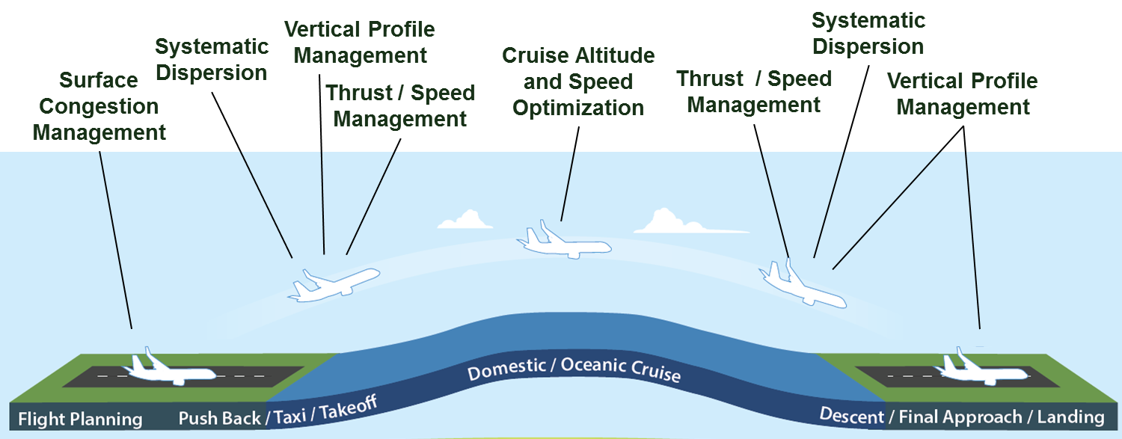
Clean, Quiet and Energy Efficient Operational Procedures
P4: Operations
Note: Briefing on Ops Concepts to Reduce Noise
Program Goals:
Identify and accelerate implementation of air traffic management concepts that will reduce aviation environmental impacts and/or improve energy efficiency
Investigate energy and environmental effects of operational changes
Transition research for implementation
Key Program Elements:
Target all phases of flight and all environmental aspects
Identify new opportunities to reduce community noise
Coordinate/collaborate with ATO, ARP, ANG, NASA, etc.
Notes:
22
Concepts:
Surface - Hold aircraft at gate or other location with engines off to reduce surface congestion, fuel burn & emissions while not adversely affecting throughput
CCO - Identify causes of level-offs and mechanisms to implement continuous climbs, along with potential E&E benefits
CASO - Identify opportunities for fuel savings in cruise through optimal speed and altitude selection
DDA - “Low Power/Low Drag” – Keep aircraft in “clean” configuration for longer on approach, without impacting final approach safety criteria
SGS/DT - Investigate operational barriers and implementation potential in US of increased approach angles and displaced runway thresholds for noise abatement

Slide 23
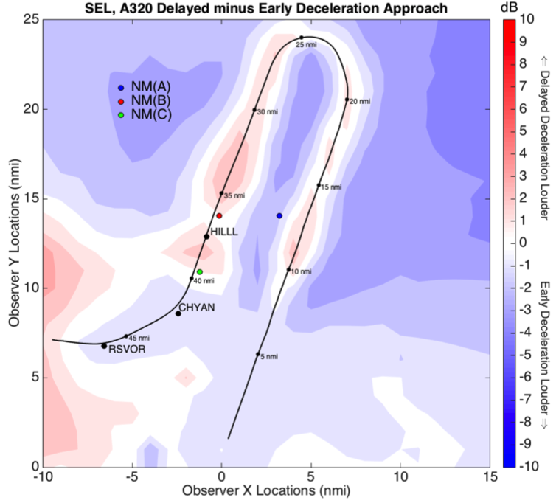
Modeling Operational Improvements
P4: Operations
Note: Briefing on Ops Concepts to Reduce Noise
Enhanced air traffic evaluation framework
Seeking better integration of noise into flight procedure design
Current analytical approach focused on engine noise
New framework also considers airframe noise
Being developed by MIT through
ASCENT Project 23
Case study to test framework
Testing framework to determine if it
is able to evaluate procedures and
procedure modifications with noise
reduction potential
Procedure ideas coming from MOU
between FAA and MassPort
Expect results in 2018
More Information:
ASCENT Project 23 website: https://ascent.aero/project/analytical-approach-for-quantifying-noise-from-advanced-operational-procedures/

Slide 24
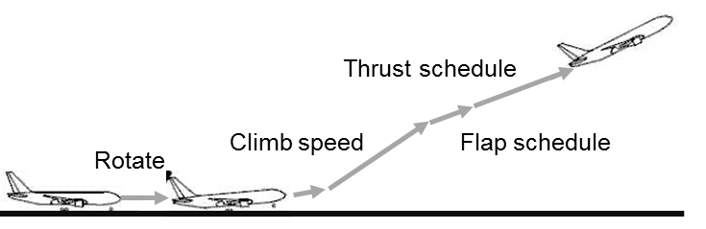
P4: Operations
Note: Briefing on Ops Concepts to Reduce Noise
Opportunities for noise reduction:
  Precision navigation determines where aircraft fly
  Airlines determine when the aircraft fly
  There might be opportunities to change how aircraft are flown to reduce noise
Concepts being evaluated:¹
Route changes
Thrust / speed management
  Noise abatement departure procedures
  Manage thrust and configuration to lower noise
  on takeoff and approach
Vertical profile
  Continuous climb operations
  Continuous descent arrival
  Modified approach angles
  Staggered or displaced landing thresholds
  Want to keep aircraft higher for longer periods and reduce level offs
Introduce systematic dispersion
Takeoff Profile
Delayed Deceleration Approach
1. Concepts are being evaluated by the MIT Team as a part of the Massport-FAA MOU (see Project 23 website), MITRE, and other efforts within FAA.
For more information on ASCENT Project 23: https://ascent.aero/project/analytical-approach-for-quantifying-noise-from-advanced-operational-procedures/

Slide 25
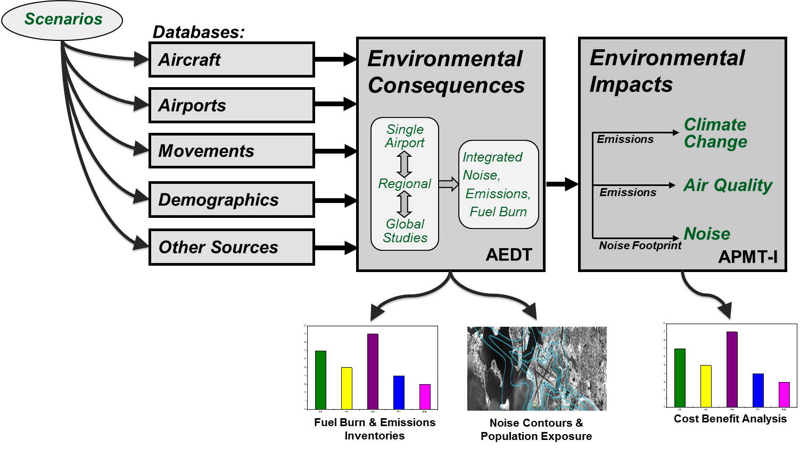
Science and Analysis to Support Decision-Making
P5: Policy
Aviation environmental policies impact noise, climate and air quality. Using the aviation environmental tool suite to assess the impacts of noise and emissions for policy assessment.
Tool suite provided analytical support to CORSIA development
Developing capabilities to support NextGen business case evaluation
  Tool suite informing
  decision making:
    CAEP/11 PM Std (2019)
    CAEP/10 CO₂ Std (2016)
    CAEP/9 Noise Std (2013)
    CAEP/8 NOx Std (2010)
  FAA uses cost/benefit analysis elements to supplement cost-effectiveness analysis in CAEP
Additional information on APMT-Impacts and its use is available at:
http://partner.mit.edu/projects/valuation-and-trade-offs-policy-options
Notes:
BAH = Booz Allen Hamilton

Slide 26
Noise Certification Standard
P5: Policy
Action: The FAA should communicate a strategy for addressing the noise certification promulgation gap at a future REDAC sub-committee meeting.
Rulemaking required for Stage 5, which applies to new airplane design on or after December 31, 2017 and December 31, 2020 depending on airplane takeoff weight.
Sets a lower noise limit for newly certificated airplanes and harmonizes the U.S. noise certification standards with those certificated under international standards.
The FAA published the Notice of Proposed Rulemaking for the Stage 5 rule in January 2016.
The rulemaking has been finalized and is currently awaiting Administration review prior to publication.

Slide 27
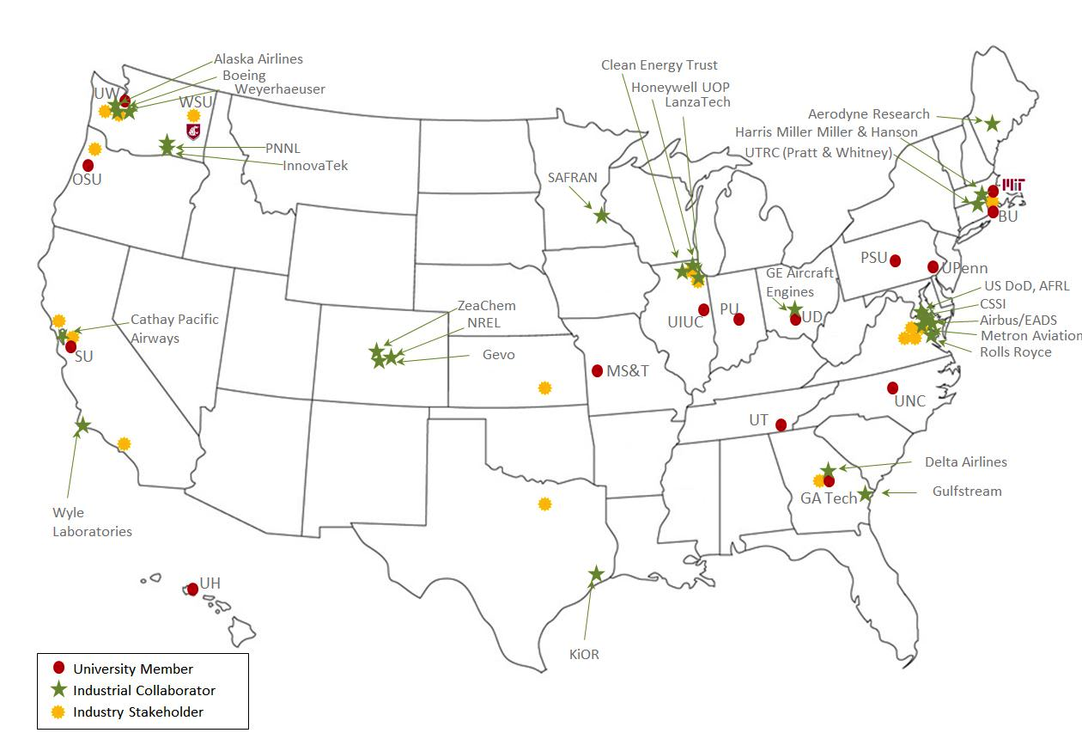
ASCENT Center of Excellence (COE)
Lead Universities:
Washington State University (WSU)*
Massachusetts Institute of Technology (MIT)
Core Universities:
Boston University (BU)
Georgia Institute of Technology (Ga Tech)
Missouri University of Science and
Technology (MS&T)
Oregon State University (OSU)*
Pennsylvania State University (PSU)*
Purdue University (PU)*
Stanford University (SU)
University of Dayton (UD)
University of Hawaii (UH)*
University of Illinois at Urbana-Champaign (UIUC)*
University of North Carolina at Chapel Hill (UNC)
University of Pennsylvania (UPenn)
University of Tennessee (UT)*
University of Washington (UW)*
Multiple international partners
Advisory Committee - 58 organizations:
5 airports
4 airlines
7 NGO/advocacy
9 aviation manufacturers
11 feedstock/fuel manufacturers
22 R&D, service to aviation sector
* Denotes USDA NIFA AFRI-CAP Leads and Participants & Sun Grant Schools
For more information:
https://ascent.aero/

Slide 28
ASCENT COE Update (1 of 2)
New Research Projects (new NFOs)
  Had one NFO this year – GCxGC testing support
  Expect more NFOs next year
Annual Tech Report
  Available from https://ascent.aero/resources/
 | Report 1 | Report 2
Time period | 9/2013 – 9/2015 | 10/2015 – 9/2016
Research Projects | 50 | 54
Publications, Reports, and Presentations | 137 | 119
Students involved | 131 | 112
Industry partners | 63 | 70

Slide 29
ASCENT COE Update (2 of 2)
ASCENT Leadership
Mike Wolcott of WSU is the new Director (as of Jan 2017)
John Hansman of MIT continues as the Co-Director
Ralph Cavalieri has retired, but he is continuing to help with ASCENT
John Gardner will be stepping down – do not have a replacement as yet
Meeting Update
Joint ASCENT-ANERS Meeting - April 18-21, 2017 (DC Area)
Autumn 2017 ASCENT Meeting - Sept 26-27, 2017 (DC Area)
5 Year Symposium - April 3-5, 2018 (DC Area)
Autumn 2018 meeting will take place at an ASCENT university

Slide 30
Environment & Energy Portfolio
Core RE&D (A13.a) Environment & Energy
Improve scientific understanding of environment & energy constraints
Incorporate scientific knowledge into an integrated analytical tool suite
Analyze mitigation options for reducing environmental impacts including policy measures and environmental standards
NextGen RE&D (A13.b) Environmental Research
Mature airframe and engine technologies
Advance sustainable alternative jet fuels
Aviation E&E Policy Statement (Federal Register 77-141, 2012): http://www.faa.gov/about/office_org/headquarters_offices/apl/environ_policy_guidance/policy/media/FAA_EE_Policy_Statement.pdf

Slide 31
Airport Technology Research (ATR)
ATR Overview:
Three Research Programs Areas (RPA): Airport Safety, Pavement and Airport Environment
All three RPAs presented to Airports Subcommittee
Environmental Efforts within ATR:
Airport noise research started in FY12
Expanded to cover broader environmental research in FY16
Collaborative effort among Tech Center, Office of Airports, and Office of Environment and Energy

Slide 32
Airport Environmental Research Projects
FY16 | Evaluating Fixed dB Values used in Determining Noise Level Reduction (NLR) Requirements (with sound insulation programs)
 | Noise Dispersion with ELSO PBN departures
 | Develop Air Quality Screening Criteria for Airport Actions
 | Review of Airport Guidance for Climate Adaptation and Resiliency
 | National Noise Survey and Supporting Analyses
 | 10-Year Plan on Airport Environmental Concerns and Mitigation Measures
FY17 | Analysis of Noise Abatement Procedure Usage and Effectiveness
 | National Noise Survey Support and Telephone Results Analysis
 | National Study on the Impact of Aviation Noise on Sleep
 | Noise Level Reduction (NLR) Measurement Method Equalization and Consistency
 | Assess the Operational Feasibility of Steeper Approaches for Noise Abatement in the National Airspace System (NAS)
 | Initial Feasibility Analysis for Environmental Geospatial Tool

Slide 33
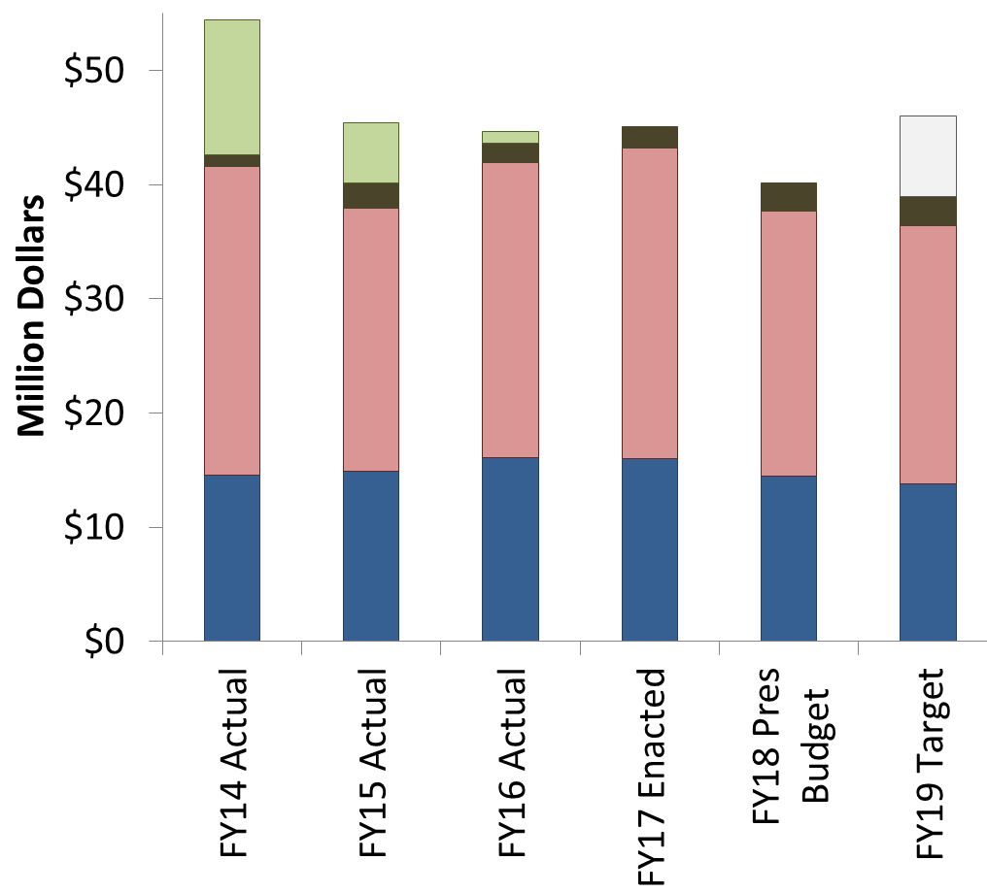
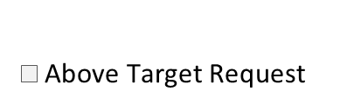
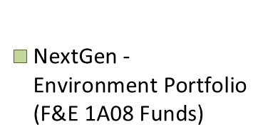
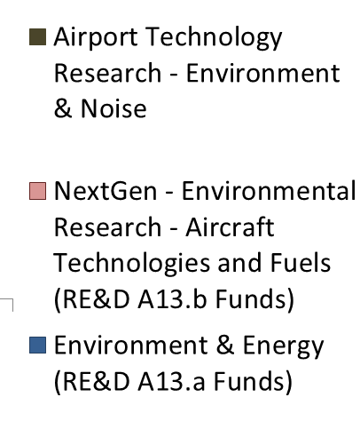
FY14-19 Financial Summary
Not shown on graph:
Airports Cooperative Research Program (ACRP) provides ~$5M/year for environment projects
FAA FY 2017 President’s Budget Highlights
https://www.transportation.gov/mission/budget/fiscal-year-2017-budget-highlights-book

Slide 34
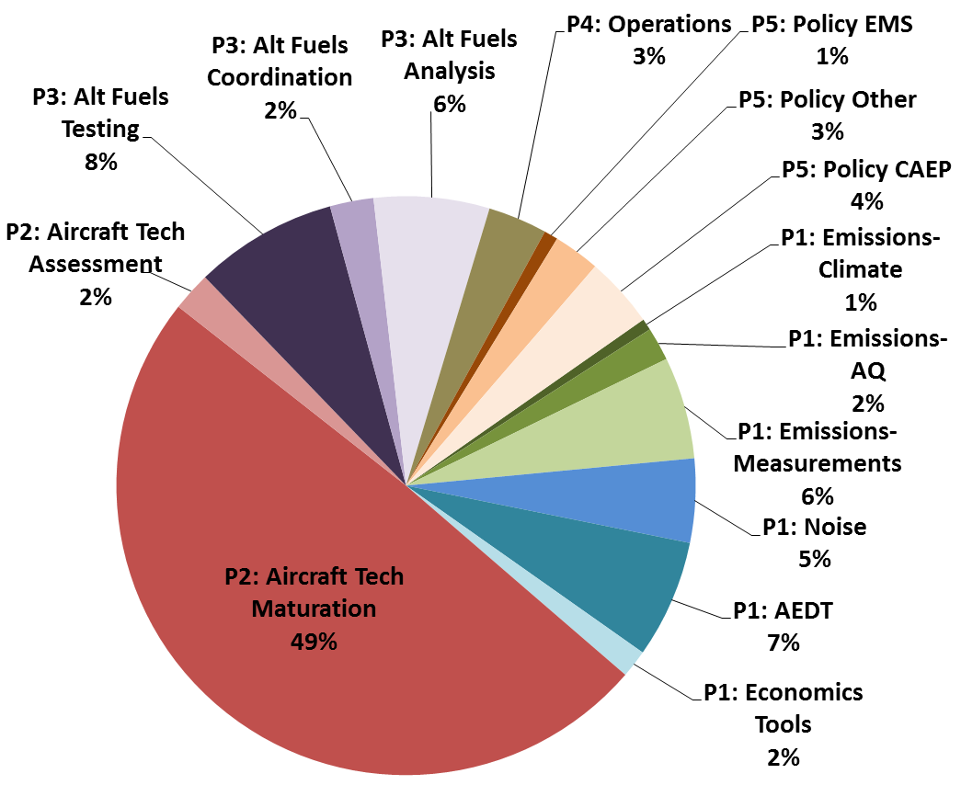
FY17 Budget Allocation by Pillar & Topic

Slide 35
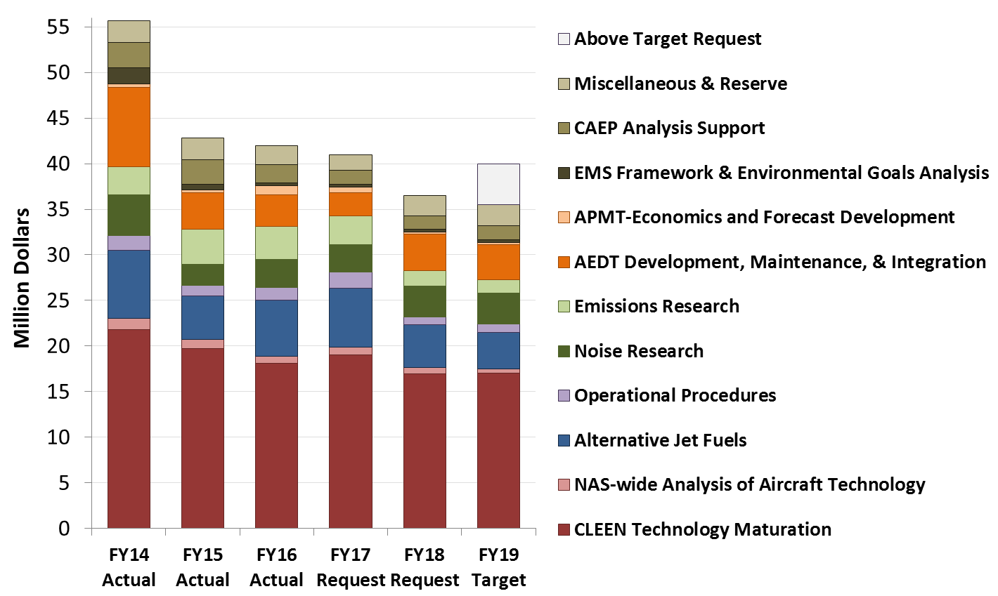
Environment and Energy Funding
Includes: RE&D, F&E, ATR, Operations, and non-FAA funds (e.g., other US Government and Transport Canada)

Slide 36
Recent Successes capabilities and solutions that are helping today
Noise impacts work is starting to deliver results. Community noise survey is complete. Published report on pilot phase of aircraft noise sleep impacts study.
Provided critical analytical support to development of Carbon Offsetting and Reduction Scheme for International Aviation (CORSIA)
Measurement technique and data providing foundation for ICAO CAEP PM standard
Integrated tool suite and analyses provided the scientific data used to support the decision making for the ICAO CAEP CO₂ standard
Alternative fuels scenarios adopted by ICAO CAEP for future trends assessment and research efforts instrumental for alternative fuel inclusion within CORSIA
Federal Alternative Jet Fuel Strategy has been released showing coordinated plan for federal government R&D investments
ASCENT CLEEN aircraft and engine technologies appearing in next generation of aircraft with FMS technologies retrofitted into today’s fleet - reduces noise, emissions and fuel use for many years to come
Certification of five alternative jet fuel pathways – certification enabled United Airlines to buy and use biofuel at LAX as well as purchases by Gulfstream
Aviation Environmental Design Tool being used extensively
Analytical framework being used to develop operational procedure concepts that could provide noise reduction

Slide 37
Questions for Tomorrow:
Are there R&D areas within the E&E Portfolio that should be lower / higher priority?
Are there R&D areas that AEE is not examining that should be added to the E&E Portfolio?
What do you see coming on the horizon regarding E&E that may require future R&D efforts?

Slide 38


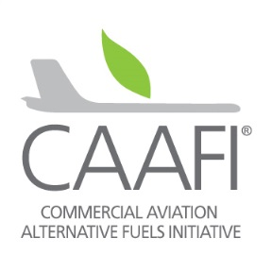
Online Materials
FAA Environment and Energy
http://www.faa.gov/go/environment
Center of Excellence (COE) Program
University research on alt jet fuels and environment
http://ascent.aero and http://partner.aero
Continuous Lower Energy, Emissions and Noise (CLEEN)
Reduce aircraft fuel burn, emissions and noise through technology & advance alternative jet fuels
http://www.faa.gov/go/cleen
Commercial Aviation Alternative Fuels Initiative (CAAFI)
Coalition that focuses the efforts of commercial aviation to engage the emerging alternative fuels industry
http://caafi.org
Notes:
COE Technical Areas – Alt Jet Fuels
Feedstock Development, Processing and Conversion Research
Regional Supply and Refining Infrastructure
Environmental Benefits Analysis
Aircraft Component Deterioration and Wear Assessment
Fuel Performance Testing
Technical Areas – Environment
Aircraft Noise and Impacts
Aviation Emissions and Impacts
Aviation Modeling and Analysis
Aircraft Technology Assessment
Environmentally and Energy Efficient Gate-to-Gate Aircraft Operations

Slide 39
2016 Alt Jet Fuel Advancements and Highlights
AltAir Fuels completed commissioning of the first U.S. commercial facility producing SAJF and commenced renewable fuel deliveries to multiple customers, including United Airlines, World Fuel Services, SkyNRG, Gulfstream, and the U.S. Navy (1Q 2016)
United Airlines initiated regularly scheduled flights at Los Angeles International Airport (LAX) using SAJF from AltAir Fuels (March 2016). Subsequent deliveries continue, with SAJF going directly to the LAX fuel farm.
ASTM International added a new Alcohol-to-Jet (ATJ) Synthetic Paraffinic Kerosene (from isobutanol) to the ASTM D7566 specification, supplementing the four previously approved D7566 Annexes (April 2016)
CAAFI wrapped up collaboration with CORE-Jet Fuel, a research coalition sponsored by the European Commission (April 2016), and CORE-Jet Fuel findings and recommendations were provided to the European Union (October 2016)
The U.S. federal government released the Federal Alternative Jet Fuels R&D Strategy, the culmination of a several year exploration with industry to understand critical R&D needs for SAJF development and commercialization (July 2016)
Gevo, Inc. signed an agreement with Lufthansa for future SAJF supply (August 2016)
KLM, AltAir Fuels, and SkyNRG signed a three year offtake agreement for SAJF supply (September 2016)
JetBlue announced a 10-Year, 10 million gallon per year neat SAJF offtake agreement for supply from SG Preston (September 2016)
Virgin Atlantic and LanzaTech partnership produced SAJF from industrial waste gas using an ATJ production process (from ethanol) which will seek approval in 2017 (September 2016)
Members of the International Civil Aviation Organization (ICAO) achieved an historic agreement: the Carbon Offsetting Reduction Scheme for International Aviation (CORSIA) - the world’s first market-based measure to help mitigate net carbon dioxide emissions from an entire industrial sector (October 2016)
The 2016 CAAFI General Meeting energized more than two hundred stakeholders and highlighted advancements and opportunities in SAJF deployment (October 2016)
BP Ventures and Air BP announced a $30 million investment in Fulcrum BioEnergy (November 2016)
Alaska Airlines flew a commercial demonstration flight from Seattle to Washington, D.C. using Gevo’s forest residues-based SAJF as the culmination of the USDA-funded Northwest Advanced Renewables Alliance (NARA) project (November 2016)
U.S. aviation used more than 1 million gallons of SAJF for year 2016

