Slide 1
Noise Research
Research Update with Focus on Helicopters and Communications
E&E REDAC Subcommittee
R. Cointin, AEE
August 1, 2017

Slide 2
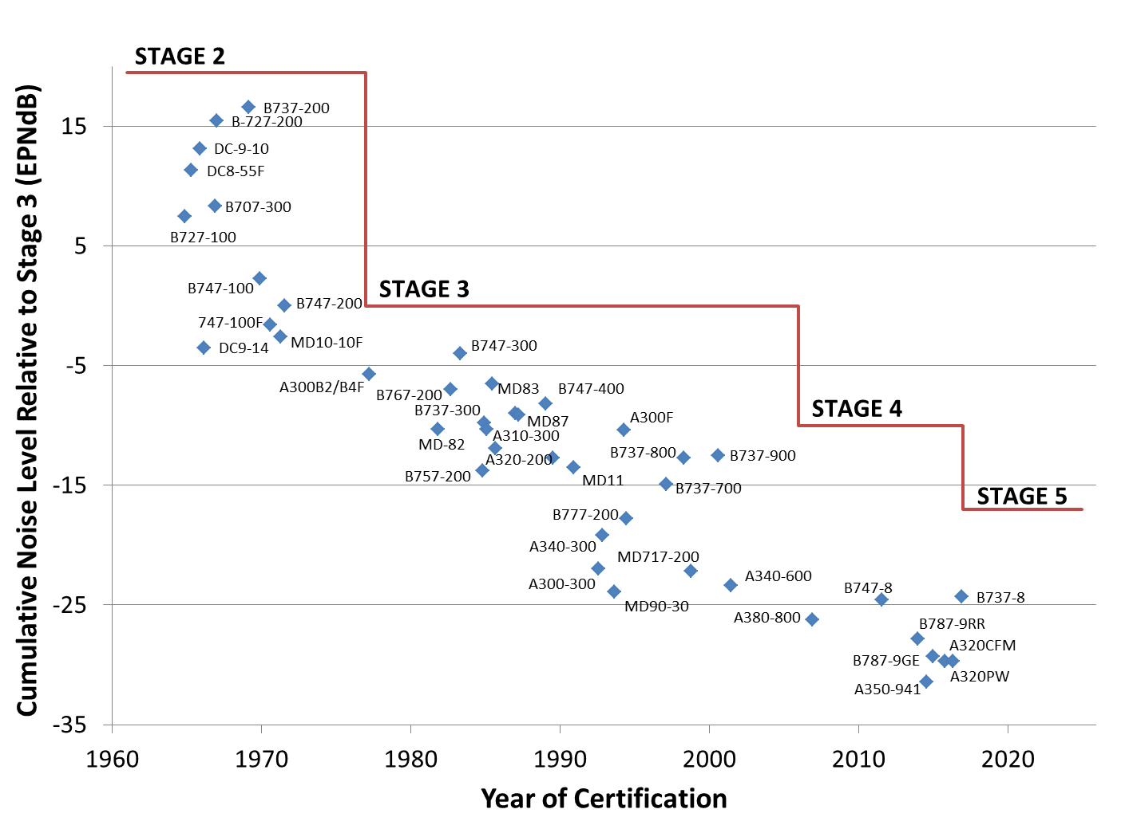
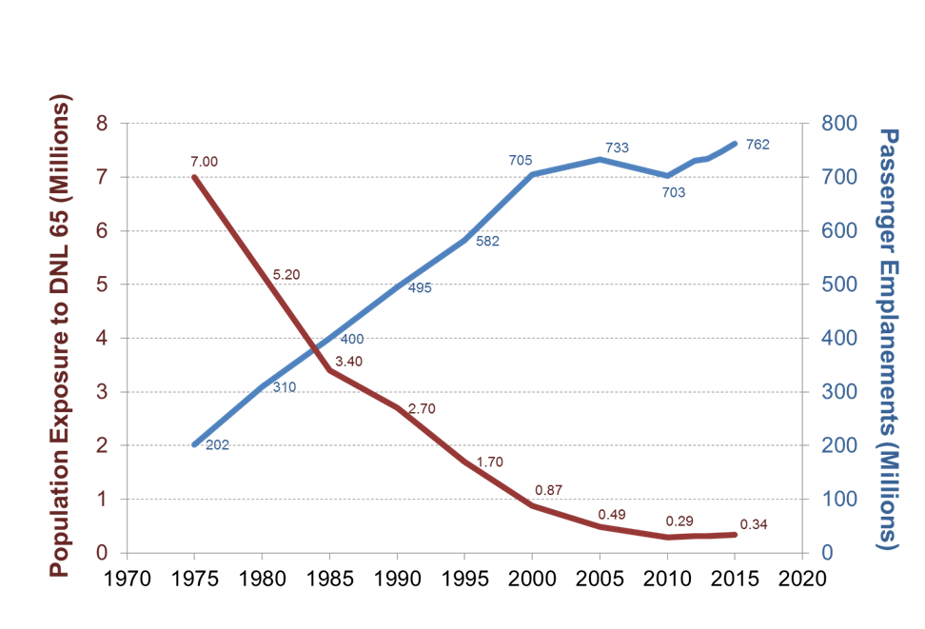
Historical Trends: Source Noise and Noise Exposure
A factor of 20 decrease in community noise exposure has been accompanied by increased community concerns
GAO Reports state environmental issues can cause delay in projects^{1, 2}
The implementation of precision aircraft navigation over the last few years has been accompanied by increased airport community concerns regarding noise
Source: 1. http://www.gao.gov/archive/2000/rc00153.pdf
2. http://www.gao.gov/assets/310/309622.pdf

Slide 3
Current Noise Challenge
Interest by the Public and Congress in re-evaluating NEPA Significance Levels
Potential increase in noise provisions in Reauthorization
Interest to accelerate the reintroduction of civil supersonic flight
Expansion of the use of UAS
Helicopter noise concerns
Public interest in noise associated with new projects
Public interest in reducing existing noise
Interest in mitigation and abatement

Slide 4
Addressing the Aircraft Noise Challenge
Completion of Noise Survey and examining the related policy implications
Beginning a National Sleep Study
Continued work in Impacts of Cardiovascular Health
Continuing Need to examine UAS noise
Increase research related to Supersonic Flight
Creating Increase public understanding
Increased Community outreach
Exploring Mitigation and Abatement Options
Source: Hileman et al. 2013 http://dx.doi.org/10.1016/j.paerosci.2013.07.003/

Slide 5
Research Areas on Noise Impacts
Annoyance
Conducted a community survey to provide scientific data to quantify the relationship between annoyance and DNL for communities around airports
Will be used to re-analyze the noise significance threshold criteria under the National Environmental Policy Act and federal land use guidelines
Sleep Disturbance
Conducted field studies to test different equipment viability
Began contract to conduct a national sleep study.
Determine what, if any, impact aviation noise has on sleep
Cardiovascular Health
Associating historic, modeled noise levels with existing epidemiological studies
Determine what, if any, correlation exists between cardiovascular disease and aviation noise
Children’s Learning
Have completed statistical analysis of standardized tests and finalizing a field study in classrooms to understand classroom reactions to aviation noise
Determine level in which aviation noise contributes to cognitive learning delays

Slide 6
Helicopter Research
Understanding Impacts
Building off ACRP and internal study to conduct a larger study to understand the relationship between helicopter noise and annoyance
Noise Abatement Procedures
ASCENT developed possible noise abatement procedures for classes of helicopters
Test with NASA August and September 2017 to determine if benefits are realized
Future work will involve additional modeling and validation
IFly Neighborly/Fly Quiet
Outreach and communication programs for operators

Slide 7
iFLY Quiet/Fly Neighborly
Goal is to have pilots consider those on the ground when flying
Training Class
First Course Conducted at HeliExpo 2017
FAA/Volpe to support development of HAI lead advanced (2018) & expert (2019) FN HeliExpo classes
Online/on demand Basic FN WINGS course in planning stage
Produce materials for the iFlyQuiet campaign including the “How To Guide” for operators.
Engage HAI and AHS during the material development and leverage any provided material and expertise.
Design and conduct a pilot of the iFlyQuiet program in an area with an existing helicopter noise situation
Notes:
Training Class: Partnership: HAI led with NASA & FAA/Volpe support
Attendees granted certification credit by FAA/WINGS
Animations used by operators for communication at public meetings (NY area, late March)
PBI airport is actively pursuing adoption of FN procedures
Pilot:
Assess the program elements using metrics defined in the iFlyQuiet Strategy
Noise Abatement Demonstration based on results of FAA/NASA test

Slide 8
Communicating Noise Effectively
Desire for new and innovated ways to engage the public
Critical given the need to disseminate results of the national survey
Goal is a consistent message regarding aircraft noise across the agency

Slide 9
Initiatives
Update AEE’s Noise webpage on the FAA website
First focus is the Annoyance Survey
Will include basic information regarding noise
Development of materials for use within FAA
Available for talking points, hand outs an public meetings, etc
Noise Complaint Initiative
Efficiently and effectively respond to and address noise complaints
Notes:
For Website:
Using a transportation communications firm, just beginning
NCI Purpose: to identify how the FAA can more efficiently and effectively respond to and address noise complaints in a clear, consistent and repeatable manner that is responsive to the public and applies the best use of FAA resources.

Slide 10
Update to AEE Noise Website
Homepage
Introduction - brief summary of key points
Historical background / overview
Research
FAQs
Glossary / Acronym Guide
Notes:
Research:
First focus is Survey
Methodology
Results
Will be expanded later

Slide 11
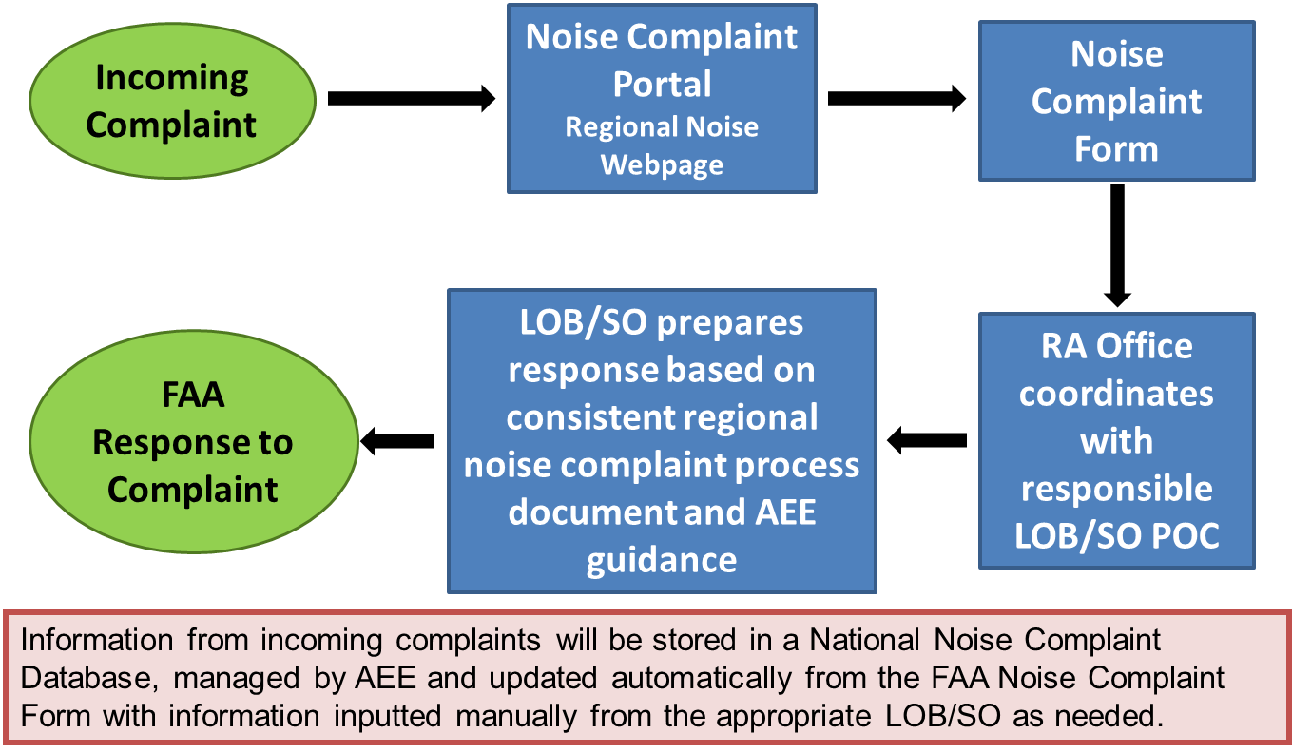
Noise Complaint Initiative
Repository of information
High profile projects
Research
Testing initiative in the Eastern Service Area
Will roll it out across the U.S. in stages
Noise Portal where all complaints are logged and coordinated
Testing since June 1

Slide 12
Summary
Noise continues to be a concern
Many initiatives underway to address noise from multiple aircraft types
Helicopter portfolio has blossomed in the last few years and foresee research continuing in that area
Emphasis will be added on communicating noise to ensure FAA initiatives are known, understood, and supported

Slide 13
Rebecca Cointin
Manager, Noise Division
Federal Aviation Administration Office of Environment and Energy
Email: rebecca.cointin@faa.gov

