Slide 1
Mitigation Measures Below DNL 65dB
Presented To: REDAC E&E Subcommittee
By: Sean Doyle AEE Noise Division (AEE-100)
Date: August 1, 2017

Slide 2
Introduction
If policy updates result in lowered noise thresholds, then strategies for alternative mitigation options for noise levels below DNL 65dB may be a key consideration
As part of FAA’s larger policy review process, research efforts are now engaged in:
Supporting FAA review and consideration of Noise Policy updates that will accompany findings from community noise and annoyance survey
Evaluating efficacy of existing noise mitigation programs and potential for alternative noise mitigation options
Providing concepts for mitigation at noise levels where existing mitigation techniques may not be as effective or appropriate
Considering alternative mitigation options separate from standard physical treatments

Slide 3
Existing Sound Insulation Treatments
Current aircraft noise mitigation focuses on Sound Insulation Programs
For eligible residential homes*, funds are provided to replace exterior window and doors with those having better acoustic noise level reduction (NLR) properties. HVAC systems may also be added as an incentive to reduce noise exposure by keeping doors and windows closed
Current eligibility requires that homes experience an exterior noise level of DNL 65dB or greater and that treatments would be needed in order to obtain a DNL 45dB interior noise level. Treatments must also be shown to result in at least a 5dB decrease in interior noise level
*Mitigation programs may also include non-residential structures like Schools with additional approval and requirements

Slide 4
Mitigation Eligibility Beyond DNL 65dB
Most homes experiencing less than DNL 65dB exterior noise, will already achieve an interior Noise Level of DNL 45dB without added treatments
The DNL 45dB Interior criteria is supported as a “Natural Indoor Noise Floor” consistent with the ambient interior noise level of a typical indoor environment
A typical NLR level for an un-treated home already exceeds 20 dB
Sound Insulation treatments are therefore typically not required to achieve indoor noise levels below DNL 45 dB
The need for and eligibility requirements for alternative treatments below DNL 65 dB will therefore require additional consideration

Slide 5
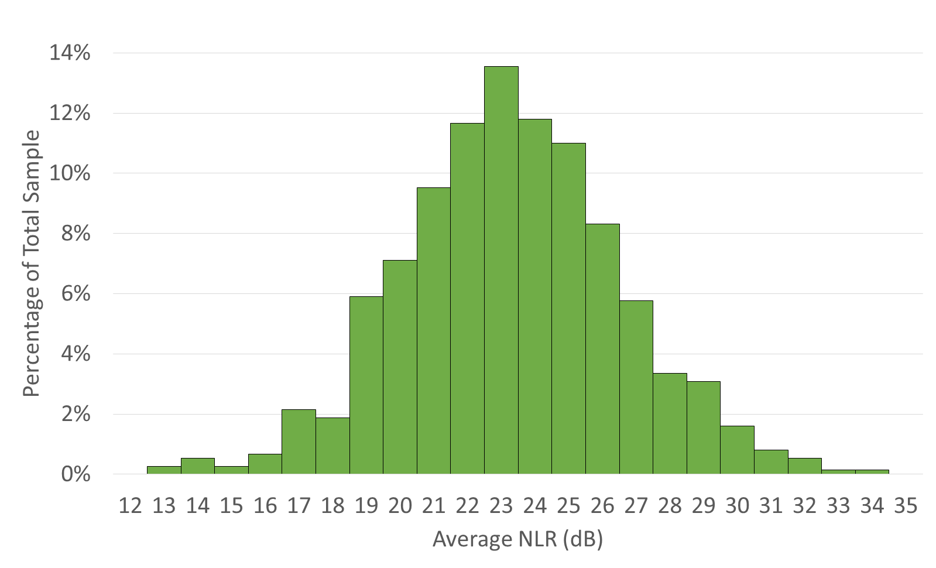
Noise Level Reduction Distribution

Slide 6
Potential Alternative Mitigation Options
If land use compatibility noise thresholds are lowered below DNL 65dB an expectation of additional mitigation at the new thresholds may result
To understand what type of possibilities may be of interest, two groups of stakeholders were polled
Sound Insulation Program Managers: Industry experts who complete evaluation and analysis of homes for sound insulation eligibility
Airport Operator Representatives: Airport Directors or Noise Office Directors who are aware of their communities’ perspective on noise exposure

Slide 7
Program Manager Feedback
Structural
HVAC Only
Mitigate Exposed Façade Only
Mitigate Eligible Rooms Only
Mitigate Homeowner Room of Preference
Secondary Treatment Package
Allow Homeowner to Upgrade Non-Treatable room to Habitable Indoor Space
Provide Acoustical Audit / DIY Guide
Provide Focused Treatments
Provide a Menu of Treatment Options
Compensatory
Monetary Compensation
Local Property Tax Breaks
Low Interest Bank Loans
Grants for Sound Insulation Improvements
Other
Landscaping / Ground Cover
Active Noise Control
Masking Noise / Soundscape System
Exterior Roll-Down Shutters
Mass Loaded /Leaded Vinyl Curtains
Relocation / Sales Assistance
Passenger Facility Charge Use
Mitigate NextGen Corridors

Slide 8
Airport Operator Feedback
Acoustical audit of homes along with some subsidized mitigation or cost sharing between for home improvements
Installation of ventilation or central air conditioning (and not new doors/windows)
Input on Flight Procedure changes to reduce noise exposure

Slide 9
Feasibility Estimates
From Program Manager and Airport Operator feedback, the suggested mitigation topics are being evaluated for feasibility
Priority is being given to the Airport Operator feedback, but where applicable, elements from the Program Manager feedback is also being reviewed
The feasibility review will include:
Economic estimates of application costs
Consideration of eligibility criteria
Identify areas needing additional consideration to determine how to implement alternative mitigation options
These finding will be used to support FAA deliberations on potential updates to current noise threshold and noise policy

Slide 10
Sean Doyle
Noise Division
Federal Aviation Administration Office of Environment and Energy
Email: sean.doyle@faa.gov

