Slide 1
Departure and Arrival Concepts to Reduce Noise
Presented To: REDAC E&E Subcommittee
By: Office of Environment & Energy (AEE)
Joe DiPardo, AEE-100 Chris Dorbian, AEE-4
Date: August 1, 2017

Slide 2
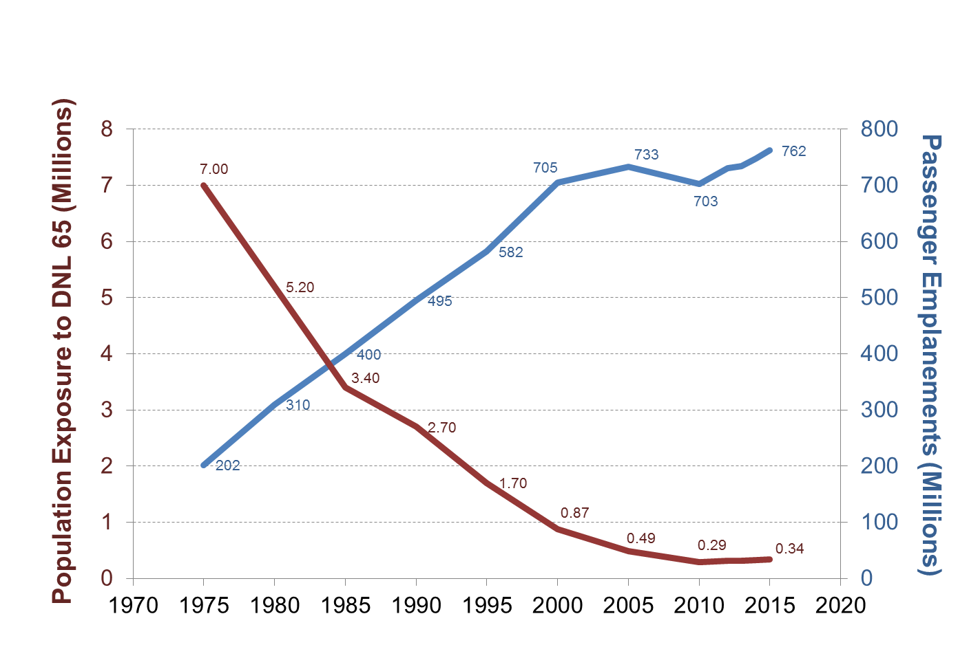
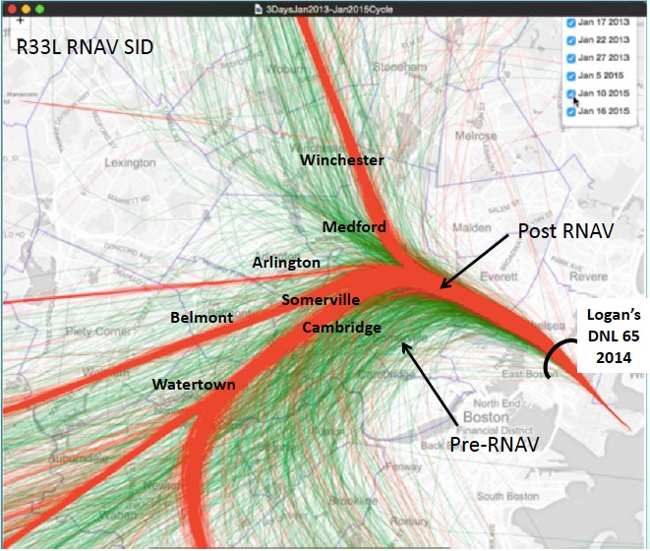
Current Challenge – Noise
Despite traffic growth, community noise exposure has decreased by a factor of 20
Yet, implementation of precision aircraft navigation over last few years has been accompanied by increased airport community concerns regarding noise
A/C already much quieter – what can be done operationally?
AEE is working to ensure that airspace planners have the best tools and toolbox to enable low noise procedures
Image Source: Massport

Slide 3
Multiple Efforts Underway to Develop Noise-Mitigating Operational Procedures
ASCENT-23 Developed analytical framework for assessing operational procedures
AEDT Development efforts underway to improve modeling capabilities
MIT
FAA–Massport MOU (BOS case study; FAA collaborative effort on Noise)
Industry/Gov’t. Collaboration
Potential industry collaboration
Potential NASA Research Transition Team (RTT)
“Toolbox” of procedures & procedural changes to mitigate noise
ATO Mission Support Services (AJV) “Low Altitude PBN” Research (performed by MITRE)
Airport Technology Research Projects (ARP-AEE collaboration)
Flight Management System enhancements (CLEEN)
Notes:
MOU establishes a framework for cooperation between Massport & FAA to explore operational changes to mitigate noise impacts
This is a BOS specific case study; Massport is providing funding to MIT (& HMMH) to help them with this
FAA side of this MOU is a collaborative effort across LOBs to provide expertise and to evaluate proposed changes
Massport has enlisted MIT; basis for that is AEE work w/MIT to develop analytical framework for assessing operational procs under ASCENT-23
RTTs ensure NASA research needed for NextGen is identified, conducted, and effectively transferred to the FAA
FMS – May be opportunity there to leverage FMS development work to pursue noise benefit, and may also be a necessity as we look at procs to incorporate FMS considerations, and CLEEN is a mechanism to do that

Slide 4
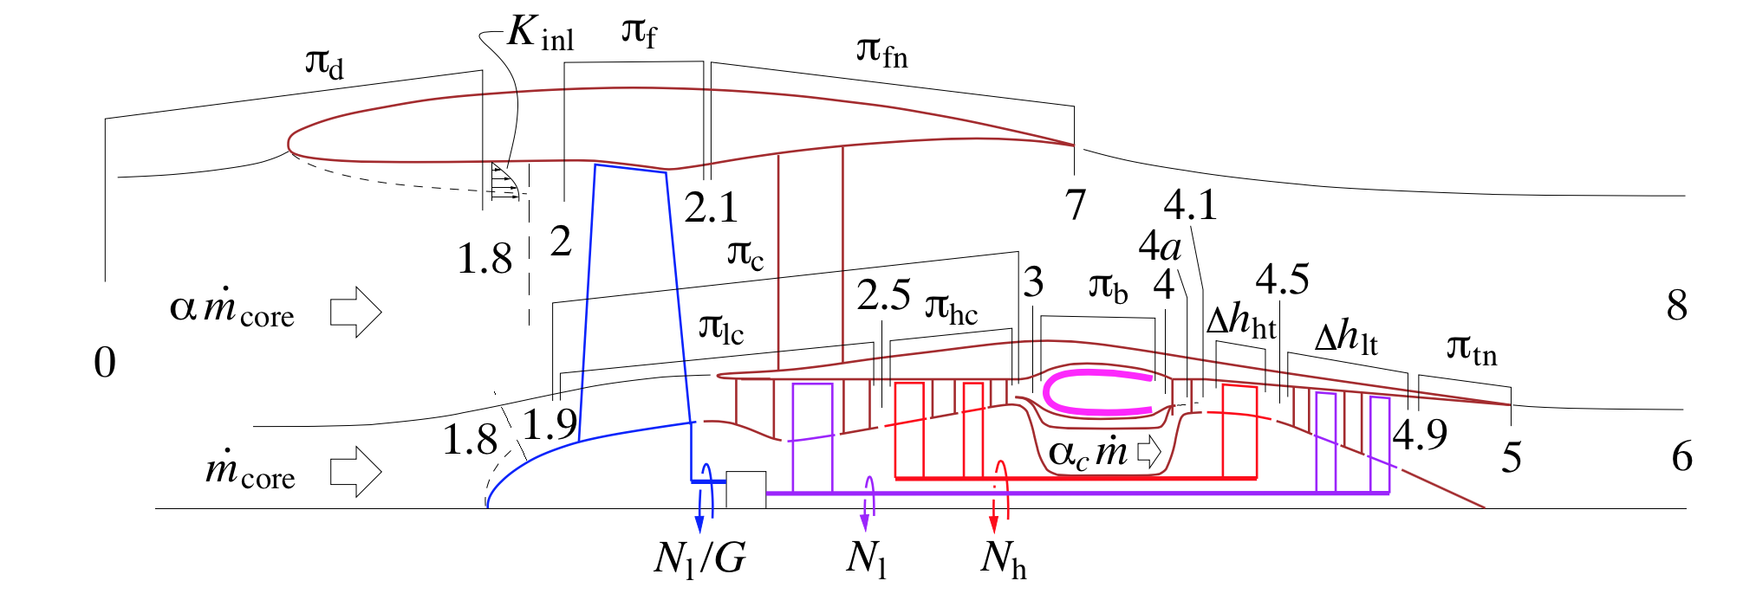
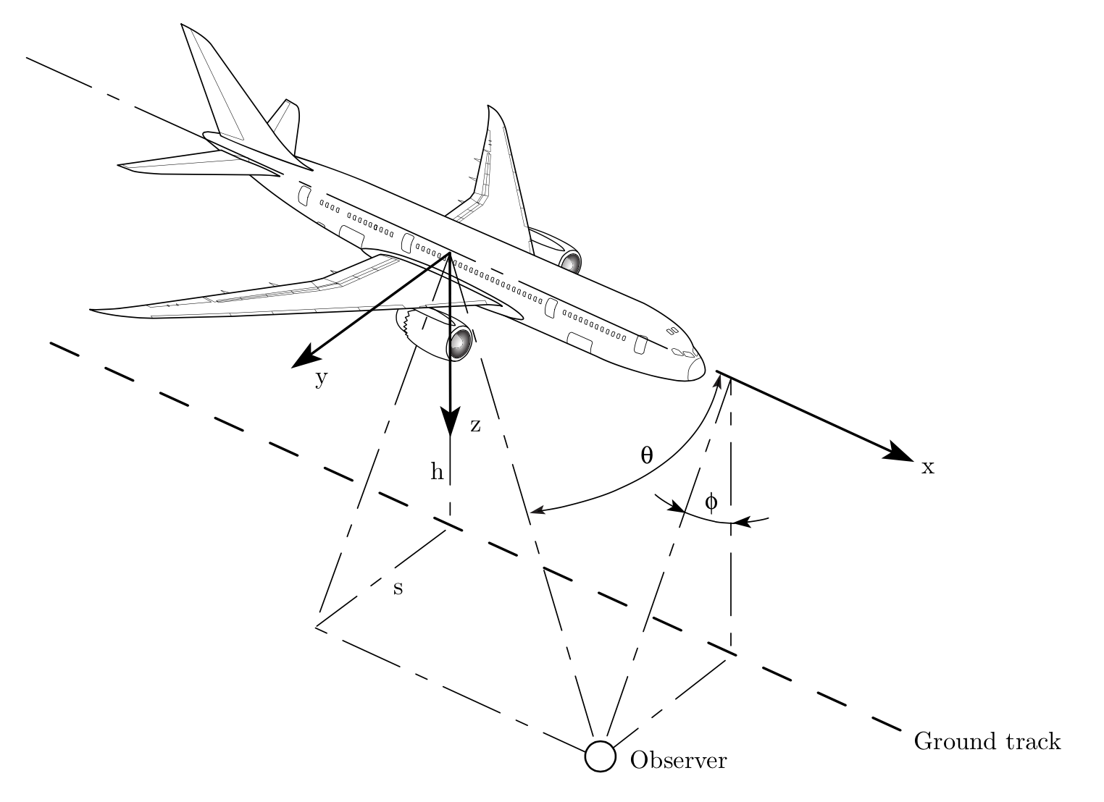
Limitations of Industry-Standard Noise Analysis Method
Current noise analysis method: Noise-Power-Distance (NPD) based computations (AEDT, INM)
Requires thrust and distance interpolation from flight test data
Crude accounting of noise effects for different flap/gear settings & operational procedures
Two options for improving noise analysis method:
Expand database of NPD curves to include advanced configuration/thrust settings
Compute noise directly using a physics-based approach
Physics-Based Noise Computation Method

Slide 5
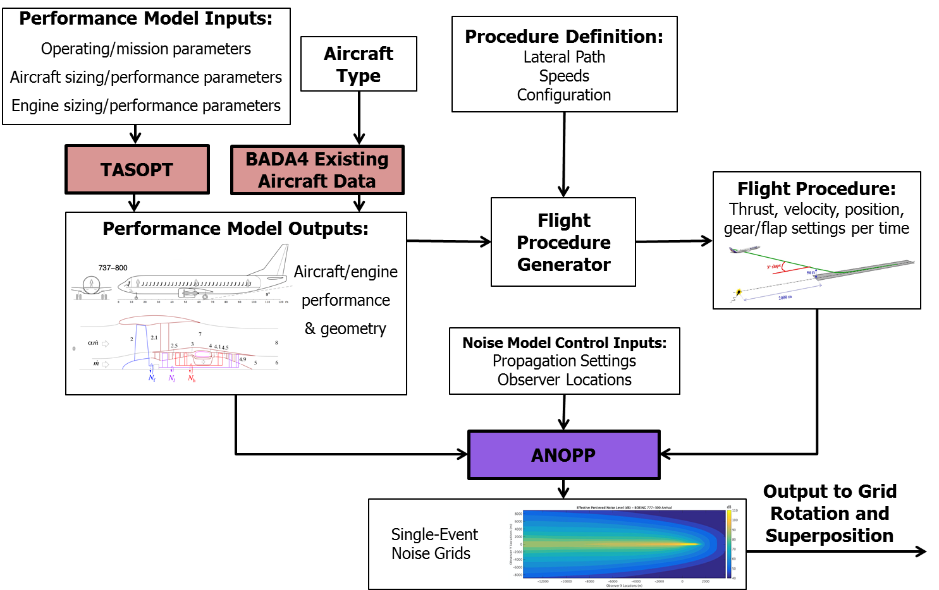
Physics-Based Noise Modeling Framework
Notes:
Physics-Based Noise Analysis Framework

Slide 6
Concepts for Mitigating Aviation Noise Impacts
Moving Noise Away from People
Changing the Noise Signature
Dispersing Noise

Slide 7
Moving Noise Away from People

Slide 8
Runway 22R Departures: 2010-2015
2010

Slide 9
Runway 22R Departures: 2010-2015
2015

Slide 10
Runway 22R and 22L Departure Procedure Concepts
Reduced separation with Rwy 27 arrival flow
Early turn after takeoff to reduce noise at Castle Island and surrounding areas

Slide 11
22R, 22L, and 15R Departure Tracks
ILS Altitude: 950’
*2,100ft (15R dep)
†2,900ft (15R dep)
*2,500ft (22R dep)
†4,000ft (22R dep)
* Lowest Observed A320 Departure at FOXXX
† Median A320 Departure at FOXXX

Slide 12
22R/22L Departure Spacing with 27 Arrivals (Early Turn) and 15R Departure Waypoint Relocation
22R Early turn:
Initial turn at 500’ AGL
Direct-to initial waypoint located on target departure corridor
Runway 15R Departure Fix:
Current procedure uses same departure fix as 22R departures (FOXXX)
Potential benefit from changing departures to use fix offset from Hull

Slide 13
Noise Exposure: 22R/22L Early Turn
22R/22L Early Turn and Waypoint Relocation
Aircraft: B737-800
Metric: LAMAX
Noise Model: AEDT
Population Exposure
Baseline Flight Track Baseline Noise Contours Early Turn Flight Track Early Turn Noise Contours
60
60
60
65
60
65
70
70
 | 60dB | 65dB | 70dB
Baseline | 36,807 | 11,698 | 2,649
Early Turn | 26,821 | 6,517 | 510
Difference | 9,986 | 5,181 | 2,139
70
70
65
65
60
60
60
65
70
65
60
65
70
60
60
60
65
60

Slide 14
Discussion Points with ATO
Reduced procedural separation with 27 arrivals
Procedural separation requirements?
Early turn option when 27 arrivals not in use
Multiple SIDs for use in varying runway configurations
Procedural deconfliction requirements
Implementation issues
Minimum turn altitude?
ARINC 424 leg types to best capture narrowbody & heavy departures
Track to fix (TF), Course to fix (CF), Direct to Fix (DF)
Process for new waypoint definition

Slide 15
Runway 4R Arrivals: 2010-2015
2010

Slide 16
Runway 4R Arrivals: 2010-2015
2015

Slide 17
Runway 4R Arrival Noise Mitigations
Standard steep approaches
2-segment steep approaches
Late turn to final
RNAV (Lighthouse-like approach paths)
RNP(Canarsie-like approach paths)
Overflight of areas with high ambient noise
Milton
– (i.e. Expressway approach)

Slide 18
3° and 3.77° Continuous Descent Approach Comparison
BADA-4 model indicates that steeper glideslopes may be feasible for some aircraft types
Feedback from operators: Airbus aircraft in planned descent autoflight mode cannot exceed 3.77° glideslope angle
B757-200 Steep Approach
Significant Concerns from Airline Technical Pilots and ATC for Operational Feasibility

Slide 19
Two-Segment Approach Concept
B757-200 Two Segment Steep Approaches
Significant Concerns from Airline Technical Pilots and ATC for Operational Feasibility

Slide 20
Changing the Noise Signature

Slide 21
Runway 33L Departures: 2010-2015
2010

Slide 22
Runway 33L Departures: 2010-2015
2015

Slide 23
Standard Departure Definition
Standard departure procedures vary by airline
Typical profile includes thrust reduction at 1,000’ AGL followed by an acceleration to 250 kt climb speed and flap retraction

Slide 24
Increasing Speed Causes Increased Airframe Noise
As speed increases, airframe noise becomes as loud or louder than engine noise
Airframe Louder
Engine Noise Dominates (Low Speed)
Engine Louder
160 KTAS
190 KTAS
Airframe Noise Dominates (High Speed)
220 KTAS
250 KTAS

Slide 25
Delayed Acceleration Climbs
Thrust reduction at 1,000’ AGL followed by an acceleration to 200 kt or 220 kt climb speed and appropriate flap retraction secondary acceleration at TBD altitude

Slide 26
737-800: Delayed Acceleration Climb – 180 knots
Aircraft | B737-800
Metric | ^{L}A,MAX
Noise Model | ANOPP
Notes | Runway 33L: Maintain Standard Climb Thrust & 180 KIAS to 10,000’
Population Exposure
 | 60dB | 65dB | 70dB
Standard Departure | 237,952 | 105,869 | 38,599
Delayed Acceleration | 172,598 | 59,392 | 24,025
Difference | 65,354 | 46,477 | 14,574
Preliminary

Slide 27
737-800: Delayed Acceleration Climb – 200 knots
Aircraft | B737-800
Metric | ^{L}A,MAX
Noise Model | ANOPP
Notes | Runway 33L: Maintain Standard Climb Thrust & 200 KIAS to 10,000’
Population Exposure
 | 60dB | 65dB | 70dB
Standard Departure | 237,952 | 105,869 | 38,599
Delayed Acceleration | 169,124 | 66,585 | 26,811
Difference | 68,828 | 39,285 | 11,788
Preliminary

Slide 28
737-800: Delayed Acceleration Climb – 220 knots
Aircraft | B737-800
Metric | ^{L}A,MAX
Noise Model | ANOPP
Notes | Runway 33L: Maintain Standard Climb Thrust & 220 KIAS to 10,000’
Population Exposure
 | 60dB | 65dB | 70dB
Standard Departure | 237,952 | 105,869 | 38,599
Delayed Acceleration | 190,128 | 75,469 | 28,239
Difference | 47,824 | 30,401 | 10,359
Preliminary

Slide 29
737-800: Delayed Acceleration Climb – 240 knots
Aircraft | B737-800
Metric | ^{L}A,MAX
Noise Model | ANOPP
Notes | Runway 33L: Maintain Standard Climb Thrust & 240 KIAS to 10,000’
Population Exposure
 | 60dB | 65dB | 70dB
Standard Departure | 237,952 | 105,869 | 38,599
Delayed Acceleration | 220,781 | 91,525 | 31,007
Difference | 17,171 | 14,345 | 7,592
Preliminary

Slide 30
Preliminary Fuel Burn and Time Impact
Reduced speed climb profiles impact total trip fuel burn and flight time
Magnitude varies by speed and aircraft type
 | B738 |  | E170 |  | B773
Climb Speed | Fuel Burn Increase (kg) | Time Increase (s) | Fuel Burn Increase (kg) | Time Increase (s) | Fuel Burn Increase (kg) | Time Increase (s)
180 kts | 141 | 121 | 55 | 92 | 674 | 178
200 kts | 54 | 65 | 12 | 43 | 321 | 107
220 kts | 21 | 30 | 4 | 22 | 160 | 52
240 kts | 4 | 8 | 1 | 6 | 32 | 12
Preliminary: Do Not Distribute

Slide 31
Discussion Points with ATO
Implications and precedent for speed restrictions on RNAV SIDs
Speed restriction on SID vs. ATC-cleared speed restriction
Questions:
Airspace conflicts given steeper climbs
Altitude limit on SIDs (current 5000’)
What should altitude limit for speed constraint be?

Slide 32
Dispersing Noise

Slide 33
Runway 33L Departures: 2010-2015
Using Open SIDs to Re-introduce Dispersion
2010
2015
What were design constraints on existing RNAV SID?

Slide 34
Introducing Open SID Concept
Open SIDs are RNAV departure procedures that allow for embedded ATC radar vector segments.
– Vectoring can be used to guide an aircraft to join an RNAV track, remove an aircraft from an RNAV track, or a combination of both.
Open SIDs were authorized by an FAA memo signed in 2015.
2,000 foot turn
4,000 foot turn

Slide 35
Discussion Points with ATO
Compatibility with current Open SID procedures
CLT procedures
Other PBN SID examples
i.e. LAX ORCKA1
Options for initiating direct-to
Altitude
Precedent/concerns for direct-to on altitude
Controller vectors
Other
Method for maintaining procedural separation (e.g. Rwy27 departures) under Open SID
Other methods for introducing track dispersion using PBN?

Slide 36
Current Status of FAA Noise Research

Slide 37
Extensive FAA Coordination
Monthly “Noise Operations Research Meeting” to coordinate activities
Reps from AEE, AJV, ANG, ARP, AVS
Short Term Initiative on Noise (shared across FAA LOBs/SOs)
ATO input on FAA-Massport MOU coming in from local facilities, New England Region (ANE), and FAA HQ (AJV, AFS, ARP, etc.)

Slide 38
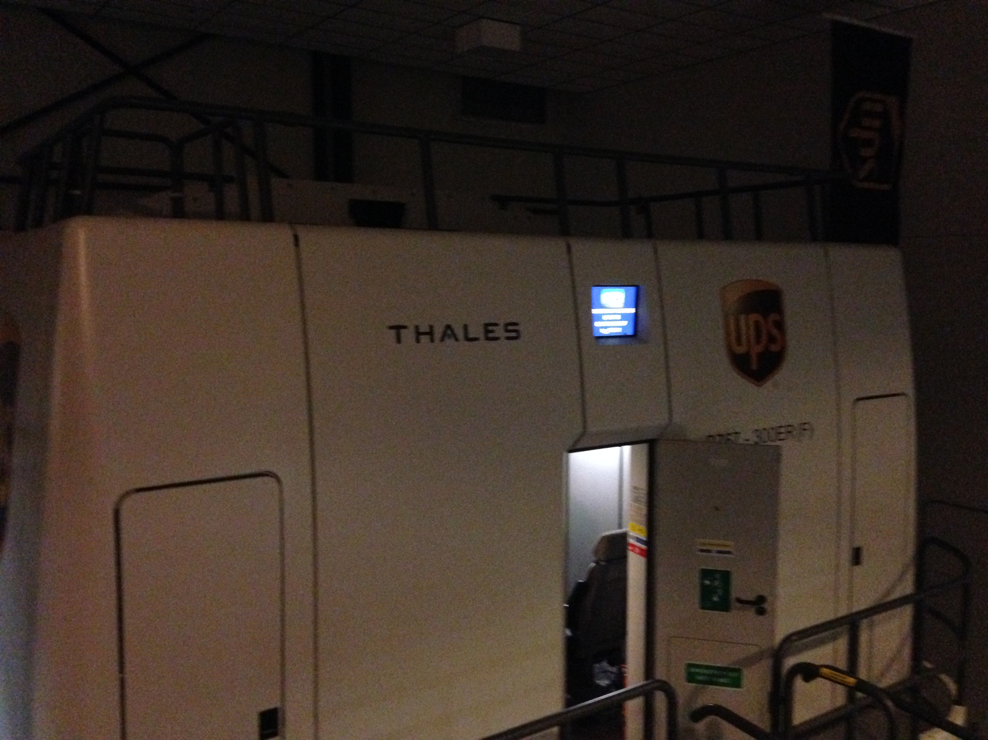
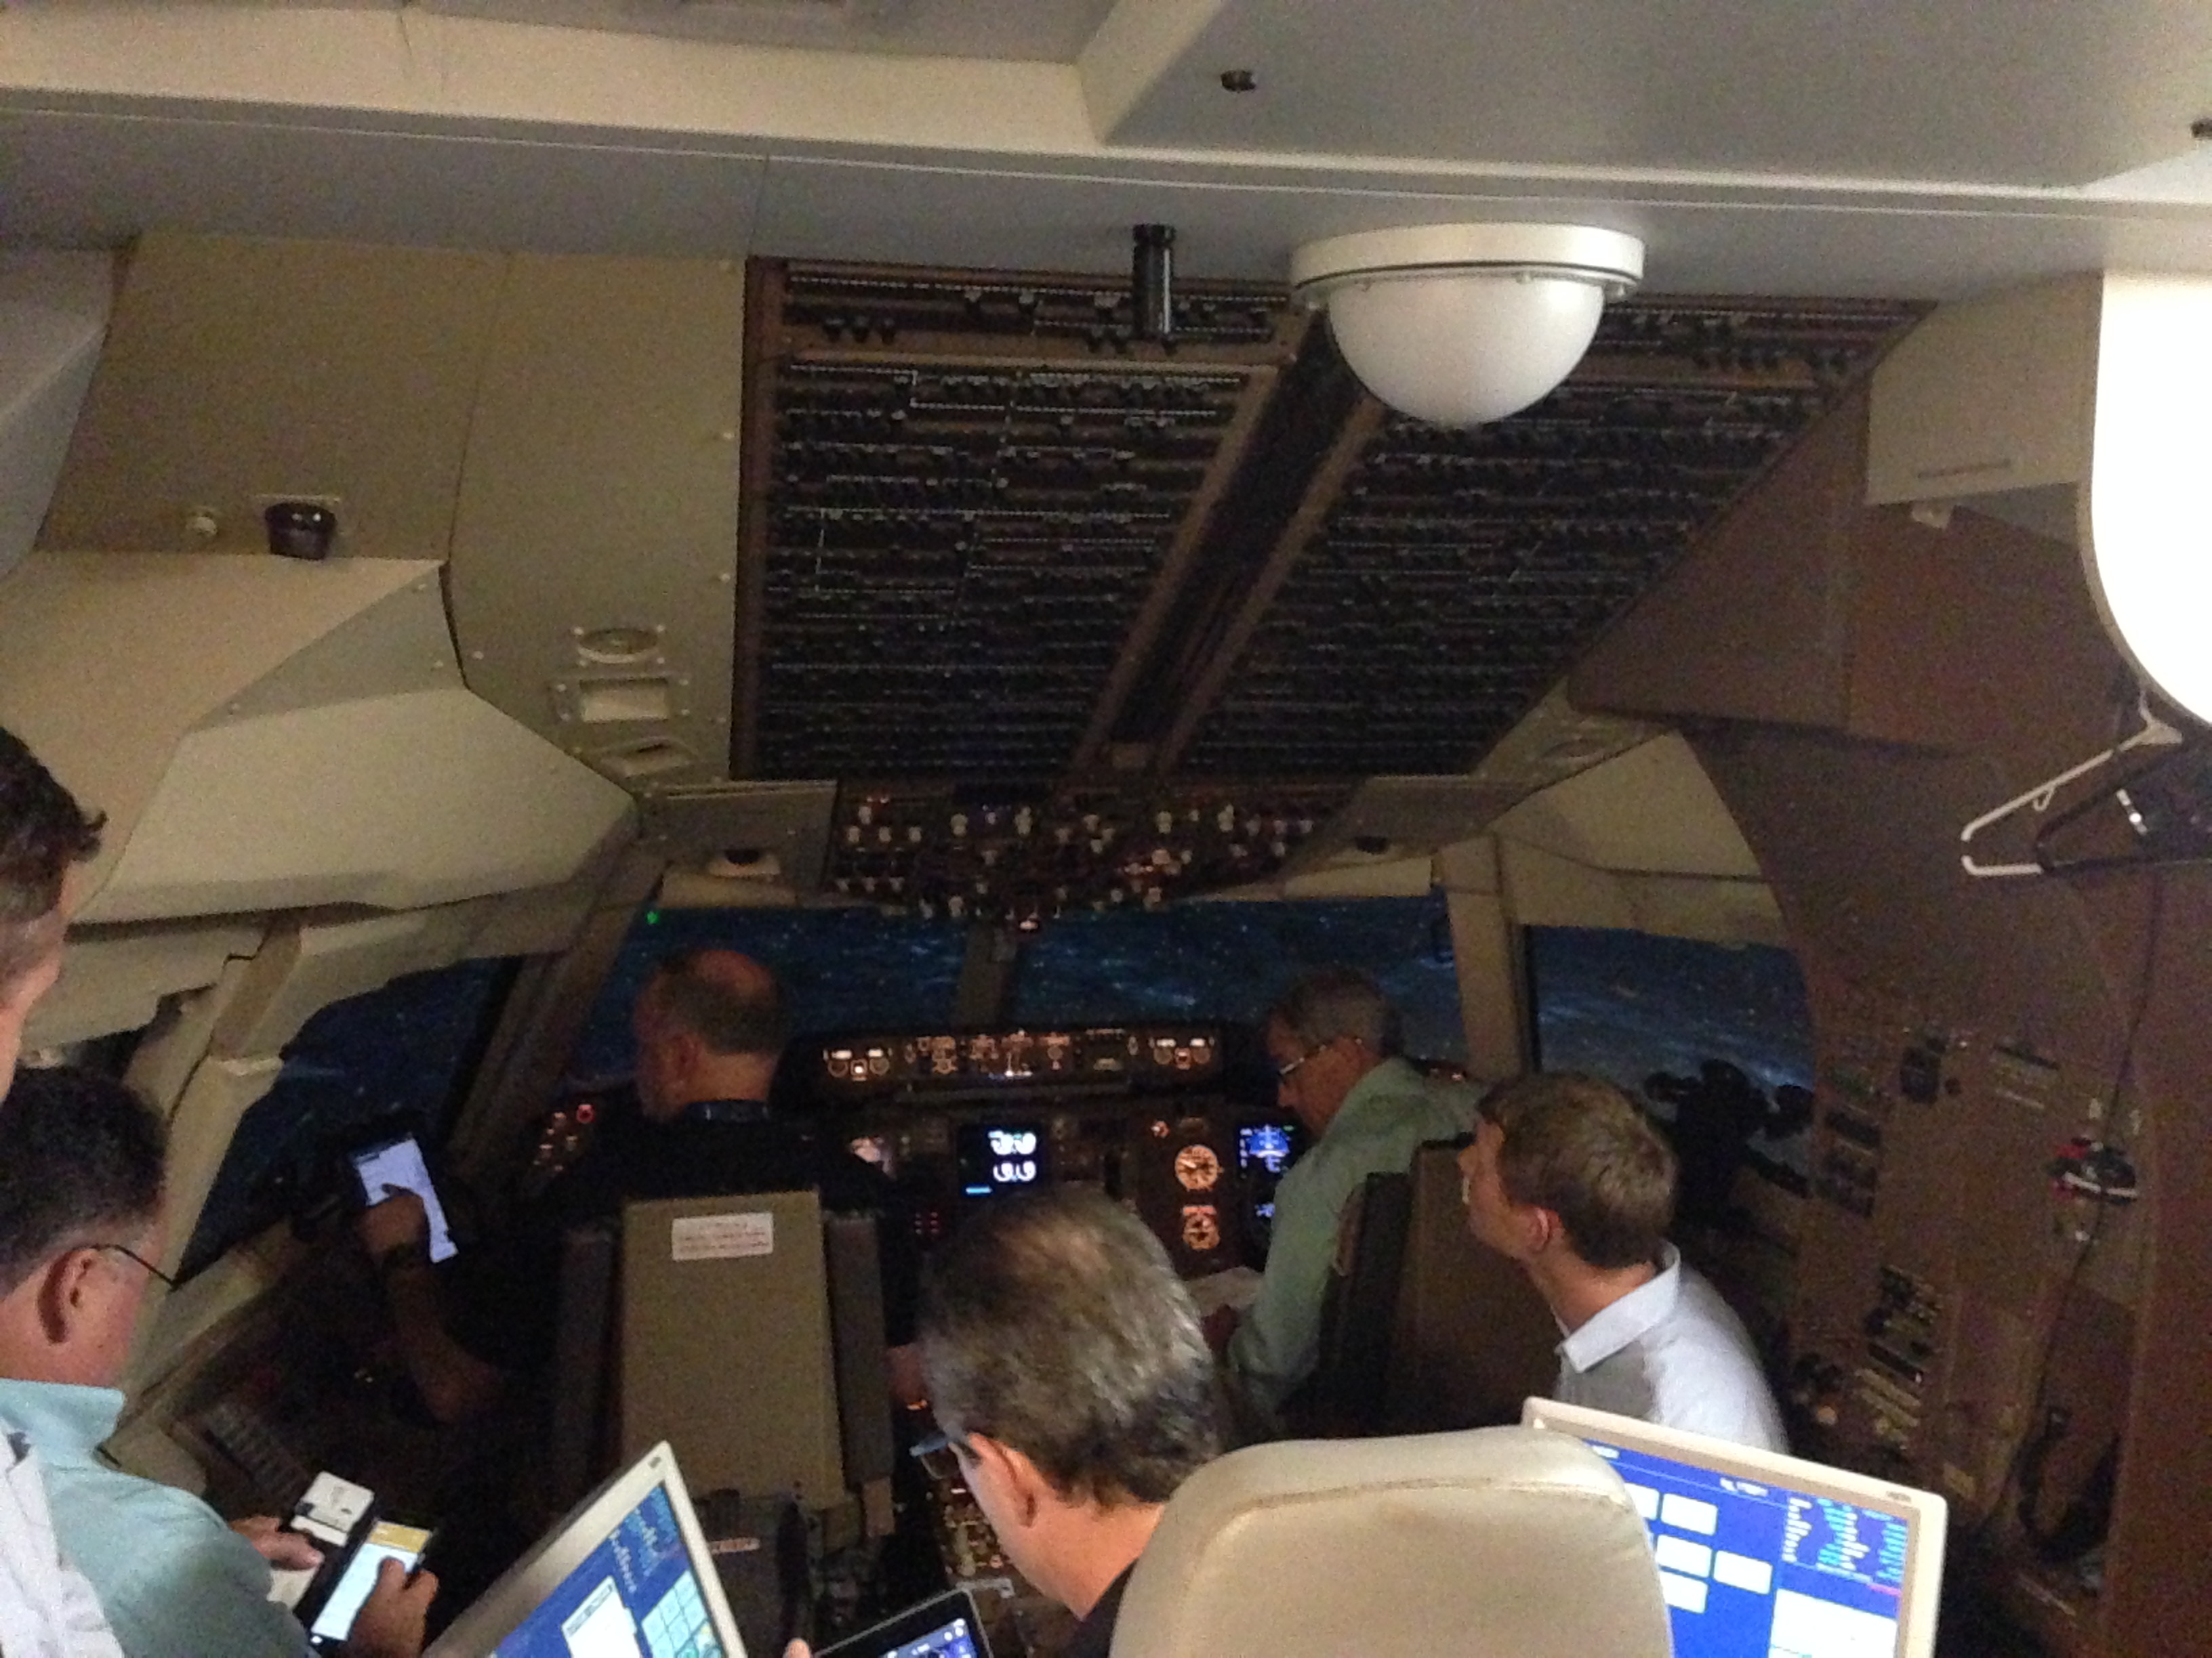
Industry Collaboration - UPS Visit
FAA/MIT visited UPS Louisville facility in July
UPS reviewed two of their projects:
CDA developed and now in regular operation at Sacramento Mather Airport → 3-7 dB reduction in target area 10 miles from the airport
Trial of dual-segment steeper approaches at Cologne Bonn Airport → observed benefit on the order of 1 dB, though some question of the reliability of their noise measurements
~3.5 hours in simulator, during which MIT flew many of the Massport concepts
MIT can run sim trajectory data through noise model – use it to validate their flight profile generator
UPS offered to fly additional procedures if needed
UPS also looking into sharing noise measurement data for use in developing relationships between noise footprint and speed/flap/slat settings
Potentially reach out to Boeing for validation
Notes:
Representatives from multiple FAA offices (AEE, AJV, ANG, AFS) traveled with the MIT researches to meet with three of UPS's chief test pilots

Slide 39
Next Steps
Continue to explore operational concepts with the potential to reduce noise
Work with ATO/ARP/AVS to identify/mitigate implementation barriers and constraints
Determine path forward for deploying concepts and integrating noise considerations into ATC / pilot decision-making, leveraging research and noise evaluation framework

Slide 40
Backup Slides

Slide 41
Solution set could be defined by type of noise impact and density of operations
 | Noise exposure due to flight concentration | Noise exposure due to “off-peak” operations
Potential Noise Mitigation
Airspace Planning
Change high density operational procedures (limited tools in toolbox)
Operating Restrictions
Change low density operational procedures (more tools in toolbox)
“Equitable” distribution (fanning, respite, etc.)
Sound Insulation / Land Use Planning
Is it possible to integrate noise considerations into ATC / pilot decision-making?

Slide 42
15R Waypoint Relocation
15R Departure Waypoint Relocation
Aircraft: B737-800
Metric: LAMAX
Noise Model: AEDT
Population Exposure
 | 60dB | 65dB | 70dB
Baseline | 14,367 | 1,765 | 84
Early Turn | 13,140 | 1,781 | 147
Difference | 1,227 | -16 | -63

Slide 43
Limitations in the Design of Steep Approaches
According to TERPS, the following are the standard maximum approach angles authorized on a final approach segment:
Precision Approach:
Aircraft Approach Category Maximum Angle
C D
3.60°
3.10°
Non-Precision Approach:
Aircraft Approach Category
Maximum Angle
C D
3.77°
3.50°
According to JetBlue pilots, the Airbus A320 FMS will also not allow for the computation of VNAV paths that are steeper than 3.77°

Slide 44
Safety Concerns - High-Energy Approaches
Runway Excursions
Figure source: The Boeing Company http://www.boeing.com/resources/boeingdotcom/company/about_bca/pdf/statsum.pdf

Slide 45
777-300: Delayed Acceleration Climb – 220 knots
Aircraft | B777-300
Metric | ^{L}A,MAX
Noise Model | ANOPP
Notes | Runway 33L: Maintain Standard Climb Thrust & 220 KIAS to 10,000’
Population Exposure
 | 60dB | 65dB | 70dB
Standard Departure | 455,746 | 275,879 | 118,685
Delayed Acceleration | 437,415 | 262,310 | 105,182
Difference | 18,331 | 13,569 | 13,502
Preliminary

Slide 46
E-170: Delayed Acceleration Climb – 220 knots
Aircraft | E-170
Metric | ^{L}A,MAX
Noise Model | ANOPP
Notes | Runway 33L: Maintain Standard Climb Thrust & 220 KIAS to 10,000’
Population Exposure
 | 60dB | 65dB | 70dB
Standard Departure | 147,222 | 58,441 | 10,437
Delayed Acceleration | 97,728 | 33,306 | 9,298
Difference | 49,493 | 25,135 | 1,139
Preliminary

Slide 47
Runway 27 Departures: 2010-2015
2010

Slide 48
Runway 27 Departures: 2010-2015
2015

Slide 49
Delayed Acceleration Climb – 200 knots
Aircraft | B737-800
Metric | ^{L}A,MAX
Noise Model | ANOPP
Notes | Runway 27: Maintain Standard Climb Thrust & 200 KIAS to 10,000’
Population Exposure
 | 60dB | 65dB | 70dB
Standard Departure | 200,576 | 102,274 | 37,078
Delayed Acceleration | 181,206 | 67,635 | 14,375
Difference | 19,370 | 34,639 | 22,703
Preliminary

Slide 50
Delayed Acceleration Climb – 220 knots
Aircraft | B737-800
Metric | ^{L}A,MAX
Noise Model | ANOPP
Notes | Runway 27: Maintain Standard Climb Thrust & 220 KIAS to 10,000’
Population Exposure
 | 60dB | 65dB | 70dB
Standard Departure | 200,576 | 102,274 | 37,078
Delayed Acceleration | 187,400 | 76,261 | 21,066
Difference | 13,177 | 26,014 | 16,011
Preliminary

Slide 51
AJV Low Altitude PBN Research
AEE is monitoring and coordinating with AJV project being conducted by MITRE
Site-specific concept development using near-term candidate concepts (primarily dispersion techniques)
Also exploring applicability of Equivalent Lateral Spacing Operations (ELSO) standard for noise dispersal (ATR funded)
Examine operational scenarios for ELSO
Develop process for identifying noise-optimal headings
Assess noise, fuel, emissions, and throughput tradeoffs
Source: MITRE CAASD

