Slide 1
REDAC E&E Subcommittee – August 1st - 2nd 2017
Supersonics & Sonic Boom Recommendations
Provided by: Charles L. Etter

Slide 2
Introduction
The timing is right for the FAA to increase their level of involvement in civil supersonics
Design for a U.S. led low-boom flight demonstration experimental aircraft is currently underway and funding for detailed design and fabrication is included in the FY18 US President’s Budget request.
U.S. House and Senate interest with associated legislative actions under consideration within the FAA Reauthorization Bill
H.R.2997 – 21st Century AIRR* Act (Section 629)
S.1405 – FAA Reauthorization Act of 2017 (Section 5017)
CAEP actively engaged in developing sonic boom and supersonic LTO noise and emissions standards
Recent industry announcements for prototype aircraft test programs and potential TC applications appear imminent
* Aviation Innovation, Reform and Reauthorization

Slide 3
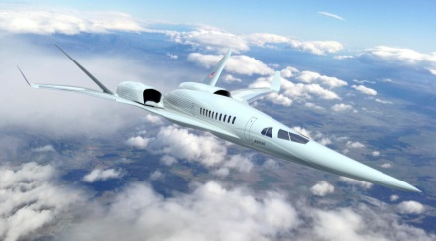
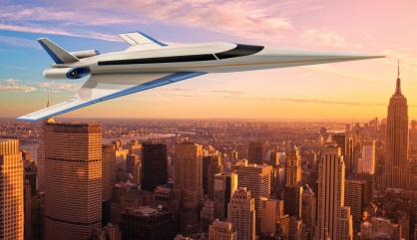
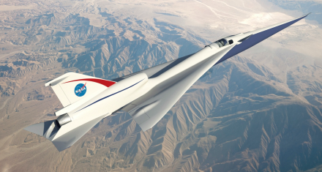
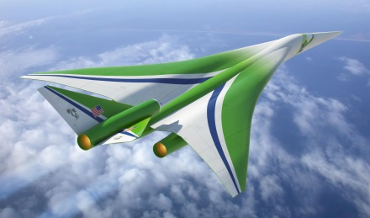
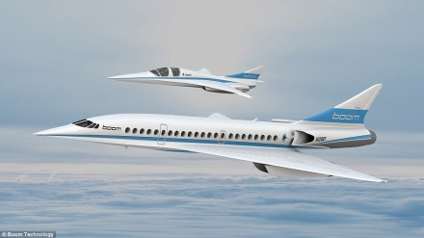
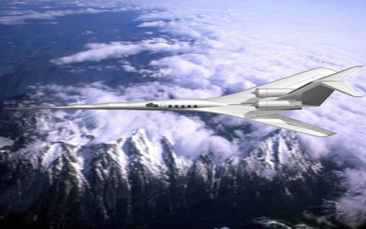
Perspective from U.S. Industry
Spike Aerospace
Boeing
Aerion / Airbus
NASA QueSST
Lockheed Martin
Boom Technology
Gulfstream
Significant Industry Interest In Supersonic Travel

Slide 4
Recommendation 1 – Sonic Boom Certification Tools
The FAA should continue its leadership role within ICAO/CAEP for the reentry of civil supersonic operations.
In doing so, the FAA should coordinate closely with NASA and other Government Agencies on active research programs to ensure these programs provide sufficient and necessary data, modeling development and validation for certification and regulatory needs.
Specifically, the FAA should establish a presence in the definition and validation of sonic boom propagation software, i.e. the “Gold Standard” certification code. This would be analogous to Volpe’s role of validating software and instrumentation for CFR Part 36 compliance.
High Priority

Slide 5
Recommendation 2 – Operational Analysis
The FAA should proactively begin preparations for a National scale civil supersonic operational analysis
Activities might include model development for inclusion within the FAA’s environmental tool suite
Supersonic en route noise (conventional and low sonic boom including acceleration and lateral cutoff)
High altitude emissions
Local air quality
Airport/community noise
Other activities may also include NEPA-related analyses
Consideration should be given to additional actions associated with ATC procedures and routing

