Slide 1
Update on Technology Assessment Efforts
ASCENT Project 10
Aircraft Technology Modeling and Assessment
ASCENT Project 37
CLEEN II Assessment
Presented to: REDAC Subcommittee on Environment
By: Laszlo Windhoffer
Office of Environment & Energy
Federal Aviation Administration
Date: August 2, 2017

Slide 2
Outline
ASCENT Project 10 (A10)
  Phase I
    Overview, Objectives & Approach
    Outcomes of Workshops
    Example Results
  Phase II
    Overview, Workplan & Schedule
ASCENT Project 37 (A37)
  Progress
  Technologies

Slide 3
ASCENT 10 Overview: Phase I
Objectives:
  Define a broad set of future scenarios, out to 2050, that bound the demand for future aviation activity
  Evaluate scenarios to capture effects of technology and mission specification changes on fuel burn, emissions, and noise
  Provide modeling and assessment mechanism for aircraft technology
Approach:
  Develop harmonized fleet assumptions for use in future fleet assessments
  Get input from industry, government and academia through workshops
  Model vehicles expected to enter fleet through 2050
  Leverage previous technology and vehicle modeling work from CLEEN, PARTNER, and NASA programs
  Fill gaps as necessary for scenarios developed
  Perform vehicle and fleet level assessments
Notes:
Overview of the Scope of the last few years
Project served initially as follow-on to CLEEN Technology modeling under PARTNER
Main goal was to create set of scenarios for technology assessment that could be applied across tools and analysis needs

Slide 4
Team Approach to Tasks
Objectives |  | Georgia Tech | Stanford | Purdue
1 | Harmonize Fleet Assumptions | Lead process, coordinate industry, government participation, provide basis for discussion | Support assumptions definition, provide expert knowledge | Support assumptions definition, provide expert knowledge
2 | Advanced Vehicle and Technology Modeling | Use EDS for public domain technology modeling, Provide tech models to Stanford and Purdue | Input into public domain technology modeling | Develop cost, fuel burn, block hour values for aircraft models from Georgia Tech
3 | Vehicle and Fleet Assessments | Perform vehicle and fleet level assessments using GREAT and ANGIM | Provide trade factors for mission specification changes using SUAVE. Provide tech factors for some tech modeled in (2) | Fleet-level assessments using FLEET
EDS – Environmental Design Space
GREAT – Global and Regional Environmental Analysis Tool
ANGIM –Airport Noise Grid Integration Method
SUAVE – Stanford University Aerospace Vehicle Environment
FLEET – Fleet-Level Environmental Evaluation Tool
Notes:
Overview of tasks and distribution of responsibilities to team members
Want to emphasize team effort

Slide 5

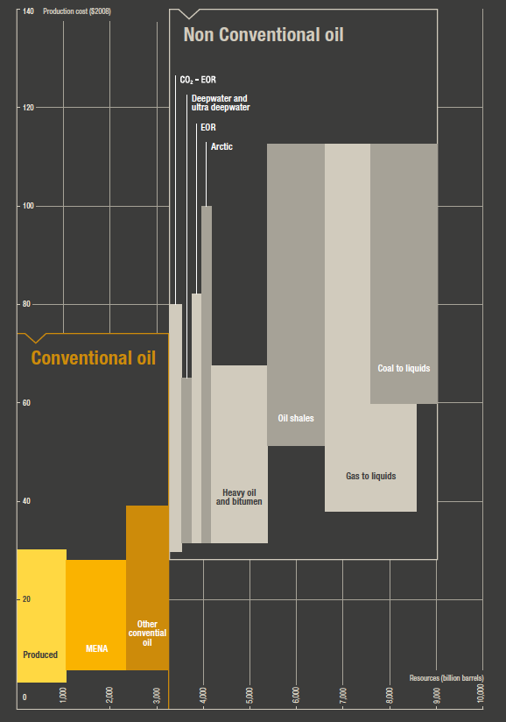
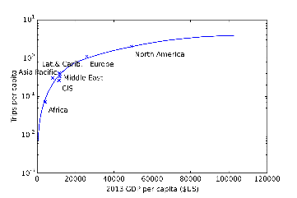



Project Focus Areas
Fleet Benefits Assessment
Use each university’s analysis tools to understand fleet level implications of advanced technology/mission spec. changes on
  Fuel Burn
  Emissions
  Noise
Technology Assessment Assumptions Setting
Work with broader community to define a standardized set of technology and fleet modeling assumptions for future benefits assessments
Ascent 10 Team
Subsystem Technology
Impacts
Technology
Effects on
Vehicle
Fleet Level Implications
Notes:
How do we go form subsystem technology impacts to vehicle level to fleet level?
Need to set common assumptions at each level and understand implications

Slide 6
Workshops
Fleet Workshop #1
Fleet Workshop #2
Tech Workshop #1
Tech Workshop #2
Fleet Scenario Definitions Setting
Goal: Determine what defines a world view or scenario
Feedback on descriptors (variables, ranges, and importance)
Bring forward initial worldviews for comment
Goal: Select specific worldviews/scenarios of interest
Feedback on technology insertion opportunities and their timing
Feedback on worldviews and scenarios
Goal: Identify technology maturation and availability for a broad range of technology areas
Feedback on examples of 1st/2nd/3rd generation technologies
Goal: Consensus on technology evolution scenarios
Feedback on specific technology impacts and maturation rates
Notes:
Held 2 workshops each for Fleet and Technology assumptions
Broad participation from academia, industry, government
Main purpose was to generate input to help setup fleet scenario definitions

Slide 7
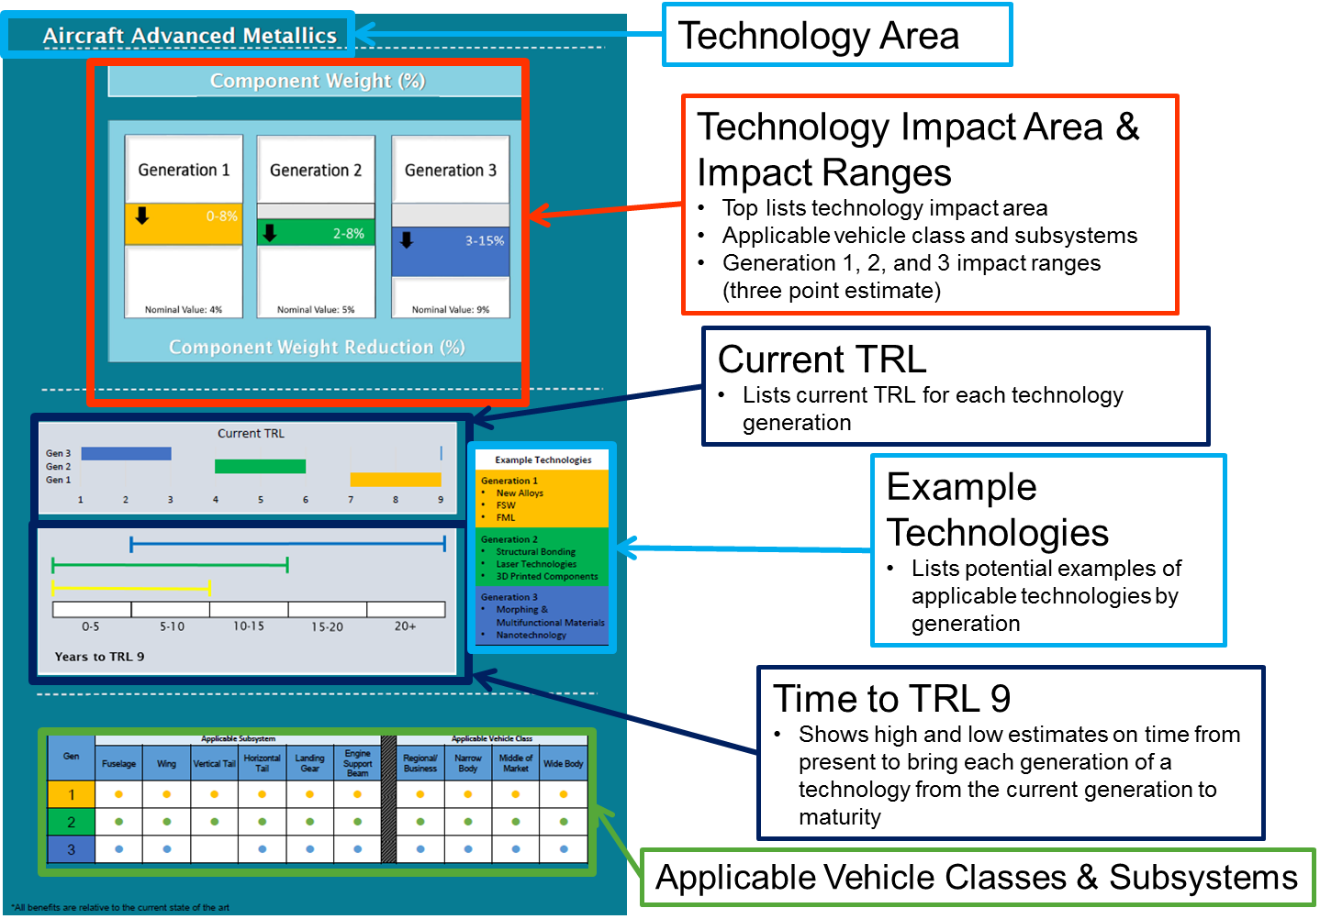
Technology Workshop Outcomes
Notes:
This is an example of the technology workshop results
Example of one specific technology, created much larger list
Each technology by area, impact ranges, time line, possible actual examples and what it applies to

Slide 8
Fleet Workshop Outcomes
Aircraft Technology
Economic Growth
Energy Price
Scenarios
Nominal
Nominal
Nominal
Current Trends “Best Guess”
High
Nominal
Nominal
Current Trends + High R&D
Low
High
Environmental Bounds “Low”
Low
High
Low
Environmental Bounds “High”
High
Nominal
High Demand + High R&D
Nominal
High Demand + Low R&D
Nominal
Low Demand + High R&D
Low
Nominal
Low Demand +
Low R&D
Also evaluate with mission specification changes
* ‘Frozen technology’ scenario not shown above
Notes:
Fleet Scenario “tree”
Each column defines one specific setting at low/nominal/high settings with colors
The right most columns shows the resulting scenarios that the team down selected
There are additional scenarios, but they serve as reference scenarios and don’t apply to being able to explore potential outcome range extremes

Slide 9
World View Scenarios Assumptions
Demand/Economic Factors | Min | Nominal | Max
GDP Growth (%/year) | 1.8 | 2.8 | 4
Energy Price ($/bbl) | 41 | 77 | 181
Population Growth (%/year) | 0.45 | 0.58 | 0.68
International Trade (%/year Asia) | 3.3 | 4.3 | 5.9
Industry Competetiveness (cent/ASM) | 12 | 12 | 12
Airport Noise Limitations (% airports noise limited in future) | 4 | 25 | 95
Cost of CO2 Emissions ($/MT) | 0 | 21 | 85
Fleet Evolution Factors
Fleet Evolution Schedule | Single Aisle First | Twin Aisle First
Aircraft Retirement | Early | Nominal | Late
Production Capacity | Limits | No Limits
Aircraft Technology Factors
Amount and Speed of Technology R&D Investment (relative) | 0 | 1.365 | 1.71
TRL 9 Dates | Early | Medium | High
Benefit Levels | None | Medium | High
Mission Specification Changes |  | None | Yes (CSR)
 | Demand/Economic Factors |  |  |  |  |  |  |  | Fleet Evolution Factors |  |  |  | Aircraft Technology Factors
 | GDP Growth (%/year) | Energy Price ($/bbl) | Population Growth (%/year) | International Trade (%/year Asia) | Industry Competetiveness (cent/ASM) | Airport Noise Limitations (% airports noise limited in future) | Cost of CO2 Emissions ($/MT) |  | Fleet Evolution Schedule | Aircraft Retirement | Production Capacity |  | Amount and Speed of Technology R&D Investment (relative) | TRL 9 Dates | Benefit Levels | Mission Specification Changes
Current Trends "Best Guess"
Current Trends + High R&D
Current Trends + High R&D + Mission Spec.
Current Trends Frozen Tech - In-Production Only
Environmental "Bounds" - Low
Environmental "Bounds" - High
High Demand (Including Global) + High R&D
High Demand (Including Global) + Low R&D
Low Demand (Including Global) + High R&D
Low Demand (Including Global) + Low R&D
Very High Demand with Noise Limits - Low R&D
Very High Demand with Noise Limits - High R&D
View descriptors become inputs to fleet model
Stakeholder-generated worldviews also useful for future studies
Notes:
The “noise limits” is in red because GREAT and FLEET have the largest difference for these scenarios.
In the result section, I use “noise limits” scenarios to show the different simulation results between FLEET and GREAT

Slide 10
Results Across Scenarios: Demand
Significant uncertainty in out years is now bounded by comprehensive ASCENT 10 studies
Notes:
This shows the range of actual demand in seat miles across all scenarios.

Slide 11
Results Across Scenarios: Relative CO₂
Technology
Technology improvements lower emission
Noise constraint
limits AC operations
Demand
Demand drives up emissions
Notes:
This shows the relative CO2 results for all scenarios
The top row shows the variation by technology level – aka how fast and how much better aircraft become available
The bottom row shows the variation by demand. The very high level is less than high due to other factors reducing emissions, such as noise constraints.

Slide 12
Results Across Models: Relative CO₂
Technology
General trends in both models are similar.
Different ways to model
Noise Limits
Demand
Difference results between models
due to different assumptions
Notes:
The top row shows the variation by technology level – aka how fast and how much better aircraft become available
The bottom row shows the variation by demand. The very high level is less than high due to other factors reducing emissions, such as noise constraints.

Slide 13
Project Outcomes
Successfully completed Project 10 initial intent
  Suggested Fleet Scenario inputs for future assessment activities
  Technology evolution scenarios for future assessment activities
  Conducted long term technology assessment for defined fleet and technology scenarios
  Understand bounding of technology and demand on future fleet-wide environmental impacts
  Comparison of similarities and differences using multiple fleet evaluation tools (FLEET and GREAT)
Provided framework for deeper investigation of sensitivities to demand and technology drivers
Final ASCENT 10 Phase I report is being finalized

Slide 14
A10 Overview: Phase II
Supersonic Aircraft
Primary Objectives:
  Assess potential environmental impact of supersonic air travel (domestic & global)
  Develop demand and forecast through 2050
  Analyze existing and future supersonic technologies (e.g. traditional, low sonic boom shaping, etc.)
  Provide scenarios with potential changes in fuel burn, CO₂, H₂O, NO_{X} and noise exposure
Heavily leverage Phase I effort
Notes:
Scope of the project for the coming year
Preliminary analysis of supersonic aircraft impact on environment
Want to leverage prior work
4 major tasks

Slide 15
ASCENT 10 Supersonic Work Plan
Task 1: Fleet Assumptions & Demand Assessment
Task 4: Fleet-level Impact Assessment
L
GT/P
Use A10 Scenarios to identify drivers of supersonic demand for domestic and international (to/from US)
GT/P
Fleet estimates for fleet of supersonic aircraft
GT/P
Estimate water vapor at likely cruise altitudes
GT/P
Develop estimates of latent demand for supersonic travel as f(performance, cost)
GT/P
Estimate LTO NOx
GT
User latent demand, perf, and cost to identify airports that could support supersonic travel
GT/P
Estimate en-route NOx
P
GT
Develop daily flight schedules based on bounding scenario, perf, cost
GT
P
Estimate scaling factors of arrival and departure noise (DNL) at affected airports
Task 2: Preliminary Vehicle-level Impact Assessment
GT
Develop estimates of points of highest # of daily overflights and using estimates of boom overpressure, predict maximum daily exposure
GT
Develop estimates of performance and key environmental indicators (KEI) for current tech aircraft from prior studies
GT/P
Estimate relative impact compared to subsonic for KEI
GT
P
Develop estimates of perf and KEI for future technology aircraft
GT
Develop multipliers of KEI for aircraft relative to current technology subsonic transports
Task 3: AEDT & EDS Vehicle Definitions
P
GT
Develop estimates of performance penalties due to operational restrictions
GT
Test current version of AEDT ability to analyze existing supersonic models
GT
Test future supersonic vehicle AEDT definitions in AEDT
GT
P
Develop estimates of likely operating altitudes
LEDGEND
GT
Develop future supersonic vehicle EDS definitions
LEAD
SUPPORT
Task Description
Notes:
Breakdown of the 4 tasks by Lead/Support university

Slide 16
Schedule
Year 1 Tasks:
Fleet Assumptions and Demand
  Identify drivers of demand
  Develop estimates of demand using developed scenarios
  Develop flight schedules/route possibilities
Preliminary Vehicle Environmental Impact Prediction
  Develop Estimates of Key Environmental Indicators (KEI) for future supersonic aircraft
  Develop multipliers of KEI for supersonic relative to subsonic
AEDT Vehicle Definition
  Test AEDT and provide suggestions
Fleet Impact Assessment
  Estimate fuel burn for fleet of supersonic aircraft
  Estimate water vapor emissions at likely cruise altitudes
  Estimate LTO NO_{X}
Notes:
Planned schedule of all 4 tasks for the first year
Have developed multi year plan for more in-depth analysis and other aspects

Slide 17
Schedule
Year 2:
International scope version of domestic year 1 work
Year 3+:
AEDT and EDS development of future supersonic vehicles
Detailed fleet-level impacts assessment
Notes:
Planned schedule of all 4 tasks for the first year
Have developed multi year plan for more in-depth analysis and other aspects

Slide 18
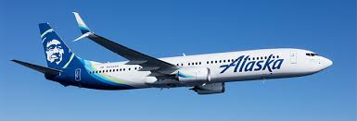
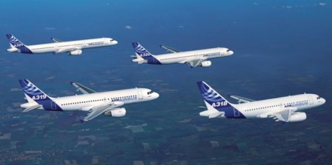
ASCENT 37 – CLEEN II Assessment
Modelling process:
Exchange of proprietary data with CLEEN II companies to
accurately represent technologies at subsystem and vehicle
level
Vehicle and fleet-level assessment of CLEEN II and other
complementary technologies impacts to fuel burn, emissions,
and noise
More involvement by FAA with in-house use of tools.
Divide and conquer modeling with GT to cover 8 companies.
Progress to date:
Georgia Tech has almost completed Aurora modelling,
report coming soon
Georgia Tech working with GE-MESTANG to obtain initial data for simulations
FAA made significant progress on simulations:
  GE-FMS Optimum Cruise: Completed initial calculations and sent results to GE
  Delta Leading Edge Protective Coating Simulations: Conducted initial simulations
Single vehicle
Aircraft fleet
Notes:
The ASCENT 37 project is a simulation effort of the benefits of the key technologies that the OEMs are employing. These key technologies are designed to reduce fuel burn, NOx emissions and aircraft noise generation.
Steps taken in the 2016-2017 year towards the simulation effort are:
Exchanging proprietary data with CLEEN II companies so can simulate their vehicles and fleet benefits accurately
Conducting simulations of the key technologies on a single vehicle as well as on a fleet of aircraft
FAA is more involved with modeling of the 8 companies.
Additionally the progress achieved are:
Georgia Tech almost completed the Aurora modelling and the report is coming soon
Georgia Tech is working with GE-MESTANG to get data.
FAA has made significant progress on simulating the key technologies below:
GE-FMS Optimum Cruise
FAA has completed initial baseline vehicle calculations and sent results to OEM
For the Delta Leading Edge Protective Coating Simulations:
FAA has, with Georgia Tech assistance, conducted initial fuel burn savings simulations

Slide 19
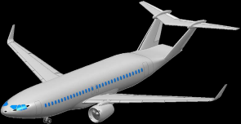
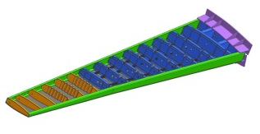
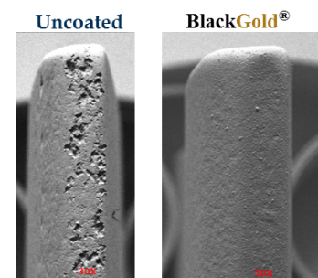
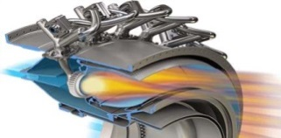
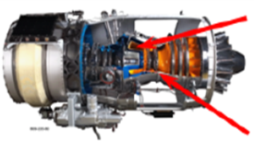
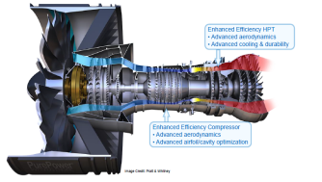
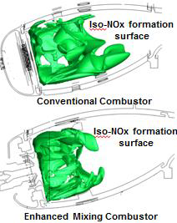
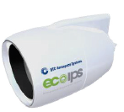
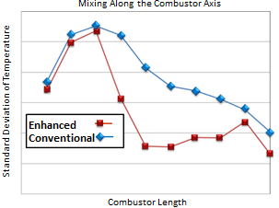
CLEEN II Technologies being Modeled
Aurora D8 Fuselage
Aurora Flight Sciences: D8 Subsonic Transport Aircraft
Boeing: Structurally Efficient Wing (SEW)
Delta Tech Ops/MDS Coating Technologies/America’s Phenix:
Leading Edge Protective Coating for Turbofan Blades
GE: TAPS III Combustor
GE: FMS Technologies
GE: More Electric Systems and Technologies
for Aircraft in the Next Generation (MESTANG)
Honeywell: Compact Combustor System
Honeywell: Advanced Turbine Blade Outer Air Seal (BOAS) System
Rolls Royce: Advanced RQL Low NOx Combustion System
Pratt & Whitney: High Pressure Compressor Aero-Efficiency Techs
Pratt & Whitney: High Pressure Turbine Aero-Efficiency & Durability Techs
UTAS: Thrust Reverser Technology
Uncoated
Coated
Boeing SEW
Delta Tech Ops / MDS
/ America’s Phenix
Compact Combustor System
GE TAPS III
Honeywell
Advanced Turbine BOAS
Pratt & Whitney HPC & HPT
UTAS Thrust Reverser
Rolls Royce – RQL Combustor
Notes:
This slide shows the list of technologies that are being developed under CLEEN II
Aurora, Boeing and Delta are working on structural design improvements and aircraft weight reductions
GE TAPS III, Honeywell, Rolls Royce and Pratt & Whitney have aircraft engine compressor, combustor or turbine design changes
UTAS, FE-FMS and GE-MESTANG are special technologies.

Slide 20

Laszlo Windhoffer
Emissions Division
Federal Aviation Administration
Office of Environment and Energy
Email: laszlo.windhoffer@faa.gov

