Slide 1
Aircraft Engine Particulate Matter: Measurement and Modeling

Slide 2
Outline
Background
Research efforts on nvPM number size distribution and formation in gas turbine engines
Research efforts on PM modeling from commercial aircraft
Discussion on emissions from new entrants

Slide 3
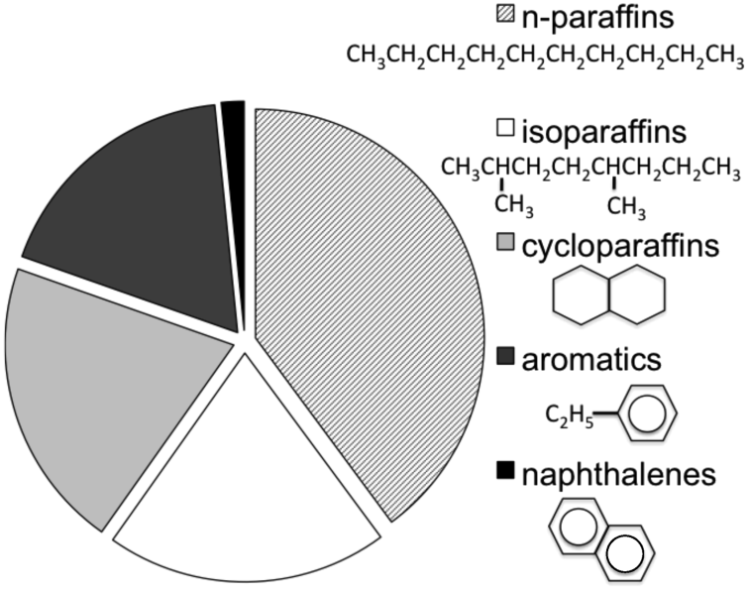
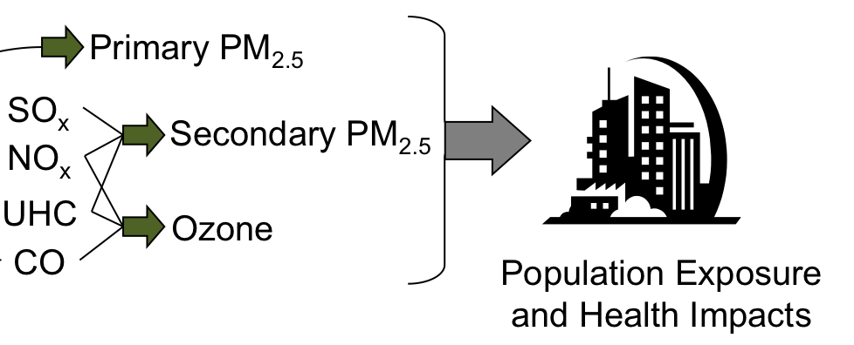
Impact of Emissions on Surface Air Quality
Fuel composition and engine design determine emissions
Fuel: C_{n}H_{m} + S
Air:
N₂ + O₂
Tank-to-Wake Actual Combustion Emissions
CO₂ + H₂O + NO_{X} + SO_{X} + soot + CO + HC + N₂ + O₂
Non-volatile PM
Atmospheric transformation, dispersion and removal determine pollutant concentration
Volatile PM

Slide 4
PM2.5 vs UFP
PM2.5 (particles less than 2.5µm in diameter) referred to as “fine” particles are believed to pose the greatest health risks.
Aircraft engines produce particles of less than 2.5µm in diameter that are solid at the exit plane (non-volatile particulate matter or nvPM).
Aircraft contribution to PM2.5 on a mass basis is very small. However, particles of aviation origin are also smaller in size and belong to the class of “Ultrafine” Particles (UFP) that may be more harmful than “fine” particles.
Emitted UFP mass and number may be relevant to quantifying health consequences.
Notes:
It is well known that there is no PM standard for aircraft engines. The first order approximation is used to estimate PM mass concentrations from certification smoke number measurements. It should be noted that the smoke number standard was developed originally as a visibility standard.

Slide 5
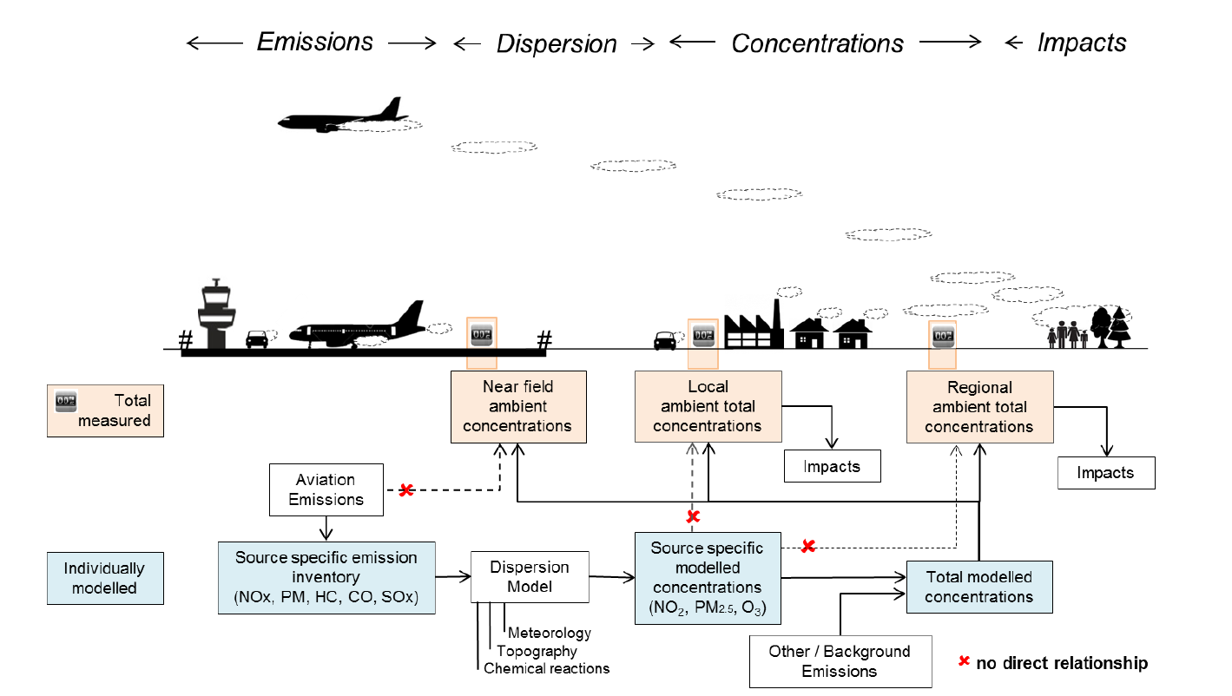
Air Quality – Measurements versus Modeling
Schematic presentation of emissions, dispersion, concentrations and impacts with their interaction at airport level (graphic from CAEP/10-WP/54 ISG White Paper on Air Quality)
Avalable at:
http://www.icao.int/environmental-protection/Pages/env2016.aspx

Slide 6
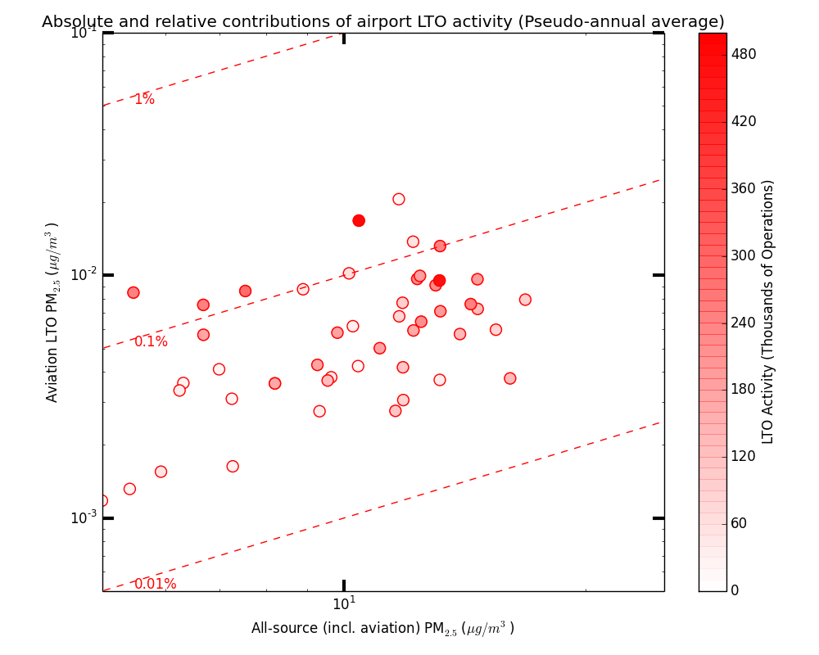
Air Quality Impacts of Aviation - in Perspective 1
Individual airport-attributable PM_{2.5} contributions compared to all-source contributions as a function of airport operations
Each dot represents one of the top 66 U.S. airports
Dotted line shows the % of airport-attributable PM_{2.5} compared to total PM_{2.5} from all sources
All U.S. airports contribute less than 1% of the ambient PM_{2.5} from all sources
Source:
Boone, S. S. Penn, J. Levy and S. Arunachalam (2015). Calculation of sensitivity coefficients for individual airport emissions in the continental United States using CMAQ-DDM3D/PM, In Proceedings of the 34th International Technical Meeting on Air Pollution, Montpellier, France, May 2015.

Slide 7
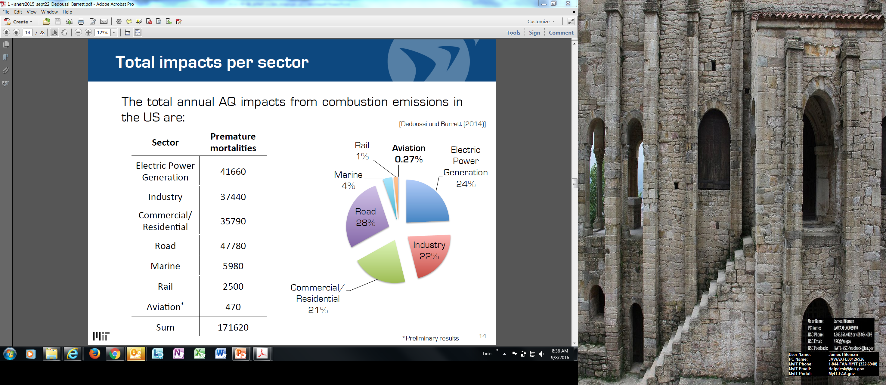
Air Quality Impacts of Aviation - in Perspective 2
Total annual AQ impacts from combustion emissions in U.S.
* Note the aviation emissions are based on the LTO cycle and are an estimate for the US. The MIT research group calculates that North America LTO emissions result in 650 premature mortalities when accounting for both PM and ozone. Including full flight emissions results in 1,500 premature mortalities for North America and 16,000 premature mortalities globally (uncertainty range is 8,300–24,000).
Sources:
Dedoussi and Barrett, “Air pollution and early deaths in the United States. Part II: Attribution of PM2.5 exposure to emissions species, time, location and sector,” Atmospheric Environment 99 (2014). http://dx.doi.org/10.1016/j.atmosenv.2014.10.033
Yim et al., “Global, regional and local health impacts of civil aviation emissions,” Environ. Res. Lett. 10 (2015). doi:10.1088/1748-9326/10/3/034001

Slide 8
Source Characterization
Non-volatile Particulate Matter (nvPM): Emitted particles that exist at gas turbine engine exhaust nozzle exit plane that do not volatilise when heated to a temperature of 350°C.
Characterization of nvPM mass and number emissions
Size distribution

Slide 9
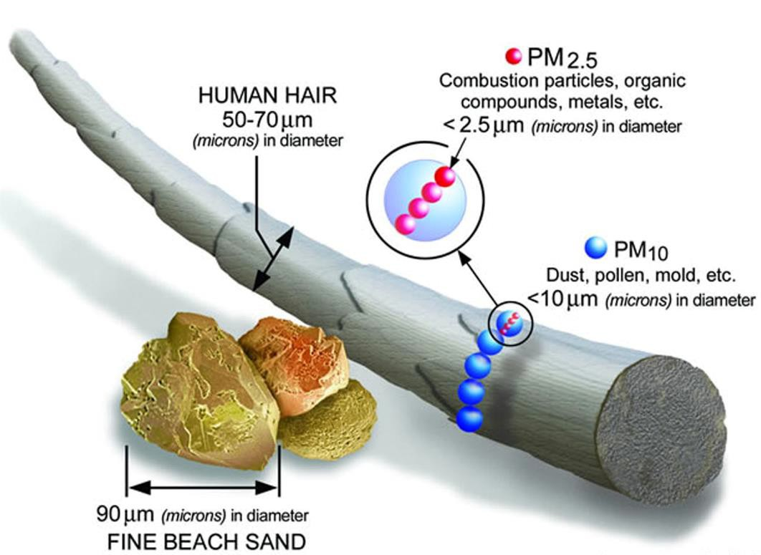
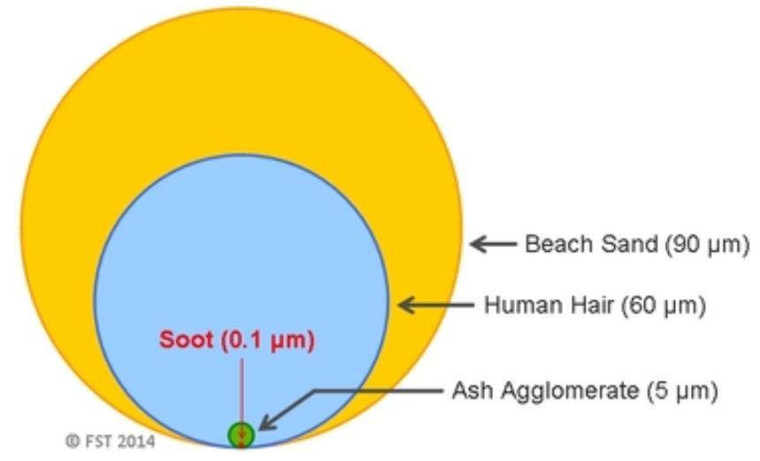
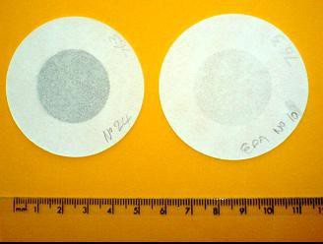
All combustion particles are less than 0.1 microns (less than 100nm)
nvPM particles are bigger than vPM particles.
EI nvPM Mass from 1-400mg/kg (0.001-0.4g/kg)
For comparison EI NO_{X} 5-70g/kg
But nvPM number 5*10¹³ – 5*10¹⁵ #/kg
Except on lean burn which is at atmospheric level of number (note equivalent to 10¹⁰ to 10¹¹)
Smoke measurement deemed outdated

Slide 10
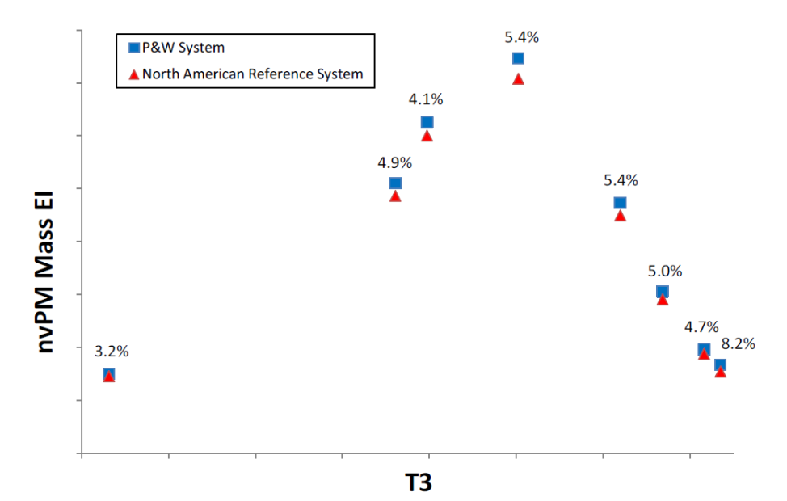
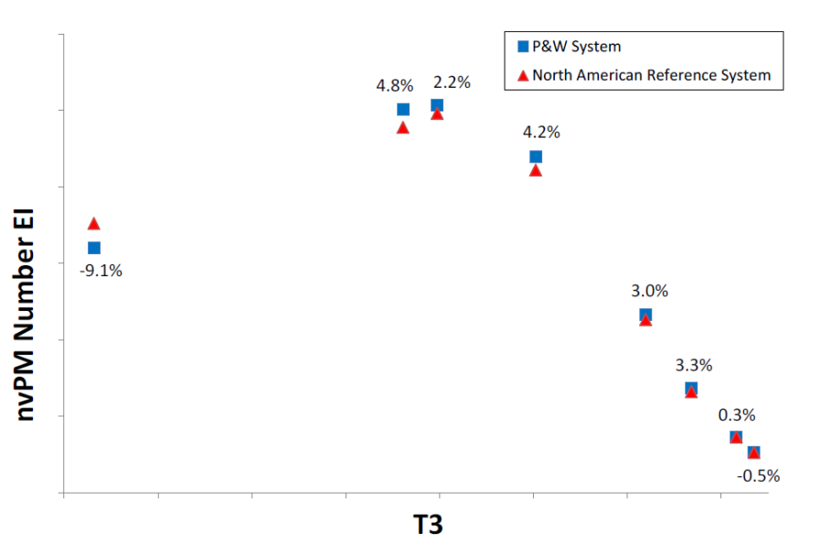
Technology Effects on nvPM Mass and Number
No Landing Takeoff (LTO) nvPM Standard
EI_{Mass} and EI_{Number} vs. Thrust for two modern combustors
Power

Slide 11
By Contrast, NO_{X} is Well Behaved
Impact of engine NO_{X} standards
EI_{NOx} vs. Thrust for a Modern Rich Burn Combustor

Slide 12
nvPM Standard: Reduction at Source
CAEP/10 agreed to the inaugural engine nvPM Certification Requirement and nvPM Emissions Standard
CAEP/10 Certification Requirement
  Standardized nvPM Measurement System
  New Appendix 7 to Annex 16 Vol. II
Engine nvPM Emissions Standard
  CAEP/10 Standard based on smoke visibility limit
  New Chapter 4 to Annex 16 Vol. II

Slide 13
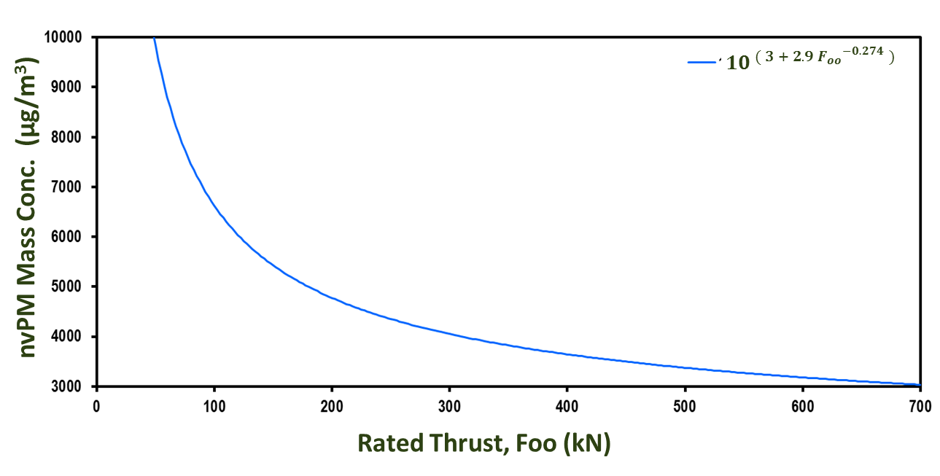
The CAEP/10 nvPM Standard Regulatory Level
Visible Exhaust Plume
Invisible Exhaust Plume
$$Regulatory limit concentration of {nvPM}_{mass}= {10}^{ ( 3 + 2.9{ F_{oo}}^{−0.274} )}$$

Slide 14
CAEP/11 nvPM Remits
Provide representative engine data for assessing the nvPM emissions standard for mass and number regarding turbofan/turbojet engines ≥26.7kN by February 2017.
Provide recommendations on technology responses, stringency options and applicability to CAEP Steering Group 2017.
Develop an aircraft engine based LTO nvPM mass and number standard for turbofan/turbojet engines ≥26.7kN.
Investigation the possible replacement of the smoke number standard for engine categories ≥26.7kN and other engine categories <26.7kN.
Develop improved nvPM model inputs to both local air quality models

Slide 15
CAEP/11 LTO Based nvPM Mass and Number Standard Tasks
Full Standard Setting Process in CAEP/11:
  Develop metric system
  Develop stringency options
  Develop technology response
  Conduct cost effectiveness analyses
  Determine LTO-based nvPM mass and number regulatory levels
Refine and finalize corrections for ambient conditions, fuel sensitivity and engine-to-engine variability
Refine steps to replace SN standard with nvPM mass and number standard based on CAEP/10 nvPM standard

Slide 16
Data from Representative Engines
Engine Tests
  21 of the 24+2 representative engines have been tested
  Multiple Engine Tests on 7 engine types
Provided funding for 6 engine tests
Data from 21 types and 58 thrust variants have been made available to CAEP in agreed upon format
  Two more engines will be reported shortly
  Alternative approaches for three engines
  Minimal impact of missing engines on the metric systems

Slide 17
nvPM Data Update
nvPM Values Database includes 21 Engines with 58 thrust variants
LTO nvPM Mass
LTO nvPM Number
Chart Showing Large Variation in LTO nvPM Mass Data of Production Engines
Chart Showing Large Variation in LTO
nvPM Number Data of Production Engines

Slide 18
Ambient Conditions Corrections
Provided funding for nvPM measurements during a NASA rig test
  Not a commercial combustor but an N+3 Technology
  Both cruise and sea level static conditions simulated
Provided funding – GE annular rig test
  Commercial combustor
  A large matrix of test conditions simulated
  Initial ambient conditions correction function for both nvPM mass and number developed.
  Being evaluated by other engine manufacturers
Qualitatively similar results from the NASA Lean Direct Injection (LDI) combustor

Slide 19
Fuel Sensitivity Corrections
Swiss Federal Office of Civil Aviation (FOCA) funded three tests on fuel sensitivity
  CFM commercial engine
  Fuel hydrogen content spanned the cert fuel spec range
NASA/ DLR Emission and Climate Impact of Alternative Fuels Experiment (ECLIF) Data
  On-wing IAE Engine
  Wider range of fuel hydrogen content
Provided funding for a consistent data analysis
Initial fuel sensitivity correction is in place and refinement is in progress

Slide 20
Engine-to-Engine Variability – Development of Characteristic Value
FAA provided funding for a test of 25 production engines of the same type
A number of engines have finished testing
Data analysis is in progress
Plan to complete by Q4, 2017

Slide 21
nvPM Modeling Inputs to Inventory Models
WG3/PMTG has reached initial agreement to replace FOA3 with a new method: Smoke COrrelation for Particle Estimation – CAEP11 (SCOPE11)
  Based on about 1400 Smoke Number and nvPM Mass Concentration from the representative engine tests
  ICAO Doc 9989 will be updated with this method
Supported the development of the cruise nvPM model
  nvPM mass emissions could be modeled with the proposed number
  nvPM number emissions will also use a recommended method.

Slide 22
Technology Standards for Engine nvPM Emissions: Summary
Major Milestone: Visibility-based nvPM standard and certification requirement agreed to at CAEP10 meeting.
Progress is being made toward the development of nvPM mass and number standards
May need additional work on refining ambient conditions corrections
Impact of alternative fuels on nvPM emissions need to be quantified

Slide 23
Ambient Monitoring and Source Attribution
Near Airport Source Attribution
Characterization of PM mass, number and Size Distribution
Source Attribution to a Sector
Combination of Measurement and Plume Modeling

Slide 24
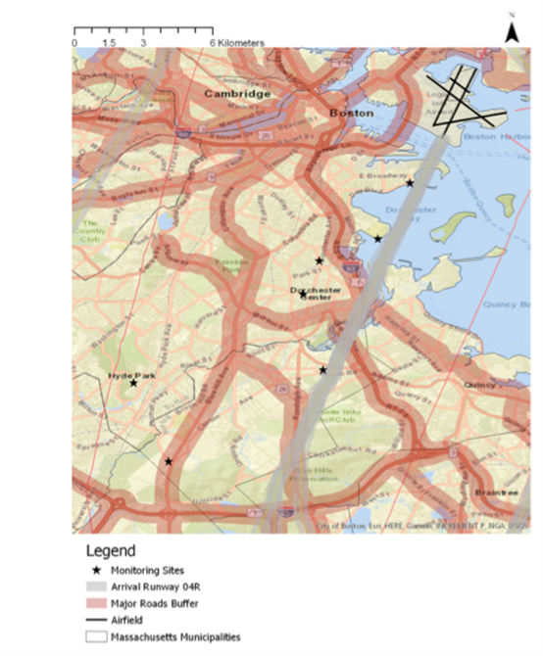
ASCENT 18: Monitoring and Modeling
Monitoring Plan at Boston Logan International Airport with high resolution instruments
Plume Modeling and Statistical Analysis
Source Attribution

Slide 25
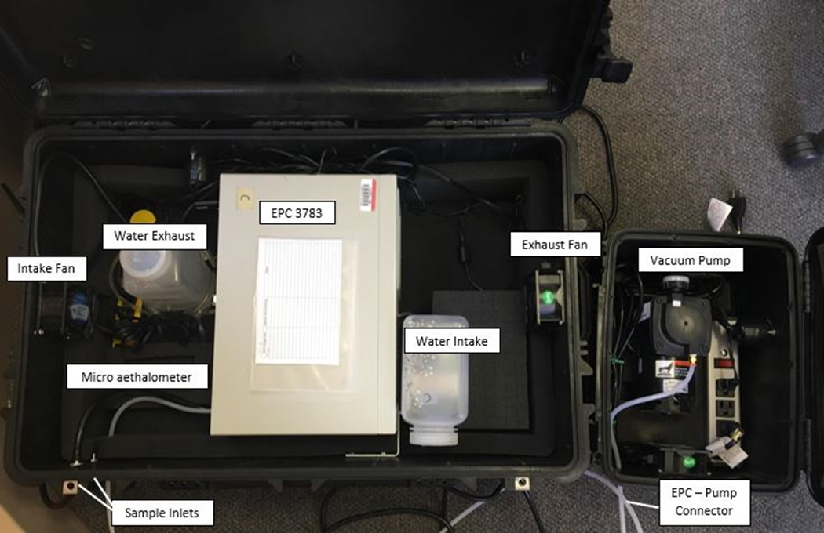
High resolution fast response mass instrument
7 nm D₅₀ Condensation Particle Counter

Slide 26
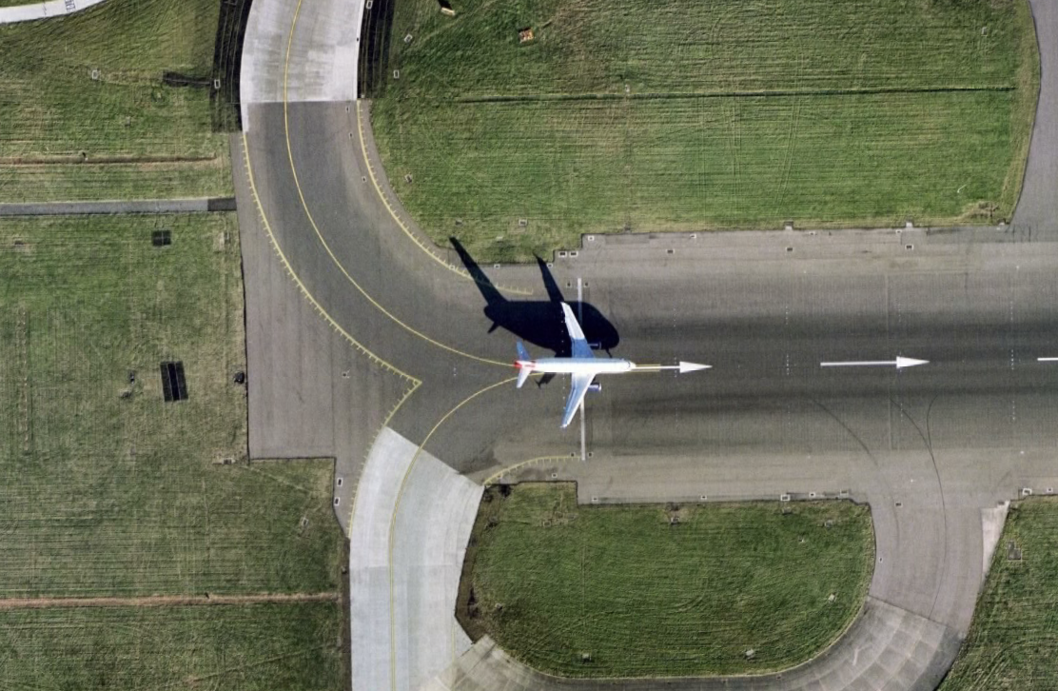
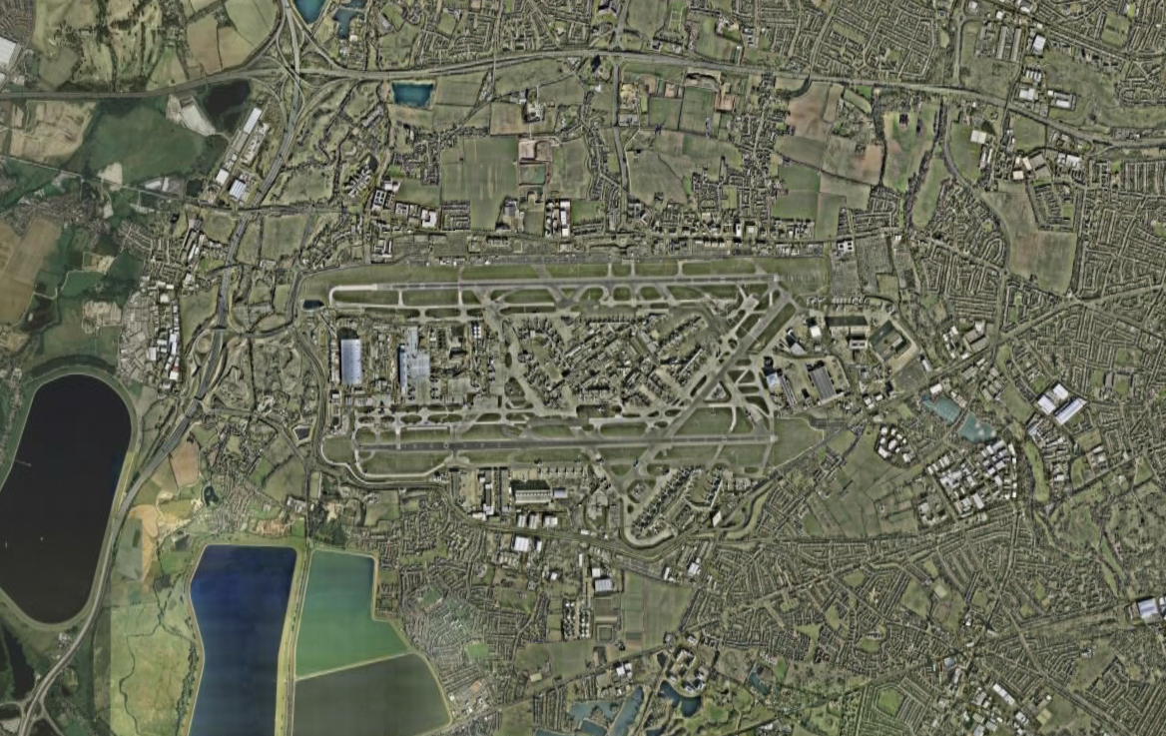
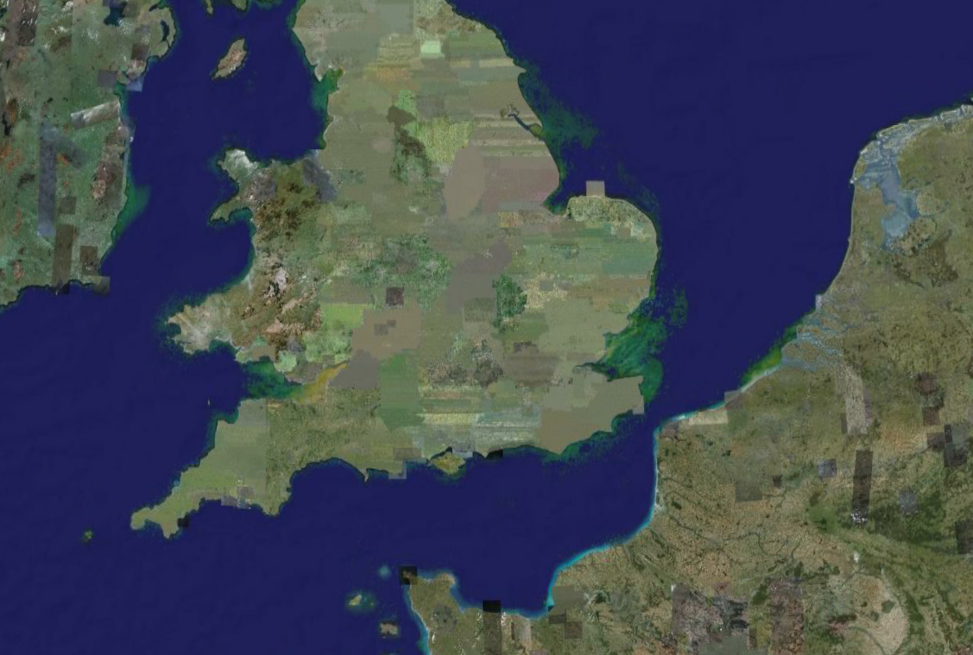
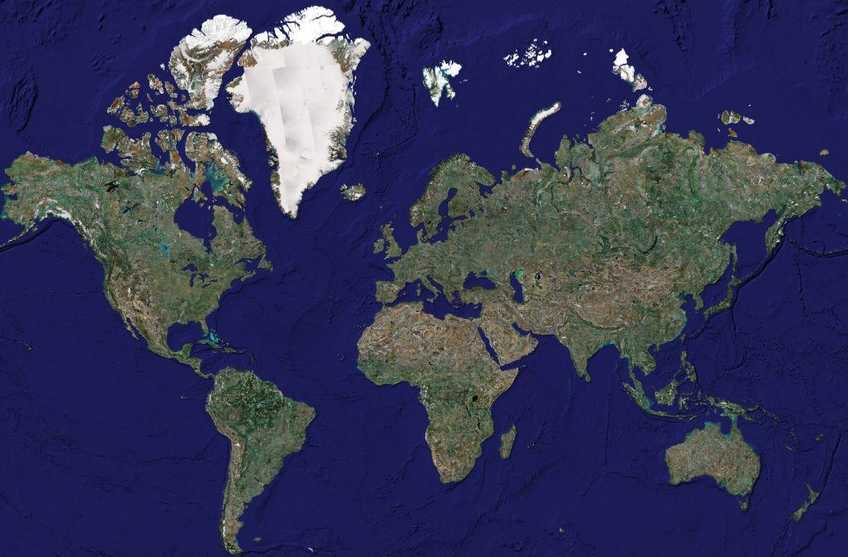
operation
PM Modeling Scales
airport
regional
global

Slide 27
PM Modeling Framework for Commercial Aircraft
Local
NAS
Global
Plume
CMAQ
Geos Chem
A20
Weather
Non-Aviation Emissions
Air Quality Modeling
Pollutant Distribution
Aviation Emissions
A19
Population
Concentration-Response Functions
Valuation Functions
A18
Health Impacts
Benefits and Costs
Exposure
Diff. Toxicity

Slide 28
ASCENT 20: AIRPORT LEVEL and NAS WIDE
Community Multiscale Air Quality (CMAQ) Model:
  Airport Level
  nvPM and vPM
  Total PM_{2.5} and UFP Mass for Health Impacts
  PM_{2.5} and UFP number and Size Distribution

Slide 29
ASCENT 20: AIRPORT LEVEL and NAS WIDE
Airport-based emissions: U.S. airport total fuel burn and emissions for year 2005 and estimated the total contribution from the top 66, 100, 150, 200 and 300 airports relative to all U.S. airports fuel burn
Top 300 airports cover ~97% of the U.S. aviation fuel burn
Number concentrations of UFP at major airports in North America were simulated by CMAQ
Increase in nitrate PM (secondary vPM) due to NO_{X} from LTO emissions in the downwind areas of airports – Preliminary Result

Slide 30
ASCENT 19: NAS WIDE and GLOBAL
Impact of background Emissions and Uncertainty
Total PM Mass
  LTO
  Full Flight

Slide 31
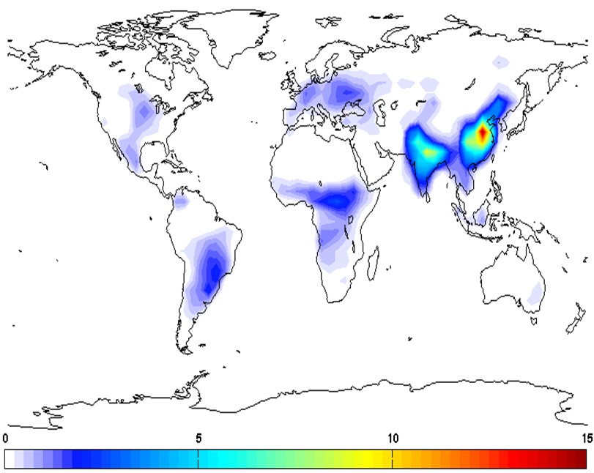
Background Ammonia
Background ammonia concentrations peak in India and China

Slide 32
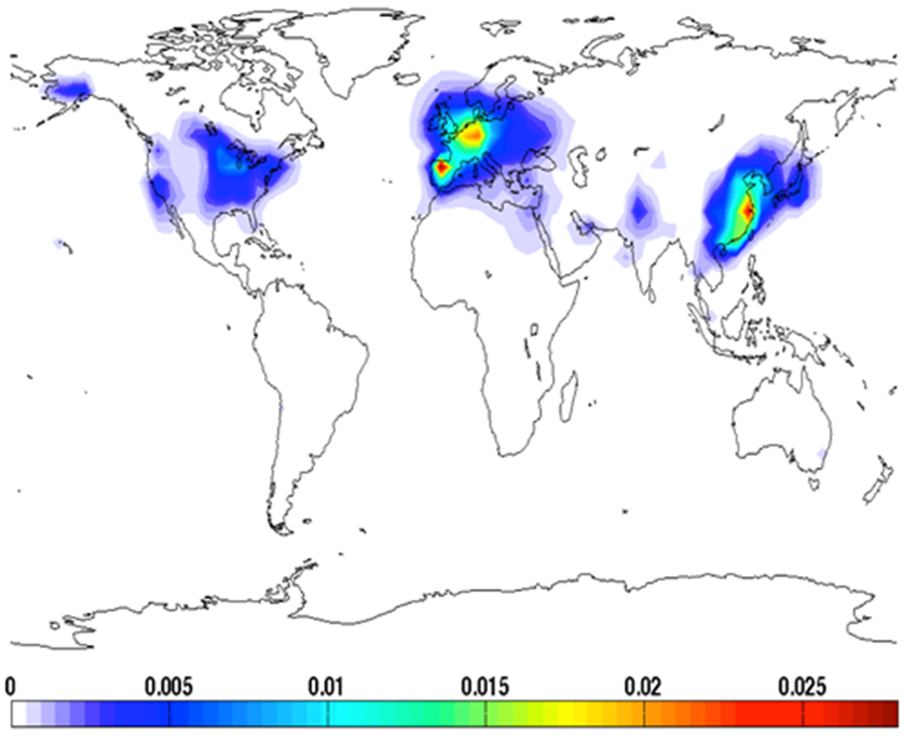
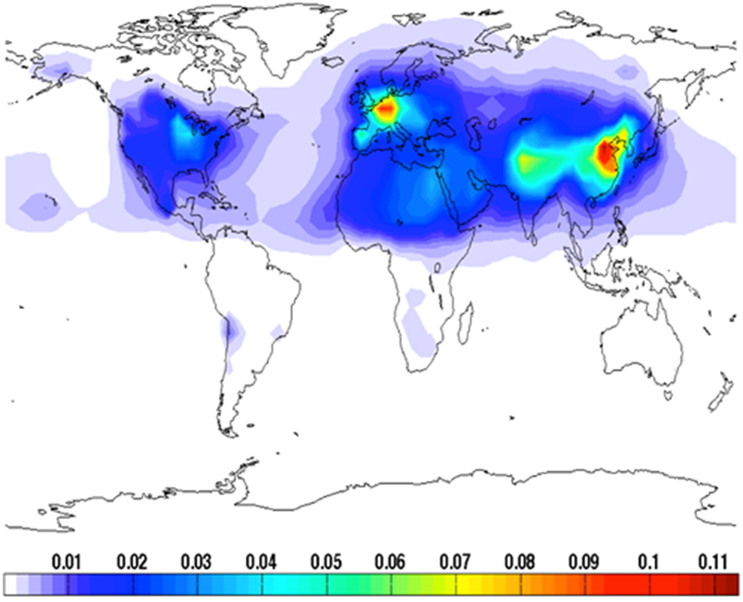
Aviation Surface PM2.5: LTO and Full Flight
LTO
Full Flight

Slide 33
Ambient PM Monitoring and Modeling: Summary
Systematic source attribution study is in progress
  Combines monitoring and modeling
Airport and NAS wide aviation induced PM2.5 and UFP mass, number and size distribution being addressed using CMAQ
The uncertainties in aviation induced PM2.5 and UFP are being investigated using global models

Slide 34
New Entrants for Commercial Aviation
Unmanned Aerial Vehicles
  Small Gasoline Engines
  Battery Operated
Commercial Space – Rocket Emissions
  May be a significant source of PM

Slide 35
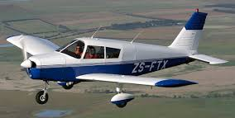
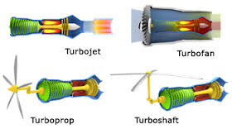
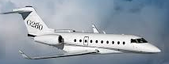


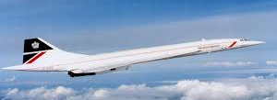
Current Aviation Emission Regulations
(40 CFR Part 87/14 CFR Part 34 & Annex 16 Volumes II + III)
Engine Type | Fuel | Max Rated Thrust | Engine Emissions |  |  |  |  |  | Aircraft
 |  |  | Fuel Venting | SN | HC | CO | NOx | nvPM | Examples | Fuel Venting | CO₂
Turboprop (TP) | Av Gas/ Jet A | > 1,000kW | ⎫ | ⎫ |  |  |  |  |  | ⎫ | MTOW over 8,618kg
Turbofan(TF)/ Turbojet (T3, T8) | Jet A | < 26.7kN | ⎫ | ⎫ | ⎫ | ⎫ | ⎫ |  |  | ⎫ | MTOW over 5,700kg
 | Jet A | > 26.7kN | ⎫ | ⎫ | ⎫ | ⎫ | ⎫ | ⎫
Supersonic Transport (TSS) | Jet A | > 26.7kN | ⎫ | ⎫ | ⎫ | ⎫ | ⎫ |  |  | ⎫

Slide 36
PM emissions from Rockets
Differential emission indices DEI X with respect to: (a) particle number, (b) surface area, and (c) mass.
The points represent the average of four encounters, while the curves are lognormal fits to the data.
From Schmid et al., 2003.

Slide 37
PM emissions from Commercial Rockets
Very basic assumptions indicate that rocket emissions are approaching that of aviation with even moderate growth
Nature of prior work and assumption leave large uncertainties in impact estimates
Possible future growth: need better estimates and more quantitative analysis

Slide 38
QUESTIONS?

Slide 39

S. Daniel Jacob, Ph.D.
Emissions Division
Federal Aviation Administration
Office of Environment and Energy
Email: daniel.jacob@faa.gov

