Slide 1
Alternative Jet Fuel Testing Efforts
Presented to: REDAC Environment & Energy Subcommittee
By: Cecilia Shaw and Levent Ileri
Office of Environment & Energy
Federal Aviation Administration
Date: August 2, 2017
Notes:
We work with many different stakeholders including some you met with this morning
Govt. agencies
Businesses
Universities
U.S. Vision
Alternative Jet Fuels must be “drop-in”, have equivalent safety and better environmental performance than petroleum Jet fuel
Enable all possible fuels that meet criteria
Government role to address key barriers
Work through Public-Private Partnerships
Fund University research
Address the whole supply chain
Leverage expertise and resources of other government agencies and other countries
Aviation should be a lead user of alternative fuels

Slide 2



FAA Alternative Jet Fuel Activities
Testing
  Support Cert/Qual testing
  Improve Cert/Qual process (NJFCP)
  Emissions measurements
Analysis
  Environmental sustainability
  Techno-economic analysis
  Future supply
Coordination
  Interagency
  Public-Private
  State & Regional
  International
Notes:
Areas of support

Slide 3
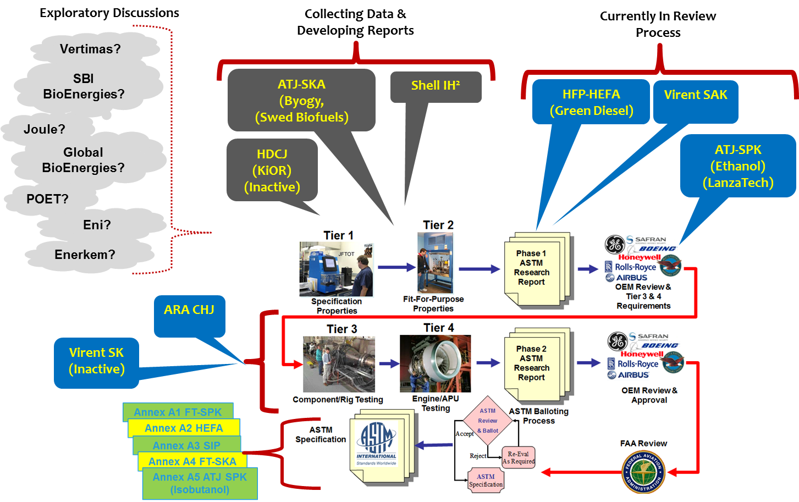
Status of Alternative Jet Fuel Approvals
  Since 2009 five fuels included in the ASTM International alternative jet fuel specification (D7566)
Notes:
5 fuels are included in the ASTM International alternative jet fuel specification (D7566):
2009 - Fischer-Tropsch Synthetic Paraffinic Kerosene(FT-SPK)
2011 - Hydroprocessed Esters and Fatty Acids (HEFA)
2014 - Synthesized Iso-Paraffinic fuels (SIP)
2015 - Fischer-Tropsch Synthetic Kerosene with Aromatics (FT-SKA)
2016 - Alcohol-to-Jet (ATJ-SPK)
6 fuels are currently undergoing evaluation and additional fuels will be evaluated in the future

Slide 4
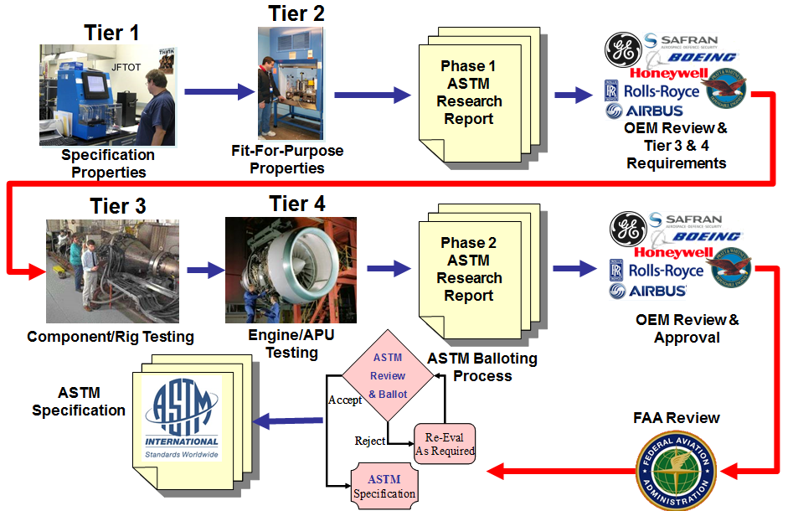
Alternative Jet Fuel Testing
ASTM International manages jet fuel specification
FAA supports the evaluation of alternative jet fuels
Support ASTM D4054 certification & qualification testing activities to develop data for new approvals
OEM review process
Data gathering & analysis
Understanding correlation
between fuel properties
and combustor operability
Notes:
1) Near term effort to Support ASTM D4054 testing activities to enable development of data for approvals
BAA/SEMRS/CLEEN
Honeywell APU testing of 7 fuels underway
ASCENT Project 31
IHI BB oil (similar to HEFA) will start testing in 2018
2) Support for Research Report Review & Coordination
Via CLEEN
Support organized approach to fuels in ASTM pipeline
Boeing, GE, Honeywell, P&W, RR and SWRi
3) Data Gathering
Alternative Jet Fuel Test Data Library (ASCENT A33) -- focus on creating a library to catalogue the test data that has and will be collected from previous, current and future alternative fuels testing. Plan to establish a framework for the database, as well as host a web-portal that will make the data collected accessible to the general public.
Worldwide Jet Fuel Data (SEMRS) – Metron & A4A project gathering fuel specification data of conventional jet fuel at airports throughout the US and the world. Track the spec properties at the various airports over time to give insight to the variation of properties in conventional jet fuel, and substantiate a tolerance level for spec properties in alternative fuels. Conventional jet fuel property data at multiple areas can be useful in aircraft emissions modeling and future alternative fuel blending efforts.
4) Mid term effort to streamline ASTM International jet fuels approval process
Develop generic fuel composition/chemistry evaluation methodology
Standardized rig/lab tests
Chemical kinetic/combustion modeling
Collaborative OEM/university/federal effort

Slide 5
Currently funded Alt Jet Fuel Testing Activities
CLEEN II
  GE Testing
  Rolls Royce Testing
ASCENT COE
  P31: Testing Support & D4054 Clearinghouse Concept
  P25-P30, P34: National Jet Fuels Combustion Program
  P33: Alternative Jet Fuel Database Library
  New: GC x GC Project

Slide 6
CLEEN II Alt Fuels Testing - GE
92% HEFA-SPK + 8% SAK (aromatics)
  Fully synthetic
  Virent providing 900 gallons of SAK - expected to arrive Q1 2018
  US Air Force providing 10,000 gallons of HEFA-SPK
  Full Annular Combustor Rig (FAR) testing expected to start possibly not before Q2 2018
  Supports the approval of SAK as well as fully synthetic fuels
ATJ-SPK testing in support of NJFCP
  Testing will be on 100% Gevo sourced Alcohol-to-Jet (ATJ-SPK)
  Testing is to correlate NJFCP tests with full combustor tests
  3000 gallons of Gevo ATJ-SPK fuel arrived at GE end of June
  Tier 3 testing was ready to start at the end of June; delayed to Oct/Nov due to test cell maintenance and test priorities
Notes:
HEFA-SPK :
-In the fuel acquisition process
ATJ-SPK :
- testing will be focused on operability (ignition and LBO) which is Tier 3 type – research oriented, not approval/qualification.
Note: Although doing rig testing this fuel is not a fuel candidate seeking approval
GE expects to start testing Q4 of 2017 on their Full Annular Combustor Rig

Slide 7
CLEEN II Alt Fuels Testing – Rolls Royce
LanzaTech blend with Swift Fuels mesitylene
  Fully formulated synthetic blend jet fuel
  90% LanzaTech - ATJ-SPK (Ethanol-based ATJ)
  10% Swift non-renewable mesitylene – aromatic fuel blending component
  Rolls-Royce will start fit for purpose testing in Q4 2017
  Support 100% synthetic fuel approval
  Support pathways with synthetic aromatics

Slide 8

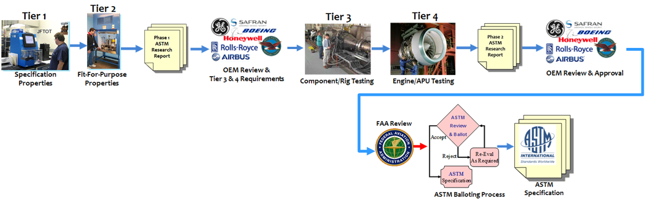

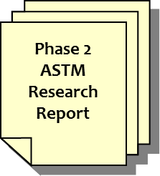
Project 31 - D4054 Clearinghouse Concept
Structured as a Cost Share Arrangement
Stakeholder Engagement / Support Needed!
Accepts In-Kind Contributions (testing partners)
Also Accepts Direct Contributions
FAA Seed Money Under ASCENT Center of Excellence
Final Research Report Out
University of Dayton Research Institute (UDRI)
Candidate AJF In
UDRI Contact
Dr. Steven Zabarnick
Steven.Zabarnick@udri.udayton.edu
(937) 255-3549
Notes:
ASCENT Project 31A

Slide 9
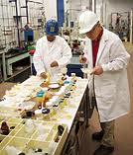
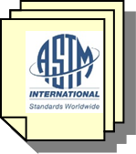
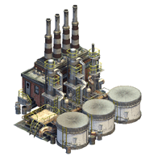
D7566 Generic Annex
Permit Production of ANY Pathway at Nominal Blend %
Specific Criteria to Ensure Compositional Control and Product Quality
Fuel Producer
Meets Generic Annex?
Fail
Fail
Meets Existing Annex?
D4054
Testing
OEM Review
ASTM Ballot
No
Pass
Pass
ASTM D7566 Pathway Specific Annex
Yes
AJF Production
Notes:
-D7566 Generic Annex is currently under consideration by ASTM
*Funded by the Air Force
Carbon number distribution by gc x gc testing
LanzaTech, HEFA

Slide 10
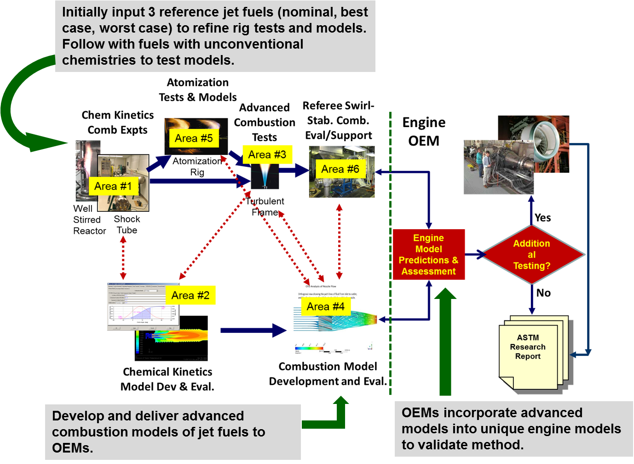
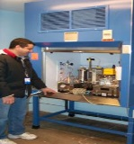
Overview of NJFCP Program
ASTM Tier 1/2
ASTM Tier 3/4
Program uniqueness:
Integrated systemwide approach involving all stages of testing and modeling areas for identical conditions
Real-time communication and share of info among all 6 areas (experimentalists and modelers) and OEMs
Brings state of the art knowledge, computer capabilities, and engineering experience together
Fit-for-purpose testing
Area 7: Program interface and integration
NJFCP Objective: relate fuel properties to combustion figures of merit
Notes:
FAA has new Center of Excellence for Aviation and Environment (get real name), also termed the Aviation Sustainability Center (ASCENT). Industry advised that “Rules and Tools” was valuable and needed to be resurrected. FAA prime mover. Go through flow of getting data…plus improved models to industry
Area 1: 1 rig
Area 3: 3 = 1 OSU and 2 GT
Area 5: 1 Purdue
Area 6: 1 Ref rig
Area 7: 1
Total: 7 rig funded by NJFCP

Slide 11
Fuel Candidates and Screening
Reference Fuels Required to
Characterize Rig and Engine Fuel Response
Category A:
Three Conventional (Petroleum) Fuels
“Best” case (A-1)
“Average” (A-2)
“Worst” case (A-3)
Category C:
Six “Test Fluids” with Unusual Properties
C-1: low cetane, narrow boiling (downselected)
C-2: bimodal boiling, aromatic front end
C-3: high viscosity
C-4: low cetane, wide boiling
C-5: narrow boiling, full fuel (downselected)
C-6: high cycloparaffins (OEMs also prefer)
Plan to examine three additional fuels
Note: chart provides a measure of the
boiling point of the fuel being examined
Notes:
•A-1 (JP-8), ‘best’ case Jet A
•A-2 (Jet A), ‘average’ case Jet A
•A-3 (JP-5), ‘worst’ case Jet A
•C-1 (100% Gevo Alcohol-to-Jet), low cetanenumber
•C-2 (C-14 iso-paraffin blended with 1,3,5-trimethylbenzene), bi-modal with aromatic front end
•C-5 (C-10 iso-paraffin blended with 1,3,5-trimethylbenzene), ‘flat’ distillation range
Mention to that we will test C7-C9

Slide 12
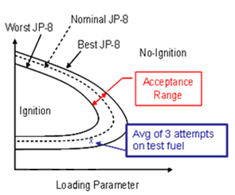
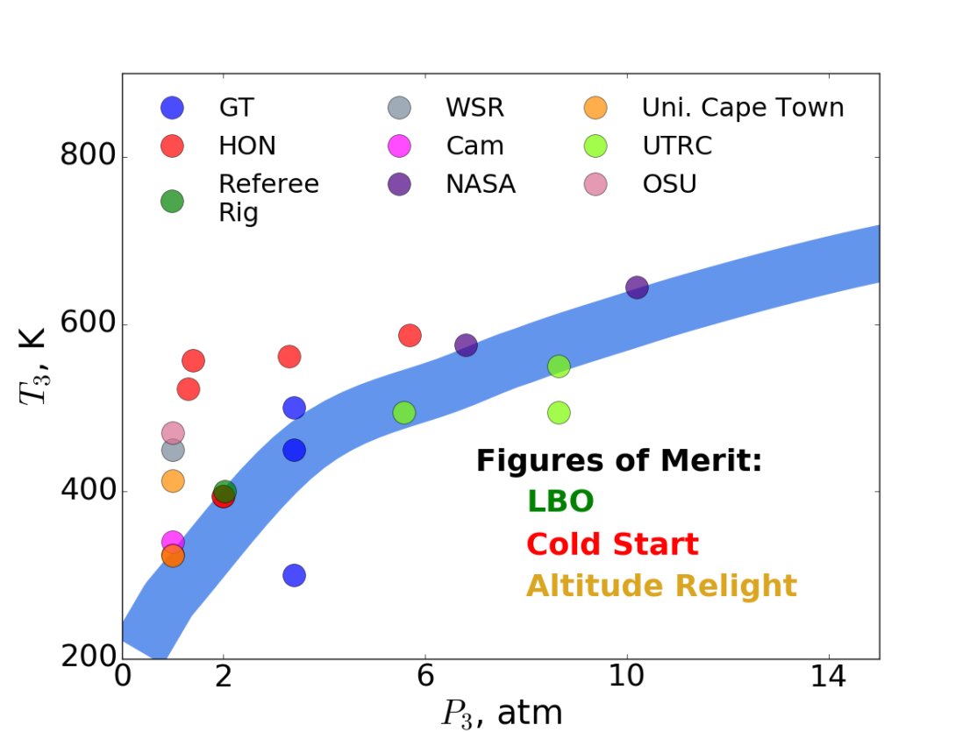
Figures of Merit Mapping
Stability Loop
Three operating regimes identified as sensitive to fuel properties and thus AJF
These fuel sensitive phenomena can be translated to relevant temperatures and pressures for testing.
T₃ - P₃ Regime of Interest
One of the tasks of NJFCP is to map fuel and geometry variation to stability loops via Lean Blow Out and ignition probabilities (Cold Start and Altitude Relight)
LBO (Descent)
Cold Start (Ground Idle)
Altitude Relight (Cruise)
Note: T₃ and P₃ are the combustor inlet temperature and pressure for a gas turbine engine
Notes:
These fuel sensitive phenomena, Figures of Merit, can be translated to relevant temperatures to relevant temperatures and pressures for testing
- Three operating regimes have been identified as sensitive to fuel properties and thus Alternative Jet Fuels (AJF)
-Three operating regimes are: Lean Blow Out, Cold Start, Altitude Relight
Requires extensive fuel and geometry testing
Perhaps more fuels that have been identified in the program would need to be tested.
Multiple swirlers, nozzles, and semi-/full annular configurations would need to be tested.
*Blue shaded region is the typical flight envelop. Only LBO points are plotted.
The goal: is for the rigs to be inside the flight envelop ideally inside the green loop. The
Stability: X axis air flow, y axis altitude
Are three operating regimes: add

Slide 13
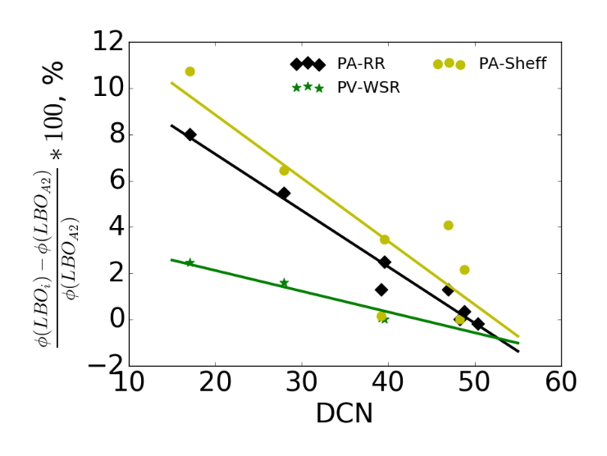
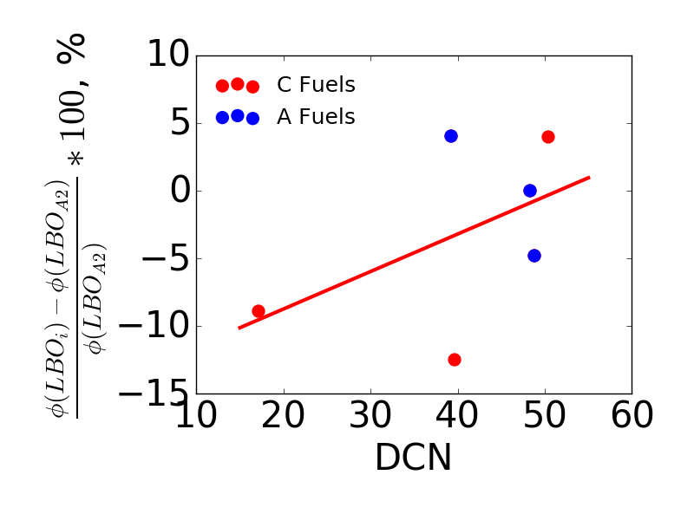
Derived Cetane Number (DCN)
Prediction of Lean Blow Out (LBO)
Multiple tests showed that DCN predicts LBO as auto-ignition extends lean stability limit for swirl stabilized single cup rigs at NJFCP reference conditions
Honeywell rig shows no significant dependence on the DCN
*Cetane = 1/octane
Honeywell
Notes:
DCN- go to pump. You have different octane. The inverse octane is cetane.
Dervied cetane = new way to measure cetane
Octane = inabition of a fuel to auto ignite
Cetane = propensity of fuel to auto ignite
Honeywell might behave differently due to the combustor geometry

Slide 14
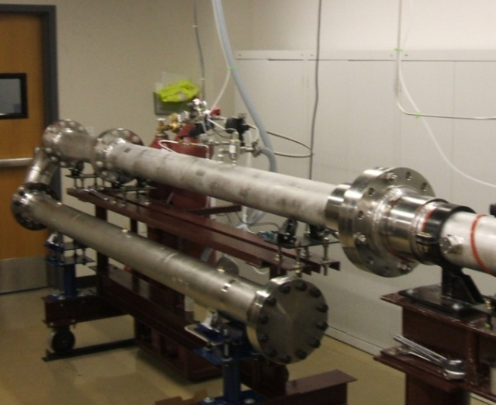
Shocktube Testing
Purpose: Measure ignition delay time and species time history.
Accomplishment: Developed new measurement technique to quantify variation of carbon species in alternative jet fuels.
Plan for Year 4: Expand database to new fuel characteristics in alternative jet fuel candidate
Notes:
Understanding the chemical breakdown of fuel at the high temperature conditions in a combustor. Pyrolysis occurs at a faster timescale than oxidation. Measuring pyrolysis products and correlating with ignition and blowout.
Two types of shock tube experiments are performed:
1- Ignition delay time measurements – provide global characterization of fuel behavior
2 – Species time history measurements – Provides detailed description of fuel decomposition products
Ignition delay→DCN→ LBO
ethylene's species have

Slide 15
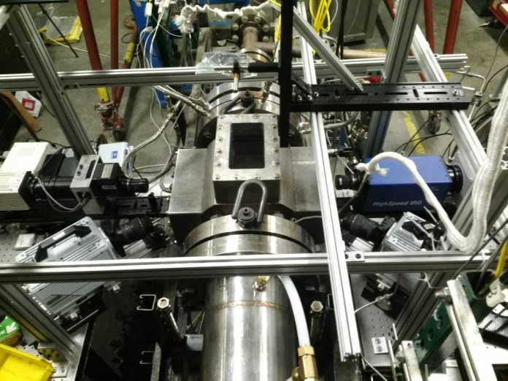
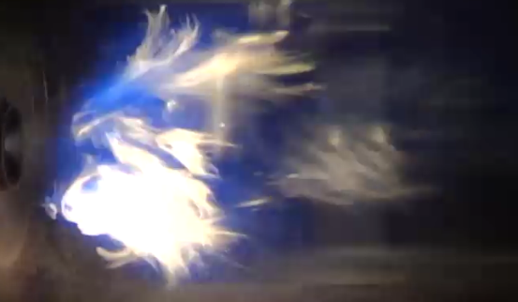
Combustion Rig
  Purpose: Measure fuel sensitivity at figure of merit conditions.
Accomplishment: Provided DCN correlation with LBO.
Plan for Year 4: Measure cold start, and altitude relight test new C7, C8, C9 fuel for LBO and additional LBO conditions.
Notes:
Understanding the process of blow out and ignition, sensitivities to F/A ratio, temperature, altitude. Can we decouple fuel effects from rig effects?
Combustion performance measurements with conventional fuels and fuels with unconventional chemistries determines sensitivities to properties
High shear task demonstrates correlation between fuel properties and blowoff
• Forced ignition task model demonstrates fuel chemistry influence on forced ignition
• Turbulent flame speed task produces large fuel sensitivity parameter studies
1st picture: High shear Rig

Slide 16
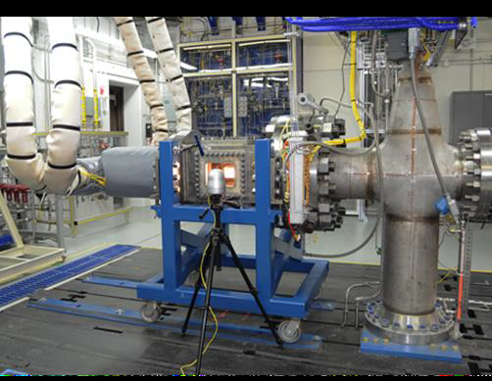
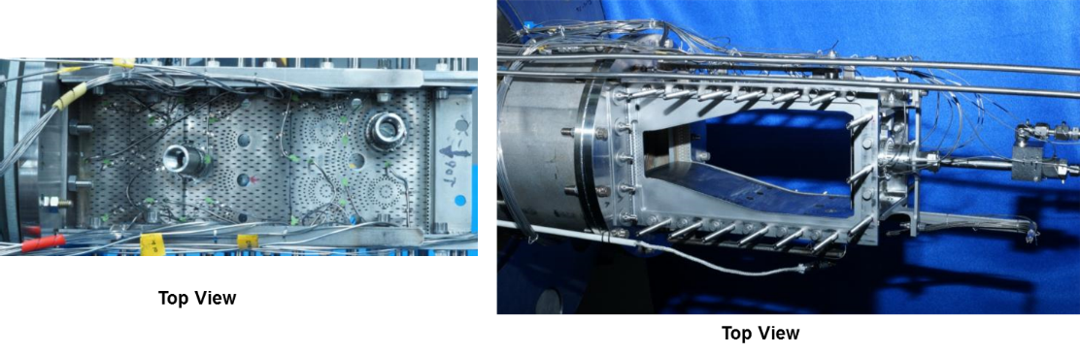
Referee Rig
  Purpose: Smallest and most efficient combustor rig that still captures most dominant features in an engine (swirler, liner, nozzle)
  Accomplishment: Provided DCN correlation with LBO, cold ignition measurement, viscosity, and distillation properties.
  Plan for Year 4: Additional testing on cold ignition measurements for C7, C8, and C9.
Notes:
Realistic combustor to be used as a referee for the effect of alt fuels on combustion characteristics.
The referee rig is used to conduct and analyze combustion experiment for conventional and alt fuels. It’s used for fuel sensitivity demonstration for lean blowout, ignition and stability characteristics
.
Bottom: Referee combustor operating near LBO

Slide 17
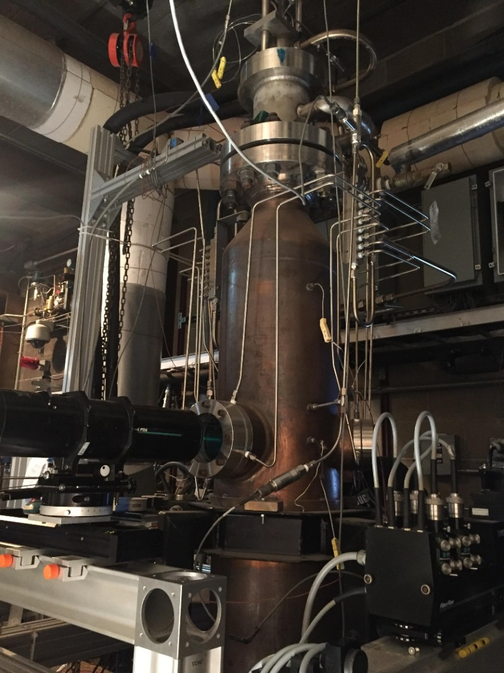
Spray Rig
  Purpose: Captures the effect of fuel physical properties (e.g., viscosity, freeze point) on spray quality.
  Accomplishments: Determined physical properties are not as crucial as originally thought for LBO. Chemical properties such as DCN are more important.
  Plan for Year 4: Continue studying test fuels at lower temperatures. Fuel viscosity changes exponentially with temperature
Variable Ambient Pressure Spray (VAPS) Rig
Notes:
- Captures the effect of fuel physical properties (viscosity, freeze point, etc.) on spray quality

Slide 18
NJFCP at Year 3
NJFCP Purpose: Improve understanding of fuel effects on combustion and streamline the current ASTM fuel approval process through testing and modeling
FAA has funded this project for 3 years thus far
Two yearly meetings with OEMs and University PIs
Tasked NJFCP and OEMs last November to inform the FAA with early benefits of this program:
  Confidence Levels, Modeling and Funding, and Summary

Slide 19
OEM Report Out on NJFCP (1 of 3)
OEMs provided the following feedback on NJFCP:
More than doubled their confidence levels (15% to 30%) on identifying chemical/kinetic properties of fuels
Improved understanding of the various Figures of Merit (FOMs) - primarily Lean Blow Out (LBO)
OEMs agree that we may not get to 100% confidence in 5 years; however, the progress is moving asymptotically and it is very likely that we may get to 80% confidence level with sufficient funding
The increased confidence affects the OEM fuel approval process by lowering risk of how fuel property variation can affect operability and therefore can reduce Tier 3 and 4 testing requirements

Slide 20
OEM Report Out on NJFCP (2 of 3)
The activities help OEMs model fuel effects with CFD analysis
Modeling capability is important to assess large range of product designs but OEMs acknowledge that modeling capability will take long time to develop
There was a concern that NASA funding for modelling may not be enough, and by design, the focus of the NASA program is based on newer and lower TRL models. So FAA may need to step back in to fund modelling activities. ($ is unknown)
It was noted that the AFRL, “referee rig” is central test facility of the program and much more testing (cold ignition) in that rig will be important. For this reason, AFRL would welcome some FAA funding for the Referee Rig work to meet all the tasks for that rig.
  Additional of funding ($250k-$500k) will meet the referee rig needs

Slide 21
OEM Report Out on NJFCP (3 of 3)
Capabilities and understanding developed under NJFCP is reducing risk and increasing confidence on fuel effects which may enable OEMs to streamline when and if a new fuel should be further evaluated before it is sent to ASTM for approval. Confidence levels have doubled.
OEMs agreed that capabilities and understanding developed under NJFCP could save significant time spent executing tier 3 and 4 activity because OEMs will have better understanding of the kinetic properties and risks for fuel effects in engines.
The tools (referee rigs and CFD) and knowledge gained from NJFCP have shown potential to enable the OEMs to reduce their risk when determining acceptability of candidate alternative jet fuels. This will allow them to approve these fuels more quickly and with greater confidence.

Slide 22
Test and Analysis of AJF Combustion Performance at University of Sheffield (1 of 2)
PI: Dr. Bhupendra Khandelwal, Low Carbon Combustion Center, University of Sheffield
Test Campaign 1: Develop a numerical tool to predict LBO limit based on correlations developed in test campaign
  test large number of conventional fuels, novel fuels and blends with a wide range of properties for their LBO limit
  testing would be done on a single can combustor
  correlations between key fuel properties and LBO performance will be investigated

Slide 23
Test and Analysis of AJF Combustion Performance at University of Sheffield (2 of 2)
Test Campaign 2: Analyze the performance of different blends of aromatics species with a base component to systematically evaluate the effect on seal performance, particulate mass concentration and smoke emissions.
Selection of specific aromatics and blends can lead to reduced particulate and smoke emissions while giving right amount of elastomer and fuel systems compatibility.
  Number of aromatics species is 20
  Total # of test points is about 80
Notes:
Systematic testing of fuel specification in both test campaigns will be done. Testing includes GC x GC, Lubricity, Viscosity, Density, C/H Ratio, Trace Metals, Aromatic Speciation, Cetane number and specific energy
Final Report: September 30, 2017

Slide 24
New ASCENT Project
Two-Dimensional Gas Chromatography Method Documentation and Analysis
Two dimensional gas chromatography is a novel analysis technique to accurately characterize fuel composition. However, GC x GC is lacking standardized procedure and is not utilized by ASTM.
FAA is establishing a project to conduct foundational investigative tasks to document and standardize the test method currently used for two dimensional gas chromatography analysis of alternative jet fuel candidates

Slide 25
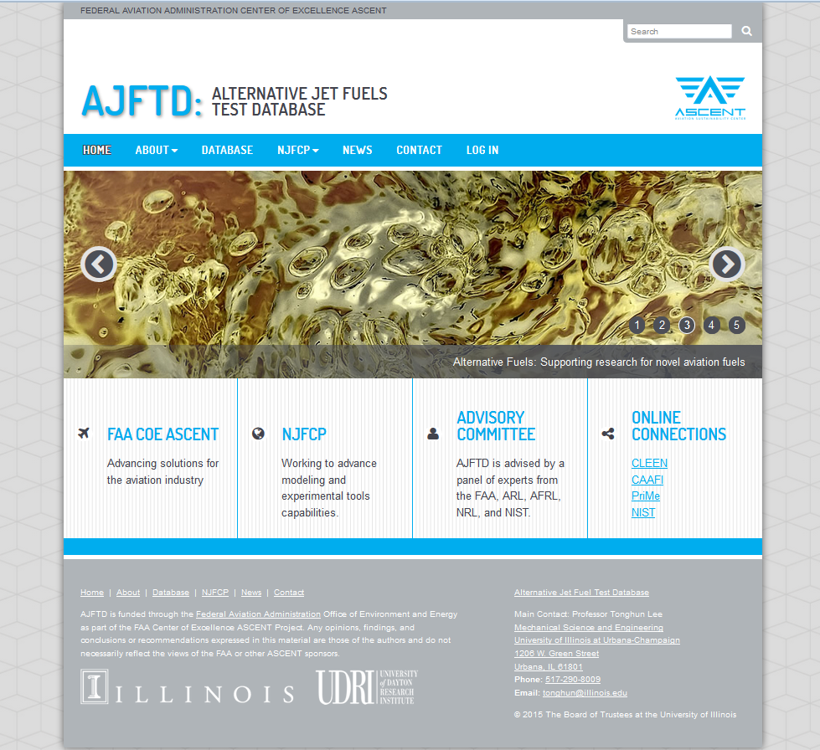
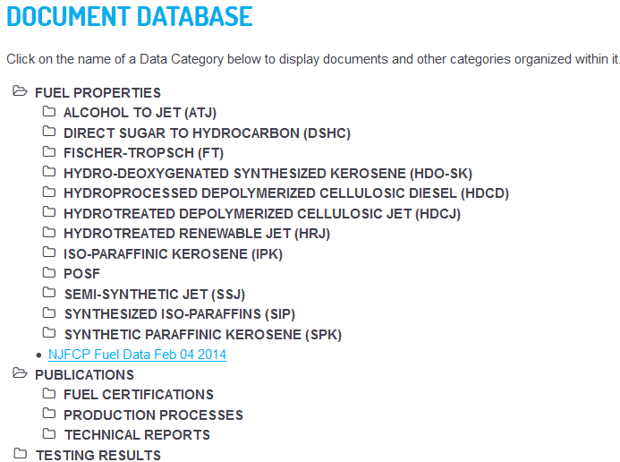
ASCENT Project 33:
Alternative Jet Fuel Test Database Library
Fuel specification and rig testing data, technical papers, fuel approval reports
  400+ documents
  ~300 POSFs covering alternative and conventional jet fuels
Looking to support ASTM Generic Annex through tools and test data access
  Potential to extend fuel blending property prediction
Notes:
POSF is a organizational symbol same thing as we are AEE
- POSF is NOT an acroynm

Slide 26
ASCENT Project 33:
Websites
Data Library:
  http://altjetfuels.illinois.edu/
For more information:
  https://ascent.aero/project/alternative-fuels-test-database-library/

Slide 27
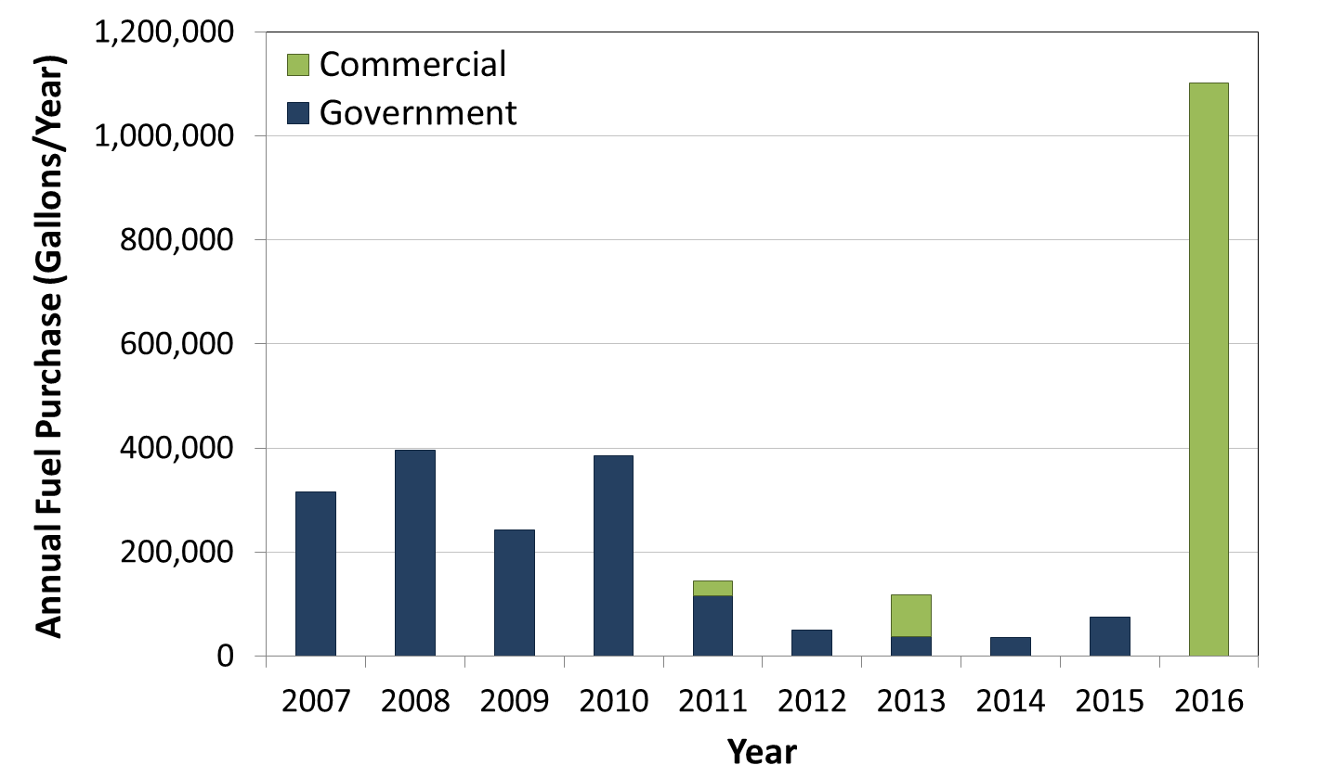
Where We Stand Today
Commercial flights on SAJF are taking place
1.1 million gallons in 2016 from one commercial producer, one demonstration
U.S. Alternative Jet Fuel Procurements¹
United Airlines & Altair Fuels
Gulfstream & Altair Fuels
Alaska Airlines & Gevo Inc.
Notes:
Based on voluntarily reported data from Airlines for America (A4A), Department of Defense (Defense Logistics Agency, DLA-Energy) and Gulfstream Inc.

Slide 28
Summary
Alternative jet fuels are a key component of FAA strategy in meeting environmental goals
R&D efforts making progress on overcoming key challenges via testing, analysis and coordination
Public private partnerships have played key role in standing up an industry
Strong domestic and international coordination is essential
Industry is building momentum with many AJF advancement and highlights in 2016
Continue R&D efforts via testing, analysis and coordination in the future

Slide 29

Cecilia Shaw
CLEEN Program, FAA AEE
Email: cecilia.shaw@faa.gov
Levent Ileri
CLEEN Program Manager, FAA AEE
Email: levent.ileri@faa.gov

