Slide 1
by: Shelley Yak Director, FAA William J. Hughes Technical Center
FAA Research and Development
National Aviation Research Plan Redesign
Presented to: REDAC Subcommittee
February - March, 2017

Slide 2
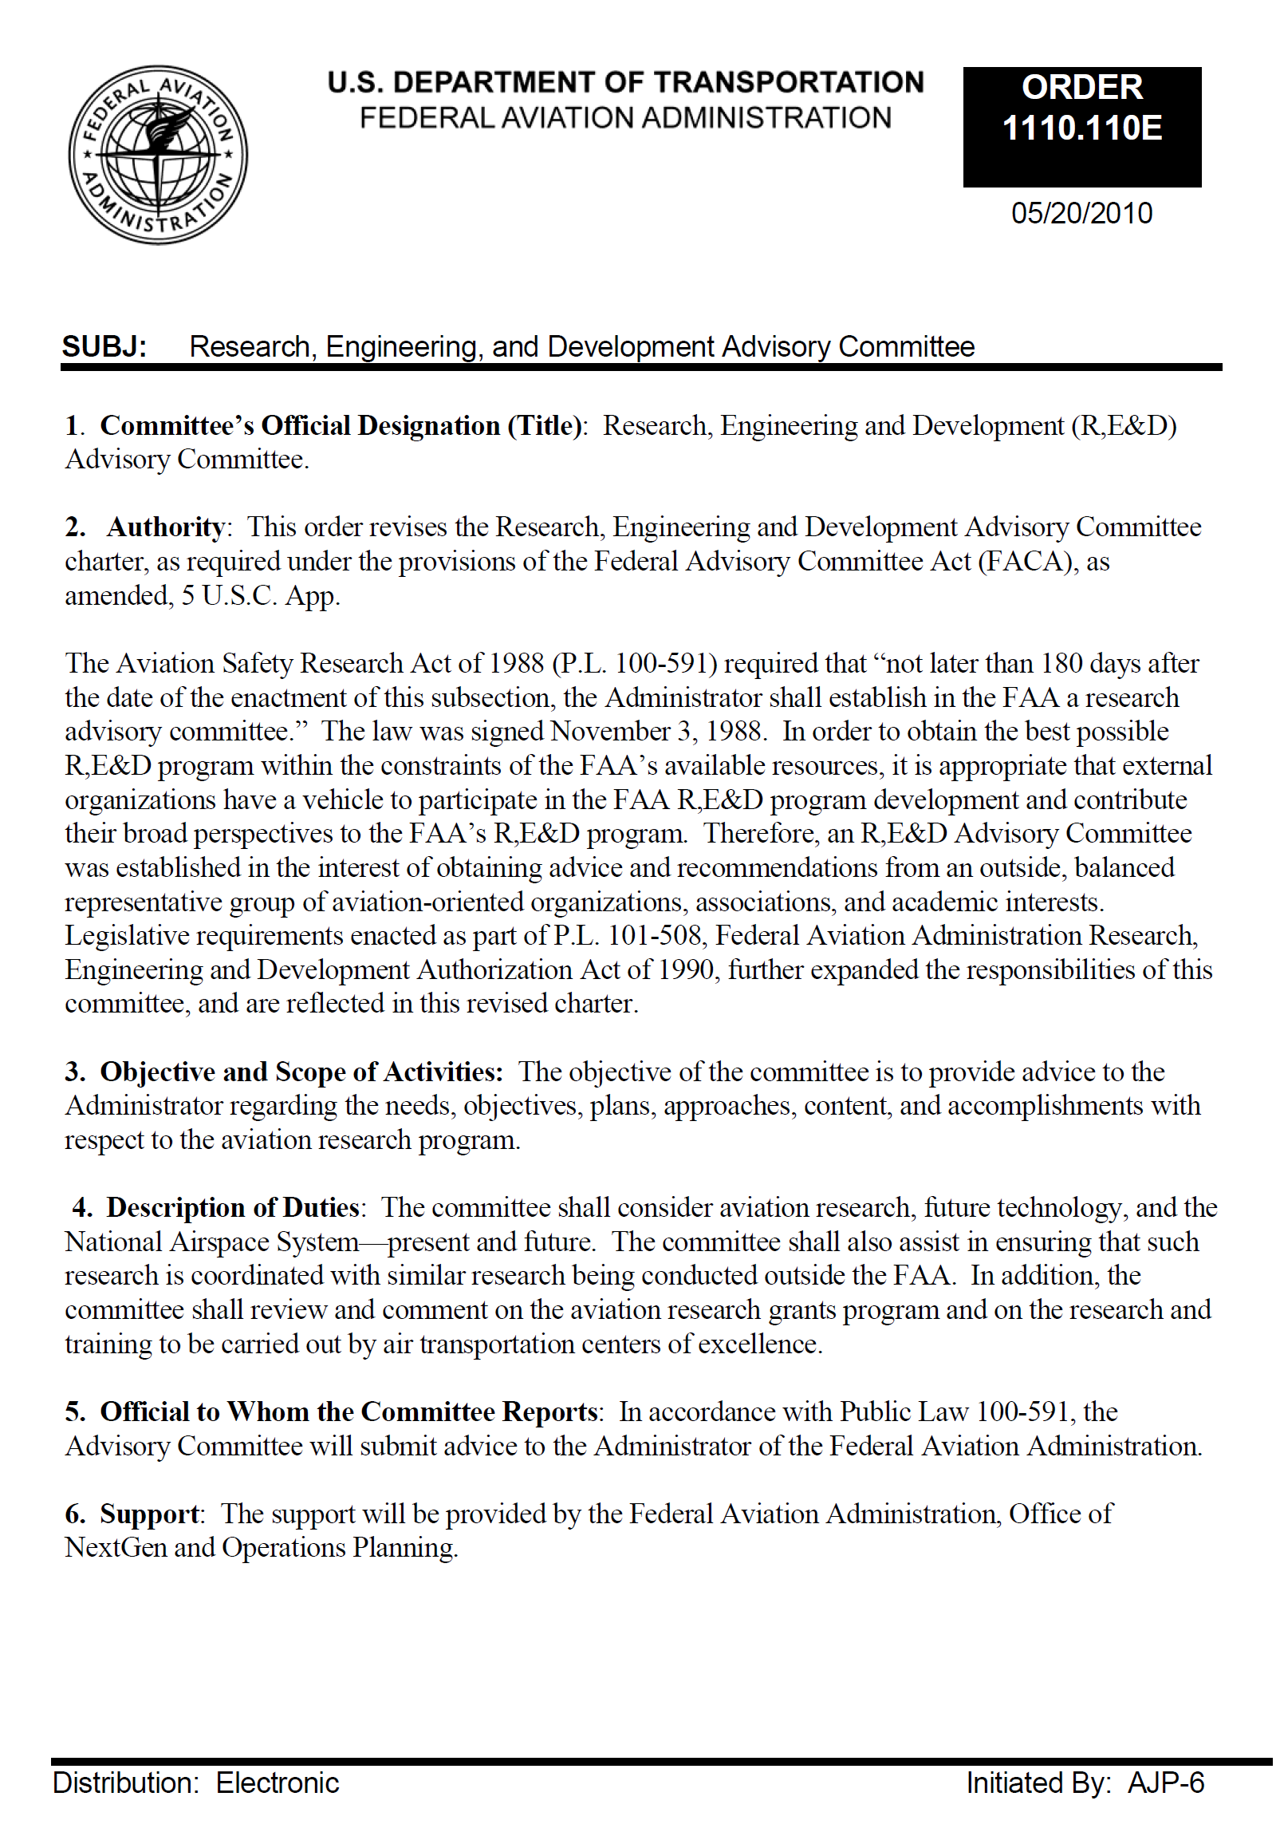
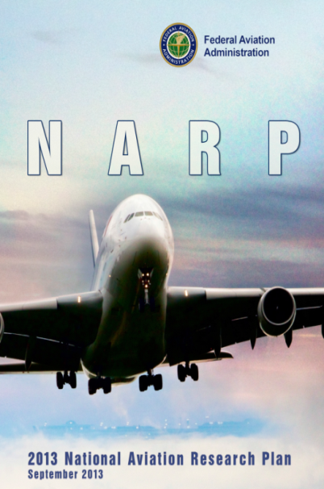
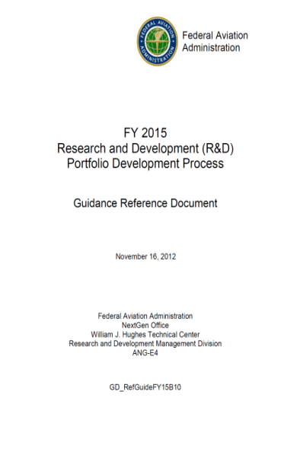
Agenda
Briefing Purpose/Executive Summary
Research Planning Feedback
NARP Redesign
Research Planning Framework
Draft Outcomes/Goals/Objectives
Plans/Schedules

Slide 3
Briefing Purpose
To share direction and obtain feedback on:
FAA’s National Aviation Research Plan Redesign
Research Planning Framework
Draft
Outcomes
Goals
Objectives

Slide 4
FAA Research and Development Executive Summary
FAA’s Research
Multiyear investment to advance knowledge, technology and methods to support FAA safety, efficiency and environmental mission objectives
Annual investment across three appropriation sources
Research, Engineering and Development (RE&D)
Safety, Efficiency, Environmental and Mission Support (21 BLIs)
Emphasis on aircraft safety and environment (noise and emissions)
Major research thrust aimed at informing regulatory activity
Facilities & Equipment (F&E)
Advanced Technology Development & Prototyping (ATD&P)
NextGen Portfolios
Center for Advanced Aviation Systems Development (CAASD)
Airport Improvement Program (AIP)
Airport Technology Research
Airport Cooperative Research
Research performed by industry, academia, government agencies, and in-house FAA staff

Slide 5
FAA Research and Development Executive Summary
The National Aviation Research Plan (NARP) is the FAA's plan to ensure that research and development (R&D) investments are well managed, deliver results, and sufficiently address national aviation priorities.
Provides 5 year R&D planning outlook across safety/efficiency/environmental principles
Aligns R&D investments with FAA/DOT strategic priorities
Companion Annual R&D Review highlights yearly program performance and progress
Section 44501(c) of Title 49 of the United States Code (49 U.S.C. § 44501(c)) requires the Administrator of the FAA to submit the NARP to Congress annually with the President's Budget.
The NARP highlights and reports on applied R&D as defined by the Office of Management and Budget (OMB) Circular A-11

Slide 6
Research Planning Feedback
Advisory Committee (REDAC)
May, 2016: REDAC chair’s letter to Administrator Huerta
“The REDAC also identified the need for a high level research strategy and plan which coordinates research across the research areas of the agency. We strongly support the plan to develop such a strategy and offer any assistance which would be effective.”
REDAC Questions:
What is FAA’s Research and Development Strategy?
Is there a strategic context for the agency’s R&D investments?
How is research aligned with FAA’s mission and operational outcomes?
What are Interagency, Industry, and Centers of Excellence work activities?
Government Accountability Office
Review of FAA’S Research and Development (Feb. 2017)
Preliminary general observations:
Need for forward looking outlook – aware of NARP redesign
Need for transparent prioritization process
Areas for improvement in fulfilling statutory requirement

Slide 7
National Aviation Research Plan Redesign
Objective: Improve FAA’s Research Plan to better express Research & Development strategy and priorities
Performer: Research Executive Board (REB)
Timeframe: 2018 NARP
Desired End Product:
Communicates the driving forces for research (Vision)
Communicates the big picture (Strategy)
Prioritizes research (results focused)
Leverages resources and aligns investments (i.e. FAA, Academia, Interagency, Partnerships)
Identifies emerging technologies and knowledge gaps
Communicates budget decision impacts/mitigations/alternatives on research
Support: Engage REDAC by providing status and obtaining input on redesign efforts
Challenge: Communicating a coherent long-range research strategy while meeting highly prescriptive statutory requirement

Slide 8
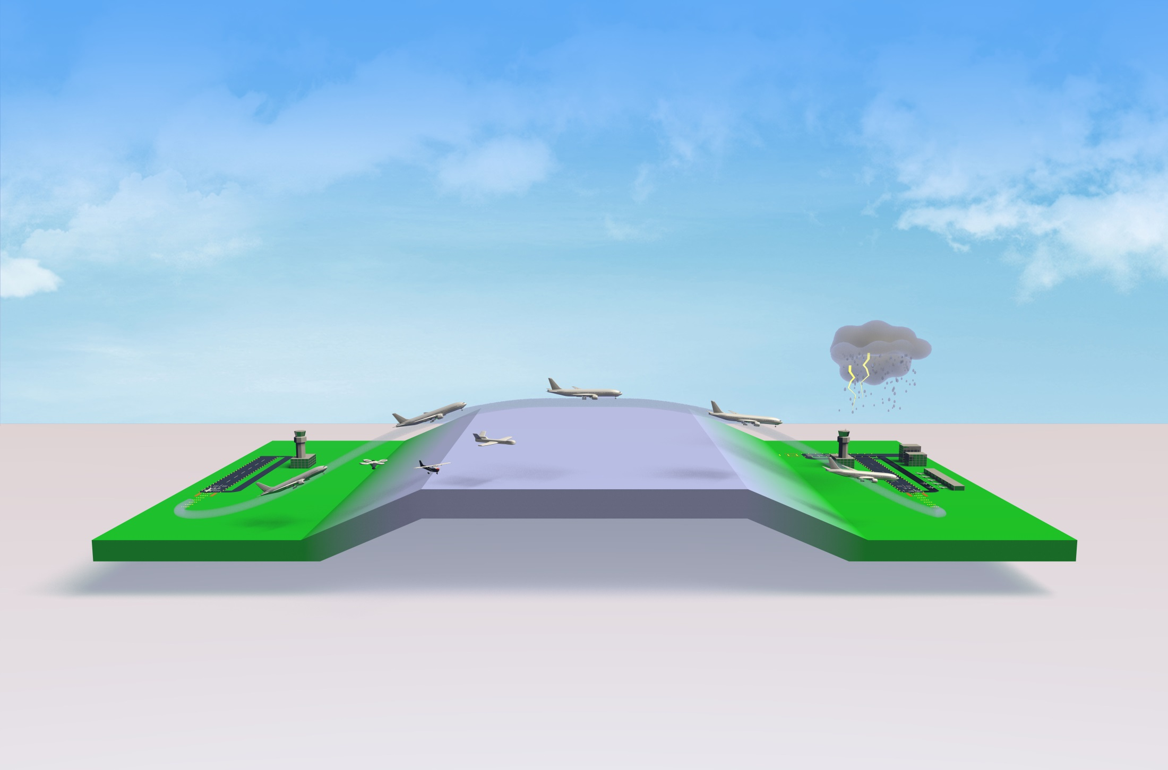
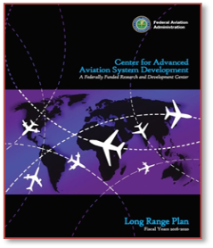
Research and Development
Commercial Space
Air Traffic Management
Fire Safety
Propulsion and Fuel systems
Aircraft
Structures
Digital Systems
Airport and Terminal
UAS
Weather
Pavement
Icing
Mission Support
Human Engineering
Cyber Security
System Safety
Management
Environment
and Energy/Fuels
8

Slide 9
NARP Purpose/Requirements
Purpose: Communicate FAA’s Research and Development (R&D) strategies, goals, and objectives over the next five years. To serve as a blueprint for developing capabilities through applied research and partnerships that address aviation’s critical needs and emerging challenges.
Requirements:
• Meets Legislative requirements
• Links and feeds into DOT plans
• Focuses on FAA outcomes and research goals
• Separates strategic story from programmatic budget detail
• Has fewer and tighter goals
• Shows integration across FAA Lines of Business (goal based)
• Shows line of sight between outcome, goal, objective and output
• Utilizes clear, plain language that speaks to the challenge or the problem, the research, and the anticipated resolution
• Identifies emerging technologies and knowledge gaps

Slide 10
Research Plan Framework and Terminology
Outcomes
Improve Aviation Safety
Improve Operational Efficiency
Reduce Environmental Impact
Goals
Goal 1
Goal 2
Goal 3
Goal 4
Objective
Objective
Objective
Objective
Objectives
Output*
Output
Output
Outputs
*Key outputs within a 5 year horizon

Slide 11
Is there a strategic context for the agency’s R&D investments?
Outcomes:
Improve Aviation Safety
Improve Operational Efficiency
Reduce Environmental Impact
Goals
Improve airport operations, air traffic and air space management capabilities.
Accelerate use of new aerospace vehicle and airport technologies.
Increase infrastructure durability and resiliency.
Optimize human performance and reduce vulnerability in the operation of the system.
Improve integrated modeling capabilities for system-wide analysis.
DRAFT
11

Slide 12
How is research aligned with FAA’s mission and operational outcomes?
Review Draft Goals/Objectives
Improve airport operations, air traffic and air space management capabilities.
Accelerate use of new aerospace vehicle and airport technologies.
Increase infrastructure durability and resiliency.
Optimize human performance and reduce vulnerability in the operation of the system.
Improve integrated modeling capabilities for system-wide analysis.
DRAFT
12

Slide 13
NARP Redesign Plan
Activity | Schedule
Draft Goals and Objectives | COMPLETE
Develop NARP Outline | Jan-Mar, 2017
Draft NARP content | Feb-Aug, 2017
Finalize Goals/Objectives | Apr, 2017
Align work/outputs to goals/objectives FAA, MITRE/CAASD, Centers of Excellence, NASA | Mar-May, 2017
Develop Budget Narratives | May-Jun, 2017
Finalize NARP content | Aug, 2017
Research Executive Board review | Sep, 2017
FAA review | Oct, 2017
Informal OMB/OST review | Nov-Dec, 2017
Final FAA review/approval | Jan, 2018
OMB/OST review/concurrence | Jan, 2018
Deliver 2018 NARP | Feb, 2018
Finalize NARP redesign for 2019 publication | Apr, 2018-Jan, 2019

Slide 14
NARP Redesign
Communication/Feedback Plan
Activity | Schedule
REB/LOB Design Off-sites | Ongoing
Brief Deputy Administrator | COMPLETE
REB members update FAA Executives | Feb-Apr, 2017
REDAC Feedback/Dialog | Feb-Apr, 2017
Brief FAA Administrator/Executives | Apr, 2017
Review Approach with MITRE/CAASD & NASA | Apr-May, 2017
Review Approach with OMB/OST | May, 2017
REDAC Feedback/Dialog | Aug - Sep, 2017
REDAC Feedback/Dialog (2018 NARP) | Feb-Apr, 2018 Aug-Sep, 2018

Slide 15
Redesigned NARP Advisory Committee (REDAC)
October, 2016: REDAC chair’s letter to Administrator Huerta
“The REDAC also strongly supports the current efforts to make the National Aviation Research Plan (NARP) a more integrated and strategic document that covers the entire FAA research portfolio.
The REDAC has long struggled to have a comprehensive view of the FAA research portfolio. If successful, the enhanced NARP provides a great mechanism to communicate the FAA research strategy to the community and will also be a strong tool to manage and coordinate research across the FAA and it's collaborating research partners.”
Goal: The redesigned NARP will better position the REDAC to
Review and advise on planned R&D
Share insights on research activities occurring within industry/academia
Identify emerging technologies and knowledge gaps
Identify future/long-term R&D requirements

Slide 16
Feedback?

Slide 17
BACKUP

Slide 18
NARP Redesign Terminology
Use “Outcomes”, “Goals”, “Objectives” and “Outputs” as forward looking research planning terms
Outcome: Principles that serve as the foundation for FAA’s research
Goal: A domain of new information or knowledge discovery toward which research investments are directed in order to support the pursuit of an operational outcome or agency level strategic priority;
Objective: The demonstrable production of new information or knowledge that result from an investment in the research portfolio;
Output: Tangible product or deliverable from a distinctive investment which contributes toward the achievement of a specified objective;

Slide 19
Governance Model
FAA RESEARCH EXECUTIVE BOARD
RESEARCH ENGINEERING & DEVELOPMENT
ADVISORY COMMITTEE**
CHAIR - FAA RESEARCH DIRECTOR
APL
AVS
INDUSTRY CHAIRED
REB
AIRCRAFT
SAFETY
REDAC
HUMAN
FACTORS
ARP
AST
AIRPORTS
NAS
OPERATIONS
ANG
ENVIRONMENT/
ENERGY
FAA VOTING MEMBERS*
PORTFOLIO DEVELOPMENT
REVIEW & OVERSIGHT
SUBCOMMITTEES
* Advisory Members:
AFN, ATO, Weather, NextGen
COMMERCIAL SPACE
TRANSPORTATION
FAA
PROGRAM PLANNING
TEAMS
AIRPORTS
WEATHER
NAS OPERATIONS
MISSION SUPPORT
AVIATION SAFETY
ENVIRONMENT/ENERGY
**Note: Commercial Space Advisory Committee is Commercial Space Transportation Advisory Committee (CSTAC)

Slide 20
Linking Taxonomy and FAA Documents
Outcome
Document
NARP (5 year forward)
Outcome/Goal/
Objectives/Outputs
Research Report (1 year back)
Outcome/Goal/
Objectives/Outputs
Goal
Goal…
Objective
Objective..
Output*
Activity
Activity
Budget White Sheet (1 year)
Activity/Outputs
(Goal/Objective)
Outputs
Task
Task
Org. Research Plans (1 year)
Activity/Tasks/Outputs
(Goal/Objective)
Output
Output
*Key outputs within a 5 year horizon
17

