Slide 1
FY 2019 Environment and Energy Program Proposal
To: REDAC E&E Subcommittee
By: Dr. Jim Hileman Chief Scientific & Technical Advisor for Environment and Energy
Office of Environment and Energy
Date: February 28, 2017

Slide 2
Presentation Outline
Environment and Energy Portfolio Overview
Financial Summary
PPT Financial Summary Table
PPT 5-Year Financial Plan Table
Quad Charts
Summary

Slide 3
Aviation Environmental Challenges
NOISE AIR QUALITY WATER QUALITY ENERGY GLOBAL CLIMATE
Aviation impacts community noise, air quality, water quality, energy usage, and climate change
Environmental impacts from aviation could pose a critical constraint on capacity growth
FAA are pursuing aircraft technology, alternative jet fuels, operations, and policy measures to address the environmental challenges facing aviation

Slide 4
Environmental Protection that Allows Sustained Aviation Growth
ENVIRONMENT AND ENERGY GOALS
NOISE
Reduce the number of people exposed to significant noise around U.S. airports
AIR QUALITY
Reduce significant air quality impacts attributable to aviation
CLIMATE
Achieve carbon neutral growth by 2020 relative to a 2005 baseline
ENERGY
Develop and deploy sustainable alternative aviation fuels

Slide 5
Environmental & Energy Strategy
PLAN
Environment and energy policy statement ¹
U.S. climate action plan ²
Research roadmaps ³
FAA VISION
Reach the next level of safety, efficiency, environmental responsibility and global leadership
GOALS
Noise
Air Quality
Climate
Energy
ADVANCE SCIENCE AND INTEGRATED MODELING
IMPROVE
Adapt roadmaps
Fill research pipeline
Source characterization
Propagation and dispersion
EVALUATE
Progress toward goals
Mitigation opportunities
Health and welfare impacts
Aviation Environmental Tool Suite
IMPLEMENT
Technology
Alternative Fuels
Operations
Policy
Notes:
Aviation E&E Policy Statement (Federal Register 77-141, 2012): http://www.faa.gov/about/office_org/headquarters_offices/apl/environ_policy_guidance/policy/media/FAA_EE_Policy_Statement.pdf
U.S. Aviation GHG Emissions Reduction Plan: http://www.icao.int/environmental-protection/Pages/ClimateChange_ActionPlan.aspx
Environment and Energy Website: http://www.faa.gov/go/environment

Slide 6
The Five Pillar Approach
Science and Tools
Technology
Alternative Fuels
PILLAR 1: Improved Scientific Knowledge and Integrated Modeling
Decision-making based on solid scientific understanding
Work with research community through the Aviation Sustainability Center (ASCENT)
Understand public health and welfare impacts
Incorporate this knowledge within the Aviation Environmental Tool Suite
PILLAR 2: New Aircraft Technologies
Offer the greatest opportunity to reduce environmental impacts
Partner with industry, research community, NASA, and Department of Defense
Mature new engine and airframe technologies through the Continuous Lower Energy, Emissions and Noise (CLEEN) Program
PILLAR 3: Sustainable Alternative Aviation Fuels
Reduce environmental impacts, enhance energy security, and provide economic benefits
Collaborate with stakeholders through the Commercial Aviation Alternative Fuels Initiative (CAAFI)
Test alternative jet fuels to ensure they are safe for use through ASCENT and CLEEN
Analyze their potential for reducing the environmental impacts of aviation
Operations
Policy
PILLAR 4: Air Traffic Management Modernization and Operational Improvements
Increase efficiency of aircraft operations through the Next Generation Air Transportation System (NextGen)
Engage with industry, research community, NASA, and Department of Defense
Develop advanced operational procedures to optimize gate-to-gate operations
Integrate infrastructure enhancements to the National Airspace System (NAS), improving environmental performance
PILLAR 5: Policies, Environmental Standards, and Market Based Measures
Implement domestic policies, programs, and mechanisms to support technology and operational innovation
Develop and implement aircraft emissions and noise standards
Work within the International Civil Aviation Organization (ICAO) to pursue a basket of measures to address emissions that affect climate, including a global market based measure as a gap filler
Seek international partners to further our environmental and energy strategy
http://www.faa.gov/nextgen
http://www.caafi.org
http://www.faa.gov/go/cleen
http://ascent.aero

Slide 7
Research Programs
ASCENT Center of Excellence (COE)
COE for Alternative Jet Fuel and Environment
Continuous Lower Energy, Emissions and Noise (CLEEN)
Reduce aircraft fuel burn, emissions and noise through technology & advance alternative jet fuels
Cost share partnership with industry
CLEEN I: 2010-2015 & CLEEN II: 2015-2020
Additional Efforts
Commercial Aviation Alternative Fuels Initiative (CAAFI)
Contract mechanisms (e.g., SEMRS, PEARS, PEARS-II)
Volpe Transportation Center
Notes:
COE Technical Areas – Alt Jet Fuels
Feedstock Development, Processing and Conversion Research
Regional Supply and Refining Infrastructure
Environmental Benefits Analysis
Aircraft Component Deterioration and Wear Assessment
Fuel Performance Testing
Technical Areas – Environment
Aircraft Noise and Impacts
Aviation Emissions and Impacts
Aviation Modeling and Analysis
Aircraft Technology Assessment
Environmentally and Energy Efficient Gate-to-Gate Aircraft Operations

Slide 8
ASCENT COE Update
New Research Projects (new NFOs)
Due to current budget uncertainty, we are not committing to new ASCENT Projects
Will make decision after CR is lifted
Intend to share NFOs with E&E Subcommittee
ASCENT Leadership
Mike Wolcott of WSU is the new Director
John Hansman of MIT continues as the Co-Director
Ralph Cavalieri has retired, but he is continuing to help with ASCENT
Joint ASCENT-ANERS Meeting in Alexandria VA
ASCENT Meeting – April 18-19
ANERS Meeting – April 20-21

Slide 9
R&D Developments
Considerable emphasis on noise:
Research on noise impacts and tool development efforts continue
Utilizing FAA-Massport MOU to explore low noise operational procedures in collaboration with ATO
Presented noise R&D needs to joint APL-NASA meeting
Above target requests for UAS noise certification and development of low noise operational procedures for commercial aircraft
Particulate Matter efforts in CAEP continue
Growing efforts on supersonic aircraft
Developing long term vision for AEDT
Alternative jet fuels: CAAFI, ASTM, and CAEP
Technology maturation in CLEEN II continues and we are setting stage for CLEEN III

Slide 10
Environment & Energy Portfolio
Core RE&D (A13.a) Environment & Energy
Improve scientific understanding of environment & energy constraints
Incorporate scientific knowledge into an integrated analytical tool suite
Analyze mitigation options for reducing environmental impacts including policy measures and environmental standards
NextGen RE&D (A13.b) Environmental Research
Mature airframe and engine technologies
Advance sustainable alternative jet fuels
Mature noise mitigation techniques for new arrival and departure concepts that could reduce community noise exposure
NEW
Aviation E&E Policy Statement (Federal Register 77-141, 2012): http://www.faa.gov/about/office_org/headquarters_offices/apl/environ_policy_guidance/policy/media/FAA_EE_Policy_Statement.pdf

Slide 11
Airport Technology Research (ATR)
ATR Overview:
Three Research Programs Areas (RPA): Airport Safety, Pavement and Airport Environment
All three RPAs presented to Airports Subcommittee
Two ATR programs related to environment:
Airport Noise Program (started in FY12)
Airport Environmental Research (started in FY16)
These two programs are collaborative efforts among Tech Center, Office of Airports, and Office of Environment and Energy
Further details given tomorrow by Tom Cuddy

Slide 12
2017 NARP Milestones - RE&D A13.a
Year | Milestone | Status
2016 | Advance the understanding of noise impacts on social welfare and health | Completed
2016 | Develop new standard for aircraft carbon dioxide emissions | Completed
2016 | Develop methodologies to quantify and assess the impacts of aviation emissions | Completed
2017 | Refine methods for estimation of aircraft contribution to climate change and implement them in analytical tools | On schedule
2017 | Advance the understanding of noise impacts on social welfare and health | On schedule
2018 | Advance air quality modeling capabilities to capture global impacts of aviation emissions to inform decision-making and enable solution development | On schedule
2018 | Release Aviation Environmental Design Tool (AEDT) Version 3 with improved noise, emissions, and fuel burn estimation methodologies | On schedule
2018 | Provide quantitative analysis to support 2018 U.S. Aviation Green House Gas Emissions Reduction Plan (for submission to ICAO) | On schedule
2019 | Complete analyses to support the development of a new engine exhaust particulate matter standard in ICAO CAEP | On schedule
2019 | Explore metrics for community exposure to aircraft noise | On schedule
2019 | Develop improved analytical tools and methodologies for cost-benefit analysis of both domestic and international policy options and scenarios | On schedule
2019 | Complete analyses to inform the development of a global market based measure for international aviation | On schedule
2020 | Develop enhanced methodology for estimation of aviation contribution to climate change | On schedule
2020 | Advance understanding of the public reaction to advanced supersonic airplanes to support the development of en-route noise standards for airplanes that exceed Mach 1 | On schedule
2021 | Improve analytical capabilities of aviation environmental analysis tools | On schedule
2022 | Develop new noise and emissions standards | On schedule

Slide 13
2017 NARP Milestones - RE&D A13.b
Year | Milestone | Status
2016 | Refine the environmental and economic sustainability assessment of renewable alternative turbine engine fuels using the latest methods and knowledge | Completed
2016 | Develop methodology to estimate global lifecycle emissions of alternative jet fuels | Completed
2016 | Demonstrate technologies that can reduce energy use, emissions, and noise in year two of the second phase of the Continuous Lower Energy, Emissions and Noise Program | Completed
2017 | Demonstrate Continuous Lower Energy, Emissions and Noise Advanced Turbine Components | On schedule
2017 | Demonstrate technologies that can reduce energy use, emissions, and noise in year three of the second phase of the Continuous Lower Energy, Emissions and Noise Program | On schedule
2018 | Develop methods to streamline the ASTM approval process for alternative jet fuels | On schedule
2018 | Demonstrate technologies that can reduce energy use, emissions, and noise in year four of the second phase of the Continuous Lower Energy, Emissions and Noise Program | On schedule
2019 | Advance the understanding of alternative jet fuel composition to enable fuels with lower emissions | On schedule
2019 | Develop lifecycle greenhouse gas emissions values for alternative jet fuels for use by ICAO CAEP | On schedule
2019 | Demonstrate technologies that can reduce energy use, emissions, and noise in year five of the second phase of the Continuous Lower Energy, Emissions and Noise Program | On schedule
2020 | Demonstrate certifiable aircraft and engine technologies via CLEEN II | On schedule
2020 | Initiate Continuous Lower Energy, Emissions and Noise Phase III activities to demonstrate technologies that can reduce energy use, emissions, and noise | On schedule
2020 | Support testing to ensure the approval of at least one alternative jet fuel type per year | On schedule
2021 | Demonstrate technologies that can reduce energy use emissions and noise via the third phase of the Continuous Lower Energy Emissions and Noise Program | On schedule
2022 | Demonstrate technologies that can reduce energy use, emissions and noise in year 3 of the third phase of the CLEEN Program | On schedule

Slide 14
PPT Financial Summary
 | FY 17 Request |  | FY 18 Request |  | FY 19 Target
Program Title | In-House | Contracts | In-House | Contracts | In-House | Contracts
Base Program (Funding Appropriation)
A13.a. Environment & Energy | 2,362,923 | 12,397,075 | 2,400,498 | 12,796,502 | 2,467,487 | 12,697,163
Above Target Request |  |  |  |  |  | 1,500,000
Base Subtotal | 2,362,923 | 12,397,075 | 2,400,498 | 12,796,502 | 2,467,487 | 12,697,163
With Above Target Request |  |  |  |  |  | 14,197,163
NextGen Program (Funding Appropriation)
A13.b. NextGen Environment & Energy-Aircraft Technologies and Fuels (R,E&D) | 714,208 | 24,950,596 | 722,563 | 25,962,437 | 743,292 | 25,883,860
Above Target Request |  |  |  |  |  | 3,000,000
NextGen Subtotal | 714,208 | 24,950,596 | 722,563 | 25,962,437 | 743,292 | 25,883,860
With Above Target Request |  |  |  |  |  | 28,883,860
PPT Total | 3,077,131 | 37,347,671 | 3,123,061 | 38,758,939 | 3,210,779 | 38,581,023
With Above Target Request |  |  |  |  |  | 43,081,023

Slide 15
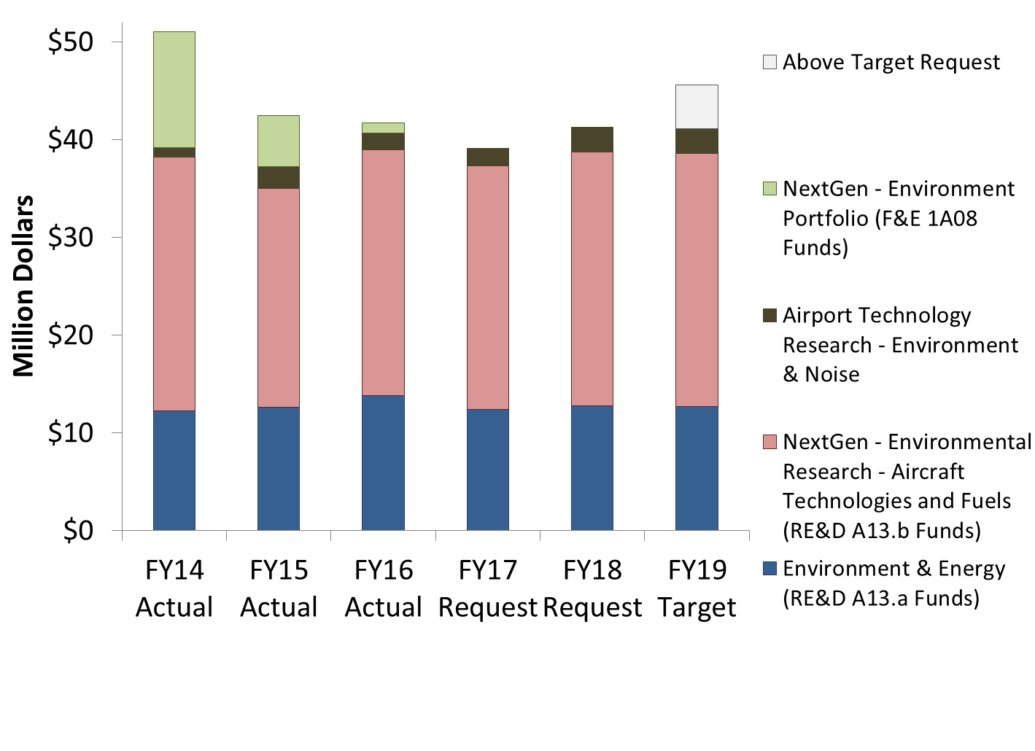
FY14-19 Financial Summary
Not shown on graph:
Airports Cooperative Research Program (ACRP) provides ~$5M/year for environment projects
FAA FY 2017 President’s Budget Highlights https://www.transportation.gov/mission/budget/fiscal-year-2017-budget-highlights-book

Slide 16
PPT 5-Year Financial Plan
Program | Out-Year Contract Dollars
 | FY 2019 | FY 2020 | FY 2021 | FY 2022 | FY 2023
Base Program (Funding Appropriation)
A13.a. Environment & Energy | 12,697,163 | 12,834,191 | 13,078,444 | 13,203,677 | 13,435,794
Above Target Request | 1,500,000 | 1,500,000 | 0 | 0 | 0
Base Subtotal | 12,697,163 | 12,834,191 | 13,078,444 | 13,203,677 | 13,435,794
With Above Target Request | 14,197,163 | 14,334,191 | 13,078,444 | 13,203,677 | 13,435,794
NextGen Program (Funding Appropriation)
A13.b. NextGen Environment & Energy-Aircraft Technologies and Fuels (R,E&D) | 25,883,860 | 26,302,921 | 26,881,306 | 27,296,658 | 27,871,228
Above Target Request | 3,000,000 | 3,000,000 | 3,000,000 | 3,000,000 | 3,000,000
NextGen Subtotal | 25,883,860 | 26,302,921 | 26,881,306 | 27,296,658 | 27,871,228
With Above Target Request | 28,883,860 | 29,302,921 | 29,881,306 | 30,296,658 | 30,871,228
PPT Total | 38,581,023 | 39,137,111 | 39,959,750 | 40,500,335 | 41,307,023
With Above Target Request | 43,081,023 | 43,637,111 | 42,959,750 | 43,500,335 | 44,307,023

Slide 17
Core RE&D Program (A13.a) - Environment & Energy
FAA Strategic Plan
Research Goals
Deliver benefits through technology and Infrastructure
Enhance global leadership
By 2019, explore appropriate metric for community exposure to aircraft noise.
By 2019, develop improved analytical tool and methodologies for cost-benefit analysis of both domestic and international policy options and scenarios.
By 2019, complete analyses to support the development of policy measures and standards in ICAO CAEP.
By 2020, advance understanding of the public reaction to advanced supersonic airplanes to support the development of en-route noise standards for supersonic airplanes
By 2021, release AEDT Version 4 with high fidelity noise characterization.
Need
Characterize environmental and energy challenges
Develop and implement mitigation solutions
Enhance international leadership on environment and energy matters
FY 2019 Milestones
Advance the understanding of noise impacts on social welfare and health.
Improve ability to model the air quality and climate impacts of aviation emissions.
Enhance the aviation environmental tool suite to improve our ability to calculate environmental consequences and impacts of aviation.
Analyze mitigation options for reducing environmental impacts including policy measures and standards.
Develop improved certification methods
Out Year Funding Requirements
 | FY 2019 | FY 2020 | FY 2021 | FY 2022 | FY 2023
Funding Target ($000) | 12,697 | 12,834 | 13,078 | 13,204 | 13,436
Above Target Request | 1,500 | 1,500 | 0 | 0 | 0
This above target request would enable the development of a more robust understanding of potential environmental impacts, particularly noise, of UAS vehicles and develop an appropriate noise certification scheme.
Notes:
First three accomplishments are from NARP for FY14-FY16
Research goals are from Section 912 briefing, previous year PPT, and my thoughts

Slide 18
NextGen RE&D Program (A13.b) - Environmental Research - Aircraft Technologies and Fuels
FAA Strategic Plan
Research Goals
Deliver benefits through technology and Infrastructure
Enhance global leadership
By 2019, advance the understanding of alternative jet fuel composition to enable fuels with lower emissions.
By 2019, develop lifecycle greenhouse gas emissions values for alternative jet fuels for use by ICAO CAEP.
By 2021, mature noise mitigation techniques for new arrival and departure concepts that could reduce community noise exposure.
Through 2021, support testing to ensure the approval of at least one alternative jet fuel type per year.
Through 2021, demonstrate certifiable aircraft and engine technologies via CLEEN.
Need
Characterize environmental and energy challenges
Develop and implement mitigation solutions
Enhance international leadership on environment and energy matters
FY 2019 Milestones
Continue CLEEN II activities to assess and demonstrate aircraft and engine technologies that can reduce energy use, emissions, and noise. Initiate CLEEN III activities.
Develop operational procedure concepts that could reduce community noise exposure.
Support the approval of additional alternative jet fuel pathways via ASTM International.
Evaluate regional alternative jet fuel supply chains to identify the key barriers to the development and deployment of ‘drop-in’ alternative jet fuels.
Quantify the economic and environmental benefits of alternative jet fuels at local, regional and global levels.
Out Year Funding Requirements
 | FY 2019 | FY 2020 | FY 2021 | FY 2022 | FY 2023
Funding Target ($000) | 25,884 | 26,303 | 26,881 | 27,297 | 27,871
Above Target Request | 3,000 | 3,000 | 3,000 | 3,000 | 3,000
This above target request would accelerate the maturation of low noise aircraft technologies and noise mitigation techniques for new arrival and departure concepts that could reduce community noise exposure.
Notes:
First three accomplishments are from NARP for FY14-FY16
Research goals are from Section 912 briefing, previous year PPT, and my thoughts

Slide 19
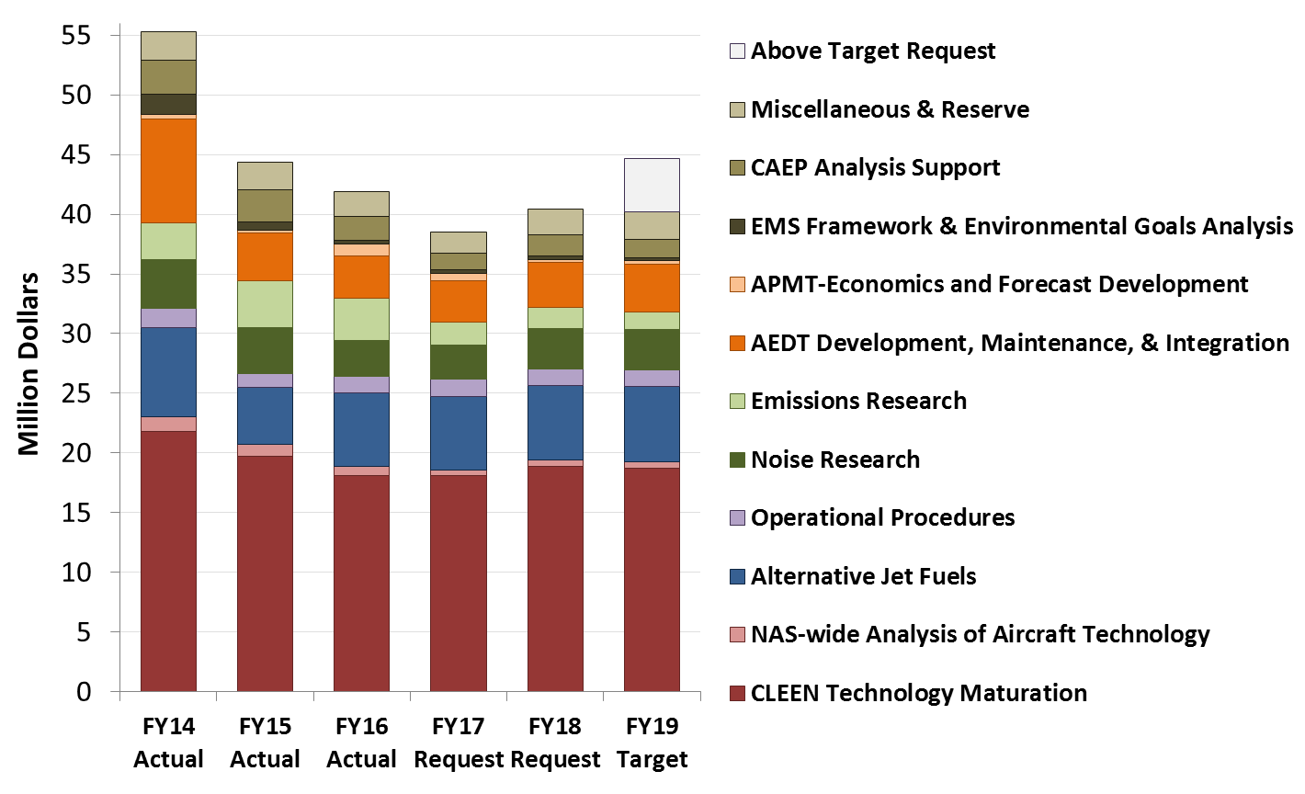
Environment and Energy Funding
Includes: RE&D, F&E, ATR, Operations, and non-FAA funds (e.g., other US Government and Transport Canada)

Slide 20
Recent Successes capabilities and solutions that are helping today
Noise impacts work is starting to deliver results. Community noise survey is complete. Published report on pilot phase of aircraft noise sleep impacts study.
Provided critical analytical support to development of Carbon Offsetting and Reduction Scheme for International Aviation (CORSIA)
Emissions measurements providing foundation for ICAO CAEP PM standard
Integrated tool suite and analyses provided the scientific data used to support the decision making for the ICAO CAEP CO₂ standard
Alternative fuels scenarios adopted by ICAO CAEP for future trends assessment and research efforts instrumental for alternative fuel inclusion within CORSIA
Federal Alternative Jet Fuel Strategy has been released showing coordinated plan for federal government R&D investments
ASCENT CLEEN aircraft and engine technologies appearing in next generation of aircraft with FMS technologies retrofitted into today’s fleet - reduces noise, emissions and fuel use for many years to come
Certification of five alternative jet fuel pathways – certification enabled United Airlines to buy and use biofuel at LAX as well as purchases by Gulfstream
Aviation Environmental Design Tool being used extensively

