Slide 1
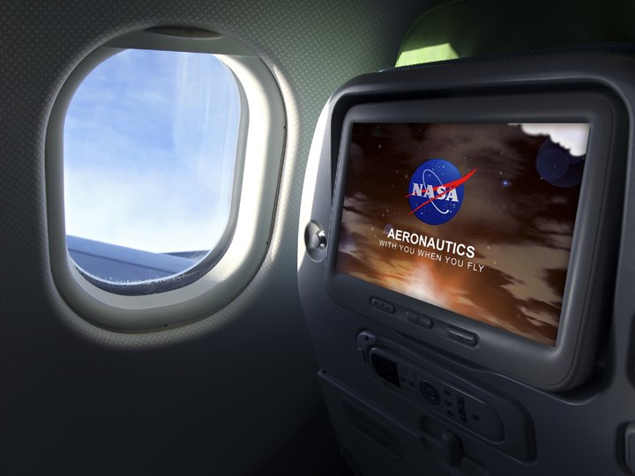
NASA Update
E&E REDAC Meeting
February 28, 2017
Notes:
Th 2
RT ….
Th 3a
RT 1,2,3,4(modsim)
Th 3b
RT 1
RT 2
RT 3
RT x
Th 4a
RT 1 4 subthemes
RT 2 5 subthemes

Slide 2









NASA Aeronautics Six Strategic Thrusts
6 Strategic Research and Technology Thrusts
Safe, Efficient Growth in Global Operations
Enable full NextGen and develop technologies to substantially
reduce aircraft safety risks
Innovation in Commercial Supersonic Aircraft
Achieve a low-boom standard
Ultra-Efficient Commercial Vehicles
Pioneer technologies for big leaps in efficiency and
environmental performance
Transition to Low-Carbon Propulsion
Characterize drop-in alternative fuels and pioneer
low-carbon propulsion technology
Real-Time System-Wide Safety Assurance
Develop an integrated prototype of a real-time safety
monitoring and assurance system
Assured Autonomy for Aviation Transformation
Develop high impact aviation autonomy applications
http://www.aeronautics.nasa.gov/pdf/armd-strategic-implementation-plan.pdf

Slide 3

ARMD Programs with Strategic Thrusts
MISSION PROGRAMS
Airspace Operations and Safety Program
Advanced Air Vehicles Program
Integrated Aviation Systems Program
Safe, Efficient Growth in Global Operations
Real-Time System-Wide Safety Assurance
Assured Autonomy for Aviation Transformation
Ultra-Efficient Commercial Vehicles
Innovation in Commercial Supersonic Aircraft
Transition to Low-Carbon Propulsion
Assured Autonomy for Aviation Transformation
Flight Research-Oriented Integrated, System-Level R&T support all six thrusts
X-Planes / Test Environment
Transformative Aeronautics Concepts Program
SEEDLING PROGRAM
High-risk, leap-frog ideas supporting all six thrusts
Critical cross-cutting tools and technology development

Slide 4
FY 2017 President’s Budget
$ Millions | FY 2015 | Enacted FY 2016 | FY 2017 | FY 2018 | FY 2019 | FY 2020 | FY 2021 | FY 2022 | FY 2023 | FY 2024 | FY 2025 | FY 2026
Aeronautics | $642.0 | $640.0 | $790.4 | $846.4 | $1,060.1 | $1,173.3 | $1,286.9 | $1,294.2 | $1,307.6 | $1,218.1 | $829.7 | $839.5
Airspace Operations and Safety | 154.0 |  | 159.4 | 159.2 | 176.2 | 189.1 | 221.5 | 198.7 | 200.9 | 193.2 | 175.5 | 167.8
Advanced Air Vehicles | 240.6 |  | 298.6 | 277.4 | 308.8 | 311.6 | 312.6 | 321.3 | 315.0 | 318.9 | 317.7 | 326.7
Integrated Aviation Systems | 150.0 |  | 210.0 | 255.4 | 381.4 | 493.0 | 556.7 | 591.5 | 612.2 | 525.0 | 203.8 | 210.6
Transformative Aeronautics Concepts | 97.4 |  | 122.3 | 154.4 | 193.8 | 179.7 | 196.2 | 182.8 | 179.4 | 181.0 | 132.7 | 134.4
Note that NASA is still under a Continuing Resolution at this point. This budget is included as a reference but is not enacted.

Slide 5
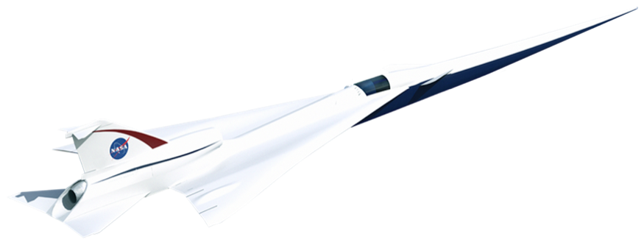
New Aviation Horizons - Supersonics
Low-boom flight demonstrator will pave the way for the development of a noise design standard for overland flight and new generations of supersonic civil aircraft.
Preliminary Design underway and proceeding on track with completion expected in Summer 2017. Further action pending Agency decisions.

Slide 6
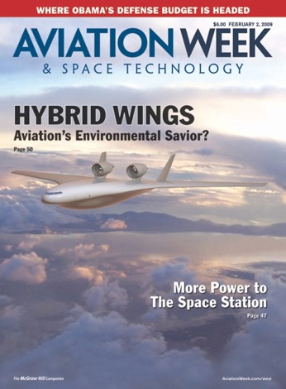
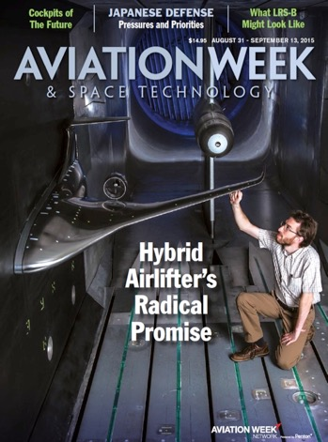
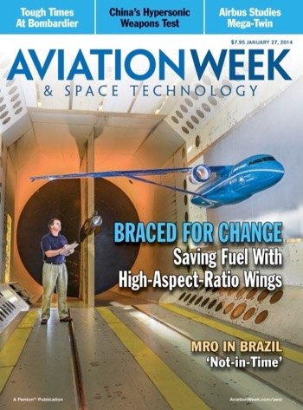
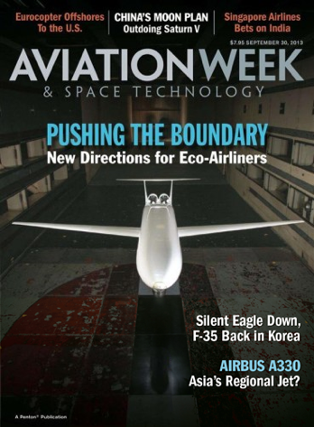
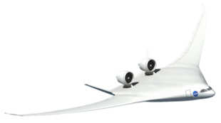
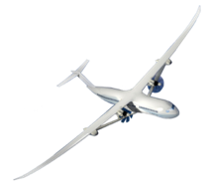
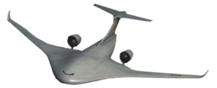

New Aviation Horizons - Ultra-Efficient Subsonic Transport Demonstrators
Copyright, The McGraw-Hill Companies. Used with permission.
Copyright Penton Media. Used with permission
Copyright Penton Media. Used with permission
Copyright Penton Media. Used with permission
HWB Concept 1 (Tailless)
Hybrid/blended wing body without a tail
    Non-circular, flat-walled pressurized composite fuselage
Upper aft fuselage mounted propulsion
Propulsion noise shielding
Unique cargo door for
military/civil application
HWB Concept 2
(Tail w/OWN)
Hybrid/blended wing body with conventional T-tail
    Non-circular, oval pressurized composite fuselage
Aft, Over-the-Wing Nacelles
Fan noise shielding from wing
Unique cargo door for military/civil application
TTBW–Transonic Truss-Braced Wing
Truss-braced, thin, very high aspect ratio wing with folding tips
Conventional, circular pressurized fuselage
Conventional T-tail
Conventional under-wing propulsion system w/hybrid-electric variant
D8–Double Bubble
Double bubble fuselage with unique Pi-Tail
    Non-circular, pressurized composite fuselage
Upper aft fuselage boundary layer ingesting (BLI) propulsion system
Propulsion noise shielding
Thin, flexible, high aspect ratio wing
Image Credit: Lockheed Martin

Slide 7
Ultra Efficient Subsonic Transport (UEST)
X-Plane System Requirements Definition
Award September 8, 2016
Kickoff Complete September 20, 2016
Midterm Review January 17-20, 2017, Armstrong FRC
Final Reviews
  DZYNE Blended Wing Body (BWB) February 21 Irvine
  Boeing BWB February 22 Huntington B
  Boeing Transonic Truss Braced Wing February 23 Huntington B
  Lockheed Hybrid Wing Body February 27 Marietta
  Aurora Double Bubble/Boundary Layer Ingestion February 28 Manassas
Contract Complete March 8, 2017

Slide 8
UEST System Requirements Definition
Mid Term Review Completed
Review Vision System (VS) Concept and VS Performance in terms of Subsonic Transport System Level Metrics (STSLM)
Review Overall Tech Maturation Plan (TMP) for Vision System
  Critical Technologies, Test Approaches and Maturation Timeline
    Computations and/or Simulations, including Piloted Simulations
    Wind Tunnel Tests, or Structural Tests, or Ground-based Propulsion Tests
    Flight Tests, including X-Plane Flight Tests
Review Specific X-Plane Requirements
  Rationale/Business Case for X-Plane Flight Asset describing needs, goals, and objectives. ID programmatic level key performance parameters and measures of success
  Top Level “Technical or Driving” Requirements for X-Plane Flight Test Program
    Tech data to be “acquired” with the X-Plane asset with traceability to the vision system in terms of Measure of Effectiveness, Measures of Performance, Technical Performance Measures
  Vehicle Level System Requirements of X-Plane
    Data and associated test requirements supporting X-Plane design, fab, integration, assembly, ground test, flight qualification, and for conducting a one year research program phase
    Overall concept of operations for the X-plane research program phase
  Day to Day Management Plan, including Program Planning and Control Functions
  Risks and Risk Mitigation Plans – entire life cycle
  Risk Infused Cost and Schedule – entire life cycle

Slide 9
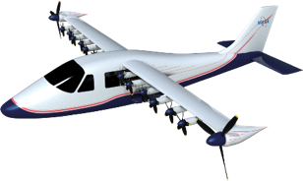
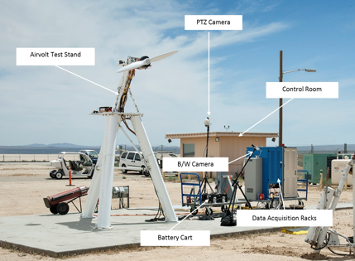
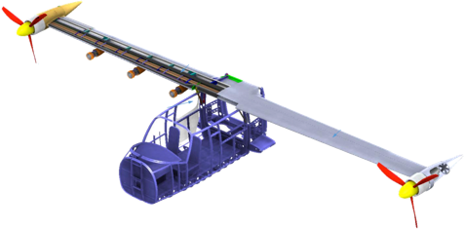
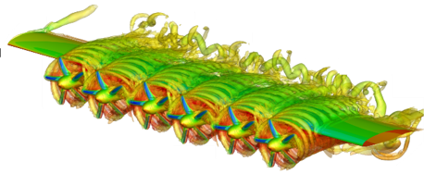
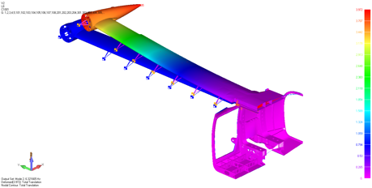
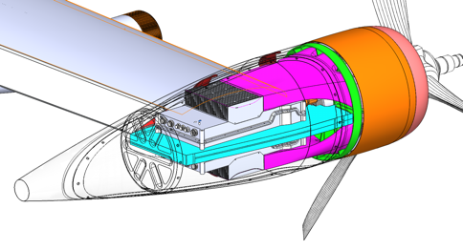
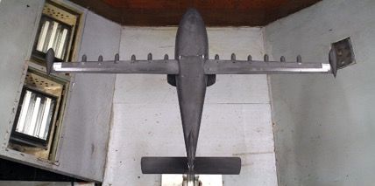
X-57 approaching first flight
X-57 “Maxwell”: general aviation-sized all-electric airplane
Phased modifications make X-57 a “design/build/learn” for future larger X-plane
Phase 1 first flight: March 2018
GROUND TESTING
NUMERICAL ANALYSIS
X-PLANE DESIGN
Critical ground testing to validate key technology systems and vehicle performance and control
Computational Analysis to ensure Aerodynamic and Structural Performance
X-Plane Design Passes Critical Design Review
ERA-0009GM HWB Model (5.75%) in LaRC Wind Tunnel

Slide 10
Advanced Composites Project Flow and Budget
FY13
FY14
FY15
FY16
FY17
FY18
FY19
Formulation
Formulation Review
Phase 2 Plan Review
Meeting of Experts
Technology Toll Gate
Key Decision Point
Phase 1 :
“Baseline” capture
Tech. requirements
Screening
Small scale testing
Startup
Phase 2 :
Technology integration tests
Subcomponent / component
Standards, guidance
NASA
IDIQ Contracts: Industry
Consortium
Formation
RFP
RFP
ACC
RFP
NRAs
$25M
$24.7M
$25M
$28.5M
$25M
$6M
10
Notes:
Phase 1 requirements:
Baseline to assess progress: Generic timeline, requirements, performance indicators
Screening: Characterize state of practice; Quantitative assessment of SoA
Systems analysis to develop Phase 2 plan

Slide 11
Summary – A New Era for NASA Aeronautics
Investing In Our Future - Investments in NASA’s cutting edge aeronautics research today are investments in a cleaner, safer, quieter and faster tomorrow for American aviation:
NASA is entering the Administration transition with a strong portfolio with good stakeholder support.
No decisions have been made regarding the New Aviation Horizons (X-Plane) Initiative.
The X-57 distributed propulsion electric aircraft was announced.
The Advanced Composites Project is moving into Phase II

