Slide 1
Noise Research
Update and Planning
E&E REDAC Subcommittee
Rebecca Cointin
February 28, 2017

Slide 2
Outline
Setting the Scene
Addressing the Challenge and Research Needs
FY17 Priorities
Current Collaborations
Future Priorities
Project Updates
Survey
Supersonics
Helicopter
UAS

Slide 3
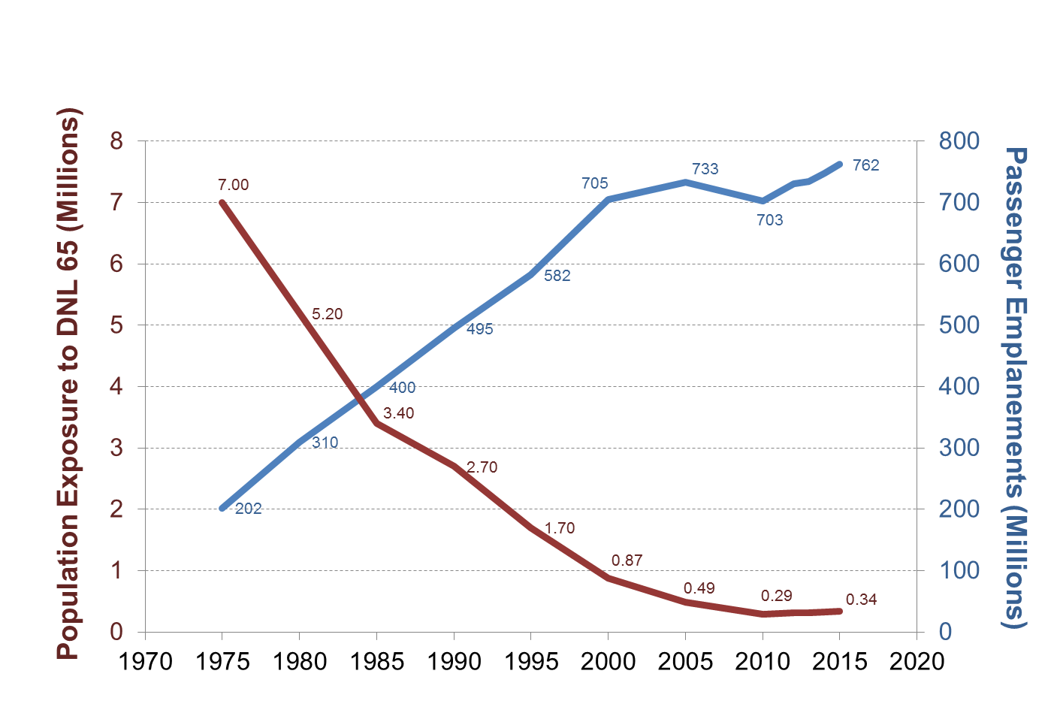
Historical Trends
95% reduction in population exposure to DNL 65
260% increase in passengers traveling in the US
Data Sources:
Enplanements: FAA Terminal Area Forecast
Population Exposed: FAA Office of Environment and Energy

Slide 4
Large Reduction in Population Exposure, but…
GAO Reports:
2000 Survey of 50 Busiest Commercial Airports: US airport capacity expansion projects - 72% of delayed work and 25% of project cancellations due to environmental issues¹
2010 Report: “new runway construction from initial planning to completion takes a median of 10 years, but delays from lawsuits or addressing environmental issues can add an additional 4 years to the median time” ²
The implementation of precision aircraft navigation over the last few years has been accompanied by increased airport community concerns regarding noise
Source: 1. http://www.gao.gov/archive/2000/rc00153.pdf
2. http://www.gao.gov/assets/310/309622.pdf

Slide 5
Challenges
A factor of 20 decrease in community noise exposure has been accompanied by increased community concerns about aircraft noise
Aircraft are much quieter than they were in the past, but there are many more operations
With precision navigation, aircraft are no longer randomly dispersed around flight tracks

Slide 6
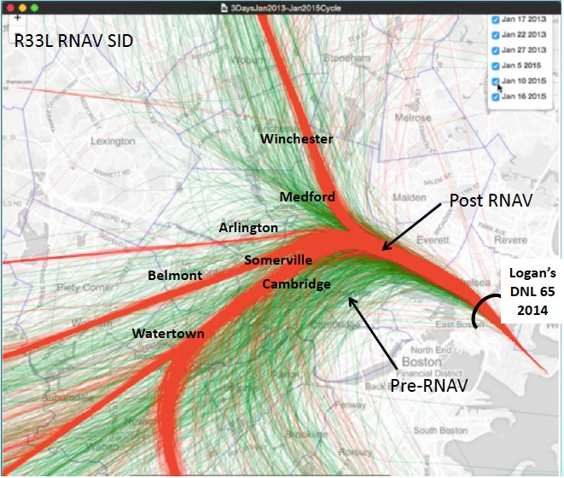
Precision Navigation
Image Source: Massport
Precision navigation
delivering considerable
benefits (e.g., fuel burn,
workload, efficiency), but also concentrating noise
Precision navigation is ideal
when you can utilize
compatible land use (water or
industrial corridors), but few airports have this
A better understanding of impact and communicating that impact to the public is needed.
Mitigation of operational procedures and aircraft technology is needed

Slide 7
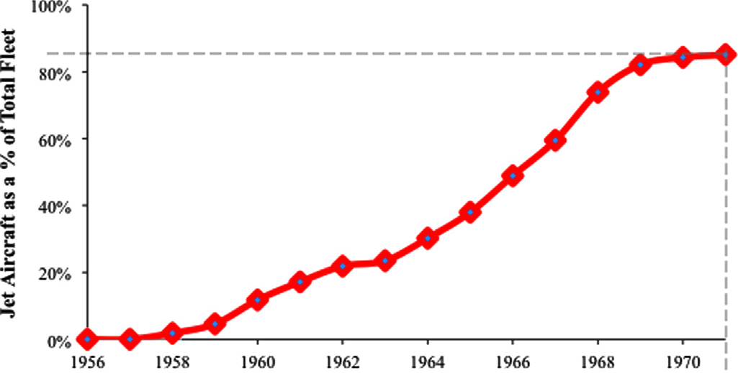
Addressing the Aircraft Noise Challenge
Understanding Impact of Noise
Noise impacts: annoyance, sleep, health and children’s learning
Sonic boom / puff acceptability
Public reaction to UAS noise
Commercial Space vehicles
Outreach
Increase public understanding
Community outreach
Mitigation
Land use planning
Vehicle operations
Airframe and engine technology
Aircraft Technology Requires Time to Enter the Fleet
Diffusion of first generation jet aircraft into the airline fleet: 15 year diffusion dynamic¹ (Data source: ATA Annual Reports 1958–1980)
Source: Hileman et al. 2013 http://dx.doi.org/10.1016/j.paerosci.2013.07.003/

Slide 8
Research Needs
Commercial aircraft
Communication and outreach needed to improve public understanding
Continue to improve our understanding of aviation noise impact on people
Develop reduced-noise operations to change how today’s fleet is flown
Supersonic Aircraft
Develop a certification scheme
Re-evaluation of 14 CFR Part 91.817
Helicopters
Develop noise abatement procedures to reduce the impact of helicopters
Create Pilot awareness programs
UAS
Develop a certification scheme
Understand potential noise annoyance concerns
Commercial Space
Support NEPA evaluation, including modeling, metrics and significance threshold

Slide 9
FY17 Project Priorities
Annoyance Survey
NEPA Significance Policy
FAA Noise Certification
Stage 5 Rule and Advisory Circular (AC) Update
Organizational Delegation Authority
ICAO CAEP Working Group 1
Impacts Research
Sleep
Cardiovascular Health
Supersonics
Certification
Re-evaluation of 14 CFR Part 91.817
UAS Certification
Scheme for mid and large UAS
Noise Level Reduction
Helicopter Work
Flight tests
Fly Neighborly with Helicopter Association International (HAI)
IFly Quiet with HAI
Air Tour
Grand Canyon Quiet Technology Incentives
Coordination with National Park Service
Noise Complaint Initiative

Slide 10
Collaboration with Other Agencies\Entities
NASA
Supersonics
UAS
Helicopters
Operations (covered in Operations briefing)
Technology development (covered in CLEEN briefing)
Helicopter Association International (HAI)
Fly Neighborly
Pilot awareness program
Federal Interagency Committee on Aviation Noise
Update to Federal Land Use Guidelines

Slide 11
Collaboration within FAA
Across Agency
Noise Steering Group
Update to DNL 65 dB Policy
Park Air Tours
Noise Complaint Initiative
Airports
Noise Level Reduction for Sound Insulation Program
Commercial Space
Modeling methodology and significance for launch vehicles and launch site permits
UAS
Certification
National Environmental Policy Act

Slide 12
FY18, 19 and Beyond - Project Priorities

Slide 13
FY18, 19 and Beyond - Details on Impacts
Annoyance Study - Re-evaluation of DNL metric
Data mine survey results to determine if there is more appropriate metric than DNL to correlate annoyance and aircraft sound level
Multi-Site Sleep Study
Conduct large scale sleep study to determine national relationship between sleep and aircraft noise
Cardiovascular health
Continue to examine health cohorts to quantify aviation noise health impacts
Leverage existing project NIH grant for additional cohorts and analysis
NPS Dose Response Research
Examine if updates in dose-response science should lead to re-examination of dose-response relationship used for National Parks with respect to air tours
Commercial Space
Identify appropriate modeling methodology, metric and threshold for commercial launch vehicles

Slide 14
FY18, 19 and Beyond - Details on Mitigation
Rotorcraft Noise Abatement Procedures Development
Continue to develop through modeling and then flight test noise abatement procedures
Rotorcraft Noise Abatement Program (Fly Neighborly)
Continue to work with HAI to update the Fly Neighborly Program and continue the ensure WINGS credit for Fly Neighborly Classes
Rotorcraft Pilot Noise Awareness Program (IFlyQuiet)
Develop the program based on the plan developed in FY17
Noise Level Reduction - Sound Insulation Eligibility Guidelines
Finalize the research on methodology for home eligibility and help Airports develop any guidance

Slide 15
PROJECT UPDATES

Slide 16
U.S. Civil Aircraft Noise Annoyance Survey: Time Line and Next Steps
Survey results will be available by the end of the year*
Information regarding survey results will be disseminated appropriately and include:
New aviation-only Dose Response Curve
Supporting Materials
FAA will review dose-response curve and determine what, if any, actions, policy, or guidance will be needed
FAA internal policy research and review programs have been initiated
FAA will coordinate with other Federal Agencies, including coordination through the Federal Interagency Committee on Aviation Noise (FICAN), regarding survey results
A public review and comment process will occur prior to making any policy determinations
*Barring any unforeseen circumstances

Slide 17
Research on Potential Policy Implications of Noise Survey
NEPA significant impact criteria review
Developing options for possible noise significance criteria and comparing their application under alternative dose-response relationships
Considerations for land use compatibility also being reviewed
Sound insulation efficacy for alternative eligibility criteria
Evaluating effectiveness of standard sound insulation treatments over range of alternative eligibility criteria
Alternative mitigation options for noise levels below 65dB DNL
Considering alternative mitigation options to standard sound insulation treatments
Each research project will yield “possibility” menus to inform policy makers as they consider results from noise annoyance survey

Slide 18
Supersonic Aircraft Research
Reconsider ban on flying over Mach 1 in the US
Research with NASA on community response to sonic booms
Economic and Environmental Analysis
Develop procedures and limits for an enroute standard
Both for aircraft producing low booms and aircraft using technology to fly at Mach cut-off speeds
Examine current landing and take-off procedures to determine what, if any gaps exists for supersonic aircraft

Slide 19
Helicopter Noise Research
Noise Abatement Procedures
Coordinating on flight test with NASA scheduled for Fall 2017
Total of six helicopters, flying modeled noise abatement procedures developed under ASCENT
Information will update HAI Fly Neighborly Program
Pilot Awareness Program
Developed a promotional video for training at HAI Heli-Expo for a Fly Neighborly Course (get WINGS credit)
Developing a Self-Training Video Proposal on Fly Neighborly for WINGS credit
iFlyQuiet (pilot awareness) program being created to educate pilots on their role regarding helicopter noise – intend to share knowledge via a campaign for operator groups

Slide 20
UAS Noise Research
Certification
Exempted in certain situations (Section 333 and Part 107)
Measurement of UAS of multiple propulsions and weights is happening, but we need more noise data
Laying ground work to develop certification framework for all UAS – examining potential for it to be risk-based
Examining alternative positioning options for certification - current options do not work with all UAS sizes
National Environmental Policy Act (NEPA)
Examining modeling needs
Determining how to gather necessary information to satisfy noise analysis for NEPA

