Slide 1
Emissions Roadmap Update
Office of Environment & Energy

Slide 2
Outline
Setting the Scene
FY17 Priorities
Future Priorities
Project Updates

Slide 3
NAS-wide Energy Efficiency Trend
0.423
0.359
0.329
0.331
0.328
2000-2013
22% increase in energy efficiency

Slide 4
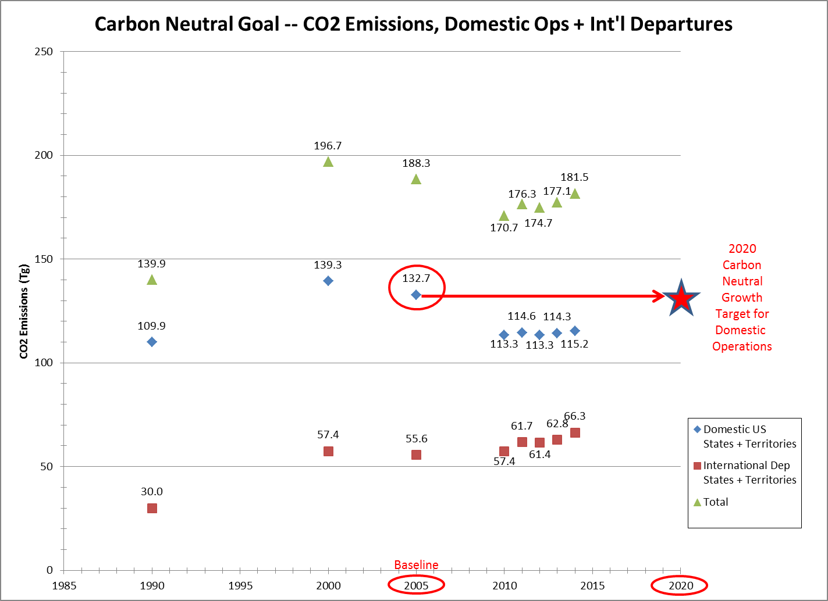
1990-2015
54% increase in domestic enplanements
4.8% increase in domestic fuel burn

Slide 5
FY17 Emissions Research Overview
ASCENT Project | Description | Emissions Roadmap
2 | nvPM Emissions Engine Measurements
10 | Forecast Technology and Influence of Commercial SST
18 | Health Effects of Aviation Emissions
19 | CMAQ-based Airport AQ Model Development
20 | Fast-time APMT-I AQ Model Development (Adjoint)
21 | Updates to APMT-I Climate Model
22 | Independent Evaluation of APMT-I Climate Model
24 | Emissions effects of fuel components Closing out…
39 | CBA of removing Naphthalene from Jet-A
48 | Engine nvPM Emissions Standard Setting Support
Health Impacts Research
Emissions Tools Development
Emissions Source Characterization
Climate Impacts Research
Certification and Regulations
Aviation Emissions Modeling
Emissions Guidance Research

Slide 6
FY18, FY19 and Beyond
 | FY18 | FY19 | Beyond
Emissions Source Characterization
nvPM emissions ambient and fuel corrections | X
Emissions effects of alternative fuels | X | X | X
Removing Naphthalene from Jet-A | X
Certification and Regulations
Domestic Implementation of aircraft CO2 emissions std | X | X | X
Domestic Implementation of engine nvPM emissions std | X | X | X
ICAO engine nvPM emissions stringency | X | X | X
Health Impacts Research
Ultra-fine particle measurements at airports | X | X
Emissions Tools Development
Airport AQ Model Development | X | X | X
Fast-time APMT-I AQ Model Development (Adjoint) | X
Updates to APMT-I Climate Model | X | X
Aviation Emissions Modeling
ICAO engine nvPM emissions stringency | X | X | X

Slide 7
A2: nvPM Emissions Engine Measurements
Successfully funded 7 nvPM emissions engine tests
Only one test remaining
Upcoming in 1 month
Ambient Conditions Corrections campaign
Combustor rig test
Upcoming in 2 months
Engine-to-Engine variability tests
25 engines of same type measured off production line
Upcoming in 3 months
Next Steps
NASA engine tests at altitude
Potentially additional ambient conditions and fuel sensitivity correction measurement tests

Slide 8
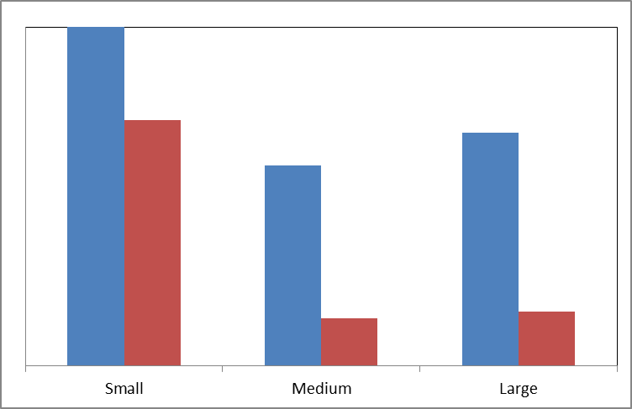
A2: nvPM Emissions Engine Measurements
Impact of Technology on nvPM Mass Emissions for Engines in Different Thrust Class
“old” vs. “new” technology

Slide 9
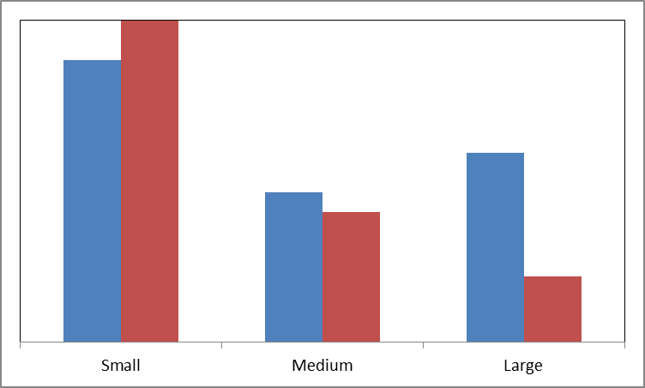
A2: nvPM Emissions Engine Measurements
Impact of Technology on nvPM Number Emissions for Engines in Different Thrust Class
“old” vs. “new” technology

Slide 10
A10: Forecast Technology and Influence of Commercial SST
Define potential demand and develop a forecast supersonic air travel (out to 2050)
3 types of SST
Type1: operate at supersonic speeds in unrestricted areas and subsonic speeds over other areas
Type2: same as Type 1 except has technology to fly at Mach cut-off speeds over prohibited areas.
Uses atmospheric characteristics to prevent sonic booms from propagating to the ground (Mach 1.1 to 1.15)
Type3: aircraft designed to produce very low sonic boom levels during all phases of supersonic flight
Fuel burn, CO₂, H₂O, and if possible NOx, by altitude
Comparison of fuel burn to subsonic traffic
Estimate community & en-route noise impacts

Slide 11
A18: Health Effects of Aviation Emissions
Conduct field campaign to measure ultra-fine particulate matter at airports
Under flight paths using PDARS radar tracks
Perform statistical analysis
Carry out monitor vs. modeling comparisons

Slide 12
A19: CMAQ-based Airport AQ Model Development
NAS-wide AQ modeling + CMAQ DDM 2nd order sensitivity analysis work
Work with BU re UFP monitoring & modeling comparisons
Conduct Northern Hemisphere CMAQ analysis
Gridding Tool Development
Real Weather: WRF and MERRA work
Work with Nation Aviation University in Kiev Ukraine
Attainment-to-nonattainment from aviation emissions

Slide 13
A20: Fast-time APMT-I AQ Model Development (Adjoint)
Adding fine grids:
Canadian + SE Asia + European grid,
Emissions uncertainties work
Conduct multi-scale adjoint modeling
Evaluation of ammonia propagation into tool
Transition from research to operations for tool

Slide 14
A21: Updates to APMT-I Climate Model
Continue tool development
Inclusion of global impacts of regional emissions
Investigate regional damages of regional temperature changes (from CICERO)
Update of contrail impacts beyond fuel burn scaling

Slide 15
A22: Independent Evaluation of APMT-I Climate Model
UIUC to review and evaluate…
Exercise latest version of APMT-I Climate tool
Evaluate inclusion of regional impacts capabilities after review of CICERO memorandum
Review of future contrail updates

Slide 16
A39: CBA of removing Naphthalene from Jet-A
Objective:
Gather and perform analyses regarding reduction and/or removal of naphthalene from jet fuel in a refinery, and then to quantify the public health, global climate change, and economic impacts of reduction and/or removal of naphthalene in jet fuel.
2-year project. Kicked-off in September 2016
Consider changes in both nvPM and sulfur oxide emissions that could accompany the changes in fuel composition.

Slide 17
A48: ICAO/CAEP Engine nvPM Emissions Standard
CAEP/10 agreed to the inaugural engine nvPM Certification Requirement and nvPM Emissions Standard
CAEP/10 Certification Requirement
Standardized nvPM Measurement System
New Appendix 7 to Annex 16 Vol. II
Engine nvPM Emissions Standard
CAEP/10 Standard based on smoke visibility limit
New Chapter 4 to Annex 16 Vol. II
Notes:
It is well known that there is no PM standard for aircraft engines. The first order approximation is used to estimate PM mass concentrations from certification smoke number measurements. It should be noted that the smoke number standard was developed originally as a visibility standard.

Slide 18
The CAEP/10 nvPM Standard
The CAEP/10 nvPM standard enables:
Reporting of certified LTO nvPM mass and number Emission Indices (EIs) for all in-production engines of >26.7 kN rated thrust
Establishment of a regulatory level for the nvPM mass concentration equivalent to smoke number regulatory level. Sets the stage for:
Health and climate relevant nvPM standards
Expected removal of the Smoke Number standard for engines of rated thrust >26.7 kN
Use of standardized nvPM measurement system
Designed for use with existing probe/rake systems and simultaneous operation with gaseous measurement system.
Comparison of engine technology and engine types for nvPM emissions

Slide 19
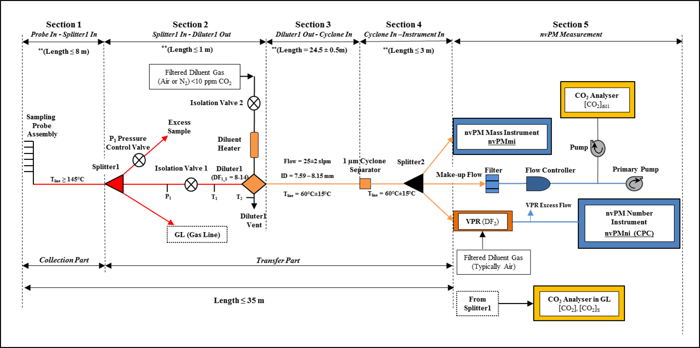
Standardized nvPM Measurement System – Appendix 7
Notes:
While research grade PM sampling systems have been used to acquire nvPM mass and number concentrations, a conceptual non-volatile PM sampling system was developed by January 2011 by SAE E31. The probe is on the left with FS1 indicating the first splitter. Until the first splitter, the particle or gas transfer system remains identical to that of the Annex 16 gaseous sampling system. At the first splitter, there is a 1:3 split with one line continuing on to the Annex 16 system. A PM line connects to an eductor where the PM sample is diluted with Nitrogen to prevent volatile PM from forming. The sample is then taken downstream through a standard length of line through a cyclone in to the mass and number concentration measuring instruments.

Slide 20
nvPM Measurement Systems: Reference and OEM systems
= Reference Systems
FOCA Empa ETH
U.S. Air Force, Arnold Engineering Development Complex

Slide 21
CAEP/11 nvPM Remits
Provide representative engine data for assessing the nvPM emissions standard for mass and number regarding turbofan/turbojet engines ≥26.7kN by February 2017.
Provide recommendations on stringency options and applicability to CAEP Steering Group Sept/2017.
Develop an aircraft engine based LTO nvPM mass and number standard for turbofan/turbojet engines ≥26.7kN.
Investigation the possible replacement of the smoke number standard for engine categories ≥26.7kN and other engine categories <26.7kN.
Develop improved nvPM model inputs to both local air quality models

Slide 22
CAEP/11 LTO Based nvPM Mass and Number Standard Tasks
Full Standard Setting Process in CAEP/11:
Develop metric system
Develop stringency options
Develop technology response
Conduct cost effectiveness analyses
Determine LTO-based nvPM mass and number regulatory levels
Refine and finalize corrections for ambient conditions, fuel sensitivity and engine-to-engine variability
Refine steps to replace SN standard with nvPM mass and number standard based on CAEP/10 nvPM standard

