Slide 1
AEDT Development Plan
Presented to: E&E REDAC Subcommittee
By: Joseph DiPardo and Mohammed Majeed
Office of Environment and Energy
Federal Aviation Administration
Date: February 28, 2017

Slide 2
Outline
AEDT Development Team
AEDT Development Drivers
FY16 Development
  Current status - AEDT 2c SP1
  Continued development
FY17 Development
FY18 Development Plan
  AEDT 3
FY19 and Beyond
Action Item from August REDAC
Summary
2

Slide 3






AEDT Development Team
3

Slide 4
AEDT Development Drivers
Features:
Airspace and airport design (e.g., National Environmental Policy Act (NEPA) reviews, Land Use consideration)
CAEP analyses
  Noise, Emissions (NO_{X}, CO₂, and Black Carbon), Global Market Based Measure (GMBM within CORSIA)
NextGen analyses
  Performance reporting (annual basis)
  Future goals analysis (out to 2050)
  Assessing benefits of NextGen
Technology evaluation (e.g., CLEEN Program)
Usability:
User feedback from AEDT support
Lessons learned from Uncertainty Quantification (UQ) work (ASCENT Project 36)
User survey
4

Slide 5
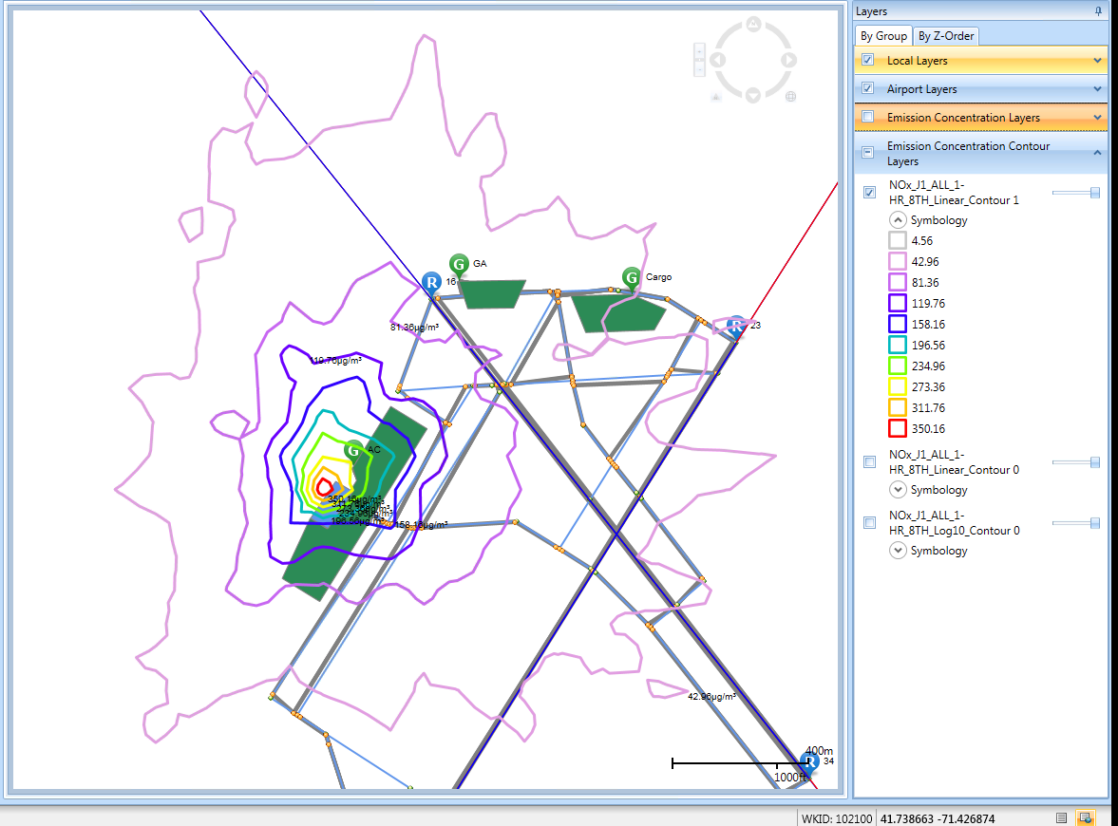
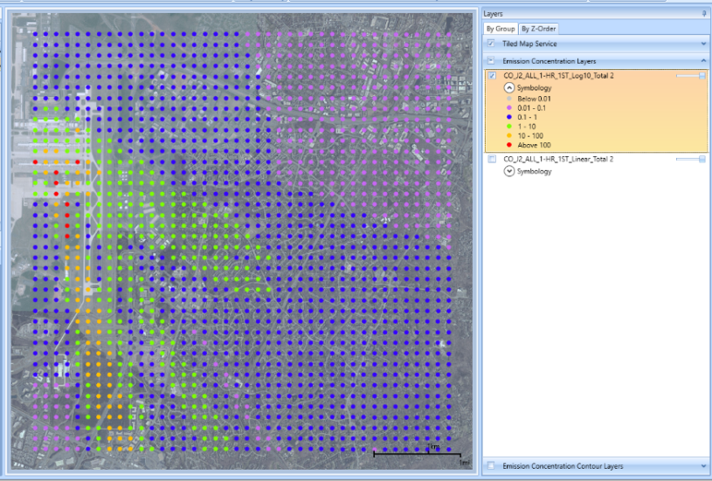
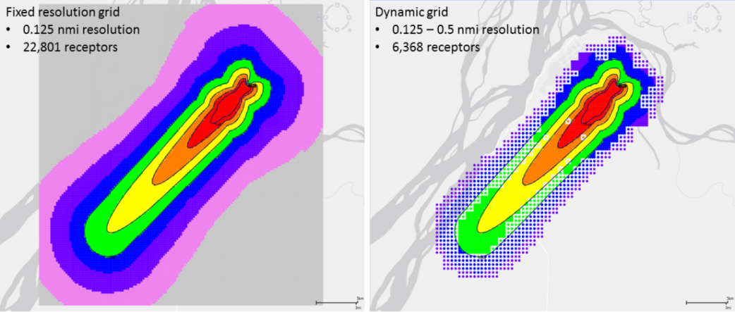
AEDT Current Status – 2c SP1
    Enhanced Emissions Modeling Analysis Capability
      Emissions Dispersion Output Selection
        Matches EPA’s modeling requirements
        Provides flexibility in output selection
      Emissions Concentration Display
        Log-linear for significant conc. gradients
      Improved Input Workflow Allows for more Efficient Modeling
        Expanded Dynamic Gridding to all dB noise metrics
        Provided ability to edit inputs including bulk editing
5

Slide 6
Continued FY16 Development
AEDT 2c SP2 Scheduled for Release March 2017
  AERMOD/AERMET
    Upgrade to the latest EPA version 2016216
    1-hr NO2 dispersion modeling
      EPA’s 3-tiered approach will not be implemented
      Assessment for aviation sources not done yet
  Improved emissions dispersion computational efficiencies
  Detailed grid functionality added to Graphical User Interface
  Multi-version support
CAEP/NextGen Development (not for public release)
  BADA4 with sensor path capability
  Continued non-volatile Particulate Matter (nvPM) enhancements
  High-fidelity weather implementation for MERRA2 & WRF sources
6

Slide 7
FY17 Development Plan (AEDT2c and 2d)
AEDT 2c SP2
AEDT 2d
AEDT 2d SP1
Mar 17
Sep 17
Mar 18
Define airport roadway network in AEDT GUI
Aircraft database updates
  Utilize manufacturer data submittals
Usability Improvements
  Managing and editing Inputs
  Vector tracks
  Backbone tool (restore legacy INM capability)
  Combining contours over different receptor sets
7

Slide 8
FY18 Development Plan (AEDT 3a)
Focus of AEDT 3a will be improved aircraft performance modeling
  Public release of BADA 4 (considered most accurate data source)
  Incorporation of more accurate aircraft profiles
    Aircraft takeoff weight
    Reduced thrust takeoff
    Additional standard procedures
  Improved helicopter performance
Change in performance input data structure
  Higher fidelity performance coefficients
Goal is Release of AEDT 3a by September 2018
  Highly dependent on maturity of research and availability of BADA 4
  Also dependent on noise sensitivity results
8

Slide 9
Base of Aircraft Data (BADA)
Database and methodology developed and maintained by EUROCONTROL with input from the aircraft/engine manufacturers
Designed for simulation and prediction of aircraft trajectories
  BADA can provide fuel burn but not noise or emissions
Most current public version of BADA is 3 series (v13)
  Intended for cruise; not accurate for terminal area
  Public version of AEDT uses Aircraft Noise and Performance (ANP) and certification data for terminal area and BADA3 for cruise.
Most current version of BADA is 4 series (v2)
  High fidelity aircraft model (thrust, lift, drag)
  Includes terminal area data (excluding ground roll)
  More accurate than ANP in terminal area
  Currently not publicly available (AEDT use only approved for CAEP and NextGen analyses)
9

Slide 10
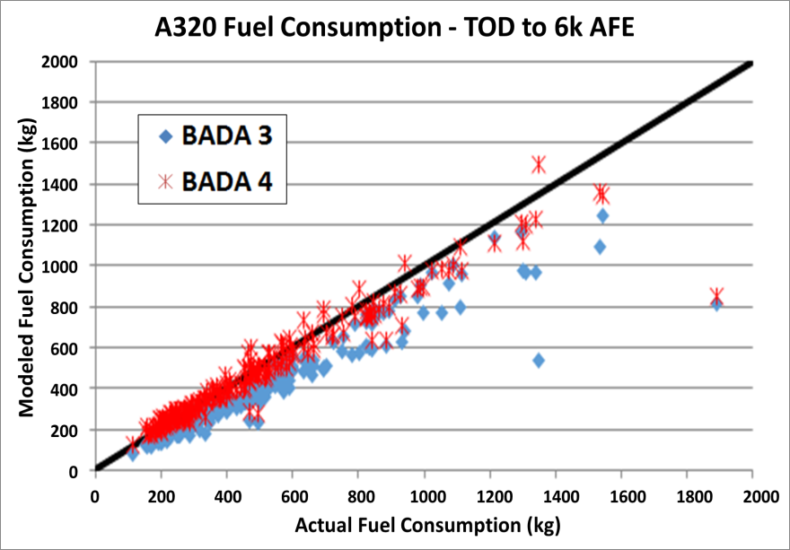
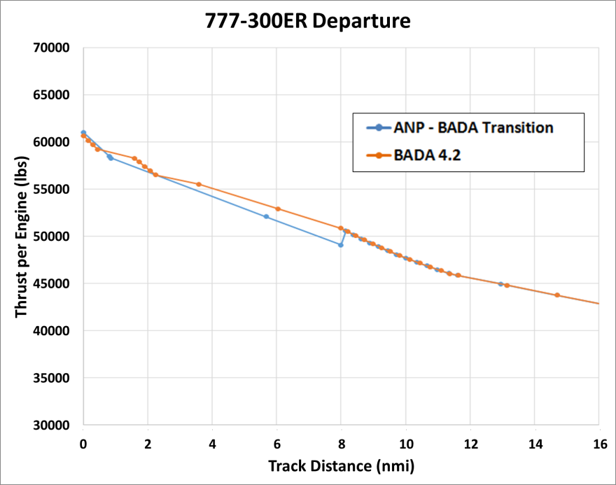
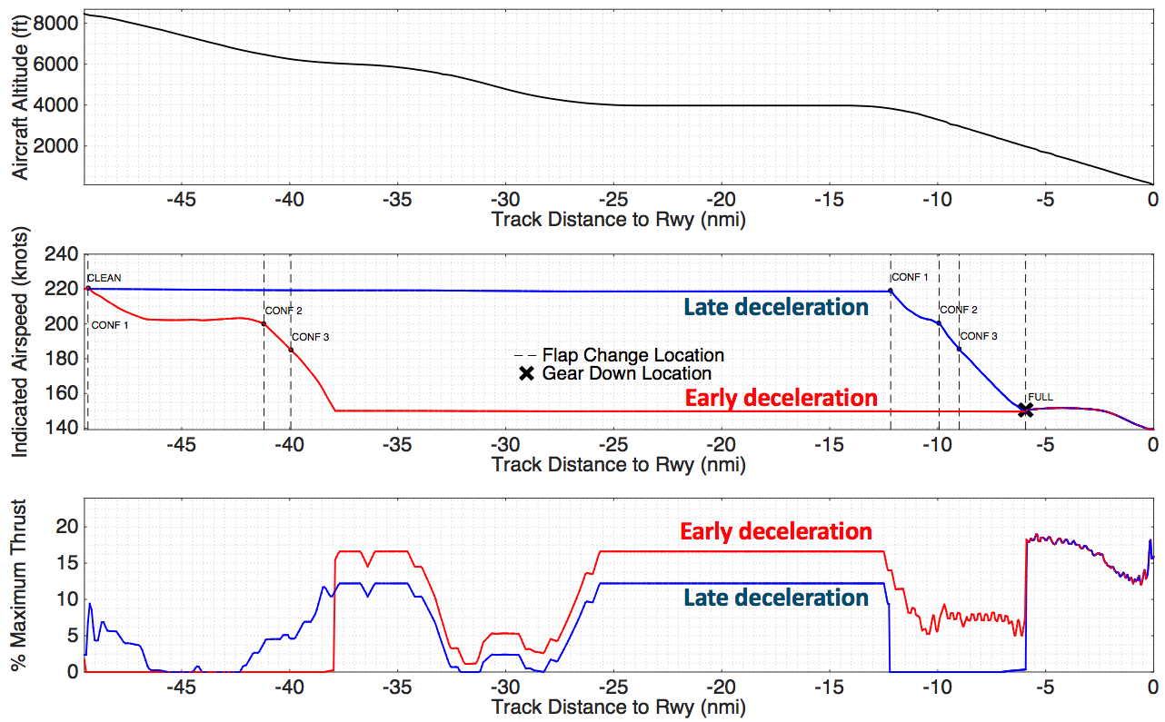
BADA 4: Improved Performance for AEDT Modeling
BADA 4 will improve accuracy of fuel burn calculation below cruise.
  Necessary for NextGen procedure benefits analysis
BADA 4 allows for one performance model runway to runway, eliminating data mismatches between performance models.
Higher fidelity BADA 4 performance data will allow for more detailed procedure modeling
  Captures configuration and speed changes of advanced operational procedures
1.
Altitude (ft)
3.
2.
Airspeed (KIAS)
% Thrust
10

Slide 11
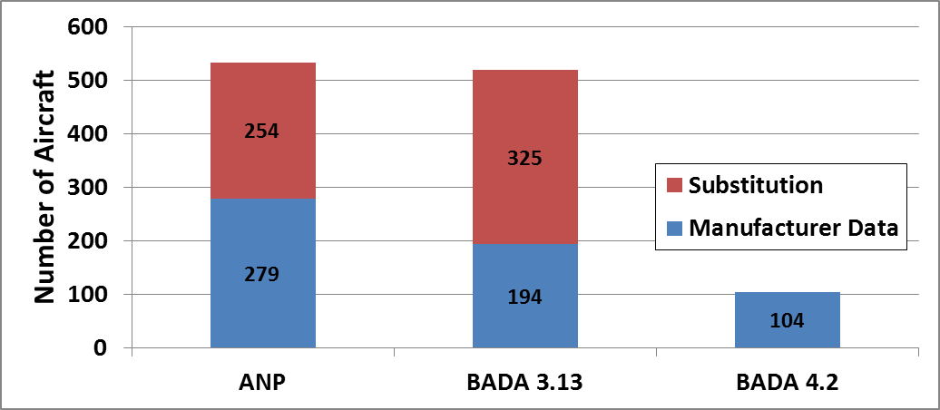
BADA 4: Technical Issues
Aircraft fleet coverage
Sensitivity Analyses
  Determine path forward for modeling substitutions with BADA 4
  Determine effects of using BADA 4 performance on noise results
Updates to existing recommended practices
  Intend to update SAE-AIR-1845 and ICAO Doc 9911
11

Slide 12
BADA 4: Challenges and Potential Alternatives
Challenges
EUROCONTROL and manufacturers will need to agree to make BADA 4.2 publically available
Legal hurdles in current BADA agreement must be overcome
Alternatives
Build a data set like BADA 4 (Total Energy Model)
  Requires support from manufacturers who may be reluctant
  Intellectual property concerns if outcome is too similar to the work done by EUROCONTROL
Expand ANP data collection process to include higher fidelity data
  Burden on manufacturers to provide additional data
Clean sheet environmental aircraft performance model
  Increased detail for engines (improves emissions and noise estimation)
  Leverages existing work by universities
  Major long-term effort
  Still reliant on manufacturers for validation
12

Slide 13
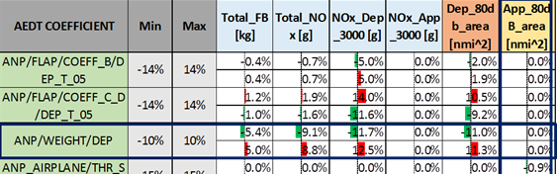
AEDT3a: Improved Aircraft Takeoff Weight
AEDT Stage Length method underestimates takeoff weight (ASCENT 35)
10% variation in weight can lead to roughly 5% variation in fuel burn and 11% variation in noise (ASCENT 36)
Updating Load Factor Assumptions will improve weight estimation (ASCENT 45)
ASCENT Project 35
ASCENT Projects 36 and 45
13

Slide 14
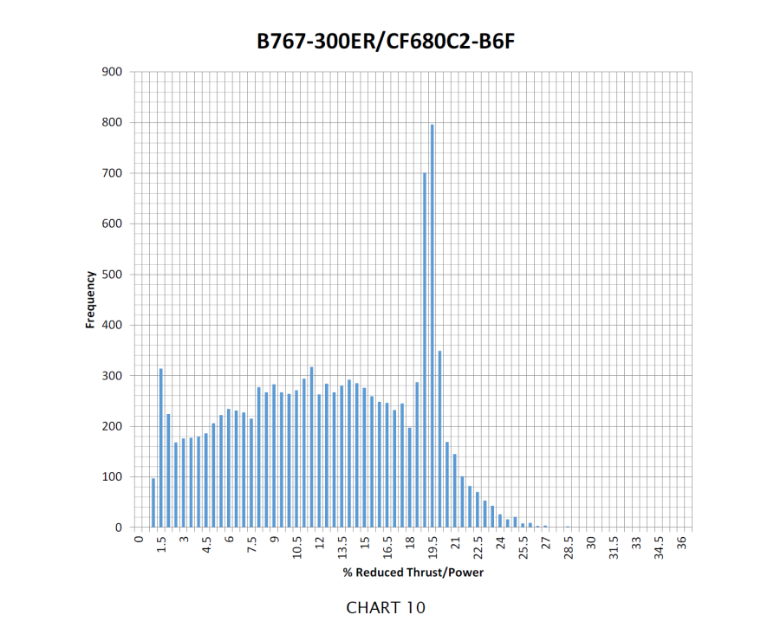
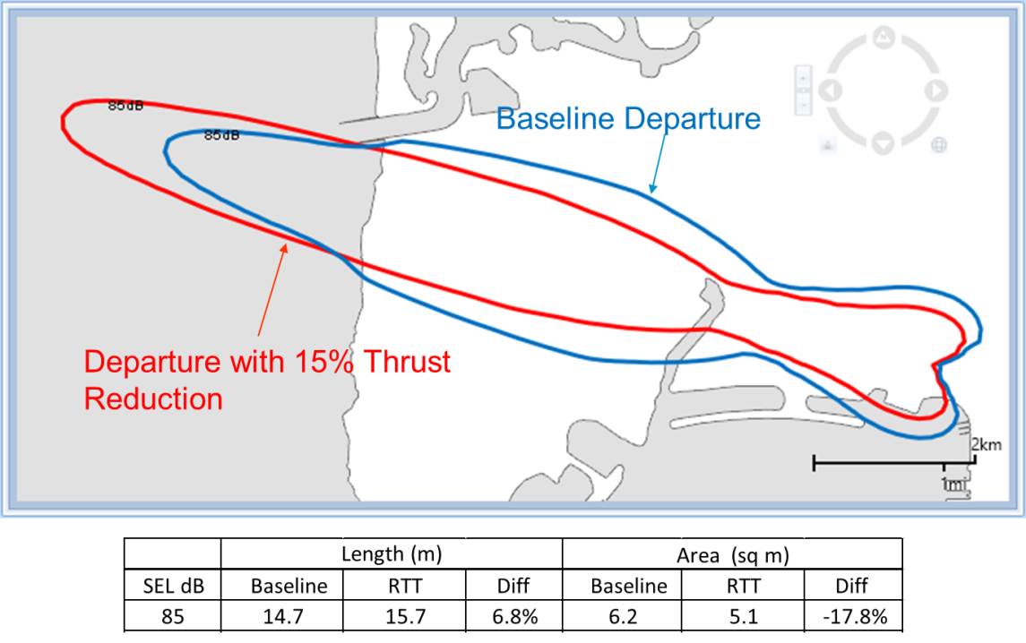
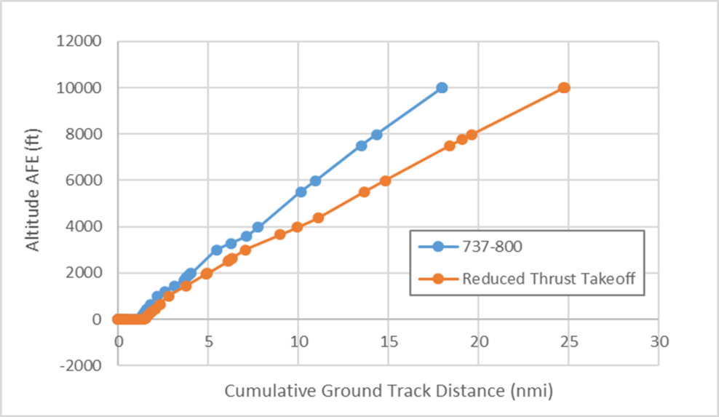
AEDT3a: Modeling Reduced Thrust Takeoff
ASCENT Project 35
Reduced Thrust Takeoffs are standard practice to reduce engine wear
Current environmental modeling assumes full power takeoff
Increasing demand from user community to model reduced thrust
ASCENT Project 45
Baseline
14

Slide 15
Standard Procedures in AEDT
Standard profiles most common for regulatory modeling
  Assumes 100% power at takeoff
  Continuous 3-deg approach (most cases)
Option for user-defined profiles with FAA approval
Fidelity can be improved by additional Standard profiles (ACRP 02-55)
Issues:
  Should Reduced Thrust be Standard for Regulatory Modeling?
  What Level of Reduced Thrust Should be Modeled?
  How much Flexibility Should be Given to the User?
LOW
Fidelity/Resources
HIGH
Existing STANDARD Profiles
Profile Customization Tool
User Defined Profiles
SensorPath
ACRP 02-55
Additional STANDARD Profiles
Altitude Controls
15
15

Slide 16
AEDT3a: Helicopter Performance Modeling
Goal
  Improve helicopter performance modeling, stop using obsolete mode-based methods
Approach
  Current methods use hard-wired 85% power for fuel flow – all speeds, weights, altitudes and flight regions
  New Rotorcraft Performance Model (RPM) is physics-based: power requirements from weight, speed, altitude determine fuel flow
  Source data availability
    When OEM data are not available, use NASA performance models to generate data
16

Slide 17
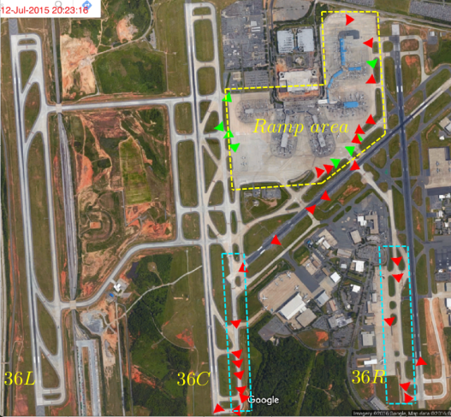
FY19 Development Plan (AEDT 3b)
Improved taxiway modeling
  ACRP 02-27 Aircraft Taxi Noise Database for Airport Noise Modeling
    develop a NPD and spectral class database for nominal taxi, break-away, and idle thrust levels
  ASCENT 46 Surface Analysis to Support AEDT APM Development
    Develop statistical models of taxi performance (from FDR and ASDE-X data) that are representative of a wider range of taxi conditions, aircraft types, airports, airlines, and weather conditions
Re-evaluation of ESRI
  Investigate open source GIS software as alternative to ESRI GIS
17

Slide 18
AEDT 3 Development Timeline
ACRP 02-41 Estimating Takeoff Thrust (July 2014)
ASCENT 35 Airline Flight Data
Aug ‘15 - Aug ‘16
ACRP 02-55 Enhanced AEDT Modeling of Arrival and Departure
June ‘14 - June ‘17
ASCENT 45 Takeoff/Climb Analysis
Aug ‘16 - Aug ‘17
Implementation of Research Results
Aug ‘17 - Sep ‘18
Helicopter Performance Modeling
Mar ‘18 - Sep ‘18
BADA 4 Performance for NextGen (Sensor Path)
July ‘16 - June ‘17
Analysis of BADA 4 Aircraft Coverage
Mar ‘18 - Sep ‘18
BADA 4 Noise Implementation and Analysis
June ‘17 - Sep ‘18
Agreement for Public Release of BADA 4.2
Nov. ‘16 – Sep. ‘18
ACRP 02-27 Aircraft Taxi Noise Database for Airport Noise Modeling (March 2013)
ASCENT 46 Surface Analysis to Support AEDT APM
Implementation of Research Results
Aug ‘16 - Aug ‘17
2015
2016
2017
2018
2019
Q1
Q3
Q1
Q3
Q1
Q3
Q1
Q3
Q1
Q3
December 22
December 19
SP2
SP1
July 29
June 13
March 13
March
March
FP1
SP3
SP2
SP1
SP1
May 29
September 14
September
September
September
AEDT 2b Released
AEDT 2c
AEDT 2d
AEDT 3a
AEDT 3b
18

Slide 19
FY20 and Beyond (AEDT 4)
Higher fidelity noise characterization
  Utilize improved aircraft performance from BADA 4
  Develop analytical techniques to capture airframe noise (ASCENT 23)
  Develop NPD + configuration (NPDC) format that enables more accurate noise prediction due to aircraft configuration and speed changes (ASCENT 43)
Incorporate improved version of AERMOD for local-scale airport air quality modeling
Include capabilities to model supersonic aircraft
19

Slide 20
Action Item from August 2016 Meeting
Examine the sample problems for AEDT and see if they could be augmented with additional simple problems of interest.
  AEDT currently has six sample studies that cover both airport level and regional studies for noise, emissions and fuel burn metric results.
  AEDT website contains training materials including study development exercises.
  Current AEDT sample problems can be augmented with study results from the AEDT training exercises to provide simpler and more basic study examples.
20

Slide 21
SUMMARY
FY16 – FY17 development supports continued feature and usability improvements for AEDT 2 series
  Also developing non-public features to support CAEP nvPM and NextGen FB analyses
FY18 – FY19 will develop AEDT 3 series
  Focus of AEDT 3 will be improved fidelity and accuracy of aircraft performance
Significant hurdles to overcome
  Availability of BADA 4 (or equivalent)
  Usage agreements
Maturity of research and data availability will determine AEDT 3 development timeline
Providing direction for FY20
21

