Slide 1
AEE Operations Research Program Overview/Status
Presented to: REDAC E&E Subcommittee
By: Chris Dorbian, AEE-4
Date: March 1, 2017

Slide 2










The Five Pillar Approach
Science and Tools
Technology
Alternative Fuels
PILLAR 1: Improved Scientific Knowledge and Integrated Modeling
Decision-making based on solid scientific understanding
Work with research community through the Aviation Sustainability Center (ASCENT)
Understand public health and welfare impacts
Incorporate this knowledge within the Aviation Environmental Tool Suite
PILLAR 2: New Aircraft Technologies
Offer the greatest opportunity to reduce environmental impacts
Partner with industry, research community, NASA, and Department of Defense
Mature new engine and airframe technologies through the Continuous Lower Energy, Emissions and Noise (CLEEN) Program
PILLAR 3: Sustainable Alternative Aviation Fuels
Reduce environmental impacts, enhance energy security, and provide economic benefits
Collaborate with stakeholders through the Commercial Aviation Alternative Fuels Initiative (CAAFI)
Test alternative jet fuels to ensure they are safe for use through ASCENT and CLEEN
Analyze their potential for reducing the environmental impacts of aviation
Operations
Policy
PILLAR 4: Air Traffic Management Modernization and Operational Improvements
Increase efficiency of aircraft operations through the Next Generation Air Transportation System (NextGen)
Engage with industry, research community, NASA, and Department of Defense
Develop advanced operational procedures to optimize gate-to-gate operations
Integrate infrastructure enhancements to the National Airspace System (NAS), improving environmental performance
Calculate the environmental benefits of air traffic management modernization and operational improvements,
PILLAR 5: Policies, Environmental Standards, and Market Based Measures
Implement domestic policies, programs, and mechanisms to support technology and operational innovation
Develop and implement aircraft emissions and noise standards
Work within the International Civil Aviation Organization (ICAO) to pursue a basket of measures to address emissions that affect climate, including a global market based measure as a gap filler
Seek international partners to further our environmental and energy strategy
http://www.faa.gov/nextgen
http://www.caafi.org
http://www.faa.gov/go/cleen
http://ascent.aero

Slide 3
Program Goals
AEE E&E Air Traffic Management Modernization (ATMM) Research
Identify and accelerate the implementation of air traffic management concepts that will reduce aviation environmental impacts and/or improve energy efficiency
Investigate the energy and environmental effects of operational changes implemented by the FAA.
Transition research for implementation
Key Program Elements
  Maintain linkages to AEE Tools/Analysis Roadmap, Noise Research Roadmap, and Emissions Research Roadmap
  Maintain balanced research portfolio targeting all phases of flight and all environmental aspects
  Coordinate/collaborate with ATO, ARP, ANG, NASA, etc.

Slide 4
Contents
Noise Focus
Fuel/Emissions Focus
Modeling/Tools Focus

Slide 5
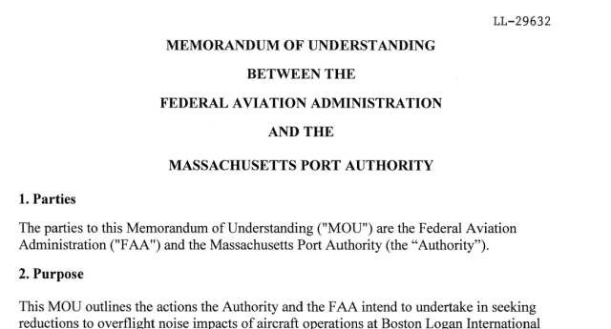
Multiple Efforts Underway to Develop Noise-Mitigating Operational Procedures
ASCENT-23
Developed analytical framework for assessing operational procedures
MIT
FAA–Massport MOU
(BOS case study; FAA
collaborative effort on Noise)
Industry/Gov’t. Collaboration
Potential industry collaboration
Potential NASA Research Transition Team (RTT)
“Toolbox” of procedures & procedural changes to mitigate noise
ATO Mission Support Services (AJV) “Low Altitude PBN” Research (performed by MITRE)
Airport Technology Research Projects (ARP-AEE collaboration)
Flight Management System enhancements (CLEEN)
Notes:
RTTs ensure NASA research needed for NextGen is identified, quantified, conducted, and effectively transferred to the FAA

Slide 6
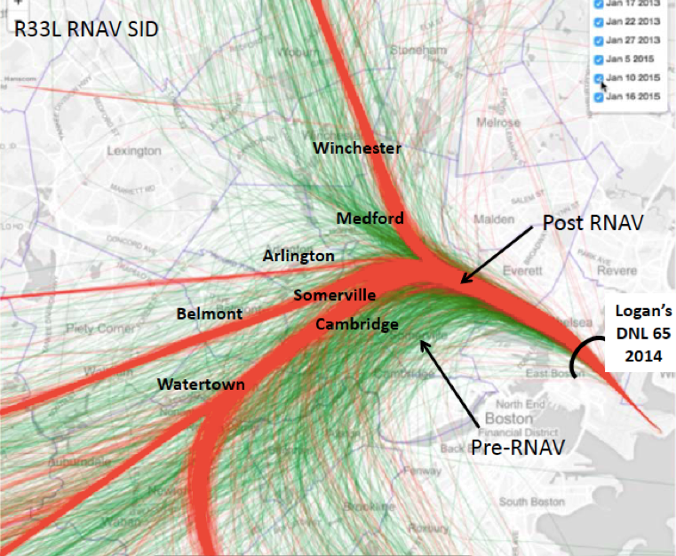
Recent MOU Activities
Outreach and consultation with FAA New England Region, ATO, and AEE
Met with airline technical pilot representatives about feasibility of different operational noise mitigation strategies at BOS
  Participants: JetBlue, United, Delta, American
  Outcomes: Feasibility and feedback on candidate arrival and departures
Elected official outreach meetings - Identified need for additional community input
Analyzed pre/post RNAV noise complaint data from Massport
Analyzed pre/post RNAV flight tracks at BOS to understand procedures and neighborhoods impacted by concentration effects

Slide 7
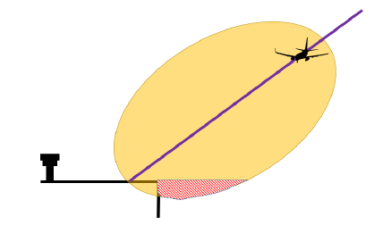
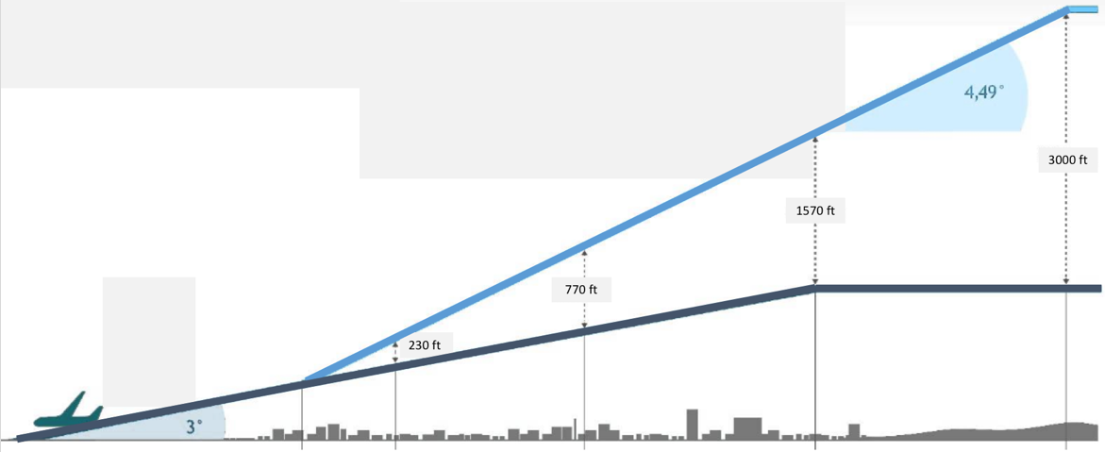
Operational Procedures Under Consideration
Precision navigation
  Early turn after takeoff
  Reduced separation with arrival flows
  Waypoint relocation
  Overflight of areas with high ambient noise (e.g., highways
Departure
  Climb speed/thrust/profile management (noise abatement departure procedures)
  Dispersion of departure trunk routes
Approach
  Steep approaches, segmented approaches, and displaced landing thresholds
  Low power / low drag approaches
Continuous Descent Approach (CDA)
Delayed Deceleration Approach (DDA)
Community Exposed to Noise
Steeper Approach & Displaced Threshold
Source: Boeing
Two-Segment Steep Approach
Figure adapted from Frankfurt Airport Community Information Center
Noise Abatement Departure Procedures
Source: The Orange County Register

Slide 8
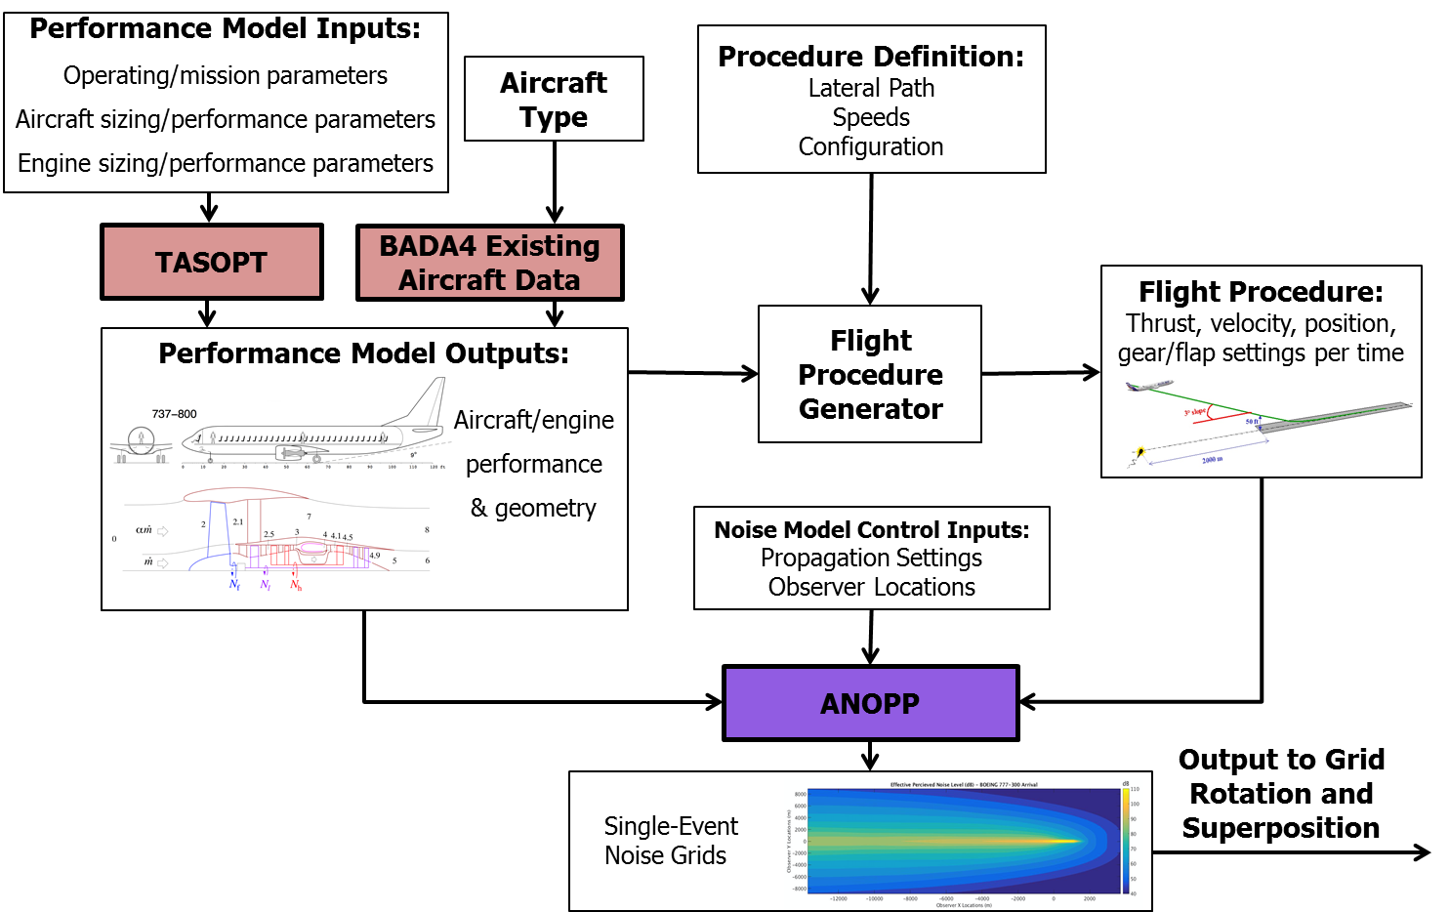
ASCENT-23: Analytical Approach for Quantifying Noise from Advanced Operational Procedures
Notes:
Physics-Based Noise Analysis Framework

Slide 9
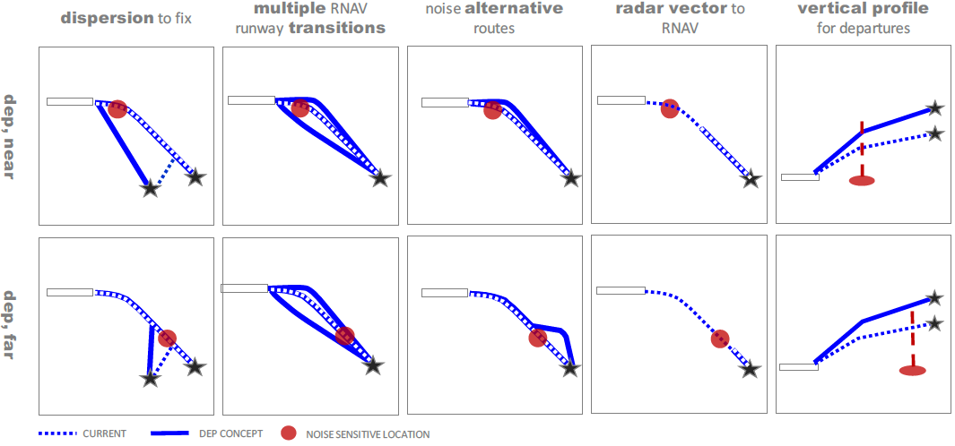
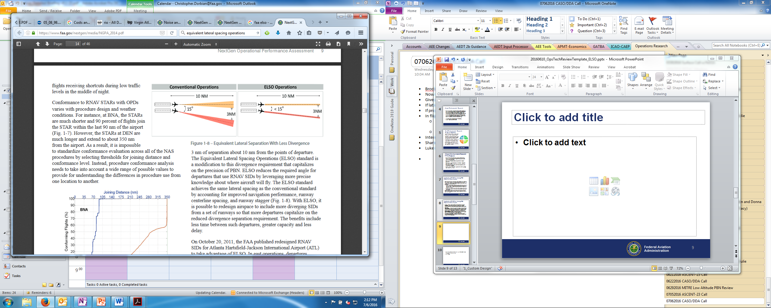
AJV Low Altitude PBN Research
AEE is monitoring and coordinating with AJV project being conducted by MITRE
Site-specific concept development using near-term candidate concepts (primarily dispersion techniques)
Also exploring applicability of Equivalent Lateral Spacing Operations (ELSO) standard for noise dispersal (ATR funded)
  Examine operational scenarios for ELSO
  Develop process for identifying noise-optimal headings
  Assess noise, fuel, emissions, and throughput tradeoffs
Source: MITRE CAASD

Slide 10
Future Research
Airport Technology Research (planned FY17)
  Noise Abatement Procedure Usage and Effectiveness
    Assess utilization and impact of current noise abatement procedures (e.g., as laid out in airport-specific Standard Operating Procedures)
  Steeper Noise Abatement Approach Operational Feasibility
    Understand operational constraints and tradeoff considerations
    Understand aircraft performance / FMS / TERPS dependencies
Industry/Gov’t. collaboration (NASA, UPS, …)
FY19+ NextGen RE&D above target request:
  Accelerate the maturation of low noise aircraft technologies and noise mitigation techniques for new arrival and departure concepts that could reduce community noise exposure
Notes:
Drafting research memos now

Slide 11
Contents
Noise Focus
Fuel/Emissions Focus
Modeling/Tools Focus

Slide 12
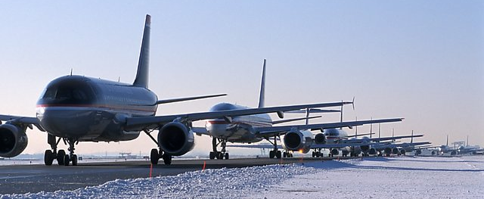
Investigation and Support of Integration of Departure Metering Concepts into Surface Capabilities
Motivation:
Potential to mitigate
adverse environmental
impacts of surface
congestion
Concept:
Departure metering is critical element of surface congestion management
Departure metering needs to be more effectively integrated into broader “gate-to-gate” traffic management programs, e.g. Terminal Flight Data Manager (TFDM), Traffic Flow Management System (TFMS), Time-Based Flow Management BFM), Surface Collaborative Decision Making (S-CDM), etc.

Slide 13
Current Activities
Exploring impact to S-CDM ConOps and estimated benefits of:
Specific departure metering
algorithms
  Fast-time simulations
  for CLT operations
  Characterize airport dynamics
  with/without metering
Availability and quality of
airline-derived data
  E.g., EOBT, Gate information (departures and arrivals)
Synthesize findings and implications for relevant programs
  NASA ATM Technology Demonstration-2 (ATD-2) activities at CLT
  TFDM assessment of non-movement area dynamics at core airports
  RTCA Surface NextGen Integrated Working Group

Slide 14
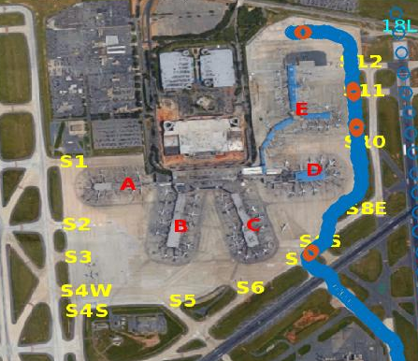
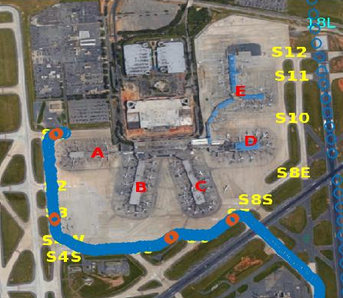
Modeling Complex Ramp Operations: Current Picture at CLT
Departures (minutes) | Runway configuration
 | North-flow | South-flow
Avg. gate to spot time | 10.2 | 11.9
Avg. spot to takeoff time | 11.0 | 8.0
Avg. total taxi-out time | 21.2 | 19.9
Arrivals (minutes) | Runway configuration
 | North-flow | South-flow
Avg. runway to spot time | 4.4 | 5.2
Avg. spot to gate time | 5.8 | 6.2
Avg. total taxi-in time | 10.2 | 11.4
Analysis of current operations shows significant holding in ramp area, especially near spots
Makes push-back time ⬄ Target Movement Area entry Time (TMAT) determination challenging
Indicates accurate ramp area modeling critical to departure metering at some airports
Notes:
Developing and validating fast-time simulations of CLT ops for algorithm design and departure metering benefits assessment
Develop mapping between target spot times and target push-back times

Slide 15
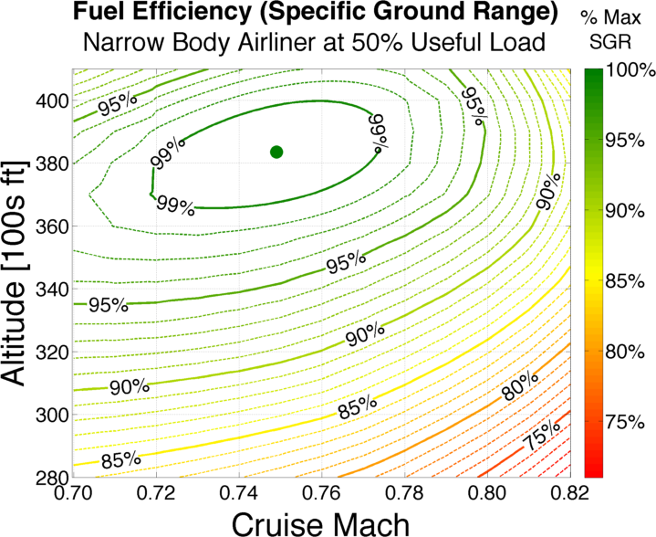
Cruise Altitude and Speed Optimization
Fuel burn reduction important for
airlines, regulators, and society
2012 Radar analysis shows 56% of domestic flight time spent in high-altitude cruise
Typical airliner cruise conditions are not fuel-optimal with respect to speed and altitude
  Opportunities in flight planning, dispatch, and cockpit procedures
  Potential applications in NextGen ATM systems and workflows
Typical Narrow Body Jet Efficiency Contours
Typical Operating Regime
(fast,
off-optimal alt)
Optimal Mach/Alt

Slide 16
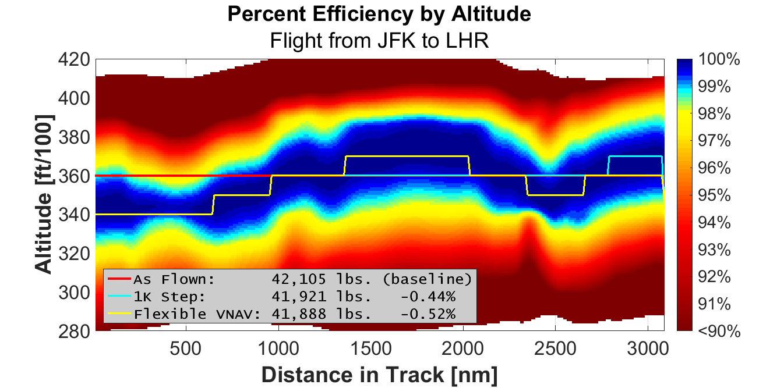
Optimal Altitude Tunnel Information in the Cockpit
Access to “Altitude Tunnels” could be useful to pilots, provide a graphic depiction of efficiency information not normally available in-flight
A decision support tool (DST) in the cockpit (showing a variant of the efficiency tunnel) could improve cruise planning capability

Slide 17
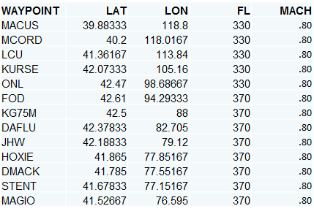
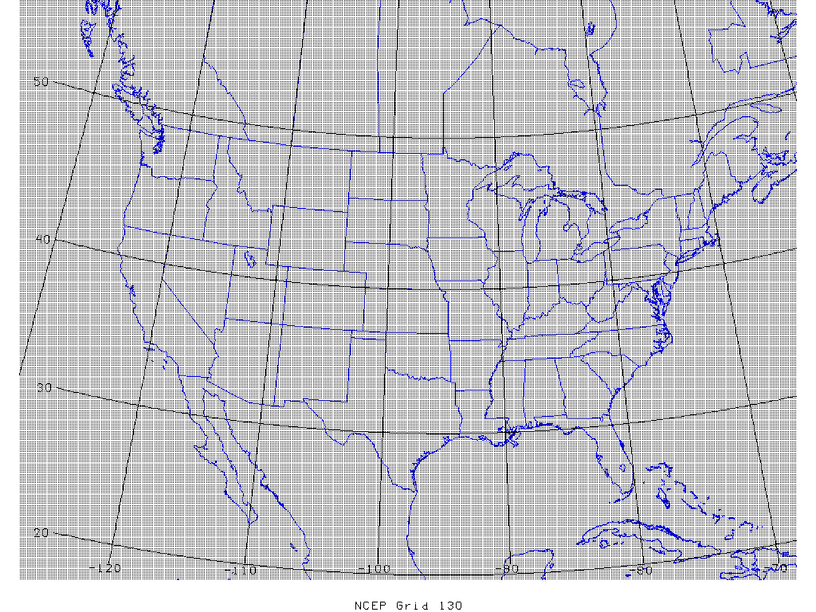
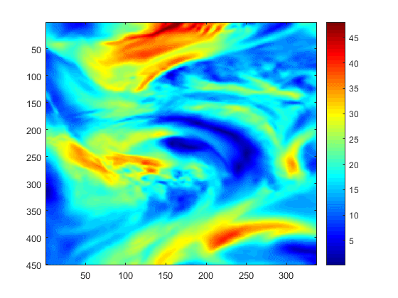

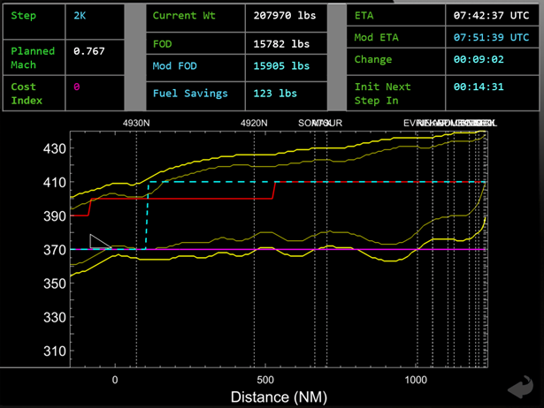
Cruise Optimization DST
Prototype laptop-based DST being developed to aid discussion with airline operations experts and pilots
  Objective: To identify opportunities, limitations, and practical considerations for altitude optimization in airline operations
Interactive laptop program using current weather and representative performance data
Aim to demonstrate working prototype in passenger cabin
  In-flight entertainment system Wi-Fi for downloading data
Stand-alone, portable unit
  No access to aircraft instruments / databus needed
Find opportunities for wider demonstration and evaluation
Tool will already be operational to aid discussions
  Adaptable to increased sophistication / for specific operators
Could eventually be ported to a tablet-based application
Preloaded / Inflight Wi-Fi

Slide 18
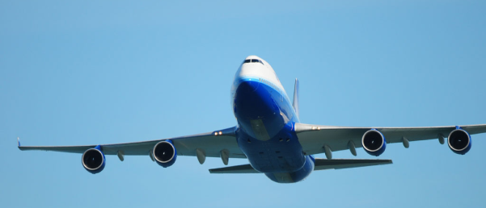
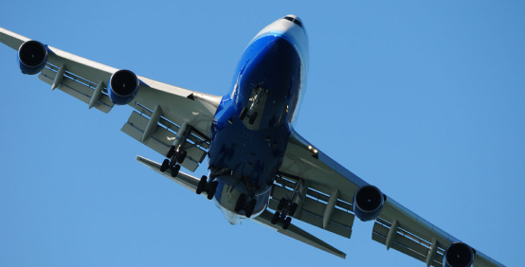
Delayed Deceleration Approach (DDA)
Keep aircraft “clean” for longer on approach when appropriate without impacting terminal area entry or final approach stabilization criteria
  Between these speed gates,
  opportunity for
  encouraging more
  efficient approach
  speed profiles
“Clean” configuration
230-250
kts IAS
Airspeed
160-180
kts IAS
“Dirty”
configuration
≈30 nmi
Distance to Touchdown
≈10 nmi

Slide 19
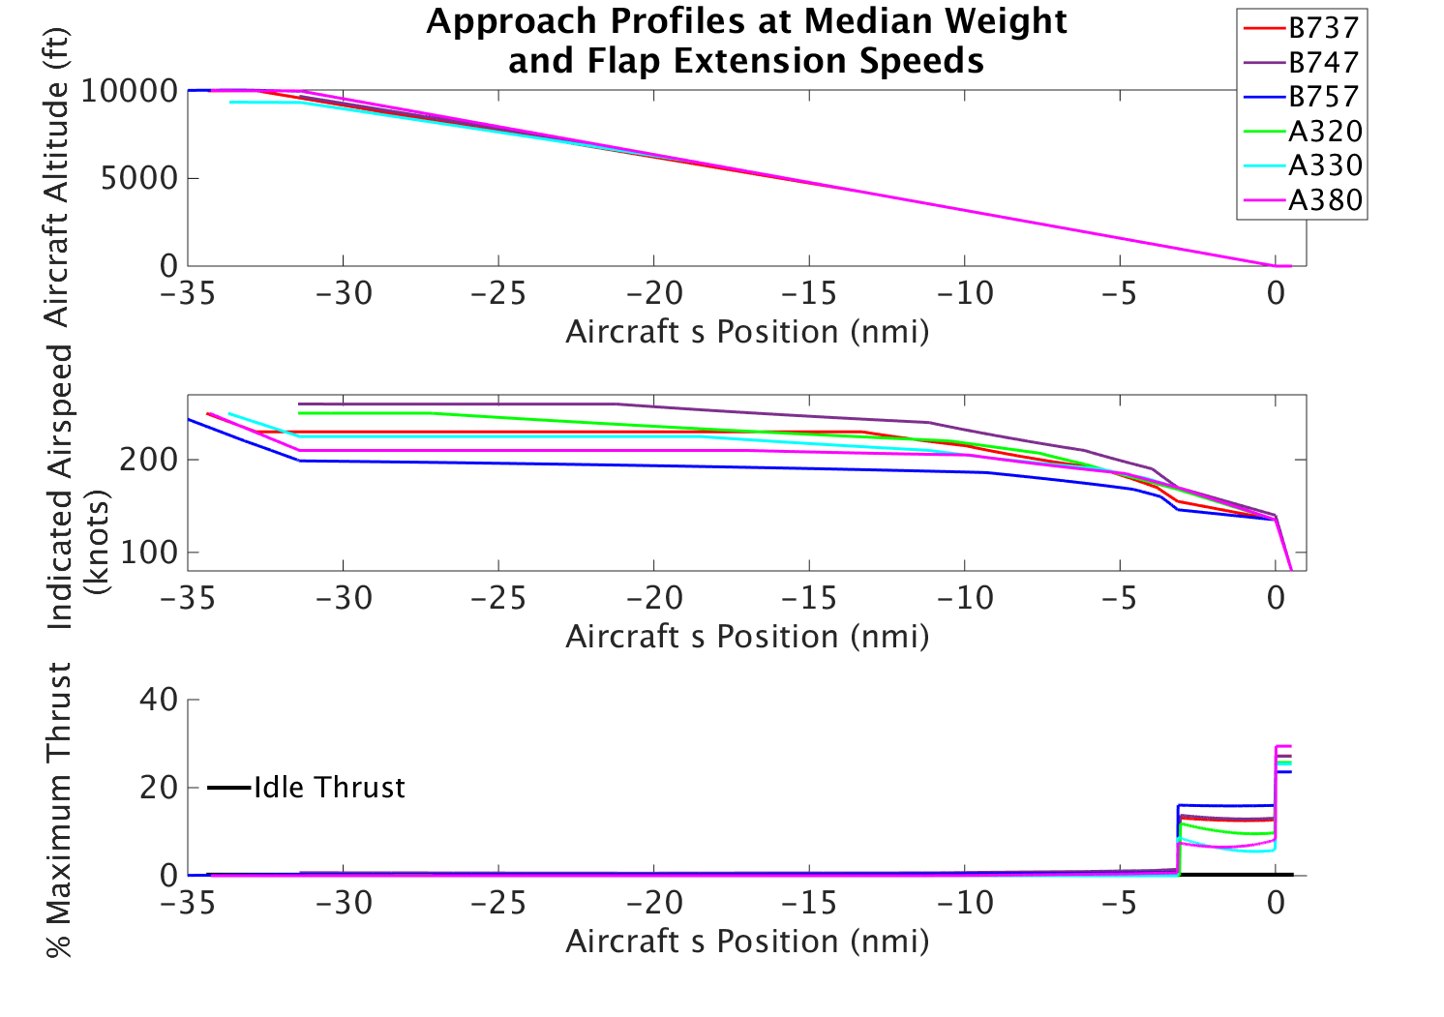
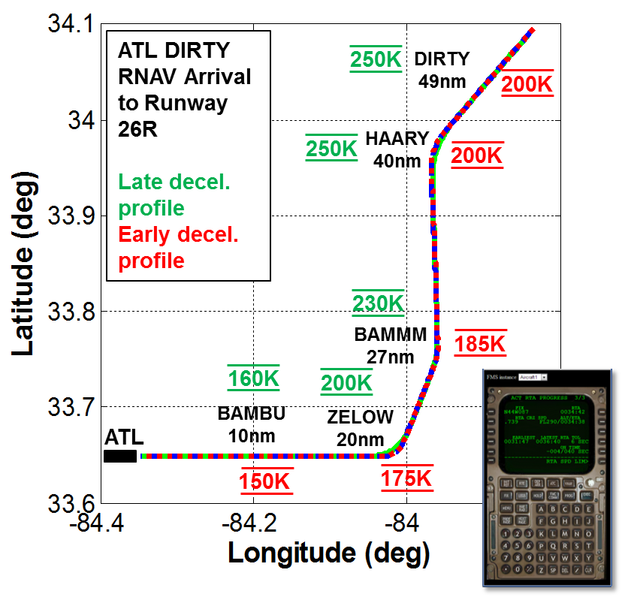
Exploring DDA Integration into RNAV Arrival Procedures
DDA potentially implementable through tailored speed targets in RNAV procedures, but need to account for range of aircraft deceleration profiles
Notes:
We’ve shown the speed profiles at airports and a method to analyze what’s driving the speed profiles.
Once we’ve identified candidate airports, we’ll use this method for developing procedures.
This gives us a tool to test various speed targets and the feasibility of them.
Without RNAV controllers/pilots have to plan for the worst case because uncertain of the distance to touchdown.

Slide 20
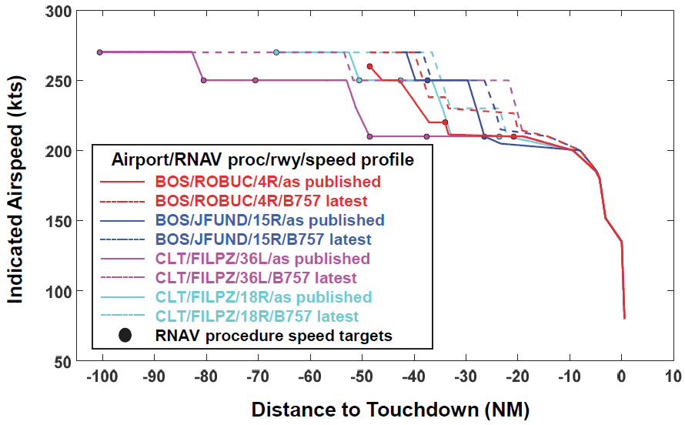
Assessing RNAV Procedure Speed Targets
Some procedures are better candidates than others for DDA-enabling speed target modification
Similar analysis could be used as a screening tool to identify DDA opportunities, or be used during the procedure design process to ensure efficient speed profiles

Slide 21
Contents
Noise Focus
Fuel/Emissions Focus
Modeling/Tools Focus

Slide 22
Modeling Projects Related to Operations Research
Project Title | Objective(s)
ASCENT-43: Noise Power Distance Re-evaluation | Understand sensitivity of aircraft configuration changes and speed on resulting noise contours Physics-based recommendation on format of NPD + Configuration Curves for use in AEDT
ASCENT-45: Takeoff/Climb Analysis to Support AEDT Aircraft Performance Model (APM) Development | Assess current modeling gaps within APM and collect relevant research Develop recommendations for improving AEDT to better represent real-world takeoff weight and thrust
ASCENT-46: Surface Analysis to Support AEDT APM Development | Identify and evaluate methods for improving taxi performance modeling in AEDT in order to better reflect actual operations

Slide 23
Summary
Diverse portfolio targeting multiple flight phases and environmental impact areas
  Increasingly focused on noise
Seeking to understand E&E benefits, operational applications, and barriers to implementation
Actively coordinating with other organizations:
  AEE-ARP environmental research collaboration
  Noise efforts being shared across lines of business
  Seeking increased industry and interagency collaboration

Slide 24
Questions?

