Slide 1
Modeling &
Tools Update
Presented to: E&E REDAC Subcommittee
By: Fabio Grandi
Office of Environment and Energy
Federal Aviation Administration
Date: March 1, 2017

Slide 2
Outline
Tools and analysis roadmap
Updates on R&D and Analysis
  FLEET-Builder
  ASCENT Projects
  Internal AEDT activities
Analysis coordination efforts
Action item: encroachment analysis
Summary
2

Slide 3
tools and analysis,
Roadmap
Overview

Slide 4
Tools and Analysis Roadmap
LEGEND
Milestone, Interim deliverable/report
Final deliverable/report
Analysis Tools

Slide 5
R&D and Analysis
Updates on

Slide 6
R&D and Analysis Efforts
Details provided in this briefing
FLEET-Builder development
Tools related ASCENT projects
Internal AEDT development and testing
Covered elsewhere in briefings
AEDT
Alternative fuels analysis (covered in alt fuels briefing)
Operations modeling (covered in ops research briefing)
Not covered during this meeting
APMT-Impacts
ASCENT projects without direct AEDT link
6

Slide 7
FLEET-Builder
FLeet Evolution, Estimation and evaluaTion Builder
Ongoing Development Status Update

Slide 8
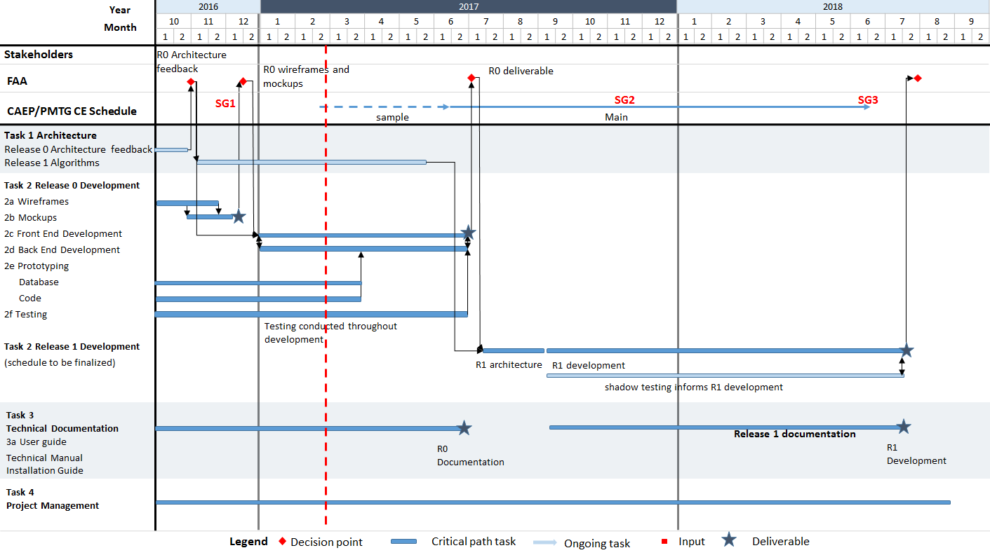
FLEET-Builder Requirements
Use generic fleet and traffic demand forecasts as inputs to:
  Develop and allocate fully-defined fleets
  Generate projected AEDT-compatible schedules of operations assigned to specific aircraft
  Generate associated airline industry operating costs data
  Estimate associate fuel and emissions data
Allow the user to:
  Explore fleet-related policy scenarios, including analyses that alter the relative importance of aircraft properties in the fleet allocation process, vary geographical scope, vary criteria by market, vary environmental performance, etc.
  Generate AEDT-compatible data, upload bulk data inputs, execute efficiently, provide document set-up functionality for transparency

Slide 9
Data and Algorithm Flows
Base Year Data (e.g. 2015 Fleet and Operations)
System Reference Data (e.g. Operators, Airports)
Structural Input Data (e.g. Distance Band, Route Groups)
Feet Evolution Data (e.g. Forecast, Replacement Fleet)
Results Input Data (e.g. Load Factor, Fuel Price)
Data
1. Initialize
2. Error checking
3. Fleet evolution
4. Results
Load the base data according to the analyses parameters
Verify the integrity of the user and system scenario inputs
Starting from the baseline evolve the fleet and operations for each unique analysis, year, and operator
Output the economic, fuel, and emissions results
Algorithm

Slide 10
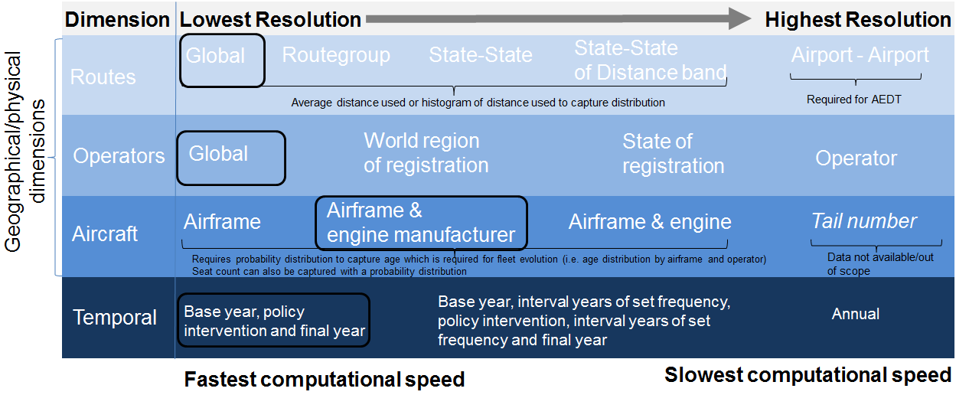
FLEET-Builder Flexibility: Data Resolution vs. Computational Speed
CAEP Spreadsheet Model Data Resolution
The tool was specifically developed for use in CAEP and provides a fixed low resolution capability in a simple to use and fast executing format

Slide 11
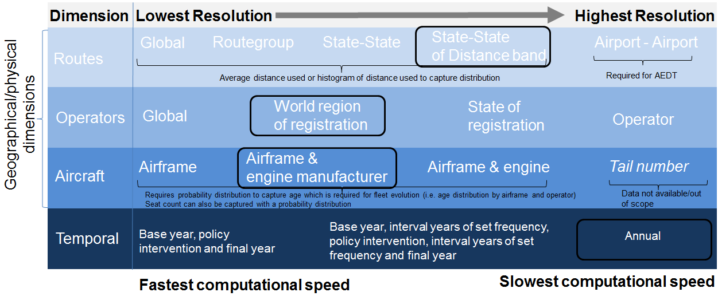
FLEET-Builder Flexibility: Data Resolution vs. Computational Speed
APMT-E Data Resolution for CAEP/10
The tool provides a higher resolution capability, but the difficult and time consuming set-up and reconfiguration procedures along with no AEDT-compatible outputs limited its use to CAEP analyses only

Slide 12
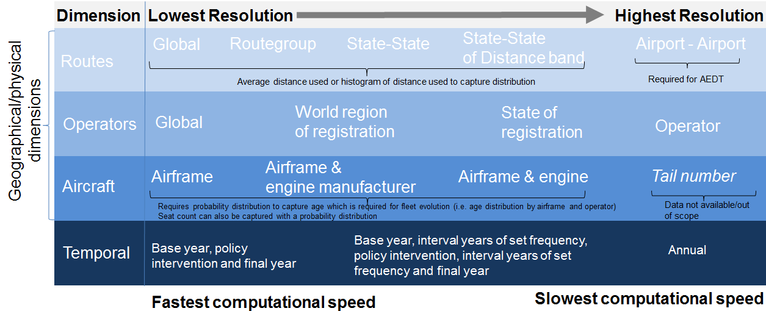
FLEET-Builder Flexibility: Data Resolution vs. Computational Speed
Proposed FLEET-Builder Data Resolution
The tool will provide a full range of resolution capabilities along with an efficient user interface and outputs functionality that is fully AEDT-compatible

Slide 13
Ascent Projects
Aviation Sustainability Center Projects
Tools and Analysis Related Activities and Contributions

Slide 14
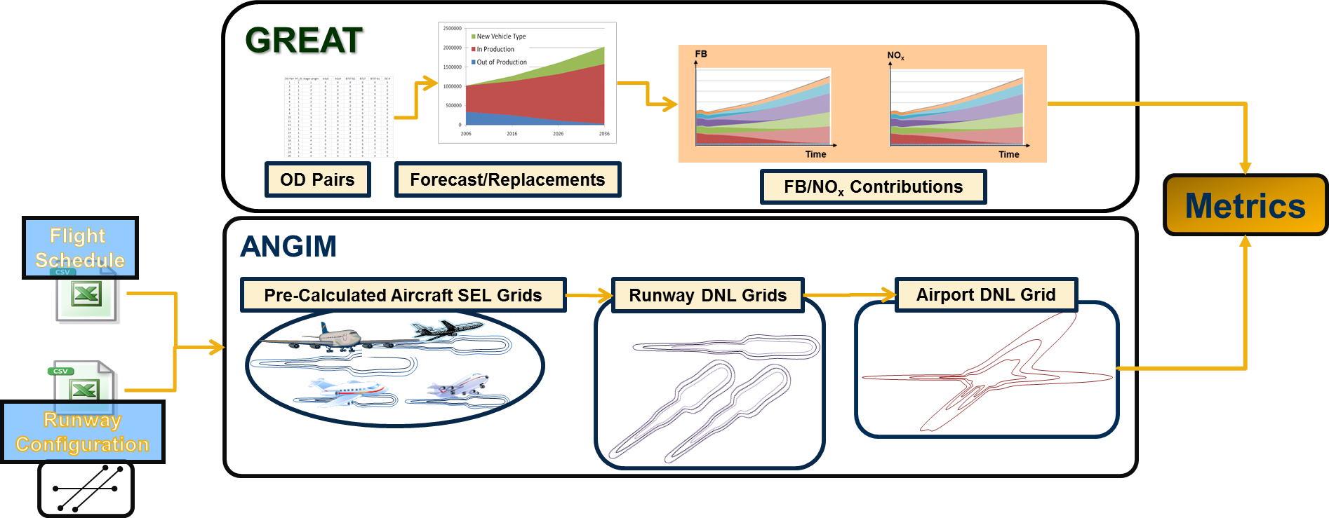
ASCENT Project 11a: GT - Global and Regional Environmental Aviation Tradeoff (GREAT)
Provides a quick means of quantifying the impact of new technologies applied at the aircraft level to assess fleet-wide interdependencies on fuel burn and emissions.
The Airport Noise Grid Interpolation Method (ANGIM) was combined with GREAT to provide full environmental impact coverage: noise contours, population exposures, fuel burn, and NOx
Generic Airports and Generic Vehicles were also developed and added to the system to enable increased flexibility for analyzing technology infusion scenarios by exchanging fidelity for reduced runtimes
Leveraging scenarios developed under A10, fleet level assessment of the CLEEN II technologies’ impact (A37) will be conducted with GREAT.
Notes:
Methods developed to enable rapid analysis of fleet-level environmental impacts:
Global and Regional Environmental Aviation Tradeoff
Metrics: Fuel-Burn, Nox
Airport Noise Grid Interpolation Method (ANGIM)
Metrics: Grids of DNL values, DNL contours (measures areas & shape metrics), and population exposure
Methods developed to enable increased flexibility for analyzing technology infusion scenarios by exchanging fidelity for reduced runtimes
Generic Airports
Reduced major airports to a subset of airports that represent average operational schedules and runway geometry/configurations
Generic Vehicles
Reduced fleet to a few vehicles matching average vehicle-level metrics per vehicle class, which Improved fleet-level accuracy relative to typical representative vehicles
Generic vehicles serve as virtual testbed for technology modeling in bottom-up exploratory fleet-level analysis

Slide 15
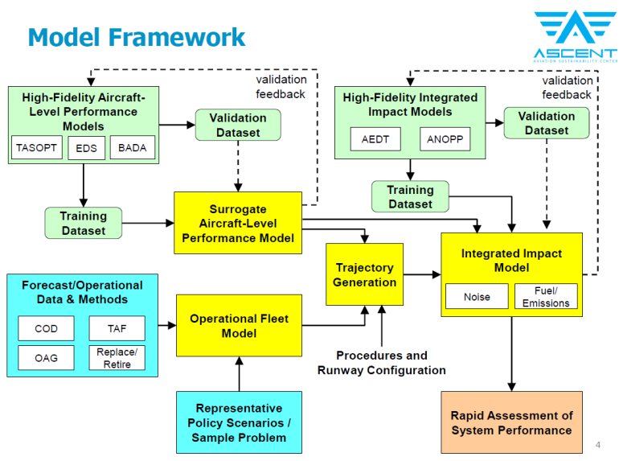
ASCENT Project 11b: MIT - Rapid Fleet-wide Environmental Assessment Capability
Develop surrogate models for aircraft performance that will enable broad scenario explorations and fast parametric analyses in environmental studies with aircraft performance derived from the Transportation Aircraft System OPTimization (TASOPT) tool.
Develop a modeling architecture that provides integrated impact modeling for fuel burn, emissions, noise, and population exposure
Developing both AEDT and ANOPP*-based methods to support modeling of current and future fleet
Ongoing model validation being conducted against aircraft noise certification data, measurement data at Boston Logan Int’l airport, and modeling comparisons based on a representative data at Washington National Airport
Performed a sample analysis of the Delayed Deceleration Approach procedures (A23)
*NASA’s Aircraft Noise Prediction Program
Notes:
Initial phase: develop modeling architecture
Metrics: fuel burn, emissions, noise
Integrated Impact Model approach
Noise
Location specific problem that requires segment-by-segment analysis of a procedure
Fuel Burn and Emissions
Calculations based on emissions indices based on altitude, speed, thrust level, and fuel flow information from flight procedures definitions generated for noise calculations

Slide 16
AEDT-related ASCENT Projects
ASCENT 35
Estimate Reduced Thrust Takeoff
Refine Takeoff Weight Assumptions
ASCENT 5
Noise emission and propagation modeling
ASCENT 45
Model More Representative
Departure Procedures
AEDT
ASCENT 40
Quantifying uncertainties in predicting aircraft noise in real-world situations
ASCENT 43
Noise Power Distance Re-evaluation
ASCENT 23
Analytical Approach for Quantifying Noise from Advanced Operational Procedures
ASCENT 46
Surface Analysis to Support AEDT APM Development
ASCENT 36
Parametric Uncertainty Assessment for AEDT 2b

Slide 17
Internal AEDT activities
Aviation Environmental Design Tool
AEE Driven Development and Testing

Slide 18
AEDT Internal Testing: DCA Emissions Dispersion Study
AEE has been performing internal pre-release testing of new AEDT functionalities (e.g. Background concentrations, nvPM modeling, Number of Events Above)
One of the tests focused on modeling emissions dispersion using a actual operations at DCA, but execution encountered several issues
  Computer memory and hard drive space depletion
  AEDT application crashing and corruption of study database
Exchanges with the AEDT development team resulted in the identification of several issues with the setup and execution of emissions dispersion studies
  A study built using noise study styled flight tracks and subtracks causes the system to create several orders of magnitude greater number of operations then in the input data
  The excess in operations overtaxes the system resources and prevents the creation of the hourly emissions rate file (HRE) necessary for computing dispersion
The diagnostic work resulted in the taking of the following steps
  Verification of proper functioning of operations profile approach (emission style study)
  Improvements in emissions dispersion computational efficiencies including memory management, HRE file generation, processing speed, and more
  Some improvements have already been released with AEDT SP2, while the remainder will be completed by the SP3 release

Slide 19
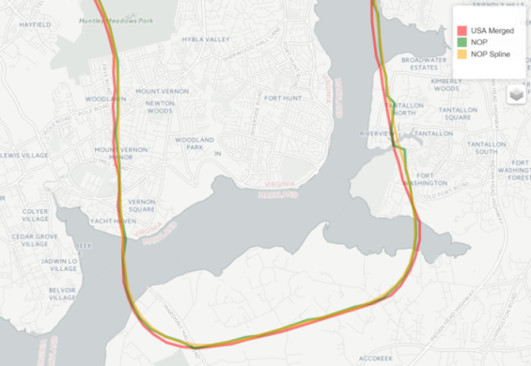
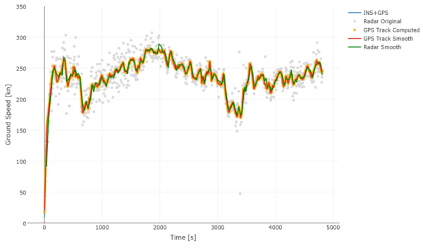
Sensor Paths Filtering and Smoothing Algorithm
FAA has access to multiple historical sensor path data sources for use in analyses (e.g., ETMS, TFMS, PDARS, NOP, etc.)
Sensor path data cannot be used in their “raw” form for direct injection into AEDT as they ‘confuse’ the Aircraft Performance Model (APM)
The algorithm will support the most accurate integrated computational approach of noise, fuel burn, and emission impacts assessment for use in NextGen and inventories analyses
Development and V&V work based on NASA Discover-AQ and other high fidelity data
It is a key component of the AEDT BADA 4 and sensor path functionality implementation

Slide 20

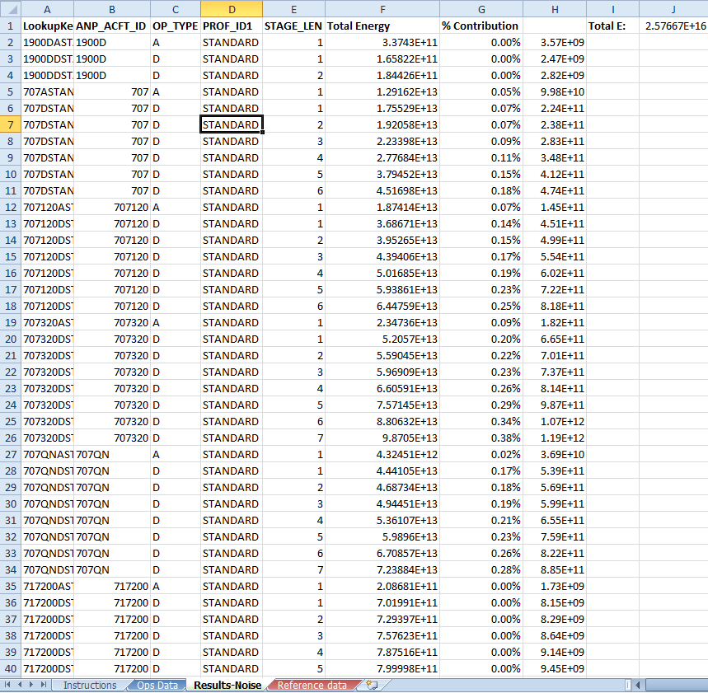
Single Event Methodology Tool (SEM Tool)
A tool for fleet level analysis of inventory movements data developed to support the interpretation and V&V of noise results
Will Allow the user to assess an AEDT study noise and emissions results by reviewing aircraft level contributions to the overall output
Developed by compiling a library of aircraft-level total SEL energy and emissions data from an AEDT custom study
Features:
  Excel workbook or SQL query based tool
  Uses AEDT study data as input*
  Provides instantaneous output
  Expandable views and graphing
  AEDT 2c ANP data driven**
*Any size study can be used, from individual airport to global
**Easily updatable to newer versions

Slide 21
analysis Coordination efforts
Updates on

Slide 22
Data Processing, Storage, and Distribution Coordination with AJR-G20
AJR-G2: Office of Performance Analysis-NAS Data Integration and Services
Current data support coordination
Enhanced Traffic Management System (ETMS) data is no longer available for use as the source of operational and trajectory data in the annual NAS inventories (for last year’s analysis a Volpe custom feed was used)
NOP has been selected as the substitute dataset as it is an FAA internal resource (and reliable for the foreseeable future) which meets the analysis requirements
The AJR-G office has already began supplying a full year dataset and the preprocessing software is being adapted to work with the new source
Planned future AEDT input sensor path data provider role
Current development on the Sensor Paths Filtering and Smoothing Algorithm includes the release of a stand-alone software component to be used with NOP data
The goal is to have the AJR-G office execute cleaning application on their raw NOP data and to store the results
The AEDT-ready data will then be made available to AEDT users so that analyses requiring detailed sensor path data might rely on a trusted and consistent data source

Slide 23
Analysis Work Coordination with ANG-B7
ANG-B7: NextGen NAS Systems Engineering & Integration Office - Systems analysis and modeling division
Current modeling support coordination
The ANG-B7 office is tasked with assessing the NextGen procedures pre- and post-implementation benefits
Their analysis require a level of precision that is currently not achievable with standard modeling tools
Current BADA4 sensor path with high fidelity weather is large part aimed at supporting NextGen assessment needs and ANG has provided detailed descriptions of the input/output needs
Current modeling support coordination
AEE has been supporting ANG AEDT modeling assessments since AEDT 2a
ANG personnel has been a valuable member of the AEDT Design Review Group (DRG)
ANG and AEE are currently beginning to explore the possibility of conducting joint analyses to further develop and refine the shared understanding of how to best leverage AEDT’s capabilities in the context of NextGen analyses

Slide 24
Population Encroachment analysis
Action Item from Summer 2016 Meeting

Slide 25
Population Encroachment Analysis
Action item from the August 2016 REDAC meeting:
Quantify the importance of population encroachment to increased population
exposure over time
Analysis Approach:
Use Census block level population data from the 2000 and 2010 census datasets
Use the CY15 US Inventory Tier 1 airports contours to perform the population counts for the 55, 60, and 65 dB DNL contours on both census datasets
Analysis Outcome:
Between the 2000 and 2010 censuses the population within the 65dB contour decreased
Population in the 60dB and 55dB contours increased
The net change in all cases is within a quarter of a percent and therefore within the noise floor of the system

Slide 26
Summary
Continuing to focus our efforts on key tool users:
  Practitioners for airspace and airport design and planning
  CAEP
  NextGen
  Research
Using ASCENT to advance AEDT capabilities
Reaching across Lines of Business to pool resources and expertise
Have grown internal work and are exploring collaborative efforts with ANG
Will face challenges due to hiring freeze and attrition

Slide 27
Backup Information

Slide 28
AEDT-related ASCENT Projects
A5 - Noise emission and propagation modeling
  As part of the balanced solution in managing aviation noise, the FAA insulates residential buildings near airports. It is important to understand and estimate the noise reduction performance of the buildings exposed to aircraft noise.
A23 - Analytical Approach for Quantifying Noise from Advanced Operational Procedures
  Conduct an assessment of gaps in current noise modeling tools in terms of capturing non-standard operational procedures (e.g., Optimized Profile Descents, Optimized Profile Climbs, Delayed Deceleration Approaches, etc.) with specific interest in an approach to modeling Delayed Descent Approach (DDA) .
A35 - Airline flight data examination to improve flight performance modeling
  Access aircraft takeoff weight, actual (reduced) takeoff thrust, fuel burns and other parameters collected by airlines and conduct a comprehensive statistical analysis to obtain trends or distributions and plausible explanations of the observations. Develop reduced data sets to evaluate the aircraft performance modeling capabilities of AEDT and other relevant research efforts and make suggestions on priorities in further enhancing AEDT and other aircraft performance prediction tools.
A36 - Parametric Uncertainty Assessment for AEDT 2b
  Perform a system level parametric uncertainty analysis on the Aviation Environmental Design Tool (AEDT). This system level assessment will quantify how input uncertainties propagate through the system and contribute to uncertainty in overall policy outcomes. The team will also report any issues encounter while running the tool and assist the development team in diagnosing the software problem.

Slide 29
AEDT-related ASCENT Projects (cnt’d)
A40 - Quantifying uncertainties in predicting aircraft noise in real-world situations
  Review and analyze available field measurement data for patterns that are influenced by the meteorological conditions which are suitable for input into modeling capabilities for validation and subsequently use the enhanced capabilities to understand the field measurement data and quantify uncertainties.
A43 - Noise Power Distance Re-evaluation
  Evaluate possible improvements to the existing NPD methodologies for noise propagation modeling to develop NPD datasets that can capture aircraft configuration, speed, and thrust (NPD “plus configuration” or NPDC) thus enabling assessment of noise impacts of certain advanced operational procedures. This work will build upon the research done under A23 on the assessment framework.
A45 - Takeoff/Climb Analysis to Support AEDT APM Development
  Build on the research under A35, the Airport Cooperate Research Program (ACRP), and the Fuel Efficiency Metric task efforts to develop a robust set of recommendations for improved estimation processes for takeoff weight, reduced thrust takeoffs, and departure profiles within AEDT, which currently assume full rated takeoff power/thrust.
A46 - Surface Analysis to Support AEDT APM Development
  Identify and evaluate methods for improving taxi performance modeling in AEDT by building thrust profiles by taxi segment given a surface trajectory (whose geometry can vary) for a variety of aircraft types. Recommendations should also be made on how the outcomes of this research can be combined with existing research (e.g., ACRP projects 02-45 and 02-27) to inform development of the Aircraft Performance Model (APM) in AEDT.

