Slide 1
Continuous Lower Energy, Emissions and Noise (CLEEN) II Program
Overview
REDAC Subcommittee on Environment and Energy
Levent Ileri and Jim Skalecky
FAA CLEEN Program Managers
March 1 , 2017

Slide 2
Outline
CLEEN Program Overview
CLEEN II Overview
CLEEN II Goals
CLEEN II Projects

Slide 3

CLEEN Program Overview
CLEEN Program (2010-2015)
  Industry partners: Boeing, General Electric, Honeywell, Pratt & Whitney, Rolls-Royce
  Federal Funding: $125M (1:1 minimum cost share is required)
  CLEEN Fact Sheet http://www.faa.gov/news/fact_sheets/news_story.cfm?newsId=20454
CLEEN II Program (2015-2020)
  Industry partners: Aurora Flight Sciences, Boeing, Delta/MDS/America’s Phenix, General Electric, Honeywell, Pratt & Whitney, Rohr/UTC Aerospace Systems, and Rolls-Royce
  Federal Funding: $100M (1:1 minimum cost share is required)
  CLEEN II Fact Sheet
  http://www.faa.gov/news/fact_sheets/news_story.cfm?newsId=20994

Slide 4
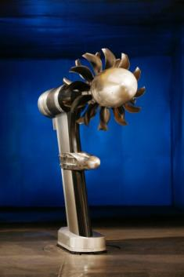
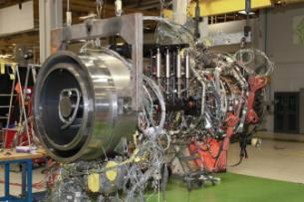
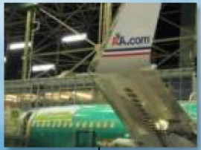
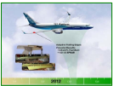
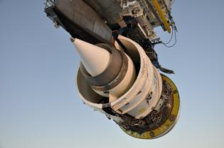
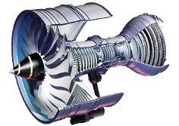
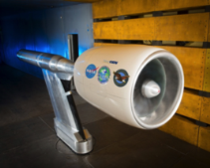

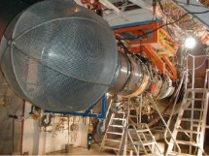
CLEEN I: Completed Technology Demonstrations
General Electric (GE) –
TAPS II Core Engine
Test (TRL 6)
GE Open Rotor
Wind Tunnel Tests
(TRL 5)
Boeing Ground Demonstration
(TRL 6)
Boeing Adaptive Trailing Edge Flight Test (TRL 7)
Boeing - Ceramic Matrix Composite (CMC) Nozzle Ground Test (TRL 6)
GE Dynamic Synchronization Simulation
(TRL 6)
Dec
Jan
Jul
Sep
Jan
Mar
2011 | 2012 | 2013
2014 | 2015
May
Jul
Nov
Pratt & Whitney Fan Rig Wind Tunnel Test
(TRL 5)
Final Honeywell Engine Test (TRL 6)
Pratt & Whitney Engine Test Q1 2017 (TRL 6)
Rolls-Royce - CMC Turbine Blade Track Engine Ground Testing (TRL 6)
Pratt & Whitney Fan Rig Wind Tunnel Test
Boeing - CMC Nozzle Flight Test (TRL 7)
Honeywell
Engine Test
(TRL 6)
GE FMS/Engine Ground and Flight Tests (TRL 6+7)
Rolls-Royce Dual Wall Vane Testing (TRL 6)

Slide 5
Benefits of CLEEN Program:
Demonstrated technologies that reduce noise, emissions and fuel burn
Boeing
Adaptive Trailing Edge
~ 2% fuel burn reduction
~ 1.7 EPNdB cum in some single and twin aisles
CMC Acoustic Nozzle
~ 1% fuel burn reduction
~2.3 EPNdB cumulative noise margin to Stage 4
Honeywell
Fuel Burn Technologies
CLEEN technologies contributed to ~5% fuel burn reduction as part of a 15.7% fuel burn reduction engine package
Pratt & Whitney
Geared Turbofan Technologies
CLEEN techs expand design space for engine with ~ 20% fuel burn reduction, > 20 EPNdB cumulative noise margin to Stage 4
General Electric
TAPS II Combustor (entered fleet in 2016)
> 60% margin to CAEP/6 LTO NOx was achieved
FMS/Engine and FMS/ATM Integration
0.7-1.0% fuel burn reduction
Open Rotor
~26% reduction in fuel burn (re: 737-800)
~15-17EPNdB cumulative noise margin to Stage 4
Rolls Royce
Ceramic Matrix Composite Turbine Blade Track
CMC blade tracks offer > 50% reduction in cooling and component weight.
Rolls-Royce – Dual Wall Turbine Airfoil
Dual Wall turbine airfoils provide > 20% reduction in cooling and increased operating temperature capability.
CLEEN tech will provide ~1% fuel burn reduction
11

Slide 6
CLEEN II Overview
Purpose:
  Mature previously conceived noise, emissions and fuel burn reduction technologies for civil subsonic airplanes from Technology Readiness Levels (TRL) of 3-5 to TRLs of 6-7 to enable industry to expedite introduction of these technologies into current and future aircraft and engines
  Assess the benefits and advance the development and introduction of “drop-in” alternative jet fuels, including blends
CLEEN II technologies expected to be on a path for introduction into commercial aircraft by 2026

Slide 7


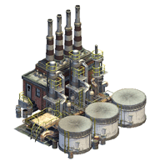

CLEEN II Program Goals
Develop and demonstrate (TRL 6-7) certifiable aircraft technology
 | CLEEN I | CLEEN II
Noise (cum below Stage 4) | -32 dB | -32 dB | and/or reduces the noise contour area in absolute terms
LTO NOx Emissions (below CAEP 6) | -60% | -75% (-70% vs. CAEP/8) | and/or reduces absolute NOx production over the aircraft’s mission
Aircraft Fuel Burn | -33% | -40% | and/or supports the FAA’s goal to achieve a net reduction in climate impact from aviation
Advance use of “drop-in” renewable alternative fuels
Bio feedstock
Fuel Production
Jet fuel

Slide 8
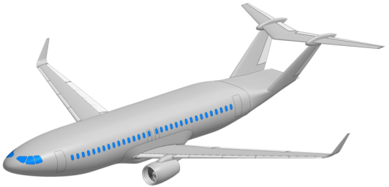
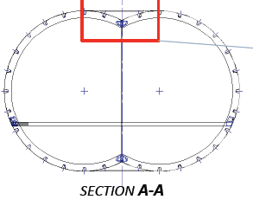
Aurora CLEEN II Technologies
Technology | Goal Impact | Benefits and Application | Key Milestones
D8 aircraft fuselage: Advanced composite structure and Y-joint demonstration | Fuel burn, enables NOx and noise reduction | Wing-Mounted engine configuration benefit: ~16% fuel burn reduction when compared to 737-8 Enables ~16 EPNdB cumulative noise reduction and ~21% LTO NOx reduction With current technology and integrated engines, configuration provides: Up to 49% fuel burn reduction 40 EPNdB noise reduction 52% reduction in LTO NO_{X} emissions (re: CAEP/6) Additional technologies’ benefits may stack on top of configuration benefit. | Y-joint Test Demonstration (Q2 CY 2017)

Slide 9
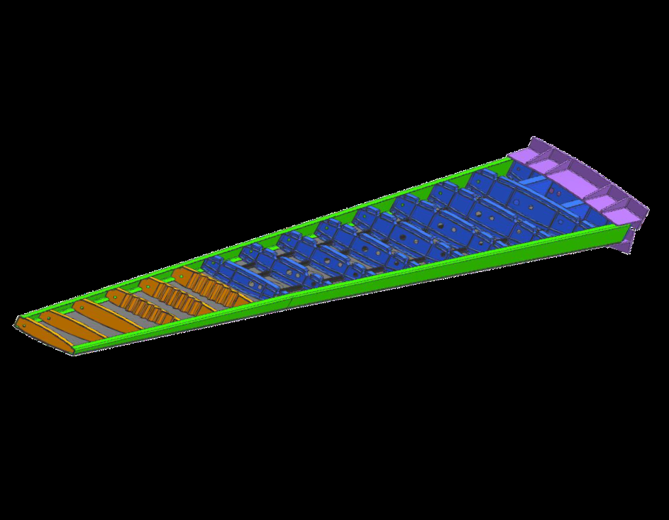
Boeing CLEEN II Technologies
Technology | Goal Impact | Benefits and Application | Key Milestones
Structurally Efficient Wing - enabled by advanced manufacturing and composites technologies | Fuel Burn | Lower weight, higher performance wing, reducing fuel burn by 3.5% | CoDR – COMPLETE 3/2016 PDR (Q1 CY 2017) -COMPLETE DDR (Q3 CY2017) TRL 6 Demonstration (Q1 CY 2019)

Slide 10
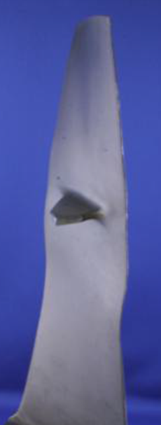
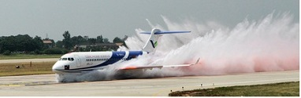
Delta/MDS/America’s Phenix CLEEN II Technologies
Technology | Goal Impact | Benefits and Application | Key Milestones
Leading Edge Protective Coating for Turbofan Blades | Fuel Burn & Emissions | Up to 1% fuel savings at cruise Up to 2% fuel savings at max power Application: 1st stage turbofan blades on a breadth of engines | Blade Condition & Operational Analysis – COMPLETE 3/2016 Fluid Erosion Component Test – JT8D; COMPLETE 5/2016 – CFM56, CF6, PW2037, V2500; Tested Nov 2016 Flight Service Evaluation (Q2 CY 2017 to Q3 CY 2019)

Slide 11
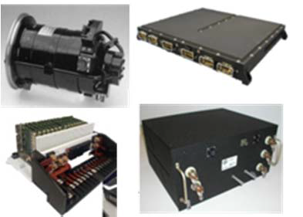
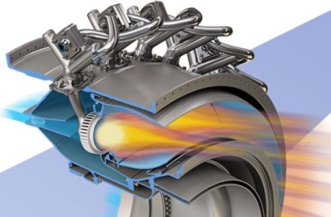
GE CLEEN II Technologies (1 of 2)
Technology | Goal Impact | Benefits and Application | Key Milestones
TAPS III Low-NOx Combustor Development | Emissions | 35% margin to CAEP/8 NOx @ 55 OPR – large twin aisle class aircraft | CDR (Q3 CY 2017) PDR (Q4 CY 2018) DDR (Q2 CY 2019) TRL6 Core Demo of emissions/performance (Q3 CY 2020)
More Electric Systems and Technologies for Aircraft in the Next Generation (MESTANG) | Fuel burn | Up to 3% fuel burn reduction for single-aisle aircraft | PDR (Q1 CY 2017) DDR (Q4 CY 2017) Component Tests (CY 2018, 2019) TRL 6 System demonstration (CY 2020)

Slide 12


GE CLEEN II Technologies (2 of 2)
Technology | Goal Impact | Benefits and Application | Key Milestones
Flight Management System (FMS) – Engine Integration | Fuel burn | Up to 1% fuel burn reduction | PDR (Q2 CY 2018) DDR (Q3 CY 2018) TRL 6 testbed assessment (CY 2017-2018)
Alternative Jet Fuel Test and Evaluation | Alternative Fuels | Testing of drop-in alternative jet fuels to support ASTM International approval | FAR rig testing of baseline, synthetic and NJFCP fuels (CY 2017) Core testing and data analysis of baseline and synthetic fuels (CY 2019-2020)

Slide 13
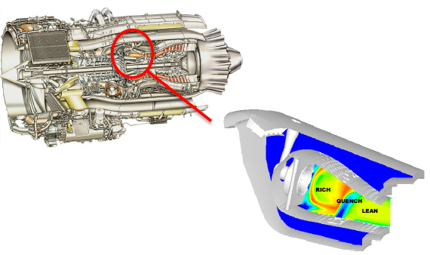
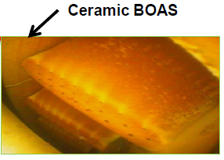
Honeywell CLEEN II Technologies
Technology | Goal Impact | Benefits and Application | Key Milestones
Singular Annular Combustor for Emissions Reduction (SABER) Compact Combustor | Emissions, fuel burn | 53% margin to ICAO CAEP/8 NOx Reduced weight, emissions | Development testing (CY2017-2019) TRL 6 Engine Test (Q2 CY 2020)
Advanced Turbine Blade Outer Air Seal (BOAS) | Fuel burn | Contributes to package that delivers 27% fuel burn reduction vs. in service baseline | Development testing (CY2017-2019) TRL 6 Engine Test (Q2 CY 2020)

Slide 14
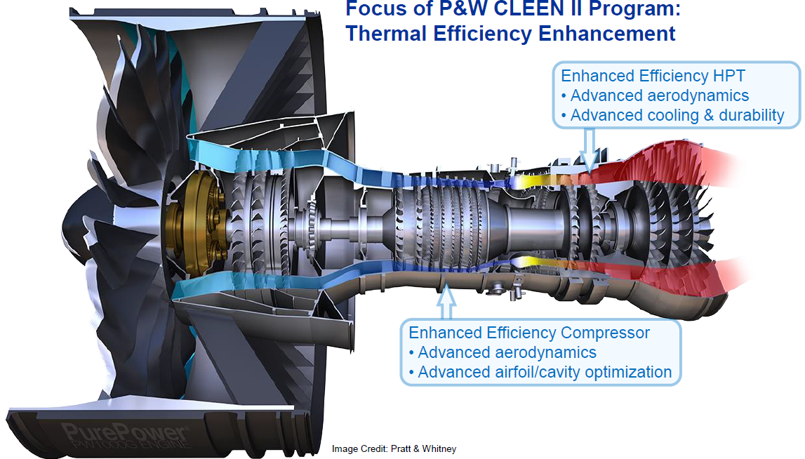
Pratt & Whitney CLEEN II Technologies
Technology | Goal Impact | Benefits and Application | Key Milestones
Compressor Aero-Efficiency Technologies | Fuel burn | 0.8-1.0% fuel burn reduction | Rig Tests (Q3-4 CY 2016) - COMPLETE Redesign cycle (Q4 CY 2016-Q2 CY 2017) Engine Test (CY 2019)
Turbine Aero-Efficiency and Durability Technologies | Fuel burn | 0.8-1.0% fuel burn reduction | Baseline Rig Testing (CY 2017) Full-Scale Rig Tests (CY 2018)

Slide 15
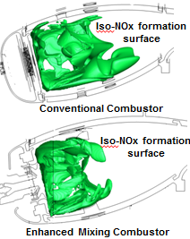
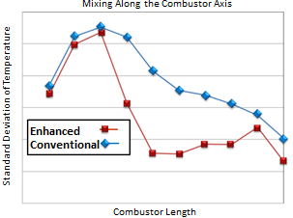
Rolls-Royce CLEEN II Technologies
Technology | Goal Impact | Benefits and Application | Key Milestones
Advanced Rich Quench Lean (RQL) Low NOx Combustion System | NOx Reduction, Fuel burn | 65% margin to ICAO CAEP/8 NOx | Fabrication (CY 2017 – 2018) Component and Full Annular Rigs (CY 2016 – 2019)
Alternative Jet Fuel Test and Evaluation (Area A) | Alternative Fuels | Testing of drop-in alternative jet fuels to support ASTM International approval | Alternative Fuels Testing and Demonstration (CY 2016- 2019)

Slide 16

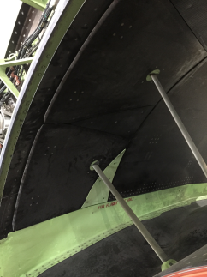

Rohr / UTAS CLEEN II Technologies
Technology | Goal Impact | Benefits and Application | Key Milestones
Short, Integrated Fan Duct Thrust Reverser | Fuel burn | ~1.0% fuel burn reduction | PDR (Q3 CY 2017) DDR (Q3 CY 2018) TRL 6 engine ground test (Q3-Q4 CY 2019)
Advanced Acoustics | Noise | ~2.5 EPNdB noise reduction*
* to offset short fan duct
Legacy Thrust Reverser Fan Duct
CLEEN II Thrust Reverser Fan Duct

Slide 17
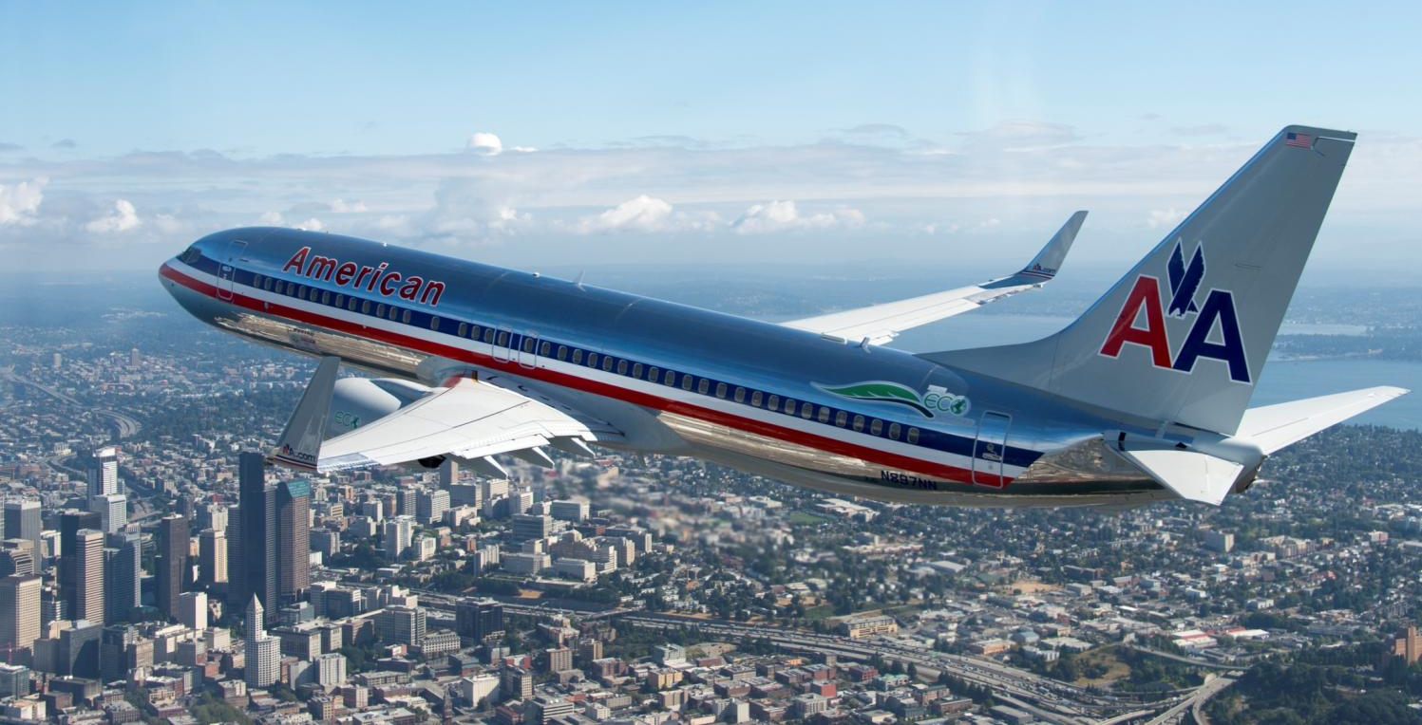
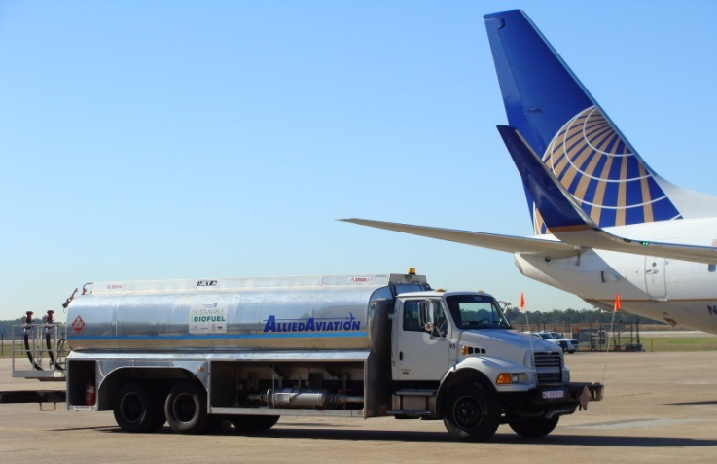
In Summary
CLEEN has successfully accelerated aircraft technology development to reduce noise, emissions and fuel burn
CLEEN has helped and is helping to accelerate alternative jet fuel development
Initial CLEEN Program wrapping up
CLEEN II work is progressing
May 2-4, 2017 Consortium meeting in Cincinnati, OH

