Slide 1
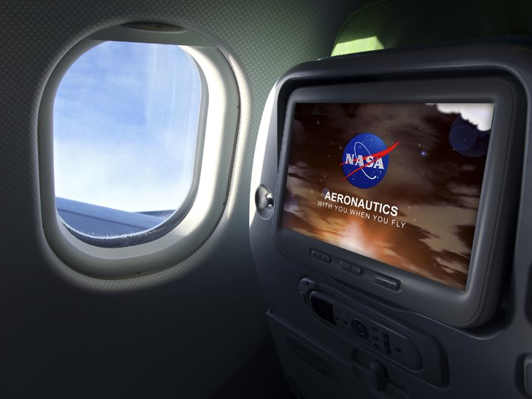
NASA Aeronautics Strategy – Briefing to the FAA REDAC
Robert Pearce
Director – Strategy, Architecture & Analysis
Aeronautics Research Mission Directorate
April 17, 2014

Slide 2

Why a New Aeronautics Research Strategy?
Now is the time to lay the groundwork for the next 100 years of excellence.
NASA Aeronautics has solid partnerships, high relevancy, and is delivering high impact
But need to recognize:
  Rising competition in international R&D
  Challenges in mobility, energy and climate
  Opportunities to infuse rapidly advancing non-aerospace sector technologies
ARMD’s new strategy builds on current leadership and focuses on enabling revolutionary advances
“Civil aviation [is] blessed with growing demand, record orders and increasing deliveries, but facing global competitors, affordability and sustainability challenges, and an industry-shaking technological revolution.”
Graham Warwick,
AvWeek, September 2013
The Time Bomb of Complacency – AvWeek Editorial, September 2, 2013
“ An alarm needs to be sounded. A vital and vigorous aeronautics research program is essential… NASA’s unveiling of a new strategy for aeronautics research is a bold and welcome move.”
For Internal NASA Use Only

Slide 3
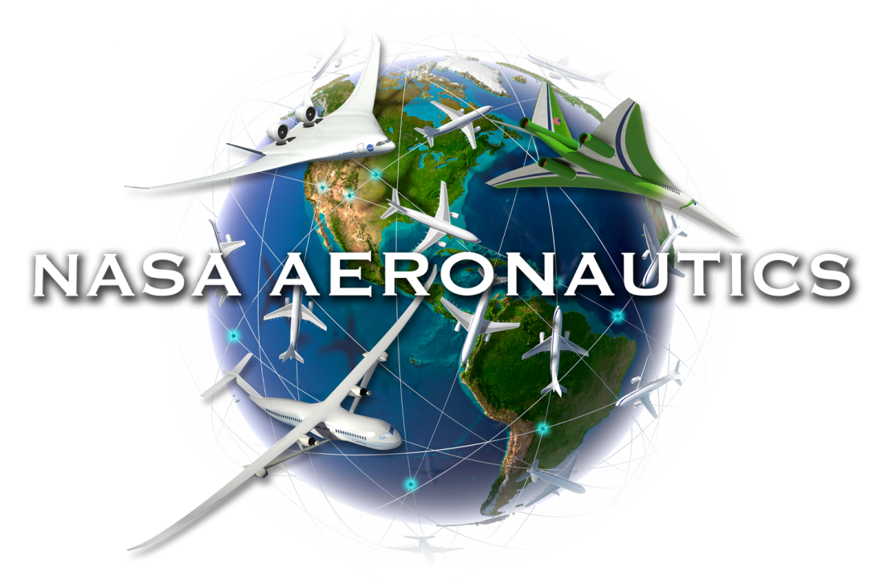

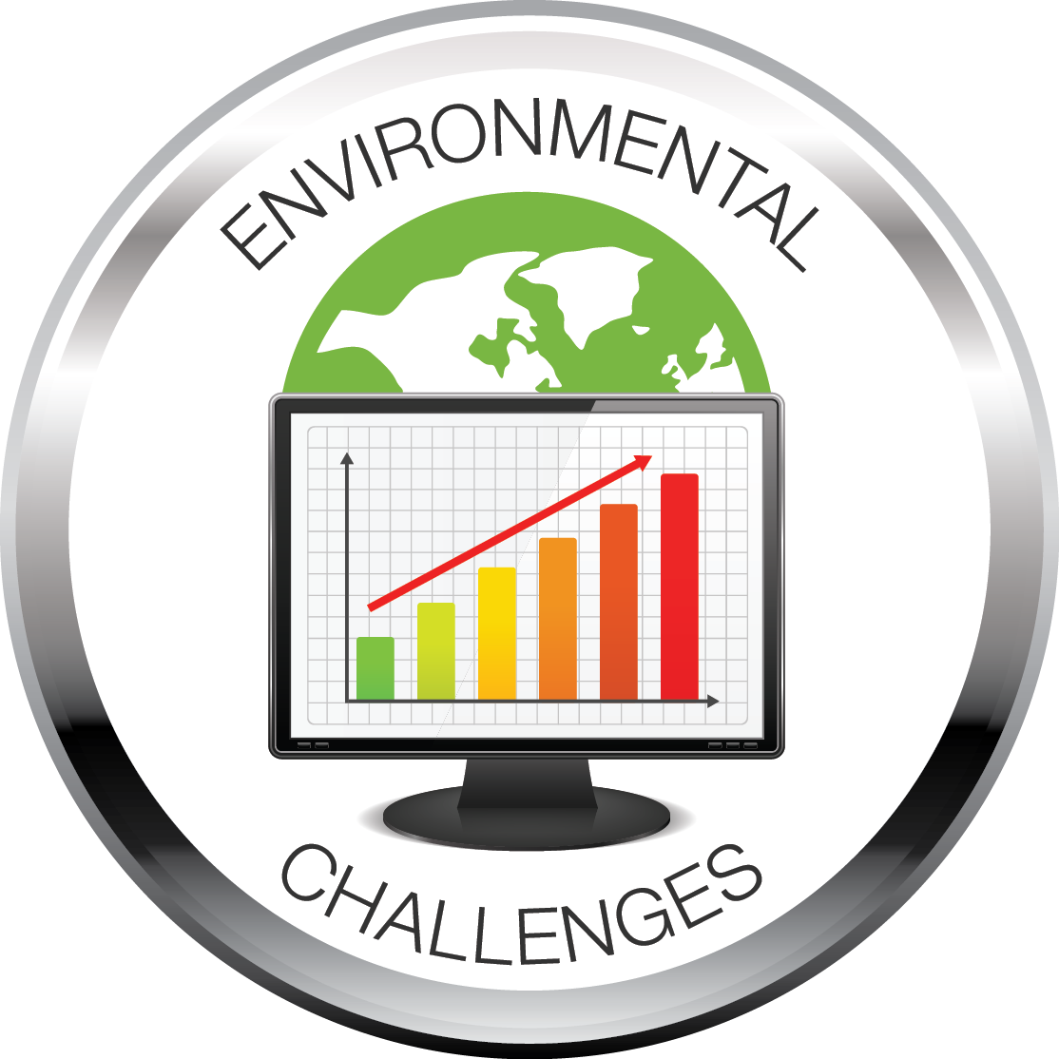
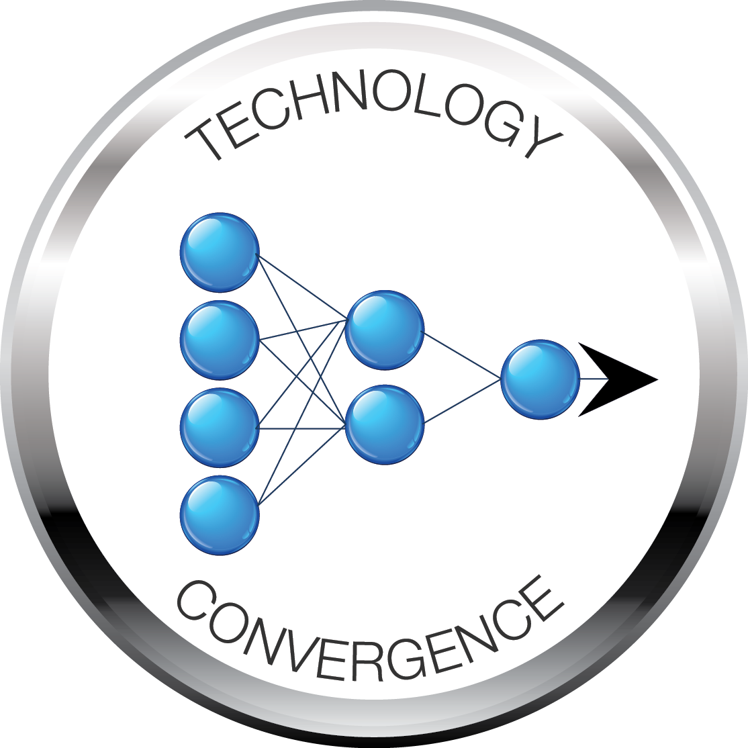
Three Aviation Mega Drivers
Traditional measures of global demand for mobility - economic development, urbanization - are growing rapidly
Severe energy and climate issues create enormous affordability and sustainability challenges
Revolutions in automation, information and communication technologies enable opportunity for safety critical autonomous systems
Notes:
Looking at those emerging trends, NASA has identified three “mega-drivers” that are changing the face of aviation over the next 20 to 40 years.
(top)
Mega-driver 1: Global demand for air mobility is growing rapidly. World traffic volume is projected to dramatically expand by 2050, with the larger share going to high-speed (air) travel as compared to ground vehicles.
(lower left)
Mega-driver 2: Energy and climate issues challenge aviation’s ability to be sustainable in the long term. Aviation must dramatically reduce fuel use and related emissions. Energy costs to U.S. airlines nearly tripled between 1995 and 2011, and continue to be the highest percentage of operating costs.
(lower right)
Mega-driver 3: Opportunities for aviation exist in technologies from other industries. Robotics and automation are already creating a wave of innovation in unmanned aircraft systems. Technology convergence is the wave to ride.

Slide 4
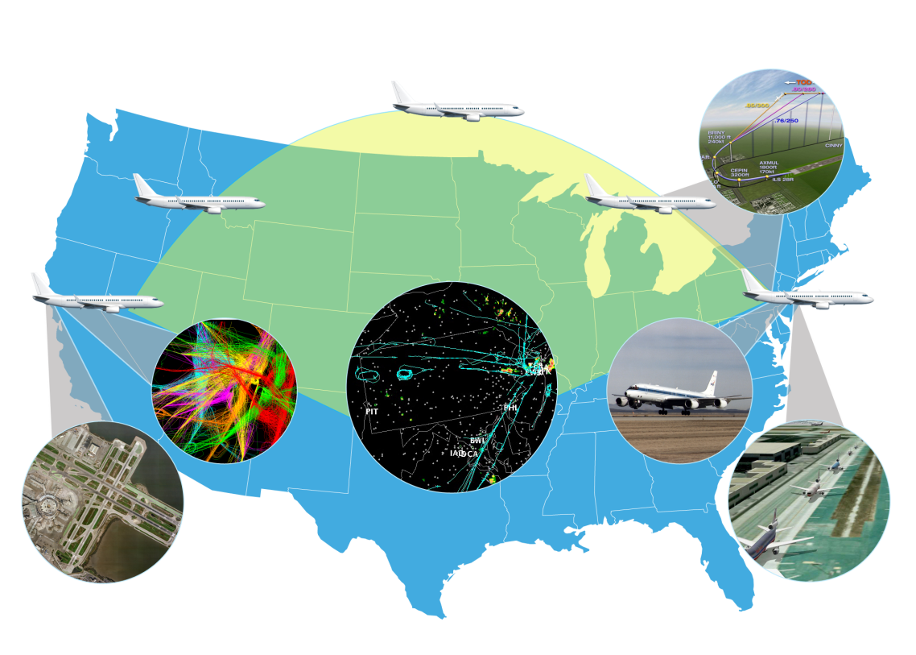
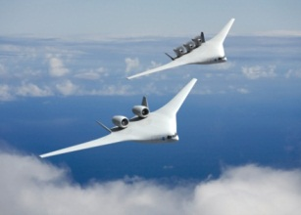
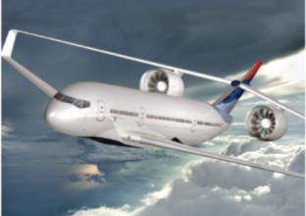
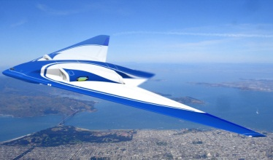
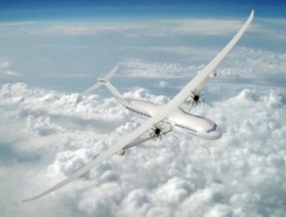
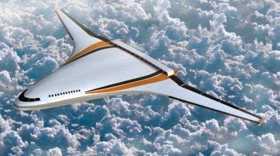
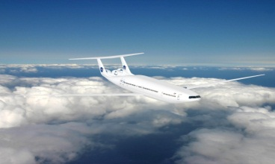
Strategic Systems Analysis
N+2 Aircraft
Concepts and Technology
NextGen ATM
Concepts and Technology
N+3 Aircraft
Concepts and Technology
Core Technologies support needed capacity growth and enable simultaneous reduction in energy use, noise and emissions
Structural, Aerodynamic & Propulsion Component Efficiency
New Configurations
Automation for Efficient TBO Operations
However, performance gaps remain to fully account for future challenges in mobility, cost and climate
Low Carbon Fuel and Propulsion to close gaps in carbon emissions
Autonomy closes gaps in cost and enables mobility innovation

Slide 5
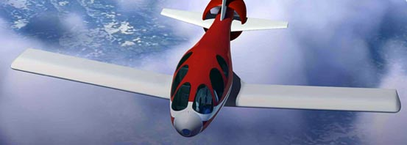
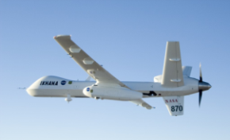
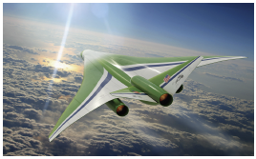
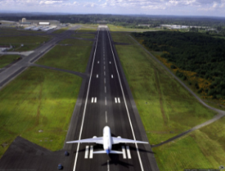

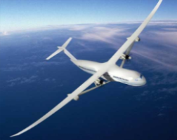
NASA’s Vision for Aviation
TRANSFORMATIVE
A revolution in sustainable global air mobility
On Demand
SUSTAINABLE
Fast
Intelligent
Low Carbon
GLOBAL
Safety, NextGen
Efficiency, Environment
Notes:
All of those elements lead into our strategic vision for aeronautics research and development.
We want to be able to leapfrog into widening spheres of technical achievement.
The inner oval at the bottom represents what we do now. It’s great work and we’ve proven we’re the ones to do this work.
But given what’s happening in the world, it’s no longer enough.
To take care of the near-term, we will continue to work the challenges of safety, NextGen, efficiency, and the environment as stepping stones to broader sustainable and transformative aviation.
To achieve the level where aviation is truly sustainable, we will explore the application of more intelligent systems and low-carbon approaches to reducing costs and improving safety.
And to achieve the level of transformation, we will develop solutions to make high-speed flight possible, and investigate the potential for technology convergence that could lead to widespread, on-demand, fully autonomous private flight.

Slide 6





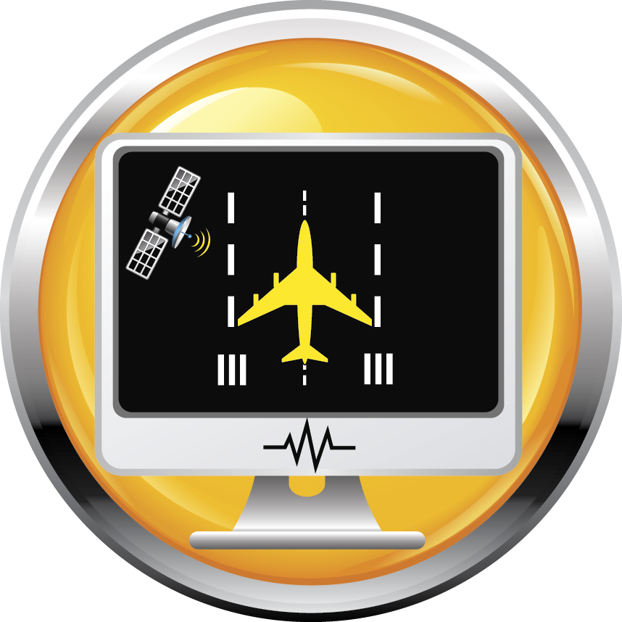
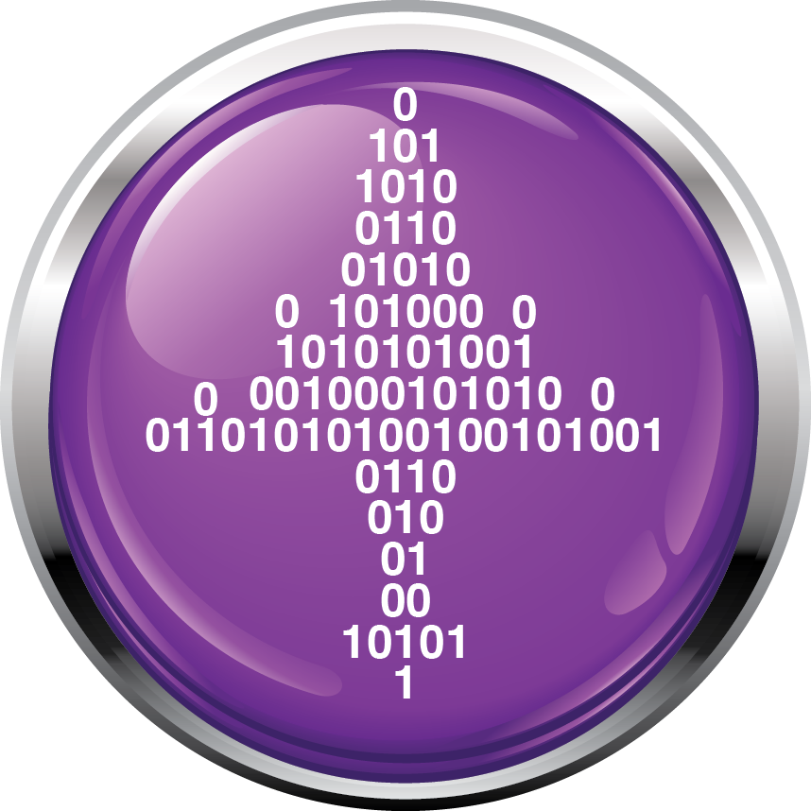
NASA Aeronautics Six Strategic Thrusts
Safe, Efficient Growth in Global Operations
Enable full NextGen and develop technologies to substantially
reduce aircraft safety risks
Innovation in Commercial Supersonic Aircraft
Achieve a low-boom standard
Ultra-Efficient Commercial Transports
Pioneer technologies for big leaps in efficiency and
environmental performance
Transition to Low-Carbon Propulsion
Characterize drop-in alternative fuels and pioneer
low-carbon propulsion technology
Real-Time System-Wide Safety Assurance
Achieve proactive safety management of the integrated aviation system
Assured Autonomy for Aviation Transformation
Develop high impact aviation autonomy applications

Slide 7
Safe, Efficient Growth in Global Operations
NASA Role
Technology Provider for Safe, Efficient and High Capacity Global Air Traffic Operations
Strategies:
Develop advanced automation technologies that leverages NextGen infrastructure
Analyze emergent aviation risks and enable safety solutions for commercial aviation fatality risk reduction
Enable the highly complex integration of automation systems to achieve full NextGen trajectory-based operations functionality
Research transformational system architectures and automation technologies that fundamentally overcome current limits to the efficiency, agility, flexibility, and resilience of the air transportation system
Risk Management and Challenges:
Limited high-fidelity modeling and simulation capabilities limit opportunities for testing of advanced capacity, efficiency, and safety solutions
Notes:
ATM – more automation, intelligence, trajectory-based operation
Aircraft – lighter (composites), much more fuel efficient (re-engine, more efficient combustor, larger C/D, more efficient wings, laminar flow control)
PDRC
Challenge
Controllers unable to schedule departures to merge into available slots in overhead streams with the current manual process
Increased delays due to lost overhead slot opportunities
Objective
Integrate aircraft OFF time predictions to Traffic Management Advisor to fit departing aircraft in an overhead stream, thereby reduce delays significantly
Approach
Develop prototype decision support planning tool and validate at operational
FAA tower and air traffic control center
Provide automated and integrated means of communication between planners
at the tower and en-route air traffic control centers
Results
Developed Surface Decision Support System (SDSS), and enhanced the Traffic Management Advisor (TMA)
Conducted two operational evaluations over 29 weeks at Dallas-Ft. Worth International Airport and Dallas-Ft. Worth FAA Air Route Traffic Control Center. Average OFF time improved by about 1 min, and number of flights departing within release window improved by more than 50% when compared to the baseline.
Concept of Operations, Technology Description and Operational Evaluation results all handed over to the FAA (the third tech transfer through Research Transition Team in the last two years)
Significance
Over 30,000 aircraft per month will get improved departure clearances into constrained overhead/enroute flows
22% of arrival aircraft will have significantly improved arrival meter schedules
Reduce departure delays with potential to reclaim up to 80% of lost overhead slot opportunities

Slide 8

Innovation in Commercial Supersonic Aircraft
NASA Role
Technology and Standards Development for a New Global Market
Strategies:
Establish a flight validated database necessary to inform the international rule-making community’s policy discussion regarding an overland supersonic low-boom standard
Risk Management and Challenges:
Development of scientifically acceptable test methodology and database
Notes:
ATM – more automation, intelligence, trajectory-based operation
Aircraft – lighter (composites), much more fuel efficient (re-engine, more efficient combustor, larger C/D, more efficient wings, laminar flow control)
PDRC
Challenge
Controllers unable to schedule departures to merge into available slots in overhead streams with the current manual process
Increased delays due to lost overhead slot opportunities
Objective
Integrate aircraft OFF time predictions to Traffic Management Advisor to fit departing aircraft in an overhead stream, thereby reduce delays significantly
Approach
Develop prototype decision support planning tool and validate at operational
FAA tower and air traffic control center
Provide automated and integrated means of communication between planners
at the tower and en-route air traffic control centers
Results
Developed Surface Decision Support System (SDSS), and enhanced the Traffic Management Advisor (TMA)
Conducted two operational evaluations over 29 weeks at Dallas-Ft. Worth International Airport and Dallas-Ft. Worth FAA Air Route Traffic Control Center. Average OFF time improved by about 1 min, and number of flights departing within release window improved by more than 50% when compared to the baseline.
Concept of Operations, Technology Description and Operational Evaluation results all handed over to the FAA (the third tech transfer through Research Transition Team in the last two years)
Significance
Over 30,000 aircraft per month will get improved departure clearances into constrained overhead/enroute flows
22% of arrival aircraft will have significantly improved arrival meter schedules
Reduce departure delays with potential to reclaim up to 80% of lost overhead slot opportunities

Slide 9
Ultra-Efficient Commercial Vehicles
NASA Role
Technology for Ultra-High Efficiency, Low Environmental Impact Transports
Strategies:
Develop and mature portfolios of advanced airframe and engine technologies to achieve aggressive energy efficiency, noise and emissions goals
  Support Industry/FAA on N+1 (Next Generation Transports) to achieve 33% reduction in energy use
  Mature technologies for N+2 (50% reduction in energy use)
  Pioneer technologies for N+3 (60% reduction in energy use)
Explore advanced vehicle concepts capable of achieving revolutionary levels of efficiency and environmental performance
Risk Management and Challenges:
Flight demonstrations of advanced configurations enable industry to buy down the risks of commercial development of fuel efficient and environmentally responsible technologies and systems
U.S. leadership and market share are at stake in a highly competitive industry
Notes:
ATM – more automation, intelligence, trajectory-based operation
Aircraft – lighter (composites), much more fuel efficient (re-engine, more efficient combustor, larger C/D, more efficient wings, laminar flow control)
PDRC
Challenge
Controllers unable to schedule departures to merge into available slots in overhead streams with the current manual process
Increased delays due to lost overhead slot opportunities
Objective
Integrate aircraft OFF time predictions to Traffic Management Advisor to fit departing aircraft in an overhead stream, thereby reduce delays significantly
Approach
Develop prototype decision support planning tool and validate at operational
FAA tower and air traffic control center
Provide automated and integrated means of communication between planners
at the tower and en-route air traffic control centers
Results
Developed Surface Decision Support System (SDSS), and enhanced the Traffic Management Advisor (TMA)
Conducted two operational evaluations over 29 weeks at Dallas-Ft. Worth International Airport and Dallas-Ft. Worth FAA Air Route Traffic Control Center. Average OFF time improved by about 1 min, and number of flights departing within release window improved by more than 50% when compared to the baseline.
Concept of Operations, Technology Description and Operational Evaluation results all handed over to the FAA (the third tech transfer through Research Transition Team in the last two years)
Significance
Over 30,000 aircraft per month will get improved departure clearances into constrained overhead/enroute flows
22% of arrival aircraft will have significantly improved arrival meter schedules
Reduce departure delays with potential to reclaim up to 80% of lost overhead slot opportunities

Slide 10
Transition to Low-Carbon Propulsion
NASA Role
Support National Efforts to Transition to Alternative Fuels and Pioneer Low Carbon Propulsion
Strategies:
In partnership with other government agencies, characterize “drop-in” alternative fuels to enable certification for aviation use to achieve lower carbon emissions in the near to midterm
Explore and pioneer scalable alternative propulsion cycles, such as electric propulsion, to enable very low or no carbon emission propulsion for transport class aircraft in the long-term
Demonstrate technology for smaller aircraft scale applications in the near to mid-term to deliver benefits, and support transformational on-demand transportation models, on the way to transport scale applications
Pace research to match developments in the energy sector and seek substantial leverage and partnership
Risk Management and Challenges:
Significant external research in other industry sectors, such areas as batteries and electric motors, needs to be leveraged in spite of the significant differences in requirements
Flight demonstrations of new propulsion concepts speed the transition of aviation to a low carbon future
Notes:
ATM – more automation, intelligence, trajectory-based operation
Aircraft – lighter (composites), much more fuel efficient (re-engine, more efficient combustor, larger C/D, more efficient wings, laminar flow control)
PDRC
Challenge
Controllers unable to schedule departures to merge into available slots in overhead streams with the current manual process
Increased delays due to lost overhead slot opportunities
Objective
Integrate aircraft OFF time predictions to Traffic Management Advisor to fit departing aircraft in an overhead stream, thereby reduce delays significantly
Approach
Develop prototype decision support planning tool and validate at operational
FAA tower and air traffic control center
Provide automated and integrated means of communication between planners
at the tower and en-route air traffic control centers
Results
Developed Surface Decision Support System (SDSS), and enhanced the Traffic Management Advisor (TMA)
Conducted two operational evaluations over 29 weeks at Dallas-Ft. Worth International Airport and Dallas-Ft. Worth FAA Air Route Traffic Control Center. Average OFF time improved by about 1 min, and number of flights departing within release window improved by more than 50% when compared to the baseline.
Concept of Operations, Technology Description and Operational Evaluation results all handed over to the FAA (the third tech transfer through Research Transition Team in the last two years)
Significance
Over 30,000 aircraft per month will get improved departure clearances into constrained overhead/enroute flows
22% of arrival aircraft will have significantly improved arrival meter schedules
Reduce departure delays with potential to reclaim up to 80% of lost overhead slot opportunities

Slide 11
Real-Time System-Wide Safety Assurance
NASA Role
Pioneering Methods for Real-Time System-Wide Safety Monitoring and Assurance
Strategies:
Pioneer technical solutions that overcome access restrictions currently inhibiting multi-dimensional analysis for deeper and comprehensive understanding of safety threats
Leverage developments in sensing, communication, and computation technologies to create continuous aviation safety monitoring capabilities
Explore data analytics that reduce safety threat detection time from months to seconds
Integrate technological advancements in the near, mid, and long-term to demonstrate progressive improvements in automated system-wide safety assurance systems
Risk Management and Challenges:
An integrated demonstration of a prototype is necessary to reduce the risk of a Real-Time System-Wide Safety Assurance System
The inability to successfully deploy such system will result in a slower, evolutionary approach that may inhibit the implementations of NextGen technologies
Notes:
ATM – more automation, intelligence, trajectory-based operation
Aircraft – lighter (composites), much more fuel efficient (re-engine, more efficient combustor, larger C/D, more efficient wings, laminar flow control)
PDRC
Challenge
Controllers unable to schedule departures to merge into available slots in overhead streams with the current manual process
Increased delays due to lost overhead slot opportunities
Objective
Integrate aircraft OFF time predictions to Traffic Management Advisor to fit departing aircraft in an overhead stream, thereby reduce delays significantly
Approach
Develop prototype decision support planning tool and validate at operational
FAA tower and air traffic control center
Provide automated and integrated means of communication between planners
at the tower and en-route air traffic control centers
Results
Developed Surface Decision Support System (SDSS), and enhanced the Traffic Management Advisor (TMA)
Conducted two operational evaluations over 29 weeks at Dallas-Ft. Worth International Airport and Dallas-Ft. Worth FAA Air Route Traffic Control Center. Average OFF time improved by about 1 min, and number of flights departing within release window improved by more than 50% when compared to the baseline.
Concept of Operations, Technology Description and Operational Evaluation results all handed over to the FAA (the third tech transfer through Research Transition Team in the last two years)
Significance
Over 30,000 aircraft per month will get improved departure clearances into constrained overhead/enroute flows
22% of arrival aircraft will have significantly improved arrival meter schedules
Reduce departure delays with potential to reclaim up to 80% of lost overhead slot opportunities

Slide 12

Assured Autonomy for Aviation Transformation
NASA Role
Enable Safe Application of Aviation Autonomous Systems
Strategies:
Develop key technologies and information to enable UAS to achieve routine access to the NAS
Pursue long-term research to solve the major hurdles for the development and safe operation of autonomous systems, such as V&V techniques for highly complex software-intensive systems, and guidelines and technologies for human-autonomy teaming
Partner with the aviation community on autonomy “challenge problems” to explore real-world issues and support near and mid-term innovation
Develop and maintain a relevant test environment to support high confidence research and experimentation
Establish partnerships to leverage accelerating developments in machine learning, robotics and other key autonomy disciplines
Risk Management and Challenges:
Verification and validation of complex systems will set the pace of progress of implementing safe, autonomous aviation systems
The inability to implement research in this area could limit the discovery of unknown issues and risks
Notes:
ATM – more automation, intelligence, trajectory-based operation
Aircraft – lighter (composites), much more fuel efficient (re-engine, more efficient combustor, larger C/D, more efficient wings, laminar flow control)
PDRC
Challenge
Controllers unable to schedule departures to merge into available slots in overhead streams with the current manual process
Increased delays due to lost overhead slot opportunities
Objective
Integrate aircraft OFF time predictions to Traffic Management Advisor to fit departing aircraft in an overhead stream, thereby reduce delays significantly
Approach
Develop prototype decision support planning tool and validate at operational
FAA tower and air traffic control center
Provide automated and integrated means of communication between planners
at the tower and en-route air traffic control centers
Results
Developed Surface Decision Support System (SDSS), and enhanced the Traffic Management Advisor (TMA)
Conducted two operational evaluations over 29 weeks at Dallas-Ft. Worth International Airport and Dallas-Ft. Worth FAA Air Route Traffic Control Center. Average OFF time improved by about 1 min, and number of flights departing within release window improved by more than 50% when compared to the baseline.
Concept of Operations, Technology Description and Operational Evaluation results all handed over to the FAA (the third tech transfer through Research Transition Team in the last two years)
Significance
Over 30,000 aircraft per month will get improved departure clearances into constrained overhead/enroute flows
22% of arrival aircraft will have significantly improved arrival meter schedules
Reduce departure delays with potential to reclaim up to 80% of lost overhead slot opportunities

Slide 13
ARMD Reorganization
Promoting Innovation and Convergent Research
Goal 1: Pursue Innovative Solutions Aligned to the Strategic Thrusts
Enable programs to clearly define most compelling technical challenges and retire them in a timeframe that is supportable by stakeholders and is required by the flying public.
Addressed through the formation of three Mission Programs and the integration of safety research throughout all programs.
Airspace Operations and Safety Program
Advanced Air Vehicles Program
Integrated Aviation Systems Program
Goal 2: Incentivize Multi-Disciplinary “Convergent” Research
Establish a flexible and organic environment to allow for the development of high-risk, leap-frog ideas that will address “big problems.” This will allow rapid demonstration of feasibility with high turnover rates, conducted in a convergent, multi-disciplinary, integrated manner.
Addressed through the formation of the Transformative Aeronautics Concepts Program.
Goal 3: Enable Greater Workforce and Institutional Agility and Flexibility
Enable more flexibility to embed flight research throughout research phases and maximizing partnership opportunities.
Enable more agile research practices that combine high-fidelity simulation, ground testing, and flight research.
Addressed by embedding the Aeronautics Test facilities and aircraft into the Advanced Air Vehicles and Integrated Systems Research Programs.

Slide 14
Aeronautics Programs
Airspace Operations and Safety Program
Develops fundamental concepts, algorithms, and technologies to safely increase throughput and efficiency of the National Airspace System. Provides knowledge, concepts, and methods to the aviation community to manage increasing complexity in the design and operation of vehicles and the air transportation system.
Strategic Thrusts: Safe, Efficient Growth in Global Operations, Real-Time System-wide Safety Assurance, Assured Autonomy for Aviation Transformation
Advanced Air Vehicles Program
Conducts research to improve aircraft performance and minimize environmental impacts from subsonic air vehicles; to overcome key barriers, including noise, efficiency, and safety, for rotorcraft vehicles; and for potential advanced capabilities and configurations for low boom supersonic aircraft. Conducts research to reduce the timeline for certification of composite structures for aviation. Ensures the strategic availability, accessibility, and capability of a critical suite of aeronautics ground test facilities to meet Agency and national aeronautics testing needs.
Strategic Thrusts: Ultra-Efficient Commercial Vehicles, Innovation in Commercial Supersonic Aircraft, Transition to Low-Carbon Propulsion, Assured Autonomy for Aviation Transformation

Slide 15
Aeronautics Programs
Integrated Aviation Systems Program
Conducts research on promising concepts and technologies at an integrated system level. Explores, assesses, and demonstrates the benefits of these potential technologies in a relevant environment. Supports the flight research needs across Aeronautics.
Strategic Thrusts: Supports all six.
Transformative Aeronautics Concepts Program
Cultivates multi-disciplinary, revolutionary concepts to enable aviation transformation and harness convergence in aeronautics and non-aeronautics technologies to create new opportunities in aviation. Solicits and encourages revolutionary concepts, creates the environment for researchers to become immersed in trying out new ideas, performs ground and small-scale flight tests, allows failures and learns from them, and drives rapid turnover into new concepts.
Strategic Thrusts: Supports all six.

Slide 16

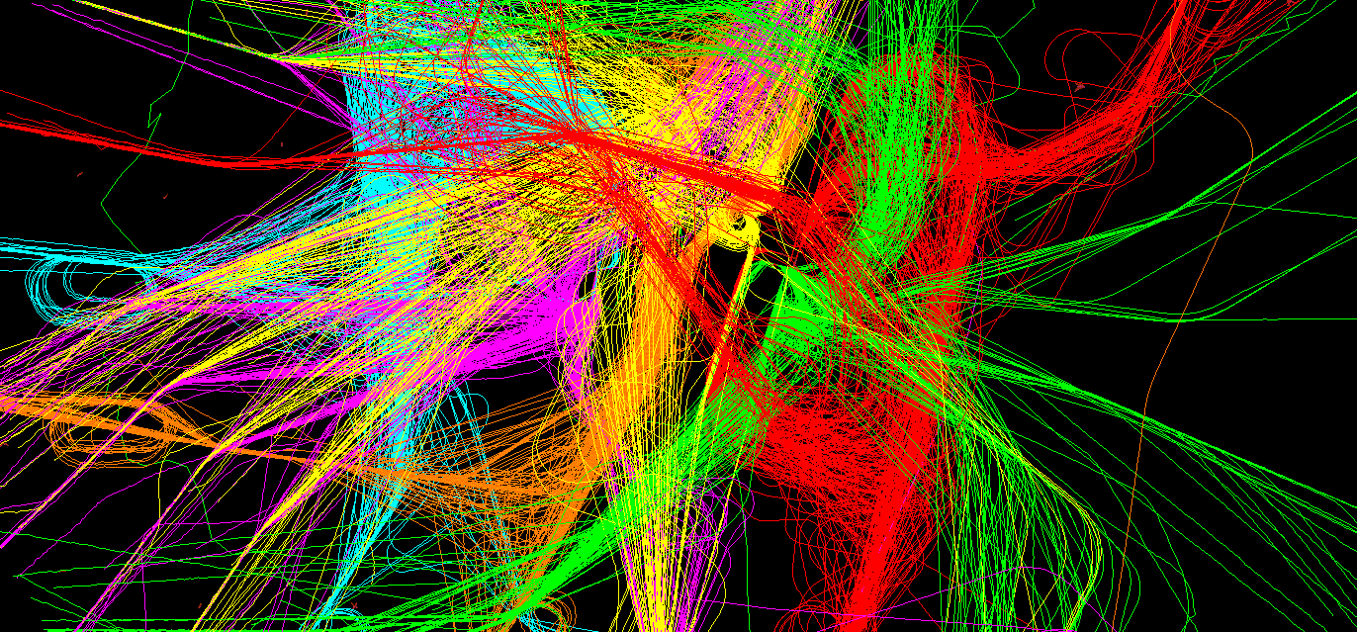
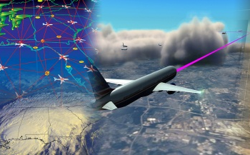
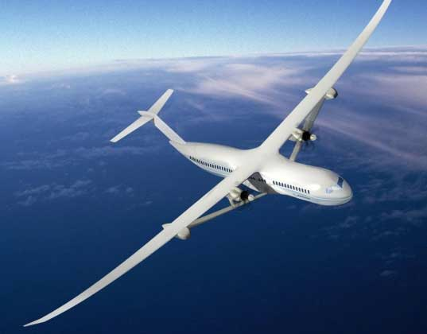
Summary
Economic Growth
High Quality Jobs
Revolutionary Mobility
Long-Term Sustainability
Innovative Solutions and High Payoff Technologies
Urgent Drivers

