Slide 1
Unmanned Aircraft Systems (UAS)
UAS Updates

Slide 2
Our New Executives & Their Roles
Mark “Hoot” Gibson
Senior Advisor on UAS Integration
Reports directly to Deputy Administrator on:
External outreach and education
Inter-agency initiatives
Enterprise-level approach to UAS integration efforts
Notes:
UAS Integration Office Roles and Responsibilities
The FAA made the decision to up-level its UAS Integration Office to a Directorate within the Aviation Safety Line of Business, with two Agency executives dedicated to integration efforts – a Director and a Senior Advisor to the Deputy Administrator.
Marke “Hoot” Gibson is the Senior Advisor on UAS Integration, reporting directly to the Deputy Administrator (ADA-1). He will be responsible for external outreach and education, inter-agency initiatives, and an ensuring an enterprise-level approach to the FAA’s management of UAS integration efforts.
Formerly Executive Director of the Next Gen Institute and distinguished career in Air Force (retired Major General)

Slide 3
Our New Executives & Their Roles
Earl Lawrence
Director of FAA’s UAS Integration Office
Reports directly to AVS Associate Administrator
Leads FAA’s effort to safely integrate UAS
Defining clear path for UAS manufacturers and operators
Notes:
UAS Integration Office Roles and Responsibilities
Formerly Director of Small Airplane Directorate and Senior Executive in AIR for UAS integration
Former Vice President for Industry & Regulatory Affairs at Experimental Aircraft Association
Earl Lawrence is the Director of the FAA’s UAS Integration Office, reporting directly to the Associate Administrator for Aviation Safety (AVS-1). He will be responsible for leading the agency’s effort to safely and effectively integrate UAS, defining a clear path for UAS manufacturers and operators.
Hoot and Earl officially started in their respective roles on September 20, 2015 and will work together to refine and execute the Agency’s vision for UAS integration moving forward.

Slide 4
Who is Operating UAS in the National Airspace System (NAS)?
 | Public Operations | Civil Operations (including Section 333) | Hobby or Recreational
Type | Governmental | Compensation or hire | Hobbyist
Requirements | Must be Public Aircraft Operator eligible & Certificate of Waiver or Authorization (COA) | Grant of Exemption & Certificate of Waiver or Authorization (COA) Special Airworthiness Cert | Must comply with Section 336 of FAA Modernization and Reform Act of 2012
Rules | Detailed in COA Self-certification of crew and equipment | Detailed in COA & Exemption Special Airworthiness Certificate Restricted Category Experimental (no comp or hire) | Generally must operate in visual line-of-sight, under 400’, avoid manned aircraft, operate during daylight hours and fly according to community-based safety guidelines
Examples | Federal Agencies State and Local Entities | Operators Agriculture Surveying | Members of Community Based Organization General Public

Slide 5
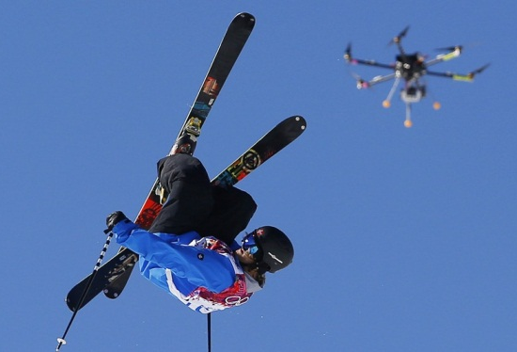
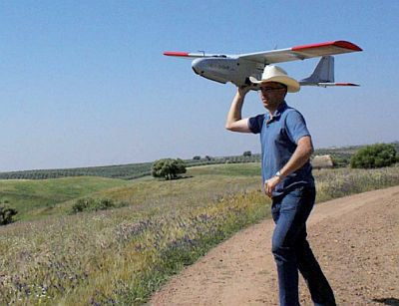
Proposed Small UAS Rule
Proposed framework of regulations to allow routine use of small UAS
Currently in DRAFT
Notice of Proposed Rulemaking (NPRM) Published to Federal Register on February 23, 2015
Public comment period concluded on April 24, 2015
Produced approximately 4,500 public comments
FAA expects to finalize rule in 2016
Notes:
Proposed framework of regulations that would allow routine use of certain small unmanned aircraft systems (UAS) in today’s aviation system, while maintaining flexibility to accommodate future technological innovations
Offers safety rules for small UAS (under 55 pounds) conducting non-recreational operations
Limits flights to daylight and visual-line-of-sight operations
Addresses height restrictions, operator certification, optional use of a visual observer, aircraft registration and marking, and operational limits
NPRM Comments
Public comment period closed April 24
4,542 comments submitted
200 comments from associations, companies, governmental entities and industry groups
Approximately 50% of individual comments were submitted as part of the Academy of Model Aeronautics (AMA) commenting campaign
Most popular comment subjects:
Beyond visual-line-of-sight
Flying over people
Operations from moving vehicles

Slide 6
Petitions for Section 333 Exemption
Bridge for commercial UAS operations before finalization of small UAS rule
More than 4,000 petitions received to date; more than 1,800 exemptions granted*
FAA has improved processing:
Streamlined Blanket COA (March 23)
Under 200’, within visual line of sight, during daylight hours, certain distances away from airports and heliports
Streamlined evaluation process (March 30)
http://www.faa.gov/uas/legislative_programs/section_333/
*as of October 6
Notes:
First exemptions granted September 25, 2014
There are a number of industries benefitting from Section 333 exemption, including motion picture and television filming, transportation, flare stack inspection, mine inspection, insurance, construction, pipeline inspection, infrastructure inspection, and more
A complete list of the Section 333 grantees is on our website; you can sort by Petitioner name or the date the petition was granted.
Based on language in FMRA Section 333, which grants the Secretary of Transportation the authority to determine whether an airworthiness certificate is necessary for certain UAS to operate safely in the NAS.

Slide 7
Focus Area Pathfinder Overview
Announced at AUVSI May 2015
Purpose: Identify the safety mitigations that can lead to expanded access for UAS and inform future rulemaking
Approach: Work with industry partners to gain operational approval for key UAS operations and establish a repeatable process
sUAS rule
BVLOS
Over People
EVLOS
Notes:
UAS meeting these criteria may be approved for certain operations
Approval considerations will be in accordance with the safety continuum and emerging airworthiness approval guidance

Slide 8
Focus Area Pathfinders
Three Focus Area Pathfinder Partners:
CNN
UAS in visual line of sight, urban areas over people
Precision Hawk
UAS in extended visual line of sight, rural areas
BNSF Railways
UAS beyond visual line of sight, rural areas

Slide 9
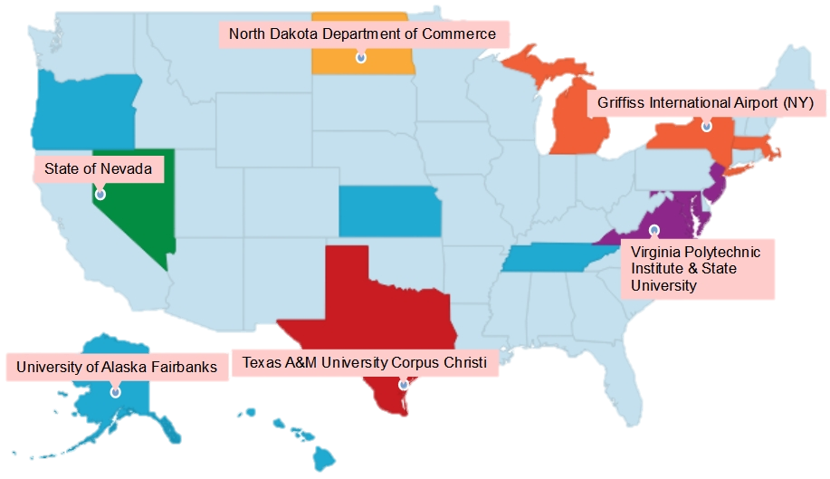
UAS Test Sites
Support UAS R&D
initiatives
FAA’s Test Site Data Lead
works through FAA William Hughes Technical Center
Test Sites provided research topics of interest in 2014
Designated Airworthiness Representatives at UAS Test Sites
Nevada is the only Test Site to use a DAR to date
Nationwide COA for operations under 400 feet issued to Test Sites on September 1, 2015
Notes:
Test Sites selected December 30, 2013
Test Site privacy policy also published December 30
All issued initial COA by August 2014
Four Technical Interchange Meetings held
William J. Hughes Technical Center, March 18-19, 2014
Virginia Tech, Blacksburg, VA, September 23-24, 2014
Nevada Test Site, March 31-April 1, 2015
University of Alaska Test Site, August 31-September 1, 2015
Data lead assigned to Test Sites – works out of Technical Center in Atlantic City
Test Sites also provided research topics of interest to the FAA in October 2014
North Dakota granted “Broad Area COA” covering most of the state on February 11
All Test Sites granted blanket 400’ COA on September 1
Broad Area COA covering airspace below 200’ was approved in late May 2015
The FAA issued an Order for Designated Airworthiness Representatives for UAS Certification at UAS Test Sites on September 17, 2014.
This order sets policy and provides training requirements limited to the issuance of special airworthiness certificates in the experimental category at UAS Test Sites. Experimental certificates are issued to aircraft that do not possess traditional airworthiness certificates, for specific operations including crew training or showing compliance with regulations.
UAS Test Site Master Agreements for funding research to the UAS Test Sites sent/released on FAA Contract Opportunities website on June 16
All Test Sites hosting Public Meetings in August-September

Slide 10
UAS Center of Excellence
http://www.assureuas.org/
Core Team__________________________________________________________________
Associate Members_____________________________________________________________________
Notes:
Selection announced May 8 – Alliance for System Safety of UAS through Research Excellence (ASSURE)
Lead university: Mississippi State University
Team includes: Drexel University; Embry Riddle Aeronautical University; Kansas State University; Kansas University; Montana State University; New Mexico State University; North Carolina State University; Oregon State University; University of Alabama – Huntsville; University of Alaska – Fairbanks; University of North Dakota; Wichita State University; The Ohio State University; University of California – Davis
Associate Members: Auburn University; Concordia University; Indiana State University; Louisiana Tech University; Tuskegee University; Southampton University
Focus: research, education and training in areas critical to safe and successful integration of UAS into the NAS
Initial research in: detect and avoid technology; low-altitude operations safety; control and communications; spectrum management; human factors; compatibility with air traffic control operations; and training and certification of UAS pilots and other crewmembers
Expected to begin research by September 2015 and be fully operational by January 2016
$5 million appropriated by Congress (5 years); will be matched one-by-one by team
Public meeting to be held on September 15; COE Quarterly Meeting will also take place September 15-16

Slide 11
UAS CoE Research Areas
Air Traffic Control Interoperability
Airport Ground Operation
Control and Communication
Detect and Avoid
Human Factors
Low Altitude Operations Safety
Noise Reduction
Spectrum Management
Notes:
Research areas fro CoE final Solicitation 08-12-14

Slide 12
UAS CoE Research Areas
UAS Crew Training and Certification, including Pilots
UAS Traffic Management
UAS Wake Separation Standards for UAS Integration into the NAS
Notes:
Research areas fro CoE final Solicitation 08-12-14

Slide 13
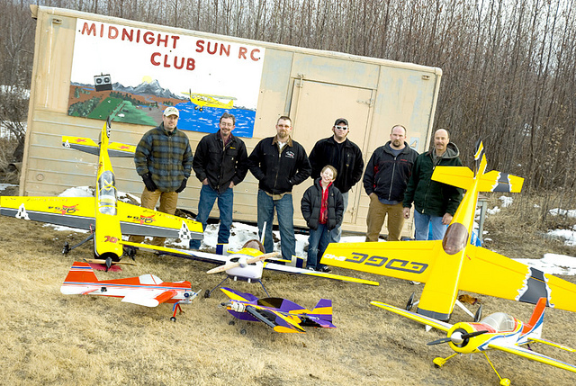
New World for Recreational Aircraft
Model aircraft have been around for decades, but there are new entrants into the recreational community
These types of aircraft may be purchased at a hobby shop or online for a few hundred dollars
Many of these new recreational operators do not have aviation experience, and may not know FAA model aircraft guidelines (AC 91-57A):
Avoid manned aircraft
Remain within visual line of sight
Notes:
Model aircraft operations are for hobby or recreational purposes only
The recreational community has changed as aircraft have become more accessible – in the past, model aircraft enthusiasts would build and fly their aircraft. Today, it is easy to visit a hobby shop or go online to purchase a highly advanced piece of technology which requires no aviation knowledge or experience
While many traditional model aircraft operators do follow the guidelines established by the FAA and promoted by national or local branches of a recreational club, many of these new users are unfamiliar with these guidelines, and are more likely to create safety risks

Slide 14
Education, Compliance, and Enforcement
FAA’s primary approach to new UAS operators is education
FAA has authority to take enforcement action against any persons who operate a UAS:
In violation of the Federal Aviation Regulations (FARs)
In a manner that endangers the safety of the NAS or people and property on the ground
Enforcement tools include:
Warning notices, letters of correction, civil penalties
Notes:
The FAA has been reaching out to the public to inform all that UAS is an aviation industry and must act accordingly with regard to aviation safety rules.
So, if someone does violate any CFRs, or if they endanger the NAS or people and property on the ground or in the air while flying their UAS, they could get enforcement from the FAA.
That could result in a warning notice, a letter of correction, certificate action, or even a civil penalty.
FAA Guidance to Inspectors
See 8900.313
Compliance and Enforcement Bulletin published January 2015
- Defines authorized vs. unauthorized operations
- Outlines actions for violators

Slide 15
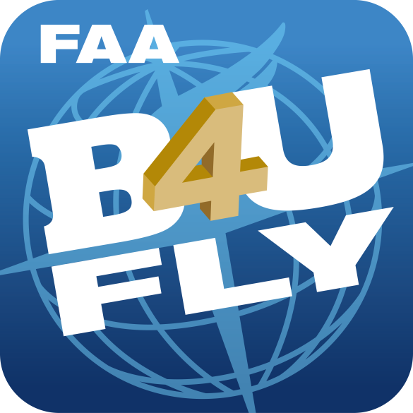
UAS Outreach Initiatives
www.faa.gov/uas
Notes:
Know Before You Fly
Announced December 22, 2014
Provides prospective UAS users with information and guidance to fly safely and responsibly
Founding members: AUVSI, Academy of Model Aeronautics (AMA) and the Small UAV Coalition
FAA reached voluntary agreement with UAS manufacturers to include guidance materials in packaging
DJI, Parrot, and Yuneec Electrical Aviation
www.knowbeforeyoufly.org
B4UFLY Smartphone App
Announced at AUVSI Unmanned Systems 2015 on May 6
Designed to provide model aircraft situational awareness of any restrictions or requirements prior to flight
Limited beta test began August 28
1,000 users
Will last two months, then available to general public
Initially iOS; Android version to follow
www.faa.gov/uas/b4ufly
No Drone Zone
Education about federal rules prohibiting aircraft from operating in the Flight Restricted Zone around Washington, DC
Digital toolkit of outreach materials available to partners
Cross-agency outreach effort
www.faa.gov/uas/no_drone_zone

Slide 16
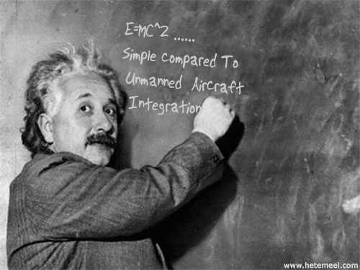
Questions?
www.FAA.gov/UAS

