Slide 1
NextGen Update
Pamela Whitley
REDAC Meeting
October 7, 2015

Slide 2
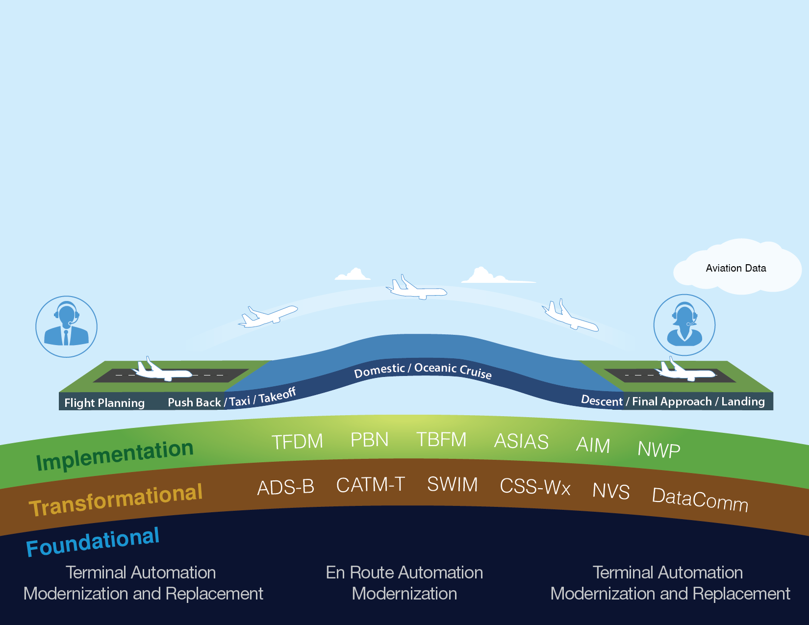
Delivering NextGen Improvements
Legacy System
NextGen
Radar
Inefficient Routes
Voice Communications
Disparate Information
Fragmented Weather Forecasting
Weather Restricted Visibility
Forensic Safety Systems
Nationwide Focus
Satellite
Performance Based Navigation (fuel savings)
Voice & Digital Communications
Automated Decision Support Tools
Integrated Weather Information
Improved Access in Low Visibility
Prognostic Safety Systems
Focus on Congested Metroplexes
2

Slide 3
NextGen Accomplishments
NextGen Now
Infrastructure
ERAM
Surveillance
ADS-B
Navigation
PBN & Metroplex
Information Management
SWIM
Separation Standards
Wake Recat
Decision Support Tools
TFMS and CATM
NextGen Future
Infrastructure
Completion of TAMR
Communication
NAS Voice System & Data Communications
Navigation
PBN & Metroplex (more)
Information Management SWIM (enhancements)
Equipage
Equipage 2020
Collaboration
Completion of NextGen Priorities
3

Slide 4

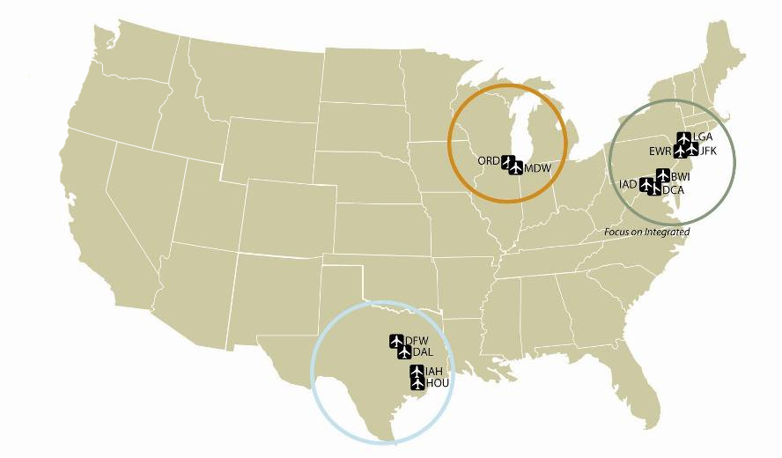
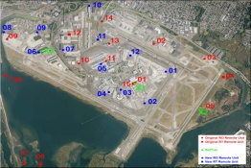
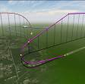
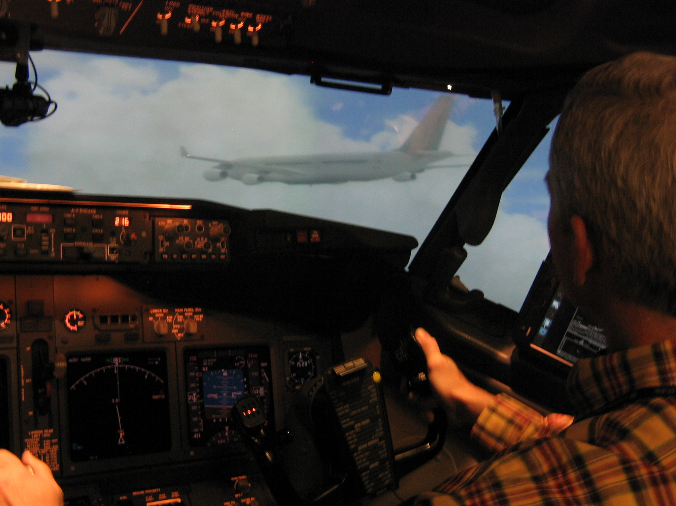
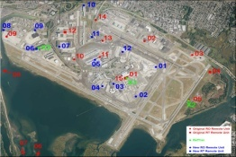

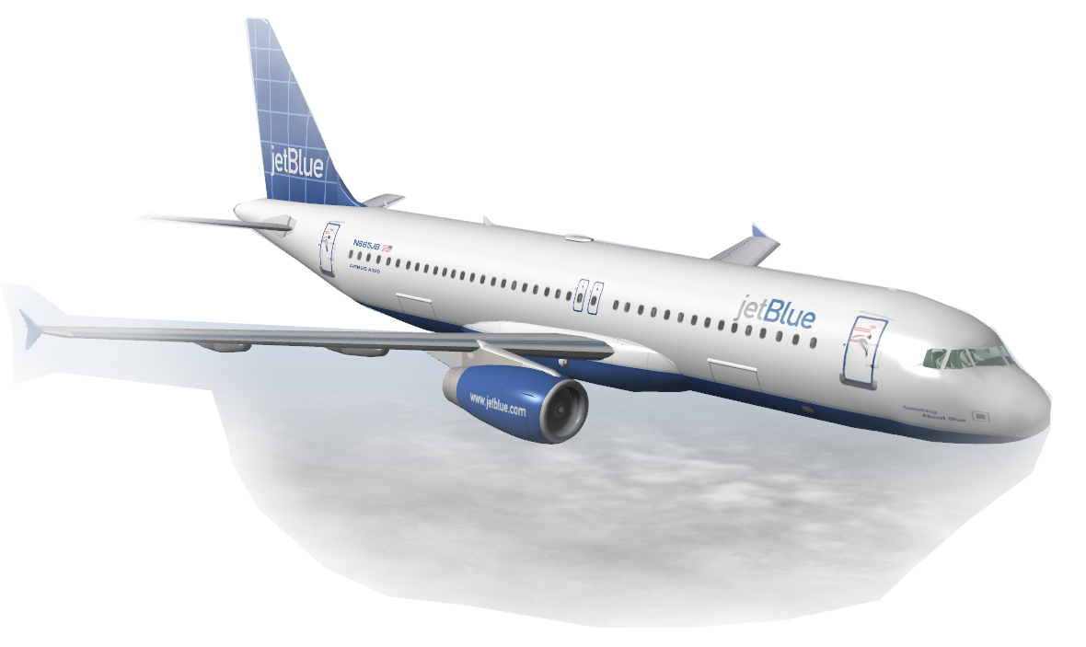
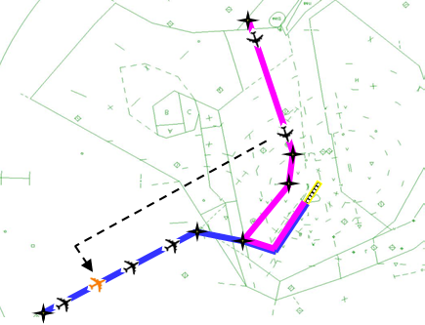

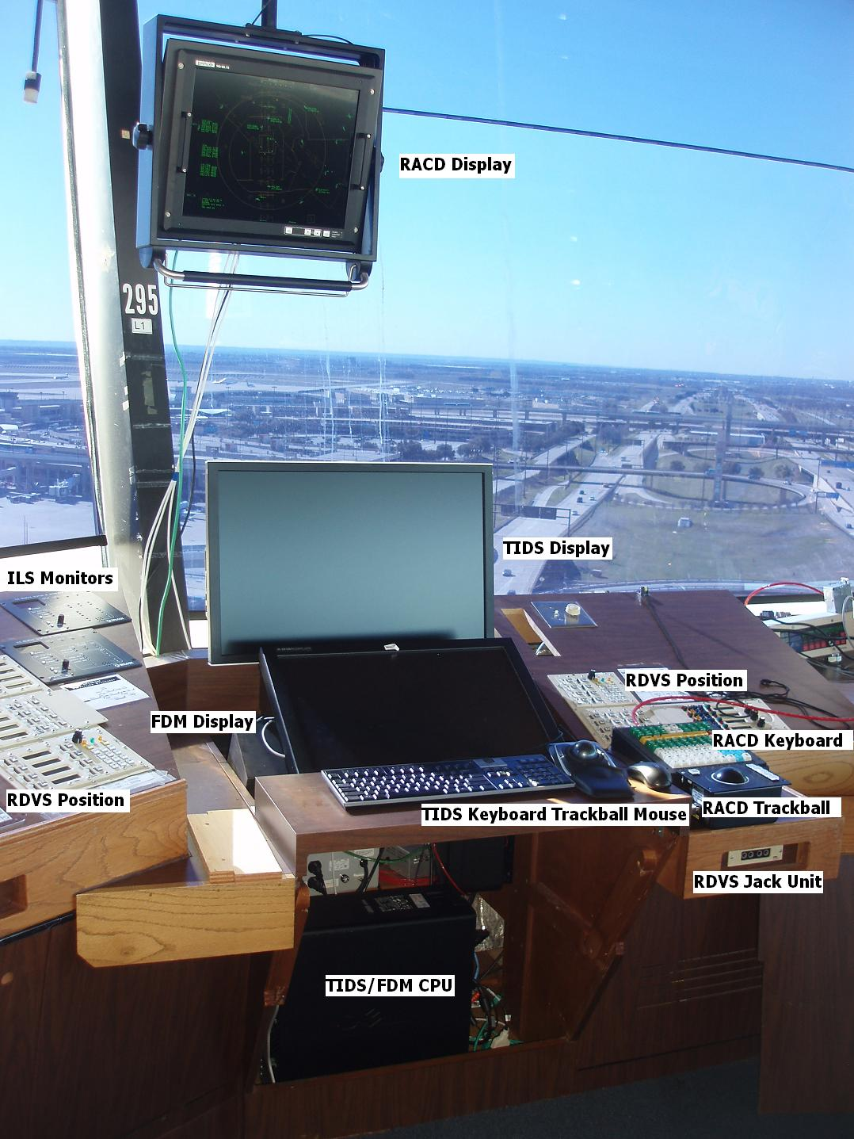
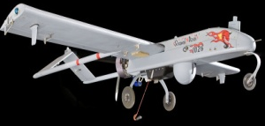
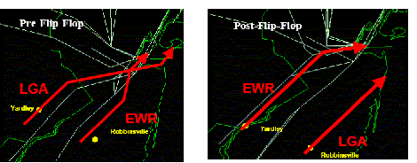
Incremental Approach to Implementing NextGen
Produces Benefits and Builds a Foundation
Best Equipped Best Served Prototyping
Airspace Deconflict
Airspace Deconflict
Surface Management
Tailored Arrivals
GBAS
3D PAM
CSPO
RPI
Optimized
Profile
Descent
ADS-B Routes
Airspace Deconflict
Surface Management
Surface
Management
DFW
4-D FMS
DFW
Staffed NextGen Tower
Tailored
Arrivals
UAS
Notes:
4
4
NextGen is a portfolio of investments
There will be incremental progress as the FAA implements NextGen solutions and capabilities throughout the near and mid-term.
This new infrastructure and associated capabilities will provide a foundation for expanded capabilities and benefits that will be introduced over the long term.
The approach to implementing NextGen is very targeted with greater emphasis being placed up front on the capabilities and locations that will offer the greatest benefit
We also have a number of ongoing demonstration activities to help mature capabilities before they become operations
We have made significant progress towards implementing NextGen
The FAA met 94 percent of our high-priority NextGen goals for the year
While significant progress has been made to date, we must continue to find ways to leverage opportunities to realize benefits sooner

