Slide 1
AVS R&D Program
F&R
Human Factors Subcommittee
Mark S. Orr
24 Feb. 2015

Slide 2
Agenda
F&Rs
ID #: Fall_2013_30 Subcommittee: Human Factors
AVS RE&D Process
Strategic Guidance
Continual Improvement
Vision
ID #: Spring_2014_09 Subcommittee: Human Factors
FRMS activities and planned research

Slide 3
F&R
ID #: Fall_2013_30 Subcommittee: Human Factors
DFO Name: Jason Demagalski Recommendation Assignee Name: Mark Orr
Recommendation: AVS should undertake a process improvement activity to refine the requirements generation process to address the issues defined above. Specifically:
clarify the inputs needed for the milestones and project phase template items,
include in the template a means to appropriately weight cross-cutting requirements and ways in which the current requirement builds upon previous work, and
consider surveying those who have written requirements concerning their experience of the process and areas where further guidance would be helpful.
Status History
Date: 09/17/2014 Status: Action reassigned to AVS R&D Manager Mark Orr. Mark presented on this to SAS REDAC Subcommittee at Summer 2014 meeting about intentions to get beyond the process. The HF subcommittee wants to know how process is maturing and how HF is included in that process. Mark explained that more of HF requirements have made it above the line in FY16. Mark also gave the SAS meeting a presentation on Strategic guidance in the AVS processes such as CAST. In to the future, the plan it to look at not only what AVS knows but also what is emerging. Three actions will progress this recommendation:-
1 – Copy of guidance for FY16 budget year to HF REDAC (Sent FY16 & FY17 SG on 9/30/14)
2 – Copies of paper products provided to SAS meeting (Sent files on 9/24/14)
3 – Update briefing to be given to HF Subcommittee at Feb 15 Meeting on the AVS Process.
(Briefing follows)
Current Status Date: 9/17/2014 Current Status: OPEN

Slide 4
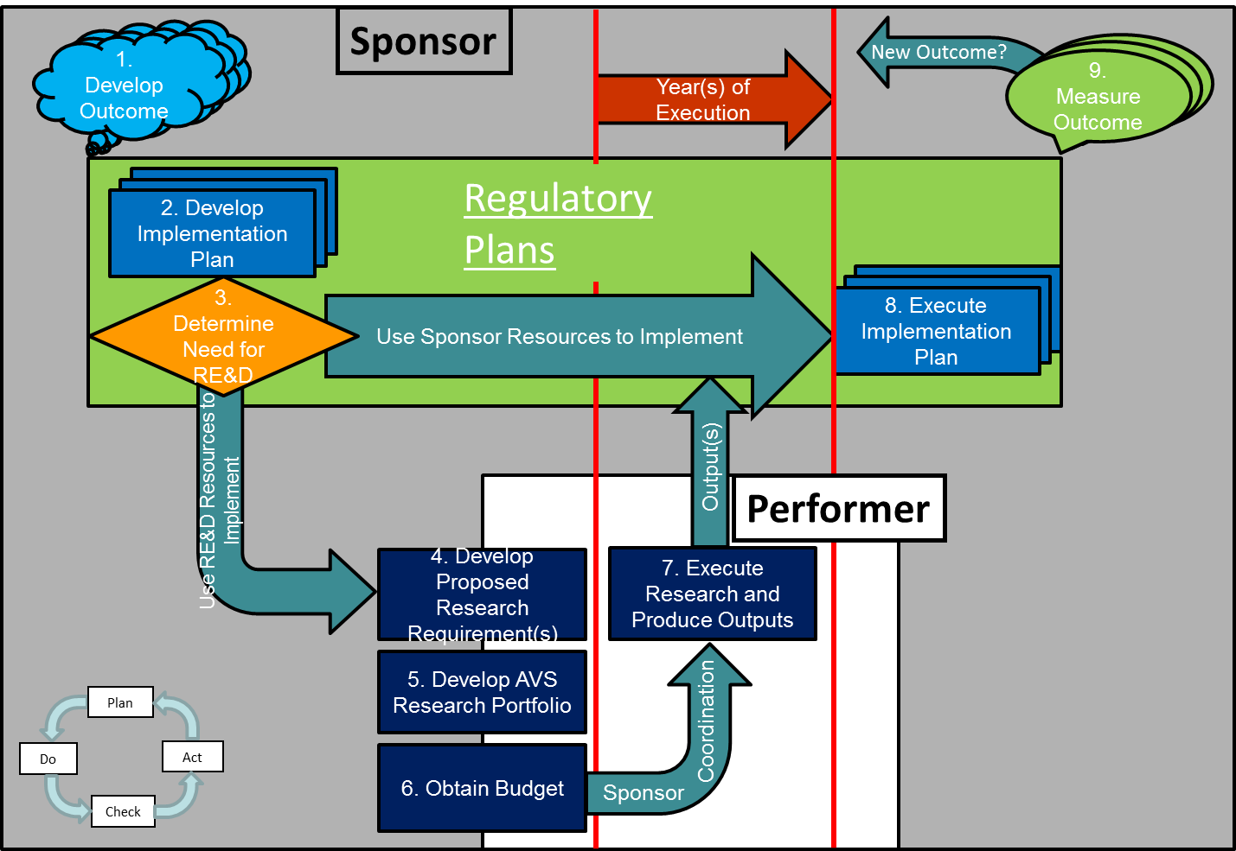
AVS R&D Life-cycle Model

Slide 5
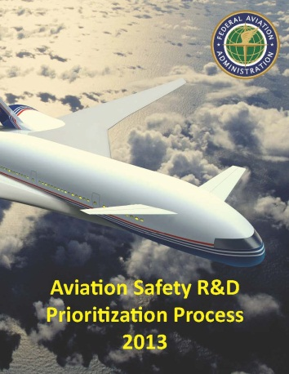
The Process
Develop portfolio & budget Programming
Release Strategic Guidance
Collect proposals
Prioritize
Program projected funding per prioritized list
(Mendoza Line)
Management reviews, changes & approves
Manage budget changes
Adjust portfolio in response to changes (e.g. Sponsors, OMB, OST, PC&B, Congress)
Management reviews, changes & approvals
Year-of-execution planning and research
Sponsor Requirement Execution Plans (REP) & Provider Research Execution Plans (PREP)
Monthly Status Reports (MSR) & sponsor reviews and approvals
Year-of-execution unbudgeted research
Prioritize
Program budgeted funding per prioritized list
Management reviews, changes & approves
Sponsor implementation & Outcome measurement
FY-3
FY-2
FY-1
FY-0
FY+

Slide 6
AVS Mission Focus
Three primary focus areas
Continued Operational Safety
Ensure existing certificate holders continue to meet the safety requirements, standards, and regulations of their original certification
Standards & Policy
Create & amend as necessary the rules & standards that provide for the safety of the U.S. civil aviation system
Certification
Issue and renew certificates for
Type Design
Operations
Manufacturing aircraft and avionics
Maintenance services

Slide 7
Evaluation Criteria
AVS Research Portfolio
1.0
Address Safety Risks
0.43
Develop Regulations and Standards
0.35
Respond to other influences
0.22
XOR
Criteria 1: Potential to Prevent or Mitigate Safety Risks
0.43
Criteria 2: Enhance Existing Safety Regulations and Standards
0.35
Criteria 3: Develop New Safety Regulations and Standards
0.35
Criteria 4: Fulfilling commitments in response to Internal and External Drivers
0.22

Slide 8
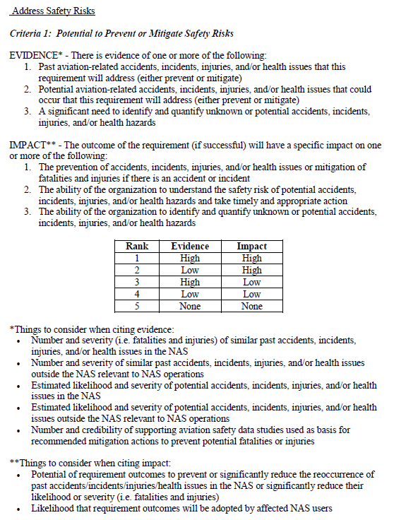
AVS R&D Ranking Criteria
Criteria: address the 3 criteria that make the strongest case for the requirement.
Evidence & Impact: cite safety data in the justifications to back up the evidence and impact.
Ranking: determine 1-5 based on the strength of the evidence and impact using this table.
Things to consider: use these to help when writing evidence and impact justifications.

Slide 9
Strategic Guidance
The Strategic Guidance is…
Used to provide focused safety hazard and risk data to the research sponsoring offices
Intended to provide some examples of safety hazard and risk data that may drive research; however S/O’s should also consider other data sources
Supportive of implementation of Safety Management System (SMS) processes
Intended to be used as guidance for sponsoring offices and TCRGs to consider as they develop requirements
Used by sponsor management to apply adequate resources for requirement development
The Strategic Guidance is NOT…
AVS Strategic Guidance (SG) is not a checklist for the AVS RED Group

Slide 10
FY17 SG Development
Risk Based Approach
AVP-200 reviewed data sources to identify high priority hazards and risks to the NAS
Purpose was to stimulate multi-disciplinary and coordinated efforts across AVS to enable AVS to meet its safety goals
Each AVS office and TCRG encouraged to address trends in data to submit strong research requests
Aviation Safety Hazards and Risks for AVS-Wide Considerations
Risks to aviation safety in the current NAS
Emerging risks to aviation safety
Key technology areas
General statement only about maintaining key in-house capabilities competencies

Slide 11
FY17 SG – Risks to Aviation Safety in the Current NAS
Address documented and significant risks through a critical review of accident statistics (GAJSC & CAST)
The following event types have maintained established trends
Loss of Control – Inflight (All flight phases)
Controlled Flight Into Terrain (Including wires and obstacles)
Collisions (Including runway incursions, midair, and runway excursions)
System/Component Failures (Both powerplant and non-powerplant)

Slide 12
FY17 SG – Emerging Risks to Aviation Safety
Identifying future hazards with a potential to result in significant safety risks
Anticipating and preparing for future risks
Anticipated risks gleaned from government and industry studies and reports that rely on historical data, statistical trends and the input of subject matter experts
Human-Centered:
Human-Automation Interaction
Human Fatigue
Workforce Fluctuations and Shortages
Components and Systems:
Aircraft Mixed Fleet Equipage
Assurance of Functional Integrity for Critical Systems
Certification Methods for Complex Systems (e.g., Software)
Information and Systems Security
Interoperability and System Incompatibilities
Safety Management Systems:
Data Collection, Management and Analysis; Data Protection and Sharing
System Safety Assessment Methods and Tools

Slide 13
Data Sources Considered in Development of SG
Current Risks
Commercial Aviation Safety Team (CAST) – Domestic Part 121 Accidents through 2010
General Aviation Joint Steering Committee – Occurrence Reports through 2010
For the CAST/ICAO Occurrence Taxonomy: http://intlaviationsstandards.org/CommonTaxonomies.html
Boeing Statistical Summary of Commercial Jet Airplane Accidents Worldwide 1959 – 2010
NALL Report 2010 (AOPA)
NTSB: Review of U.S. Civil Aviation Accidents 2007-2009 & Most Wanted List – July 2011
To reduce duplication of resources and for productive allocation of research funds, ongoing or planned efforts to address these hazards should be taken into consideration, such as research activities within or outside the FAA, industry activities, legislative efforts, etc.,.
NTSB data through 2005 shows Personnel as the most common contributing factor category across commercial and general aviation sectors (as compared to Environment or Mechanical).
Emerging Risks
Department of Transportation Inspector General (DOT IG) Report to the FAA, “Timely Actions Needed to Advance the Next Generation Air Transportation System,” June 2010, Report Number: AV-2010-068
Joint Planning and Development Office (JPDO) 2012 National Aviation Safety Strategic Plan
JPDO 2010 Safety Working Group Capability Safety Assessment
NASA Aviation Safety Assessment Team Program Research (research article in press)
Issues are organized in alphabetical order only – placement does not suggest priority.
Society of Automotive Engineers (SAE) ARP4754A and EUROCONTROL ED–79A, “Guidelines For Development Of Civil Aircraft and Systems”

Slide 14
Continual Improvement
Standard Process
Annual kick-off meetings (held three 3-hour sessions in May 2014, ALL invited)
Discussed roles & responsibilities
Detailed sponsor vs. performer input fields
Stressed the importance of the Criteria Justifications
Presented AVS Sponsor tips for writing a requirement
Presented the FY17 Strategic Guidance and Process Supplement
Walked through the schedule in detail
Walked through the AVS RE&D Management Sharepoint site including how to create a write-up
Stressed availability of AVS R&D Team for assistance
AVS RED Group lessons learned collected and addressed each year. Specifically for FY17 cycle:
Added new and updated guidance to input form fields
Removed obsolete input form fields
Added OPI comment field on input form per request
Deployed new “standard” cost estimate sheet that was used across all requirements
Current Improvement Efforts for FY18
Major rework of input form
New instructions for completing the form
Extensively revised instructions for research plan section
Standardized criteria evaluation rubrics
Updated embedded guidance
Improved logical flow of form
Clarification of terms
Added new “look-ahead” section of FY18 SG developed by CSTA/STS’
Initiated a Working Group to develop improved project status reporting process

Slide 15
RE&D Vision
Life Cycle approach
Outcome based
Driven by safety risks
Active Sponsorship
Project-based research requirements
Approve initial project once
Measure and Manage project to obtain outputs in support of sponsor implementation plans

Slide 16
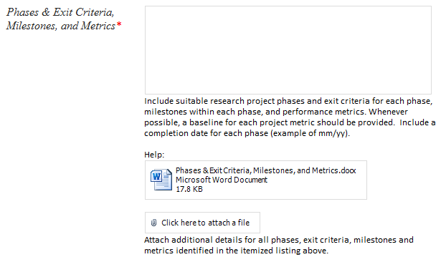
Recommendation Closure
Recommendation: AVS should undertake a process improvement activity to refine the requirements generation process to address the issues defined above. Specifically:
clarify the inputs needed for the milestones and project phase template items,
include in the template a means to appropriately weight cross-cutting requirements and ways in which the current requirement builds upon previous work, and
consider surveying those who have written requirements concerning their experience of the process and areas where further guidance would be helpful.
Specific guidance embedded in input form
Instructions briefed at the beginning of each cycle
AVS R&D Team available for consultation year-round
Requirements are prioritized based on the justifications for the criteria (i.e. safety case and FAA commitments)
Process was changed in 2013 to encourage more focus (i.e. single sponsoring office, single sponsor POC, implementation and outcome dates)
Fields to specify related offices and other research
NextGen linkage process available
Comments, questions, & suggestions collected year-round
AVS R&D Team available for consultation year-round

Slide 17
F&R - cont
ID #: Spring_2014_09 Subcommittee: Human Factors
DFO Name: Jason Demagalski Recommendation Assignee Name: Mark Orr
Recommendation (7): To ensure that the pilot scheduling rules called for under CFR 117 are meeting their intended fatigue reduction goals, and for the reasons also cited in previous recommendations, the proposed research developing a FRMS database should be moved earlier, i.e., viewed as a pop-up within FY 2014 and/or scheduled to start in FY 2015.
Status History:
Date: 09/17/2014 Status: Activities have been ongoing to work with MITRE to discuss development of this database. Currently assessing the feasibility of getting this data from the data owners. Recommend keeping this open and a briefing be provided at Spring 2015 meeting.
Current Status Date: 09/17/2014 Current Status: OPEN

Slide 18
Fatigue Risk Management
Current State
CFR 117 requires operators to have Fatigue Risk Management Plans (FRMPs) and to collect and report data
AFS-200 is receiving reports (no database)
Current Work/Plan
FY14/FY15
Working with CAASD (OPS $) on:
Draft non-disclosure agreement to facilitate getting de-identified data
Soliciting participants for a demonstration
Contracts to develop Fatigue Risk Management System (FRMS) database (OPS $)
FY16/FY17
Research planned (A11g.HF.8) to analyze data from FRMS database to study effectiveness of programs and to make recommendations on future guidance (RED $)

