Slide 1
Federal Aviation
Administration
Human Factors
Civil Aerospace Medical Institute (CAMI) Human Factors Research Division
Carla Hackworth, Ph.D. (AAM-500)

Slide 2
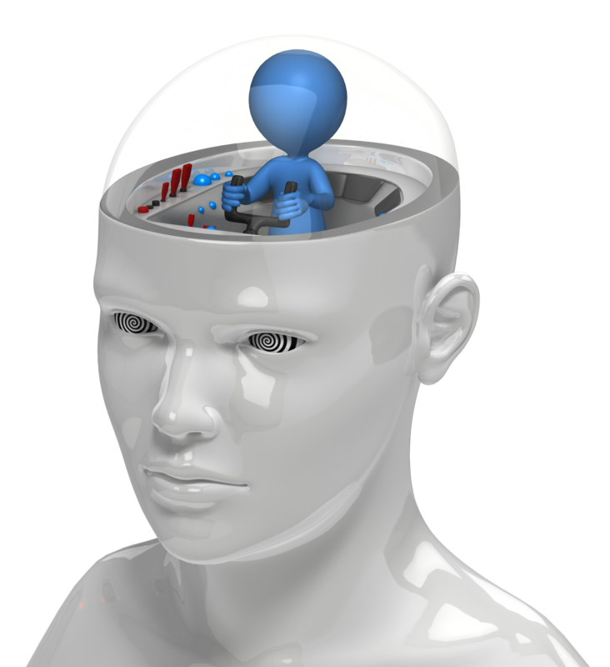
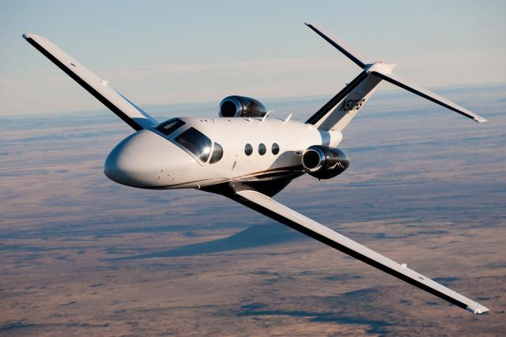
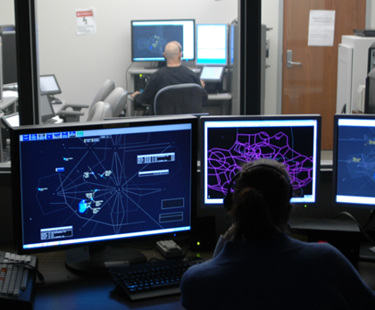
Human Factors Research Division (AAM-500)
  Flight Deck Human Factors Research Branch
  Air Traffic/Tech Ops Human Factors Research Branch

Slide 3
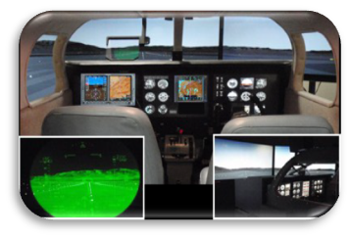
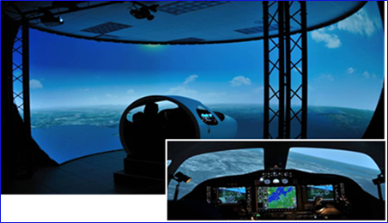
Flight Deck Human Factors
  Determine the effects of stressors on human performance, identify human factors involved in accidents and incidents, and quantify the effects of advanced NextGen displays, procedures, and task design on pilot performance.
  Simulation Research Capabilities:
        GA, UAS, & Rotorcraft
  Biophysiological Research
        Fatigue risk management
        LED lighting and Color Vision Requirements
  Human and Organizational Assessment
        Surveys, Training Assessments, and System Safety Reviews

Slide 4
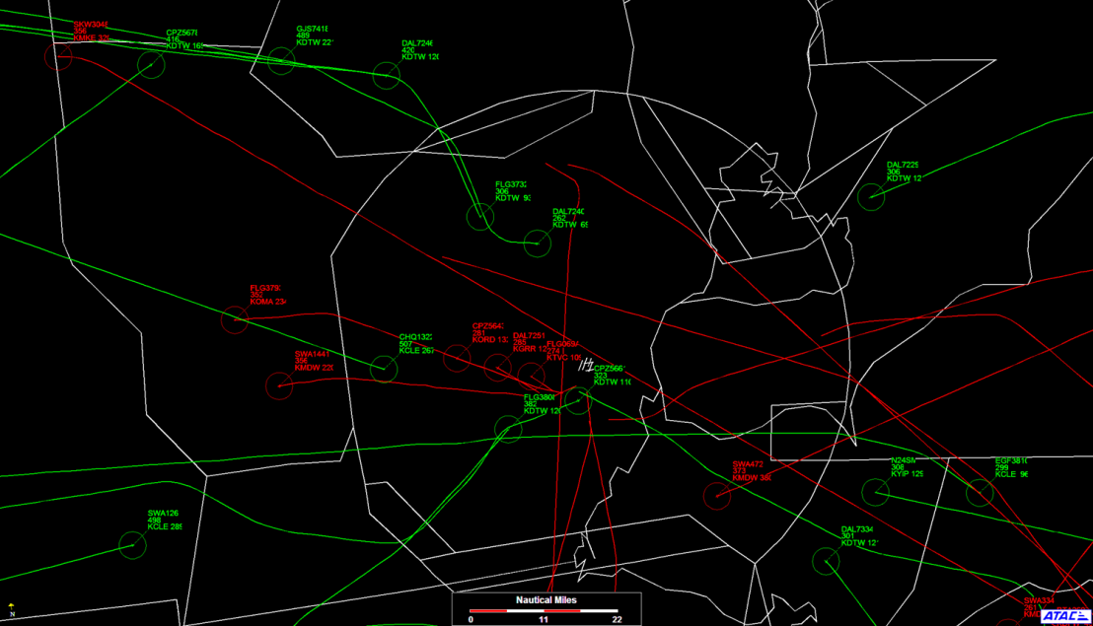
Air Traffic/Tech Ops Human Factors
  Research focuses on the relationship of factors affecting individuals, work groups, and organizations in the work environment. Examines improved person-job fit through training and changes to technology.
Training and Performance
        Conduct job analyses, develop individual and group job performance metrics
        Develop, deliver, and evaluate training programs
        Develop assessment methods (e.g., tests and questionnaires)
Air Traffic Simulation
        Assess trust in automation
        Identify information requirements and evaluate new technologies
        Conduct HITL simulations of current/future ATC environments

Slide 5
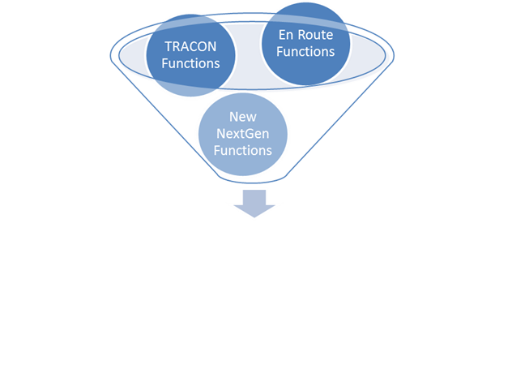
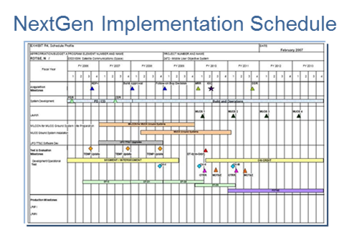
REDAC Rec: System Information Mgmt
  Increasing the similarity of En Route and TRACON interfaces can provide cost savings for system development and training
The Common Information Requirements project will explore ways to make en route and TRACON interfaces more similar.
Document information requirements, obtain recommendations about changes needed to make the human-system interface more similar
Recommend when proposed HSI changes should be made

Slide 6
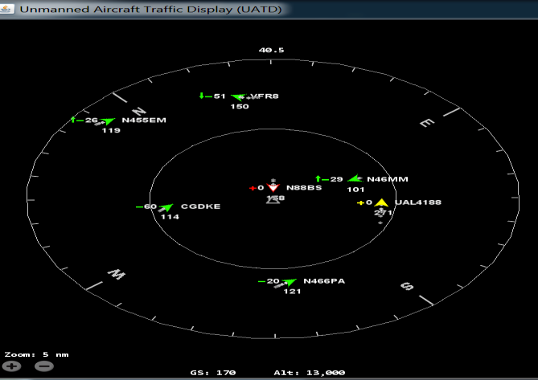
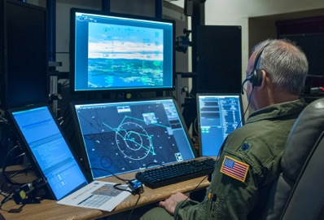
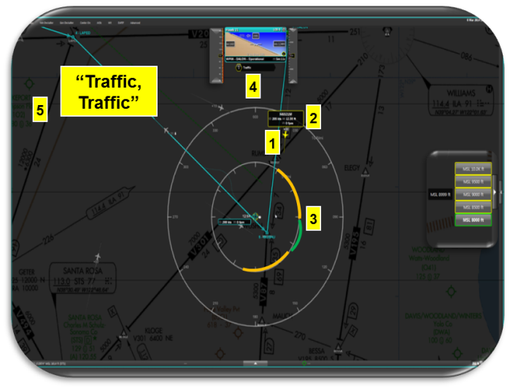
  REDAC Rec: Integration of UAS into the NAS
  Detect and Avoid (DAA) Display Requirements
  Support DAA display validation efforts
UATD
Vigilant Spirit Control Station
Autoresolver

Slide 7
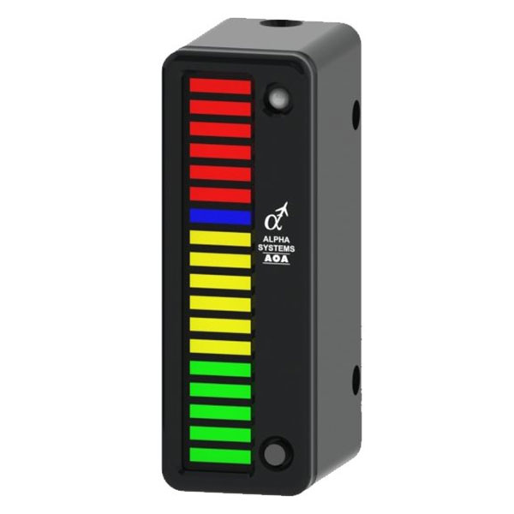
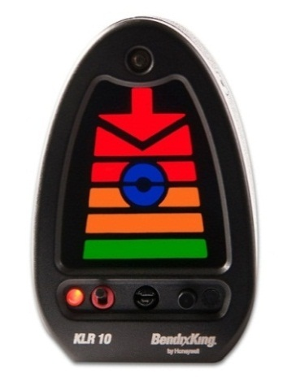
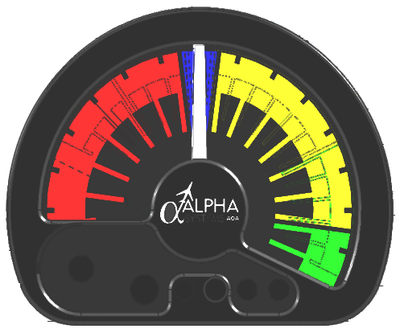
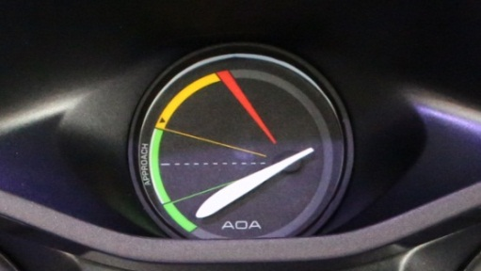
REDAC Rec: Human-Machine Interface Design, Integration, and Certification
Evaluate existing & potential add-on after-market AoA displays
  Define/compare categories of displays/instrumentation
  Examine in context of specific flight tasks
  Identify display features critical to providing usable data
  Generate guidance/recommendations for:
    Design
    Certification
    Use in small GA aircraft

Slide 8
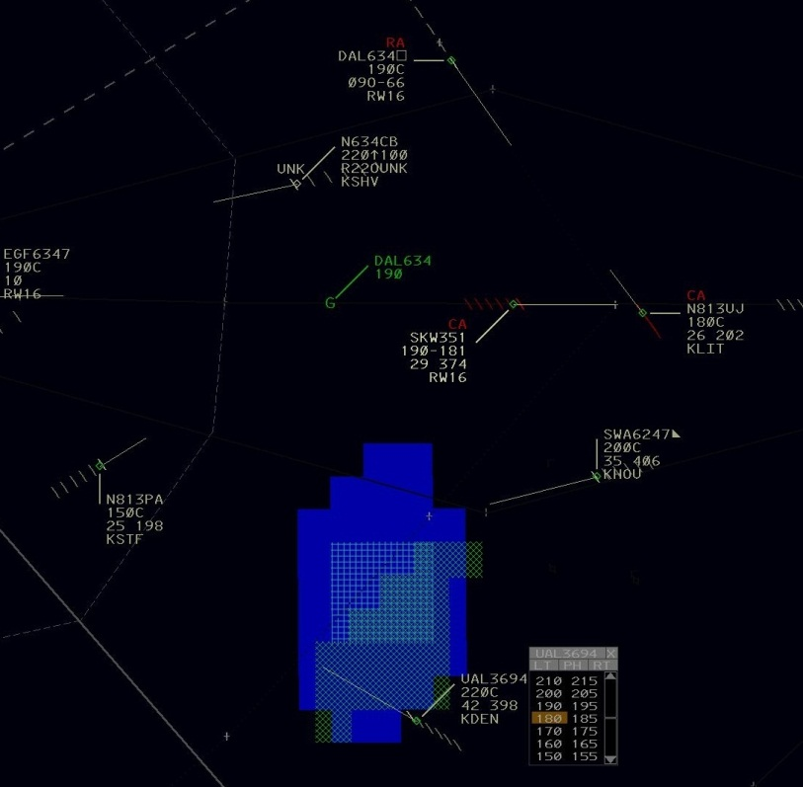
REDAC Rec:Human-Machine Interface Design, Integration, and Certification
  Standardized Scenario Development will develop a small set of scenarios that incorporate off-nominal events into testing of new systems. A more complete set of scenarios could be produced if funding were available.

Slide 9
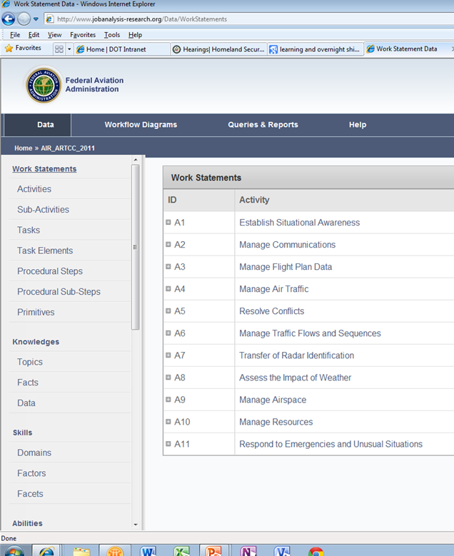
REDAC Rec: Workforce Selection, Training, and Proficiency
Strategic Job Analysis is being used to identify tasks expected to be performed and abilities expected to be required in future jobs involving risk-based decision making
Job Analysis Information Database links ATC JAs, will support JA comparisons

Slide 10
Future Considerations
  System Information Management
      Identify how/ why various information systems are being used today
      Assess the value of new information systems
      Determine risks associated with new informations systems as they relate to workload, distractions, performance, and errors
  Automation roles and responsibilities
      Develop methods to ensure appropriate levels of trust in automation
      Identify risks and mitigations associated with automation
      Management of information complexity

Slide 11
Future Considerations
  Integration of UAS/RPAS into the NAS
      Identify the human requirements for operators
      Determine appropriate skills and knowledge for training and proficiency requirements
  Dealing with Mixed Equipage Operations in the Design and Evolution of the NAS
      Use standardized scenarios to assess potential impact of mixed equipage operations

Slide 12
Future Considerations
  Human-Machine Interface Design, Integration, and Certification
      Develop a Human Factors process for design, engineering, integration, training and procedure development
      Assess human performance envelopes for human and automated system components to avoid degraded performance

Slide 13
Future Considerations
  Workforce Selection, Training, and Proficiency
      Use Strategic Job Analysis to identify future knowledge, skill, & aptitude requirements
      Measurement and improvement of controller performance when using new ATC tools and automation.
      Develop controller agent model to predict impact of new tasks on performance.
      Human factors issues on existing Crew Resource Management practices and training

Slide 14
Questions?

