Slide 1
John E. Marksteiner
Advanced concepts and Technology Development Office, NextGen
Federal Aviation Administration
NextGen Briefing and Update
(As of July 2015)
Presented by

Slide 2
Outline
Background
Foundational Programs
Transformational Programs
Portfolios/Pre-Implementation Programs

Slide 3

Aviation’s Impact on the U.S. Economy
Aviation Contributions
$1.5 trillion to the National Economy
5.4 percent of GDP
$459 billion in earnings

Slide 4


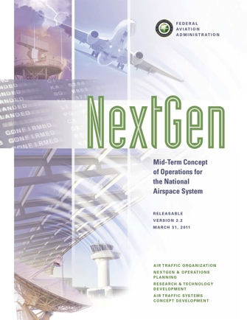




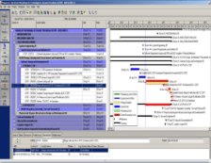
NextGen Foundational Documents
External Communications
NAS Concept of Operations and Vision for the Future of Aviation
JPDO Concept of Operations for the Next Generation Air Transportation System
NextGen Implementation Plan (NGIP)
Mid-Term Concept of Operations for the National Airspace System
2002
2003
2004
2005
2006
2007
2008
2009
2010
2011
2012
2013
2014
NAS Enterprise Architecture (EA)
Integrated Master Schedule (IMS)
Capital Investment Plan (CIP)
NAS Segment Implementation Plan (NSIP)
Internal Communications
4
Notes:
NextGen concepts have established roots.
The NextGen concepts are rooted in the RTCA concept in 2002.
JPDO concept updated the RTCA concept and added the multiagency view
Tied NASA research objectives to FAA implementation
The NextGen Midterm concept refined the JPDO concept for FAA.
Melded FAA implementation with NASA mid term research
Does not include NASA farther term research in JPDO concept
The NAS Enterprise Architecture and the Capital Investment plan pre-date NextGen
NextGen has been added to these foundational planning documents.
The NextGen Segment Implementation Plan (NSIP) added a more detailed programmatic view of NextGen initiatives
NextGen Implementation Plan became the higher level external communication of the NSIP
The Integrated Master Schedule is the networked schedule view of planning, pre implementation, and program execution activities to achieve a NextGen capability

Slide 5
NextGen is more than just a…
Single project. It is the integration of many projects, concepts,
and technologies.
Program plan. It is the integration of many program plans, some new and some ongoing, to deliver new service capabilities to meet increasing needs.
New system. It is the integration of
  new systems,
  new procedures,
  new aircraft performance capabilities,
  renewable fuels,
  new supporting infrastructure, and
  a new way to do business
  as the Air Transportation System.

Slide 6
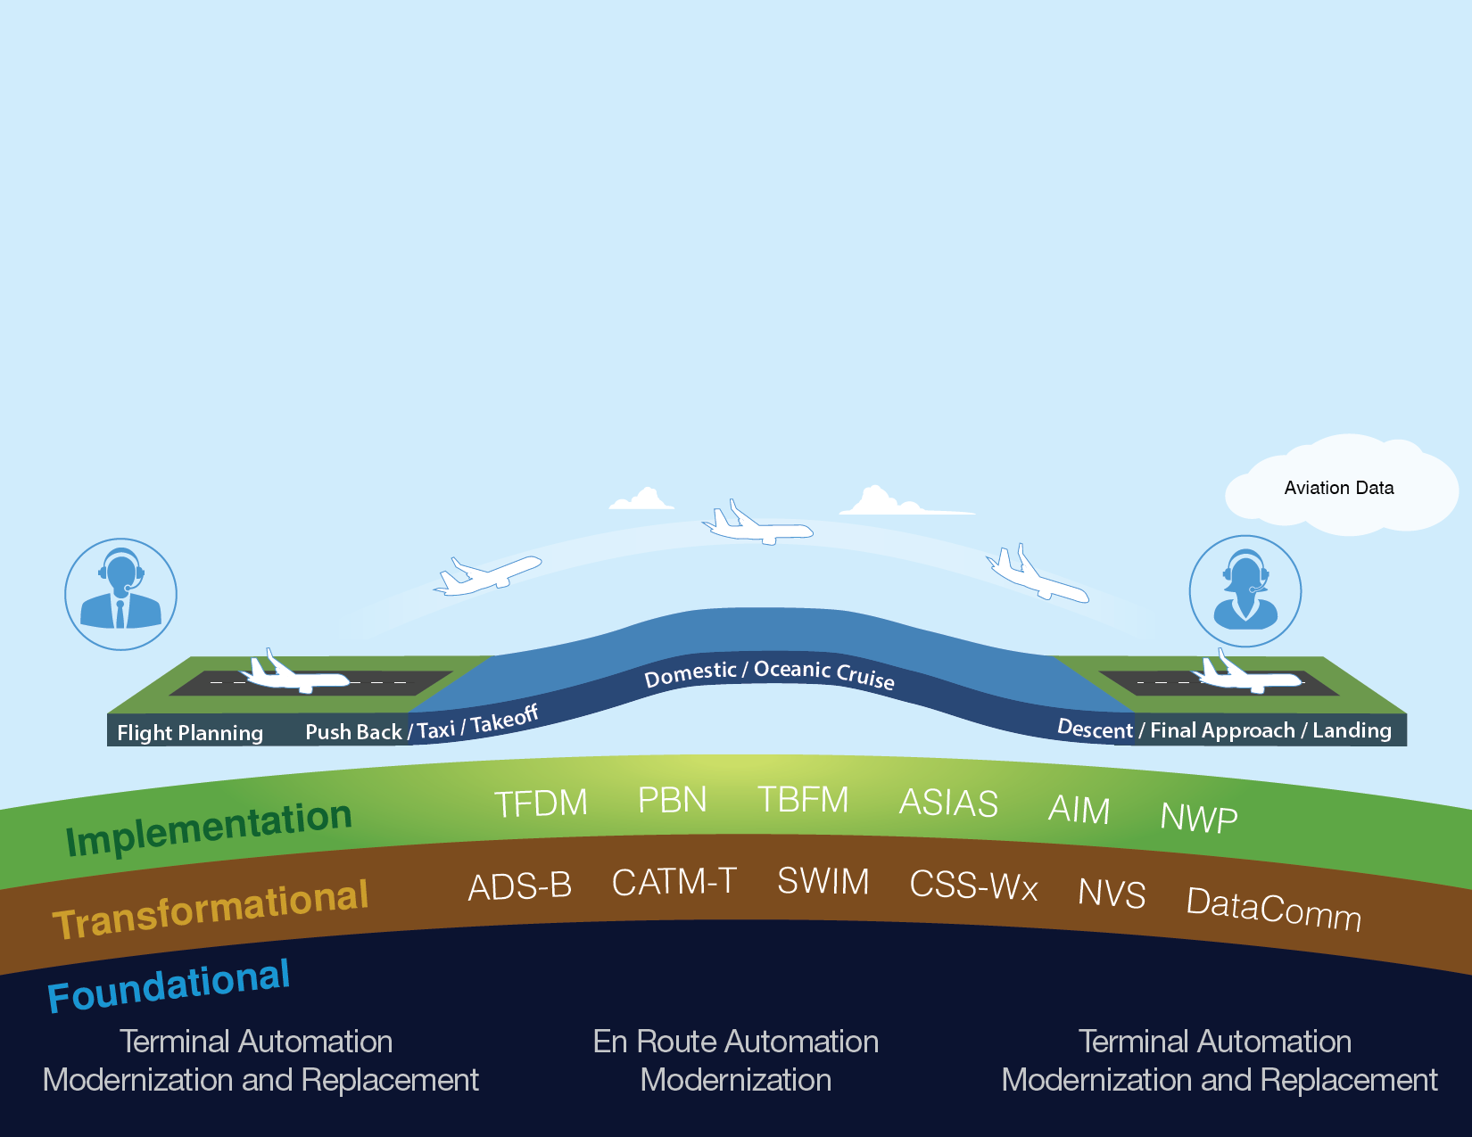
Delivering NextGen Improvements
Legacy System
NextGen
Radar
Inefficient Routes
Voice Communications
Disparate Information
Fragmented Weather Forecasting
Weather Restricted Visibility
Forensic Safety Systems
Nationwide Focus
Satellite
Performance Based Navigation (fuel savings)
Voice & Digital Communications
Automated Decision Support Tools
Integrated Weather Information
Improved Access in Low Visibility
Prognostic Safety Systems
Focus on Congested Metroplexes
6

Slide 7



Top Seven Programs
As of: July 2015
Sep-13
Dec-13
Mar-14
Apr-14
Sep-14
Dec-14
Mar-15
Jun-15
Sep-15
Dec-15
2016+
Communications
Data Communication (Data Comm)
Full En Route Services FID Nov. 2015
Initiate DCL Tower Trials: MEM Jan.2013 & EWR April 2013
Initial En Route Services FID October 2014
DCL Tower Service Ops Test & Eval. (OT&E) March 2015
Complete DCL Tower Trials Jan 2016
NAS Voice System (NVS)
DCL Tower Service IOC Key Site (SLC) March 2016
First Site Initial IOC En Route Service 2019
Achieve Gov’t Acceptance of two NVS Demo systems at contractor's facility
Complete Initial Demonstrations March 2014
NAS Qualification Final Investment Decision (FID) September 2014
Complete Critical Design Review
June 2015
Begin ATC Task & Skills Analysis (TASA) Development Aug 2016
Initiate OT&E June 2018
Surveillance
Automatic Dependent Surveillance–Broadcast (ADS-B)
Radio Infrastructure Complete March 2014
NAS-wide Pilot Advisory Services (Traffic & Weather) April 2014
Complete Final 24 of 24 En Route IOCs Sept. 2015
Complete All Term. & Surf. IOCs 2019
ADS-B Out Rule Compliance January 2020
Automation
Terminal Automation Modernization and Replacement (TAMR)
1 ARTS IIIE IOC (Dallas – D10) April 2013
Complete 3 ARTS IIE IOCs September 2014
Final ARTS IIIE IOC Oct 2016
Terminal Flight Data Manager (TFDM)
Initial Investment Decision (IID)
March 2014
Surface Visualization Tool IOC at SCT April 2014
Screening Info. Request (SIR)
Release April 2015
Final Investment Decision (FID) and Contract Award FY2016
En Route Automation Modernization (ERAM)
Legend
Complete Final / 20th IOC
September 2014
Complete Final / 20th ORD March 2015
Activity is completed
Activity is in progress
Activity is at risk
Activity is missed
Integration
System Wide Information Management (SWIM)
Complete NextGen Capabilities Package September 2013
Complete SWIM Terminal Data Distribution System (STDDS) Implementation June 2014
Complete Flight Data Publication IOC July 2015
SWIM Segment 2B FID September 2015
Changes from Previous Month: TAMR – Final ARTS IIIE IOC changed to October 2016
7
Notes:
As of July 2015: Source Melanie Cook
This slide is a 24 month look at seven major NextGen programs.
The slide depicts progress of the programs to advance and enhance NextGen capability programs through FY-16.
Program status will be depicted in typical green, yellow and red format, allowing us to highlight both positive progress and program challenges.
At present, all depicted programs are progressing in accordance with these published milestones.
Here are some highlights:
Data Communications (Data Comm):
Prototype trials continue at Memphis and Newark, data is being collected.
Multiple operators have signed MOAs to participate in the avionics equipage initiative, achieving the target of 1,900+ aircraft.
Primary Contractor: Harris Corporation
NVS:
Successfully achieved NAS Qualification FID on September 17, 2014;
A second early user event for ATO Technical Operations’ evaluation was conducted November 17 – 21, 2014.
Successfully completed Critical Design Review (CDR) on June 26, 2015 (APB Milestone).
SWIM:
System Wide Information Management completed the first NextGen capabilities package in Sep. 13 with the completion of the On-Ramping of Corridor Integrated Weather System (CIWS) and Weather Message Switching Center Replacement (WMSCR) using SWIM NAS Enterprise Messaging Service (NEMS) Services
Completed SWIM Terminal Data Distribution System (STDDS) Implementation June 2014
SWIM Flight Data Publication Service (SFDPS) In Service Decision planned for July 2015
Segment 2B FID DP is planned for Q4 CY2015 (Sept DP and August target)
TAMR: Achieved IOC at 9 ARTS IIE sites (Allentown on April 2014, Austin on August 2014, Billings on September 2014, Ft. Myers and Midland on February 2015, Harrisburg on March 2015, Savannah, Fresno and Springfield-Columbia on April 2015. Southern California (SCT) TRACON achieved IOC on July 12, 2015 (APB milestone for Segment 1).
ERAM: Final site (Washington) ORD was achieved on March 27, 2015
TFDM: Per the action from IID, TFDM returned to the JRC on August 20, 2014 to provide a briefing on the revised program strategy, including the prioritization results and viability of segmentation. Received approval from the JRC to move forward to FID based on the revised scope and strategy presented on August 20, 2014.
Next Steps:
Develop a Business Case based on the revised Strategy
Provide a Status Briefing to the JRC next Spring (2015)
Proceed to FID in March 2016
Based on program segmentation strategy that was discussed at the CIT and approved by the JRC, funding will be distributed over two segments. Key site IOC is now planned for 2019.

Slide 8
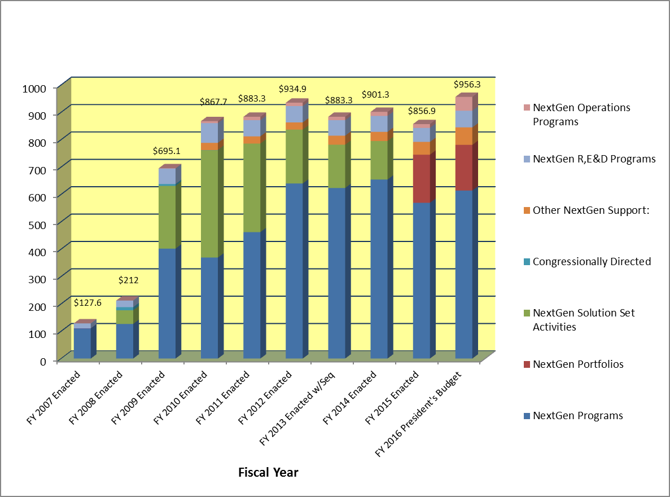
NextGen Budget Profile
(FY 2007 – FY 2016)
8

Slide 9
Top Seven Budgets
As of: July 2015
 | FY 2014 | FY 2015 | FY 2016
Facilities and Equipment | Enacted | Enacted | President’s Budget | Baselined Amount
Automatic Dependent Surveillance-Broadcast (ADS-B) (NAS Wide Implementation, ADS-B and Colorado WAM Subscription Costs, and Excludes WAAS GEO Satellite Leases) | $281,300,400 | $254,700,000 | $211,200,000 | $2,655,500.000
Data Communications in Support of NextGen (Data Comm) (Only S1P1, S1P2 Initial Services and Data Comm Network Services are baselined.) | $115,450,000 | $150,340,000 | $234,900,000 | $1,558,100,000
En Route Automation Modernisation (ERAM) | $35,000,000 | $45,200,000 | $79,400,000 | $2,484,400.000
Terminal Automation Modernization/Replacement Program – TAMR Phase 3 | $155,550,000 | $146,150,000 | $159,350,000 | $900,500.000
Terminal Flight Data Manager (TFDM) | $19,250.000 | $38,808,000 | $15,000,000 | Not baselined
National Airspace System Voice System (NVS) | $16,000,000 | $20,550,000 | $53,550,000 | $294,200.000
System Wide Information Management (SWIM) – Segment 1, 2A & 2B (Excludes CSS-Wx) | $44,900,000 | $34,661,000 | $23,900,000 | $426,700.000
Changes from Previous Month: No Changes
9
Notes:
As of July 2015: Melanie Cook provide update to the NVS and SWIM FY2016 President’s Budget Data.
As of February 2015:
NVS: FY 2016 President’s Budget submission of $53M includes $6M for Contingency Work for NVS (corrected FY16 budget submission to include full amount for IOT&E)

Slide 10
Foundational Programs
10

Slide 11


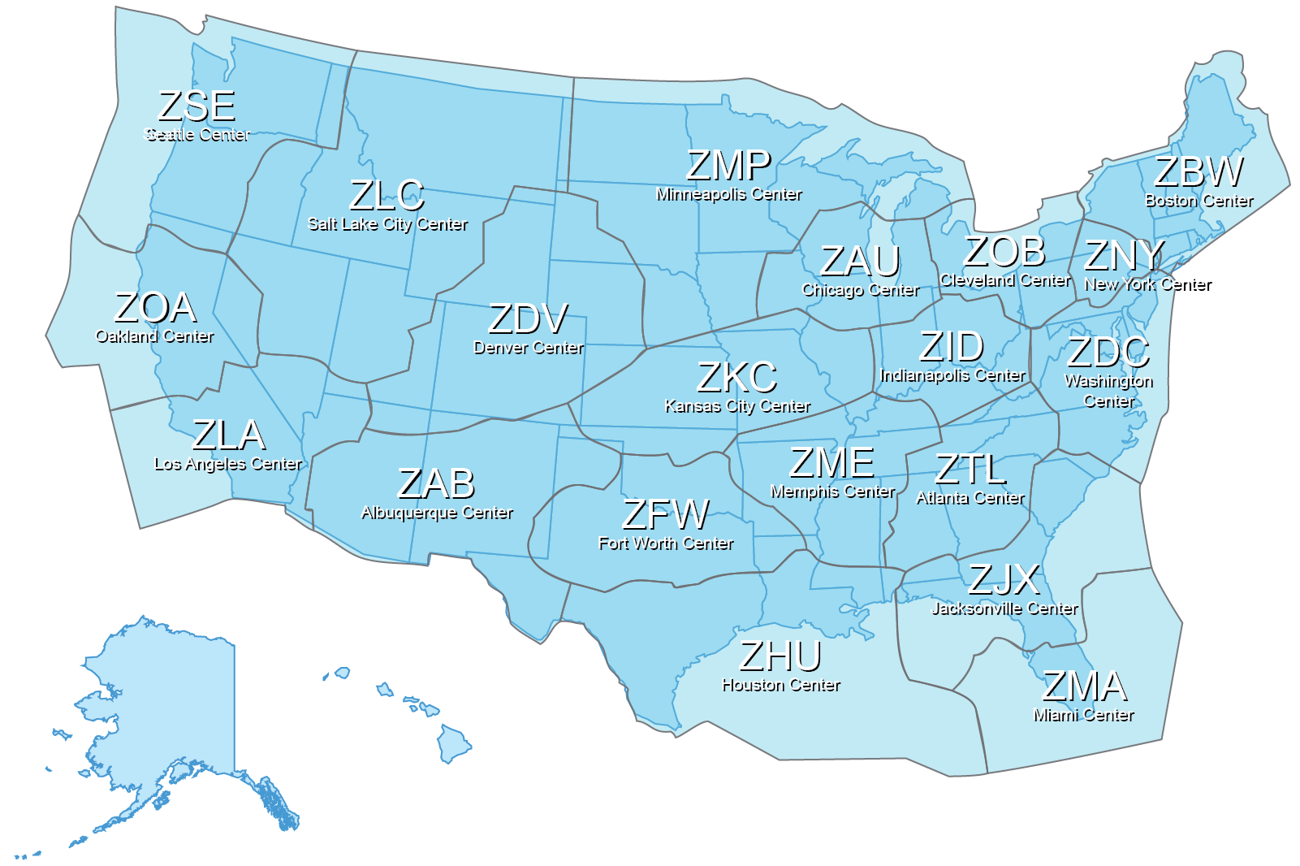
En Route Automation
As of: July 2015
Key
Airspace Boundaries
Operational Readiness Demonstration
Continuous Operations
Initial Operating Capability (IOC)
HOST Sites: Pre-IOC
COMPLETE
ORD 20 of 20
Cont Ops 20 of 20
IOC 20 of 20
Pre-IOC 0 of 20
Benefits
Provides real-time aeronautical information, enabling more efficient data management
Increases flexibility in routing aircraft around congestion, weather and other airspace restrictions – automatic flight coordination increases efficiency and capacity.
Enables seamless information sharing and coordination between controllers and en route centers.
Subsequent updates will enable key NextGen capabilities: ADS-B, SWIM, Data Comm, Trajectory Based Operations
En Route Automation Modernization (ERAM)
Complete Final / 20th IOC
Sep 2014
Complete Final / 20th ORD Mar 2015
11
Notes:
As of March 2015:
Recent successes include:
Operational Readiness Date (ORD) achieved at:
Atlanta (ZTL) on March 10,
Washington (ZDC) on March 26 and
New York (ZNY) on March 27, 2015 (20 of 20 sites complete)
All sites achieved ORD by March 2015 (Goal completed)
Additional Information: Primary vendor is Lockheed Martin.

Slide 12
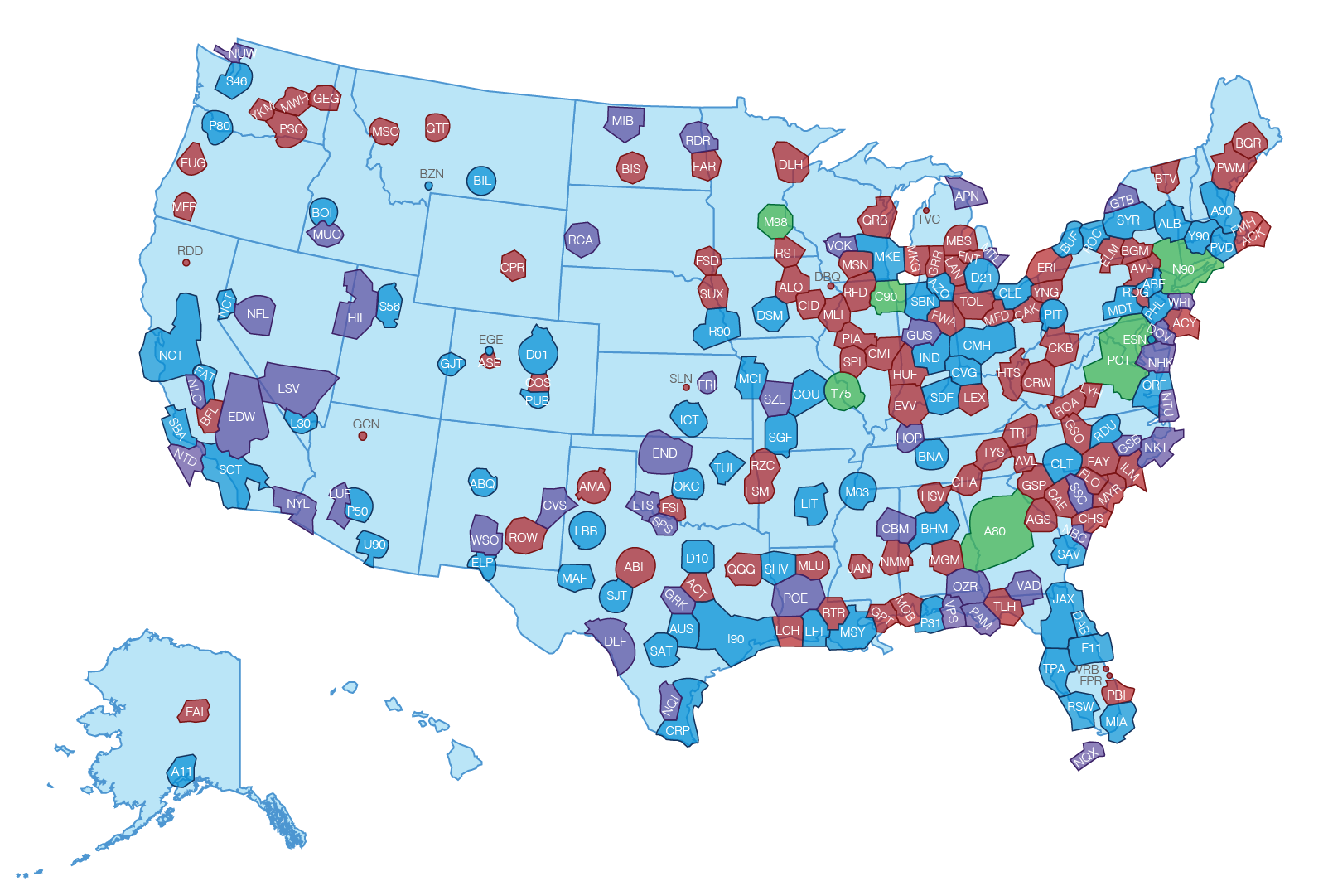
Terminal Automation
As of: July 2015
Key
STARS
ARTS 2E
ARTS 3E
DOD
STARS Lite
ARTS 1E
STARS Tech Refresh
- Site survey: Completed 8 out of 47 sites.
- Equipment deliveries Completed at 6 out of 47 sites.
- IOC achieved at 5 out of 47 sites.
CARTS (large TRACON) replacement
- Site Survey: Completed 11 of 11 sites
- Equipment deliveries completed at 11 out of 11 sites.
- IOC achieved at 5 (+1) out of 11 sites.
ARTS IIE (lower level terminal) replacement
- Site survey: Completed 67 (+2) out of 97 sites.
- Equipment deliveries completed at 12 out of 97 sites.
- IOC achieved at 11 out of 97 sites.
Changes from Previous Month: Changes highlighted in red
Terminal Automation Modernization and Replacement (TAMR)
1 ARTS IIIE IOC (Dallas – D10) Apr 2013
Complete 3 ARTS IIE IOCs Sep 2014
Final ARTS IIIE IOC Oct 2016
12
Notes:
As of July 2015: Map was changed to show Alaska
TAMR will consolidate terminal automation into a single platform with a common, upgraded and advanced version of our existing STARS system.
The locations depicted in green are currently in mid deployment, those in red are future deployment and those in blue are either completed or are existing STARS facilities awaiting upgrades.
Key program milestone will be the completion of the Large TRACON transition to STARS by APB date October 2016.
Recent accomplishments, by Segment, include:
STARS Tech Refresh
- Site survey: Completed 8 out of 47 sites.
- Equipment deliveries Completed at 6 out of 47 sites.
- IOC achieved at 5 out of 47 sites.
CARTS (large TRACON) replacement
- Site Survey: Completed 11 of 11 sites
- Equipment deliveries completed at 11 out of 11 sites.
- IOC achieved at 5 out of 11 sites.
ARTS IIE (lower level terminal) replacement
- Site survey: Completed 67 out of 97 sites.
- Equipment deliveries completed at 12 out of 97 sites.
- IOC achieved at 11 out of 97 sites.

Slide 13
Transformational Programs
13

Slide 14
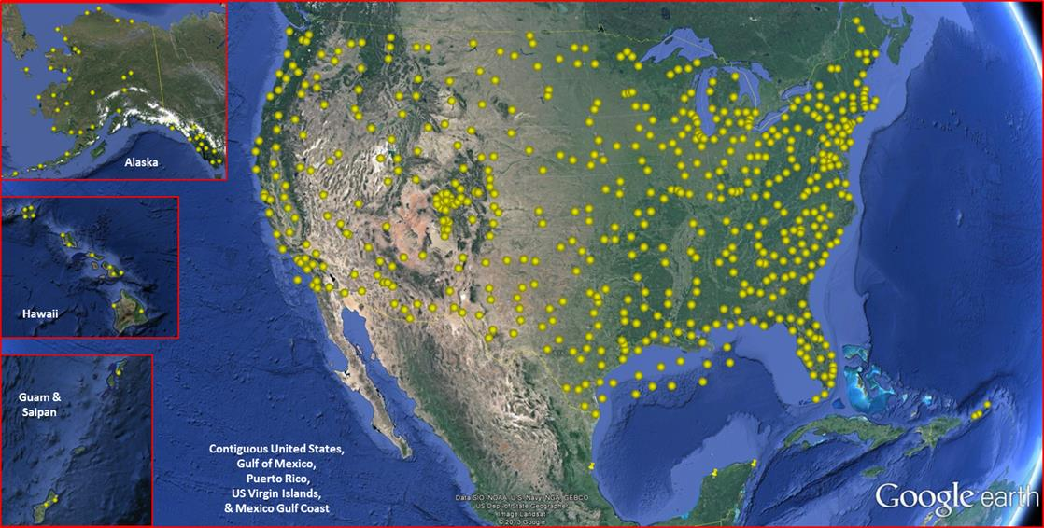
Delivering NextGen
Automatic Dependent Surveillance - Broadcast
ADS-B
ADS-B uses GPS technology to determine an aircraft’s location (and other information, such as airspeed), and broadcasts that information to controllers and other equipped aircraft via a nationwide network of ground stations.
ADS-B provides surveillance where radar can not be deployed, such as remote areas of Alaska and the Gulf of Mexico, where ADS-B radio stations are mounted on oil platforms.
ADS-B also enables aircraft-to-aircraft surveillance.
Moving Forward
Baseline radio stations are in place nationwide
Surveillance coverage available
  En Route by 2015
  Terminal and Surface by 2019
Reduced separation
Oceanic in-trail altitude changes
Benefits
Provides more frequent position update-rates than radar = precise location information of aircraft
Provides in-cockpit traffic and weather information
Improves safety for pilots
14

Slide 15




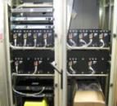



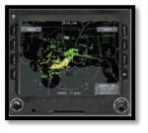
Essential Services System
Flight Information Services Source
ADS-B Infrastructure
Airborne
Existing Infrastructure
Service Delivery Point
Control Station
Radars
Greenfield
Cell on Wheels
Notes:
15

Slide 16
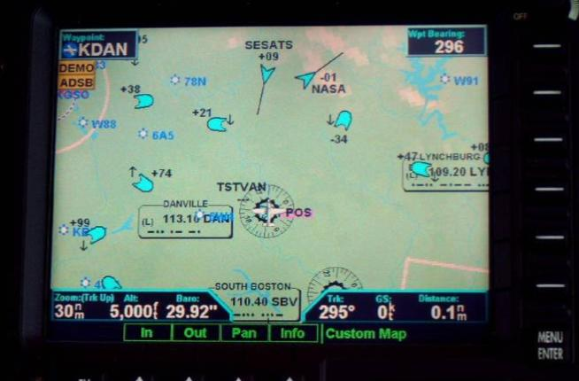
Essential Services: Traffic Information Service - Broadcast
TIS-B is a service which provides ADS-B equipped aircraft with position reports from secondary surveillance radar on non-ADS-B equipped aircraft.
Notes:
16
16
TIS-B:
During NAS-wide deployment of ADS-B, aircraft will begin equipping with ADS-B avionics. During this transition, ADS-B-equipped aircraft will lack surveillance information on aircraft that are not ADS-B equipped. The Surveillance and Broadcast Services ground infrastructure will support air-to-air operations by broadcasting TIS-B Messages on both the 978 UAT and 1090 ES data links for targets detected and reported by radar or other surveillance systems. This, in conjunction with the ADS-R service, will provide equipped aircraft the information needed for a more complete picture of the traffic situation. TIS-B service will be decommissioned in the end state when all aircraft are ADS-B-equipped.

Slide 17
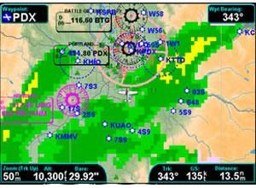


Essential Services: Flight Information Service - Broadcast
FIS-B transmits graphical National Weather Service products, temporary flight restrictions (TFRs), and special use airspace.
Notes:
FIS-B:
FIS-B provides the broadcast of weather and non-control advisory information providing users aeronautical information supporting safe and efficient operations. FIS-B products will be uplinked using the 978 UAT from the Data Link Processor and will not be available on the 1090 ES link. There are many potential future FIS-B products that may be provided as their concepts mature. Therefore, the FIS-B service and data link capacity should allow for growth to accommodate additional products. The uplinked products will come from both government and commercial sources. Free FIS-B products include:
AIRMET: Airmen's Meteorological Information, is a weather advisory issued by a meteorological watch office for aircraft that is potentially hazardous to low-level aircraft /aircraft with limited capability
Convective SIGMET: Significant meteorological event (Thunderstorms or hail )
METAR / SPECI: METAR- hourly weather report and SPECI: special weather observation
NEXRAD Reflectivity (CONUS and Regional): Radar weather (graphical weather)
NOTAMs D/FDC: Distance Notice to Airmen / National Notice to Airmen
PIREP: Pilot report
SIGMET: Significant meteorological event
SUA Status: Special use airspace status
TAF / AMEND: Terminal area forecast / any amendments to the forecast
Temperature Aloft: report of the temperature forecast every 12 hours
Winds Aloft: report of the wind forecast 12 hours
The FAA is working with the vendor (ITT) to add an additional five products:
Lightning
Turbulence NOWcast
Icing NOWcast
Cloud Tops
1 minute AWOS – uplinked every 10 minutes

Slide 18


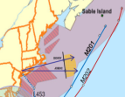
Critical Services System
Airborne
ADS-B Infrastructure
Facilities
Existing Infrastructure
Radars
Aircraft
Control Station
Service Delivery Point
Greenfield
Routes
Critical Services ISD 9/2010
Cell on Wheels
Display
Notes:
18

Slide 19

ADS-B Data Displayed on ARTS Color Display (ACD)
First line of the data block is the Aircraft ID (ACID) and can either be N-number or flight number. Aircraft without the circle as a first character are ADS-B equipped. When the first Character is a filled or hollow circle it indicates that the aircraft is either not ADS-B equipped or it is equipped but not receiving ADS-B respectively.
Embry Riddle test aircraft (ADS-B equipped)
Non ADS-B equipped aircraft
UPS ADS-B equipped aircraft
Notes:
There are three distinct types of targets on this display. UPS2325 is an ADS-B equipped aircraft. To the right, N44139 is a non ADS-B equipped aircraft (the green dot next to the ID indicates that it’s not ADS-B equipped). The third group of aircraft near the top of the screen are all Embry Riddle aircraft that are ADS-B equipped that are assisting in the flight test.
First line of data block Is Aircraft ID (ACID) can either be N-number or flight number. When first Character is a filled or hollow circle it indicates that aircraft is either not ADS-B equipped or it is equipped but not receiving ADS-B respectively. Second line is altitude in first block. Airspeed in second block. On the UPS the H indicates Heavy aircraft on the Embry Riddle aircraft the V indicates VFR.
19

Slide 20
Building Block for Aircraft Applications
Situational Awareness
Indications and Alerts
Enhanced Visual Acquisition
SURF-IA
Notes:
20

Slide 21
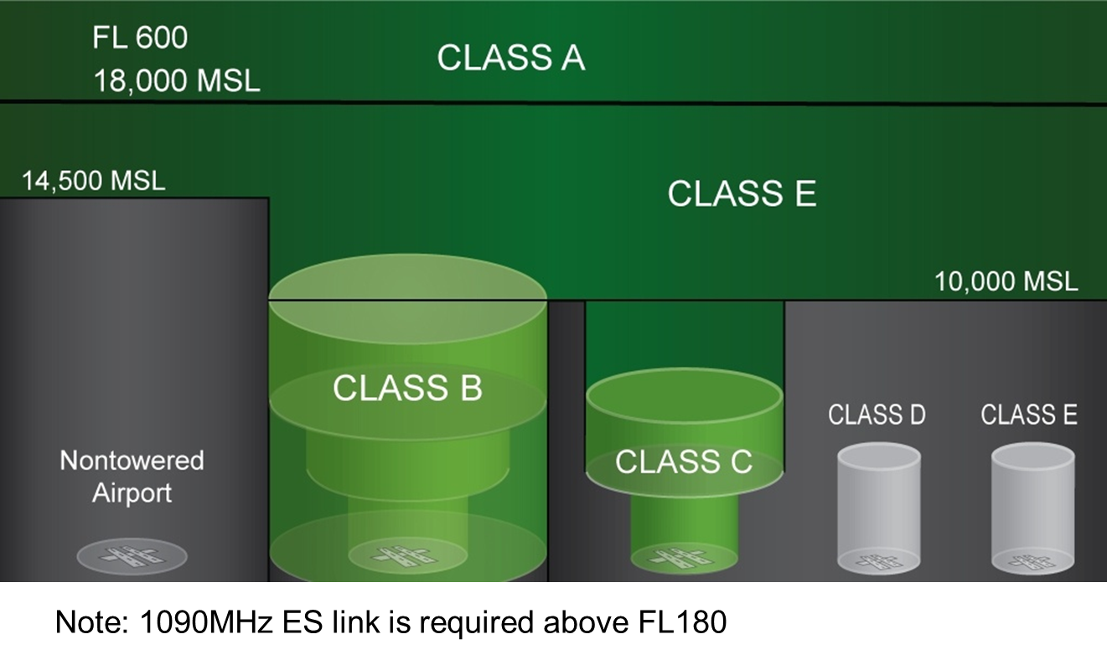
ADS-B Airspace Requirements

Slide 22
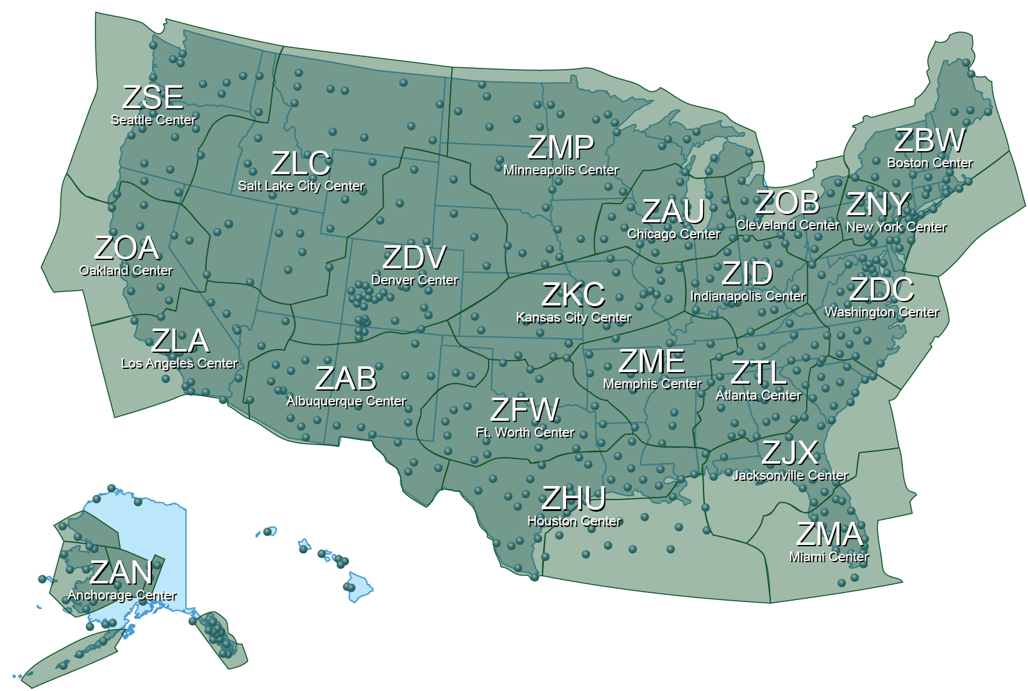

ADS-B Coverage & En Route Integration
As of: July 2015
Key
ADS-B integrated into en route automation
ADS-B Coverage Area
Radio Station
Service Delivery Points for ATC Separation Services
En Route 23 of 24
Terminal 64 of 159
Surface (Advisory) 35 of 44
Oceanic 1 of 3
Rule-Driven ADS-B Out Avionics Equipage: 13,462 (+651)
ADS-B In Avionics Equipage: 9,127 (+593)
634 Baseline Radios Installed
En Route IOCs: No Change
Terminal IOC: No Change
Surface IOC: No Change
Oceanic IOC: No Change
Changes from Previous Month: Changes highlighted in red
Automatic Dependent Surveillance–Broadcast (ADS-B)
Radio Infrastructure Complete Mar 2014
NAS-wide Pilot Advisory Services (Traffic & Weather) Apr 2014
Complete Final 24 of 24 En Route IOCs Sep 2015
Complete All Term. & Surf. IOCs 2019
ADS-B Out Rule Compliance Jan 2020
22
Notes:
As of July 2015: Changes noted in Red. Source Melanie Cook

Slide 23
Data Comm
As a system, it is a portfolio consisting of:
  FAA Automation Platforms – Tower, En Route, TRACON
  Network – VHF Digital Link Mode 2
  Avionics
    FANS1/A+ - Future Air Navigation System
    ATN VDL-2 - Aeronautical Telecommunications Network
  Services
    Traffic flow management
    Flight crew requests/reports
    High availability, guaranteed delivery and low latency times
    Data exchange for Safety Critical Air Traffic Control (ATC) clearances and instructions
Simplified:
  Two-way digital communications controllers/pilots
  “Canned” messages and/or “on the fly” messages
Notes:
23
Data Comm is designed around the basic principles listed on this slide:
First, Data Comm builds on the experience gained from CPCLC in Miami, over the Ocean, and through the European Link 2000 program to design a practical approach, implementing Data Communications in an incremental fashion (Data Comm is harmonized with Europe. We are leveraging the same Mode 2 technology being implemented by the Europeans for their initial and follow on data network).
Second, Data Comm is being designed to meet all safety requirements. (Design, performance requirements that are not extensible, we will build to meet Seg Two requirements from outset.)
Third, Data Comm is leveraging existing equipage such as Mode 2 avionics, and program plans include accommodating FANS.
Additionally, the Data Communications Program is working jointly with EUROCAE Working Group 78 through RTCA Special Committee 214 to develop avionics standards that will support all Data Comm capabilities through Segment Two to maximize airspace user benefits. We are expecting SC-214 to become the converged application for Europe and the US since the Europeans have indicated their plans to leverage SC-214 standards in their follow on data link implementation.

Slide 24
Data Comm Scope
Controller Facility
TOWER
TDLS
STDDS
TFDM
Data Communications Applications
Ground-Ground Telecom Network
Data Communications Applications
Aircraft
Avionics
ARTCC
ERAM
Air-Ground
Data Communications
VDL-2 Network Service
TRACON
Data Communications Applications
TAMR III
Provides two-way transfer of data between controllers and flight crews
Data includes safety-of-flight air traffic control (ATC) clearances and instructions for traffic flow management
Requires enhancements to automation systems for ATC message management
Requires avionics equipage
Data Comm is necessary to transition from voice-based ATC communications system to data-centric NextGen
Notes:
. Data Comm System Components include:
Incorporating Data Comm requirements into the Tower and En Route automation platforms: Tower Data Link System for Tower services and the En Route Automation Modernization System for En Route services.
Procuring the ground-ground and air/ground network services for the transmission of the data messages between FAA facilities and the aircraft
Leveraging existing aircraft avionics based on the Future Air Navigation System or FANS and developing standards for avionics capable of supporting all Data Communications capabilities for maximum value.
2. Services will be implemented in all phases of flight – pre-departure, en route, and approach.
3. And, Data Comm will provide controllers with the automation support tools they need to handle more traffic while providing improved service, and that Data Comm equipped aircraft will have improved flight times resulting in reduced operating costs.
Safety of Flight
Level C / Assurance Level 4
High availability (99.999%)
Guaranteed delivery
Low latency
24

Slide 25
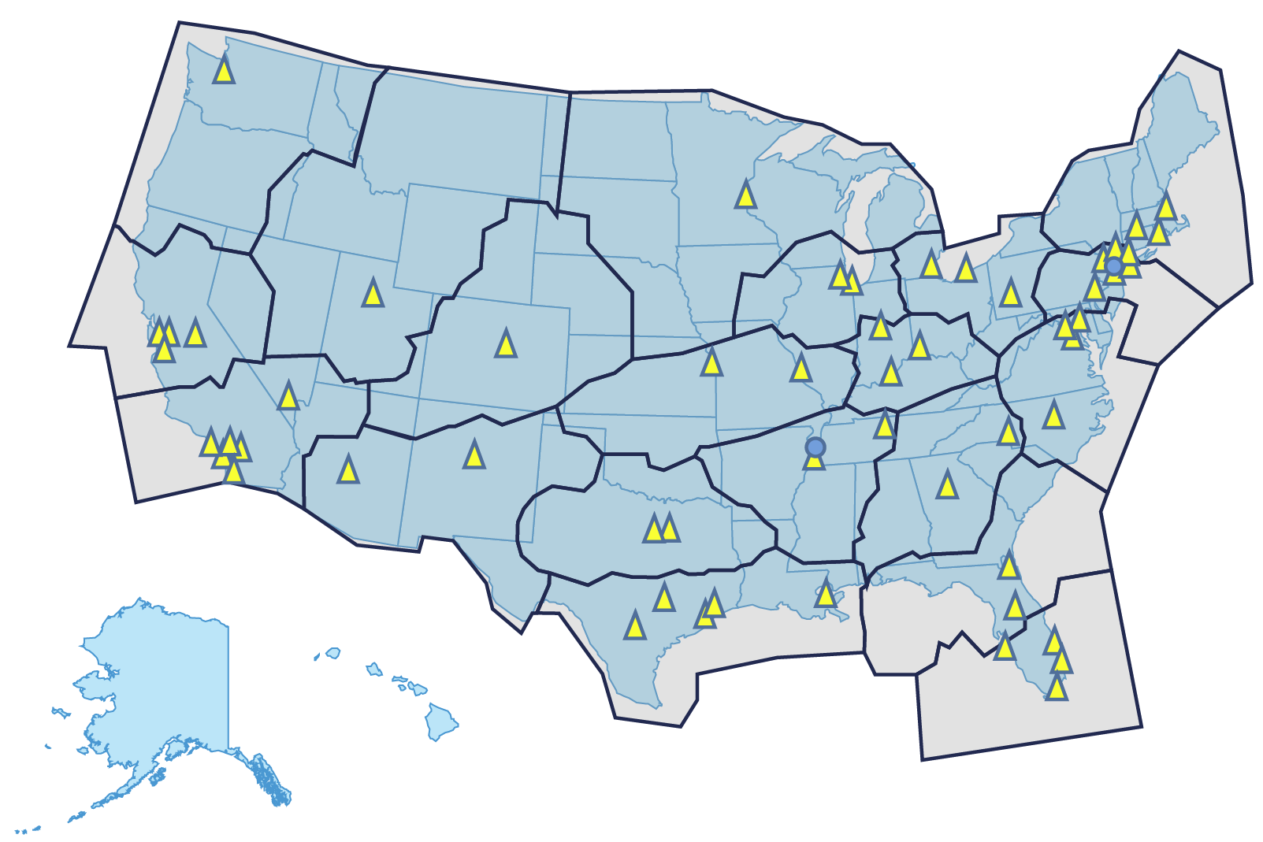
Data Communications
Departure Clearance Tower Service
As of: July 2015
Key
Trials Sites
Tower DCL Sites (57 Towers)
Changes from Previous Month: No Changes
Data Communication (Data Comm)
Full En Route Services FID Nov 2015
Initiate DCL Tower Trials: MEM Jan 2013 & EWR Apr 2013
Initial En Route Services FID Oct 2014
DCL Tower Service Ops Test & Evaluation. (OT&E) Mar 2015
Complete DCL Tower Trials Jan 2016
DCL Tower Service IOC Key Site (SLC) Mar 2016
25
First Site Initial IOC En Route Service 2019
Notes:
As of March 2015:
The Data Communications Program (Data Comm) will provide data communications services between the pilots and air traffic controllers. Data Comm will provide a direct link between ground automation and flight deck avionics for safety-of-flight Air Traffic Control (ATC) clearances, instructions, traffic flow management, flight crew requests and reports. Data Comm is critical to the success of NextGen operations, enabling efficiencies not possible using the current voice system by providing NAS infrastructure enhancements to support NextGen operational improvements.
Data Comm will enhance NAS operations through:
• Reduced impact of ground delay programs, airport reconfigurations, convective weather, congestion, and other causes;
• Reduced communication errors;
• Improved controller and pilot efficiency through automated information exchange;
• Enabled NextGen services (e.g., enhanced re-routes, trajectory operations); and
• Increased controller productivity leading to increased capacity.
Data Comm: Prototype trials continue at Memphis and Newark, data is being collected. Trials are scheduled to run until January 2016.
Multiple operators have signed MOAs to participate in the avionics equipage initiative, achieving the target of 1,900+ aircraft.
Primary Contractor: Harris Corporation
Completed DCL Tower Service operational test and evaluation (OT&E) in March 2015.
Data Comm Key Sites for Tower are Salt Lake (SLC) and Houston Hobby (HOU) and Houston International(IAH). The Acquisition Program Baseline (APB) date for Initial Operating Capability (IOC) is March 2016.
57 towers at 56 airports (DFW has two towers)
Data Comm successfully achieved Segment 1 Phase 2 (S1P2) FID for Initial En Route Services on October 29, 2014. Will return for FID for Full En Route Services in Q4 CY2015.
Added $816,700,000 to baseline amount for S1P2 Initial Services. Services will be delivered to all 20 CONUS ARTCCs.
IOC for S1P2 Initial En Route Services is July 2019.

Slide 26






NVS
The Challenge
Traditional Airspace
VOICE
VOICE
VOICE
Voice
Switch
Voice
Switch
Point-to-Point
Communications
Communications
Infrastructure
Inflexible and aging voice communications infrastructure
ATC personnel and resources geographically bound to very limited number of pre-defined configurations
Voice
Switch
Voice
Switch
Voice
Switch
Voice
Switch
Air Traffic Center
Notes:
26
The NAS Voice Switch (NVS) is a forward-looking program to replace national airspace system (NAS) voice switches more than 20 years old with a new technology switching system capable of supporting future requirements for NextGen.
The NVS program will allow the FAA to achieve voice switching modernization objectives such as network-based infrastructure, and evolution of ATC toward a flexible communications routing that support dynamic re-sectorization, resource reallocation, airspace redesign and the NextGen vision.

Slide 27





Voice Communications Capabilities
Needed for NextGen
Universal High Altitude Airspace (UHAA)
High Performance Airspace
Mixed Performance Airspace
Traditional Airspace
VOICE
VOICE
VOICE
UAS Pilots
UAS Pilots
More Flexible Communications Capabilities to support:
  Business Continuity Planning
  Operational Security
  Consolidation/Co-location
  Load Sharing and Balancing across facilities
  Virtual Towers
  UAS Communications
Underlying
Communications
Network
Network Management Ops Center
Air Traffic Center

Slide 28
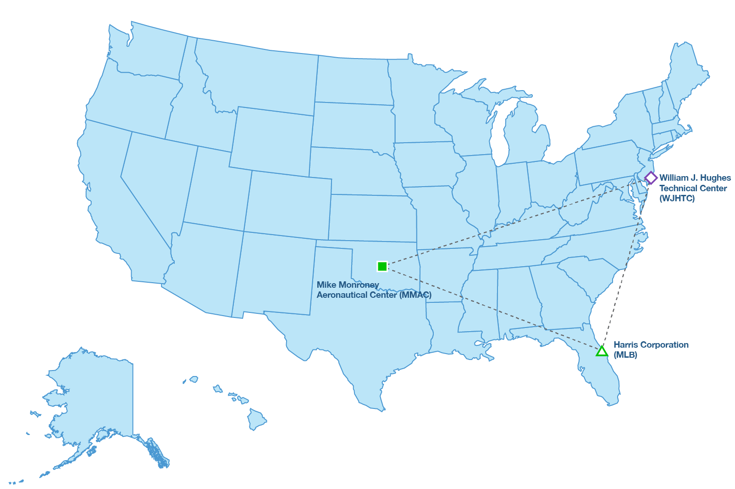
NAS Voice System
Flexible operational voice capability
As of: July 2015
Key
ARTCC
ATCT
TRACON
ATCT/TRACON
1 ARTCC
1 TRACON
1 ATCT
(Air Traffic Facilities are simulated and linked over FTI national test bed)
Changes from Previous Month: No Changes
NAS Voice System (NVS)
Achieve Gov’t Acceptance of two NVS Demo systems at contractor's facility
Complete Initial Demonstrations Mar 2014
NAS Qualification Final Investment Decision (FID) Sep 2014
Complete Critical
Design Review
Jun 2015
Begin ATC Task &
Skills Analysis (TASA) Development Aug 2016
Initiate OT&E
Jun 2018
28
Notes:
As of July 2015:
NVS successfully achieved NAS Qualification FID on September 17, 2014.
NAS Voice System (NVS) replaces the 25-year-old legacy voice switches with a modern and flexible operational voice capability and will support ground-to-ground voice communications between air traffic controllers and air-to-ground voice communications between controllers and aircraft. The FAA will deploy NVS in air traffic control towers, terminal and en route facilities, and future NextGen air traffic control facilities.
NVS will support airspace redesign, dynamic re-sectorization and offloading, Unmanned Aerial Systems (UAS), and business continuity planning to protect against a loss of communications at air traffic control facilities. With the implementation of NVS, the FAA will have enhanced visibility and control over communications resources and will be able to manage them as a unified system versus individual platforms.
Program Status:
Contract award for the NVS was made to Harris Corp. of Melbourne, Florida on August 24, 2012.
Three (3) Validation/Demonstration Systems have been built, tested, and installed at the WJHTC, MMAC, and Harris (Melbourne, FL).
Dry runs over the FTI National Test Bed (FNTB).
Formal Validation/Demonstration testing occurred in November/December 2013 with NextGen stakeholders in attendance.
First Early User Involvement Event (EUIE) was held April 15 – 17, 2014 and focused on human factors with NATCA involvement.
A second EUIE for ATO Technical Operations’ evaluation was conducted November 17 – 21, 2014.
Final investment decision (FID) for NAS Qualification successfully achieved on September 17, 2014. Second FID for deployment approval of operational systems is planned for in late FY2017.
Successfully completed Critical Design Review as of June 26, 2015 (APB milestone).
Second Round of AT and Tech Ops EUIEs are planned for 1st Quarter FY2016; Start of Factory Acceptance Test (FAT) is planned for 1st Quarter of FY2017.

Slide 29
Business as Usual
SWIM
Today
- More point-to-point unique interfaces
- Costly development, test, maintenance, CM
- New decisions linked to old data constructs
- Cumbersome data access outside the NAS
Host
ETMS
WARP
ASDE-X
IDS/
ERIDS
ERAM
ATOP
STARS/
ARTS/
TAMR
CIWS
Enterprise
Management
FAA Systems
TMA
Inter-
Agency
AIM
ERAM
TFMS
TFM
CIWS
- Existing point-to-point hardwired NAS
- Unique interfaces, custom designs
TDDS
SWIM Compliant Government Systems
SWIM Compliant Non-Government Systems
FTI
STARS
ITWS
CARTS/
WMSCR
TBFM
LEGEND
DOTS
SWIM Segment 1
SWIM Future Segment
SWIM Adapter
29
Notes:
29
Core of Program Concept
How SWIM lowers information costs: Uses standard interfaces and new protocols such as XML. This greatly reduces the amount of software that must be created share data between FAA systems.
How SWIM increases speed for new interfaces: Use of standard interfaces reduces customization time. Plus, XML protocols eliminates the need for “information consumers” to write special parsing program to figure out which data they need.
The ability to manage data at a lower cost (and faster setup speed) means more data sharing… which increases common situational awareness and improved agility.
Lower information costs
Increase speed to establish new interfaces
Increase common situational awareness
Increase NAS agility

Slide 30
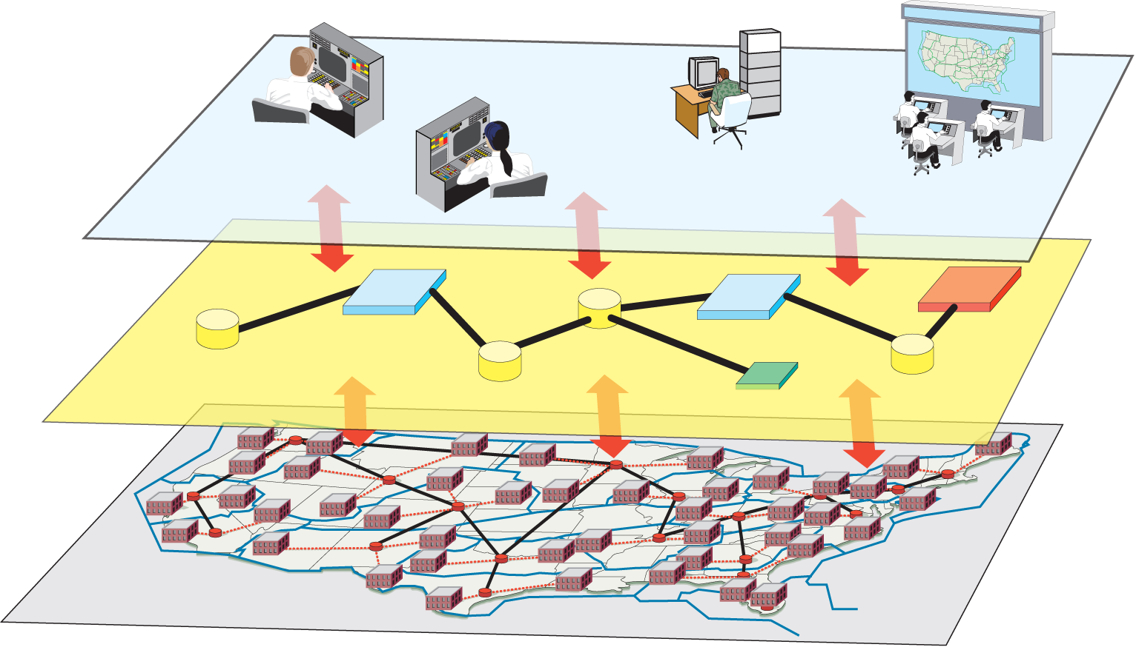
SWIM Conceptual Overview
Terminal
Controllers
En Route
Controllers
Non-FAA Users
(e.g., Airlines, DoD
DHS, ANSPs)
NextGen Applications
FAA
Command Center
SWIM Infrastructure for Messaging
FTI IP Backbone
Notes:
NextGen Application Systems (Publishers) (Enroute Automation, Traffic Flow Management, NextGen Weather Processor etc.)
External Users (Subscribers) (Airspace user Flight Ops Centers, DoD Command and Control Centers, Airports, etc.)
SWIM
(messaging, identity and certificate management, enterprise service mgmt., interface adaptation, conflict resolution, data re-distribution)
NAS IP Network Infrastructure
(IP addressing, routing and forwarding, NAS boundary protection, naming
(DNS, LDAP), intrusion detection, bandwidth management, etc.)

Slide 31
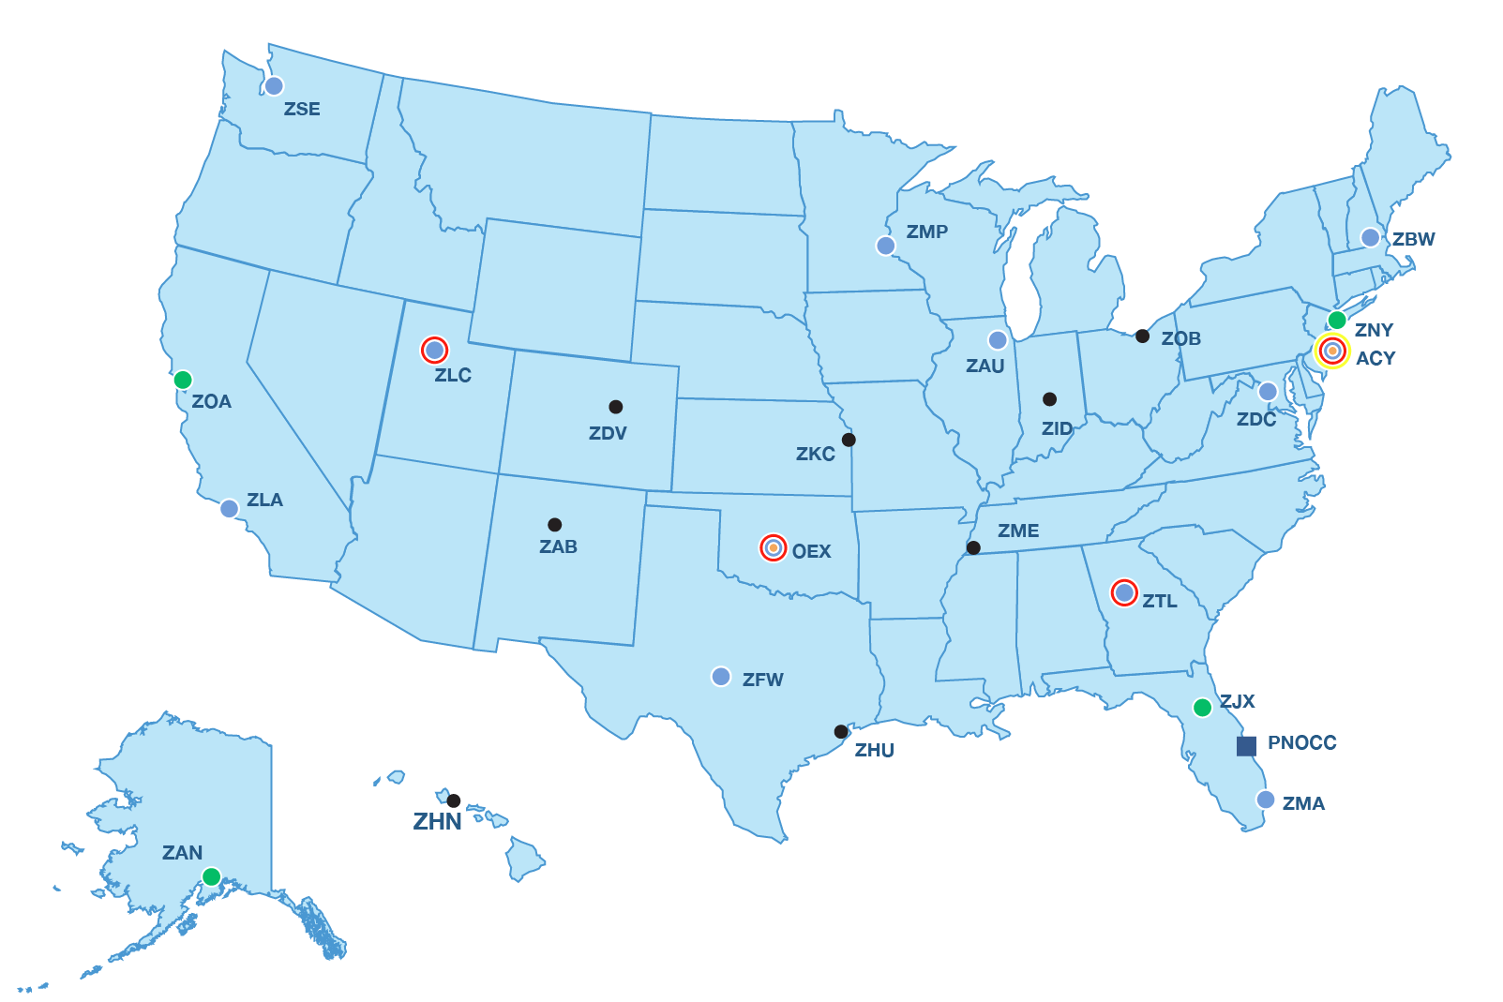

SWIM Infrastructure Deployment
NAS Enterprise Messaging Service (NEMS)
As of: July 2015
Key
Existing NEMS Nodes
NEMS Gateway
R&D FNTB Nodes
2015 NEMS Nodes Complete
Mission Support Nodes (Admin)
ARTCC Sites
FTI Operations Center
NEMS Deployment Status
FAA Internal Messaging Capabilities
16 nodes deployed of 20 total nodes
FAA Mission Support Messaging Capabilities
2 nodes deployed in Mission Support Network
FAA External Messaging Capabilities
8 nodes deployed in 4 NESG sites (ACY, OKC, ZLC, ZTL)
26 Total NEMS Messaging Nodes deployed
Changes from Previous Month: Completed Flight Data Publication IOC
System Wide Information Management (SWIM)
Complete NextGen Capabilities Package September 2013
Complete SWIM Terminal Data Distribution System (STDDS) Implementation June 2014
Complete Flight Data Publication IOC July 2015
SWIM Segment 2B FID September 2015
31
Notes:
As of July 2015:
NEMS nodes installations status:
NEMS Nodes Planned for FY2015: ZOA, ZAN, ZNY, ZJX (Scheduled for July 2015 completion).
FY 2015 NEMS Node deployment at ZNY, ZAN, ZJX, and ZOA deployment successfully completed on June 18, 2015
NEMS Nodes Planned for FY2016: ZHU, ZOB, ZME, ZDV
SWIM Segment 2B FID DP is planned for Q4 CY2015 (Sept DP).
System Wide Information Management (SWIM) will provide the information-sharing platform that will deliver real-time, traffic, weather and other NAS information in a standard data format to promote a common view or situational awareness among NAS users.
The first use of SWIM is the sharing of surface movement data from Core airports.
ASDE-X and ASSC surface data provide the surface situational awareness
Current users also receive common flight related weather situational awareness. SWIM also interfaces with several NAS weather systems to obtain the following data:
Runway visual range information for over 100 airports provides the visibility conditions at airports
Terminal weather products
Enroute weather products
SWIM services increase in-flight situational awareness by the delivery of:
Special Use Airspace status information and Notices to Airman (NOTAMS) to promote situational awareness
Metering information to maintain efficient use of airspace
Traffic flow information to decrease congestion in high use areas
Flight planning and flight tracks or location information to further common situational awareness
The SWIM NAS Enterprise Messaging Service (NEMS) provides the infrastructure required for NextGen's internal and external distribution of operational data.
To accommodate the needed processing power and customer demand for data SWIM has twelve installed operational NEMS nodes and four additional installations are scheduled this year to meet anticipated increased demand. Each year the program evaluates capacity vs demand to determine the location and number of nodes to add to the network.

Slide 32
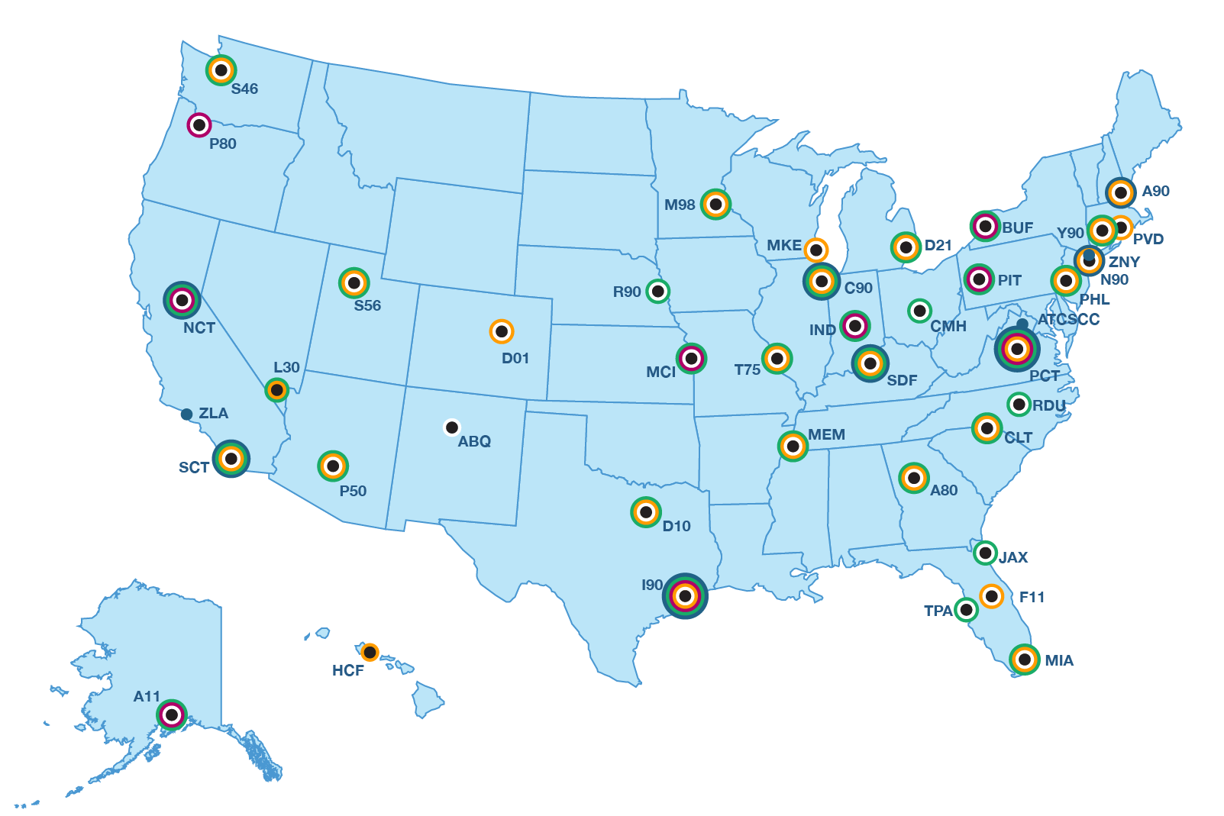
SWIM Terminal Data Distribution System (STDDS) by TRACON
As of: July 2015
Key
Tower Data Link System (TDLS)
Runway Visual Range
Airport Surface Detection Equipment, Model X
Airport Surface Surveillance Capability
Electronic Flight Strip Transfer System
SWIM Visualization Tool (SVT)
Changes from Previous Month: No Changes
32
Notes:
As of July 2015:
Release 3.1.1
Second Level Support software fix testing completed at the Raytheon site in Marlboro on July 22, 2015. R3.1.1 is planned for key site testing at Northern California TRACON (NCT) in August 2015 (SFO data) and Buffalo TRACON (CLE data) in September 2015.
Release 3.2 –
Terminal Automation Modernization and Replacement (TAMR) STDDS
Developed R3.2 Site prep plan. Holding briefings with Engineering Service Managers to ensure support and acceptance of the plan. STDDS site prep for R3.2 to be completed by June 1, 2016.
The STDDS Key Site Testing Software Release 3.2 for Northern California TRACON (NCT) and Fresno (FAT) has been successfully completed with no issues.
Key Site Testing scheduled for January 25, 2016 at Bradley (BDL/Y90)
The second keysite NCT scheduled for February 29, 2016.
RVR Digital Feed (DF) Transition: Planned shutdown of the TFMS Legacy feed is November 2015.
Currently 8 consumers have transitioned to receive RVR data from STDDS (Sabre, NEMC, SOSC, ATO Safety, Embry-Riddle, FlightAware, WSI and TFMS.
Initiated discussions on the plan to host the new Runway Visual Range (RVR) website on July 9, 2015, with ANG-E13 (Tech Center Laboratory Services Branch).
Presented to AJM-3 & AJW-1 management the issue of bad RVR clock data in the monthly coordination meeting with Tech Ops and Enterprise Services.
TFMS is currently the primary NAS consumer of STDDS RVR data which, due to the bad RVR clock data, is not able to rely on STDDS data for their metering calculations and traffic flow information.
The RVR latency issues were resolved by Tech Ops as of July 7, 2015.
Non-Movement Area Data – held meetings with AJM-23 to discuss STDDS connection to JFK Mini-ramp system. Preparing a draft briefing to present to FAA management on the benefits and parameters of including non-movement area in the SWIM feed.
Held a meeting with the Data Release organization on July 22, 2015, to discuss unfiltered Cat11 data from the JFK Ramp System and STDDS’ plans for connecting and publishing the non-movement data to external consumers. AJR-D agrees with the plan to move forward with the stipulation that we filter the Cat 10 data in the same manner SWIM filters Cat 11 data.
To initiate closure of an action from the SWIM Segment 2B JRC pre-brief regarding STDDS publishing non-movement area data (NMA) (ASDE-X Cat 10 data), conducted a meeting with AJV-7 and AJM-2/TFMS on July 21, 2015. Discussed the capability and received agreement to move forward with publishing the Cat 10 data via STDDS to external consumers stipulating that no new sensors would be installed to collect additional NMA data.
SWIM Visualization Tool (SVT) deployment
Eleven (11) sites are connected which provide a live surface movement area display at the following facilities: Southern California TRACON (SCT), Northern California TRACON (NCT), Potomac (PCT), New York (N90), Chicago (C90), Command Center (ATCSCC), Louisville (SDF), Boston (A90), Houston (I90), New York (ZNY), and Los Angeles (ZLA).
Two sites pending the SVT tool deployment: FAA Daily Events Network (DEN) and Hickam Air Force Base (AFB).
Held a meeting on July 13, 2015 with the core SWIM Visualization Tool (SVT) team and members from all 11 SVT facilities to discuss the upcoming SVT User Forum to be held in San Diego at the Southern California TRACON (SCT) during the week of September 14, 2015.

Slide 33

Collaborative Air Traffic Management - Technologies
As of: July 2015
Key
NAS-Wide
Air Route Traffic Control Centers (ARTCC)
  Airspace Flow Program
  Re-route Impact Assessment
  Adaptive Compression
  Corridor Integrated Weather System (CIWS)
  Unified Delay Program
  Collaborative Airspace Constraint Resolution (CACR)/Collaborative Trajectory Options Program (CTOP)
Route Availability Planning (RAPT)
Air Traffic Control System Command Center (ATCSCC)
CATM-T | NAS-Wide
Collaborative Info Exchange (CIX) | November 2014
Pre-departure Reroutes (PDRR) | FY2016
Airborne Reroute (ABRR) | FY2016
TFM Remote Site Re-engineering (TRS-R) (Phase 2) | FY2016
Changes from Previous Month: No changes
CATM-T WP4
IARD June 2014
Final Investment Decision (FID)
September 2015
Contract Award
December 2015
33

Slide 34
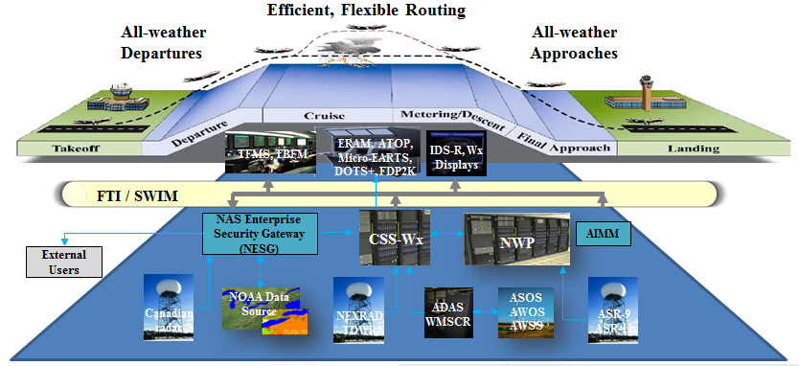
NextGen Weather Operational Overview
As of: July 2015
As-Is Weather
      Aviation Weather information limitations: inconsistencies across domains, unique data types, fixed time, space resolution, range, and latencies
      User must mentally process multiple information sources to assess the potential impact to their operations
To Be Weather
      Consistent weather information across domains and externally by the implementation of a common weather exchange model (i.e., WXXM)
  Improved aviation weather information
  Reduce avoidable air traffic delays and maximize available runway and airspace usage
CSS-Wx/NWP
Changes from Previous Month: No Changes
Initial Investment Decision (IID) 2013
Screening Info. Request (SIR)
Release Jan 2014
Final Investment Decision (FID) Mar 2015
CSS Wx Key Site IOC 2019
Contract Award Apr 2015
NWP Key Site
IOC 2020
34
Notes:
As of April 2015:
At the JRC in March the two NextGen weather programs (CSS-Wx and NWP) received positive Final Investment Decisions.
Contract awards took place in April 2015.

Slide 35
NextGen Portfolios
Performance-Based Navigation (PBN)
Time-Based Flow Management (TBFM)
Collaborative Air Traffic Management (CATM)
Improve Surface Operation (SurfOps)
Improved Multiple Runway Operations (IMRO)
Improved Approaches and Low Visibility Operations (IaLowVis)
Separation Management (SepMgmt)
On-Demand NAS Information (ODNI))
System Safety Management (SSM)
Environment & Energy (E&E)
35
Notes:
April Version Changes – Corrected CATM – used Automated in the title vs Air.
5/18/2015 – Source Mark Burd QC

Slide 36
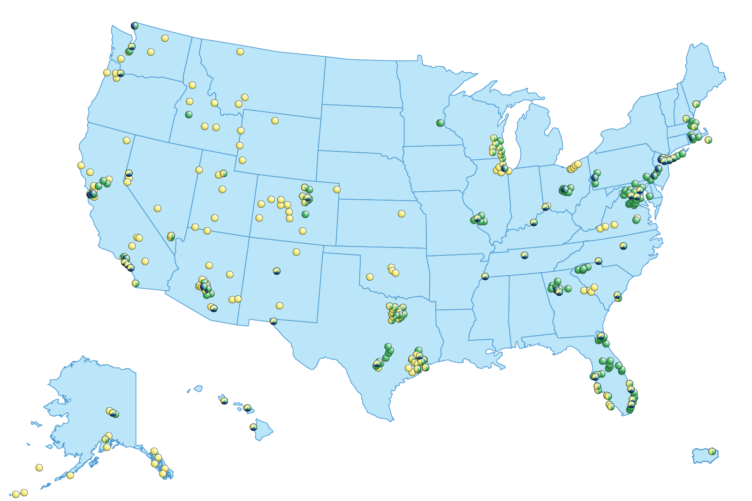
Performance Based Navigation (PBN)
As of: July 2015
Key
Airport with STAR
Airport with SID
Airport with RNP
RNAV SIDs 556
RNAV STARs 367
RNP 388
Airports 463
Reduced flight time and fuel
Flexible weather reroutes
Integrated traffic flow
End-to-end PBN network
Airspace deconfliction
Changes from Previous Month: No Changes
27
Notes:
AS of June 2015: Source IFP Gateway (AJV-5)

Slide 37
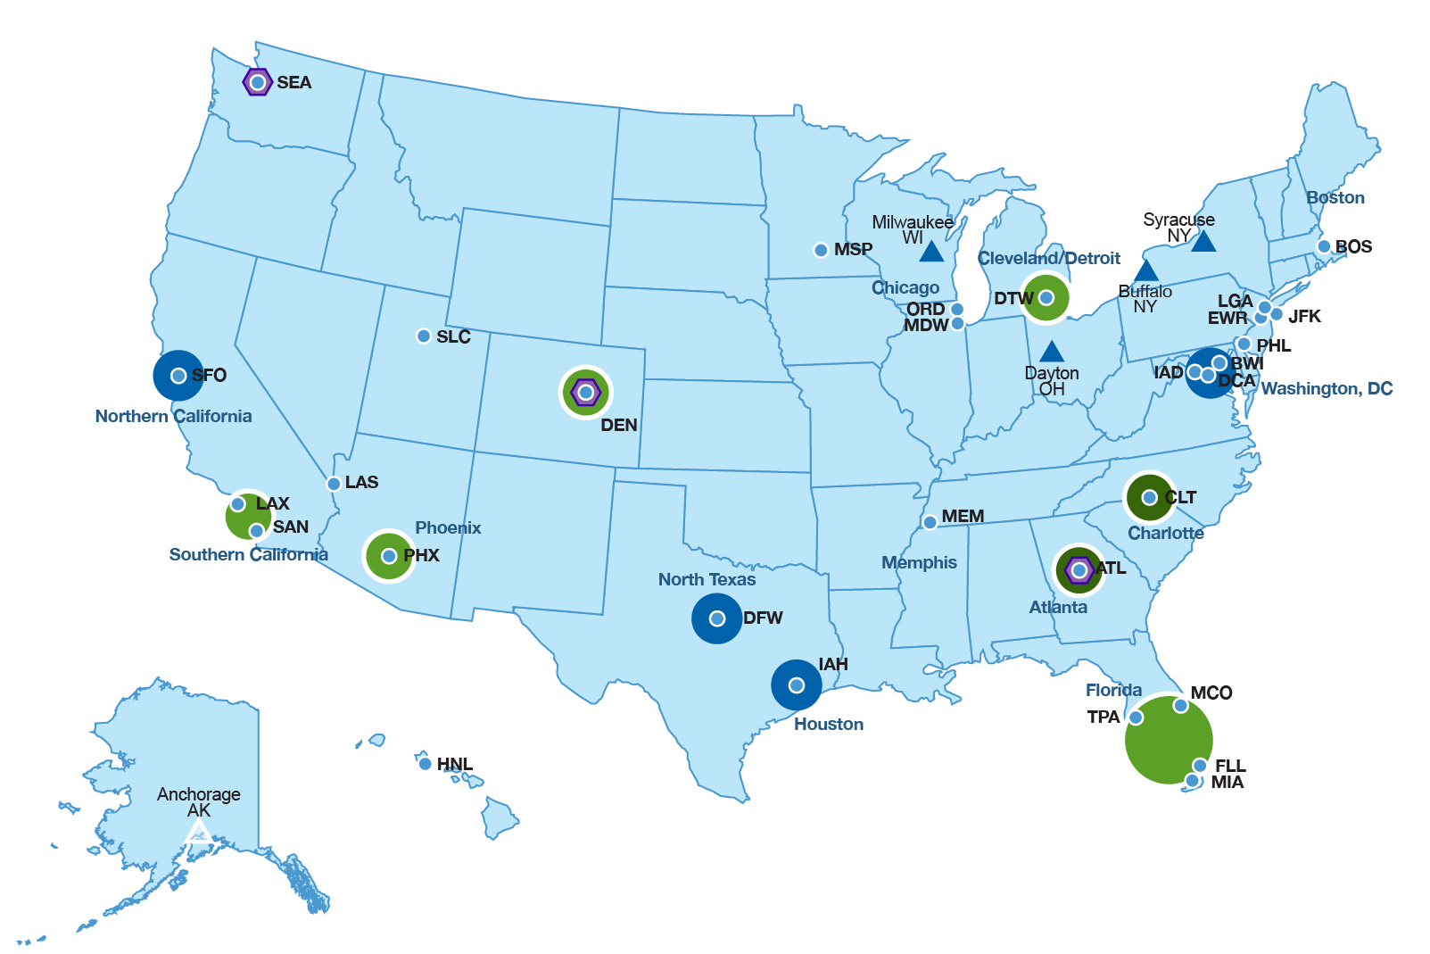
Metroplex Performance Based Navigation (PBN)
As of: July 2015
Key
Metroplex Future Site
Metroplex Study Phase
Metroplex Design Phase
Metroplex Site Implementation Phase
Metroplex Site Fully Implemented
3rd Party Vendor Site
PBN Initiatives
Core 30 Airport
Changes from Previous Month: No Changes
28
Notes:
As of June 2015: Source Skip Fisher
This shows a graphical representation of the PBN activities being completed under the FAA’s Metroplex initiative, third-party vendor initiative, and more broadly throughout the NAS.
Metroplex UPDATES
Washington DC Metroplex completed Implementation on June 29th (publication date June 25th)
Denver is in the Design Phase

Slide 38
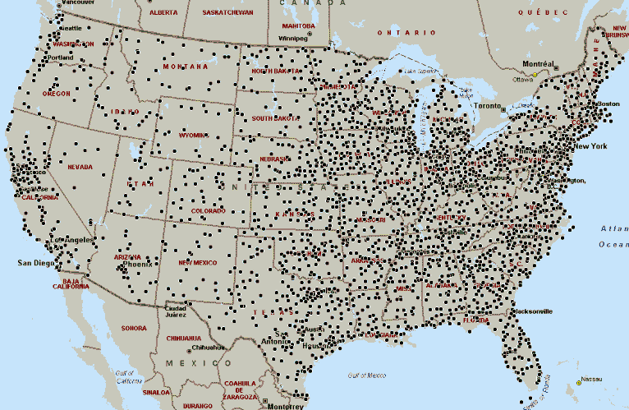
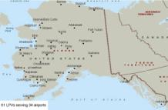
Airports with RNAV (GPS) Approaches (WAAS) Instrument Approaches
As of: July 2015
- 4,148 LP/LPVs combined
WAAS LPV Procedure
- 3,554 LPVs serving 1,732
Airports
- 928 LPV-200’s
- 1,653 LPVs to Non-ILS
Runways
- 1,142 LPVs to ILS runways
- 2,412 LPVs to Non-ILS
WAAS LP Procedure
- 594 LPs serving 427 Airports
- 591 LPs to Non-ILS Runway
- 3 LPs to ILS Runways
Changes from Previous Month: No Changes
Program Website
38
Notes:
38
38
38
As of April 2015 – Changes made to statistics. Source Melanie Cook

Slide 39
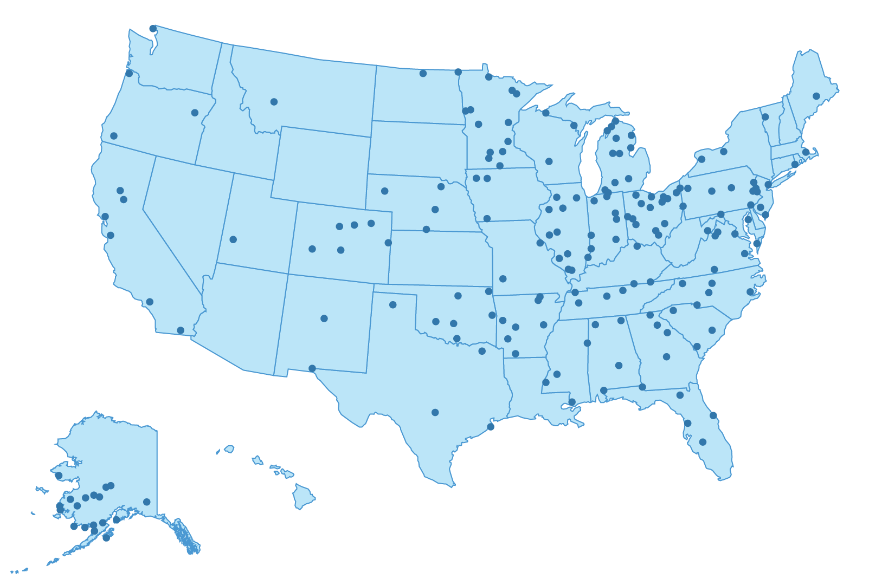
WAAS Remaining Candidate Sites
As of: July 2015
Remaining Surveys for LPV/LP
500 Total Surveys from FY14-16
348 (+7) Completed Procedures
120 Planned Procedures by FY16
*400 Total Procedures
*Note: Approximately 80% of all Runway Ends (Surveys) will qualify for a LP/LPV procedure
Changes from Previous Month: No Changes
RNAV (GPS) Approaches (WAAS)
FY14
FY15
FY16
Publish 180
Procedures
Publish 100
Procedures
Publish 120
Procedures
39
Notes:
As of April 2015 – Changed Publish 100 procedures to Complete with a check mark circle. Source: Melanie Cook

Slide 40
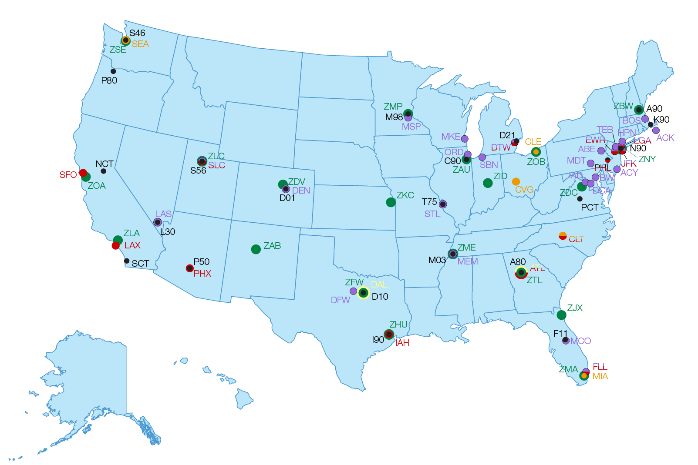
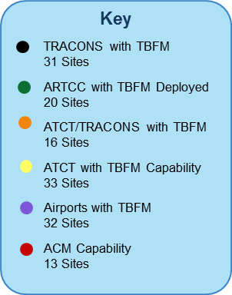
Time Based Flow Management (TBFM)
As of: July 2015
  Changes from Previous Month: IARD Interval Mgmt Spacing Cruise / Arrivals & Approach Completed
Time Based Flow Management (TBFM)
WP 3 (Integrated Departure/Arrival Capability (IDAC) / Terminal Sequencing and Spacing (TSAS) FID April 2015
IARD Interval Management – Spacing Cruise / Arrivals & Approach
July 2015
FID Interval Management
– Spacing Cruise / Arrivals and Approach
December 2016
First TSAS Site Deployed
April 2019
40
Notes:
Milestone
Code
Flag
APB Planned Date
Duration
Final investment decision S17F Apr-15
0 month
TBFM Contract Award (Not-To-Exceed (NTE))
S19
July-15
3 months
TSS System Design Review (SDR) for TBFM¹
S21
Dec-15
8 months
Factory acceptance testing (FAT) completed for initial TSS functionality²
S27
Sep-17
29 months
First IDAC site deployed³
Jul-18
39 months
Integration and Test (IT) at WJHTC completed⁴
Mar-19
47 months
First TSS site deployed⁵
Apr-19
48 months
Last (5th) IDAC site deployed⁶
May-19
49 months
TSS In-Service Decision (ISD) ⁷
S44
Apr-20
60 months
5th TSS site deployed⁸
Oct-20
66 months
Last (9th) TSS site deployed⁹
L
Sep-22
89 months

Slide 41
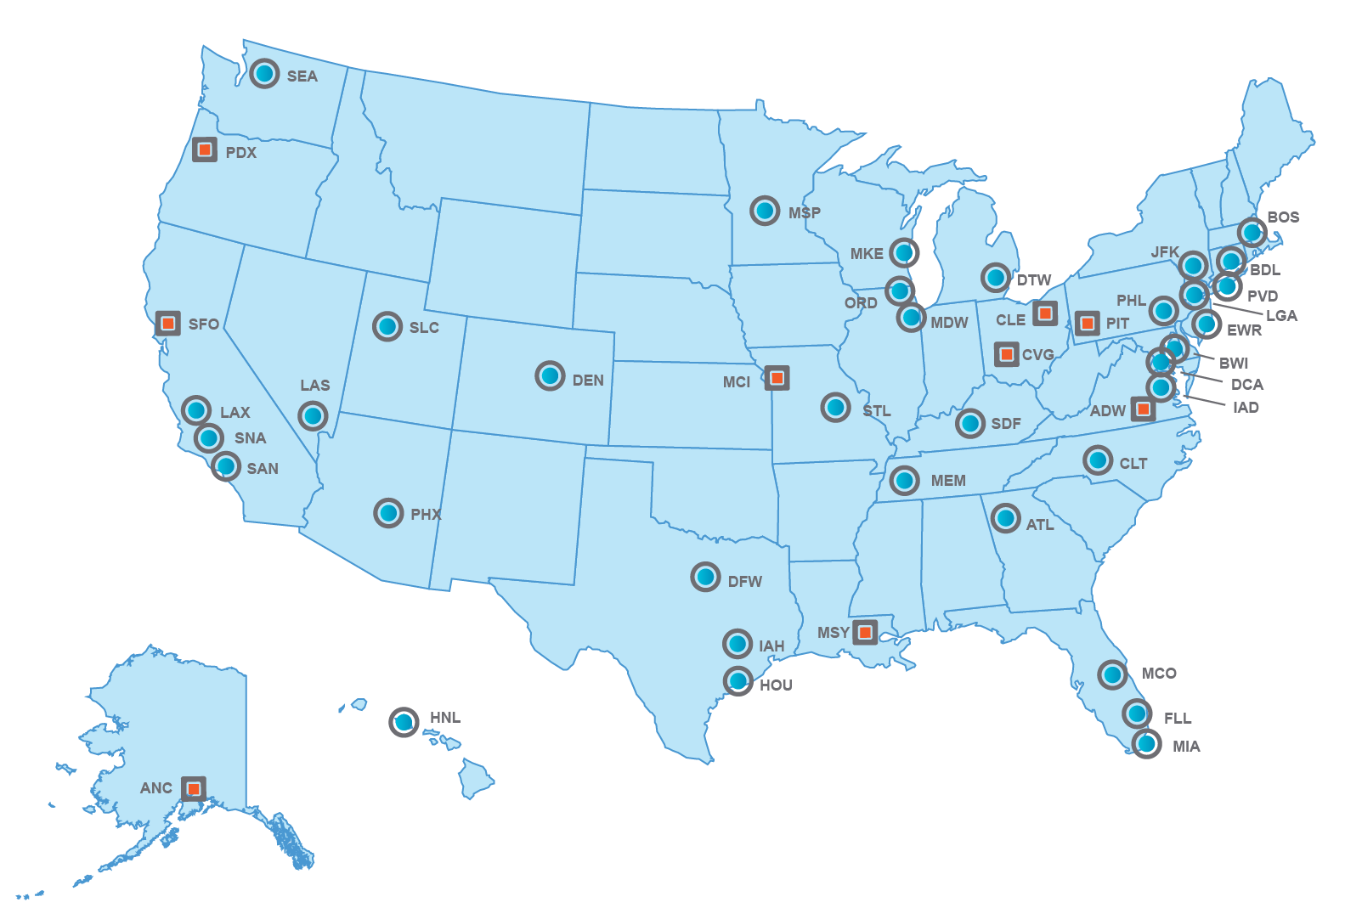
Improved Surface Operations (SurfOps)
As of: July 2015
Expansion of Surveillance
Key
ASDE-X
ASSC
 | Site | Planned IOC
1 | San Francisco (SFO) | FY2016
2 | Cleveland (CLE) | TBD
3 | Cincinnati (CVG) | FY2016
4 | Kansas City International (MCI) | FY2016
5 | Pittsburgh (PIT) | FY2016
6 | Portland (PDX) | FY2017
7 | Andrews Air Force Base (ADW) | FY2017
8 | New Orleans (MSY) | FY2017
9 | Anchorage (ANC) | FY2017
External Surface Data Release
Airlines | 3rd Party
American/USAir | Passur
Alliance | ARINC
Delta | Lockheed
FedEX | Sabre
JetBlue | Mosac ATM
United | Sensis
 | Rockwell
 | Veracity
Changes from Previous Month: No Changes
41
Notes:
As of July: Changed IOC for SFO to FY2016, changed CLE to TBD; source Melanie Cook
ASSC:
SFO key site did not achieve IOC in November 2014 due to SRMD issues. The Program Office is coordinating a proposed date for IOC on December 2015.
ASSC Program Office has directed the resumption of engineering site design at all ASSC production sites
TFDM:
Per the action from IID, TFDM returned to the JRC on August 20, 2014 to provide a briefing on the revised program strategy, including the prioritization results and viability of segmentation. Received approval from the JRC to move forward to FID based on the revised scope and strategy presented on August 20, 2014. Next Steps:
Develop a Business Case based on the revised Strategy
Provide a Status Briefing to the JRC next Spring (2015)
SIR Release scheduled for March 2015
Draft SIR was released on November 21, 2014
Proceed to FID in March 2016.

Slide 42
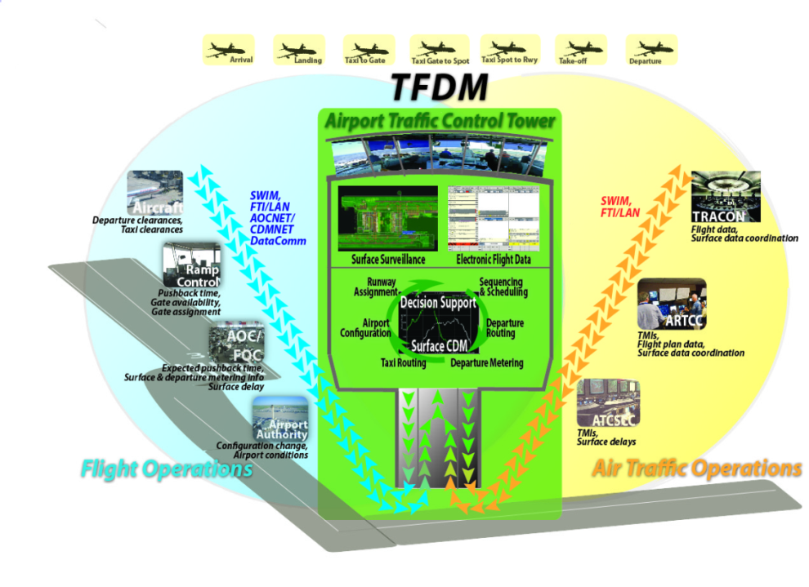
Terminal Flight Data Manager
As of: July 2015
Improved Predictability, Less Taxi Time / Out Fuel Burn & Improved Crew Utilization
Connects aircraft operators, controllers, and airports with digital flight plans, shared surface surveillance data, and collaborative decision-support tools
Fewer Delays and restrictions, improved surface situational awareness, fewer aircraft in the movement area and departure queue management
Inefficient traffic coordination
Inefficient inter-facility coordination
Surface delays and congestion
TFDM System Acquisition
Source selection evaluation began on July 15th and is scheduled to be completed by November 2015.
Best value determination will be completed by December 2015
Contract award planned for after FID in March 2016
TFDM Early Implementation Capability –
Surface Visualization Tool (SVT): All 9 SVT sites are operational.
Advanced Electronic Flight Strip (AEFS)
  CLE: AEFS went live in CLE old tower on February 8, 2015. IOC in new tower planned for September 2015.
  SFO: IOC planned for July 2016
  EWR: IOC is planned for April 2016.
  LAS: IOC is planned for September 2016
  CLT: IOC is planned for 2017
TFMS, SWIM, FTI/LAN, AOCNET/ CDMNET, DataComm
TBFM, TFMS, SWIM, FTI/LAN, ERAM, STARS, ASDE-X
Changes from Previous Month: Changes highlighted in red
Terminal Flight Data Manager (TFDM)
Initial Investment Decision (IID)
Mar 2014
Surface Visualization Tool IOC at SCT Apr 2014
Screening Info. Request (SIR)
Release April 2015
Final Investment Decision (FID) and Contract Award FY2016
42
Notes:
As of July 2015: (Source Melanie Cook)
The FAA is developing a NextGen system called Terminal Flight Data Manager. TFDM will help save time and fuel, reduce emissions, and improve the experience for the flying public.
This new system will work by digitizing flight plans and integrating them with surveillance data to create accurate, real-time predictive tools. TFDM will share data among controllers, aircraft operators, and airports so they can better stage arrivals and departures and manage traffic flow for greater efficiency.
The Initial Investment Decision (IID) was approved in March 2014.
Per the action from IID, TFDM returned to the JRC on August 20, 2014 to provide a briefing on the revised program strategy, including the prioritization results and viability of segmentation. Received approval from the JRC to move forward to FID based on the revised scope and strategy presented on August 20, 2014. Next Steps:
Develop a Business Case based on the revised Strategy
Provide a Status Briefing to the JRC next Spring (2015)
SIR Release scheduled for March 2015
Draft SIR was released on November 21, 2014
Proceed to FID in March 2016.

Slide 43
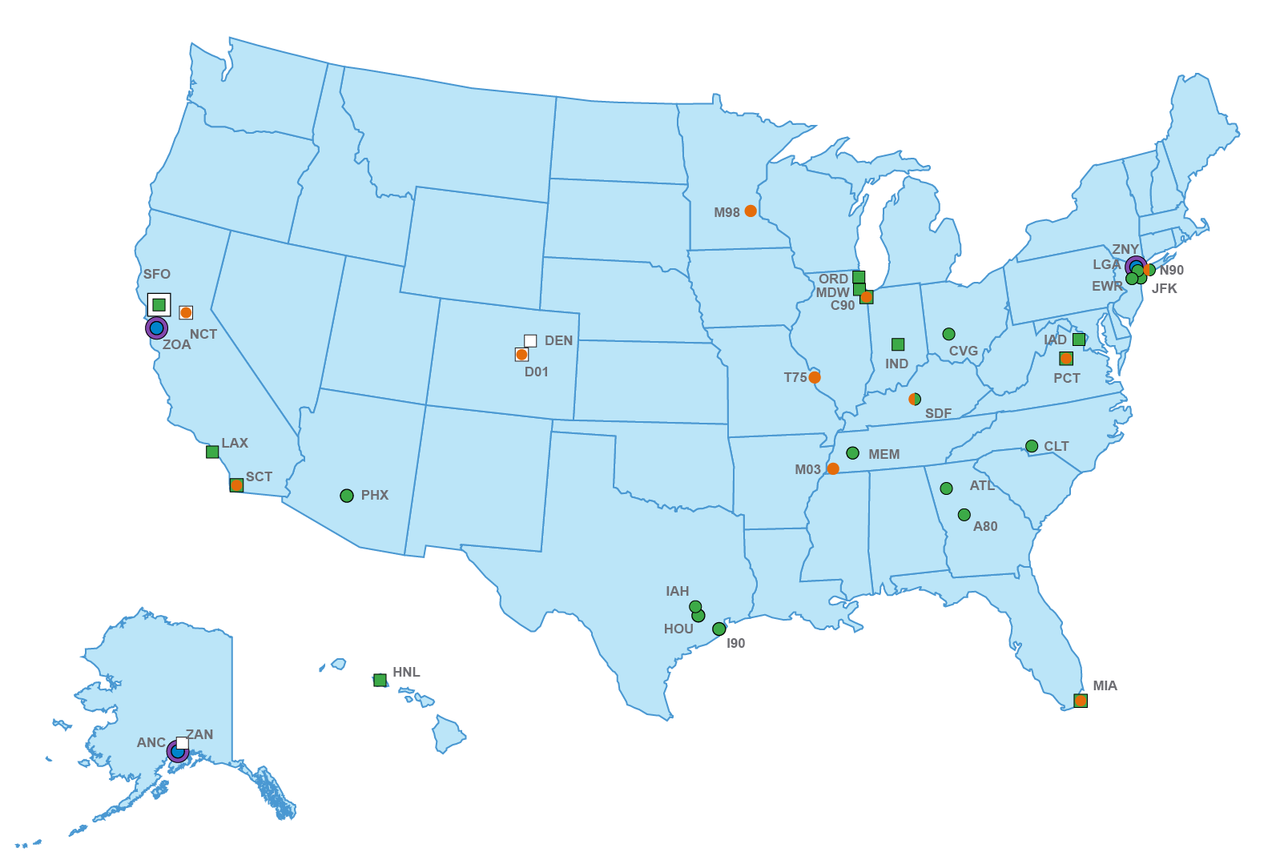
Separation Management (SepMgmt)
As of: July 2015
RECAT Phase I planned sites
Site | Planned IOC
CLT, ORD, MDW, SFO | FY2015
LAX, HNL | FY2016
MIA, IND, IAD | FY2017
RECAT Phase II planned sites
(Best effort and funding dependent)*
Site | Planned IOC
ANC*, DEN* | FY2016
SFO | FY2017
Key
Planned Actual
Re-Categorization Phase 1 Site
Re-Categorization Phase 2 Site
Enhanced Oceanic Climb/Descent Procedure via ADS-C Automation
ADS-B Oceanic In Trail Procedure and Automation
Automated Terminal Proximity Alert (ATPA) Phase 1
Changes from Previous Month: Updated Timeline with
Site Implementation dates
Wake RECAT
RECAT I Key Site IOC Nov. 2012
RECAT I Key Site CLT
Mar 2015
RECAT I Key Site ORD
Jul 2015
RECAT I Key Site MDW
Jul 2015
RECAT I Key Site SFO
Sep 2016
RECAT II Key Site IOC 2016-2017
43
Notes:
As of April 2015 – Map Change Required as defined by the PfM Standley
As of February 2015:
* FY16 RECAT funding will need to be released very early in the fiscal year to meet the timelines in the NAC commitments.

Slide 44
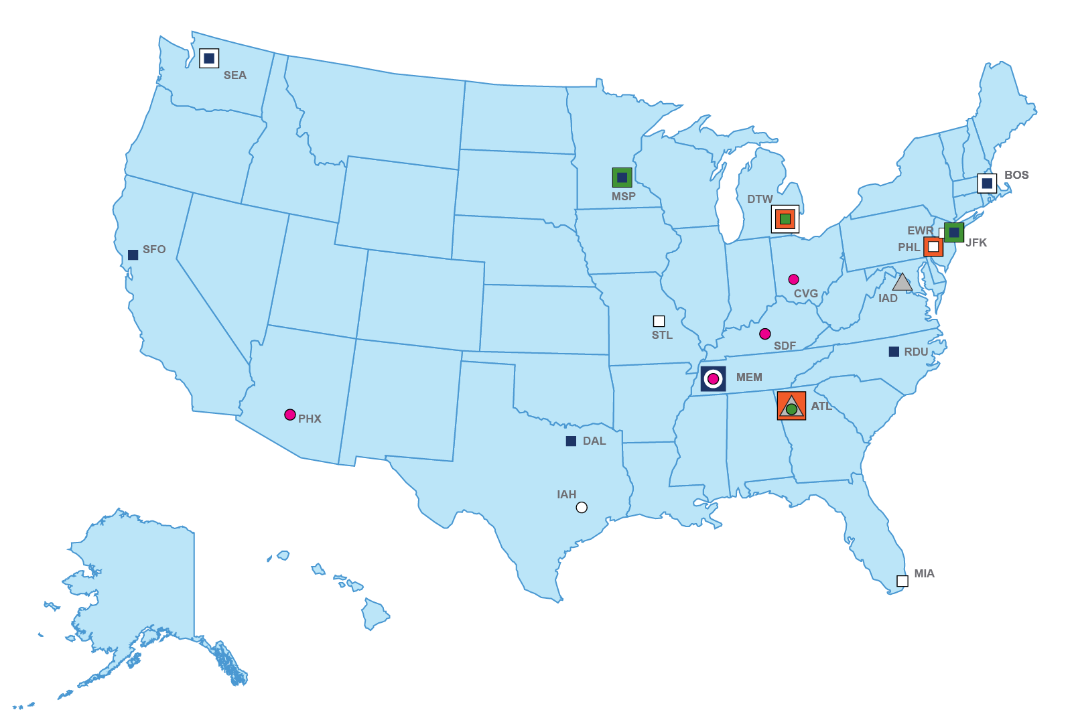
Improved Multiple Runway Operations (IMRO)
As of: July 2015
Dual Independent Parallel Ops
Site | IOC
ATL | FY2014
Dependent Parallel Ops at 1.0NM
(runways less than 2500’-3600’)
Site | Planned IOC
MSP, JFK, SEA, PDX, RDU, DAL, MEM | FY2016
SFO, BOS | FY2017
Triple Independent Parallel Ops
Site | Planned IOC
ATL, IAD | FY2017
Dual Independent Parallel Ops
with Offset
Site | Planned IOC
JFK, PDX, MSP, DTW | FY2017
Dependent Parallel Ops
(runways >3600’)
Site | Planned IOC
SDF, PHX, CVG, MEM | FY2017
Key
Dual Independent Parallel Ops With Offset
Triple Independent Parallel Ops
Dependent Parallel Ops Runways < 2500’ – 3600’
Runways > 3600’
WTMD Site (Planned) WTMD Site (Actual)
WTMA-P Site (Planned) WTMA-P Site (Actual)
Wake Turbulence Mitigation for Departures (WTMD) planned sites (dependent on FID)
Wake Turbulence Mitigation for
Arrivals-Procedures (WTMA-P)
planned sites
Site | Planned IOC
BOS, EWR, MIA, PHL, SEA | FY2016
DTW, STL | FY2017
Site | Planned IOC
PHL, DTW , ATL | FY2016
IMRO
Changes from Previous Month: Changes highlighted in red
Initiate WTMD Ops Demo at SFO May 2013
Completed WTMD Ops Demo. Benefit Analysis June 2015
WTMD Strategy Decision
Sep 2015
Dual Ind. Parallel w/ Offset Key Site Dec 2016
WTMA-P Key Site
IOC (PHL) Mar 2016
Dependent
Parallel Ops (<3600’) Key Site Jun 2016
Dependent Parallel Ops (>3600’) Key Site Mar 2017
Triple Ind. Parallel
Ops Key Site Sep 2017
44
Notes:
April Version – No Changes; updated to reflect no changes made.

Slide 45
NextGen Portfolio
Accomplishments and 90 Day Forecast
45

Slide 46
NextGen Portfolio Accomplishments
Portfolio | Increment | Current Accomplishments
PBN | 108209-12 Optimization of Airspace and Procedures in the Metroplex | Washington Metroplex Post-Implementation Analysis Plan Complete July 2015 Cleveland/Detroit EA Purpose and Need Section Complete July 2015 Phoenix Metroplex Design Phase Complete July 2015
TBFM | 102118-23 Interval Management –Spacing Arrivals and Approach 102118-21 –Interval Management –Spacing (IMS) Cruise | IARD Complete July 2015
37

Slide 47
NextGen Portfolio Accomplishments
Portfolio | Increment | Current/Projected Accomplishments
ODNI | 103305-12 - Improved Access to NAS Aeronautical, Status, and Constraint Information for Authorized NAS Users and Subscribers | Deployed SWIM NEMS Nodes July 2015
 | 103306-02 - Tailored NAS Status via Digital NOTAMs for ANSP
 | 105104-21 - Improve SAA-Based Flow Predictions
 | 103305-13 – Provide NAS Status via Digital NOTAMs | Contract with Vendor for FTI Services to support Digital NOTAMs July 2015
 | 108212-11 – ANSP Real-Time Status for SAAs | AIM Segment 3 Program Requirements Development - Preliminary Program Requirements July 2015
 | 108212-12 – Improve SUA-Based Flow Predictions | Software Integration Test Contract with Vendor for FTI Services to support SUA Enable Capability in the field July 2015
47
Notes:
April 2015 – Changes proposed by Melanie Cook on Accomplishments were for March Accomplishments which are not part of this month’s presentation.
104117-11 Integrated Departure/Arrival Capability
Integrated Departure/Arrival Capability has been deployed at Los Angeles Center (ZLA), Southern California TRACON (SCT), Los Angeles (LAX), and Bob Hope Airport (BUR). IDAC hardware installed at four (4) ZID towers (IND, SDF, CMH, and DAY).
104117-11 Integrated Departure / Arrival Capability
FAA AJI formally accepted AT National Training. Training waterfall at FAAAC started with 100 students planned in FY15.
104120-13 Arrival Interval Management using Ground Automation
*Conducted Delta Release 4.3.2 Exit Brief TBFM Release 4.3.3, planned for July release, will improve high wind issue by providing missing parallax conversion. In parallel, CRU-X weather data processing has been reformatted from 2 hours to 1 hour age consistent with ERAM’s WARP weather data.

Slide 48
NextGen Portfolio 90 Day Forecast
(August, September, and October)
Portfolio | Increment | Projected Accomplishments
PBN | 108209-12 Metroplex PBN Procedures | Las Vegas Study Team Kickoff August 2015 Las Vegas Study Team first Outreach August 2015 Las Vegas Study Team Second Outreach September 2015 Las Vegas Study Team Final Outreach October 2015 Washington Post Implementation Initial Ops Monitoring Complete, August 2015 Washington Post Implementation Data Collection Initiated September 2015 Cleveland/Detroit Affected Environment (Sept) and Final Ops Validation Complete, September 2015 Cleveland/Detroit Final Ops Validation, EA Alternative Section Complete and SMS Initiate October 2015 Florida 75% Design Complete September 2015 Florida EA Affected Environment Section Complete October 2015 Denver Environmental Purpose and Need Section and 25% Design Complete September 2015 Phoenix Metroplex Eval Phase Begin August 2015 Phoenix Design Phase End and Eval Phase Begin October 2015
38

Slide 49
NextGen Portfolio 90 Day Forecast
(August, September, October)
Portfolio | Increment | Current/Projected Accomplishments
PBN | 107103-12 RNP Authorization Required (AR) Approaches | 7 RNP AR (2 Original, 5 Amendments) are scheduled to be published August 2015 15 RNP AR (4 Originals, 11 Amendments) are scheduled to be published October 2015
 | 107103-13 RNAV SIDs and STARs at Single Sites | 10 RNAV SID (10 Amendments) and 5 RNAV STAR (2 Originals, 3 Amendments) are scheduled to be published August 2015 24 RNAV SID (2 Originals, 22 Amendments) and 17 RNAV STAR (2 Originals, 15 Amendments) scheduled to be published October 2015
 | 108209-20 Advanced and Efficient RNP | Develop EoR Widely Spaced Ops National Standard - Concept Validation Activities – Held EoR Post Fly It meeting with MITRE and Denver Stakeholders August 2015 Complete EoR Track-To-Fix (TF) fly-by Approach Safety Analysis – External Stakeholder Meeting planned for August 14 (Scope to share early results of TF Safety Analysis) August 2015
39

Slide 50
NextGen Portfolio 90 Day Forecast
(August, September, October)
Portfolio | Increment | Current/Projected Accomplishments
IMRO | 102141-23 Simultaneous Independent Closely Spaced Approaches | Independent Approaches with HUR analysis- Produce FUSION with FMA Benefits and Research Challenges White Paper August 2015 Independent Approaches with HUR analysis- Conduct dual, triple and offset independent approaches with HUR analysis September 2015 Paired Approach-Complete Paired Approach CAT. I Interim Status Memo September 2015 Report on the effectiveness of the initial PA Cat I algorithm and display requirements as tested September 2015
 | 102140-01 Wake Turbulence Mitigation for Departures | Produce documentation for WTMD strategy decision September 2015
IaLowVis | 107107-21 GBAS Category II/III Standards | Draft study Impact on Ionosphere in lower latitudes – coordination with Brazil (FAA – Brazil effort) September 2015 Submit Yearly Performance summary EWR, IAH September 2015 Submit Yearly Performance report Airlines September 2015 Summary and evaluation of Initial Architecture reviews September 2015
39

Slide 51
NextGen Portfolio 90 Day Forecast
(August, September, October)
Portfolio | Increment | Current/Projected Accomplishments
NAS Infrastructure | Common Support Services for Weather (CSS-Wx) 103305-25 - Common Support Services – Weather 103119-13 - Enhanced In-Flight Icing Diagnosis and Forecast 103119-17 - 4-D Tailored Volumetric Retrievals of Aviation Weather Information 103119-18 - Enhanced Turbulence Forecast and Graphical Guidance 103119-19 - Enhanced Ceiling and Visibility Analysis and Forecasts NextGen Weather Processor (NWP) 103119-11 - Enhanced NAS-Wide Access of 0-2 Hours Convective Weather on Traffic Forecast for NextGen Decision-Making 103119-14 - Enhanced Weather Radar Information for ATC Decision-Making 103119-15 - Extended Convective Weather on Traffic Forecast for NextGen Decision-Making 103119-16 - Convective Weather Avoidance Model (CWAM) for Arrival/Departure Operations | CSS-Wx System Specification Review (SSR), System Requirements Review (SRR), System Design Review (SDR) September 2015 CSS-Wx Integrated Baseline Review September 2015 CSS-Wx and NWP Technical Interchange Meeting with Harris and Raytheon September 2015
51

Slide 52
NextGen Portfolio 90 Day Forecast
(August, September, October)
Portfolio | Increment | Current/Projected Accomplishments
ODNI | 103305-13 – Provide NAS Status via Digital NOTAMs | Digital NOTAMs Interface Requirements Development SWIM/AIM/DoD, External Customers September 2015
 | 108212-11 – ANSP Real-Time Status for SAAs | ERAM Release Segment 6/7 Program Requirements Development September 2015
52

Slide 53
Backup
53

Slide 54
Performance-Based Navigation (PBN)
PBN is the framework for defining navigation performance along a route, during a procedure or in an airspace. Progressive stages of PBN capabilities include the safe implementation of more closely spaced paths for departure, arrival and approach that allow for improved operations and efficiency. Complementary efforts to new capabilities include NAS right-sizing activities that allow for the removal of non-beneficial procedures and infrastructure currently in place.
Complete/Operational | On Track/Low Risk | Delayed/Medium Risk | Overdue/High Risk
PBN Capability (* NAC Priority) | OA | Status
PBN Route Eligibility Check | 2013 | B
Large-Scale Redesign of Airspace Leveraging PBN | 2014 | B
Transition to PBN Routing for Cruise Operations | 2015 | G
Equivalent Lateral Spacing Operations (ELSO)* | 2018** | G
RNAV (GPS) Approaches | 2016 | G
RNAV (RNP) Authorization Required (AR) Approaches | 2016 | G
RNAV SIDs and STARs at Single Sites* | 2016 | G
Metroplex PBN Procedures* | 2017 | G
Advanced and Efficient RNP* | 2017 | G
Fuel efficient routing
Reduced delays with increased throughput
Predictability and flexibility of the system
Direct routes between busy cities pairs
Integrated STAR and SID procedures, and reduced noise and emissions
Only Near Term Bravo increments are displayed (2016-2017) Success Criteria
**ELSO National Standard (NAC/NIWG Commitment) was completed in June, however ELSO Success Criteria extends to 2018
Developing PBN in Metroplex airspace allows more efficient use of airspace and improved arrival and departure flows. Metroplex solutions are focused on optimizing procedures and traffic flows, and may include airspace structure changes to support those optimal routings. Specific operational changes include converting conventional procedures to PBN, removing level-offs on arrivals, segregating arrival routes to deconflict flows, adding departure points, expediting departures, adding new high-altitude PBN routes, and realigning airspace to support those changes.
The national emphasis on Metroplex (OAPM) programs is intended to provide early benefits to large populations of Stakeholders.
Single site implementation of PBN procedures are processed through FAAO 7100.41 process which has been recently established.
AEE
AFS
AJI
AJM
AJT
ANG
APO
ARP
PASS
Safety – ATO
Airlines
Communities
MITRE
Unions – NATCA, ALPA
54

Slide 55
Time-Based Flow Management (TBFM)
“The Time-Based Flow Management (TBFM) portfolio, will enhance system efficiency by leveraging the capabilities of the Traffic Management Advisor (TMA) decision-support tool, a system that is already deployed to all contiguous U.S. (CONUS) Air Route Traffic Control Centers (ARTCCs). In particular, improvements in TMA's core Time-Based Metering (TBM) capability and its trajectory modeler, an expansion of TMA and its departure capabilities to additional locations, and enhancements to TMA's departure capabilities, will enhance efficiency and optimize demand and capacity. Further, improvements will be made to enable controllers to more accurately deliver aircraft to the Terminal Radar Approach Control facility (TRACON) while providing the opportunity for aircraft to fly optimized descents. These changes will be leveraged to enable aircraft to maintain a spacing interval behind preceding aircraft, further improving capacity and flight efficiency. These benefits should reduce fuel burn due to more efficient flight paths. In the Bravo timeframe this portfolio focuses on scheduling and interval management tools that further expand Time-Based Metering (TBM) benefits to safely assure the smooth flow of traffic and increase the efficient use of airspace. Point-in-Space Metering, Time-Based Metering in the Terminal Environment, and Improved Management of Arrival/Surface/Departure Flow extend, enhance, and proliferate metering operations; improve the accuracy of schedules and demand predictions for more efficient and predictable NAS operations; and continue the path toward trajectory-based operations. This portfolio also begins the use of Interval Management-Spacing (IM-S) operations, using a combination of ground- and flight deck-based capabilities.”
Complete/Operational | On Track/Low Risk | Delayed/Medium Risk | Overdue/High Risk
TBFM Capability (* denotes an external commitment) | OA | Status
Extended Metering operationally available at ZAB ARTCC | 2014 | B
Complete Traffic Management Coordinator (TMC) Training Program for Extended Metering | 2014 | B
Arrival Interval Management using Ground Automation operationally available at ZAB ARTCC | 2014 | B
Use RNAV Route Data to calculate Trajectories for TBM Operations operationally available at ZLA ARTCC* | 2014 | B
Integrated Departure/Arrival Capability (IDAC) operationally available at ZLA ARTCC and LAX airport | 2014 | B
Positive decision regarding integration of TBFM and TFMS data | 2014 | B
Implementation of TBFM Adjacent-Center Metering (ACM) Capability for arriving aircraft at LAX, SFO, SAN, ATL, and IAH | 2014 | B
Implementation of TBFM for arriving aircraft BWI, CLE, DCA, HPN, SAN, and TEB* | 2014 | B
Improved Management of Arrival/Surface/Departure Flow Operations (IDAC2) | 2018 | G
Time-Based Metering and Terminal Environment (TSAS) | 2019 | G
Optimization of system demand and capacity by reducing delays at lower altitudes and improving predictability of aircraft movement
Improved flight efficiency from increased optimized descents, calculation of trajectories and slot times via RNAV-based routing, and surface operations management.
TSAS- Aircraft are time-based metered inside the terminal environment, enhancing efficiency and reducing emissions through the optimal use of terminal airspace. Terminal time-based metering will also improve the predictability of aircraft at points in space within the terminal area and at the runway increasing overall system capacity.
Only Near Term Bravo increments are displayed (2016-2017) Success Criteria
AJM
ANG
AJT
AJV
AJR
AVS
Volpe
NASA
The TBFM Program Office will be the principal office managing the implementation of these increments, leveraging the processes, products, infrastructure, and corporate expertise used in support of the TBFM program.
55

Slide 56
Collaborative Air Traffic Management (CATM)
The overall philosophy driving Collaborative Air Traffic Management (CATM) services in NextGen is to provide collaboration in traffic flow management. CATM capabilities will coordinate flight and flow decision-making by flight planners and FAA traffic managers to improve overall efficiency, provide greater flexibility to flight planners and make the best use of available airspace and airport capacity.
Complete/Operational | On Track/Low Risk | Delayed/Medium Risk | Overdue/High Risk
CATM Capability | OA | Status
Enhanced Congestion Prediction | 2011 | B
Execution of Flow Strategies (XFS) | 2012 | B
Collaborative Trajectory Operations Program (CTOP) | 2012 | B
Route Availability Planning Tool (RAPT) | 2014 | B
Collaborative Airspace Constraint Resolution (CACR) | 2014 | B
Delivery of Pre-Departure Reroutes to Controllers (PDRR) | 2016 | G
Airborne Re-Routing (ABRR) | 2016 | G
User Input to Improve Departure Predictions | 2016 | G
Establish Enhanced Data Exchange with Flight Operators (FOC) and Airport Operators | 2016 -2021 | G
Fewer en route capacity constraints are imposed as congestion is resolved through tailored incremental congestion responses.
Aggregate flight efficiency is increased by factoring individual flight trajectories into the congestion solution.
User route flexibility is increased through negotiated trajectories for congestion resolutions.
Integrated resolutions identify the flights to maneuver minimizing the number of affected flights.
Facilitates the ability of local traffic managers to balance workload
Allows focus on strategic decision making instead of planning and coordinating reroutes
Only Near Term Bravo increments are displayed (2016-2017) Success Criteria
The deployment of CATM capabilities as part of existing program baselines that enhance the TFM automation system and its interfaces.
In the near term, TFMS to build capability for Flight Operations Center (FOC)/AOC operators to enter 14 new data elements to improve departure predictions.
Additional NextGen funding is being provided to upgrade the EnRoute automation systems. The operations will receive increased information on the operator’s preferred alternative routes; enhanced tools for assessing the impact of rerouting decisions; and improved communications and display of instructions to controllers in order to accommodate user preferences to the maximum extent possible.
AIR
AFS
AJM
ANG
AJR
AJV
Airlines
Volpe
MIT LL
SRA
MITRE
CSC
AJT
56

Slide 57
Improved Surface Operations (SurfOps)
This portfolio encompasses enhancing the surface movement, surveillance and data exchange that occurs from the entrance of the aircraft into the movement area to the departure of the aircraft from the airport.
Complete/Operational | On Track/Low Risk | Delayed/Medium Risk | Overdue/High Risk
Surface Capability (* Denotes NAC Priorities) | OA | Status
Moving Map with Own-Ship Position | 2011 | B
Cockpit Display of Traffic Information | 2011 | B
ASDE-X to Additional Airports | 2012 | B
External Surface Data Release* | 2013 | B
Situational Awareness and Alerting of Ground Vehicles * | 2014 | B
Revised Departure Clearance via Data Comm* | 2016 | G
Surface Situational Awareness for Traffic Management* | 2016 | G
Expansion of Surface Surveillance* | 2017 | Y
Improve safety through increased situational awareness for airline and controller
Increase arrivals and departures at airports by introducing surface Traffic Flow Management to airports with high demand for runway capacity and complex taxiing operations due to multiple runways and airport geometry
Improve the efficient use of airspace and ground assets through integrating surface and airspace operations
Increase environmental performance by reduced taxi-time and fuel usage
Only Near Term Bravo increments are displayed (2016-2017) Success Criteria
The TFDM PO delivered enhanced surface situational awareness capabilities by coordinating SWIM implementation of a Surface Visualization Tool (SVT) to key sites in FY14/15.
Advanced Electronic Flight Strip (AEFS) System, an existing FAA electronic flight data capability will provide interim and limited capability in the Alpha timeframe. TFDM PO will sustain the AEFS at PHX and expand deployment to a limited number of airports. In the Bravo timeframe, TFDM Build 1 will replace AEFS, improve and expand electronic flight data capability, and deploy to a broader number of sites.
Surface surveillance data is being shared for most ASDE-X airports. Users migrating to this service receive surface movement data. Over the next 2 years remaining ASDE-X airports will be connected to this infrastructure.
AJM
AJR
AJT
AJV
Airline Industry
Airport Authorities
RTCA/NAC, A4A
57

Slide 58
Improved Multiple Runway Operations (IMRO)
The Improved Multiple Runway Operations portfolio improves access to closely spaced parallel runways to enable more arrival and departure operations. Improving runway access will increase efficiency and capacity while reducing delays.
Complete/Operational | On Track/Low Risk | Delayed/Medium Risk | Overdue/High Risk
IMRO Capability (* NAC Priority) | OA | Status
Implement SATNAV or ILS for Parallel Runway Operations | 2012 | B
Amend Independent Runway Separation in Order 7110.65 | 2013 | B
Use Converging Runway Display Aid (CRDA) | 2013 | B
Enable Additional Approach Options for New Independent Runway Separation Standards | 2014 | B
Additional 7110.308 Airports ² * | 2015 | B
Wake Turbulence Mitigation for Arrivals – Procedures for Heavy / B757 Aircraft ² * | 2015 | G
Wake Turbulence Mitigation for Departures (WTMD) ² * | 2015 | G
Automated Terminal Proximity Alert (ATPA) for Closely Space Parallel Runway (CSPR) | 2016 | G
Amend Dependent Runway Separation Standards in Order 7110.65¹ * | 2017 | G
Amend Standards for Simultaneous Independent Approaches – Dual with Offset ^{1, 3} * | 2017 | G
Amend Standards for Simultaneous Independent Approaches - Triple ^{1, 3} * | 2017 | G
Amend Dependent Runway Separation Standards for Runways Spaced Greater Than 4300 Feet * | 2017 | G
There are 26 Core/OEP airports with CSPRs spaced less than 4300’ apart which could benefit from increased throughput enabled by IMRO capabilities.
IMRO extends PBN benefits into terminal airspace.
Success will be achieved by reducing required separations and enabling new operations in low visibility conditions, primarily through the publication and use of new policies, standards, and procedures.
Only Near Term Bravo increments are displayed (2016-2017) Success Criteria
AJV
AFS
AJM
Safety – ATO, AOV
Unions – NATCA, ALPA
Other US Gov’t – NASA, Volpe
Airlines
Industry – MITRE, MIT-LL, others
58

Slide 59
Improved Approaches and Low-Visibility Operations (IaLowVis)
The Improved Approaches and Low-Visibility Operations portfolio supports optimizing approaches and improving operations in low-visibility conditions.
Complete/Operational | On Track/Low Risk | Delayed/Medium Risk | Overdue/High Risk
IALowVis Capability | OA | Status
Expanded Low-Visibility Ops Using Lower Runway Visual Range Minima | 2011 | B
OPDs Using RNAV STARs | 2011 | B
Initial Tailored Arrivals | 2011 | B
GBAS Category I Non-Federal System Approval | 2013 | B
Enhanced Flight Vision Systems for Approach | 2015 | G
Enhanced Flight Vision Systems for Landing | 2015 | G
Enhanced Flight Vision System for Taxi | 2016 | G
GBAS Category II/III Standards | 2017 | G
Synthetic Vision Guidance Systems (SVGS) for Approach | 2017 | G
Optimized Profile Descents provide safe separation of aircraft while allowing aircraft to fly more fuel efficient profiles – providing environmental benefits including noise and emission reductions.
Ground-Based Augmentation System (GBAS) will provide those users and airports equipped with the system greater flexibility, cost savings through improved access and more opportunity/alternatives for precision approaches.
Enhanced Flight Vision Systems (EFVS) and other similar flight deck capabilities provide access to more runways when the visibility is lower than minimums for non-EFVS equipped aircraft leading to increased throughput and reduced delay.
Only Near Term Bravo increments are displayed (2016-2017) Success Criteria
Success will be achieved by reducing required separations and enabling new operations in low visibility conditions, primarily through the publication and use of new policies, standards, and procedures.
AJV
AIR
AFS
AEE
AJE
AJM
ANG
ARP
AJM
ANG
ARP
Industry – Honeywell, Rockwell Collins, Boeing, Airbus
ASPIRE and AIRE Initiatives
59

Slide 60
Separation Management (SepMgmt)
NextGen Separation Management Portfolio focuses on the enhancement of aircraft separation assurance. Separation Management improvements will provide controllers with tools and procedures to separate aircrafts in a mixed environment of varying navigation equipment and wake performance capabilities.
Complete/Operational | On Track/Low Risk | Delayed/Medium Risk | Overdue/High Risk
SepMgmt Capability (* denotes an external commitment) | OA | Status
Automatic Dependent Surveillance Contract (ADS-C) CDP | 2012 | B
Automated Terminal Proximity Alert (ATPA) for In Trail Separation | 2014 | B
Enhanced Oceanic Climb/Descent Procedure via ADS-C Automation | 2017 | G
Automatic Dependent Surveillance-Broadcast (ADS-B) Oceanic In-Trail Procedure and Automation | 2017 | G
Wake Re-Categorization Phase 1 - Aircraft Re-Categorization * | 2017 | G
Wake Re-categorization Phase 2 - Static, Pair-wise Wake Separation Standards* | 2017 | G
Improve NAS wide performance in the key areas of Safety, Efficiency, and Capacity.
  Fuel savings to the airlines
  Reduction of emissions in the environment
  Reduction of workload to both air traffic controllers and pilots
  Reduction of operational errors
Only Near Term Bravo increments are displayed (2016-2017) Success Criteria
Enhance current NAS infrastructure through the integration of enabling technologies, new standards and procedures into automation systems. Key automation Systems impacted are Advanced Technologies and Oceanic Procedures (ATOP), Common Automation Radar Terminal System (CARTS), Standard Terminal Automation Replacement System (STARS), and En Route Automation Modernization (ERAM).
AJV
AJM
ALPA
ICAO
Boeing
NASA
United Airline
Air Carriers
FedEx
EUROCONTROL
60

Slide 61
System Safety Management (SSM)
The System Safety Management Portfolio supports development and implementation of aviation safety data acquisition, storage, analytical tools, operational metrics and system modeling capabilities to enable FAA and industry to maintain or improve safety as NextGen technologies are developed and implemented.
Complete/Operational | On Track/Low Risk | Delayed/Medium Risk | Overdue/High Risk
Safety Capability | OA | Status
Expanded ASIAS Participation | 2015 | G
ASIAS Data and Data Standards | 2015 | G
Enhanced ASIAS Architecture | 2015 | G
Upgraded and Expanded ASIAS Analytical Capabilities | 2015 | G
Vulnerability Discovery | 2015 | G
ASIAS Studies and Results | 2015 | G
ASIAS Collaboration Capabilities | 2015 | G
System-Wide Integrated Risk Baseline Annual Reports | 2017 | G
Automated Operational Anomaly Detection, Analysis and Forecasting Models | 2018 | G
Tailored, Domain-Specific Baseline and Predictive Risk Models | 2018 | G
Integrated NAS-wide Hazard Identification, Evaluation and Forecasting | 2018 | G
In the Alpha timeframe, the SSM portfolio features multiple development and implementation activities directly supporting System Safety Management capabilities, including AVS' Aviation Safety Information Analysis and Sharing (ASIAS) program, ATO's and AVS' System Safety Management Transformation (SSMT). Together these programs will define emerging safety requirements through a series of activities that include research, analysis, demonstrations, and acquisition needs.
Only Near Term Bravo increments are displayed (2016-2017) Success Criteria
AVS is the principal office leading the development and execution of the Enhanced ASIAS and SSMT enabling activities. AVS works closely with other FAA offices, including ATO, ANG, ARP, and AST, and industry partners to meet program objectives.
AVS
ATO
ANG
NASA
NTSB
VolpAirlines
GA
International
MROs
Industry – MITRE, MCR, PAI, Crown Consulting, NICE Systems, Saab Sensis
Universities – University of North Dakota, Embry-Riddle Aeronautical University, PEGASUS Consortium
61

Slide 62
On Demand NAS Information (ODNI)
The On-Demand NAS Information Portfolio will provide net-enabled information access for NextGen Mid-Term operations through aeronautical and flight object information sharing while enhancing safety and efficiency.
Complete/Operational | On Track/Low Risk | Delayed/Medium Risk | Overdue/High Risk
ODNI Capability (* denotes an external commitment) | OA | Status
Broadcast Flight and Status Data to Pilots (FIS-B & TIS-B available for suitably equipped GA aircraft and TIS-B available for commercial users) | 2011 | B
Airborne Access to Information Portal (Creation of standard services distributed via SWIM for planning and coordination) | 2015 | B
Traffic Situational Awareness with Alerts (TIS-B alerting) | 2015 | B
Improvements to SUA-Based Flow Predictions (Translates SUA activation schedule and airspace configurations into predicted traffic flow constraints) | 2015 | G
Provide NAS Status via Digital NOTAMs for FOCs/AOCs (Enables issuance of NOTAMs for constraints affecting flights based on trajectory, including external users) | 2015 | G
TFM will produce better route plans leading to reduced delays and increased system throughout.
Allows GA pilots to make timely decisions on events that affect their flights resulting in safer (TSAA) and more efficient operations (e.g. fuel savings).
Digital NOTAM & SUA distribution allows AOC/FOCs to use information from an authoritative source for more efficient planning and operations.
Aeronautical Information Management Modernization (AIMM) Segment 2 – Users will receive data from single source via SWIM allowing controllers to use Digital NOTAM information to better provide advisories.
AIMM Segment 3 - Providing static and dynamic SAA schedule and status in real-time. It will not only improve situational awareness for controllers and ANSP users.
Only Near Term Bravo increments are displayed (2016-2017) Success Criteria
SUA schedule information is submitted to SAMS by DoD and approved by the FAA. SAMS sends the approved schedule to SWIM via an OGC compliant Web Service using Aeronautical Information Exchange Model (AIXM). TFMS receives the approved schedule and sends to NTML.
As ADS-B is deployed nationwide by the ADS-B service provider, enable FIS-B ground infrastructure including FIS-B servers and TIS-B so that ADS-B equipped aircraft can take advantage of advisory information made available via FIS-B (supported by UAT) and traffic information available via TIS-B (supported by both UAT and 1090 ES).
FAA will create a set of standard services to be distributed via SWIM to the external NAS Community. Through the use of 3rd Party data management service providers, NAS users will be able to subscribe and consume FAA information for the purposes of planning and coordination.
AJV
AFS
ANG
AJM
AJR
AIR
EUROCONTROL
Airlines, GA
NOAA
NASA
DOD, Military
Industry – NATS UK, MITRE
AOC/FOC
62

Slide 63
Environment & Energy (E&E)
The Environment and Energy portfolio addresses the design and implementation of NextGen Environmental Management System (EMS) and the enabling technologies along with environmental standards and policies that will support achieving the NextGen environmental goals.
Complete/Operational | On Track/Low Risk | Delayed/Medium Risk | Overdue/High Risk
E&E Capability (* denotes an external commitment) | OA | Status
Drop-In 50-50% hydroprocessed renewable jet (HRJ)/hydroprocessed esters and fatty acids (HEFA) Blend Fuels | 2011 | B
Public issuance of NextGen Environment and Energy Policy | 2012 | B
Improvement in National Environmental Policy Act (NEPA) following initial review | 2013 | B
Environmental Assessment of NextGen Capabilities | 2014 | B
Refine targets supporting NextGen environmental goals | 2015 | G
Public release of Aviation Environmental Design Tool (AEDT) Version 2B | 2015 | G
Acceptance of noise/emissions analysis for International Civil Aviation Organization (ICAO) standards | 2015 | G
Improved Aviation Environmental Portfolio Management Tool (APMT) tool | 2015 | G
Develop NextGen Environmental Performance Tracking System | 2015 | G
Demonstrate environmental engine and aircraft technologies that meet FAA Continuous Lower Energy, Emissions, and Noise (CLEEN) program goals | 2015 | G
Drop-In >50% HRJ/HEFA Fuels | 2015 | G
Improvement to the NextGen environment benefit area through improvements in aviation fuels, aircraft/airframe technologies, NextGen EMS processes, policies, and procedures, and operational capabilities
Secondary effects include increased efficiency, capacity, mobility and flexibility in the NAS.
This portfolio achieves success through the implementation of technology (including aircraft and fuel technology), operations, and policy (including NextGen EMS, standards, and market-based measures) guided by sound science and effective analytical models.
Only Near Term Bravo increments are displayed (2016-2017) Success Criteria
AEE
ANG
ANG
ATO
ARP
Volpe
ASCENT Center of Excellence
Industry – GE, Booz Allen Hamilton, Boeing, Honeywell, Pratt & Whitney
SEMRS and eFast contractors
63

Slide 64
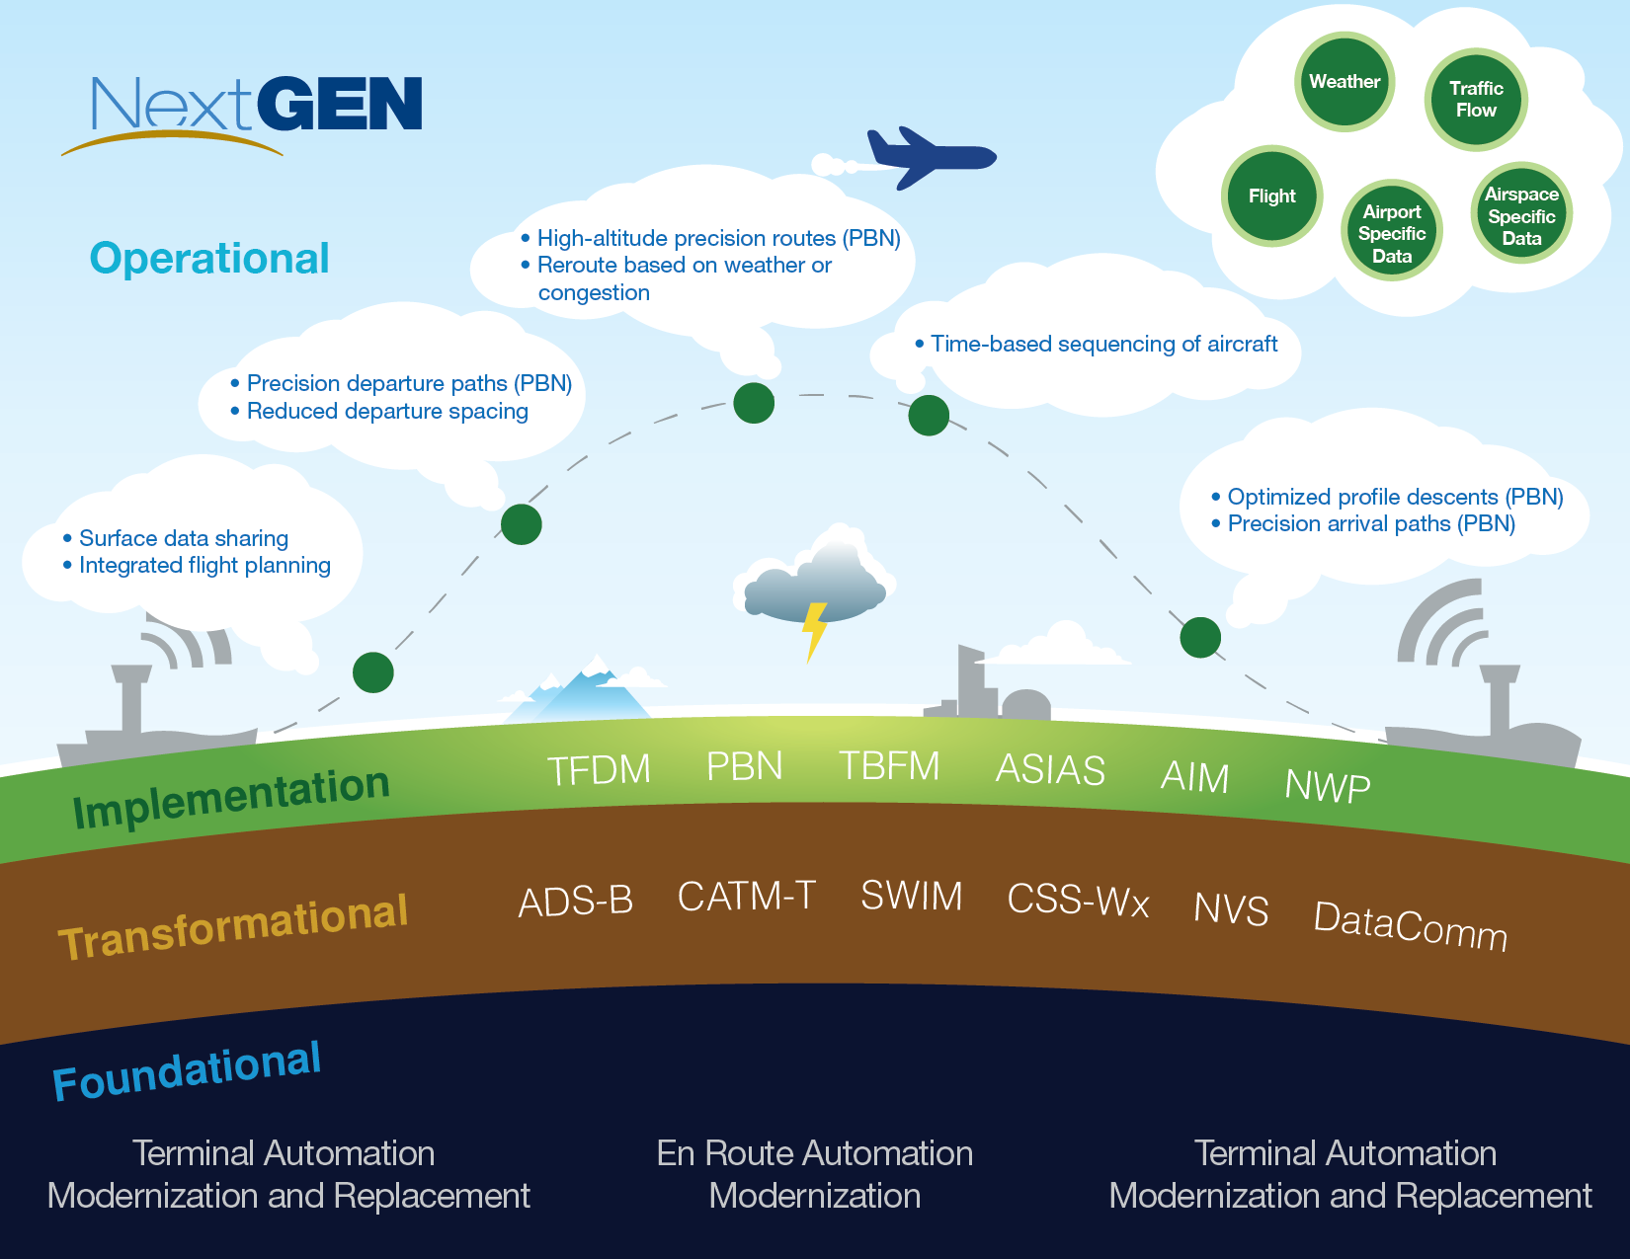
NextGen Foundation
64

Slide 65
Metroplex Schedule Status (July 2015)
Study
Study Team
Design
Evaluation
Design & Implementation (D&I) Team
Implementation
Post- Implementation
Finish
Start
Finish
Start
Finish
Start
Finish
Start
Metroplex Sites
3-4
6-9 Months
12-19 Months
9-15 Months
6-7
Notional Timeline
Washington
D.C.
9/10
2
11/10
6/11
9 Months
3/12
3/12
18 Months
12/13
10/13
20 Months
6/15
6/15
7
Houston
5/11
3
8/11
1/12
6 Months
6/12
6/12
12 Months
2/13
1/13
16 Months
5/14
5/14
8
North Texas
3
9 Months
22 Months
7 Months
7
9/10
12/10
7/11
4/12
4/12
2/14
3/14
9/14
9/14
7
Northern
California
2/11
3
5/11
3/12
9 Months
12/12
12/12
19 Months
7/14
7/14
11 Months
6/15
6/15
7
Charlotte
2/11
3
5/11
2/12
9 Months
11/12
11/12
28 Months
5/15
4/15
24 Months
4/17
5/14
Atlanta
8/11
4
12/11
2/12
9 Months
11/12
11/12
15Months
2/14
4/15
24 Months
4/17
Southern
California
8/11
4
12/11
10/12
16 Months
3/14
4/14
19 Months
11/15
11/15
Denver
4
19 Months
8/14
4
12/14
4/15
11 Months
3/16
4/16
South/Central
Florida
5/12
4
9/12
10/14
15 Months
1/16
2/16
19 Months
Phoenix
1/13
3
4/13
11/14
9 Months
8/15
10/15
10/15
19 Months
Cleveland/
Detroit
1/14
4
5/14
9/14
9 Months
6/15
6/15
19 Months
On Track (mm/yy)
Missed Date
New Proposed Date
Potential to Miss Date
New Proposed Date
Milestone Complete
68
Notes:
As of July 2015:
This slide shows the current status of the active Metroplex sites. (Note that the length of each phase in a given project varies depending on the complexity of airspace, environmental considerations, and number of proposed procedures.)
DC implemented:
Independent Utilities in August ‘12—two SIDs and five STARs implemented with modifications in 2013
Feb ‘14—2 SIDs
Apr ‘14—2 STARs
May ‘14—1 SID and 1 STAR
Sept ‘14—4 STARs and 1 SID
Nov ’14—3 RNAV STARs and 2 RNAV SIDs
Jan ‘15—4 RNAV STARs, 2 RNAV SIDs, 1 Conv. STAR, 1 Conv. SID
Mar ‘15—8 RNAV STARs, 1 RNAV SID, 1 Conv. STAR
Apr ’15—2 RNAV STARs, 7 RNAV SIDs
Jun ‘15—5 RNAV STARs, 10 RNAV SIDs
North Texas implemented 80 procedures on September 18, 2014
Houston, the Presidential dashboard initiative—procedure implementation was on May 29, 2014.
29 new Area Navigation (RNAV) Standard Terminal Arrivals, 20 new RNAV Standard Instrument Departures (SID), 6 Instrument Landing System (ILS) transitions, and 6 RNP-AR procedures.
Houston Completed the Post-Implementation Phase Jan ‘15
Northern California implemented:
Nov ‘14—8 Q-Routes, 1 RNAV STAR, and 6 RNAV SIDs
Jan ‘15—9 RNAV SIDs
Mar ‘15—8 RNAV STARs, 4 RNAV SIDs, and 1 Conv. SID
Apr ‘15—7 RNAV STARs
Charlotte’s Implementation Phase started Apr ’15
Cleveland/Detroit’s Eval Phase started Jun ‘15
Note: Diamonds without dates or colors reflect activities beyond FY2015

Slide 66
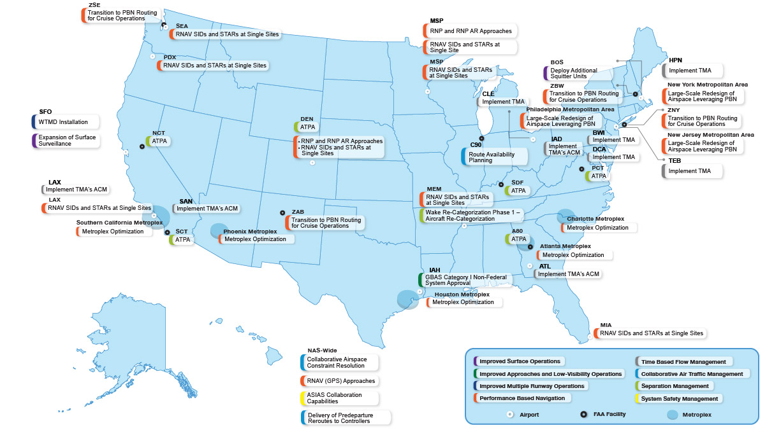
Selected NextGen Capabilities by Portfolio for Implementation 2013-2014
This map shows the location of selected NextGen capabilities implemented in 2013 and capabilities planned for delivery in 2014
66

