Slide 1
Subcommittee on Human Factors Fall 2015 Review
Flightdeck/ Maintenance/ Systems Integration Human Factors
By: Kathy Abbott
Date: September 1, 2015

Slide 2
BLI Portfolio Overview
Purpose: Provide data to support evaluation criteria and methods, regulatory material, and recommended practices related to human factors for flight deck systems and applications/functions, flightcrew procedures, training, and operational use. Establish data to support risk management programs to address hazards in the maintenance environment.
Benefits: To reduce risks associated with human performance while ensuring safety in aviation operations and maintenance activities.
Success: Results of research support development of standards, procedures, training, policy and other regulatory and guidance material as well as human factors assessments of technologies and procedures.

Slide 3
FY14-FY17 Core Flight Deck Research Requirements Prioritization
 | FY 2014 | FY 2015 | FY 2016 | FY 2017
Enhancing Aviation Safety Through Advanced Procedures, Training & Checking Methods, to include Jet Upset | ◆ | ◆ | ◆ | ◆
Human Factors Maintenance Risk Management FY17 - Maintenance Human Factors to Support Risk-Based Decision Making (RBDM) and Maintenance Safety Culture | ◆ | ◆ | ◆ | ◆
Avionics & New Technologies: Certification and Operational Approval Criteria | ◆ | ◆ | ◆ | ◆
Advanced Vision Systems (EFVS, EVS, SVS, and CVS), Head Up Displays (HUD), Head Mounted Displays (HMD): Certification and Operational Approval Criteria |  | ◆ | ◆ | ◆
General Aviation Safety Improvement Research – A Multi-Method Approach to Accident Reduction |  | ◆
Human Factors R&D for Improved Rotorcraft Operational Safety |  | ◆ | ◆
Unmanned Aircraft Systems (UAS) Human Factors Considerations |  | ◆ | ◆ | ◆
Fatigue Mitigation in Flight Operations |  |  | ◆ | ◆

Slide 4
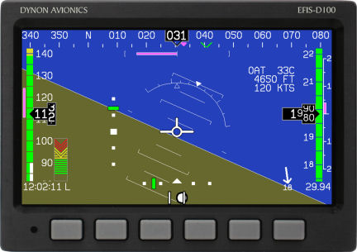
Enhancing Aviation Safety Through Advanced Procedures, Training & Checking Methods, to include Loss of Control Detection, Avoidance, and Recovery (A11G.HF.1)
Research Requirement Description
Sponsor Outcome
Pilots are insufficiently trained for flight path management, including loss of control.
Research areas include:
Mitigations for startle, surprise, and distraction for loss of control
Crew Resource Management
Alternative paths to Airline Transport Pilot
Design and use of angle of attack indicators (AOA) on integrated displays
Distance learning
Flight path management
Sponsor: Rob Burke & Doug Farrow (AFS-280), Kathy Abbott (AVS), Dave Sizoo (ACE-110)
Reduction in loss of control inflight accidents.
Reduced accidents and serious incidents due to lack of knowledge and skills for manual flight operations.
Updates to guidance for CRM training
Identification of effectiveness and appropriateness of distance learning.
Guidance for the degree to which training can supplant experience and to what degree.
Critical Milestones
Research Accomplishments in FY15
Jet upset detection and recovery
Recommendations for mitigating startle, surprise, and distraction (FY15)
Evaluation of AoA indicators for general aviation aircraft (FY16)
CRM
Data to support CRM training & checking guidance (FY15)
Recommendations for CRM training and checking (FY16)
Alternative paths to ATP
Pilot mentoring & selection criteria (FY15)
Identification of performance metrics for evaluating training program effectiveness (FY16)
Final technical report for mitigating startle, surprise, and distraction
Literature review completed on integrated AOA indicator
Technical report on advances in CRM approaches
Technical report on pilot mentoring and best practices
Draft report on selection criteria for performance based ATP
FY15 HF REDAC Fall Meeting

Slide 5
Avionics & New Technologies (A11G.HF.2)
Research Requirement Description
Sponsor Outcome
FAA needs development and update of human factors regulatory and guidance material on evolving flight deck technologies including Automatic Dependent Surveillance – Broadcast (ADS-B), Electronic Flight Bag (EFB), cockpit display of traffic information (CDTI), and moving maps
Focus is on human factors/pilot interface issues such as colors, symbols, fonts, labels, workload, situation awareness, errors, etc. as technology changes
Sponsor: Cathy Swider (AIR-134)
Develop and update regulatory and guidance material (i.e., specific rules, ACs, TSOs, Handbooks, etc.) for specific systems (e.g., ADS-B, Electronic Flight Bags (EFBs), moving maps) and documents that provide more general guidance for all flight deck displays (e.g., AC 25-11, AC 23.1311)
Critical Milestones
Research Accomplishments in FY15
Airport moving map/ADS-B/CDTI, EFBs:
Recommended symbol set (FY16)
Airport moving maps/CDTI industry product review (FY16)
Examine impact of display compellingness and potential mitigations (FY17)
“General Guidance” document
Update to Human Factors Considerations in the Design and Evaluation of Flight Deck Displays and Controls (FY16)
Evaluation guide (FY16)
Draft study methodology including design and the creation of an online symbol survey for research moving map and ADSB/CDTI study
Draft report of industry product review for Electronic Flight Bags/Portable Electronic Devices (EFBs/PEDs)
Created a test version interactive website for the General Guidance document
FY15 HF Fall Meeting

Slide 6
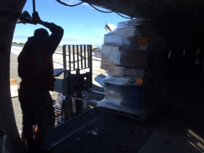
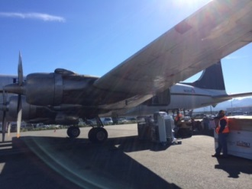
Human Factors Maintenance Risk Management (A11G.HF.3)
Research Requirement Description
Sponsor Outcome
Maintenance and inspection errors are significant contributors to both general aviation and commercial aviation accidents.
Research areas include:
Maintenance Line Operations Safety Audits
Maintenance Fatigue Risk Management
Failure to Follow Maintenance Procedures
Sponsor: Tim Shaver, Acting Division Manager (AFS-300), Dr. Bill Johnson (AVS)
Develop guidance material for inspectors and maintenance organizations
Respond to open NTSB recommendations:
A-13-001 “Establish duty-time regulations for maintenance personnel working under 14 Code of Federal Regulations Parts 121, 135, 145, and 91 Subpart K that take into consideration factors such as start time, workload, shift changes, circadian rhythms, adequate rest time, and other factors shown by recent research, scientific evidence, and current industry experience to affect maintenance crew alertness. (Supersedes Safety Recommendation A-97-71 and is classified “Open—Unacceptable Response”) “
A-15-016 “Include specific guidance in the Federal Aviation Administration inspector handbook that defines responsibilities for principal inspectors for the oversight of an operator’s loading, restraint, and documentation of special cargo loads.”
Critical Milestones
Research Accomplishments in FY15
Implement field testing of LOSA techniques with at least two major carrier/maintenance organizations (FY15)
Field test alternative Maintenance Fatigue Risk Management techniques with at least one major carrier/mx organization (FY15)
Review the FAA approval criteria and process for technical documentation. (FY15)
Review industry segments’ policies and practices across the life cycle of technical documentation (i.e., develop, evaluate, revise, approve, deliver, sustain) (FY15)
Report on best practices for Maintenance and Ramp Line Operations Safety Assessment (LOSA)
Data collection from five carriers currently using Maintenance Fatigue Risk Management systems
Technical report on literature review for failure to follow maintenance procedures to develop taxonomy for analysis and solution development
FY15 HF REDAC Fall Meeting
Notes:
More explanation on A-15-06. There currently is not a certification requirement for cargo load supervisors, load masters, flight mechanics, etc. The position is called different names depending on the organization. The sponsoring organizatin requested this research to support the potential development of a certification requirement as well as potential criteria for rest and duty schedules.
Phase 1: Researchers will conduct a task analysis to review and assess the accuracy of current job descriptions for load supervisors. This process will include reviewing the current literature, accessing known occupational databases to collect general required knowledge, skills, and aptitudes (KSAs) for the position, and performing face-to-face interviews with individuals currently performing the activities associated with load supervisors and flight mechanics.
Phase 2: Researchers will review current reports from relevant data bases and accident reports (e.g., the NASA Aviation Safety Reporting System, National Transportation Safety Board, etc.), and examine current rest policies for load supervisors and flight mechanics. This information will help develop a qualitative picture of the state of rest/fatigue in the cargo load industry. Researchers will collect and report on best practices for fatigue mitigation specifically for cargo supervisors and flight mechanics.
Phase 3: Researchers will deploy a task analysis and duty time/rest questionnaire to current cargo load supervisors and flight mechanics. In addition, a real-time field study will collect quantitative data from cargo load supervisors and flight mechanics using actigraphy, the Psychomotor Vigilance Test (PVT), and electronic work-schedule log books. Together, these items will provide information regarding discrepancies in perception and actual fatigue risks within the cargo supervisors and flight mechanics. These data collection are considered to be the “Standard” for fatigue risk assessment.
DRAFT TEMPLATE

Slide 7
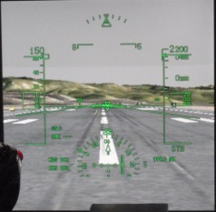
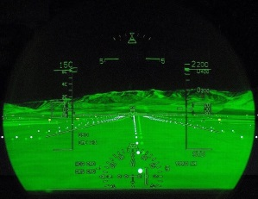
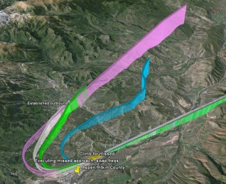
Advanced Vision Systems – EFVS, EVS, SVS, and CVS, HUD, HMD – Ops Approval Criteria (A11G. HF.4)
Research Requirement Description
Sponsor Outcome
Human factors data to support operational credit and approvals is needed for:
New applications with synthetic vision displayed on the head up display (HUD)
Synthetic vision and guidance information for civil applications of head-worn displays
Use of head-worn displays
Sponsor: Terry King (AFS-400)
Increase safety, efficiency, capacity, and throughput during low visibility conditions using advanced vision systems, head-up displays, and head-mounted displays.
Enable more flight operations to occur in low visibility conditions with less ground infrastructure while maintaining an appropriate level of safety during approach, landing, taxi, and takeoff operations.
Critical Milestones
Research Accomplishments in FY15
HMD/HUD (head mounted display/ head up display)
Simulation to quantify performance contribution of HUD use (FY16)
Industry/product review of existing HMD systems (FY16)
Research plan and data collection identifying human performance considerations (FY17)
SVGS
SVS simulation measuring baseline performance (FY16)
Characterize pilot performance using SVGS for specific low visibility operations (FY17)
Identification of minimum training and currency requirements for SVS proficiency (FY18)
Report on display formats HUD or HDD for SA CAT I approach with varied RVR and DH delivered to sponsors
FY15 HF REDAC Fall Meeting
Notes:
Soooooo…..these were the critical milestones documented in the core requirement initially and in the PREP for FY15. So, I think previously they may have been funded with core but they would be considered NG for all future funding. Given our new classificaiton scheme for HMD and CVS in the NG program, we could delete the following bullets.
FY15 Industry survey and simulation on HMD
FY16 Research plan for pilot performance with CVS.
DRAFT TEMPLATE

Slide 8
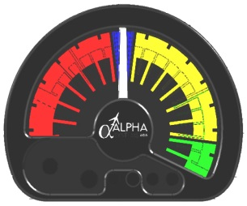
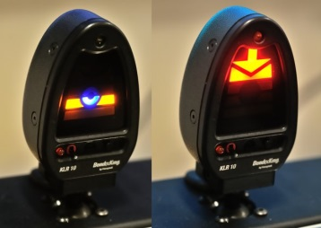
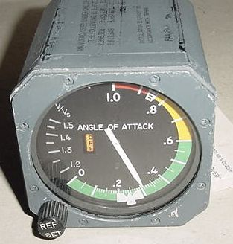
General Aviation Safety Improvements Research – A Multi-Method Approach to Accident Reduction (A11G. HF.6)
Research Requirement Description
Sponsor Outcome
Identify and evaluate appropriate interventions for reducing the GA accident rate through research focused on:
Available aircraft equipment/technologies not currently used in GA and
New ways of addressing errors in pilot decision making.
Sponsor: Dave Sizoo (ACE-110)
Update regulatory and guidance material, e.g., AC 23.1311-1C and AC 23-17C, plus policy for 23.1329 which provide more general guidance for the relevant flight deck displays
Critical Milestones
Research Accomplishments in FY15
Research plan and data collection for simulator evaluations of each AoA indicator (FY15)
Human factors data and research recommendations identifying: (1) underlying causes of loss of control and stall in GA, and (2) potential intervention points (FY16)
Developed add-on AoA simulation environment for data collection
Research plan for simulator evaluation
Collecting data on add-on AoA in simulator
FY15 HF REDAC Fall Meeting
Notes:
DRAFT TEMPLATE

Slide 9
Human Factors Research and Development for Improved Rotorcraft Operational Safety (A11G. HF.7)
Research Requirement Description
Sponsor Outcome
A number of operational and technology challenges for the rotorcraft community may impact operational safety. Three Initiatives are prioritized from high to low as shown below:
Helicopter Training Devices
Scenario Based Training (SBT) for parts 61, 91, 141, and 135 operations
Helicopter Crew Resource Management (CRM) for Part 91 and 135 operators including HAA operators.
Sponsor: Steve Sparks (AFS-810)
Improve safety of IFR operations in high density helicopter operations areas
Separate IFR operations from other commercial operations in metroplex areas.
Update guidance for aviation safety inspectors on oversight of 135 HEMS operators and weather decision making in operator training programs (FSIMS Order 8900.1). Potential update to AC 120-51 for CRM training for HEMS operations.
Critical Milestones
Research Accomplishments in FY15
Document current literature related to: (FY16)
Helicopter Training Devices
Scenario Based Training (SBT) for parts 61, 91, 141, and 135 Operations
Helicopter Crew Resource Management (CRM) for Part 91 and 135 operators including HAA operators.
Develop research plan to address knowledge gaps (FY17)
Data collection and recommendations (FY18)
Note: In FY15, this project was performed with internal staff resources only. No contract funds were programmed.
Initiated literature review on helicopter training devices, simulator based training, and helicopter CRM
FY15 HF REDAC Fall Meeting
Notes:
DRAFT TEMPLATE

Slide 10
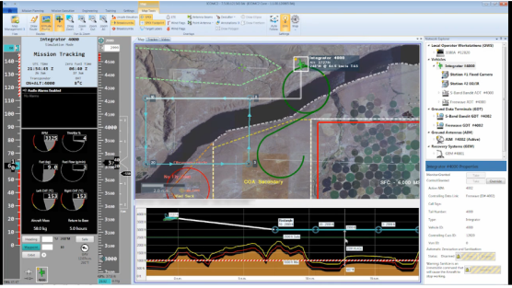
UAS Human Factors Control Station Design Standards (A11L.UAS.1530)
Research Requirement Description
Sponsor Outcome
Function allocation strategy for civil UAS
Minimum standards and guidelines for civil UAS control stations
Recommended crewmember training and certification requirements for civil UAS operations
Recommended visual observer training and certification requirements for civil UAS operations
Sponsor: Stephen Plishka (AFS-86)
Research will provide input to FAA standards and Advisory Circular material to support the safe, efficient, and timely integration of UAS into the NAS. Performing sound research will lead to preventative measures in reducing incident and accident rates due to human factors in civil UAS operations, as well as may translate to reduced rates in public UAS operations.
Critical Milestones
Research Accomplishments in FY15
Review of relevant research studies (FY16)
Analyses of UAS human factors related incidents and accidents (FY16)
Gap analysis between current flight deck/control station and crewmember regulations, standards, and guidance (FY16)
Development of control station standards and guidelines (FY18)
Development of recommended crewmember training and certification requirements (FY18)
Development of recommended crewmember procedures and operational requirements during normal and non-normal events.(FY18)
Note: This project received funding in June 2015; consequently, program execution just started. Accomplishments to support the program execution are provided below
Coordination with ANG-C2 for inclusion in the ASSURE UAS Center of Excellence Program
Proposal received from ASSURE UAS Center of Excellence
FY15 Human Factors Fall Meeting
Notes:
Directions:
General: Much of this information should reside in prior Quad Chart exercises. As you can see we replaced the ‘Funding’ quadrant with a ‘Research Accomplishments in FY15’ quadrant.
Research Requirement and Sponsor Outcome Quadrants: Draw information of the AVS research Requirement Input Form.
Critical Milestones Quadrant: Draw information from the PREP and the AVS research Requirement Input Form. It is highly recommended that you include a recent Milestone that can be clearly linked to an FY15 Accomplishment.
Accomplishments in FY15 Quadrant: Include significant research accomplishments during FY15 for this requirement. If you have a research accomplishment from an FY13 or FY14 requirement, create a separate Quad chart for that requirement.
Insert an image in the upper right corner if appropriate.

