Slide 1
Human Performance
AJI-155

Slide 2

Operational Human Factors
People make ATM work Safe, effective system performance
[cost, safety, delivery, etc.]
Business Performance
The
Business
Selection, Training, Procedures,
Tools & Equipment, Teamwork Roles & Responsibilities,
Wellbeing & Leadership
Change Management,
HP Assurance
People need support
The key human performance areas that deliver the business
Human Performance
Support needs expertise
The discipline that deals with the underlying human factors in work situations and their optimization
Situation Awareness,
Workload, Human
Centred Automation,
Design Guidance,
Training Effectiveness,
Etc.
Human Factors

Slide 3
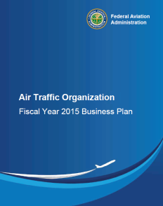

Defining Human Performance
Business Performance
ATO Business Goals
ENABLES
Human Performance
Level of effectiveness achieved by ATO employees in the conduct of their work
SUPPORTS
Human Factors
Influences that underlie the work of ATO employees and
the discipline that optimizes
these influences

Slide 4
Current Activity…..
Create a Human Performance Program (HP) in the ATO
  Define HP Program elements
  Define HP Program desired future state
  Document HP Program current state
  Identify deltas between current and desired future state
  Define phased and prioritized development approach to migrate towards desired future state

Slide 5
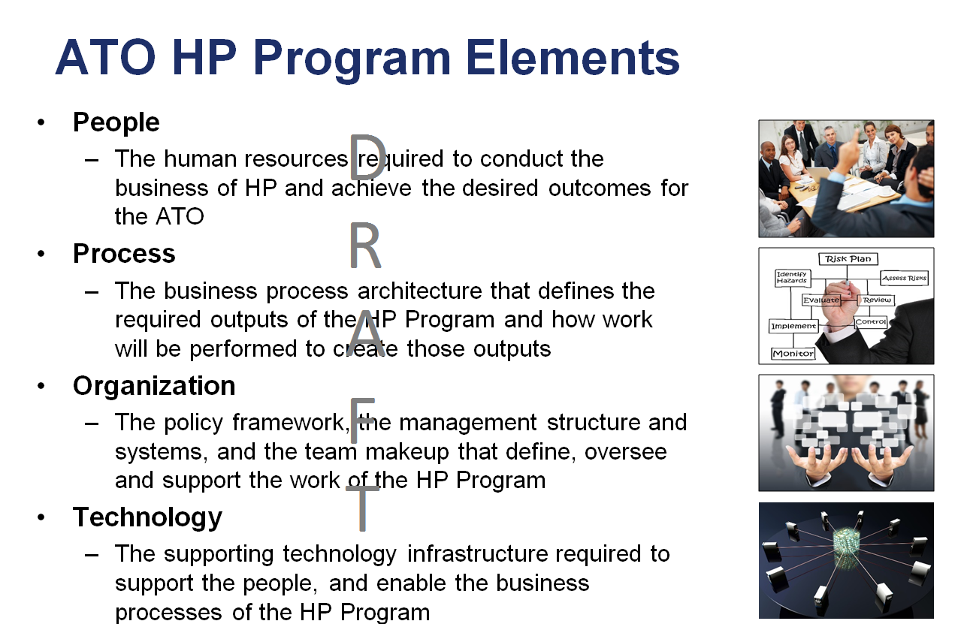

Slide 6
HP Processes

Slide 7
Planning Prioritization
Identify current state and near term program objectives (tactical delivery requirements)
Identify long term desired future state objectives (strategic development goals)
Sequence activities according to resources, dependencies and priorities
Map objectives across fiscal years
Define acquisition and development plans across fiscal years

Slide 8



Branding!
And a catch phrase!

Slide 9
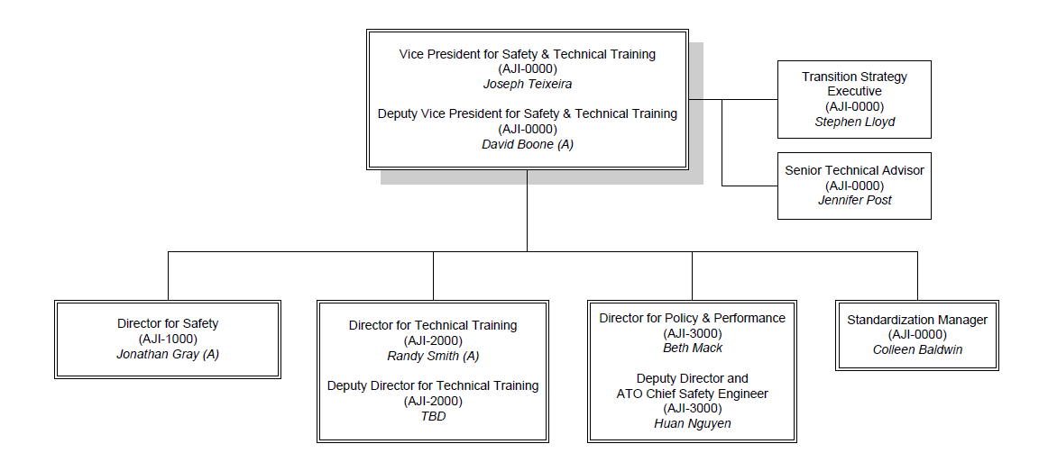
Office of Safety and Technical Training

Slide 10
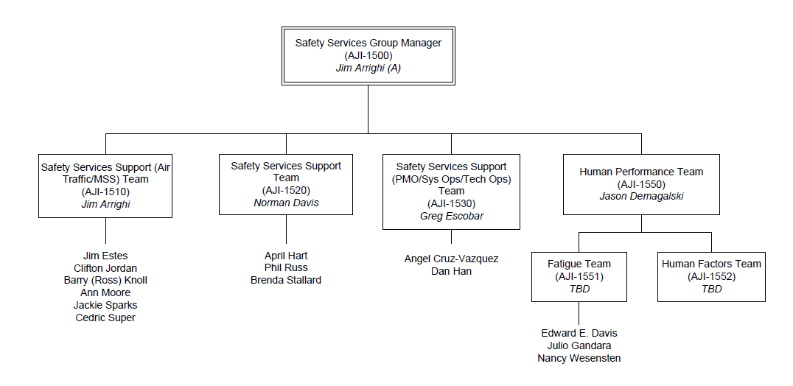
Safety Services Group

Slide 11
Human Performance Team Members
Dr. Nancy Wesensten
Ed Davis
Julio Gandara
Vacancies
Dave Buczek (CTR)
Jay Barrett (NATCA)

Slide 12
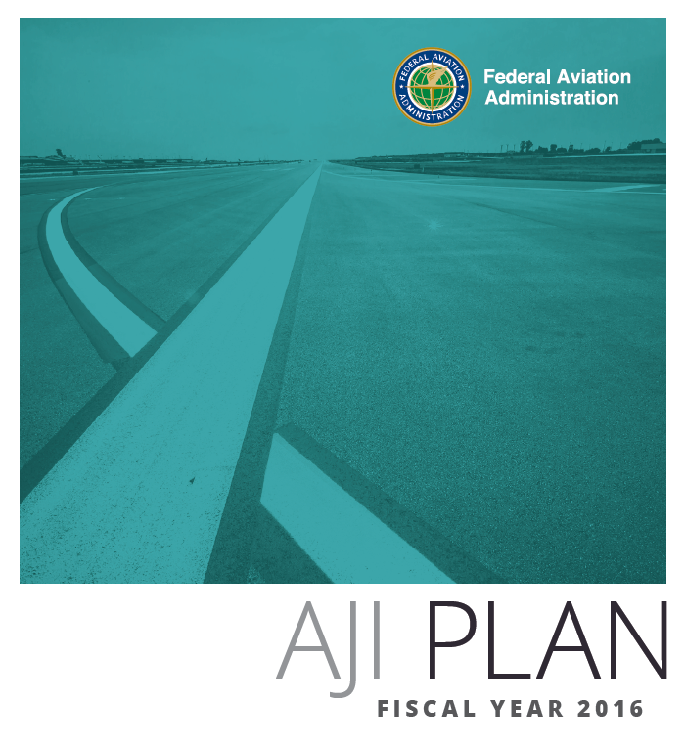
AJI FY16 – FY21 Strategic Objectives
These strategic goals will be accomplished over the next 5 years. Refer to the FY16 AJI Business Plan and Work Plan to see how AJI plans to support these goals in FY16.
  10 - Improve Human Performance Programs

Slide 13
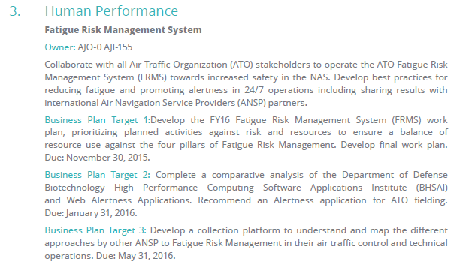
Business Plan Goals

Slide 14
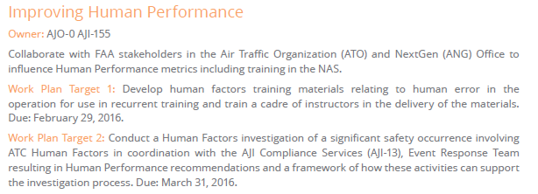
Work Plan Goals

Slide 15
Research to Reality

Slide 16
SI-RAP: From Research to Reality
AJI Identifies
Research Need
ANG-C1 Sponsors Research Program
SI-RAP was deployed to the Central Service Area in October 2014. In the three quarters since deployment, SI-RAP panel members have conducted 322 SI-RAP event assessments with the SI-RAP taxonomy and repeatability process.
FAA & International Harmonization
AJI was developing the Service Integrity Risk Analysis Process (SI-RAP) to assess the risk of unexpected failures, interruptions, or degradations of NAS technical services.
Human factors support was needed for the development and deployment of the repeatability portion of the SI-RAP risk assessment process.
ANG-C1 sponsored a human factors project to develop and deploy a consistent framework for assessing the repeatability of service integrity events.
Outputs
SI-RAP Taxonomy for classifying events
3-day training course for initial cadre of panel members
Web-based application to support panel members
AJI Implements
Research Results
The SI-RAP taxonomy is currently being harmonized with:
EUROCONTROL’S Risk Analysis Process for ATM Occurrences
FAA’s Technical Operations Safety Action Program
(T-SAP)
FAA’s Air Traffic Common Taxonomy
SI-RAP – Winner of FAA’s 2015
NAS First, People Always Award!
Future Activities
Development of SI-RAP analysis methodology
Supporting expansion to Eastern and Western Service Areas

Slide 17
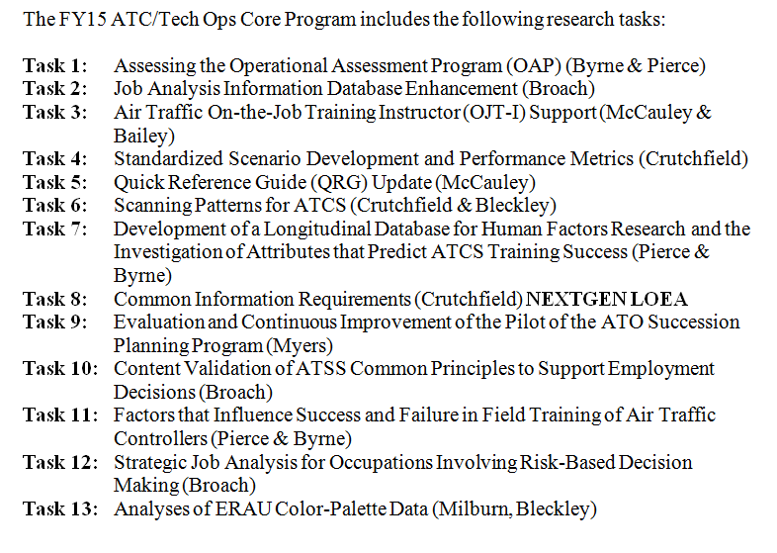
CAMI Program Directive

Slide 18
Other ANG-C1 Activities
Support to Facility Operations
VATS/Remote Tower
Human Performance Operational Library

Slide 19
Research to Reality Cont…….N90

Slide 20
Operational Assessment Program
Knowledge Test
Information Packet
OAP Facility, Location, & Travel Info
Skills Assessment
OAP Facility Orientation
Basic RADAR
Airspace Map & Scenario Info for studying
Training & Practice Scenarios with Group Feedback
Proctored by current facility manager
Test Scenarios
100 Questions
Notes:
I/O psychologists from the American Institutes for Research (AIR), working in conjunction with FAA personnel and air traffic subject matter experts (SMEs), developed and validated the Operational Assessment Program (OAP). The OAP consists of a basic radar knowledge test and a scenario-based skills assessment. AIR validated the OAP using a content validation approach (AIR, 2011) based upon two prior TRACON air traffic controller (ATC) job analyses (Krokos, Baker, Norris, & Smith, 2007; Alexander, Ammerman, Fairhurst, Hostetler, & Jones, 1989).
AIR (2011) and FAA personnel developed the OAP knowledge exam using a bank of items taken from FAA Academy radar training courses. SMEs selected the items and classified them into 27 knowledge content domains. AIR based the scenario-based skills assessment on SME interviews and workshops, resulting in the creation of critical air traffic events, scenario guidelines, and five performance dimensions identified as essential to successfully performing as a controller at these large TRACONs. Additionally, before entering the OAP assessment process, CPC-IT applications and resumes are screened for Level 8+ radar experience.
The OAP was implemented at three test facilities in Atlanta, Chicago, and Southern California.

Slide 21
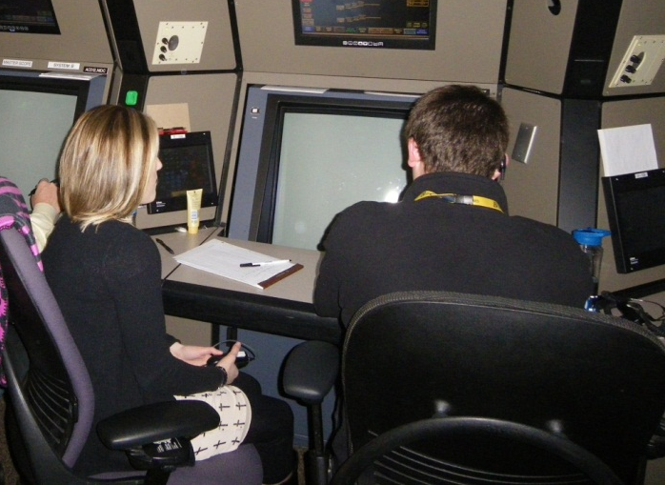
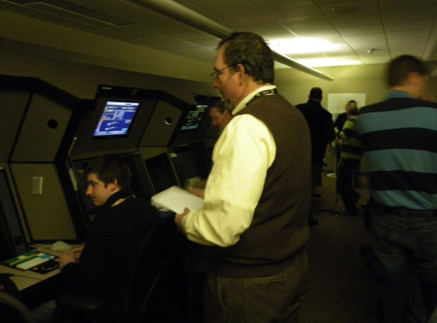
Operational Assessment Program
PERFORMANCE DIMENSIONS
Communication
Working Speed
Planning & Projection
Prioritizing
Speed Control
Notes:
The performance dimensions assessed during the skills test are Communication, Working Speed, Planning and Projection, Prioritization, and Speed Control. Behaviorally-anchored rating scales for these performance dimensions are used to rate the applicants’ performance during the skills assessment scenarios. AIR used frame-of-reference training to familiarize raters with the performance dimensions to increase agreement and reliability, as well as to reduce potential bias and error inherent in the rating process. There were discussions and activities related to rating biases and errors along with what types of things can be done to minimize these errors. For some controllers, this was their first exposure to this type of rater training. Although, most performed over-the-shoulder evaluations of trainees on a regular basis, this was the first time they had received training on coming to consensus about their ratings with other controllers and their first exposure to the human pitfalls of these types of ratings.

Slide 22
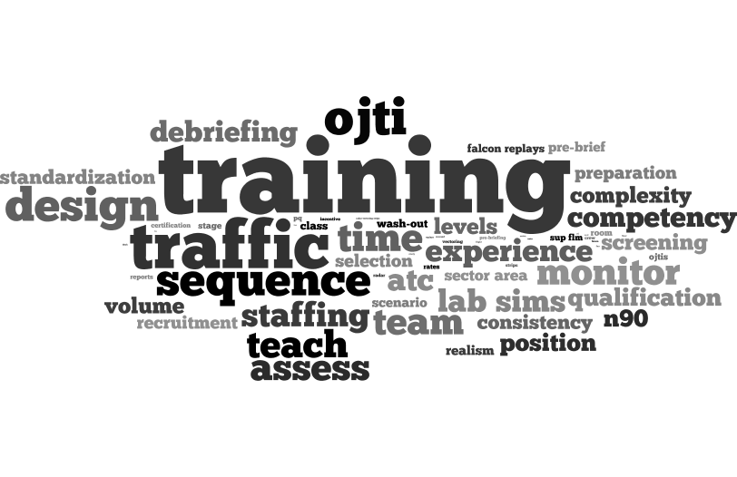
OJTI@N90: From Research to Reality
Identification of
Research Need
ANG-C1 Sponsors Research Program
Policies and procedures for application of training standards currently being developed.
Training materials have been developed and validated in trials
Workshops have also provided operationally relevant training to OJTIs at N90.
FAA & NATCA
New York TRACON was facing a critical shortage of certified professional controllers across all areas and positions.
Required applied human factors support for training improvement initiatives, including development of behavioral standards to signpost TRACON trainee progress, and enhanced skill development for on-the-job training instructors (OJTIs).
ANG-C1 sponsored a real world human factors research project to design and validate TRACON behavioral standards, determine requirements for OJTI skill enhancement training, and design & pilot training materials.
Outputs
Behavioral standards for use in training.
Review of best practices in OJTI.
Development of training materials.
Implements
Research Results
NATCA & FAA fully supportive of N90 initiative.
Initial indications that the work is having a positive effect.
Potential to roll-out training standards and materials elsewhere.
Longer term research evaluation also being planned for future.
Providing operational benefits through applied HF research
Future Activities
Consideration of wider application of standards
Continued evaluation of operational benefit of training

Slide 23

OJTI@N90: Validating training materials
“It’s not always black and white for the trainee. As a trainer, we need to connect the pieces in a positive way, so that it will be constructive and build on previous learning”.
“We all make mistakes. It’s how you react to them and pick yourself up afterwards that defines successful learning”.
Research Evaluation
Pre-OJTI Workshop Data
OJTI Skill Enhancement Workshops
Post-OJTI Workshop Data
Post-workshop surveys will provide additional data on effectiveness.
Plan to include mini-case studies of successes as well as quantitative data.
Long term evaluation plan will include a consideration or training metrics (e.g. attrition data).
Data integrity is a challenge with all “real-world” research.
21.3% of OJTIs believe that trainees could certify at N90 with the right training and support
34.4% of OJTIs give trainees clear training objectives for the session
32.8% of OJTIs prepare for a training session by reading previous reports
66.6% of OJTIs believe they can make accurate predictions about who will be able to certify
Designed 1-day OJTI skill enhancement sessions, and validated materials at N90 with operational OJTIs. Workshops were:
Approved by NATCA and the FAA
Operationally focused
Interactive & engaging
Based on frequent ATC training issues/concerns
A challenge to current training practices.
Short term evaluation via survey data, longer term evaluation planned.
Conducting robust real world research is a least-damage compromise.
Initial feedback
Workshops deemed beneficial by vast majority of delegates
Management encouraged by changes in OJTI behavior

Slide 24
On the telephone…….
Arlenne Gonzales
  N90 Training Manager
John Lizzul
  N90 NATCA Training Representative

Slide 25

Questions

