Slide 1
Airspace Operations and Safety Program (AOSP)
National Aeronautics and Space Administration
V&V Research Overview
For Human Factors REDAC Committee
September 2, 2015
Jessica Nowinski,
Safety Integration Manager
www.nasa.gov

Slide 2
AOSP Organizational Chart
Director: John Cavolowsky
Deputy Director: Akbar Sultan
AOSP Risk Management Board
Chair: John Cavolowsky
Executive Secretary: Yuri Gawdiak
Associate Director: Yuri Gawdiak
Technical Integration Manager for NextGen: Barry Sullivan
Safety Integration Manager: Dr. Jessica Nowinski (Detailee)
Technical Integration Manager for ARC: Tom Davis
Technical Integration Manager for LaRC: Mark Ballin
Program Resource Analyst: Michele Dodson (RMO)
Program Management Analyst: Kenny McCombs
AOSP Portfolio and Systems Analysis Team
Lead: Yuri Gawdiak
PROGRAM STAFF
PROJECTS
ATD Project
Leighton Quon
SMART-NAS Project
Dr. Shon Grabbe
SASO Project
Dr. Parimal Kopardekar
(TC 1) ATD-1
Jane Thipphavong

Slide 3
SMART-NAS Project
Overview
Explore and develop concepts, technologies and a test bed for safe, global, gate-to-gate trajectory based operations.
PM: Dr. S. Grabbe
DPM: R. Aquilina
APM: J. Koelling
APM for Technology: Dr. R. Mah
PROJECT LEVEL
PP&C (shared):
Host Center Analyst: Julie Nguyen
Center Analyst: Paula Chambers, LaRC
NRA manager: N. Galeon
Systems Engineering Office (shared):
Lead: R. Johnson
Scheduler: J. Cronauer
Risk manager: S. Kurasaki
Technical Challenges
Emerging Technical Challenge
SMART-NAS Test Bed
Leads: Dr. Kee Palopo and Mike Guminsky
Safe Avionics and ATM Future Evolution (SAAFE)
Lead: Dr. Paul Miner
Regional Trajectory Based Operations (TBO) Lead: Dr. Paul Lee

Slide 4
Safe Autonomous Systems Operation Project
Define and safely enable all future airspace operations (ATM+3) using justifiable and optimal autonomy for advanced air and ground capabilities
PM: Dr. Parimal Kopardekar
DPM: Sharon Graves
APM: Craig Hange
PROJECT
Resources: Julie Huynh
Scheduling: Joseph Cronauer
Risk Management: Seth Kurasaki
NRA Manager: Naz Galeon
SASO Technical Advisory Committee: Dr. Danette Allen, Tom Davis, Davis Hackenberg, Dr. Sanjay Garg, Dr. John Ryan, and Don Simon
Emerging Opportunities (Candidates for TC in out years)
Technical Challenges
Autonomous aircraft operations
Autonomous traffic flow management
Autonomous localization, sensing, and conformance
Autonomous Airport
Autonomous AOC
Additional items from ARC, AFRC, GRC, and LaRC to be considered as part of current planning
TC1: Enabling Low-Altitude UAS Operations
Lead: Dr. Joey Rios
TC2: Enable Reduced Crew Operations
Leads:
Randy Bailey and
John Kaneshige
TC3: Ab Initio Architecture
Lead: Dr. Natalia Alexandrov
Foundational, Cross-Cutting or Exploratory R&D
V&V and Certification Methods for Autonomous Operations (Guillaume Brat and Paul Miner)
Analysis Studies (Stakeholder survey, benefits, affordable air mobility) (Jeremy Smith)
Human-autonomy Teaming (TBD)
Communication, Navigation, and Surveillance (TBD)

Slide 5
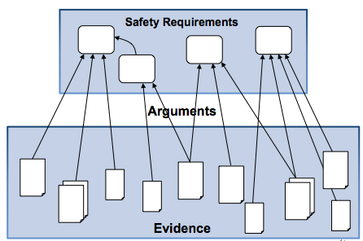
Safe Avionics and ATM Future Evolution
Overview
NASA Strategic Thrust 1: Safe, Efficient Growth in Global Operations
National Needs and Stakeholder Interests
NASA Strategic Thrust 6: Assured Autonomy for Aviation Transformation
NASA Strategic Thrust 5: Real-time System Wide Safety Assurance
National Aeronautics R&D Policy, 2010
SAAFE TC
Decadal Survey of Civil Aeronautics
Inter-Center Planning Team
FAA V&V Tech Summit
Numerous Systems Assurance NRAs
FAA/ANG/AVS
ARC, GRC and LaRC Team Members
Assurance of Flight Critical Systems TC (SSAT)
Legacy System-wide Safety and Assurance (SSAT)
Research Activities
Notes:
5

Slide 6
Goals, State-of-the-Art and Benefits
Overview
Goal:
Develop methods, tools and techniques for reducing the cost of certification, verification and validation of complex safety critical systems and ATM systems, to include assessing the impact of design decisions throughout the systems evolution. (FY19, TRL 6)
Products:
Document new approaches to software assurance (FY15Q5) [FAA/NASA RTR]
Complete study of regulatory compliance with multitier supplier networks (FY15Q4) [FAA/NASA RTR]
Document representative examples illustrating RTCA DO-330 (FY16Q4)
Publish assurance case applicability for digital system findings (FY17Q4) [FAA/NASA RTR]
Demonstrate semi-automatic reconstruction of safety arguments (FY18Q4)
Transfer tools to FAA/AVS/ANG and at least one avionics manufacturer (FY19Q4)
Benefits:
Development of industry-focused tools, techniques and architectural patterns to enable efficient verification and validation of complex safety-critical systems
Tools will enable the reduction of industry verification and validation costs at all stages of the systems lifecycle
Determination of what evidence is sufficient for establishing and preserving safety with the primary customer being the FAA and industry a secondary beneficiary
Notes:
6

Slide 7
Sample Activities
Direct collaboration with FAA
ACAS-X assurance software
Direct delivery to FAA
Explicate ’78
Human Factors (Authority and Autonomy) Research
Brahms modeling efforts

Slide 8
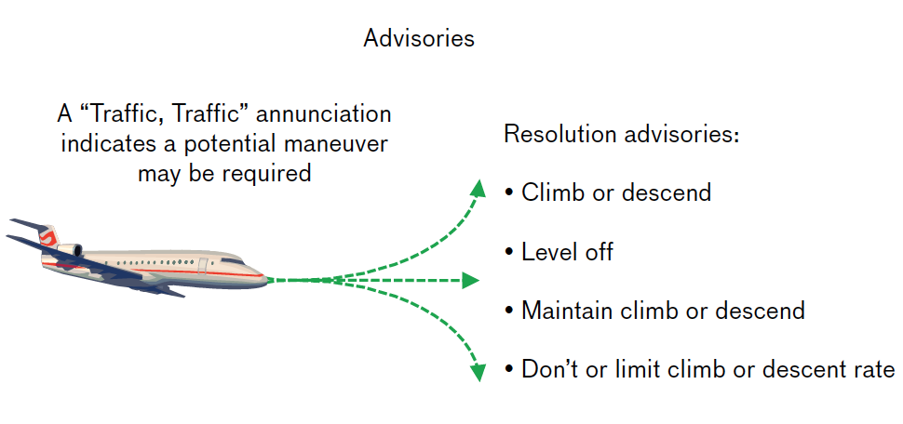
Safety Assurance for ACAS-X
ACAS-X (replacement for TCAS)
Markov Decision Process (MDP) models effect of advisories and uncertainty in pilot response and other airplane movement
MDP solved to generate state/action table
Logic of decisions hidden in table entries, not in the code
Objectives and Approach
Assist the FAA in the certification of ACAS-X. Tasks have been defined in collaboration with Neal Suchy’s verification team
Participation in the SC-147 standard committee meeting for ACAS-X
Provided V&V perspective and support to Neal Suchy’s team
The project applies advanced techniques for addressing assurance issues both in the design and verification of the ACAS-X controller
FY’14 internal work is focusing on validation of the MDP model used for creating table that picks advisories given some state estimation

Slide 9
Argument Based Safety Research Map
AdvoCATE
Formal specification of safety case patterns
Automated instantiation to create well-formed safety case instances
AdvoCATE
Extended safety cases with hierarchical abstraction
Specification of queries to produce safety case fragments, reflecting stakeholder-specific views
Automating
Creation
Managing
Complexity
STPA (MIT)
the System-Theoretic Process Analysis (STPA) approach to hazard analysis
Initiated transition to FAA
Covering
All Life
Cycle
New NRA with Dependable Computing started June 2013
Extending CertWare with Hazard analysis and Design Info
Improving
Risk/Hazard
Analysis
Integrating
Formal
Evidences
AdvoCATE: Safety case patterns as the basis for integrating formal methods into safety cases
Extending CertWare with integration of AADL specifications

Slide 10
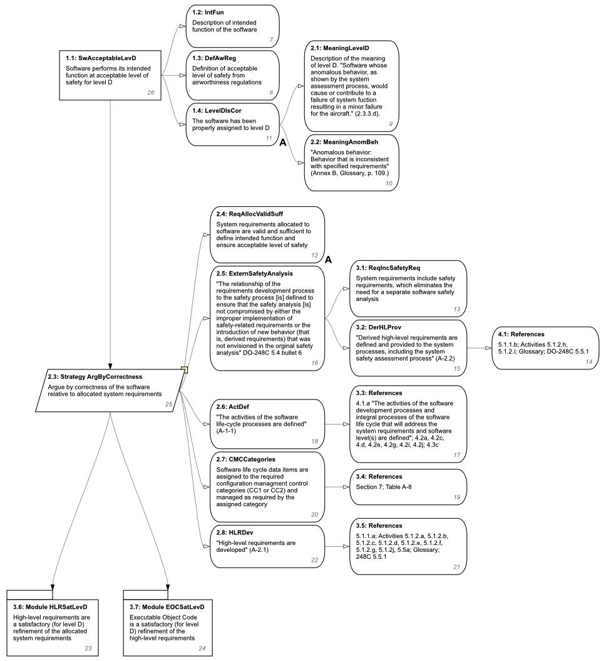
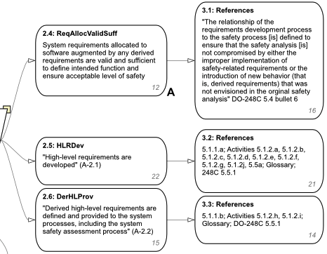
RTR Activity: Explicate ‘78
“Document in an argument-based form the implicit arguments contained in DO-178C that assert that compliance with the guidance provides sufficient confidence that software systems are safe enough for their purpose.”
Explicate ‘78 report delivered to FAA last year
What are the safety arguments implicit in DO-178C?
Final report documents a complete initial articulation of an explicit, comprehensive assurance case for the guidance contained in DO–178C.
Also contains information about
DO–178C and its associated documents,
assurance cases,
the Goal Structuring Notation, and
approaches to evaluating arguments.
Work jointly funded by FAA and NASA under interagency agreement IAI-1073
Work continuing, in conjunction with NRA partners and Phase III SBIR, in support of FY17 RTR Deliverable to the FAA

Slide 11
Formal Analysis of Human-Machine Systems
Overview
Developed an approach based on model checking for evaluating the roles and responsibilities of humans and automation.
Benefits
Can better assist in identifying authority and autonomy issues.
Description
Provides a formal framework for assessing safety in models of human/machine roles and responsibilities in organizations. The approach may involve extending existing modeling languages with formal semantics to support formal analysis.

Slide 12
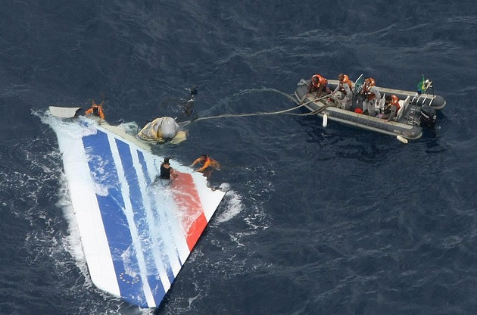
Example: Air France 447
Air France flight 447 from Rio de Janeiro to Paris:
Failure of a sensor (a set of pitot tubes) resulted in incorrect speed readings and through a sequence of events lead to a stall which an inexperienced pilot failed to diagnose
Agents Modeled
1 Human agent (pilot)
2 Automation agents
Developed a framework to formally model and
verify degrees of belief in a system of agents
Verified a property encoding the question
Does a state exist, that is reachable from the initial state, in which the pilot believes that the stall is actually occurring with a degree of less than 5%?
We are able to show in less than 1 hour that there are 5 stalling scenarios in which the pilot would be very unlikely (less than 1.5% chance) to detect a stall.
“Model Checking Degrees of Belief in a System of Agents,“ by Giuseppe Primiero, Franco Raimondi, and Neha Rungta. In Proceedings of the 13th International Conference on Autonomous Agents and Multi-agent Systems (AAMAS 2014)

Slide 13
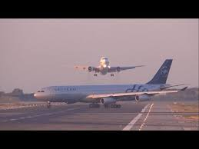
Example: Laguardia Simulation Data
Created working models that encode deterministic scenarios for the LaGuardia airspace based on the simulation data.
These models use the same high-fidelity flight traffic information as the DSAS sims.
The human agents in the Brahms model include 3 center controllers, 3 TRACON controllers, and one tower controller.
The Center and TRACON controllers perform handoffs as planes are crossing the relevant parts of the sector.
They have now successfully simulated 1.5 hours of real traffic in the Brahms model — approximately 150 planes in the airspace with planes landing at a rate of 36-40 planes per hour.
Departures take off in the gaps between arrivals.
Goal is to use simulation data and use model checking to explore off nominal events as with 447 example.

Slide 15
Data mining efforts at NASA
Through individual agreements with major airlines we are using flight data (discrete, continuous, text reports) to develop algorithms
Anomaly Detection
Compare each flight to every other flight in the database (matching for factors such as considering phase of flight, airport)
Algorithm rank orders most anomalous flight
Subject matter experts determine operational relevance
Detected unknown anomalous events, such as low speed and steep bank angle shortly after take off
Can search data for similar (less extreme) events
Validated use of algorithm on surveillance (radar track) data at LAX, DEN and NY Metroplex (e.g. arriving flight over a parallel approach path)

Slide 16
Data mining efforts at NASA
Precursor Analysis
Given a particular undesirable state, defined by multiple variables, such as unstable approach, what are the common precursor states?
Prediction
Given the state at point x, what is the probability of arriving at an undesirable state, such as an unstable approach

