Slide 1
Volpe The National Transportation Systems Center
Subjective Instrument Procedure Complexity Line Pilot Interviews and Discussions
Divya C. Chandra and Rebecca Markunas USDOT Volpe Center, Cambridge, MA
2 September 2015
Volpe The National Transportation Systems Center
U.S. Department of Transportation
Office of the Assistant Secretary for Research and Technology
John A. Volpe National Transportation Systems Center
Advancing transportation innovation for the public good
* This research is funded by the Federal Aviation Administration Human Factors Research and Engineering Division (ANG-C1) in support of Aviation Safety (AVS). Program Managers: Regina Bolinger and Sherry Chappell. Technical Sponsors: Kathy Abbott, Mark Steinbicker, and John Swigart.
Notes:
Began research program in late 2007
Supports NextGen
Small, highly specialized team
Several products generated

Slide 2
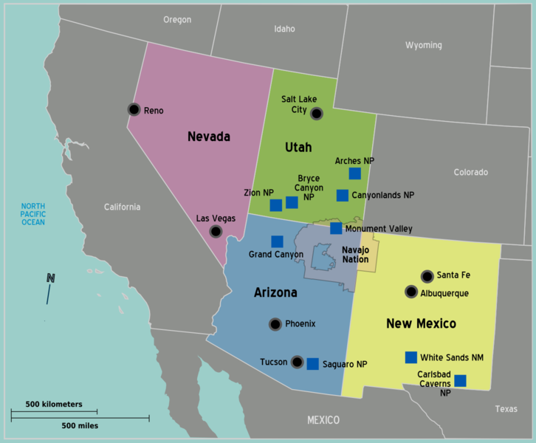
Goals: The Big Picture
Give pilots clear instructions on route to fly for arrivals (STARs), departures (SIDs), and approaches (IAPs)
Clearly convey any restrictions on speed and altitude
Allow flexibility for efficiency
Accommodate as many aircraft types as possible
Consider human performance, workload, and potential for confusion
?
http://commons.wikimedia.org/wiki/File:Map-USA-Southwest01.png

Slide 3
Viewpoints
ATC
Procedure design
Content and instructions
Cartographic design / chart depictions
Communicating the content
Interrelated with operations, avionics, aircraft performance, pilot training
Pilot
Airplane
Chart
Designer
Operator
Regulator
Human Factors?
http://en.wikipedia.org/wiki/Switchboard_operator

Slide 4
Current Research Questions and Goals
Primary
What makes a procedure subjectively “difficult” for line pilots?
Develop a comprehensive list of factors related to subjective procedure complexity
Can we use this understanding to design procedures that are implemented more smoothly?
Develop actionable recommendations…
Secondary
Understand how pilots use charts today, especially SIDs and STARs.

Slide 5
Activities Timeline
2014
2015
FAA AFS
(March)
Jeppesen
(Aug)
ICAO
(Oct)
Analysis
(Oct)
Analysis
(Jan/Feb)
Analysis
(May/June)
Initial data collection
(May-Sept)
Final data
collection
(Dec)
CNS TF
(April)
CNS TF
(Dec)
NextGen Admin
(May)
Preliminary working paper
(Nov)
Partial draft report
(July)
Full draft report
(Dec)
Presentation
Document

Slide 6
Study Overview
Participants, Procedure, and Task
3 hours of observation and discussion with groups of 2-3 line pilots from the same operator
Office setting
Review 6 procedures (2 SIDs, 2 STARs, and 2 IAPs)
Two researchers take notes
Informed consent & modest payment ($200)
Equipment
Static chart images, current for each session
Jeppesen paper (or electronic) charts

Slide 7
Participants
45 pilots across 19 sessions
From 3 major airlines, 1 regional airline, 1 air taxi, 3 corporate
All currently use Jeppesen charts
Broad range of aircraft types
All equipped with FMS
Advisory VNAV or Coupled VNAV
Some with autothrottle, some without

Slide 8
Data and Analysis
Independent notes from two researchers
Real-time transcripts
No audio/video recordings
No response times or timing data
No quantitative performance measures or analyses
Summarized all sessions into a common format using a template and rubric
For each “question of interest,” extracted data from all sessions into a single file to compare responses
Look for qualitative patterns in the responses

Slide 9
Sample Findings
Pilot reviews and briefings
Procedure design
Chart design
Operational complexity
Interactions between aircraft systems, procedure design, and operational factors
Subjective complexity factors and framework
Still under review

Slide 10
Defining Subjective Complexity
Subjective complexity is present when a task requires extra mental or physical steps by the pilot.
Examples
Increased memory/awareness/attention
More button pushes than necessary
Phrases such as “be careful when” or “pay attention to” or “don’t forget to” or “better ask” or “it only works when” indicate subjective complexity.

Slide 11
Sources of Subjective Complexity
Procedure design issues (alone)
Waypoint names
Sudden changes (e.g., descent rate, airspeed)
Constraint verification and monitoring
Procedure issues that create charting issues
Procedure variability
Transitions
Consistency between SIDs/STARs and IAPs
Chart issues (alone)
Non-contiguous paths
Chart composition
Operational complexity
e.g., ATC intervention, weather, traffic

Slide 12
Operational Complexity Factors
ATC interventions
Aircraft equipment or performance
Crew factors
Operator factors
Environment factors
These issues cannot be fully resolved through better procedure design, but procedure designers need to consider them.

Slide 13
Procedure and Chart Complexity
Chart- specific Issues
Chart composition, e.g., arrangement of elements, arrangement of sections, inconsistencies
Procedure-induced Chart Issues
Procedure Issues
e.g., non-contiguous paths
Lateral, vertical, speed, constraints, flyability, clarity, etc.

Slide 14
Subjective Complexity Factors: A Pilot-Centered Framework
Overall Procedure and Chart Complexity
Chart-Specific Complexity
Operational Complexity
Procedure Complexity
Arrangement of sections
Placement of elements within sections
Inconsistencies
Ambiguity
Constraints
Waypoint Names
Sudden Changes
Holds
Vectors
Airspace restrictions
Procedure-Induced Chart Complexity
Noncontiguous graphical path depiction
Notes
Variation
Transitions
A subjective complexity factor is one that requires an extra mental or physical step by the pilot.
Not every aspect of the procedure design creates complexity.
Everything that is complicated about the procedure design is reflected in the chart.

Slide 15
Questions?
For further information
Divya.Chandra@dot.gov
617-494-3882
http://www.volpe.dot.gov/our-work/safety-management-and-human-factors/human-factors-research-instrument-procedures-faa-nextgen

Slide 16
Acknowledgements
FAA Technical Sponsors and Program Managers
USDOT Volpe Center
Andrew Kendra, Vince Orlando, Maura Lohrenz
Subject Matter Experts
Jeppesen
Pilot participants
Pilot recruitment POCs
FAA AeroNav Products
Reviewers of study plan and script

Slide 17
Participants’ Aircraft Systems and Types
Advisory VNAV only, no autothrottle
Embraer 145
Bombardier CRJ 200
Coupled VNAV, no autothrottle
Boeing 737 Classic
Citation X (CE750)
Gulfstream 200
Bombardier Challenger 300
Coupled VNAV and autothrottle
Embraer 190, with company restriction to use managed speed only above 10000 ft alt
Boeing 737 NextGen (NG)
Boeing 757/67
Airbus 320
Gulfstream 450
Bombardier Challenger 604 and 605

