Slide 1
Validation & Verification and System of Systems
W. Clifton Baldwin, Ph.D., ESEP
Strategic Initiatives Division (ANG-B6)
NAS Systems Engineering Integration
Clifton.Baldwin@faa.gov
609-485-4832

Slide 2
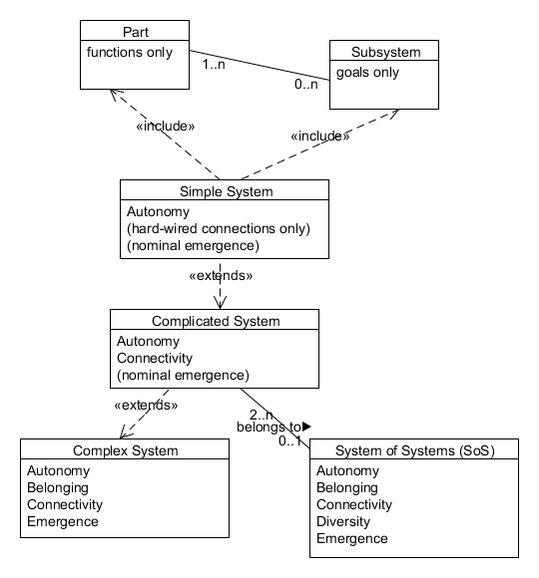
Baldwin, W. C., Felder, W. N., & Sauser, B. J. (2011). Taxonomy of increasingly complex systems. International Journal of Industrial and Systems Engineering, 9(3), 298–316.
V&V and System of Systems

Slide 3
System vs SoS
Traditional System | System of Systems
Overall system is autonomous but its parts are not | Overall SoS is autonomous as well as its constituent systems
Parts of a system collaborate only to the extent they are designed | Constituent systems collaborate as needed to help each other reach their goals
Parts of a system are statically connected | Constituent systems are dynamically connected, joining and separating from the SoS as needed
Each system is unique | SoS is composed of a diversity of constituent systems
A system is more than the sum of its parts but functionality can be traced to a component. | An SoS exhibits emergent functionality that cannot be traced to any particular constituent system.
V&V and System of Systems

Slide 4
Some Issues of SoS
Variety of configurations deter standardized processes
Changes in one system have unexpected impact on other systems
Even when individual systems have good requirements, overall SoS functionality is likely to be ambiguous
Documentation may be obsolete since the SoS evolves over time
Testing (as well as V&V) is distributed and federated
Functionality emerges from the connections between constituent systems

Slide 5
Questions

