Slide 1
REDAC Human Factors Subcommittee Core Flight Deck Program Review
Flight Deck/Maintenance/System Integration Human Factors BLI A11.G
Sherry Chappell, BLI Manager
September 8, 2016

Slide 2
Flight Deck/Maintenance/System Integration Human Factors
Description
The Flight Deck/Maintenance/System Integration Human Factors program provides the research foundation for FAA guidelines, handbooks, orders, advisory circulars, technical standards orders and regulations that help ensure the safety and efficiency of aircraft operations.
It also develops human performance information that the agency provides to the aviation industry for use in designing and operating aircraft, and training pilots and maintenance personnel.
FY16 Human Factors REDAC Fall Meeting

Slide 3
Flight Deck/Maintenance/System Integration Human Factors
8 Core TCRG research requirement areas:
Flight Deck Core Human Factors Research Requirement Area | Aviation Safety (AVS) Principal Technical Sponsor
Avionics & New Technologies - Certification and Operational Approval Criteria (A11G.HF.2) | Aircraft Certification (AIR-134)
General Aviation Safety Improvement Research – A Multi-Method Approach to Accident Reduction (A11G.HF.6) | Small Airplane Directorate, Standards Office - Programs and Procedures Branch (ACE-114)
Advanced Vision Systems (EFVS, EVS, SVS, and CVS), Head Up Displays (HUD), Head Mounted Displays (HMD): Certification and Operational Approval Criteria (A11G.HF.4) | Flight Standards – Flight Technologies and Procedures (AFS-470)
Enhancing Aviation Safety Through Advanced Procedures, Training & Checking Methods, to Include Loss of Control Detection, Avoidance, and Recovery (A11G.HF.1) | Flight Standards – Air Carrier Training and Voluntary Safety Programs (AFS-280)
Human Factors Maintenance Risk Management (A11G.HF.3) | Flight Standards – Aircraft Maintenance Division (AFS-360)
UAS Human Factors Considerations (A11G.HF.5 & A11L.UAS.30 ) | Flight Standards – Unmanned Aircraft Systems (AFS-86)
Fatigue Mitigation in Flight Operations (A11G.HF.8) | Flight Standards – Air Transportation Division (AFS-220)
Human Factors R&D for Improved Rotorcraft Operational Safety (A11G.HF.7) | Flight Standards – General Aviation and Commercial Division (AFS-820)
FY16 Human Factors REDAC Fall Meeting

Slide 4
Avionics and New Technologies: Certification and Operational Approval Criteria
Projects include:
EFB Technologies and Interfaces
Airport Map Displays
General Guidance for Multi-Function Displays
FY16 Human Factors REDAC Fall Meeting

Slide 5
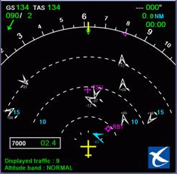
Avionics & New Technologies (A11G.HF.2)
Research Requirement Description
Sponsor Outcome
FAA needs development and update of human factors regulatory and guidance material on evolving flight deck technologies including Automatic Dependent Surveillance – Broadcast (ADS-B), Electronic Flight Bag (EFB), cockpit display of traffic information (CDTI), and moving maps
Focus is on human factors/pilot interface issues such as colors, symbols, fonts, labels, workload, situation awareness, errors, etc. as technology changes
Sponsor: Cathy Swider (AIR-134)
Develop and update regulatory and guidance material (i.e., specific rules, ACs, TSOs, Handbooks, etc.) for specific systems (e.g., ADS-B, Electronic Flight Bags (EFBs), moving maps) and documents that provide more general guidance for all flight deck displays (e.g., AC 25-11, AC 23.1311)
Critical Milestones
Research Accomplishments in FY16
Airport moving map/ADS-B/CDTI, EFBs:
Recommended ADS-B symbol set (FY16)
Airport moving maps/CDTI industry product review (FY16)
Explore methods for measuring the accuracy of charting products to understand the implications for depicting ownship position (FY17)
Update to Human Factors Considerations in the Design and Evaluation of Flight Deck Displays and Controls (FY17)
Completed and published CDTI/Airport Moving Map industry product review
Delivered draft report on airport and flight deck surface alerting systems
Delivered draft of proposed human factors revisions to the EFB Job Aid (included in FAA Order 8900.1)
FY16 Human Factors REDAC Fall Meeting

Slide 6
EFB Technologies and Interfaces
The goal of this work is to identify, understand, and help the FAA address human factors issues related to Electronic Flight Bag ( EFB) functions and Portable Electronic Devices ( PED) technology. In the past, the Volpe Center assisted the FAA by developing tools for reviewing the use of EFBs by operators. The tools were then modified by the FAA and incorporated into internal guidance for inspectors. The Volpe Center will continue to assist the FAA by conducting research to identify and address emerging issues for EFB functions and PEDs. In addition, the Volpe Center will track developments in industry and also safety issues related to the operational use of EFBs and PEDs.
Sponsor: Cathy Swider, AIR-134
This research provides data to update the EFB/PED regulatory and guidance material related to human factors (e.g. Order 8900.1 Flight Standards Information Management System (inspector handbook)). This update reflects the impact of evolving technologies intended to improve safety
Revised draft of the human factors considerations in the design and evaluation of Electronic Flight Bags (EFBs) document | Complete
Delivered draft EFB job aid revisions for review on July 22, 2016
FY16 Human Factors REDAC Fall Meeting
Notes:
Revised draft safety report analysis of EFBs and other portable technologies
Complete
First draft of human factors considerations in the design and evaluation of Electronic Flight Bags (EFBs) document
Complete
Draft input for policy (including support to EFB Users Forum Technical Group and Digital NOTAMs Working Group)
Complete
Draft electronic flight bag industry survey
Complete
Published report titled “An Examination of Safety Reports Involving Electronic Flight Bags and Portable Electronic Devices”
Complete
Revised draft of the human factors considerations in the design and evaluation of Electronic Flight Bags (EFBs) document
Complete
Amendment to the Human Factors Considerations in the Design and Evaluation of EFB/PED report
Complete

Slide 7
Airport Map Displays
The purpose of this task is to support the FAA in identifying human factors issues with the implementation and integration of airport moving map displays on the flight deck. This research will help the FAA understand what advanced functions are proposed or being implemented for the airport moving map application, and will examine any operational limitations in their use and depiction.
Sponsor: Cathy Swider, AIR-134
Research will contribute to the update of RTCA DO 317 MOPS for Aircraft Surveillance Applications (invoked by AC 20-172A and TSO-C195 ADS-B/CDTI) and data input to update RTCA DO-257A (invoked by TSO-C165a
Revised draft CDTI/Airport Moving Map industry survey (2nd draft) | Complete
Draft report of findings of symbol study – Phase 2 | Complete
Delivered draft report of findings of symbol study – Phase 2 (02/29/2016)
FY16 Human Factors REDAC Fall Meeting

Slide 8
General Guidance for Multi-Function Displays
The purpose of this task is to identify and document FAA human factors policies, guidance and other related research on a variety of flight deck systems (e.g., EFB/PED, Global Positioning System, and electronic map displays) in one document for use by Aircraft Certification personnel who are responsible for conducting human factors evaluations for certification of flight deck equipment. The document is intended to facilitate and help standardize the identification and resolution of common human factors issues in avionics submitted to the FAA for approval. Sources of information include the Code of Federal Regulations, Technical Standards Orders, Advisory Circulars, industry documents, and general human factors texts.
Sponsor: Cathy Swider, AIR-134
This document will be used as reference by field specialists for approving flight deck systems. This document is a compilation of all FAA regulatory and guidance material related to flight deck human factors
Preliminary draft of the updated version of “Human Factors Considerations in the Design and Evaluation of Flight Deck Displays and Controls” Document | Complete
Interactive website for version 2 of General Guidance Document | 11/30/2016
Draft eBook for Version 2 of General Guidance Document | 01/31/2017
Preliminary draft of version 3 of “Human Factors Considerations in the Design and Evaluation of Flight Deck Displays and Controls” Document | 09/30/2017
Delivered updated draft version of General Guidance Document

Slide 9
Advanced Vision Systems (EFVS, EVS, SVS, and CVS), Head Up Displays (HUD), Head Mounted Displays (HMD): Certification and Operational Approval Criteria
Projects include:
Human Factors of Head-up & Head-mounted Displays
FY16 Human Factors REDAC Fall Meeting

Slide 10
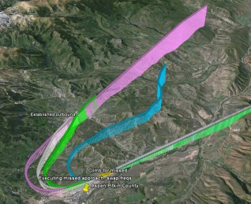
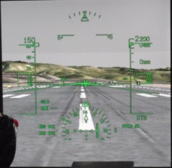
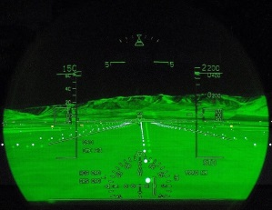
Advanced Vision Systems – EFVS, EVS, SVS, and CVS, HUD, HMD – Ops Approval Criteria (A11G.HF.4)
Research Requirement Description
Sponsor Outcome
Human factors data to support operational credit and approvals is needed for:
New applications with synthetic vision displayed on the head up display (HUD)
Synthetic vision and guidance information for civil applications of head-worn displays
Use of head-worn displays
Sponsor: Terry King (AFS-400)
Increase safety, efficiency, capacity, and throughput during low visibility conditions using advanced vision systems, head-up displays, and head-mounted displays.
Enable more flight operations to occur in low visibility conditions with less ground infrastructure while maintaining an appropriate level of safety during approach, landing, taxi, and takeoff operations.
Critical Milestones
Research Accomplishments in FY16
HMD/HUD (head mounted display/ head up display)
Simulation to quantify performance contribution of HUD use (FY16)
Industry/product review of existing HMD systems (FY16)
Research plan and data collection identifying human performance considerations (FY17)
SVGS
SVS simulation measuring baseline performance (FY16)
Characterize pilot performance using SVGS for specific low visibility operations (FY17)
Identification of minimum training and currency requirements for SVS proficiency (FY18)
Delivered HUD/HMD technology guide, cataloging current and potential HUD/HMD
Delivered HUD/HMD research proposal, identifying knowledge gaps and methods for human-in-the-loop research
Delivered final report including HMD product and literature reviews
FY16 Human Factors REDAC Fall Meeting
Notes:
Soooooo…..these were the critical milestones documented in the core requirement initially and in the PREP for FY15. So, I think previously they may have been funded with core but they would be considered NG for all future funding. Given our new classificaiton scheme for HMD and CVS in the NG program, we could delete the following bullets.
FY15 Industry survey and simulation on HMD
FY16 Research plan for pilot performance with CVS.
DRAFT TEMPLATE

Slide 11
General Aviation Safety Improvement Research – A Multi-Method Approach to Accident Reduction
Projects include:
General Aviation Safety Improvements Research – Angle of Attack Indicator Requirements
FY16 Human Factors REDAC Fall Meeting

Slide 12
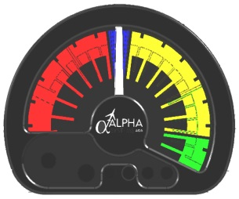
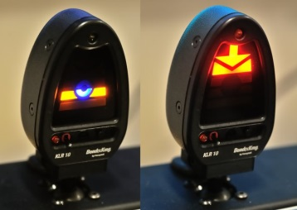
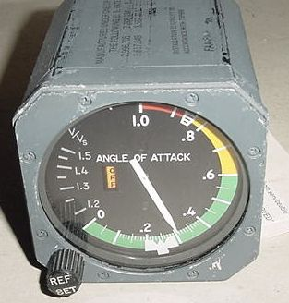
General Aviation Safety Improvements Research – A Multi-Method Approach to Accident Reduction (A11G.HF.6)
Research Requirement Description
Sponsor Outcome
Identify and evaluate appropriate interventions for reducing the GA accident rate through research focused on:
Available aircraft equipment/technologies not currently used in GA and
New ways of addressing errors in pilot decision making.
Sponsor: Dave Sizoo (ACE-110)
Update regulatory and guidance material, e.g., AC 23.1311-1C and AC 23-17C, plus policy for 23.1329 which provide more general guidance for the relevant flight deck displays
Critical Milestones
Research Accomplishments in FY16
Field study of display types/orientations using a number of tasks/maneuvers (FY16)
Report on human factor considerations for AoA displays (FY16)
Completed initial data collection in AGARS for 5 display types/orientations using a number of tasks/maneuvers
Initiated analyses of performance data and pilot interview data
Briefed research to the Human Factors Coordinating Team
FY16 Human Factors REDAC Fall Meeting
Notes:
DRAFT TEMPLATE

Slide 13
Enhancing Aviation Safety through Advanced Procedures, Training & Checking Methods, to include Loss of Control Detection, Avoidance, and Recovery
Projects include:
Evaluation of Methods for a Performance-based ATP
Integrated Angle of Attack Indicator Requirements
Identifying Crew Resource Management (CRM) Approaches for Enhancing Flightcrew Performance
FY16 Human Factors REDAC Fall Meeting

Slide 14
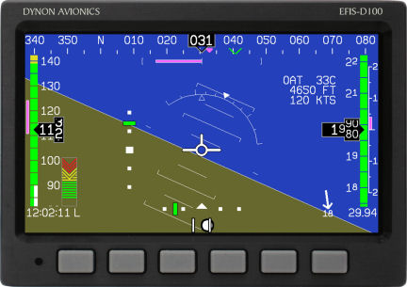
Enhancing Aviation Safety Through Advanced Procedures, Training & Checking Methods, to include Loss of Control Detection, Avoidance, and Recovery (A11G.HF.1)
Research Requirement Description
Sponsor Outcome
Pilots are insufficiently trained for flight path management, including loss of control.
Research areas include:
Mitigations for startle, surprise, and distraction for loss of control
Crew Resource Management
Alternative paths to Airline Transport Pilot
Design and use of angle of attack indicators (AOA) on integrated displays
Distance learning
Sponsor: Rob Burke & Doug Farrow (AFS-280), Kathy Abbott (AVS), Dave Sizoo (ACE-110)
Reduction in loss of control inflight accidents.
Reduced accidents and serious incidents due to lack of knowledge and skills for manual flight operations.
Updates to guidance for CRM training
Identification of effectiveness and appropriateness of distance learning.
Guidance for the degree to which training can supplant experience and to what degree.
Critical Milestones
Research Accomplishments in FY16
Jet upset detection and recovery
Evaluation of AoA indicators for integrated displays (FY16)
CRM
Recommendations for CRM training and checking (FY16)
Alternative paths to ATP
Identification of performance metrics for evaluating training program effectiveness (FY16)
Defined tasks and procedures for evaluation trials of integrated AoA research study
Delivered report, including recommendations relevant to an update to AC 120-51E, Crew Resource Management Training
Completed a first draft report detailing the summaries of interviews with training department heads of airlines with ab initio programs
FY16 Human Factors REDAC Fall Meeting

Slide 15
Identifying Crew Resource Management (CRM) Approaches for Enhancing Flightcrew Performance
A review the existing CRM literature to identify and assess state-of-the-art CRM approaches, and provide data that could be used by the FAA to update AC 120-51E as well as advance the state of CRM
Develop and conduct an empirical study to assess the efficacy of selected CRM approaches with respect to flightcrew performance (e.g., the improvement of problem-solving, decision-making, situational awareness, and team communication skills) on the flight deck
Sponsors: Doug Farrow, AFS-280 and Kathy Abbott CSTA (AIR-100)
Empirical basis for regulatory guidance for the update of AC 120-51 and empirical basis for guidance to air carriers to train and check for crew resource management performance.
Technical report detailing the results and findings of the empirical study investigating the effects of training approaches for CRM on flight crew performance | Complete
Conducted a study to assess the efficacy of selected CRM approaches
Delivered report, including recommendations for CRM training and checking relevant to an update to AC 120-51E
FY16 Human Factors REDAC Fall Meeting

Slide 16
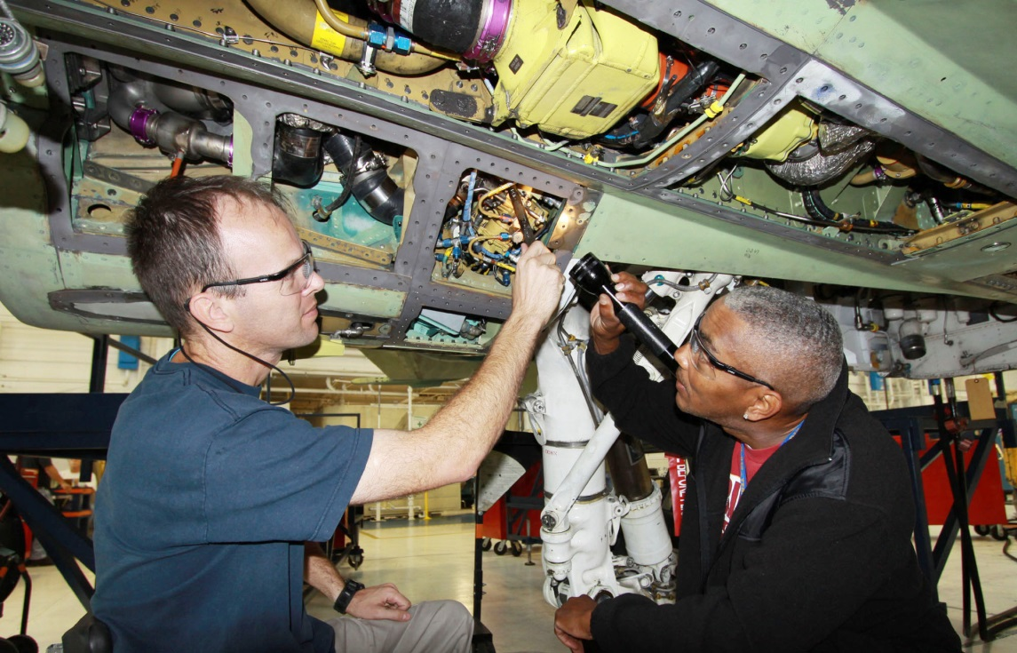
Human Factors Maintenance Risk Management
Projects include:
Human Factors Maintenance Risk Management
FY16 Human Factors REDAC Fall Meeting

Slide 17
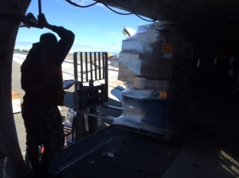
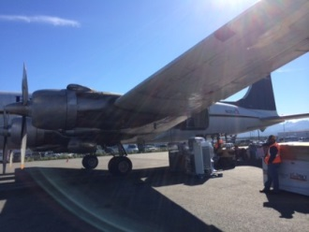
Human Factors Maintenance Risk Management (A11G.HF.3)
Research Requirement Description
Sponsor Outcome
Maintenance and inspection errors are significant contributors to both general aviation and commercial aviation accidents.
Research areas include:
Maintenance Line Operations Safety Audits
Maintenance Fatigue Risk Management
Failure to Follow Maintenance Procedures
Sponsor: Tim Shaver (AFS-300), Dr. Bill Johnson (AVS)
Develop guidance material for inspectors and maintenance organizations (AC 120-MFRM)
Respond to open NTSB recommendations and FAA ARC.
A-13-001 “Establish duty-time regulations for maintenance personnel working under 14 Code of Federal Regulations Parts 121, 135, 145, and 91 Subpart K that take into consideration factors such as start time, workload, shift changes, circadian rhythms, adequate rest time, and other factors shown by recent research, scientific evidence, and current industry experience to affect maintenance crew alertness. (Supersedes Safety Recommendation A-97-71 and is classified “Open—Unacceptable Response”) “
A-15-016 “Include specific guidance in the Federal Aviation Administration inspector handbook that defines responsibilities for principal inspectors for the oversight of an operator’s loading, restraint, and documentation of special cargo loads.”
Critical Milestones
Research Accomplishments in FY16
Report on maintenance LOSA best pracitces (FY16)
Complete study of maintenance facilities and fatigue risk management strategies (FY16)
Complete field study of cargo load supervisors, including roles, responsibilties, and duty time schedules (FY16)
Develop taxonomy of failure to follow procedures in aviation maintenance (FY16)
Completed data collection on cargo load supervisor job responsibilities and duty/rest schedules and developed draft report for sponsors
Completed data collection from 200+ AMTs between November 2015 and July 2016 for maintenance fatigue risk management study
Developed a draft report on “Maintenance Failure to Follow Procedures Taxonomy”
FY16 Human Factors REDAC Fall Meeting
Notes:
More explanation on A-15-06. There currently is not a certification requirement for cargo load supervisors, load masters, flight mechanics, etc. The position is called different names depending on the organization. The sponsoring organizatin requested this research to support the potential development of a certification requirement as well as potential criteria for rest and duty schedules.
Phase 1: Researchers will conduct a task analysis to review and assess the accuracy of current job descriptions for load supervisors. This process will include reviewing the current literature, accessing known occupational databases to collect general required knowledge, skills, and aptitudes (KSAs) for the position, and performing face-to-face interviews with individuals currently performing the activities associated with load supervisors and flight mechanics.
Phase 2: Researchers will review current reports from relevant data bases and accident reports (e.g., the NASA Aviation Safety Reporting System, National Transportation Safety Board, etc.), and examine current rest policies for load supervisors and flight mechanics. This information will help develop a qualitative picture of the state of rest/fatigue in the cargo load industry. Researchers will collect and report on best practices for fatigue mitigation specifically for cargo supervisors and flight mechanics.
Phase 3: Researchers will deploy a task analysis and duty time/rest questionnaire to current cargo load supervisors and flight mechanics. In addition, a real-time field study will collect quantitative data from cargo load supervisors and flight mechanics using actigraphy, the Psychomotor Vigilance Test (PVT), and electronic work-schedule log books. Together, these items will provide information regarding discrepancies in perception and actual fatigue risks within the cargo supervisors and flight mechanics. These data collection are considered to be the “Standard” for fatigue risk assessment.
DRAFT TEMPLATE

Slide 18
Human Factors Research and Development for Improved Rotorcraft Operational Safety
Projects include:
Human Factors Research and Development for Improved Rotorcraft Operational Safety
FY16 Human Factors REDAC Fall Meeting

Slide 19
Human Factors Research and Development for Improved Rotorcraft Operational Safety (A11G.HF.7)
Research Requirement Description
Sponsor Outcome
A number of operational and technology challenges for the rotorcraft community may impact operational safety. Three Initiatives are prioritized from high to low as shown below:
Helicopter Training Devices
Scenario Based Training (SBT) for parts 61, 91, 141, and 135 operations
Helicopter Crew Resource Management (CRM) for Part 91 and 135 operators including HAA operators.
Sponsor: Steve Sparks (AFS-810)
Improve safety of IFR operations in high density helicopter operations areas
Separate IFR operations from other commercial operations in metroplex areas.
Update guidance for aviation safety inspectors on oversight of 135 HEMS operators and weather decision making in operator training programs (FSIMS Order 8900.1). Potential update to AC 120-51 for CRM training for HEMS operations.
Critical Milestones
Research Accomplishments in FY16
Document current literature related to: (FY16)
Helicopter Training Devices
Scenario Based Training (SBT) for parts 61, 91, 141, and 135 Operations
Helicopter Crew Resource Management (CRM) for Part 91 and 135 operators including HAA operators.
Develop research plan to address knowledge gaps (FY17)
Data collection and recommendations (FY18)
Completed literature review on alternative helicopter CRM practices
Initiated literature review on helicopter training devices and scenario based testing for off-nominal events
FY16 Human Factors REDAC Fall Meeting
Notes:
DRAFT TEMPLATE

Slide 20
Fatigue Mitigation in Flight Operations
Projects include:
Fatigue Mitigation in Flight Operations
FY16 Human Factors REDAC Fall Meeting

Slide 21
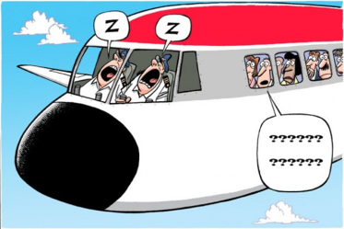
Fatigue Mitigation in Flight Operations (A11G.HF.8)
Review the scientific integrity of FRMS proposals during the processes outlined in AC 120-103A as required for certificate holders in their demonstration of an alternative means of compliance with the new regulations.
Evaluate the preparation, documentation, review, and release of other fatigue-related materials as appropriate and associated with 14 CFR Part 117 flightcrew member duty & rest requirements
Sponsor: Dale Roberts, AFS-220
Research will be used to develop and update policy for 14 CFR § 117 and 121 and OpSpec A318, Authorization to Conduct Operations Under a Fatigue Risk Management System.
Identify operationally relevant fatigue & performance measures for inclusion in AFS-200’s development of an FRMS database for tracking approved exemptions and trend analysis. (FY16)
Evaluate AFS-220 FRMS exemption review and analysis procedures for standardization and scientific validity. (FY17)
Complete a report that will be used to develop and update policy for 14 CFR § 117 and 121 and OpSpec A318, Authorization to Conduct Operations Under a Fatigue Risk Management System. (FY18)
Identify operationally relevant fatigue & performance measures for inclusion in AFS-200’s development of an FRMS database for tracking approved exemptions and trend analysis.
FY16 Human Factors REDAC Fall Meeting

Slide 22
Backup

Slide 23
Human Factors of Head-up & Head-mounted Displays
Support the development of criteria and guidelines for approving Head-Up Displays (HUDs) and Head-Mounted Displays (HMDs) with respect to human factors issues such as symbology standardization, color coding, alerting, optics and perception, installation-related issues, and integration. The emphasis is on head-mounted displays intended for operational credit.
Sponsor: Terry King, AFS-410
This research will be used to identify human factors issues and recommended guidelines for approval of Head-mounted displays for operational credit in low visibility operations. Currently, only HUDs receive operational credit for low visibility operations.
HUD/HMD Industry Review, listing current HUD/HMD products and potential new features for civil market | Complete
HUD/HMD Literature Bibliography, listing and summarizing academic research, standards, and guidance (FAA and otherwise) | Complete
HUD/HMD Issue Analysis Paper, reviewing the literature and market, and identifying potential HUD/HMD human factors issues, related needs for FAA guidance, guidance from non-FAA sources, and research needs | Complete
HUD/HMD human factors research plan | Complete
HUD/HMD technology guide, cataloging current and potential HUD/HMD | Complete
HUD/HMD research proposal, identifying knowledge gaps and methods for human-in-the-loop research | Complete
Final Report including HMD product and literature reviews | Complete
Delivered HUD/HMD technology guide, cataloging current and potential HUD/HMD
Delivered HUD/HMD research proposal, identifying knowledge gaps and methods for human-in-the-loop research
Delivered final report including HMD product and literature reviews

Slide 24
General Aviation Safety Improvements Research – Angle of Attack Indicator Requirements (add-on)
This research program provides a means for evaluating existing and potential add-on/after-market AoA indicator for its contribution towards reducing/eliminating accidents related to stall-spin and other similar situations. This research will define and compare categories of after-market AoA instrumentation in the context of flight tasks that are supportable using AoA indications. The goal is to identify those features of AoA instrumentation that are critical to providing usable data to the pilot for defined tasks and to provide guidance/recommendations for the design, certification, and use of such indicators in small GA aircraft.
Sponsor: David Sizoo, ACE-110
The research is intended to produce recommendations for minimum AoA indicator display requirements, without discouraging innovation in the design of AoA display presentations, and is thus expected to enhance safety with better stall margin awareness in existing aircraft and new designs. This is a high priority research topic for the General Aviation Joint Steering Committee and addresses one of the NTSB top ten most wanted issues “Prevent Loss of Control in Flight in General Aviation“
Literature review add-on displays | Complete
Market Survey add-on displays | Complete
Report on simulator-based research add-on displays | 9/30/2016
Completed initial data collection in AGARS for 5 display types/orientations using a number of tasks/maneuvers
Initiated analyses of performance data and pilot interview data
Briefed research to the Human Factors Coordinating Team

Slide 25
Evaluation of Methods for a Performance-based ATP
The objective of this research activity is to investigate methods of training a pilot for a specific professional flying position and evaluating training program components and the effectiveness of those training methods to determine if there is an additional path that could be developed for obtaining an ATP certificate with restricted privileges that is performance based.
Sponsor: Barbara Adams, Doug Farrow AFS-280, Kathy Abbott CSTA (AIR-100)
As a result of the US House Bill 5900 Air Safety and FAA Extension Act of 2010, the FAA increased the number of hours for an ATP license to 1500 hours. This research, along with other research programs, will determine whether this number of hours is the best criterion for experience or whether a performance-based qualification system is superior.
Monthly reports documenting technical and financial status | Monthly
Draft final report including results from the three task components | 11/30/16
Final report summarizing results of the three task components | 2/28/17
Received consent from 7 US airlines to look at their AQP data and internal training summary reports
Discussion with foreign air carriers, curricula developers, and US military (USAF AMC training command) about alternative paths for the Restricted-ATP
Collection of initial data
Completed a first draft report detailing the summaries of interviews with training department heads of airlines with ab initio programs

Slide 26
Enhancing Aviation Safety through Advanced Procedures, Training & Checking Methods, to include Loss of Control Detection, Avoidance, and Recovery– Integrated AOA
This research program provides a means for evaluating existing and potential integrated (into the PFD) AoA indicator for their contributions towards reducing/eliminating accidents related to stall-spin and other similar situations. This research will define and compare formats of integrated AoA instrumentation in the context of flight tasks that are supportable using AoA indications. The goal is to identify those features of integrated AoA instrumentation that are critical to providing usable data to the pilot for defined tasks and to provide guidance/recommendations for the design, certification, and use of such integrated indicators in small GA aircraft.
Sponsor: David Sizoo, ACE-110
The research is intended to produce recommendations for minimum integrated AoA indicator display requirements, without discouraging innovation in the design of AoA display presentations, and is thus expected to enhance safety with better stall margin awareness in existing aircraft and new designs. This is a high priority research topic for the General Aviation Joint Steering Committee and addresses one of the NTSB top ten most wanted issues “Prevent Loss of Control in Flight in General Aviation“
Literature review integrated displays | 09/30/2016
Market Survey integrated displays | 09/30/2016
Report on simulator-based research integrated displays | 03/31/2017
Identified candidate integrated-display formats
Defined tasks and procedures for evaluation trials

Slide 27
Human Factors for Advanced Autopilots & Automation Technologies in GA Airplanes
This research will study the human factors aspects for certification and approval of current and emerging automation technologies for general aviation airplanes. Specifically, this research will identify the pilot interface and usability aspects of autopilot and other flight-management automation technologies that are needed to allow a single pilot to fly an aircraft safely when supported by advanced automation systems. The goal is to identify a formal process for evaluating the equipment against applicable regulations that address proper function, intuitive use, and potential hazards.
Sponsor: Wes Ryan, ACE-114
This research would provide guidance for certification and approval processes for flight-management automation technologies that are needed to allow a single pilot to fly an aircraft safely when supported by advanced automation systems and help identify any potential hazards associated with higher levels of automation in GA aircraft. Specifically, updates to Part 23.1301, 23.1309, 23.1311, 23.672, and 23.1329
Literature and product review of advanced autopilots (Part 23) | Complete
Report on Phase I preliminary experimentation (EP sim) | Complete
Completed literature review and product review of advanced autopilots and submitted to sponsors for review.

Slide 28
Human Factors Maintenance Risk Management
This research will provide industry with empirically tested approaches/tools to proactively manage maintenance safety risks. It involves three separate, but related, efforts: delivery of Maintenance Line-Oriented Safety Audit (Mx-LOSA) materials for distribution to industry, fatigue risk management approaches modified for maintenance operations, and approaches/tools to aid quality assurance of technical documentation. The research will also provide the FAA with a scientific basis for guidance and future requirements pertinent to effective risk management strategies in maintenance operations.
Sponsor: Tim Shaver, AFS-300; Bill Johnson, AIR-100
An advisory circular (120-MFRM) is currently being developed based on the outcomes of the fatigue research. The cargo load supervisor research is informing the FAA’s focus group in their response to NTSB recommendation A-15-14. The Mx-LOSA research will result in an AC on how to conduct a line operation safety audit for ramp and maintenance. The failure to follow procedures research will strategically identify the most common root causes to prioritize for identification of mitigations.
Final version of LOSA manuals for M-LOSA and R-LOSA Programs | Complete
Report on Mx-LOSA pre-deployment testing to include a description of challenges, solutions, and recommendations for FAA inspectors regarding participation in the implementation process. | Complete
Report summarizing interviews and pilot study outcomes in terms of relative utility of alternative fatigue countermeasures and future research directions in reducing risk, safety, and cost, along with guidance for FAA inspectors and cargo only organizations. | Complete
Report summarizing Mx Field study outcomes in terms of relative utility of alternative fatigue countermeasures in reducing risk, safety, and cost, along with guidance for FAA inspectors and cargo only organizations. | 09/30/2016
Completed data collection on cargo load supervisor job responsibilities and duty/rest schedules and developed draft report for sponsors
Completed data collection from 200+ AMTs between November 2015 and July 2016 for maintenance fatigue risk management study
Developed a draft Maintenance Failure to Follow Procedures Taxonomy to classify incidents and accidents

Slide 29
Fatigue Mitigation in Flight Operations
Assist the Flight Standards Service - Air Transportation Division (AFS-200) as scientific representative for Fatigue Risk Management Systems (FRMS) proposals with responsibilities to include:
Review the science integrity of FRMS proposals during the processes outlined in AC 120-103A as required for certificate holders in their demonstration of an alternative means of compliance with the new regulations.
Assist in the preparation, documentation, review, and release of other fatigue-related materials as appropriate and associated with 14 CFR Part 117 flightcrew member duty & rest requirements
Sponsor: Dale Roberts, AFS-220
Research will be used to develop and update policy for 14 CFR § 117 and 121 and OpSpec A318, Authorization to Conduct Operations Under a Fatigue Risk Management System.
Identify operationally relevant fatigue & performance measures for inclusion in AFS-200’s development of an FRMS database for tracking approved exemptions and trend analysis. | Complete
Evaluate AFS-220 FRMS exemption review and analysis procedures for standardization and scientific validity. | 9/30/2017
Complete a report that will be used to develop and update policy for 14 CFR § 117 and 121 and OpSpec A318, Authorization to Conduct Operations Under a Fatigue Risk Management System. | 3/31/2018
Routinely received ongoing and new FRMS applications and FRMS data submissions from multiple air carriers
Provided several invited domestic and international symposium presentations regarding FAA’s new regulation and pilot fatigue management approaches, authorization process, and data analysis

