Slide 1
Maintenance Human Factors R&D: Status Report
Dr. Bill Johnson
Chief Scientific and Technical Advisor
Human Factors in Maintenance
bill-dr.johnson@faa.gov
FAA Research and Development Advisory Committee
Washington, DC
September 8, 2016
Federal Aviation
Administration

Slide 2
FAA Research and Development Advisory Committee
Washington, DC
September 8, 2016
Federal Aviation
Administration

Slide 3
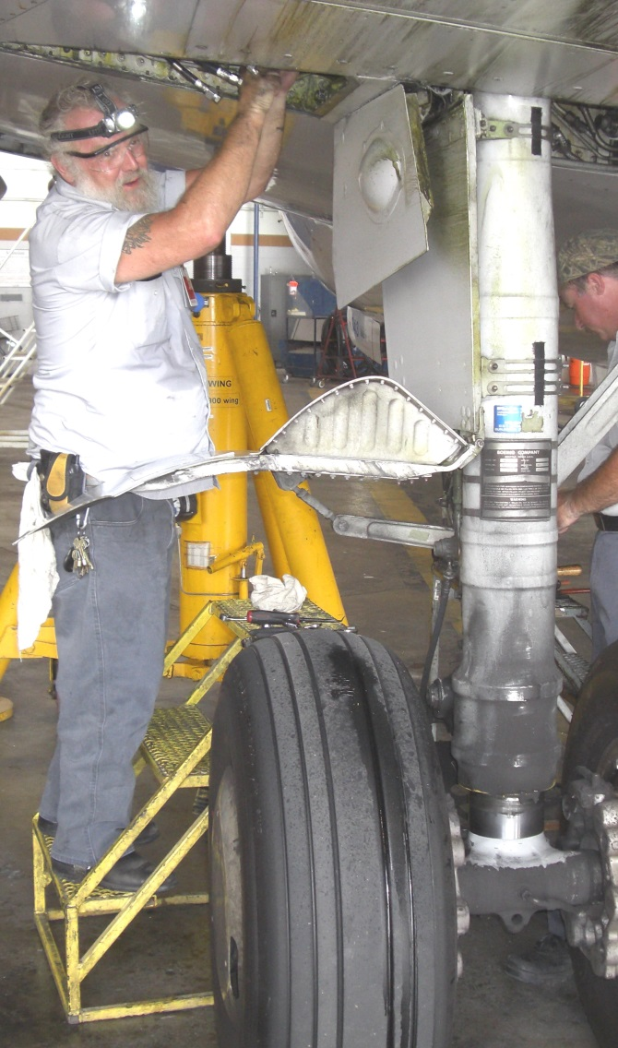
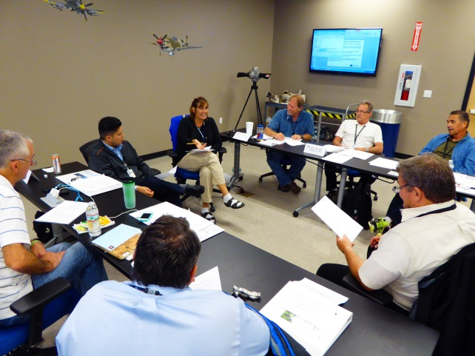

Slide 4
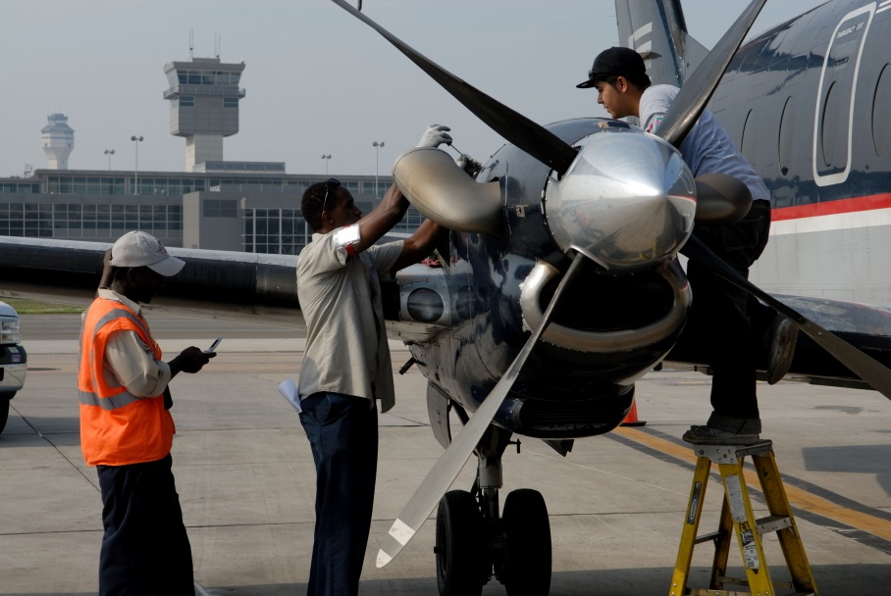
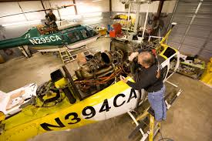
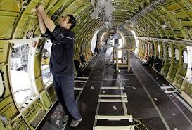

Slide 5
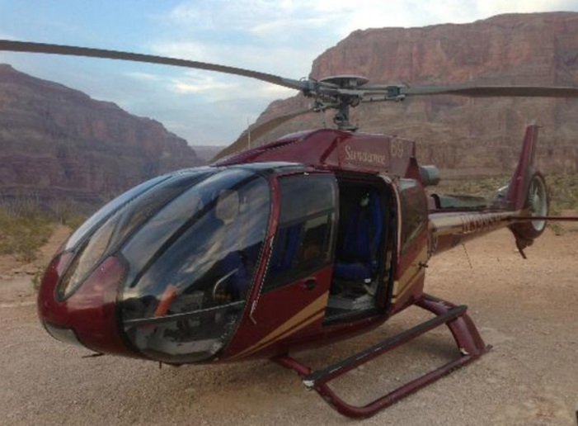
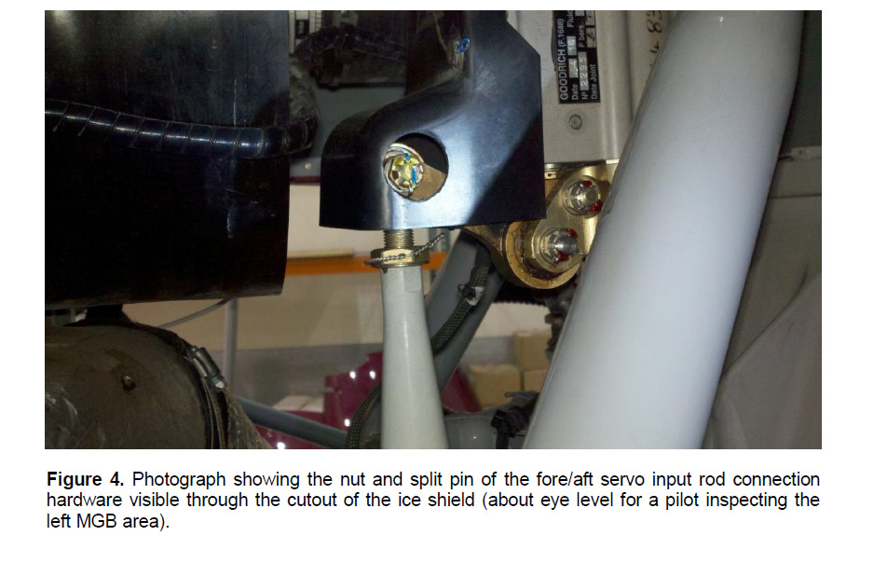
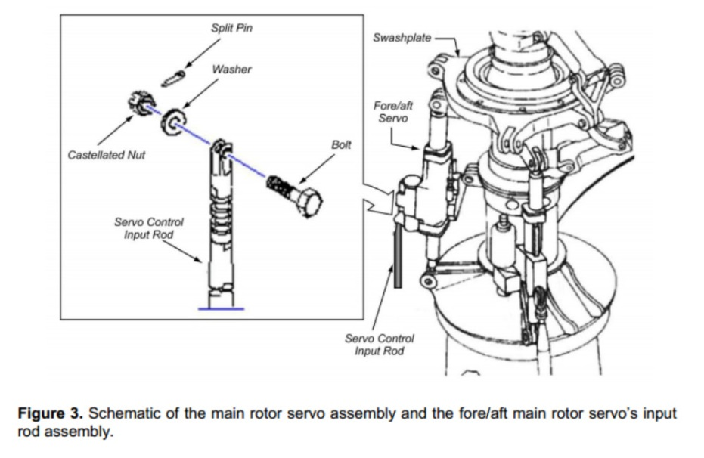

Slide 6
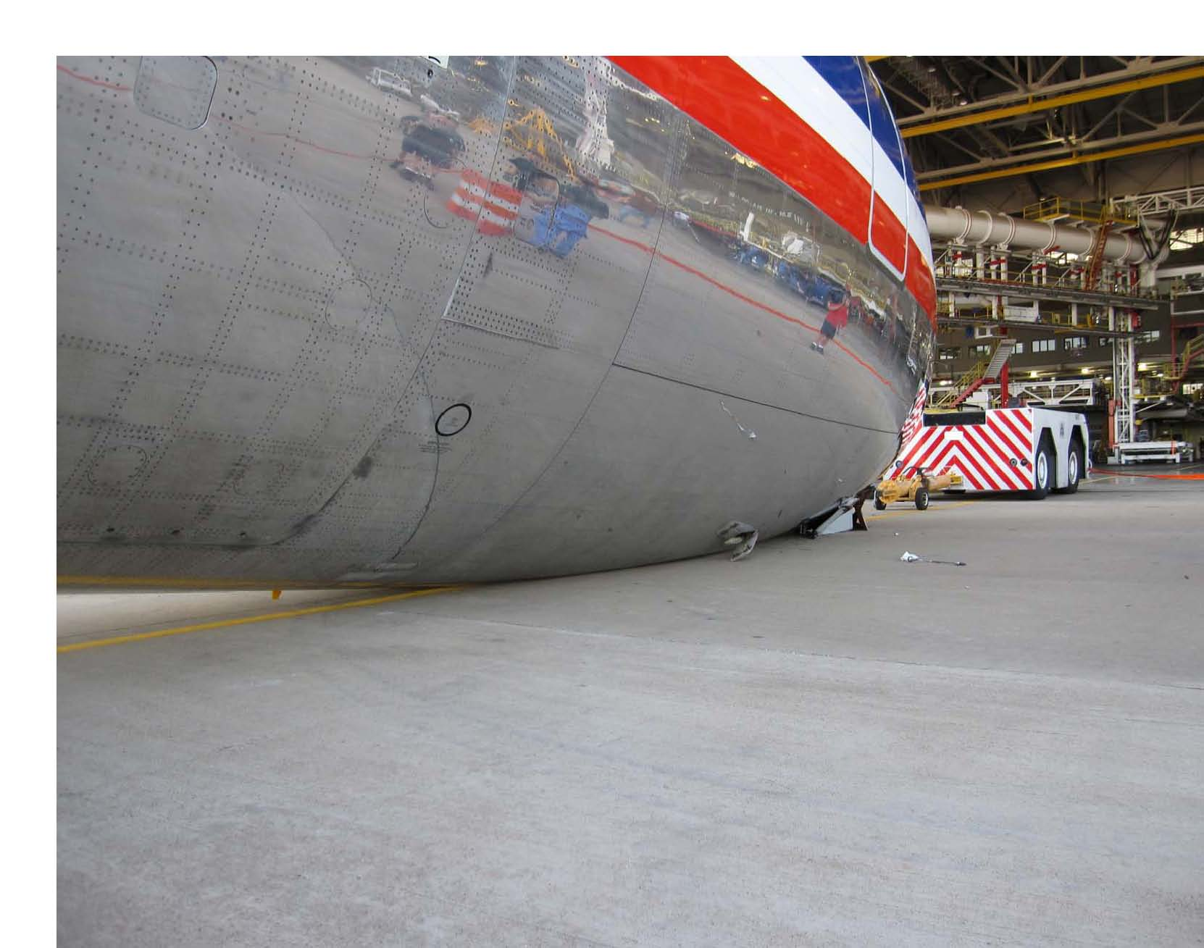
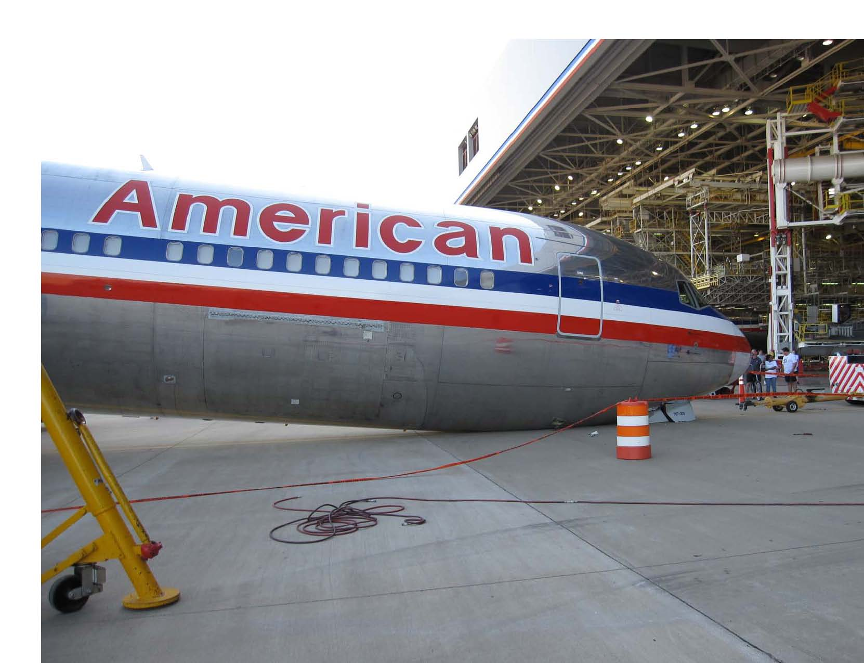

Slide 7
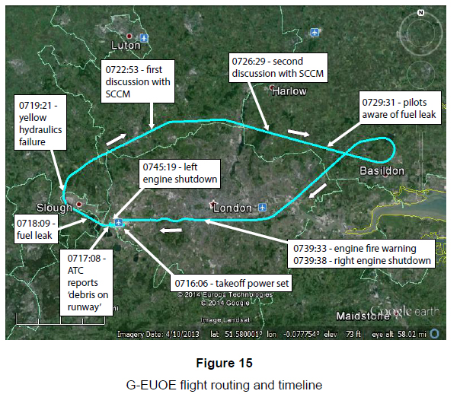

Slide 8
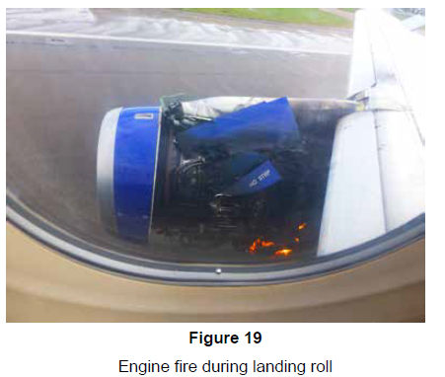
FAA Research and Development Advisory Committee
Washington, DC
September 8, 2016

Slide 10
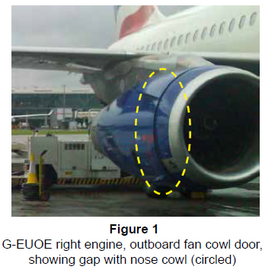
Post Mx and Preflight Checks??

Slide 11
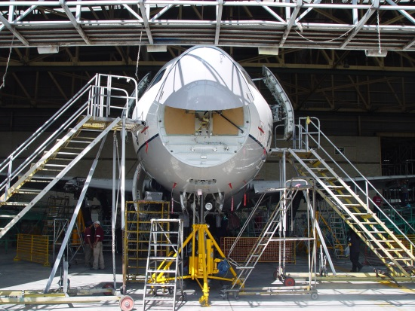
Notes:
Operational solutions
Risk Assessment and Human Factors
Predictive Data
Technical Publications
Fatigued Workers

Slide 13
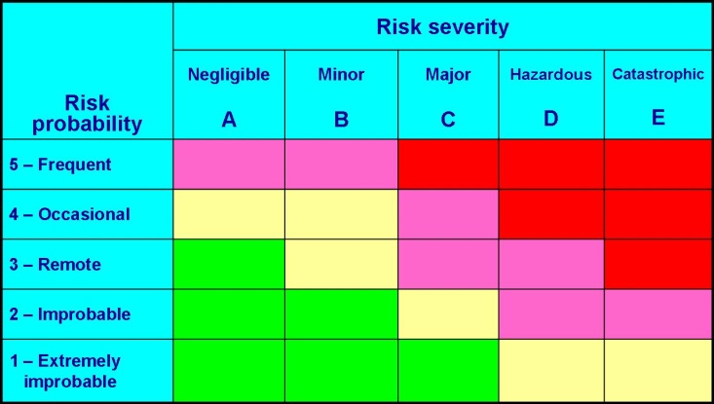
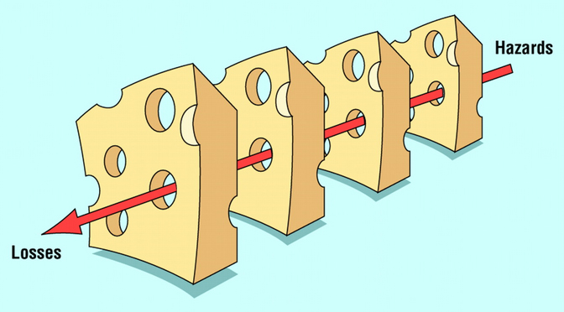
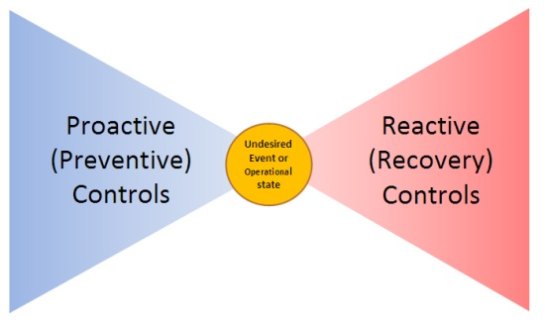
Notes:
There are actually six models that you can mention before talking about PEAR

Slide 15
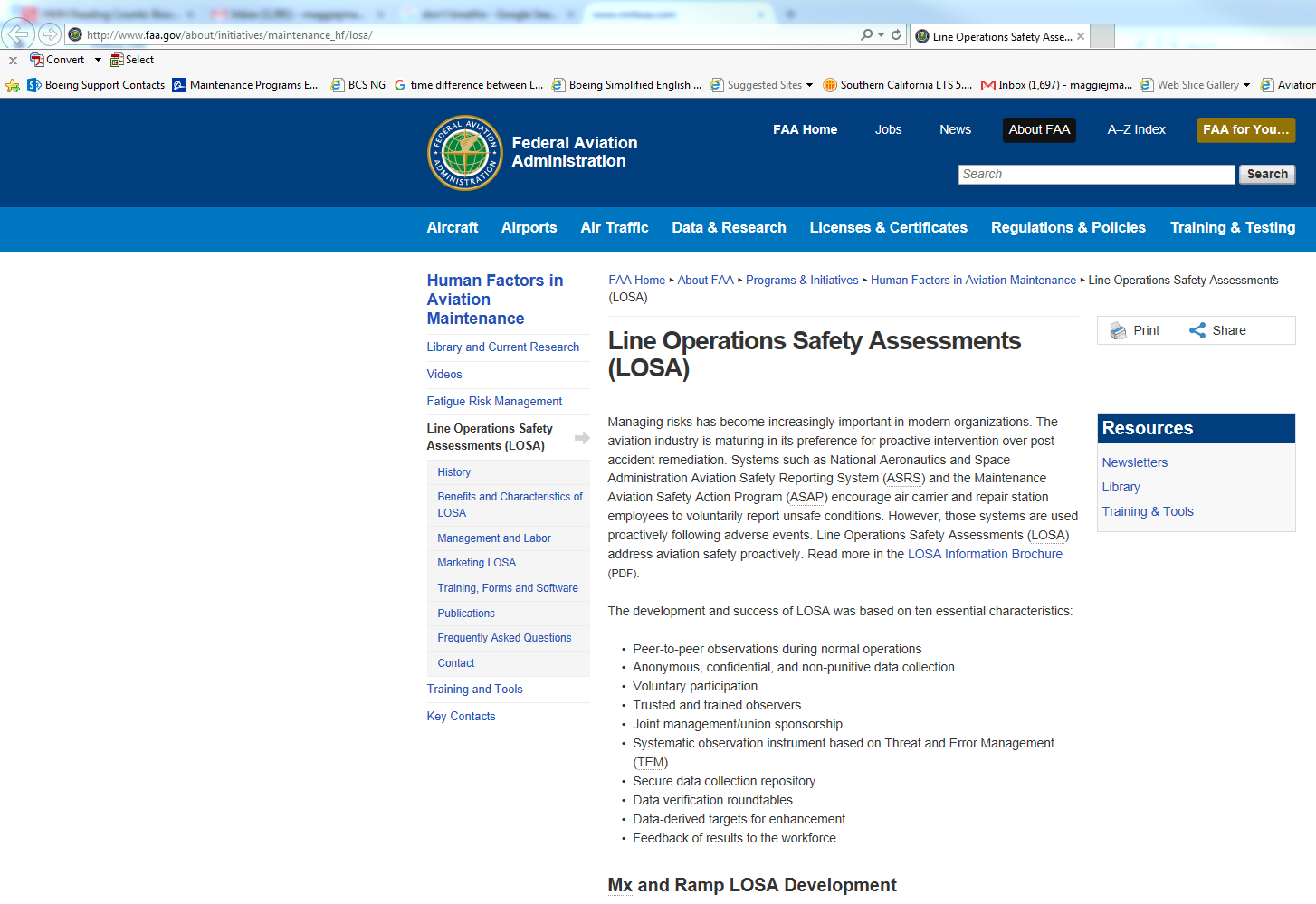
www.humanfactorsinfo.com

Slide 16
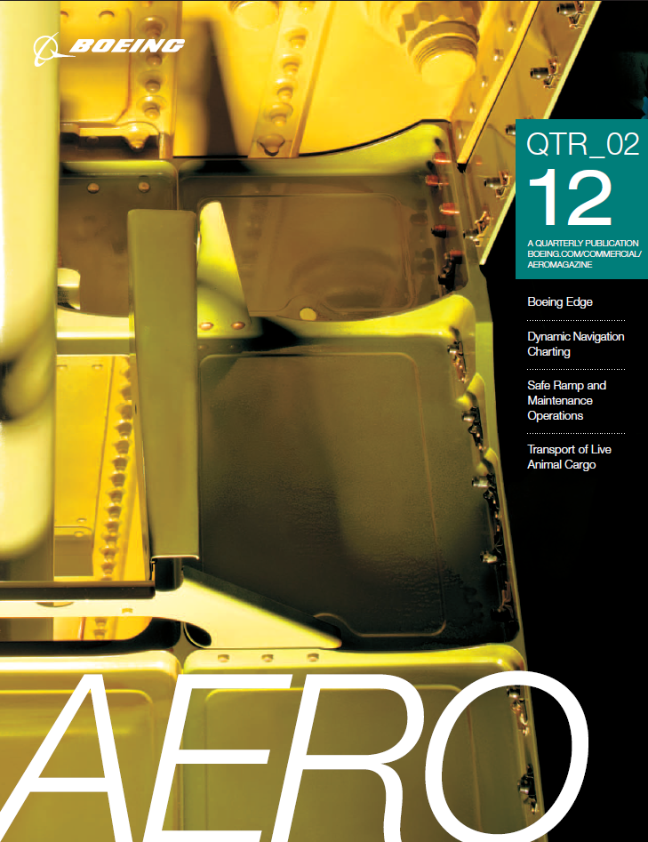
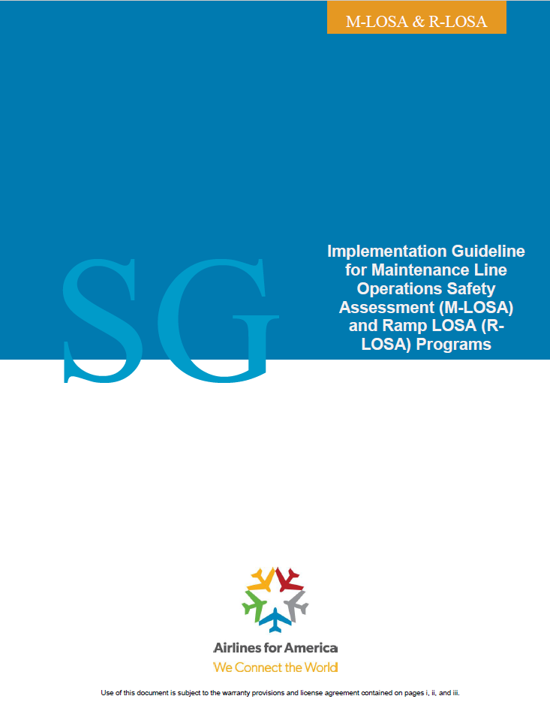
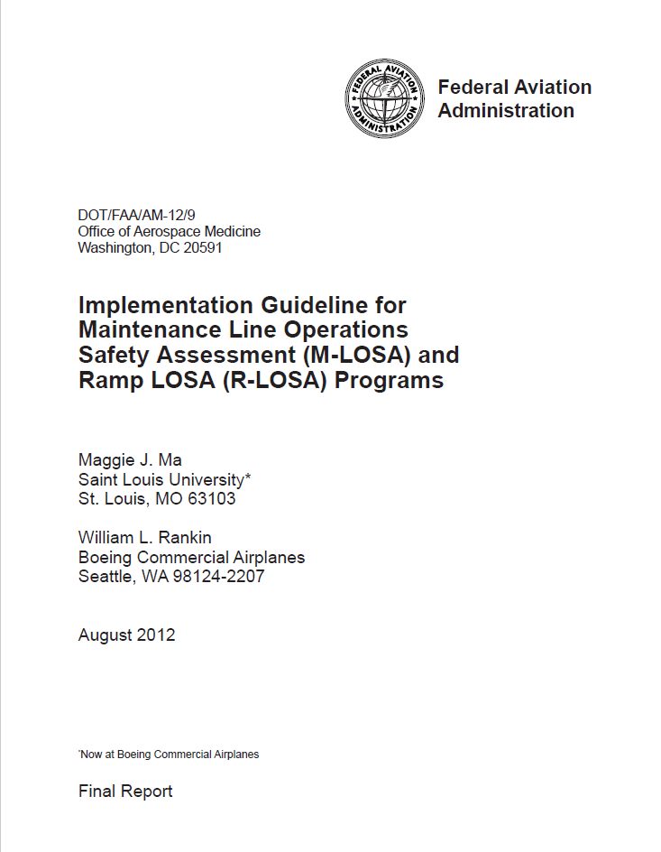
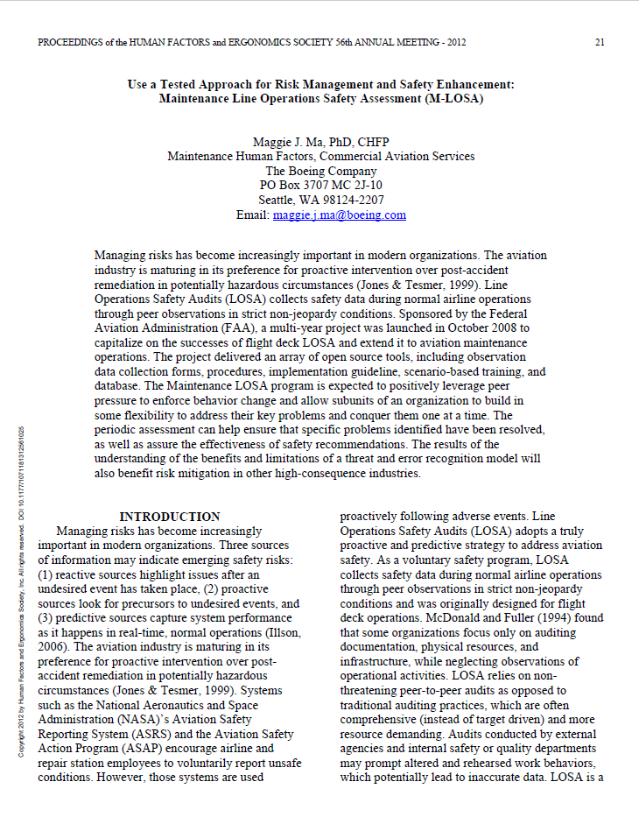
Notes:
Expected:
FAA Mx Human Factors Newsletter (Sept., 2016)
Flight Safety Foundation AeroSafety World magazine (Oct. 2016

Slide 17
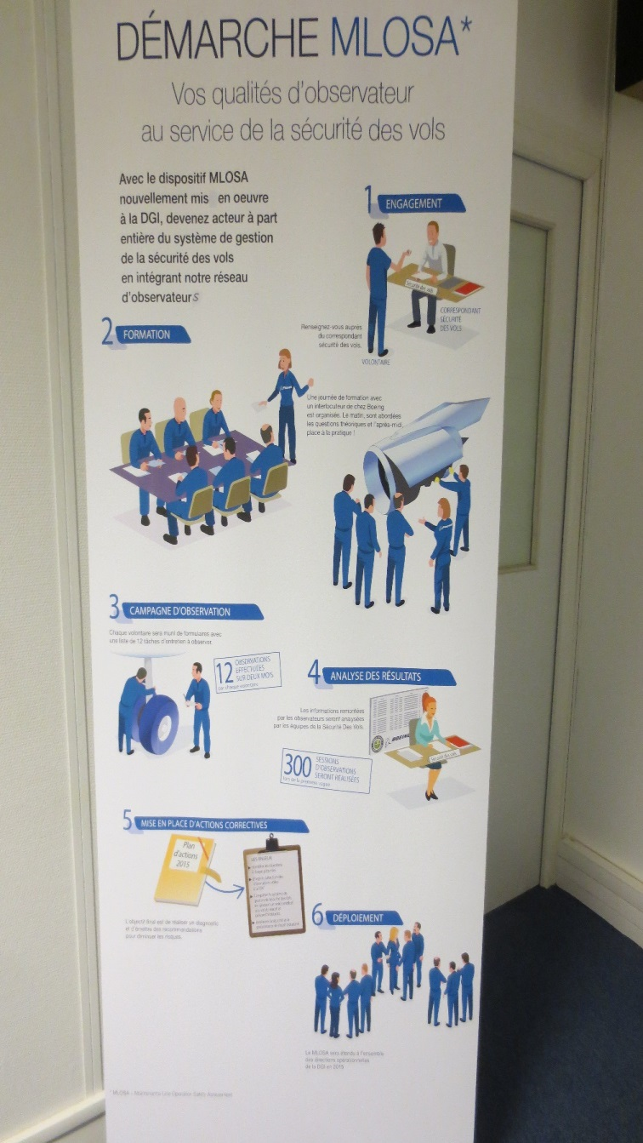
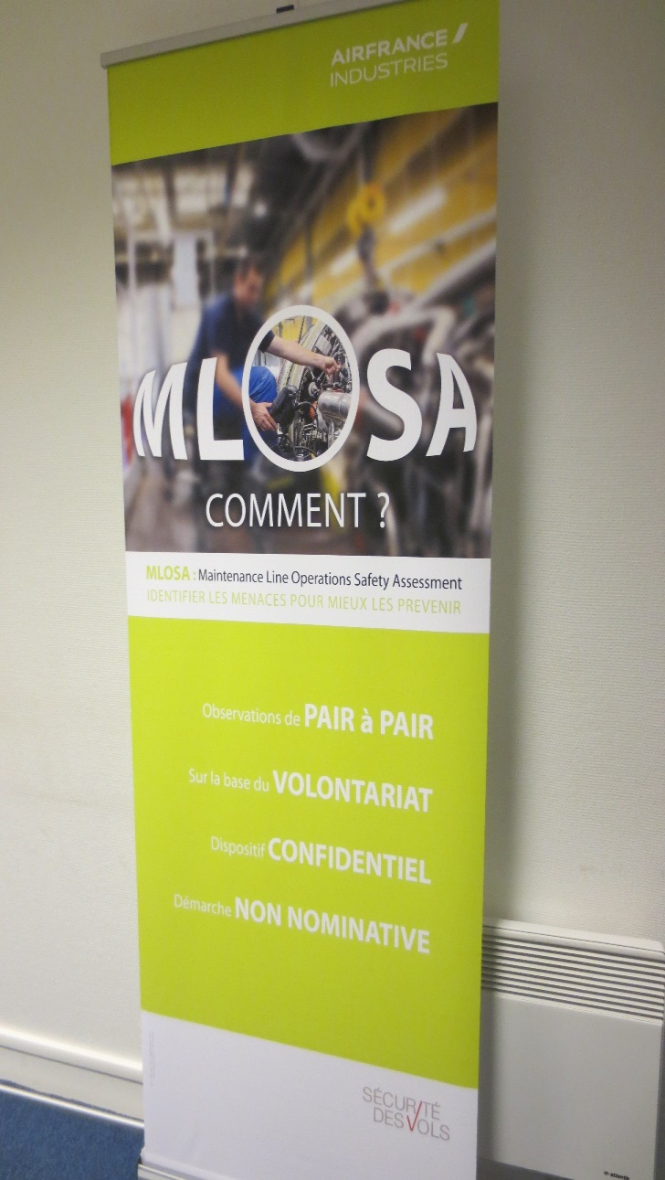

Slide 18
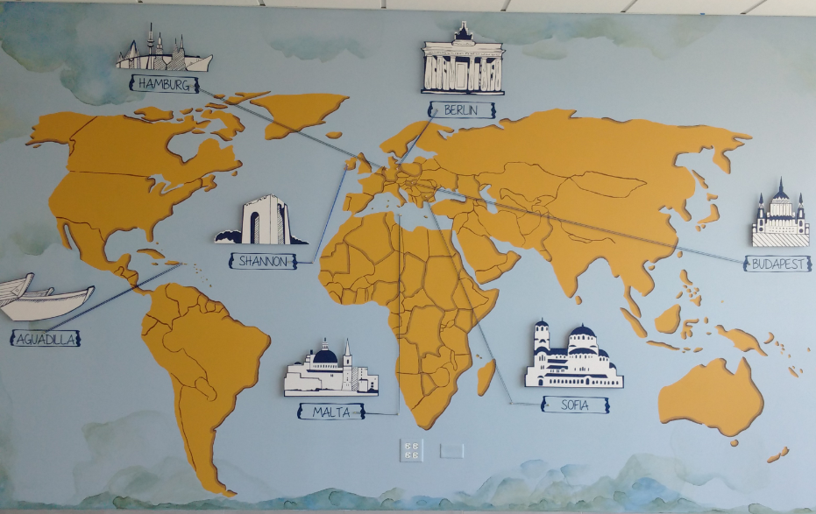
Notes:
Maintenance LOSA
American Airlines
Lufthansa Technik
Air France Industries
Aeroestructuras de Colombia
Japanese Airlines, All Nippon Airways, and Association of Air Transport Engineering & Research
Cathay Pacific Airways
China Eastern Airline Group
Ramp LOSA
Jet Blue
United Airlines
China Airlines

Slide 23
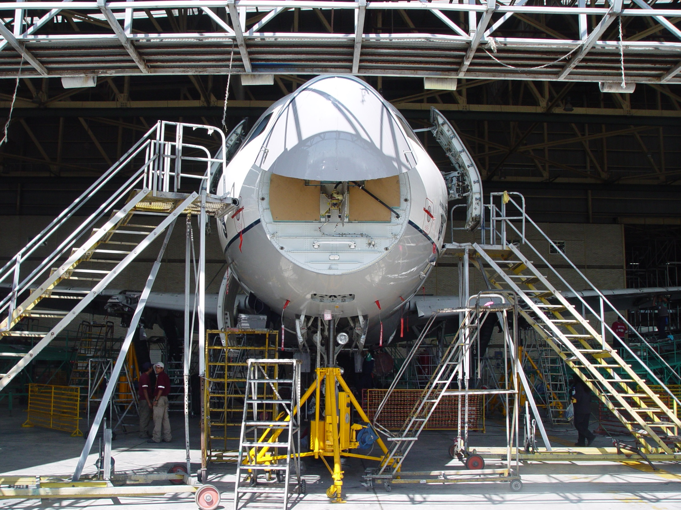
Notes:
Why do Good AMT’s Fail to Follow Procedures?
…Most follow procedures.
…but patterns of Failure to Follow Procedures (FFP) still recur too often
….hundreds of ASRS and NTSB reports and showed recurring patterns.
….We also found patterns of causal factors in:
the state of the aircraft,
the state of the AMT,
the design and updating of the procedure and
the state of the physical and visual environment. All can be improved!
Next we are turning this data into actionable help for maintenance organizations

Slide 24
Notes:
Guidance (3)
AC 120-72 B Human Factors Training Programs for Maintenance
AC 120-TBD FRMS for Maintenance Organizations
8900 Chapter on Training Programs
Technical Reports (3)
Magazine - Newsletters (12)
Conferences Presentations (17)

Slide 25
Regional Airline Association
Charlotte, NC
May 11, 2016

Slide 26
Notes:
26% are over 55
10 % are retirement eligible.
In 2015 on 8% of those retired
20% are below 35
Average Age is 45

Slide 27
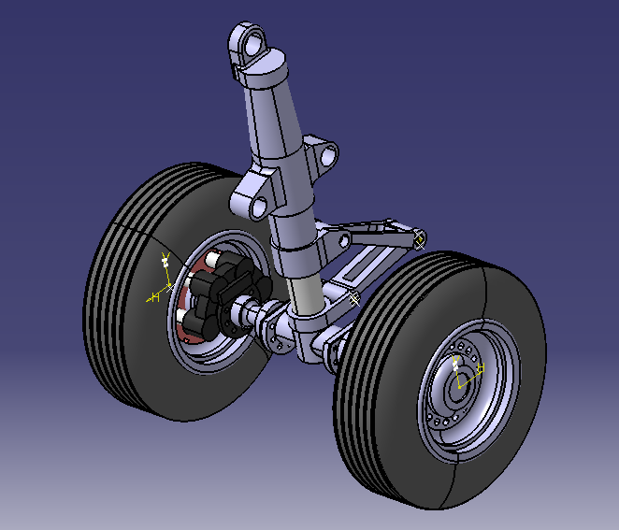
maintainability
Notes:
Mechanical maintainability
Technical manuals

Slide 29
FAA Research and Development Advisory Committee
Washington, DC
September 8, 2016
Federal Aviation
Administration

Slide 30
Thank you,
Bill Johnson

