Slide 1

ARMD Strategic Thrust 5:
Real-time System-wide Safety Assurance Vision and Roadmap
Jessica Nowinski, Ph.D.
September 7, 2016

Slide 2









ARMD Six Strategic Thrusts
Safe, Efficient Growth in Global Operations
Enable full NextGen and develop technologies to substantially
reduce aircraft safety risks
Leads: Barry Sullivan and Tom Davis
Innovation in Commercial Supersonic Aircraft
Achieve a low-boom standard
Ultra-Efficient Commercial Vehicles
Pioneer technologies for big leaps in efficiency and
environmental performance
Transition to Low-Carbon Propulsion
Characterize drop-in alternative fuels and pioneer
low-carbon propulsion technology
Real-Time System-Wide Safety Assurance
Develop an integrated prototype of a real-time safety
monitoring and assurance system
Lead: Jessica Nowinski
Assured Autonomy for Aviation Transformation
Develop high impact aviation autonomy applications
Lead: Mark Ballin

Slide 3
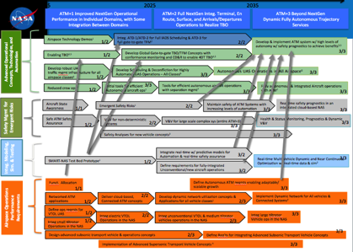


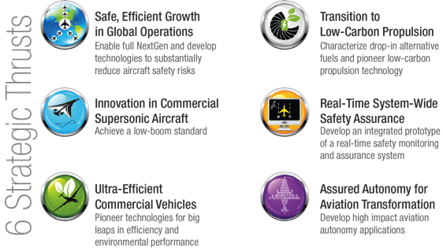
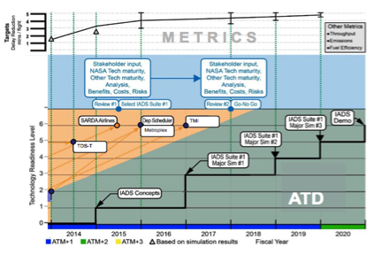

ARMD Strategic Portfolio Model
SIP Outcomes Drive Top-Down Planning
Roadmaps Provide Guidance for NASA Project / Center Innovation and Planning
Strategic Thrust Roadmaps
Partnerships & Performance Create a Feedback Loop
Tech Challenges

Slide 4
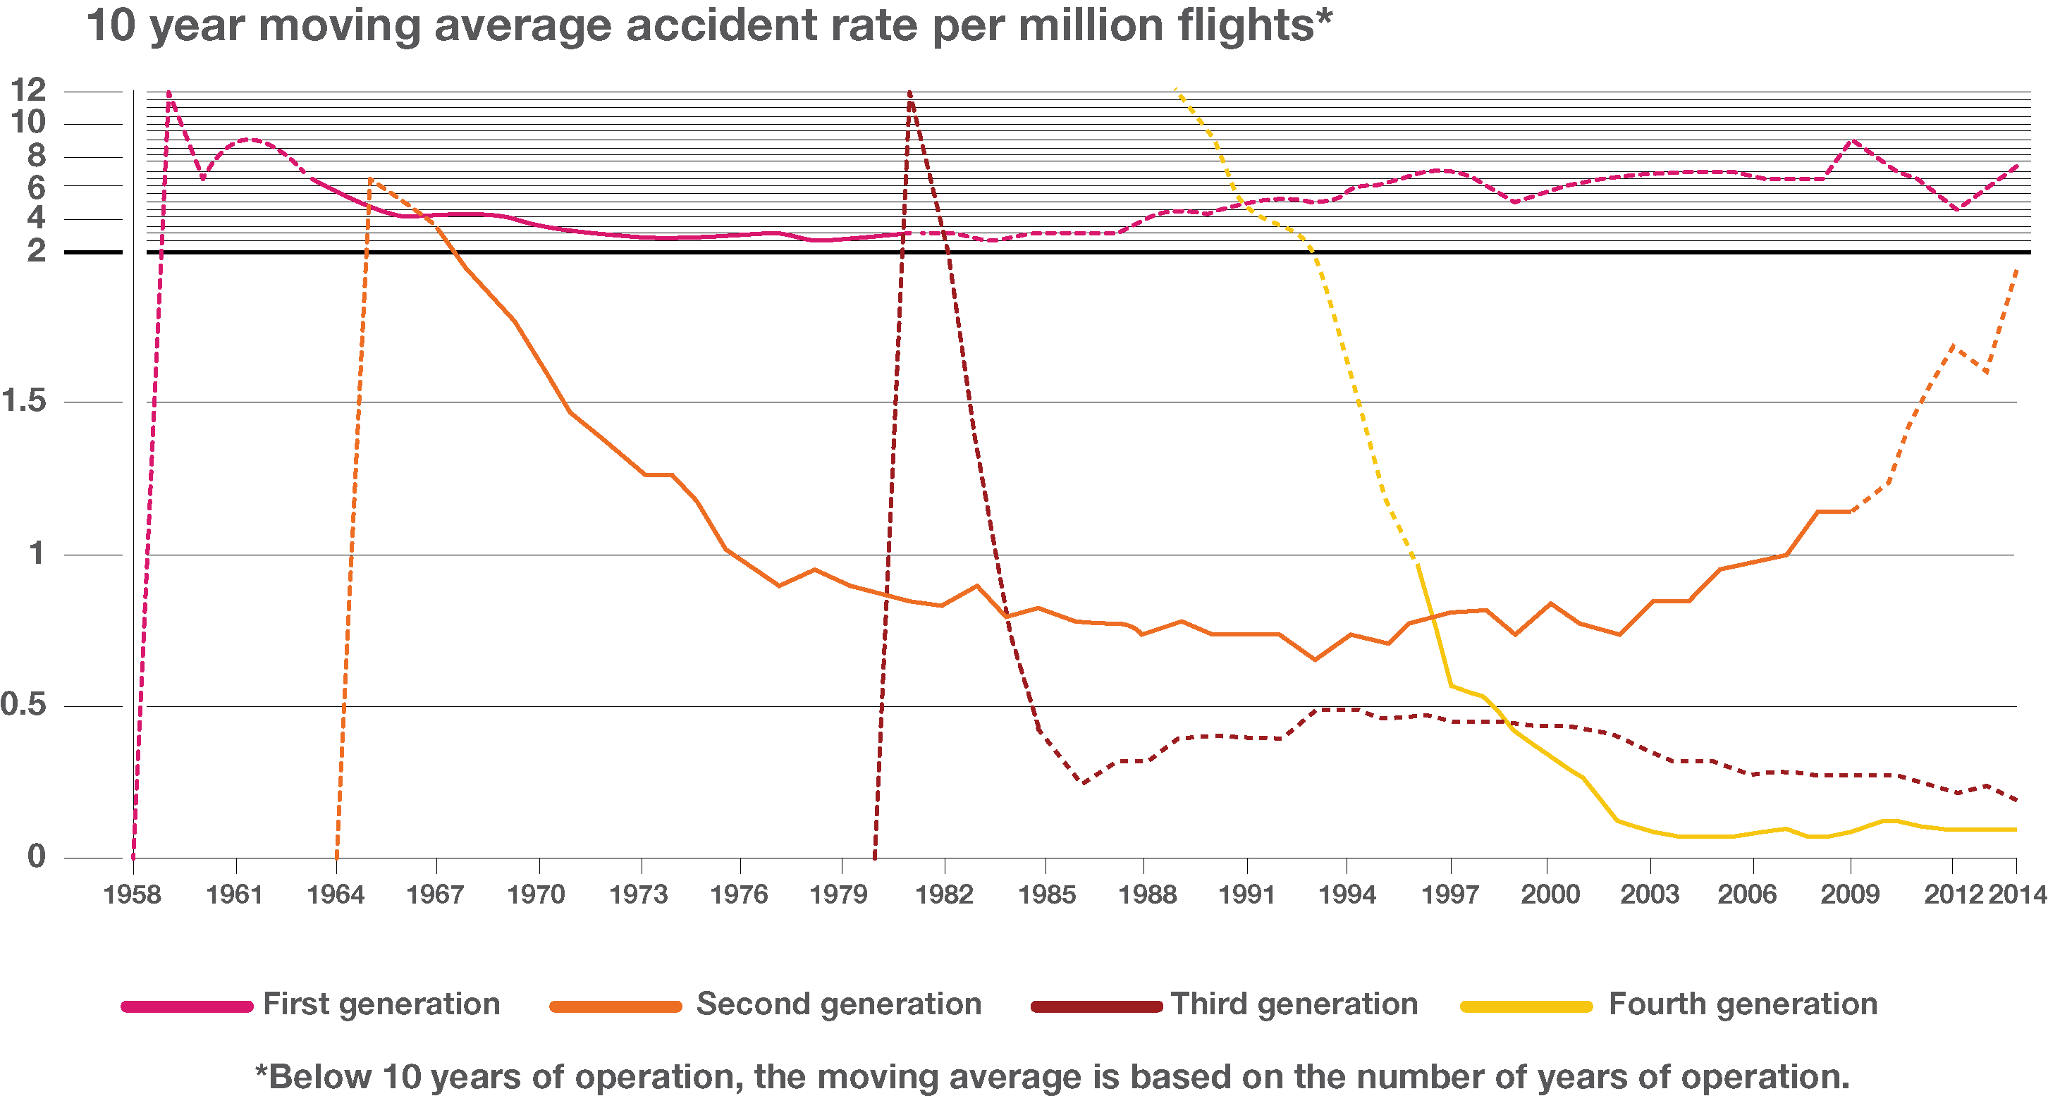
Why Real-time?
Airbus, Commercial Aviation Accidents1958 – 2014: A Statistical Analysis
Notes:
This chart shows the moving average accident rate per million flights for 1st, 2nd, 3rd and 4th generation aircraft. For aircraft with less than 10 years of operation, the moving average is based on years of operation and after those initial 10 years, the number is based on a 10 year moving average. The first generation aircraft line begins at 1958, spikes to 12 and gradually reduces to 2 before it remains between 3 and 8 through 2014. The second generation aircraft line begins in 1964, spike to 7 and gradually reduces to .75 in 1994 and from there increases back to 2 in 2014. The third generation aircraft line starts in 1981 spikes to 12 before it decreases to between .25 and .5 in 1985 to 2014. The fourth generation aircraft line starts at 12 in 1991 and gradually decrease between 0 and .25 between 2003 and 2014. The take-away is that new generation of aircraft have the highest accident rates within the first few years of operation, dropping quickly in the following hers. In addition, the accident rate each generation of aircraft eventually drops below that of the previous generation.

Slide 5






ARMD Roadmap Elements
Design Lifecycle
DESIGN
DEVELOPMENT
TRAINING
OPERATION
MAINTENANCE
MITIGATION
Requirements
Testing
Certification Standards
Best Practices
Proficiency Standards
Standard Procedures
Emergency Procedures
Scheduled Checks
Safety Assurance Methods
MONITORING
ASSESSMENT
RSSA Functions
Notes:
This chart builds on chart 3 by showing how real-time system-wide safety monitoring could support real-time mitigations as well as existing safety assurance methods. New additions include real-time monitoring and assessment. Information streaming from real-time operations is assessed by models built on information from all phases of the design lifecycle. The rapid assessment supports mitigations that can be implemented in real-time to support safety of ongoing operations.

Slide 6
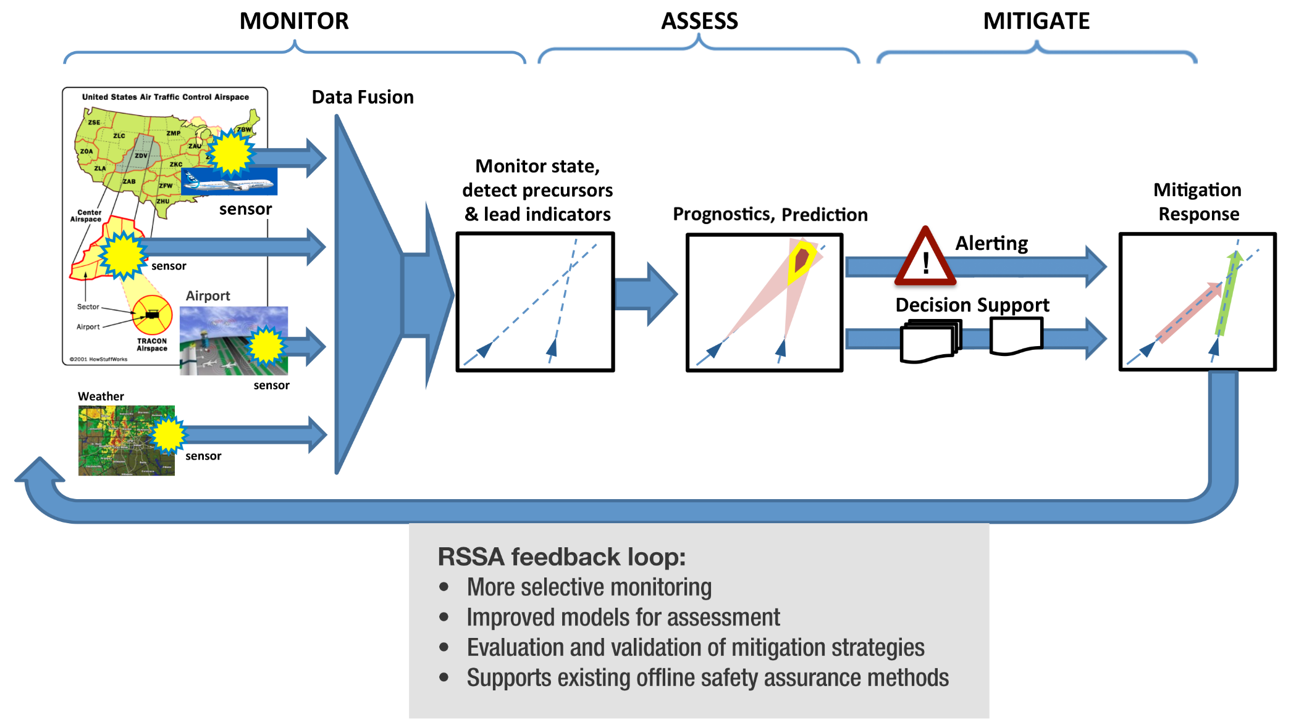
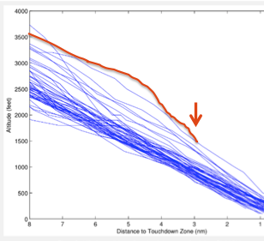


RSSA Simplified Vision
Notes:
This chart shows a simplified version of RSSA. The architecture is grouped into three functions; monitor, assess and mitigate. Monitoring includes the gathering of data from sources and sensors across the NAS to provide information about aircraft, air traffic control sectors, tracon airspace, airports and weather. This data is fused and analyzed to monitor operational state and detect precursors and lead indicators. The assessment capability analyzing the fused data to provide safety prognosis and predictions. This assessment informs decision-making tools that support selection and initiation of mitigations. The system also incorporates a feedback loop consisting of more selective monitoring, improved models for assessment, evaluation and validation of mitigation strategies and support of existing offline safety assurance methods.

Slide 7
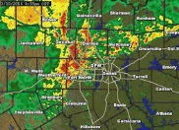
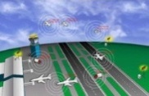

System-wide and Distributed
Awareness and analysis capabilities must be system-wide
  Data sources cover the NAS for full system-awareness and accurate models
  Analysis may occur at the domain level (e.g. models trained for a specific airport or aircraft type) but underlying capabilities are available and distributed system-wide
Decision-making and authority must be distributed
  Input for decision-making may be local or may require broader system-wide knowledge
  Authority must be designated to the operator to initiate real-time mitigations
AOC
Tower
Ground control
Weather
Pilots
Maintainers
Data exchange
local
data model
Type
data model
Notes:
The graphic on this chart shows some example potential data flows, nodes and models with the system to illustrate the distributed nature of roles and responsibilities within RSSA. Data from the Air Operations Center, Tower and Ground would flow both into a local data model and to a data exchange node. The local data model would provide assessment back to the AOC, Tower and Ground control while also receiving data from the data exchange node. Weather information could flow into the data exchange node for distribution to the system which could also receive additional data including assessment from a type data model which would receive and send data and to the pilots and maintainers for that aircraft type.

Slide 8
Strategies for Thrust 5: RSSA
Leverage growing sources of aviation data, commercial data analytics methods, architectures, “internet of things” to enable safety monitoring, prediction, and prognostics capabilities
Conduct of fundamental safety research to understand the general or composite properties of, margins for, safe operations across the NAS and enable eventual broad RSSA capabilities
Expand functionality through evolutionary development, demonstration and adoption of capabilities
Leverage the strengths of both human and machine agents to support intelligent, adaptive mitigation strategies for optimum threat management
Achieve stakeholder trust and consensus through frequent demonstration of benefits to ensure access to the rapidly growing body of safety relevant data from FAA, operators, and system providers

Slide 9
Key Dependencies and Strategic Partnerships
Data policy and regulation, stakeholder trust
  Access to sensitive data requires trust and cooperation of those who own key data sources (airlines, airports, ASIAS)
  NASA can support trust and buy-in through rigorous assurance evidence and demonstration of benefits
  Initiating collaboration with the FAA, and made initial inroads at ASIAS, through System-wide Safety RTT
  Working with individual airlines to access data and demonstrate benefit
Cybersecurity
  NASA is addressing some of the data assurance issues but will need to rely on the community effort and progress made by OGA, academia and industry.
  Need to establish partnerships
Advances in Machine Learning and Computational Power
  Advances in machine learning–cognitive computing to support of automated response planning and execution
  Leverage the synergy of data analytics, intelligent systems technologies, machine learning, high performance computing and simulation from industry, academia and DoD
  At least one large industry partner is moving forward with integration and analysis of heterogeneous aircraft data
  Have yet to identify partners pushing forward on real-time capability, though it is the logical extension of ongoing work
System-wide Implementation
  NASA will roll out assured methodologies and capabilities through individual operators (airlines, airports, ATC facilities)
  Will rely on industry partners for development of architectures to support integration of capabilities
  Look to FAA for to support NAS-wide implementation (i.e., ASIAS, ASRS) to support a comprehensive, system-wide capability
  Must find a way to encourage and enable sharing of proprietary data and tools. ASIAS has achieved success with data sharing but has been less successful in supporting integration of analysis capabilities

Slide 10
Updated Outcome Statements
Domain Specific (Real-time) Safety Monitoring and Altering Tools (2015-2025)
Expanded system awareness through increased access to safety relevant data and initial integration of analysis capabilities; improved safety through initial real-time detection and alerting of hazards at the domain level and decision support for limited, simple operations.
Integrated Predictive Technologies with Domain Level Application (2025-2035)
NAS-wide availability of more fully integrated real-time detection and alerting for enhanced risk assessment and support of initial assured human and machine decision support for mitigation response selection for more complex operations.
Adaptive Real-time Safety Threat Management (2035-2045)
Fully integrated threat detection and assessment that support trusted methods for dynamic, multi-agent planning, evaluation, and execution of real-time risk mitigating response to hazardous events.

Slide 11
Research Themes
Continuous System-wide Safety Awareness (Monitor)
Technical approaches and required architecture to support comprehensive safety monitoring through acquisition, integration and assurance of sensitive data from heterogeneous sources.
Safety Risk Identification and Evaluation (Assess)
Assured tools that improve the accuracy of real-time detection, diagnosis and prediction of hazardous states and the impact of these states on system safety.
Coordinated Prevention, Mitigation and Recovery (Mitigate)
Trusted methods for dynamic, multi-agent planning, evaluation, and execution of real-time risk mitigating response to hazardous events.
Experimentation, Demonstration and Assessment
Experimentation, demonstration, benefits analysis and transition of new RSSA technologies within all elements of the airspace.

Slide 12
Real-time System-wide Safety Assurance
2015 2025 2035
Domain Specific (Real-time) Safety Monitoring and Alerting Methodologies and Tools | Integrated Predictive Technologies with Domain Level Application | Adaptive Real-time Safety Threat Management
TECHNOLOGY INFUSION POINTS
1
2
3
4
5
6
7
8
9
Tools for High Integrity Data Capture and Fusion
Mitigation Selection Capability for Selected Applications
Local Real-Time Domain Monitoring & Alerting Tools
Continuous NAS-Wide Monitoring
Trustworthy Tactical and Strategic Decision Support Tools
Adaptive Human-Automation Teaming
Assurance Tools for Safety Preservation Systems
Real-time intelligent safety monitoring
Automated Tools for Intelligent Threat Management
Requirements for data capture and fusion
Integrated data transfer and fusion
Integrated Framework for interoperability with SMART-NAS
Accommodation of dynamically evolving requirements, datasets, scenarios, and models
Monitoring
System-wide models and metrics to characterize safe operations
Operational integrity assurance on inputs to critical decision-making functions
RSSA communication application
Automated intelligent safety monitors for real-time system-wide aviation data collection approaches
Matured analysis tools and techniques
Assurance tools for complex airspace / aviation system-of-systems.
Tools to manage assurance throughout system-wide evolution
Assurance tools for predictive system components
Automated safety assurance for aviation state assessment systems
Assessment
Framework for Uncertainty Representation
Tools for uncertainty propagation
Tools for Uncertainty Management
Tools for state awareness of all elements of the NAS
Design that enables full state awareness
Monitoring frameworks for known risks
Initial decision support tools
Methods for automated tactical and strategic decision making
Multi-objective safety decision making
Mitigation
Methodologies and tools for integrated PMR plans with information uncertainty and system dynamics
Adaptive human-automation teaming for optimum threat management
Automated execution agents for safety threat management
Integ. Modeling, Sim. & Testing
Safe and effective human/machine teaming in PMR executions
Assurance tools for safety preservation systems
Interface for automated mitigation
Demonstration of data fusion and analysis tool predictive capability effectiveness for precursor detection
Demonstration of integrated predictive capability effectiveness for safety relevant anomaly detection and mitigation across the entire NAS
Demonstration of automated RSSA System in real world operations and hardware systems
Demonstration
Demonstration of notification and guidance to end users for domain specific individual safety event detection and mitigation
Demonstration of effective alert notification and guidance to end users for NAS-wide/system-wide safety event mitigation
Demonstration of feasibility and effectiveness of autonomous/automated event mitigation based on RSSA detection and guidance
Notes:
This chart adds technology transfer points to chart 12. The technology transfers within the first outcome are Tools for High Integrity Data Capture and Fusion, Mitigation Selection Capability for Selected Applications and Local Real-Time Domain Monitoring & Alerting Tools. The technology transfers within the second outcome are Continuous NAS-Wide Monitoring, Trustworthy Tactical and Strategic Decision Support Tools and Adaptive Human-Automation Teaming. The technology transfers within the third outcome are Assurance Tools for Safety Preservation Systems, Real-time intelligent safety monitoring and Automated Tools for Intelligent Threat Management.

Slide 13
Thrust 5 Roadmap Development Team
AFRC
Jack Ryan
ARC
Misty Davies
Kai Goebel
Robert Mah
Rodney Martin
GRC
Gary Hunter
Jonathan Litt
Mary Reveley
LaRC
Manjula Ambur
Eric Cooper
Kara Latorella
Jeff Maddalon
Ann Shih
Steve Velotas
SAIC
Joe Smith
Pete Kostuik
Crown Consulting
Matt Blake
David Rinehart
Amy Pritchett
J.P. Clarke
Nancy Leveson
Jim Luxhoji

Slide 14
Website for Roadmaps and Strategic Plan
http://www.aeronautics.nasa.gov/strategic-plan.htm
E-mail comments to hq-armd-strategy@mail.nasa.gov
Notes:
NASA Presentation Sign-Off Page

Slide 15
Backup
Notes:
NASA Presentation Sign-Off Page

Slide 16
Community RSSA Outcomes by Epoch
Community RSSA Outcomes by Epoch
2015 2025 2035
Outcomes | Domain Specific (Real-time) Safety Monitoring and Altering Tools | Integrated Predictive Technologies with Domain Level Application | Adaptive Real-time Safety Threat Management
Benefits | Expanded system awareness through increased access to safety relevant data and integrated analysis capability; improved safety through initial real-time detection and alerting of hazards at the domain level and decision support for limited operations | NAS-wide availability of real-time detection and alerting with initial assured decision support for mitigation response selection | Integrated detection, alerting and decision support tools; adaptive human-automation teaming for optimum threat management

Slide 17
Community RSSA Outcomes by Epoch
Community RSSA Outcomes by Epoch
2015 2025 2035
Outcomes | Domain Specific (Real-time) Safety Monitoring and Alerting Tools | Integrated Predictive Technologies with Domain Level Application | Adaptive Real-time Safety Threat Management
Benefits | Expanded system awareness through increased access to safety relevant data and integrated analysis capability; improved safety through initial real-time detection and alerting of hazards at the domain level and decision support for limited operations | NAS-wide availability of real-time detection and alerting with initial assured decision support for mitigation response selection | Integrated detection, alerting and decision support tools; adaptive human-automation teaming for optimum threat management
Capabilities | Safe/normal operation baseline Initial continuous real-time monitoring Real-time anomaly and precursor identification Real-time alerting of safety hazards Mitigation response capability for selected applications Assured access and analysis of secure data (moved from mid-term) | Integrated system-level continuous monitoring in system-wide architecture Trustworthy decision support tools Proactive safety assurance under uncertainty | Real-time intelligent safety monitoring In-time integrated threat detection, prediction and mitigation process in a highly dynamic environment Predictive safety-case for highly-automated and evolving aviation systems

Slide 18
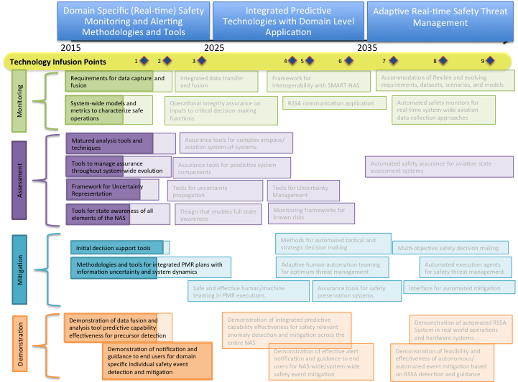
System-Wide Safety TC Roadmap Coverage
Notes:
This chart adds technology transfer points to chart 12. The technology transfers within the first outcome are Tools for High Integrity Data Capture and Fusion, Mitigation Selection Capability for Selected Applications and Local Real-Time Domain Monitoring & Alerting Tools. The technology transfers within the second outcome are Continuous NAS-Wide Monitoring, Trustworthy Tactical and Strategic Decision Support Tools and Adaptive Human-Automation Teaming. The technology transfers within the third outcome are Assurance Tools for Safety Preservation Systems, Real-time intelligent safety monitoring and Automated Tools for Intelligent Threat Management.

