Slide 1
NAS Operations PPT
REDAC NAS Ops Fall 2013 Review
Presented by: John Marksteiner
Date: August 27-28, 2013

Slide 2
PPT Portfolio Overview
NAS Ops PPT for the FY2015 FAA budget process includes the following areas:
  Status of REDAC Recommendations (Fall 2012)
  NextGen – Operations Concept Validation – Validation Modeling
Note: ATDP – Operations Concept Validation and Infrastructure Evolution – Transitioning to ATO (AJV-7) starting in FY13

Slide 3
Status of REDAC Recommendations Fall 2012 Review (4)
REDAC Recommendation:
FAA should enable and support a longer-term activity in developing a understandable plan or roadmap for these activities, specifically supported by facilities and equipment (F&E) budget line, to facilitate shortfall areas and define needed research areas.
FAA Response:
Develop multi-year (5 year) Research Plan
Plan developed to be updated in FY14
Used as Model in rest of ANG-C

Slide 4
Status of REDAC Recommendations Fall 2012 Review (cont)
2. REDAC Recommendation:
More intense cross-cutting human factors research and development efforts are necessary to ensure that the linkages among different ConOps that have been developed are carefully defined and addressed in order to ensure effective integration. All nodes of collaboration, including Airline Operations Centers.
FAA Response:
The following research proposals were included in the Multiyear plan to address this recommendation:
NextGen Trajectory Negotiation (NTN) (approved)
Special Activities Airspace (SAA) (not approved)
Unmanned Aircraft Systems (UAS) Integration into the NAS (approved)

Slide 5
Status of REDAC Recommendations Fall 2012 Review (cont)
3. REDAC Recommendation:
FAA research activities (e.g., ConOps development, validation, etc.) involving NextGen equipage need to explore the following:
Critical mass thresholds for delivery of benefits to equipped users
Potential automation mitigations to enable controllers to handle mixed capabilities
Trade space of performance requirements, benefits, costs, aircraft equipage levels, and ground capabilities with respect to overall system performance gains, system benefits, and net benefits to equipped operators
Performance and equipage levels in different timeframes and operational environments (2018 vs. the 2025 timeframe and later)
Methods to ensure that aircraft with NextGen equipage gain differential benefits over non-equipped aircraft
FAA Response:
The following research proposals were included in the multiyear plan to address this recommendation
Performance Based Navigation (PBN) ConOps (not approved)
Performance Based Navigation Flexible Route System (not approved)
Level 2 Data Comm ConOps (not approved)
Mixed Equipage Research for Operational Concepts Validation (not approved)

Slide 6
Status of REDAC Recommendations Fall 2012 Review (cont)
REDAC Recommendation:
The FAA research supporting validation of a TBO concept of operations should include the following activities: Differentiation of midterm and post midterm ops and benefits; integrate TFM, CDM with Data Comm regarding reroutes; address mixed capability ops; quantify marginal benefits of differing performance requirements and capabilities
FAA Response:
The following research proposals were included in the Multiyear plan to address this recommendation:
Trajectory Operations (TOps) Concept of Operations (approved)
Complex Clearances (approved)
Vertical Ascent and Decent Rate (VADR) (approved)

Slide 7
PPT Financial Summary
 | FY 12 Enacted |  | FY 13 Enacted |  | FY 14 Request
Program Title | In-House | Contracts | In-House | Contracts | In-House | Contracts
Base Program (RE&D)
Base Program (RE&D)
Base Program (F&E)
NextGen Program (F&E)
1A07C/NextGen Ops Concept Validation |  | 8,122,000 |  | 3,873,000 |  | 5,000,000
F&E Subtotal |  | 8,122,000 |  | 3,873,000 |  | 5,000,000
PPT Total |  | 8,122,000 |  | 3,873,000 |  | 5,000,000

Slide 8
PPT 5-Year Financial Plan
Program | Out-Year Contract Dollars (For Planning Purposes Only)
 | FY 2014 | FY 2015 | FY 2016 | FY 2017 | FY 2018
Base Program (RE&D)
NextGen Program (RE&D)
RE&D Subtotal
Base Program (F&E)
NextGen Program (F&E)
1A07C/NextGen Ops Concept Validation | 5,000,000 | 4,500,000 | 4,900,000 | 5,000,000 | 6,000,000
F&E Subtotal | 5,000,000 | 4,500,000 | 4,900,000 | 5,000,000 | 6,000,000
PPT Total | 5,000,000 | 4,500,000 | 4,900,000 | 5,000,000 | 6,000,000
Notes:
Provide a five-year projection of contract spending for FY 2012 through FY 2016. These figures will be provided by the RST Financial Manager, and are to be considered only as a target amount. The projected budget levels should be labeled “For Planning Purposes Only” and will only include contract dollars.
Confirm ATDP numbers
Include SNT and Ops Concept Validation; no numbers for 1a12a

Slide 9
FY14 Plans – Operations Concept
Validation / Modeling (OCVM)
Unmanned Aircraft Systems (UAS) Scenario Development (Oct 2013)
Analyze improved departure predictability on demand predictions (EDPT) (Nov 2013)
Optimized Route Coordinator (ORC) Functional Research Assessment (Dec 2013)
Dynamic Network Analysis (DNA) Model (Dec 2013)
Concept Development for Datalink of Complex PBN Clearances in Support of 4D TBO (PBN) (April 2014) – Project has been refocused without change in scope to develop the Dynamic RNP concept in support of AJV-7 and RTCA SC-214 (TBD)
Statistical Methods for Departure Predictability (SMDP) BBN Model (Jan 2014)
TMI Attribute Standardization for Tracking and Simulation (TAS) (June 2014)
NextGen Trajectory Negotiation (NTN) Concept Development (Dec 2013)
Enhanced Services at Non-towered Airports (ESNA) Concept Validation – project refocused to support SBS Program’s Blended Airspace project (FY14 Activities TBD)
Space Vehicle Operations (SVO) Concept Development/Initial Validation (Oct 2014)

Slide 10
FY15 Planned Activities – OCVM
Specific Ops Concept Validation Modeling project outcomes for FY15 include:
  Optimized Route Coordinator (ORC): Develop procedures and automation ability to generate optimal airspace, routing configuration, and other traffic management initiatives for consideration.
  NextGen Trajectory Negotiation (NTN): Provide the methodology for performing real-time trajectory negotiation for trial planning, coordinating, issuing, and accepting or rejecting trajectory changes (reroutes) in real time
  Dynamic Network Analysis (DNA): Develop a capability to integrate data from a NAS simulation platform with the DNA model, allowing robust, integrated analysis of NAS traffic flows and the underlying trajectory negotiation activities, supporting NTN, TBO, and CATM
  Remote Operations at Non-Towered Airports (RONA): Define and validate a concept to provide remote operations at non-towered airports in support of Blended Airspace Project
  Space Vehicle Operations (SVO): Analyze space vehicle operations to include launch patterns, trajectory characteristics, safety data, locations, expected launch quantities, and impact to airborne and ground aircraft to mature ConOps
  Complex Clearances (Dynamic RNP) using Data Communications: Concept validation
  Unmanned Aircraft Systems (UAS): Functional Analysis / Operational requirements development based on scenarios
  Vertical Conformance Verification (VCV was VADR): Provides ATC with aircraft climb and descent rate for conformance monitoring.
  TMI Attribute Standardization for Tracking and Simulation (TAS): Develop TMI System Model

Slide 11
Emerging FY16 Focal Areas
NextGen Ops Concept Validation – Validation Modeling
Develop updates for end-to-end and lower level ConOps
Validate high priority 2nd and 3rd level operational concepts, possible areas of research include:
  Optimized Route Coordinator (ORC)
  Space Vehicle Operations (SVO)
  Remote Operations at Non-Towered Airports (RONA) Research (Blended Airspace)
  Complex PBN Clearances (PBN) / Dynamic RNP
Derive inputs for future modeling of the NextGen benefits for 2025 timeframe
Modeling and simulation activities to support risk reduction activities
  Implementation of operational capabilities including those associated with ATC decision support tools procedures
Development of concept level requirements will incrementally be handed off to implementation organizations
  Requirements for future Data Comm applications, Collaborative traffic management, and SVO may be generated

Slide 12
FY13 Projects
Conflict Resolution Advisories (CRA)
Integrated Arrival/Departure Control Services (IADCS)
Optimized Route Coordinator (ORC)
Trajectory Operations (TOps) ConUse
NextGen Trajectory Negotiation (NTN)
Dynamic Network Analysis (DNA)
Enhanced Departure Predictability for TFM (EDPT)
Statistical Methods for Departure Predictability (SMDP)
TMI Attribute Standardization for Tracking and Simulation (TAS)
Space Vehicle Operations (SVO)
Datalink of Complex PBN Clearances in Support of 4D TBO (PBN)
Remote Operations at Non-Towered Airports (RONA) Research
Unmanned Aircraft Systems (UAS) Integration into the NAS
Vertical Conformance Verification (VCV)

Slide 13
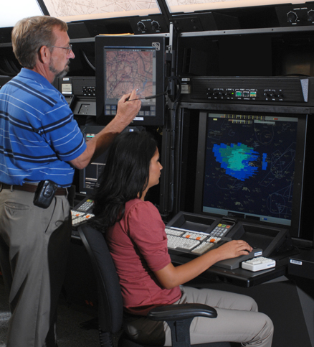
Conflict Resolution Advisories (CRA)
Description:
  Empowered by enabling technologies - NAS automation (ERAM) upgraded to provide conflict resolution advisories with voice and data in a mixed equipage environment
    Later to be transmitted solely via data in certain airspace
  More full intent entry and improved trajectory maintenance benefitting all TBO operations
  Improved ERAM Conflict Probe (reduces missed and false alerts)
Partnerships:
MITRE CAASD
ANG-E25 (Human Factors Branch)
Volpe
NASA Ames
Accomplishments / Plans:
Briefed ATO on deployment options (May 2013)
Analyze data and publish results from FY12 HITL experiments at WJHTC HF Lab (Jun 2013)
Internally packaging project deliverables and archiving for future use. (Sep 2013)
Funding:
FY11 | FY12 | FY13 | FY14 | FY15
$1,800,000 | $0 | $0 | $0 | $0
  Research activities completed as of June 2013; project on hold until funding resumes in 2017
13
Notes:
Chu Yao

Slide 14
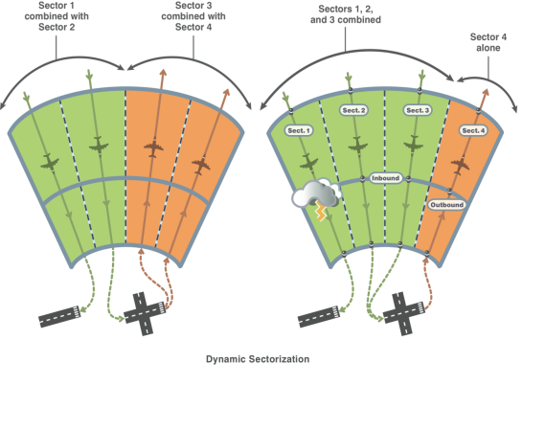
Integrated Arrival / Departure Control Services (IADCS)
Description:
To improve operational efficiencies in major metropolitan areas by:
Using expanded 3-mile separation in ARR/DEP airspace
Using visual separation standards above 18K
Using dynamic airspace reconfiguration of bi-directional ARR/DEP routes
Integrating all ARR/DEP airspace into one control service / one facility
Current Activities focus on what can be done with airspace changes alone
Accomplishments / Plans:
Partnerships:
ANG-E25 NATCA
  Selected Atlanta area facilities (A80 and ZTL) as test model (Nov 2011)
  Cognitive Walkthrough (Feb 2012)
  Validated IADCS alternatives using fast-time simulations (Nov-Dec 2012)
  Human-in-the-loop simulation (Aug-Sep 2013)
Funding:
FY11 | FY12 | FY13 | FY14 | FY15
$0 | $0 | $0 | $0 | $0
Project is supported with funding previous to FY11
14
Notes:
Phil Bassett

Slide 15
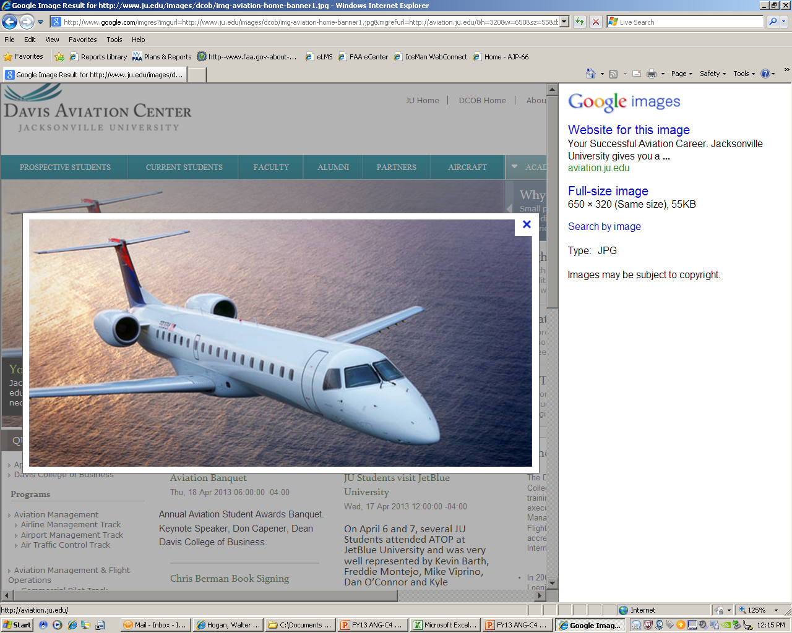
Optimized Route Coordinator (ORC)
Description:
Additional IADCS and PBN route options/playbooks make optimal route selection and coordination more complicated
ORC will research tools and procedures needed to assist ATM with assessment, coordination, and implementation of these new options in order to optimize the benefits
Partnerships:
MITRE
Accomplishments / Plans:
Preliminary ORC Functional Analysis (Oct 2012)
Cognitive walkthrough identified specific traffic management issues, and gathered input from the facilities (Nov 2012)
Optimized Route Capability Functional Research Assessment Report (Dec 2013)
Funding:
FY11 | FY12 | FY13 | FY14 | FY15
$1,550,000 | $510,152 | $1,000,000 | * | *
  * Proposed follow-on funding identified in Research Plan
15
Notes:
Phil Bassett

Slide 16

Trajectory Operations (TOps) ConUse
Description:
Support AVS/RTCA/ANG/ATO in defining an overall TOps Concept and requirements for NextGen avionics automation and collaborative capabilities
Ensure domain specific concepts work end-to-end
Identify concepts and technologies within the FAA that may enable NextGen trajectory operations in the mid-term
Identify shortfalls in concepts and technologies for the mid-term
Partnerships:
ATO
AVS
Accomplishments / Plans:
TOps ConOps information mapping, FAA and RTCA version (Oct 2012)
TOps ConOps document is in the process of being completed (Jun 2013)
Funding:
FY11 | FY12 | FY13 | FY14 | FY15
$0 | $350,000 | $0 | $0 | $0
16
Notes:
Marc Buntin

Slide 17
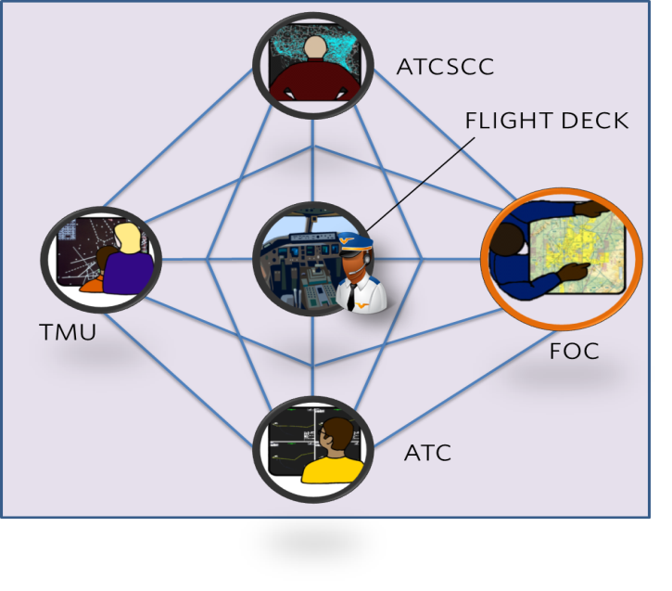
NextGen Trajectory Negotiation (NTN)
Description:
NTN will provide the methodology for performing real-time trajectory negotiation for trial planning, coordinating, issuing, and accepting or rejecting trajectory changes (reroutes) in real –time
Existing trajectory negotiation tools will be modified or developed as appropriate, utilizing defined research activities, to implement the NTN concept
Partnerships:
NASA Ames Research Center
ATO System Operations
Carnegie-Mellon University
Accomplishments / Plans:
Conducted NTN Cognitive Walkthrough (Sep 2012)
Developed NTN Cognitive Walkthrough Final Report (Dec 2012)
NTN Cognitive Walkthrough #2 (Nov 2013)
NTN Concept of Operations (Dec 2013)
Funding:
FY11 | FY12 | FY13 | FY14 | FY15
$0 | $450,000 | $500,000 | * | *
  * Proposed follow-on funding identified in Research Plan
17
Notes:
Kevin Hatton

Slide 18
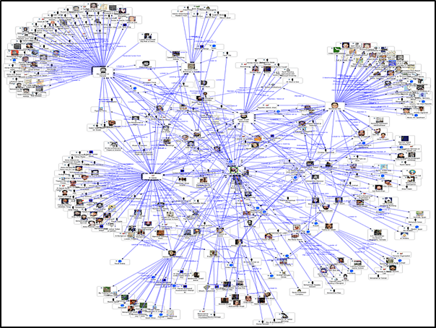
Dynamic Network Analysis (DNA)
Description:
This research will result in refinement of the DNA model of the NAS, with detailed decomposition of NAS element nodes into individual actors and systems. Research will reveal affiliated groups.
A capability will be developed to integrate data from a NAS simulation platform with the DNA model, allowing robust, integrated analysis of NAS traffic flows and the underlying trajectory negotiation activities, supporting NTN, TBO, & CATM
Partnerships:
Carnegie-Mellon University
Accomplishments / Plans:
Dynamic Network Analysis (DNA) Model (Dec 2013)
Enhance Dynamic Network Analysis (DNA) Model (Sep 2014)
Funding:
FY11 | FY12 | FY13 | FY14 | FY15
$449,870 | $750,000 | $0 | * | *
  * Proposed follow-on funding identified in Research Plan
18
Notes:
Kevin Hatton

Slide 19
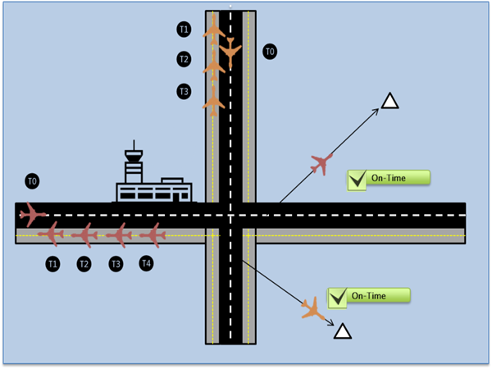
Enhanced Departure Predictability for TFM (EDPT)
Description:
  This research will analyze the amount of improvement in off-time predictions from enhanced NAS user tools, the ability to provide such improved data to TFM, and the resulting improvements in demand predictions
  EDPT proposes to demonstrate the ability and benefits of better off-time predictions through collaboration with airlines and industry to conduct an operational demonstration of such a tool
Partnerships:
Volpe
Accomplishments / Plans:
Development of improved departure prediction benefits analysis (Sep 2013)
Analyze improved departure predictability on demand predictions (Nov 2013)
Provide a framework for data mining from external sources for ingestion by NAS resources to improve systemic forecasts (FY14 Plan)
Funding:
FY11 | FY12 | FY13 | FY14 | FY15
$300,000 | $300,000 | $0 | * | *
  * Proposed follow-on funding identified in Research Plan
19
Notes:
Kevin Hatton

Slide 20
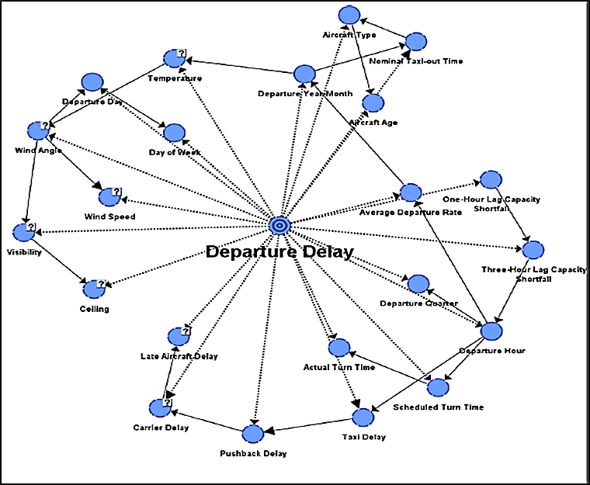
Statistical Methods for Departure Predictability (SMDP)
Description:
SMDP research will develop a probabilistic directed acyclic graphical model for improving departure time predictions by developing a Bayesian Belief Network (BBN) model that will utilize historical data to improve the reliability of departure time predictions for real-time traffic flow management
Partnerships:
TBD
Accomplishments / Plans:
Develop BBN Model Approach (Aug 2013)
Delivery of Model, Report, & Briefing (Jan 2014)
Funding:
FY11 | FY12 | FY13 | FY14 | FY15
$0 | $700,000 | $0 | * | *
  * Proposed follow-on funding identified in Research Plan
20
Notes:
Kevin Hatton

Slide 21
TMI Attribute Standardization for Tracking and Simulation (TAS)
Description:
This research will utilize historical and current TMI data to define a system model in which TMI attributes are categorized in a manner that will facilitate real-time TMI information and feedback to NAS users, unified TMI modeling, post-event analysis, and continuous flight day evaluation
This research will also result in standardized TMI entry, parsing, and tracking, by enhancing functionality currently provided by NTML
Traffic Management Initiative
Domain
Ground Delay Program
Miles-in-Trail
Tunneling
Capping
Minutes-in-Trail
Qualifier
Aircraft Type
Route
Time
Location
Facility
Miles
Speed
Partnerships:
TBD
Accomplishments / Plans:
TMI Analysis Report (Oct 2013)
TMI Workshop (Nov 2013)
TMI Taxonomy Report (May 2014)
Funding:
FY11 | FY12 | FY13 | FY14 | FY15
$0 | $700,000 | $0 | * | *
  * Proposed follow-on funding identified in Research Plan
21
Notes:
Kevin Hatton

Slide 22
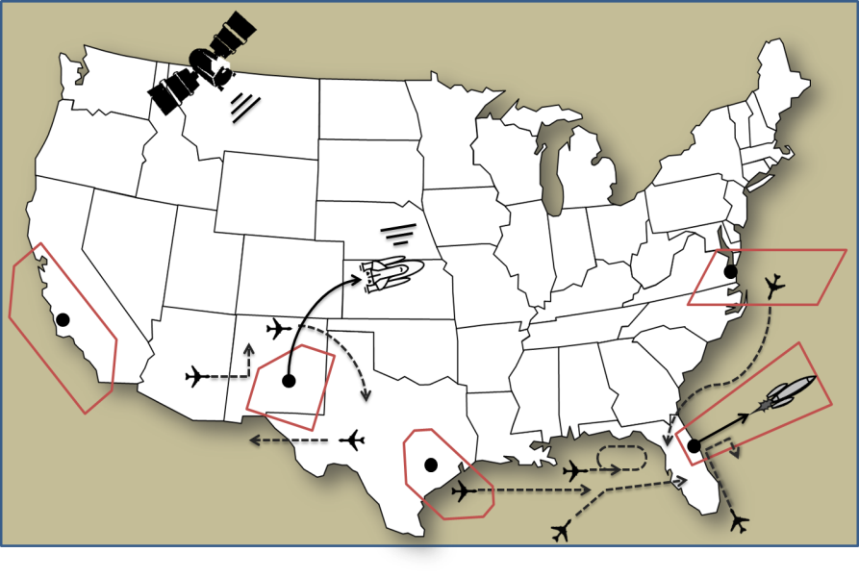
Space Vehicle Operations (SVO)
Description:
This research will analyze space vehicle operations to include launch patterns, trajectory characteristics, safety data, locations, expected launch quantities, and impact to airborne and ground aircraft
This research will result in a SVO Concept of Operations, covering pre-launch, launch, recovery, and a NAS/Safety impact assessment
Partnerships:
FAA Commercial Space Transportation (AST)
Stanford University
Accomplishments / Plans:
  Conducted Focus Group (Dec 2012)
  Developed Shortfall Analysis (Apr 2013)
  SVO Focus Group # 2 (Sep 2013)
  SVO Concept of Operations in the NAS (Jun 2014)
  Integrated NAS/SVO Simulation Model (Oct 2014)
Funding:
FY11 | FY12 | FY13 | FY14 | FY15
$300,000 | $580,000 | $500,000 | * | *
  * Proposed follow-on funding identified in Research Plan
22
Notes:
Kevin Hatton

Slide 23
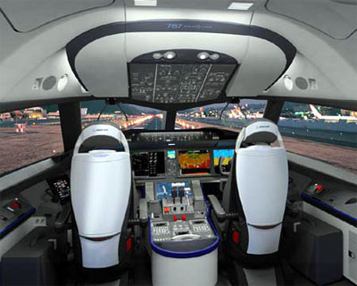
Datalink of Complex PBN Clearances in Support of 4D TBO
Description:
Research Objectives
Identify candidate Complex PBN Clearances (CPCs) that are operationally and technically viable and that yield the highest benefits
CPC applications will be mapped in support of arrival / departure and high altitude en route operations.
Focus: Further-term requirements (ATN avionics)
Accomplishments / Plans:
Partnerships:
AIR
Boeing
Commercial Airline (TBD)
Provide annotated outline of ConOps (Oct 2013)
Develop Concept of Operations (Feb 2014)
ROM Benefits Case (Feb 2014)
Provide whitepaper summarizing findings / recommendations (Apr 2014)
Funding:
FY11 | FY12 | FY13 | FY14 | FY15
$0 | $800,000 | $0 | * | *
  * Proposed follow-on funding identified in Research Plan
23
Notes:
Marc Buntin

Slide 24


Remote Operations at Non-Towered Airports (RONA) Research
Description:
Develop operational concept to remotely operate currently non-towered airports
Support the SBS Office in the development of the Blended Airspace concept
Remote Facility
Fully Remote Ops
Additional Services
Advanced Automation
Accomplishments / Plans:
Partnerships:
SBS MITRE
MIT/LL CSSI
BAH/MCR
WJHTC Human Factors Lab
Draft Shortfall Analysis (Mar 2013)
Draft Concept of Operations (Jun 2013)
Draft Research Questions (Jun 2013)
Preliminary benefits cost analysis (May 2013)
Collaborate with SBS Office to conduct CHI alternatives analysis (on-going)
Funding:
FY11 | FY12 | FY13 | FY14 | FY15
$1,050,000 | $575,544 | $850,000 | * | *
  * Proposed follow-on funding identified in Research Plan
24
Notes:
Kristina Carr

Slide 25
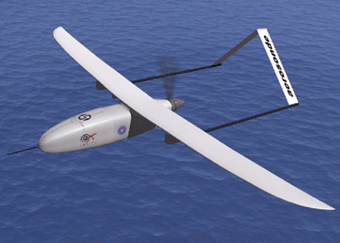
UAS Integration into the NAS
Description:
  Mature concept of operations for UAS integration into the NAS
    Identify gaps in ConOps 2.0 in need of maturation and elements ready for validation
    Generate operational scenarios for mature state and mid-term UAS operations
    Document concept-level operational requirements, for both NAS and UAS operators, for mature state and mid-term UAS operations in the NAS
Partnerships:
Flight Standards Service: AFS-80 & AFS-400
Air Traffic Organization: AJV-7
Aircraft Certification Service: AIR-130
Accomplishments / Plans:
Deliver initial set of operational requirements for mature state UAS operations based on ConOps 2.0 (Nov 2013) (FY12 PLA milestone)
Deliver updated set of operational requirements for mature state UAS operations based on concept maturation activities (Mar 2014)
Map past and current research to concept requirements to leverage existing data and identify gaps in research (Mar 2014)
Deliver initial set of operational requirements for mid-term UAS operations based on operational scenario development (Apr 2014)
Funding:
FY11 | FY12 | FY13 | FY14 | FY15
$0 | $445,627 | $500,000 | * | $0
  * Proposed follow-on funding identified in Research Plan
Notes:
Sherri Magyarits

Slide 26

Vertical Conformance Verification (VCV)
Description:
The objective of the VCV concept is to develop a means for obtaining and monitoring real-time vertical rate (climb and descent) for flights spanning from top of descent to touchdown and from departure to top of climb.
Benefits: Addition of vertical rate information will improve controllers’ ability to monitor aircraft conformance, thereby providing opportunities to increase efficiency and capacity in transition airspace.
Partnerships:
Boeing
Accomplishments / Plans:
VCV Operational Improvement Assessment (Sep 2014)
Funding:
FY11 | FY12 | FY13 | FY14 | FY15
$0 | $700,000 | * | * | *
  * Proposed follow-on funding identified in Research Plan
26
Notes:
Phil Bassett

Slide 27


