Slide 1
REDAC NASOps
Fall 2013 Review
NextGen - Wake Turbulence (Research)(A12.b) and Wake Re-Cat (1A07E)
By: Jeff Tittsworth and Paul Strande
Date: August 28, 2013

Slide 2
Backup
2

Slide 3
Wake Turbulence Re-Categorization
F&E Project 1A07E0
CIP Project G06M.02-02
3

Slide 4
Safety Example Wake Turbulence Separations
Upper Heavy to Lower Heavy
Leading aircraft
Trailing aircraft
4 NM
Separation
This Is Safe (Current ICAO)
B747
A306
Lower Heavy to Upper Heavy
2.5 NM
Separation
A306
B747
This Is Also Safe (RECAT)
4

Slide 5
Wake Turbulence Re-Categorization
Three Phases
  Phase I static 6 category procedures operational in MEM in Nov 2012
  Phase II static pairwise separation (recommendation to ICAO – Dec 2014)
  Phase III pairwise dynamic separation (2020)
  All three use F&E funding for implementation, but require wake data collection and analysis for safety case
Phase I implemented with adaptation data and rule changes in MEM (STARS and EFSTS adaptation)
  Wake Re-Cat incorporated into ATPA software for CARTS and STARS – OT&E completed, SDF to use Sep 2013, MIA Dec 2013, ……..
Phase II will harmonize on pairwise separations and allow any ANSP (or TRACON) to categorize based on local fleet mix demand
  A goal is to draw a finer line in the required separation minima between a pair of aircraft
  RE&D goal for collection and analysis of wing loading will enable drawing a finer line
  FY14/15: Development of the Phase II standards in concert with Europe
  FY16: Begin work with Europe on the more complex Phase III dynamic aircraft-to-aircraft pairing standards
5
Notes:
5
Changing over to the Re-Cat separation standards for an airport requires training for both tower, TRACON, and the publication of a Safety Alert For Operators (SAFO).

Slide 6
Re-Cat Phase I Separation Matrix Changes Relative to US
Separation was increased for some or all aircraft pairs
Separation was decreased for some or all aircraft pairs
Separation remained the same for some or all aircraft pairs
MRS
Minimum Radar Separation (3NM, or 2.5 NM when existing requirements are met)
6

Slide 7
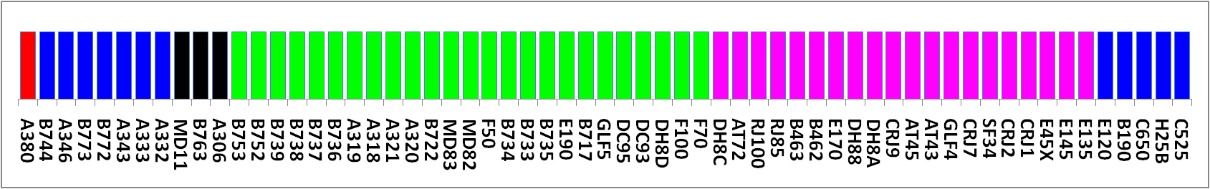
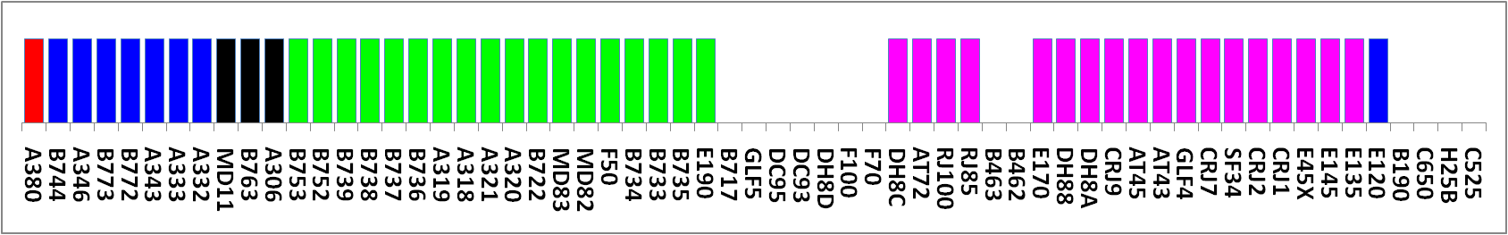
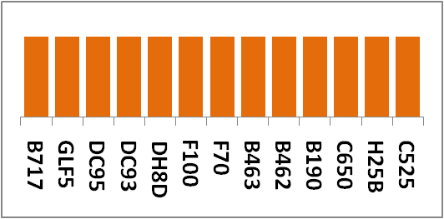
RECAT Phase II – Concept 3
RECAT Phase I
A
B
C
D
E
F
RECAT Phase II Concept 3 – Notional Airport
A
B
C
D
E
F
Category G
For Phase II, this concept optimize a 6-category system based on the 26-40 aircraft types that typically operate at an airport more than once per week. The remainder aircraft are put a 7th category, Category G

Slide 8
RECAT Phase II Implementation Concept 3
Category A-F is optimized for ANSP fleet mix (<61 aircraft), the remainder aircraft make up 7th category, G
~100x100 separation matrix
RECAT Phase I separation matrix
Separations for Category G is a conservative 8.0 nm. Aircraft in this category are uncommon to the airport, so 8.0 nm should not affect capacity.
RECAT Phase II 7-category separation matrix

Slide 9
Human Factors
OMB has voiced concerns about how much the FAA is spending on HF
  Some RE&D pays for HF in early development, but most comes from F&E during implementation
Wake HF investment for
  Wake Turbulence Recategorization (RECAT)
  Wake Turbulence Mitigation for Departures (WTMD)
  Automated Terminal Proximity Alert (ATPA)

Slide 10
RECAT HF Evaluation Plan
Pre- and post-evaluation of RECAT at key site Air Traffic Control Towers (ATCTs) and Terminal Radar Approach Control Facilities (TRACONs)
  Pre: Before use of RECAT at site
    Observe Ground Control (GC) and Local Control (LC) positions in ATCT during heavy departure pushes
    Observe Feeder and Final positions in TRACON during heavy arrival rushes
  Post: 2 months & 6 months after use of RECAT at site
    Record when RECAT separation standards were used or not used
    Record when RECAT separation standards were issued by controller but not used by pilot
    Collect controller feedback on RECAT through the use of questionnaires

Slide 11
RECAT Key Sites
RECAT Key Sites & HF Evaluation Dates
Facility | Pre-Evaluation | 2-month Post-Evaluation | 6-Month Post-Evaluation
Memphis | Oct 16-18, 2012 | Feb 5-7, 2013 | June 3-6, 2013
Louisville | Aug 12-15, 2013 | Tent. Nov 2013 | Tent. Mar 2014
Miami | Tent. Nov 2013 | Tent. Jan 2014 | Tent. May 2014
San Francisco | TBD | TBD | TBD

Slide 12
Wake Turbulence Re-Cat Project
Funding $M (Present and Out Year)
Notes:
These are FAA budget planning numbers based on OMB guidance. The House Appropriations Subcommittee FY14 Report greatly reduces NextGen funding – If the House budget is enacted, likely Wake Re-Cat funding will not be extended into FY14 and beyond.

Slide 13
National Rule Change 7110.308
CSPRs at EWR and SFO were approved this year to conduct 7110.308 procedures by Change 3
  Business plan goal to obtain approval for an additional two airports per year.
RE&D was critical in funding data collection and analysis
All airports currently approved:
  STL, BOS, CLE, PHL, SEA, EWR, MEM, SFO
FY14 Airports
  PHX and LAS (Change 4)
  Use of RNAV for Boston 4L (Change 5)
FY15: Revise 710.308 to accommodate Wake Re-Cat separations (Change 6)
FY16: Requirement completed in FY15
13

Slide 14
Example Concept for Cockpit DST Supporting WTMSR Operations
Envision ground based solution with controller DSTs first
Requirements and design for cockpit based solution will be driven by other NextGen concepts (e.g., TBO with flight deck interval management)
Example Cockpit tool concept with lateral and vertical guidance depicted
14

Slide 15
Develop Models, Data Bases, Data Sources
Incorporate NASA developed “fast time” wake characterization algorithms into the processing of LIDAR data:
  Wake track and other characterizations are determined by processing LIDAR spectral data using specialized processing algorithms
  Current algorithms under perform in certain parts of the recorded spectral data for a “wake track”
  NASA delivered improved algorithm in FY13 which is being evaluated by Volpe – more improvements by NASA is forecast for FY14/15/16
Incorporate Canadian NRC en-route aircraft wake measurements into wake en-route models
  Data collected by NRC pilot flying instrumented T33 behind commercial aircraft and flying the T33 into the commercial aircraft’s wakes
  Part of the data collection is funded via intergovernmental agreement
  Data collected in FY13 is being reviewed by FAA & NASA (once data sharing agreement is expanded
  Planning for additional NRC data collection in FY14/15
  Development and application of en-route wake models (FY14/15/16)
15

Slide 16
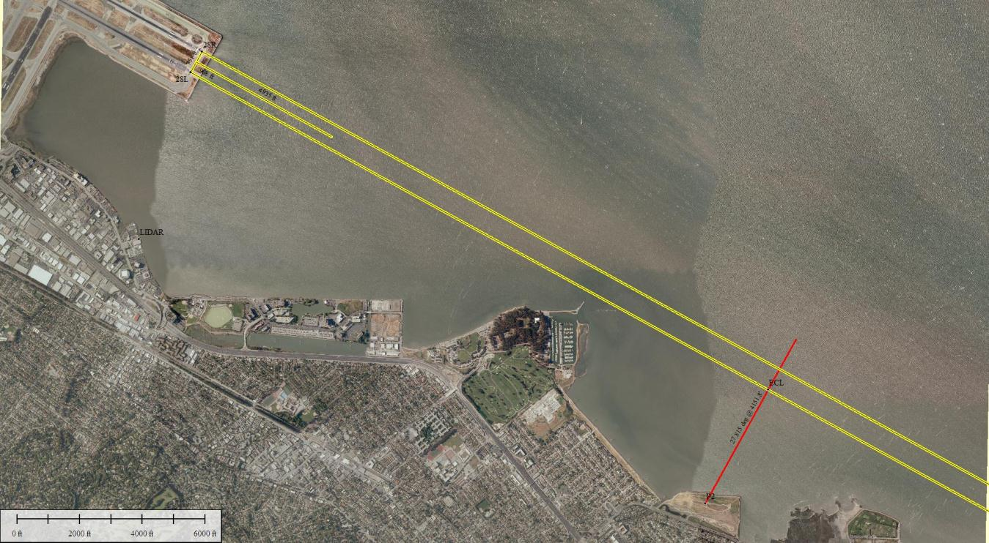
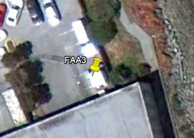
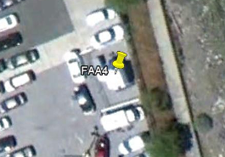

SFO – Current Measurement Setup
Sonic 2
209 Feet HAT
Sonic 3
FAA3
FAA4
Enterprise Car Rental
1158 Feet HAT
FAA2
Seal Point Park

Slide 17
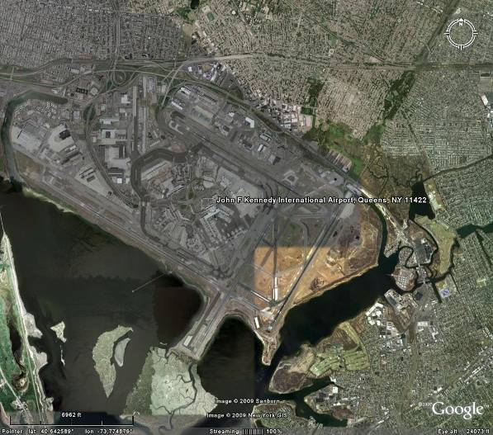

JFK – Measurement Setup (Designed)
200 Feet HAT
Sonic
FAA1

Slide 18
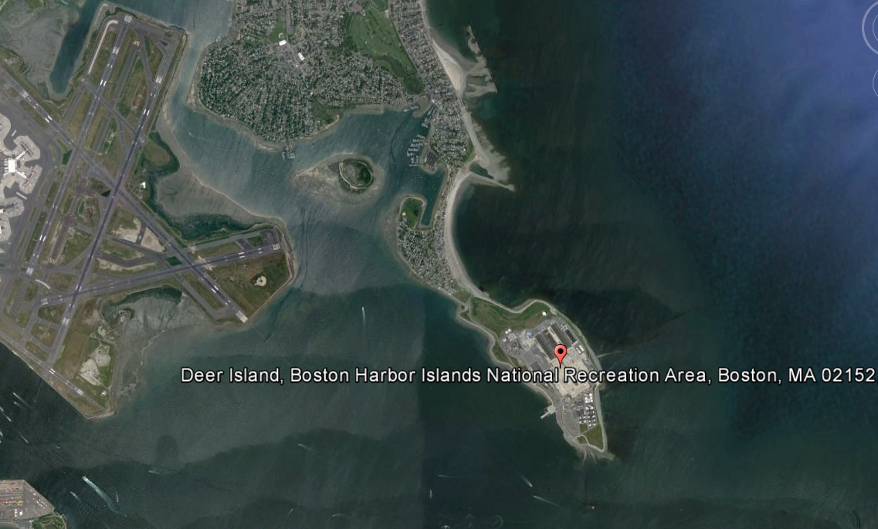
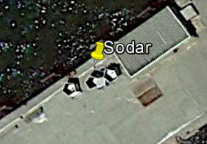
BOS – Current Measurement Setup

Slide 19
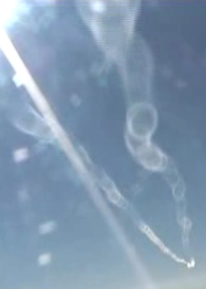
Notes:
View from the cockpit of the NRC T-33 as it approaches the wake trails of commercial aircraft.

Slide 20
Data Screening Utility for Wake Vortex Encounters
Flight Data
Screening Utility
Complex, but automated process.
Capable of ingesting large quantities and many forms of digital flight data.
Capable of processing data from take-off to landing.
Addresses a mixture of aircraft types and equipage.
Produces an output identifying flight datasets which have potential wake vortex encounter(s) within them.

Slide 21
Status on Data Processing for B737-800 Flight Data
Screening Utility has processed 53,721 B737-800 flight data sets
  Full Flights: Take-off to Landing
  Total of 86,755 hours of operational B737-800 carrier flight time
  680 potential wake encounters identified using a detection parameter tuned for the 737-800 flight characteristics
Stability of the software has been proven using operational carrier data.
It has been shown for the B737-800, significant wake vortex encounters will be correctly identified in an efficient and automated manner while maintaining a minimal number of false indications.
Notes:
The extraction tool uses as a detection parameter a resultant vector, similar to the one developed for detecting clear air turbulence, constructed from the many forces an aircraft experiences during flight. It is constructed for each aircraft type based on known wake encounters by that type of aircraft captured on a flight data recorder (very few of these) or by recording selected parameters from a full motion simulator of that aircraft type (the basis for the 737-800 tuning of the extraction tool).
The value for the detection parameter is difficult to relate to a specific seat of the pants sensation in the aircraft or to a specific severity in the safety risk matrix. That linkage is the research AFS is continuing as part of their other research use of pilot teams in the OKC full motion flight simulators. Parameter setting used for the above 737-800 flight data recorder screening was that the aircraft was impacted sufficiently by the wake encounter to be noticeable to the passengers (i.e. drinks on tray table would spill)

Slide 22
Wake Turbulence Mitigation for Departures (WTMD)
F&E Project 1A12A0
CIP Project G06A.01-01
22

Slide 23
Wake Turbulence Mitigation for Departures (WTMD)
Allows controllers to skip the 2-3 minute wait behind B757 and Heavy aircraft on departure
  Monitors for sufficient crosswind to prevent wakes from drifting onto the adjacent runway.
  At least 10 airports have consistent crosswinds, CSPR, and the traffic demand to benefit from WTMD in the US
  Enables 2-8 more departures per hour at eligible constrained airports
  Operational Demonstrations (IAH, SFO and MEM) to begin June 2013
Started with RE&D funding
  Enable data collection, analysis and safety case development
Operational demonstration, implementation funded under F&E
  Table top prototype developed by NASA
  Entered into the AMS process
SFO ATC Operational Use May 2013, IAH July 2013, MEM expected Sep 2013
23
Notes:
23

Slide 24
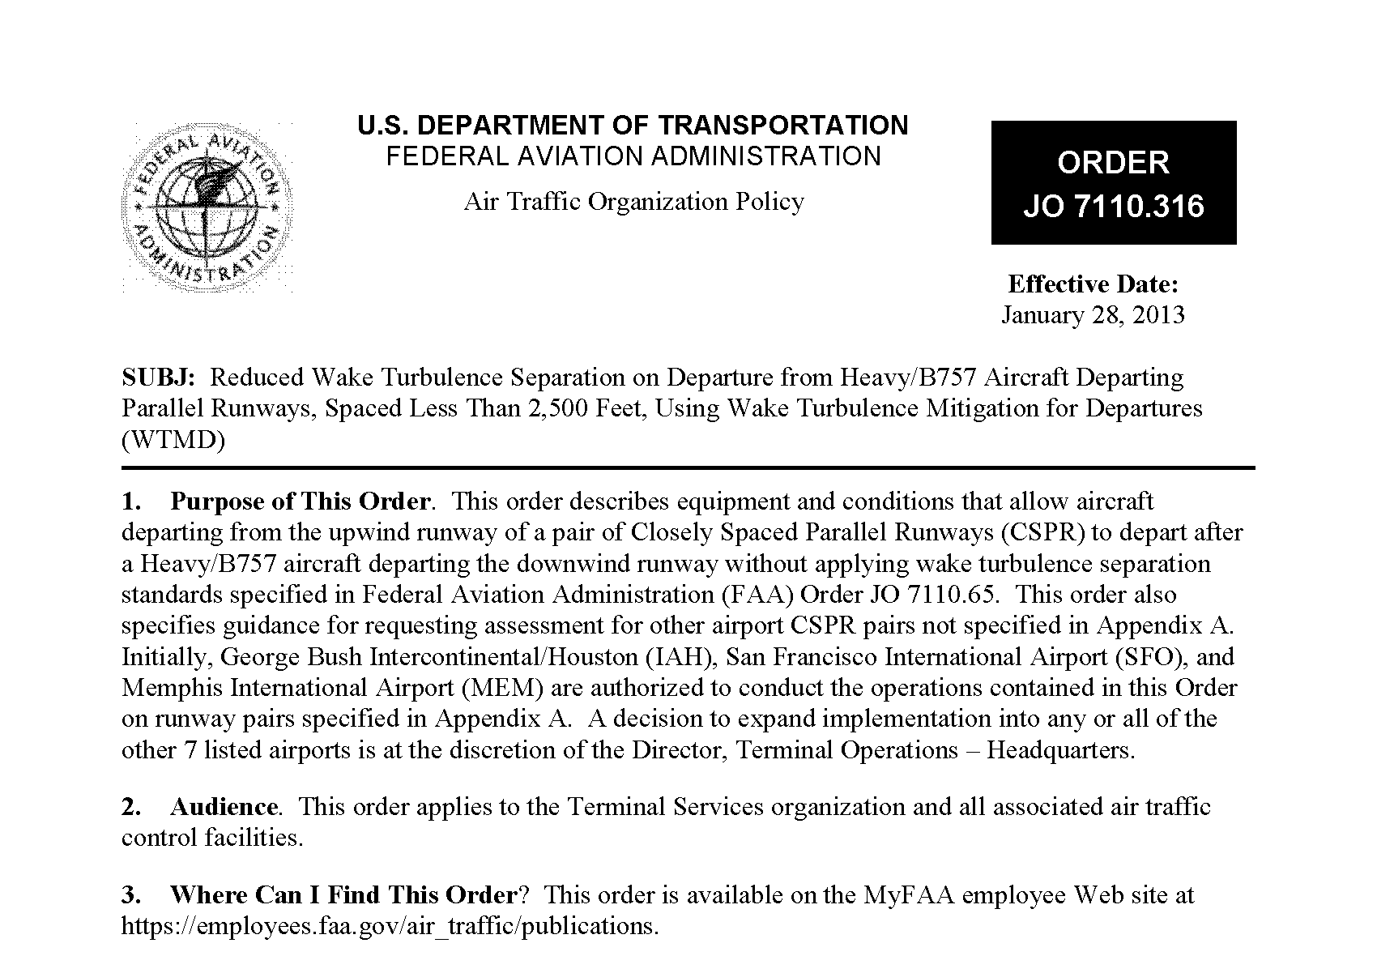
WTMD – Approved
24

Slide 25
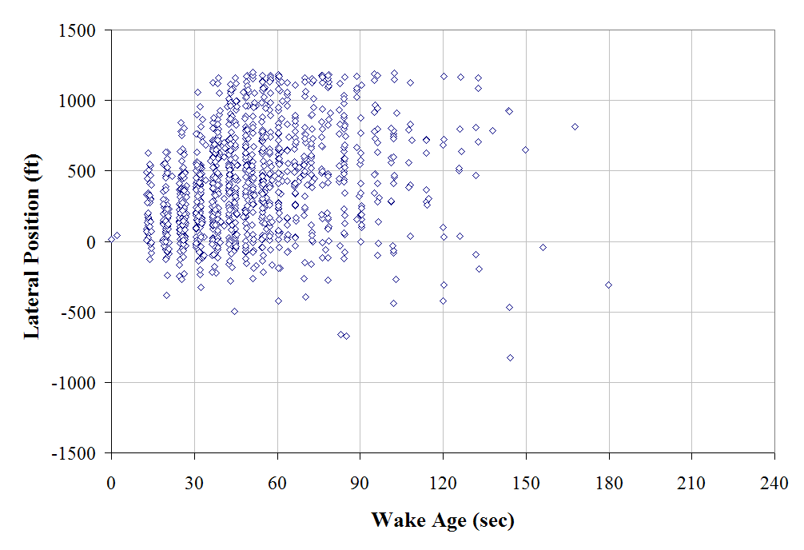
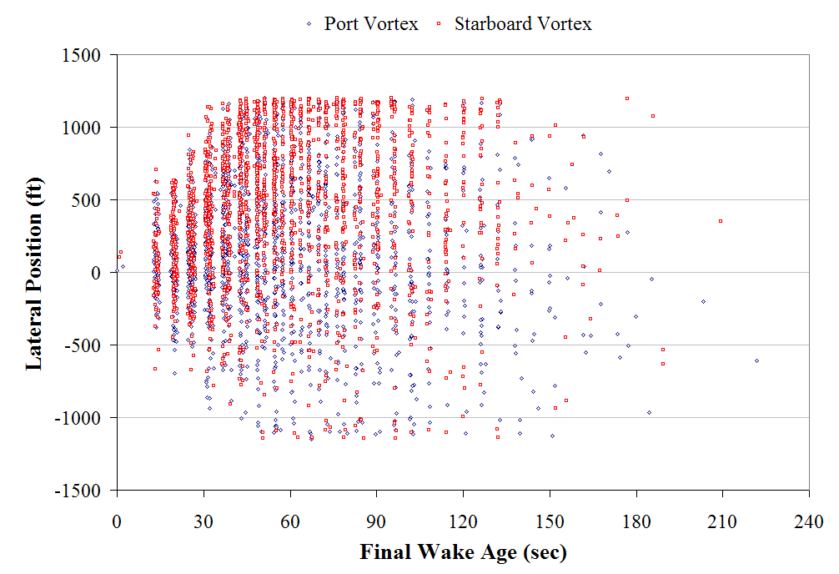
WTMD Overview: Wake Behavior – Data Collection
Edge of Measurement Region
CW: 3+ Kt Surface Wind Away
from Wake-Independent Runway
Edge of Measurement Region
Edge of Measurement Region
Comprehensive departure wake turbulence data collection required for safety case
Over 14,000 H and B757 departure wake tracks collected
25
Notes:
25

Slide 26
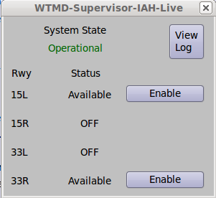
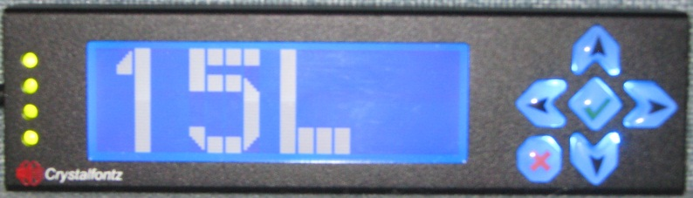
WTMD Elements
Supervisor Display Window (on stand alone display)
Local Controller Display (stand alone)
IAH Example
Two Stand Alone Processors (Tower Cab and Equipment Room) host the WTMD software
Passive tap of ASOS data
FTI line connecting processor to WJHTC for gridded winds and maintenance/monitoring functions
Notes:
26

Slide 27
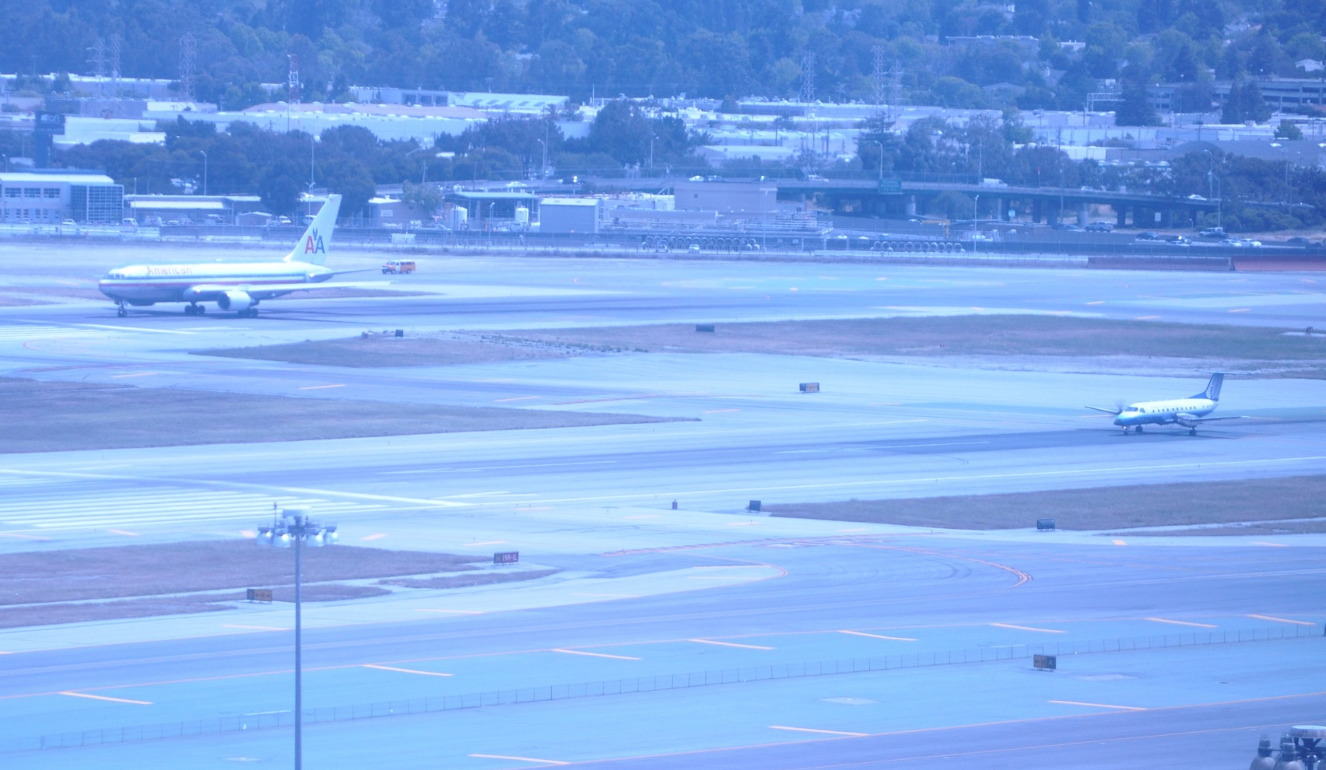
WTMD Cleared Takeoff 5/15/2013

Slide 28
WTMD FY14/FY15
Continued operational support to SFO, IAH and MEM
Sites want more availability – potential WFA improvements developed/evaluated
WTMD performance data collected
Documentation for decision to equip additional sites
If decision to deploy current WTMD system – procure off-the-shelf and install (FAA developed current WTMD in-house)
Project completes in FY15

Slide 29
WTMD HF Evaluation Plan
Pre- and post-evaluation of WTMD at key site ATCTs
  Pre: Before use of RECAT at site
    Observe GC and LC positions in ATCT
    Observe departure operations, particularly those involving heavy aircraft and B757s on the WTMD runways
    Record potential WTMD pairs
  Post: 2 months & 6 months after use of WTMD at site
    Observe WTMD use at GC, LC, and supervisor positions
    Record WTMD pairs
    Collect controller and supervisor feedback on WTMD through the use of questionnaires

Slide 30
WTMD Key Sites
WTMD Key Sites & HF Evaluation Dates
Facility | Pre-Evaluation | 2-month Post-Evaluation | 6-Month Post-Evaluation
San Francisco International Airport (SFO) | Mar 19-21, 2013 | Tent. Oct 2013 | Tent. Feb 2014
George Bush Intercontinental Airport (IAH) | June 7-9, 2013 | Tent. Sept 2013 | Tent. Jan 2014
Memphis International Airport (MEM) | TBD | TBD | TBD

Slide 31
WTMD Project
Funding $M (Present and Out Year)
Notes:
These are FAA budget planning numbers based on OMB guidance. The House Appropriations Subcommittee FY14 Report greatly reduces NextGen funding – If the House budget is enacted, likely WTMD funding will not be extended into FY14 and beyond.

Slide 32
Wake Turbulence Mitigation for Arrivals (WTMA)
F&E Project 1A12B0
CIP Project G06A.01-02
32

Slide 33
Wake Turbulence Mitigation for Arrivals (WTMA)
Safely permits dependent instrument approaches during less than visual conditions to Closely Spaced Parallel Runways
  Allows B757, Heavy, Large, and Small aircraft to lead, any aircraft may trail
Two Solutions
  WTMA-P: procedures only and similar to 7110.308 with some separation reduction
    DST optional
  WTMA-S: Similar to WTMD, wind dependent and separation reduction to 1.5 NM diagonal
    Requires the tactical DST for the controller
    Requires strategic wind forecast to get arrival demand to the airport when winds are conducive
Data collection and analysis funded under RE&D
  Need data on Heavy and B757 aircraft specifically which requires more time (only ~10% of ops).
  Data driven analysis will drive the safety case
F&E funds the decision support tools
  Tool for strategic wind forecast (next slide)
  Automated Terminal Proximity Alert (ATPA) Phase 2 for tactical DST
33
Notes:
33

Slide 34
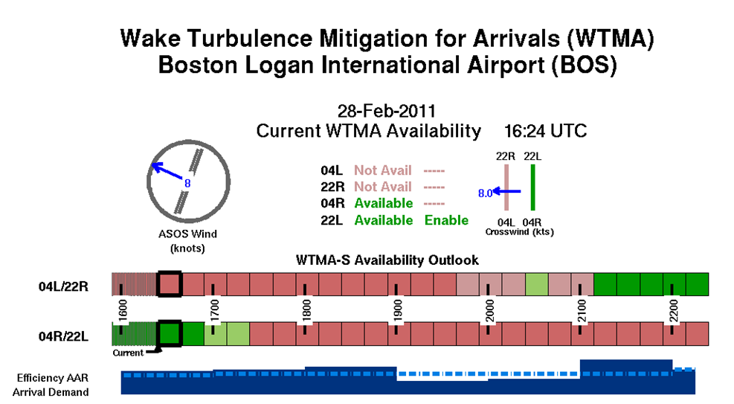
Sample Display for Strategic Wind Forecast
For WTMA-S

Slide 35
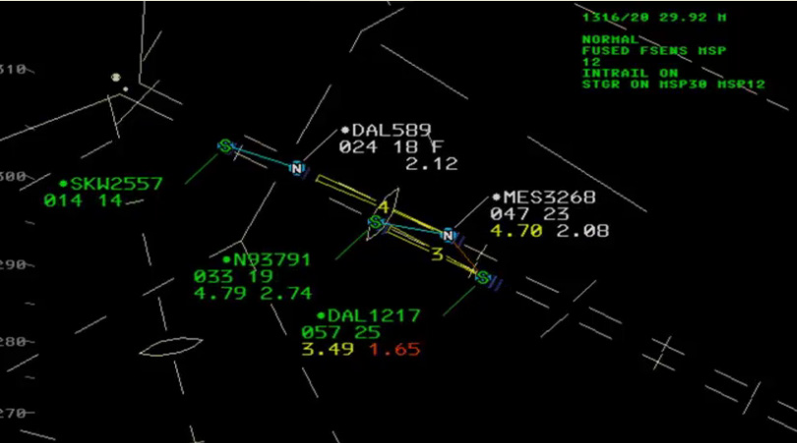
ATPA Phase I (Implemented) and II (Requirements Developed)

Slide 36
WTMA FY13 Accomplishments
Sufficient “heavy aircraft” wake data collected to determine if WTMA-P could be implemented: Answer yes – PHL and DTW
WTMA-P Operational Procedures Developed
Major components of WTMA-P SRMD completed – SRMD will be submitted in FY14
Dialog with airport authorities and FAA ATC initiated at PHL and DTW concerning usability of the WTMA-P procedure
WTMA-S feasibility evaluated for SFO

Slide 37
WTMA FY14/15 Plans
Develop the WTMA-P ATC Order (based on 7110.308)
Complete and submit to AOV the WTMA-P SRMD
Provide support to DTW and PHL in their local procedure development for WTMA-P operations
Provide ATPA Phase 2 adaptation support for WTMA-P when AJM completes ATPA Phase 2 development
WTMA-P completes in FY15
(Note – WTMA-S suspended until 2018/2019)

Slide 38
WTMA Project
Funding $M (Present and Out Year)

