Slide 1
REDAC NASOps
Fall 2013 Review
NextGen - Wake Turbulence (Research)(A12.b) and Wake Re-Cat (1A07E)
By: Jeff Tittsworth and Paul Strande
Date: August 28, 2013

Slide 2
Presentation Outline
Overview of the FAA Wake Turbulence R&D Program (R,E&D and F&E)
NextGen - Wake Turbulence Research Project (A12.b)
  What, Why, Who
  Anticipated Research for FY 14-15
  Emerging FY16 focal areas
NextGen – Wake Turbulence Re-Categorization (F&E project 1A07E)
  What is RECAT
  Anticipated Activities for FY 14-15
  Emerging FY16 focal areas
2
Notes:
2

Slide 3
Overview of the FAA Wake Turbulence R&D Program
(R,E&D and F&E)
3

Slide 4
Wake Turbulence R&D Program Overview
What is this Program?
Goal is to increase NAS capacity through safe reduction in ATC required wake turbulence separation between aircraft
Two funding sources are used to achieve these goals:
  Wake Turbulence R, E&D (A12.b)
  F&E (1A07E, 1A12A, 1A12B) for wake turbulence solutions/standards requiring FAA automation support for implementation
Purpose of R,E&D funding:
  Supports the development of procedures-only wake avoidance solutions
    7110.308, Wake separation for new aircraft (A388, B748, B787, A350, A320-Neo, 737-Max)
  Supports procedure design for wake avoidance solutions that require automation
  Supports the data driven safety assessments for all solutions (procedure only or automation)
Purpose of F&E funding: Development/validation of requirements for NAS systems to support wake solutions
4
Notes:
4

Slide 5
Wake Turbulence (R&D) Program Overview
What is this Program?
Benefits (actual and expected) coming from the program:
  Gains in airport runway throughput capacity without adding concrete:
    Safe, capacity CSPR procedures:
      7110.308 ATC dependent staggered procedure reduces capacity loss when CSPR operations change from visual separation (~60/hr) to IMC separation (~30/hr). IMC arrival capacity with 7110.308 is increased by 8-15 arrivals per hour depending on traffic mix
      Wake Turbulence Mitigation for Departures – increases airport CSPR departure capacity by 2 to 8 more departures per hour – when persistent crosswind is present
      Wake Turbulence Mitigation for Arrivals – extends the 7110.308 procedure to more aircraft types and airport CSPR configurations
    Safe, capacity efficient wake separation standards:
      Static for NextGen near and mid term
      Dynamic, weather and aircraft performance parameterized for NextGen far term – Wake Turbulence Mitigation Single Runway is the first step
      New Wake Re-Cat 6 Category standards implemented in MEM (11/2012) are allowing FedEx to increase its departure rate by 17+%, departure taxi queue to near zero, and time spent in terminal airspace reduced by 2-3 minutes. (equates to savings in fuel, emissions and fewer delays). Wake Re-Cat Phase II – another 4 to 6% increase depending on fleet mix
  Safe, capacity efficient ATC wake separation standards for new aircraft series
  Gains in capacity in constrained en-route airspace:
    Wake safe en-route ATC maneuvers when aircraft en-route separations are less than 5 nm
    Wake safe capacity efficient sharing of airspace with UAS
5
Notes:
5

Slide 6
Wake Turbulence (R&D) Program Overview
Why is Wake RE&D Necessary ?
  Products from this R&D program provide cost effective airport capacity benefits to NAS users without requiring new runways to be built
  NextGen mid to far term products (TBO, Flex Terminal) require wake solutions to deliver their full capacity benefit
  FAA, aircraft manufacturers, air carriers and airports require this program to set safe, capacity efficient wake separations for new aircraft series
6

Slide 7
Have Wake Turbulence RE&D Investments Led to Real Capacity Gains in the NAS?
7110.308 -
  Some immediate success
    Immediate use at SEA upon approval (2010): new runway opened (16R) and old runway closed for resurfacing (16L), and ~8 additional arrives per hour were observed over single runway capacity
    SFO approved Oct 2012. Runway construction has required ILS outages for significant periods. IOC Sep 2013
  Some “build it and they will come”
    EWR also approved Oct 2012
      Airspace changes underway to provide ability to run parallel approaches to 4’s and 22’s with more flexibility
      Expected IOC in Spring of 2014
    BOS approved 2010
      No ILS possible on 4L
      Waited for RNAV/ILS dependent staggered approvals to runways >2500ft apart (Feb 2012)
      RNAV approach to 4L under development
      Anticipate AOV approval of 7110.308 with RNAV/ILS in Spring 2014 and immediate use
Obvious next step is WTMA-P providing reduced separation dependent procedure with Heavy/757 leading

Slide 8
Have Wake Turbulence RE&D Investments Led to Real Capacity Gains in the NAS?
WTMD
  RE&D funded safety case and prototypes at STL and IAH
  F&E funded acquisition effort in 2010 (Wx program)
    Caught up in integration effort with ITWS
  Returned to wake Program for “re-engineering”
  Ops demonstration system developed in 2012
    Implementation SFO May 15, 2013 , IAH July 15, 2013, MEM (Oct 14, 2013)
    1 year of operations will provide seasonal variations of benefits
    Cost is $10k/site for hardware, $50k for installation and $46k/yr for maintenance
  Will be rehosted on another automation platform (e.g., TFDM) if cost/benefit analysis supports that decision

Slide 9
Have Wake Turbulence RE&D Investments Led to Real Capacity Gains in the NAS?
Very preliminary WTMD observations from SFO
Over 30 Heavy or B757-led pairs identified for the WTMD procedure in the first two weeks
No aborted takeoffs or
declined takeoff clearances
due to WTMD
No wake turbulence
encounters reported
Only ATC complaint is “why can’t
we have this all of the time?”
SFO Inter-departure Times
- Heavy/B757 Leader -
WTMD Pairs

Slide 10
Have Wake Turbulence RE&D Investments Led to Real Capacity Gains in the NAS?
RECAT Phase I
  Originally RE&D funded
  Phase I Transitioned to F&E in FY12
  ~$9.5M invested over 7 years
  Implemented in MEM Nov 1, 2013
    FedEx reporting $1.8M savings per month
    Called arrival and departure rates raised from 77 to 99/hour
  SDF IOC Sep 9, 2013
  MIA Dec 1, 2013
RECAT Phase II: F&E funded in FY13 and FY14
RECAT Phase III: RE&D funded beginning in FY14

Slide 11
NextGen – Wake Turbulence
R,E&D Project A12.b
11

Slide 12
Wake Standards for New Aircraft Designs
NTSB 1994 recommendation to assess new large aircraft for wake turbulence prior to entry into the NAS
For aircraft larger than B744, data driven assessments are preferred
  A388 was first effort:
    2006 and again in 2008 using LIDAR data
    2009 and again in 2010 using wake encounter data from flight tests
    FAA implemented notice 7110.626 in June 2013 for revised A388 procedures
  B748 was completed in 2011 using LIDAR data, joint FAA/EASA/EURCONTROL/Boeing recommendation to ICAO 2012
For aircraft smaller than B744, a sensitivity analysis is sufficient (aircraft design not stable until high lift tests)
  B787 was completed in 2011
  A350 standards to be completed prior to entry into service 6/2014 (most of FAA work will be done in FY14)
  A320-Neo standards – est. entry into service 10/2015 (most of FAA work will be done in FY14 & FY15)
  737-Max proposed entry into service 8/2017 (FAA lead organization – FY16 & FY17 work area)
12
Notes:
12

Slide 13
National Rule Change 7110.308
Dependent Staggered Approaches to Parallel Runways Spaced Less Than 2500 ft
The procedure permits any aircraft type trailing on instrument approach to one runway to be diagonally separated by a minimum of 1.5 NM from a leading small or large aircraft on instrument approach to the parallel runway. Standard radar or wake turbulence separation is applied between the trailing aircraft and the lead aircraft of the next pair.
Per RTCA TF5 recommendations,
  Authorizing 2 additional airports per year,
  Should be completed by 2015
Adding RNAV approaches to authorizations
13

Slide 14
Develop NextGen Wake Procedure Concepts/DSTs
Coordinate our NextGen concepts with SESAR
Wake Turbulence Mitigation Single Runway (WTMSR)
  Far term wake turbulence mitigation solution for single runways
    Concept is becoming more mature – built on EUROCONTOL/SESAR Concept
    RE&D funded for now (FY14/15/16 work: Enhance ability to forecast when and how long favorable winds will be present on approach/departure corridors)
    RE&D builds upon concepts developed in F&E WTMD and WTMA-S
  Ongoing data collection and analysis will determine feasibility of concept alternatives along with where and how it is implemented
Dynamic Wake Mitigation
  Build upon the static pairwise separations from RECAT and utilize lessons learned from early dynamic wake tools (WTMD, WTMA-S)
  FY16 focus – define and then develop concept alternatives
14

Slide 15
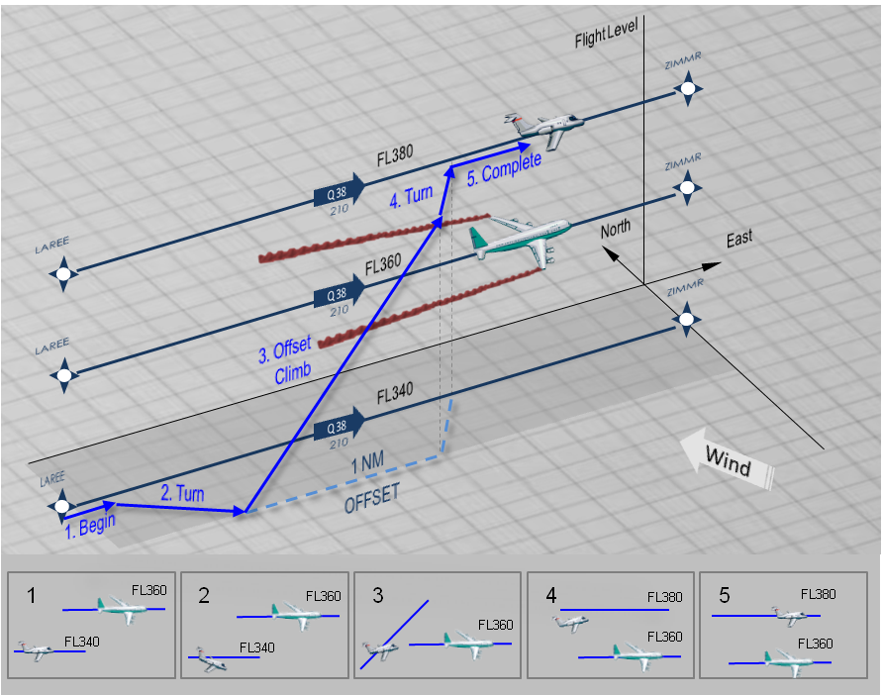
Enroute Lateral Offset Procedure For Wake Turbulence Avoidance
ASRS wake encounter reporting tells us this is a hot spot
Enroute 3NM everywhere will require this as a mitigation
Potential UAS application
15

Slide 16
Determine Statistical Wake Encounter Frequency/Severity
All safety assessments to date have been conducted using a relative risk assessment
  Today is safe
  Constrain wake severity and encounter likelihood for proposed change to be no greater than today
Absolute criteria will be necessary for NSIP C solutions (e.g., some dynamic separations)
RE&D funding supporting AFS development of ‘acceptable wake encounter’
  Aircraft simulators with line pilots encountering wakes of varying strength, height above ground and ceiling/visual conditions
  Screen flight data recorder data to establish frequency in the NAS
FY14/15: Continue severity data collection using OKC flight simulators, add more aircraft types to screening tool; NASA’s ASRS
FY16: Collect potential wake encounter statistics by scanning stored FOQA flight data recorder data sets; NASA’s ASRS
16

Slide 17
Develop Models, Data Bases, Data Sources
Enhance and maintain ground based data collection capabilities
  Continue work with Leosphere and Gallion on their “lower cost” more portable LIDAR systems – currently in use for wind profile measurements and Volpe is developing their application for low altitude wake measurements (FY14/15: Continue development, FY16: Evaluate emerging prototype RADAR based wake tracking systems)
  Keep LMCT legacy LIDARs running – component parts no longer being made (Continuing)
Develop enhanced aircraft and recorded wake track correlation techniques
  Gather aircraft data using ADS-B receiving system (Continuing)
  Data mine available FAA recorded track information (Continuing)
  Correlate weather data with recorded wake tracks (Continuing)
Develop requirements for downlinking aircraft observed weather data (parameters, timing, accuracy)
  Work being done by supporting RTCA Subcommittee 206 (Cont.)
17

Slide 18
Why Do We Need More Wake Data Collection?
Some past efforts addressed type-specific questions
  Demonstrated that winglets did not have an observable effect on wake behavior on approach and departure and associated separations
  Demonstrated that B753 was not a Heavy aircraft in terms of wake behavior, and actually bounded by B752
  Demonstrated that B752 (and B753) were actually Large aircraft with B738 and B739 bounding the risk for that category
The very large capacity gains at MEM as a result of RECAT are due to sufficient data to distinguish
  Wake separation required behind “upper heavy” versus “lower heavy” aircraft
  Wake separation required behind “upper Large” versus “Lower Large” aircraft

Slide 19
Why Do We Need More Wake Data Collection?
Data collection for these efforts is more time consuming than for solutions like 7110.308
  Large aircraft operations make up ~80 % of total operations
  Heavy aircraft operations make up ~10% of total operations
  Statistically relevant data set for Heavy aircraft takes 8x as long to collect as was needed for 7110.308
RECAT Phase II benefits will be driven by the ability to distinguish wake separation requirements on a pairwise basis
It is worth the effort and investment
  Wake constrained pairs only make up ~18% of operations, yet
  RECAT provided ~18% capacity gain only by reducing separation behind lower Heavy and B757 aircraft

Slide 20
Why Do We Need More Wake Data Collection?
RECAT Phase III and other dynamic pairwise separation standards have additional data requirements
  Static separations set for near worse case conditions – long lasting wakes
  Dynamic separations require data at a broader set of environmental conditions,
  Wake data is collected in many of these condition as we seek the longer lasting wakes required for static separation, but
  Data collection is required at a wider range of airports to ensure we can maximize safe separation reduction
Fleet mixes change over time and new aircraft are added into operations
  The types of aircraft that affect capacity will change over time
  In order to bound the efforts and achieved changes in realistic time frames, RECAT Phases I-III cannot analyze wake separations for all 2500 aircraft types,
  RECAT Phase II and III must be flexible to adjust to ne fleet mixes to ensure the capacity gains sustain over time

Slide 21
Detail A12.b Spending Estimates
A12.b Work Element | FY13 | FY14 | FY15 | FY16 | FY17
Wake Standards for New Aircraft | $0.8M | $0.6M | $0.6M | $0.8M | $0.9M
Analyze Airports for Wake Separation Requirements | $0.7M | $0.7M | $0.7M | $0.3M | $0.3M
Develop NextGen Wake Procedure Concepts/DSTs | $2.1M | $1.9M | $2.0M | $2.4M | $2.5M
Determine Statistical Wake Encounter Frequency/Severity | $1.6M | $1.4M | $1.5M | $1.5M | $1.3M
Develop Models, Data Bases, Data Sources | $4.1M | $3.9M | $3.9M | $3.9M | $4.1M
A12.b Totals | $9.3M | $8.5M | $8.7M | $8.9M | $9.1M
Issue/concern: The above funding is based on OMB guidance associated with
the President’s FY14 Budget submission to Congress. The Senate Appropriations Subcommittee provided the requested FY14 amount. The House Appropriations Subcommittee cut the project’s budget by 50%. If the 50% cut is enacted by Congress, the project will stop work on airport analysis, wake concept and DST development and development of the wake encounter safety risk management matrix (essentially halting wake R,E&D activities needed for NextGen era operations).

Slide 22
Human Factors
OMB has voiced concerns about how much the FAA is spending on HF
  Concept exploration and initial prototyping of wake avoidance solutions require mostly controller SMEs but some HF support
  Early focus is usually on getting information requirements correct, not information presentation or CHI
  Our experience is that HF involvement is best leveraged in the information presentation piece of the solution, and where this intersects with procedures and human behavior
It is much more cost effective to
  Integrate CHI and procedures and training to optimize safety , rather than
  Have a heavy HF footprint on the upfront system requirements piece
Thus the most effective investment in HF is during F&E efforts
  Procedures development,
  Operational Test and Evaluation of software, and
  Pre-implementation/post implementation phases of a program

Slide 23
Human Factors
The wake program uses the same contract support used by the FAA HF Program office to support
  Wake Turbulence Recategorization (RECAT)
  Wake Turbulence Mitigation for Departures (WTMD)
  Automated Terminal Proximity Alert (ATPA)
We believe RECAT, WTMD and ATPA have been successful because
  We took the approach that HF is not a research effort that can be completed and put in a report or captured in a requirements document
  HF is function that lives with a project through and beyond implementation

Slide 24
RECAT Example of HF Evaluation Plan
Pre- and post-evaluation of RECAT at key site Air Traffic Control Towers (ATCTs) and Terminal Radar Approach Control Facilities (TRACONs)
  Pre: Before use of RECAT at site
    Observe Ground Control (GC) and Local Control (LC) positions in ATCT during heavy departure pushes
    Observe Feeder and Final positions in TRACON during heavy arrival rushes
  Post: 2 months & 6 months after use of RECAT at site
    Record when RECAT separation standards were used or not used
    Record when RECAT separation standards were issued by controller but not used by pilot
    Collect controller feedback on RECAT through the use of questionnaires
Pre- and post-evaluation of RECAT are more effective if HF participates in training development, training execution and observes and supports early implementation

Slide 25
RECAT Example of HF Support to Initial Operational Capability
1-2 staff full time in the MEM ATCT TRACONs, 24/7 for first week of operations
Staff numbers biased towards ATCT support during departure pushes and biased towards TRACON support during arrival pushes
HF was able to
  Answer questions about procedures and training
  Observe effectiveness of both procedures and training over time (first week, and later observations)
  Feed back those observations into improved procedures and training

Slide 26
RECAT Key Sites
RECAT Key Sites & HF Evaluation Dates
Facility | Pre-Evaluation | 2-month Post-Evaluation | 6-Month Post-Evaluation
Memphis | Oct 16-18, 2012 | Feb 5-7, 2013 | June 3-6, 2013
Louisville | Aug 12-15, 2013 | Tent. Nov 2013 | Tent. Mar 2014
Miami | Tent. Nov 2013 | Tent. Jan 2014 | Tent. May 2014
San Francisco | TBD | TBD | TBD

Slide 27
Backup
27

