Slide 1
REDAC Subcommittee on
NAS OPS Fall 2013 Review: Air Traffic Control/Technical Operations Human Factors Research Core Program, A11.i
By: Dino Piccione
Human Factors Division
Date: August 27, 2013

Slide 2
Overview
Program Strategic View
Program Structure
Summary

Slide 3
Program Strategic View
Strategic Plan continues as the baseline for Mission Statement and Strategic Objectives
http://go.usa.gov/gBKd
Continued emphasis on sponsor requirements and community of interest is unchanged
Research process will be updated in FY 2014 for new research groupings that better align in-house resources to the Strategic Plan

Slide 4
Research Requirements Development and Definition
Human Centered Design
Includes Human Factors Standards
Human System Integration
Human Factors in Safety, and Operations
Training and facility placement

Slide 5
Core ATC / Technical Operations Human Factors Program, A11.i
Requirements Process
Sponsors in the ATO provide HF research requirements via Research Requirements Development and Definition (R2D2) process
Requirements vetted against HQ and CAMI available expertise and prioritized with sponsors for highest priorities
Research outputs coordinated with sponsors for implementation
Products and process documentation in web library
Provides leadership and products to ensure the ATC system’s human component will safely and reliably perform to deliver expected benefits:
Human centered design and design standards
Human system integration
Human factors in ATO safety, operations, and training
Partners
- ATO Program Management Organization, En Route, Terminal, Safety & Technical Training, System Operation, Technical Operations; Human Relations
- Action Plan 15 with EUROCONTROL on Safety and Human Performance
Major Activities
Finalize and close all Personnel Selection Research activities (Sep 30 2013)
ATC/Technical Operations Strategic Research Plan
Develop HF color Palette for air traffic control displays for future ATC systems
Revise the Human Factors Design Standard for application in acquisition programs
Complete design standard for Airport Traffic Control Tower Alerts
Analyze air traffic human factors safety issues and data to mitigate loss of separation incidents
Funding
FY 13 | FY14 | FY15 | FY16
10,014K | $6,000K | $6,200 | $6,200

Slide 6
Human Centered Design
Traditional area of HF
Sponsors mostly from Program Management Organization (PMO)
HF Standards
Joint Interagency HF Standardization Working Group
Emphasizing work station integration and longer range problems
Information management

Slide 7
Human Centered Design
 | FY 2013 | FY 2014 | FY 2015 | FY2016
Facilities Survey | ◆ | ◆
Scenarios and Human Performance Metrics | ◆ | ◆ | ◆
Collaborative Decision Making | ◆ | ◊ | ◊
Role of Automation in Technical Operations | ◆ | ◆ | ◆
Data Blocks and Information Management |  | ◊ | ◊ | ◊
Safety Alerts | ◆ | ◆
Time Based Information Display |  | ◊ | ◊

Slide 8
Human Centered Design - Standardization
 | FY 2013 | FY 2014 | FY 2015 | FY 2016
Human Factors Design Standard Update | ◆ | ◆ | ◆
ATC Display Color Standard |  | ◆ | ◆
ATC Tower Alerts Standard | ◆ | ◆
ATC Display Color Palette | ◆ | ◆

Slide 9
Human Centered Design - Standardization
 | FY 2013 | FY 2014 | FY 2015 | FY 2016
Abbreviations Standard for Tech Ops | ◆ | ◆
Technical Manual Standards for Tech Ops | ◆ | ◆
Technical Operations Symbols Standard | ◆ | ◆
Tech Ops GUI Style Guide | ◆ | ◆ | ◆
Tech Ops GUI Standard | ◆ | ◆ | ◆

Slide 10
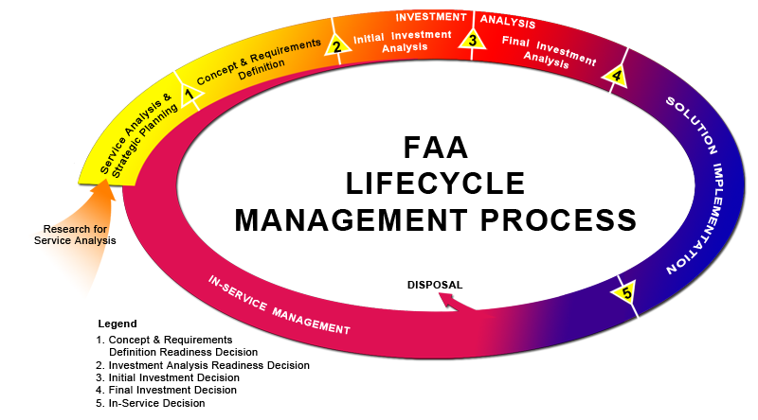
Human System Integration
Renewed emphasis on HF in the Acquisition Management System

Slide 11
Human Systems Integration
 | FY 2013 | FY 2014 | FY 2015 | FY 2016
HF Integration in Acquisition Management System | ◊ | ◊ | ◊ | ◊
HF Acquisition Working Group | ◊ | ◊ | ◊ | ◊
Automation in ATC |  | ◆ | ◆ | ◆
Contract Tower Benefits |  | ◆ | ◆
Benefits in RNAV/RNP | ◆ | ◆
Benefits in Terminal DST (tentative)

Slide 12
Safety, Operations and Training
Increased opportunity with ATO safety, operations, and training offices drawing on HF expertise to address high priority ATO challenges
Non-traditional relationship with community largely unfamiliar with HF
Example – Hosted training requirements workshop focused on key needs spanning initial Academy training, on the job training, Front Line Manager/Operations Manager, new technology training, and Technical Operations
How to measure training success?
How to best deliver training?
How to maintain competence?

Slide 13
HF in Safety and Operations
 | FY 2013 | FY 2014 | FY 2015 | FY 2016
Method for Facility-Level Analysis of ATSAP | ◆ | ◆ | ◊
HF Methods for Incident Investigation | ◆ | ◆ | ◊
Dynamic Comprehension: Time on Position and Controller Performance | ◆ | ◆ | ◆
Human Factors Safety and Risk Assessments | ◆ | ◆ | ◊ | ◊
Human Factors Operational Performance Research | ◆ | ◆ | ◊ | ◊
Top 5 Hazard Mitigation Human Factors Analysis |  | ◆ | ◊ | ◊

Slide 14
Training
 | FY 2013 | FY 2014 | FY 2015 | FY 2016
OJTI Educational Intervention | ◆ | ◆ | ◆
Analysis of training responses to Loss of Separation (LOS) events |  | ◆
Visual scanning methods used by radar controllers to improve academy and OJTI Training |  | ◆ | ◆
Analysis to understand causes of attrition from field training |  | ◆ | ◆
Research to understand training for ATC problem solving |  | ◆ | ◆

Slide 15
Questions ?
By: Dino Piccione, Jason Demagalski, Eddie Sierra, Barbara Wilper
Date: August 27, 2013

