Slide 1
NAS Operations PPT
REDAC NAS Ops Fall 2013 Review
Operations Concept Validation & Infrastructure Evolution (ATDP)
Presented by: Rob Hunt
Date: August 27-28, 2013

Slide 2
PPT Portfolio Overview
NAS Ops PPT for the FY2015 FAA budget process includes the following areas:
ATDP – Operations Concept Validation and Infrastructure Evolution – Transitioning to ATO (AJV-7) starting in FY13
Anticipated Research in FY14/15
Emerging FY16 Focus Areas
Activities funded in FY13
Carryover Activities funded prior to FY13 (ANG-C4)
2

Slide 3
Anticipated Research in FY14-15 ATDP Operations Concept Validation & Infrastructure Evolution
Unmanned Aircraft Systems (UAS) Concept Maturation
Objective: Enable the future increased use of UASs in the NAS
Activities: Scenario development/execution, functional analysis, requirements development
Operational Integration Analysis
Objective: Identify possible operational integration issues amongst emerging concepts, and amongst emerging concepts and existing operational capabilities
Activities: Scenario development/execution, mitigation recommendations (e.g. further research, requirements)
Enterprise-Based Information Delivery and Dissemination
Objective: Create an enterprise-based perspective and delivery/dissemination platform for AT support information (existing information and new information planned to be available in the mid-term)
Activities: Shortfall analyses, conceptual solutions, requirements development
National Special Activity Airspace (SAA) Concept Maturation
Objective: Improve the scheduling and real-time use of SAA in the NAS
Activities: Concept validation, CONOPs revision, requirements development, requirements allocation
Advanced Interval Management Concept Exploration
Objective: Evaluate advanced interval management applications
Activities: Concept development, high-level CONOPs
RTCA Support
Continued support of international standards and public/private collaboration
3

Slide 4
Emerging FY16 Focus Areas ATDP Operations Concept Validation & Infrastructure Evolution
Unmanned Aircraft Systems (UAS)
Objective: Further validation of lower-level UAS concepts
Potential Activities: HITL exercises, Part Tasks, updated functional analysis and requirements
Operational Integration Analysis
Objective: Continued examination of possible operational integration issues as emerging concepts evolve and new concepts are planned for the mid-term
Potential Activities: Scenario development/update/execution, mitigation recommendations (e.g. further research, requirements)
PBN Optimization
Objective: Expand the efficient use of PBN procedures in the NAS
Potential Activities: Shortfall analyses, concept exploration, CONOPs development, procedural recommendations
Advanced Interval Management
Objective: Mature advanced interval management applications
Potential Activities: Concept validation through scenario development/execution, HITLs exercises, Part Tasks
RTCA Support
Continued support of international standards and public/private collaboration
4

Slide 5
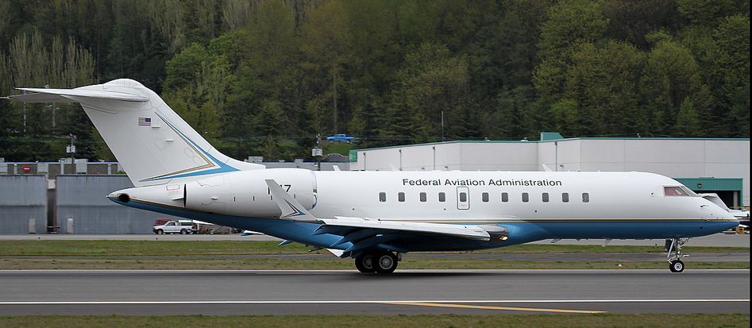
ATDP - Operations Concept Validation and Infrastructure Evolution – FY13
Description:
Develop, mature, and validate near/mid-term emerging operational concepts to improve the capacity and efficiency of the NAS
Identify and mitigate operational integration concept challenges, focusing on optimizing the integration amongst emerging concepts, and amongst emerging concepts and existing NAS capabilities
Advance an enterprise-based perspective to the evolution of NAS capabilities, enabling a more integrated, synchronized, and sustainable NAS
Partnerships:
ANG/C4/C5
PMO
Volpe
NASA
Accomplishments / Plans:
Identify and mitigate operational integration issues through the development and execution of operational scenarios with SMEs (Jan 14)
Update existing, create new, and execute operational scenarios with SMEs to evaluate the use of UASs in the NAS (Mar 14)
Shortfall analyses of AT spt info (Mar 14)
Develop SAA-ATM integration requirements and identify enabling policies/procedures to improve the use of SAAs in the NAS (Jun 14)
RTCA: Analyses/documentation in support of standards and public/private collaboration
Funding:
FY11 | FY12 | FY13 | FY14 | FY15
$4,000,000 | $3,500,000 | $3,953,000 | $4,000,000 | $4,000,000
AJV-7 controls funding from FY13 and beyond.
5

Slide 6
ATDP - Operations Concept Validation and Infrastructure Evolution (ANG-C4)
Description:
Ensure feasibility and viability within the NAS through the development, assessment, and refinement of NAS concepts
Develop common concept development, validation and measurement methodologies to support SESAR
Develop and update NAS Operational Improvements and Operational Sustainment activities
Demonstrate capacity and efficiency increases at 2025 forecasted traffic levels by 2016
Partnerships:
Drexel University ANG-E72
Czech Tech University ANG-E25
Rowan University ANG-5
Accomplishments / Plans:
NAS End-to-End Modeling
Conducted analysis of fuel burn savings for System Wide Analysis Capability simulations
Fast Time Simulation and Modeling
AGENTFLY Development – ATC Agent – agent-based simulation capability (Dec 2014)
FliteViz4D: Development of post-processing visualization tool that animates flight information from NAS recorded and simulated flight operations (Oct-2013)
IADCS support (Dec 2013)
Funding:
FY11 | FY12 | FY13 | FY14 | FY15
$4,000,000 | $3,500,000 | $3,953,000 | $4,000,000 | $4,000,000
AJV-7 controls funding from FY13 and beyond. Identified Accomplishments/Plans based on funding prior to FY13
6
Notes:
Cynthia Morris / Mike Paglione

Slide 7
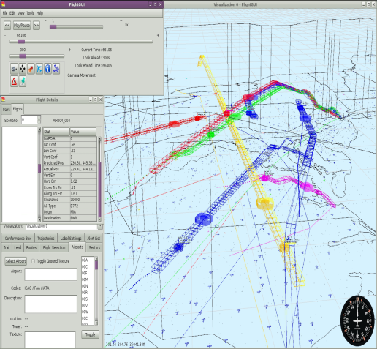
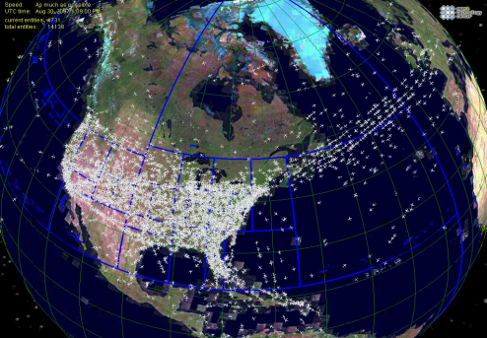
Concept Analysis – Fast Time Simulation and Analysis Infrastructure
(ANG-C4)
Description:
Validation of NextGen concepts and system capacity issues
Support National Airspace System Acquisition Management System process in particular the mission and investment analysis
Develop, validate, and support the NAS Operational Improvements and Operational Sustainment activities
Demonstrate capacity and efficiency increases at 2025 forecasted traffic levels for NextGen Ois through modeling and simulation
Partnerships:
Drexel University ANG-E72
Czech Tech University ANG-E25
Rowan University ANG-5
Accomplishments / Plans:
AGENTFLY Development – agent based simulation capability for use on NextGen
Initial prototype -Software (Jul 2012)
ATC Agent validation - Report (Sept 2013)
Scale up – Software & Report (Dec 2014)
Development of FliteViz4D, a post-processing visualization tool – Software (October 2013)
Airspace/aircraft adaptation configuration management tool – Prototype tool (Dec 2013)
Validation of internal aircraft fuel burn calculator – Final
Report (Sep 2013)
AJV-7 controls funding from FY13 and beyond. Identified Accomplishments/Plans based on funding prior to FY13
7
Notes:
Cynthia Morris / Mike Paglione

