Slide 1
Briefing to
REDAC - NAS Operations Subcommittee
Operational Weather Requirements Analysis Methodology
August 28, 2013
Rick Heuwinkel
Mark Huberdeau

Slide 2
Aviation Weather Requirements
Three tier effort in collaboration with NWS
  NowGen Requirements
    TFM Aviation Weather Requirements Group (TRWG) – Develop performance requirements for NWS produced aviation weather forecast information used in today’s support to TFM
    Aviation Weather Requirements Working Group (ARWG) – revalidates aviation weather products, and allows NWS identify opportunities to simplify/retire products
  NextGen Midterm ConOps
    Identifies weather needs and validates with operational stakeholders
    Develop and validate performance requirements for weather information
    Allocates requirements to ATM or NWS
  NextGen FOC Requirements
    To be addressed after completion of NextGen Midterm effort

Slide 3



Aviation Weather Requirements Process Overview
Objective → To develop validated operational performance requirements that address user needs and achieve the successful implementation of mid-term service capabilities.
Mid-term ConOps
NSIP 5.0 Bravo
Allocate validated requirements to FAA & NWS
Services
Portfolios
NAS Strategic TFM Services
Flight Planning Services
Airport Ops Services
CATM
ISO
TBFM
Validate performance requirements through appropriate methods, such as modeling, simulation, or Human- in-the-lop exercises.
Arrival & Departure Ops Services
Cruise Ops Services
Oceanic Ops Services
IMRO
IALVO
Others
Approve requirements.
Decomposition of capabilities through ConOps functional analysis and NSIP analysis to derive weather functions and interfaces with ATM operations.
Convert operational requirements to performance requirements.
Access User needs from an ”as-is” and “to-be” operational context to determine weather information needs in the “to-be” state.
Conduct operational validation of user needs, operational requirements, and weather information needs through use of scenarios with subject matter experts.
Analysis
Validation & Approval

Slide 4
Aviation Weather Requirements – Schedule
CY2012 |  |  |  | CY2013 |  |  |  | CY2014 |  |  |  | CY2015 |  |  |  | CY2016 |  |  |  | CY2017 |  |  |  | CY2018
Q1 | Q2 | Q3 | Q4 | Q1 | Q2 | Q3 | Q4 | Q1 | Q2 | Q3 | Q4 | Q1 | Q2 | Q3 | Q4 | Q1 | Q2 | Q3 | Q4 | Q1 | Q2 | Q3 | Q4 | Q1 | Q2 | Q3 | Q4
Traffic Flow Management (TFM) Requirements Working Group (TRWG)
TFM Requirements Definition
JAN 2012
NWS Product Baseline/Implementation
(On-Going)
Aviation Weather Requirements Working Group (ARWG)
Assessment of NWS products for ATO
FEB 2013
Identify Opportunities
DEC 2013
NextGen Midterm ConOps Aviation Weather Requirements
Initial Weather Needs
DEC 2013
Final Weather Needs
SEP 2014
Final Set of Validated Requirements
MAR 2015
Allocation to ATM or NWS
DEC 2015
Initial Set of Validated Requirements
MAR 2014

Slide 5
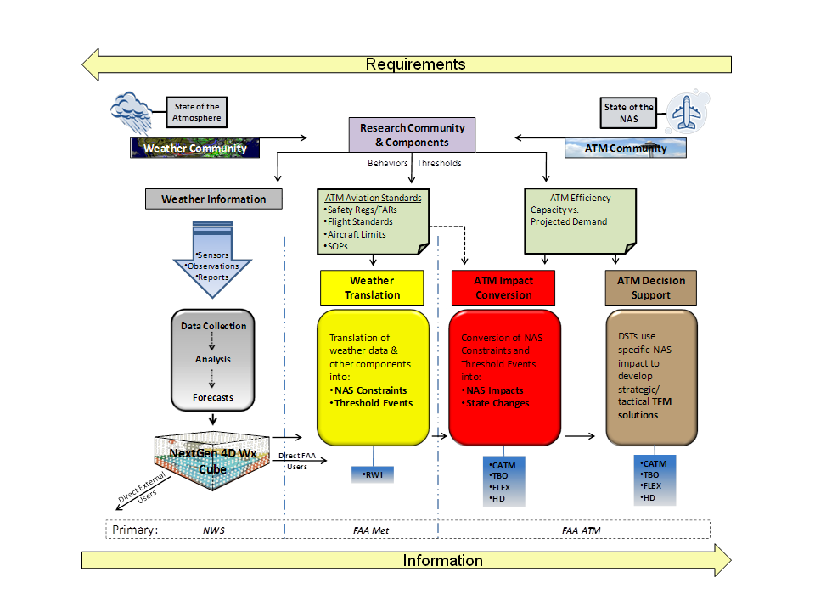
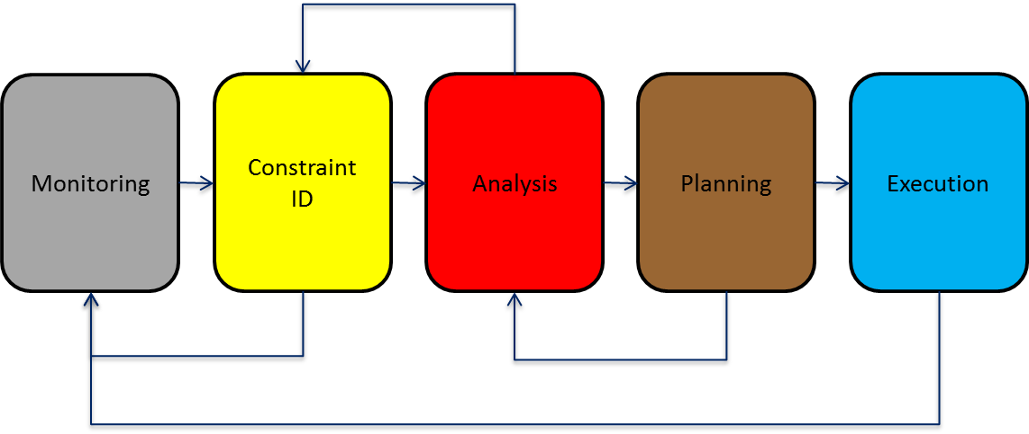
Integration of Weather, Traffic, and Airspace Information
ATM-Weather Integration Concept
ATM-Weather Decision Model

Slide 6
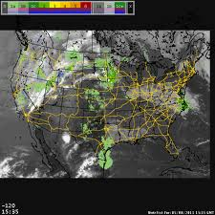

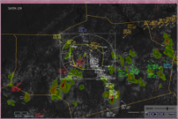

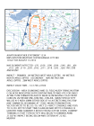
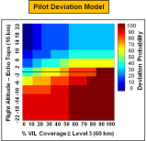
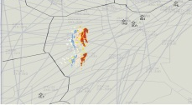
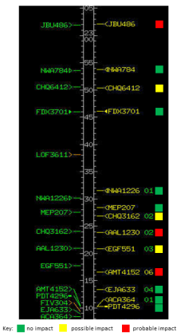
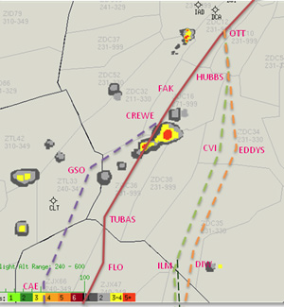



Levels of Integration
Level Ø – No integration
“I gotta’ do it all in my head…”
Monitoring
Constraint ID
Analysis
Planning
Execution
Level 1 – Weather on the glass
“It’s easier to figure out the impact…”
Level 2 – Weather Constraint
Translation to NAS Constraint or Threshold Event
Level 3 – Impact
Conversion to NAS Impact or State Change
Level 4 – Decision Support
Generation of Hierarchical Solutions

Slide 7
MONITORING
MONITORING
MONITORING
MONITORING
MONITORING
CONSTRAINT ID
CONSTRAINT ID
CONSTRAINT ID
CONSTRAINT ID
CONSTRAINT ID
National
ATCSCC
Regional
“Metro”
Local
ARTCC
Local
TRACON
Local
Tower
Control
ANALYSIS
ANALYSIS
ANALYSIS
ANALYSIS
ANALYSIS
PLANNING
PLANNING
PLANNING
PLANNING
PLANNING
EXECUTION
EXECUTION
EXECUTION
EXECUTION
EXECUTION
FOC / TMS
Pilot / Dispatcher
Pilot / CPC

Slide 8
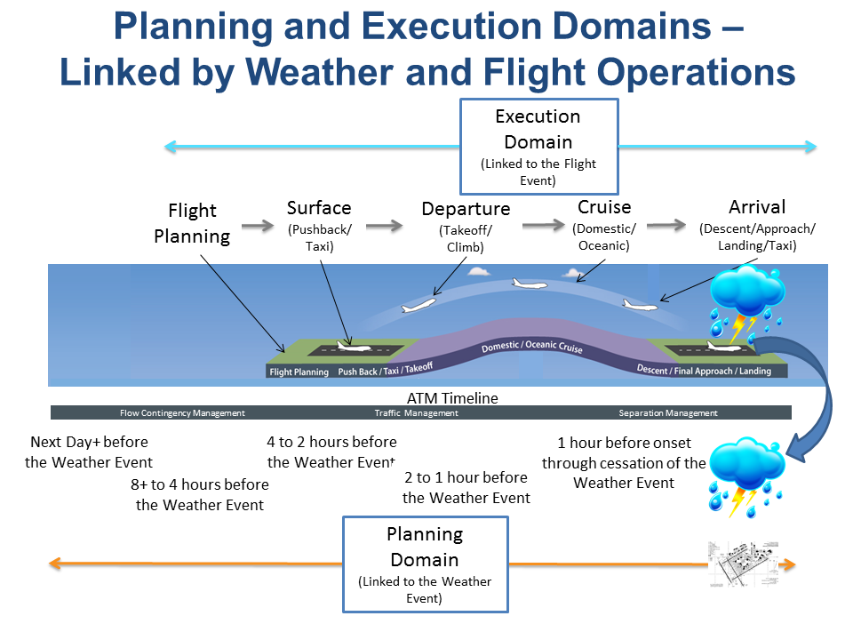

Slide 9
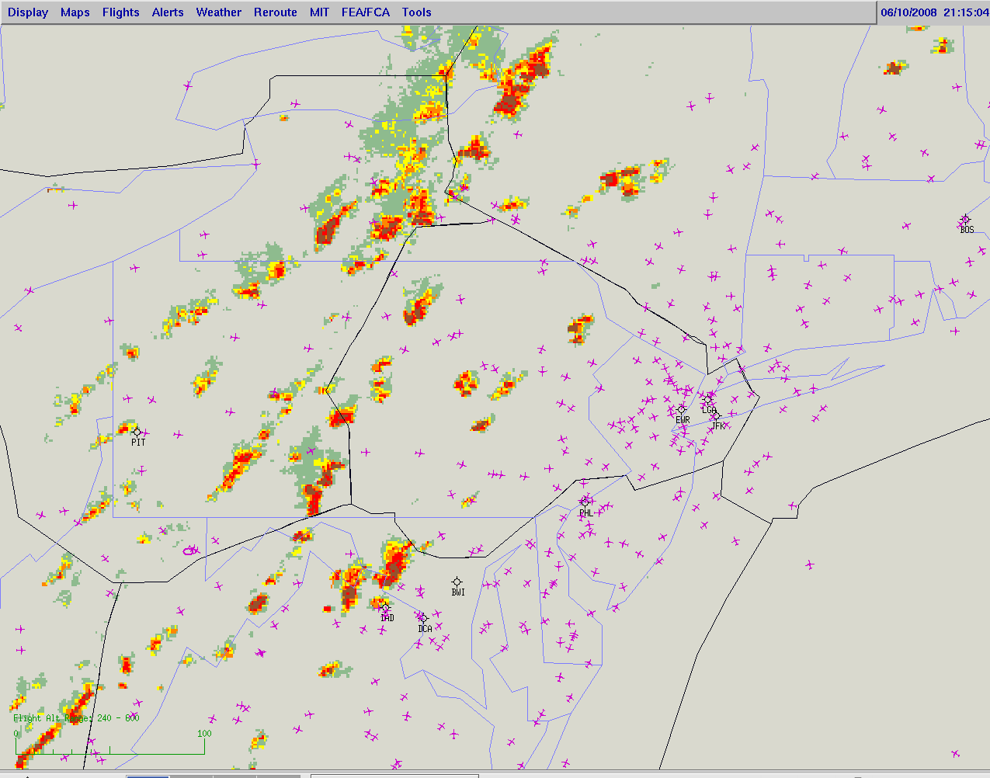
1: AFP filtered 30 percent of the flight demand going through the forecast area 5 hour prior to convective weather development
(4-8 hrs.)
2: Local ARTCC refines demand further on routes based on a near term forecast with current conditions and observations (2-1 hrs.)
3: Sector controllers assist pilot with deviation to avoid thunderstorm activity in the sector, sector has a very reduced flow rate based on previous actions taken (real time, 0-30 mins.)
4: Departures are flowing with alternate departure routes and available airspace due to a reduced arrival flow because of early arrival initiatives being put in place, (0-1 hr.)
Operational Decision Making
1: Strategic
TFM - FCA
(ATCSCC)
2:
TFM Airborne Rerouting
(ARTCC)
3: Tactical Airborne Rerouting
(TRACON)
4:
TFM Departure Flow Management
All decisions have spatial and temporal variations, but are interconnected to address a common impact problem to the system

Slide 10
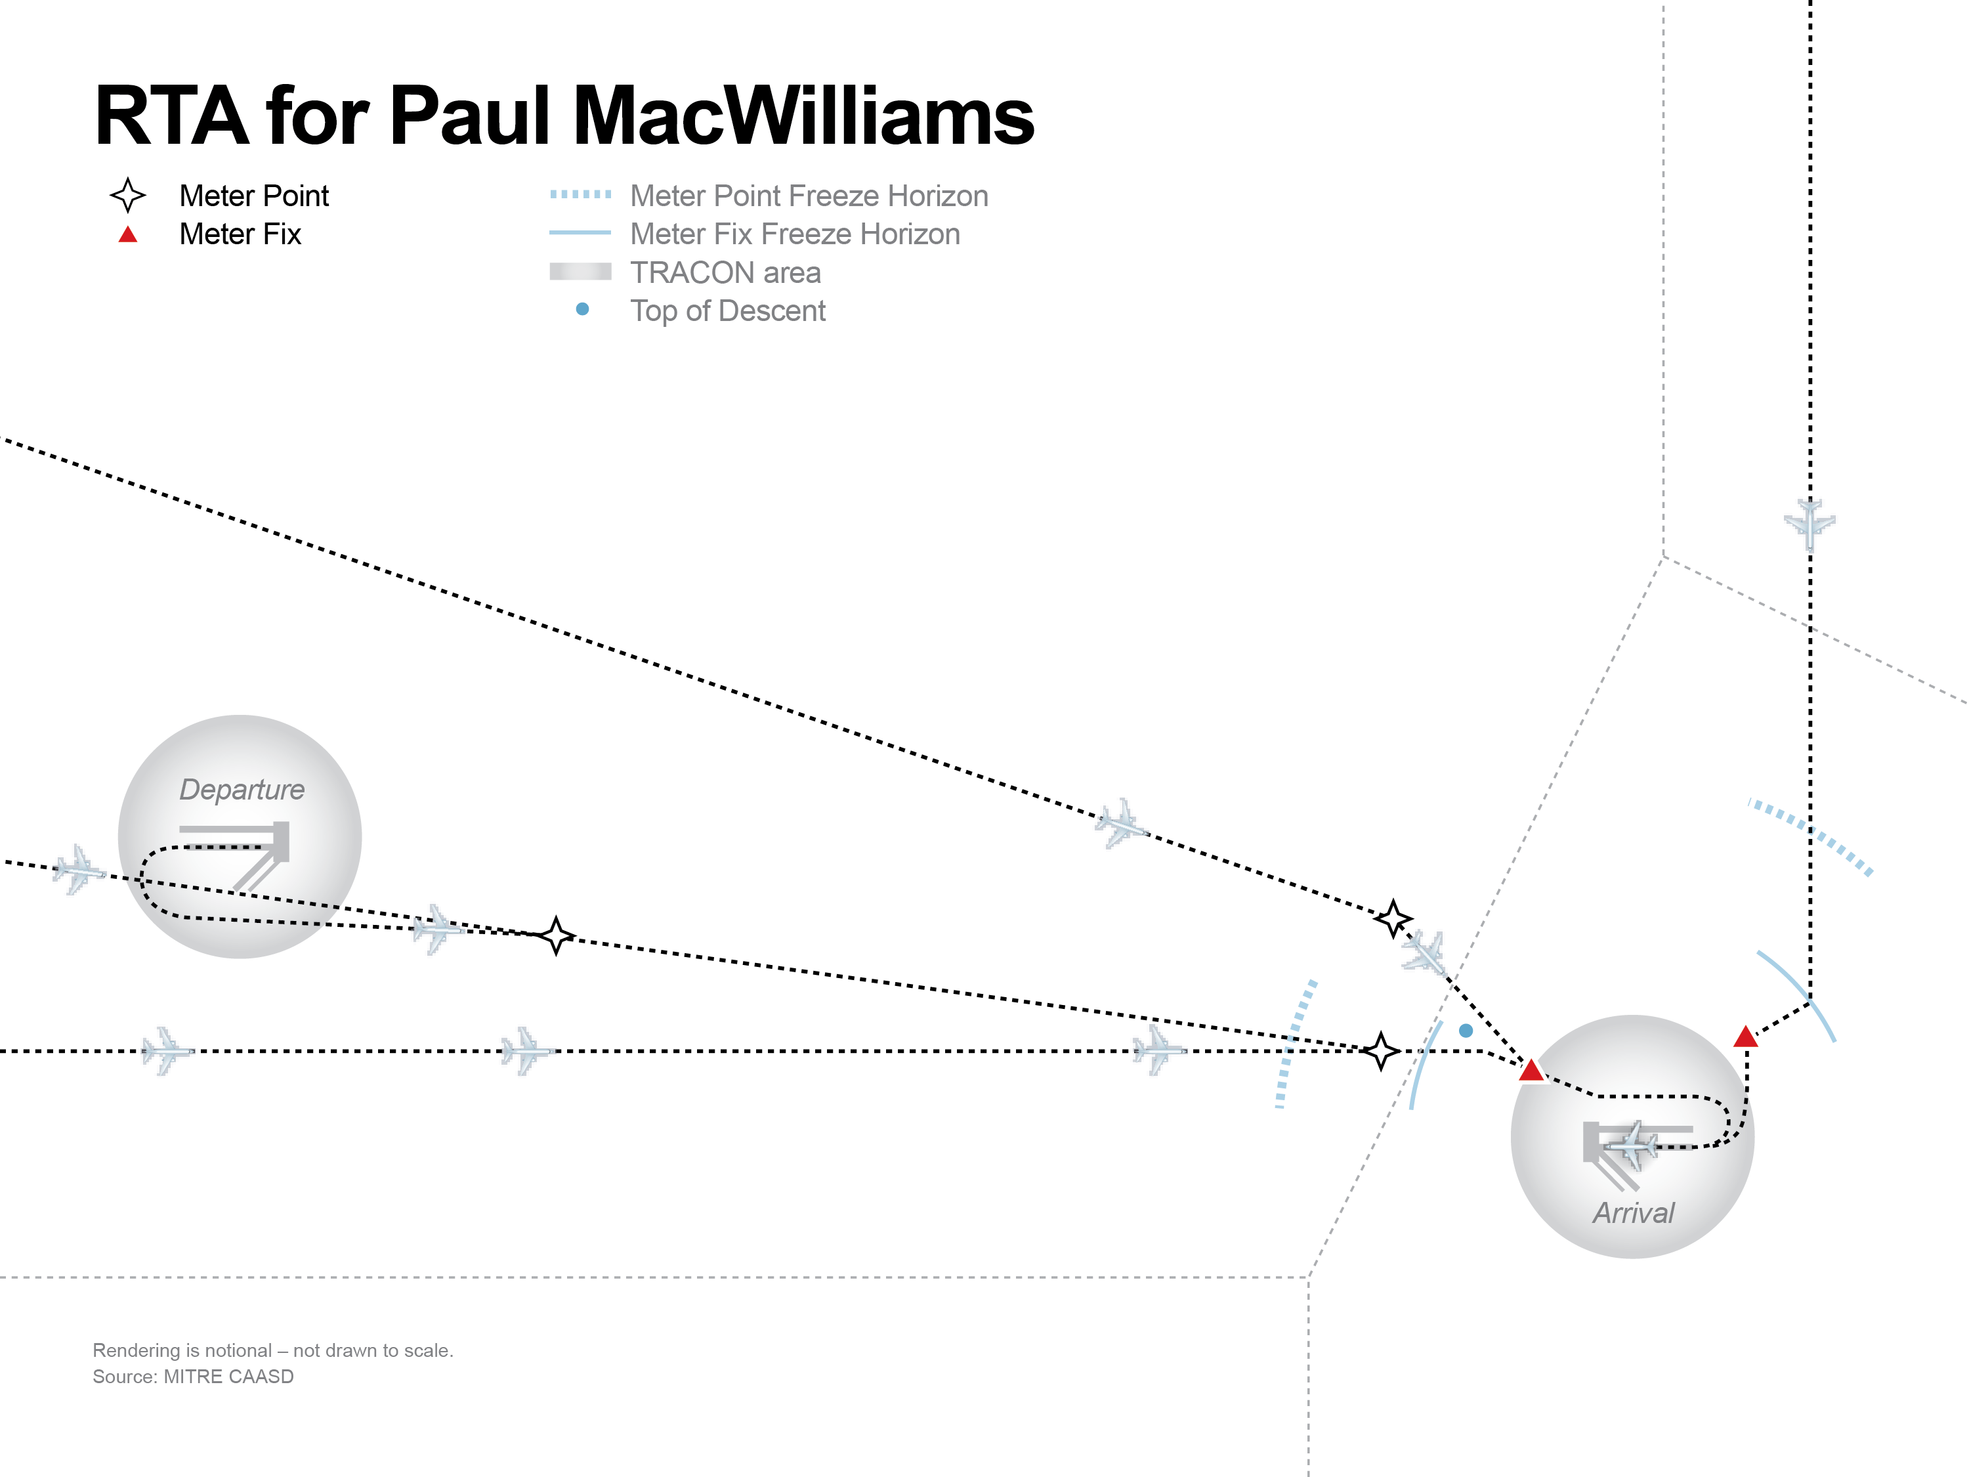
CATM Portfolio
Next Day+
Level 2 - Route Availability Planning Tool (RAPT) provides indication of departure route and fix blockage at NY metros and ORD
Level 1 - Collaborative Airspace Constraint Resolution (CACR) provides ability for FOCs to submit priority routes to avoid weather impact
Level 2 - Airport Acceptance Rate Decision Support (AARDS) allows traffic managers to maintain a strategic, multi-hour Airport Acceptance Rate (AAR) forecast
T- 8+ to 4 Hrs.
T- 0 to 60 min.
T- 4 to 2 Hrs.
T- 2 to1 Hrs.
Weather Event “T”
Level 3 - Arrival Route Availability Planning predicts flow blockage on last 90 minutes of flight
Level 4 - Integrated Departure Route Planning (IDRP) provides strategic insight on integrated traffic, weather, and available airspace capacity for departures
Segment Alpha
Segment Bravo

Slide 11
TBFM Portfolio
Flight Planning
(T-4 hrs)
Extended Metering extends the metering horizon beyond the nominal distance used today (150-200 nm)
Level 1 - Metering During Reroute Operations enables the continued use of metering during reroute operations in dynamic wx conditions
En Route Path Stretching provides automation to enable controllers to maneuver aircraft to meet metering times
Pushback/Taxi
Takeoff/ Climb
Descent/
Approach/Landing/
Taxi
Cruise
Segment Alpha
Segment Bravo

