Slide 1
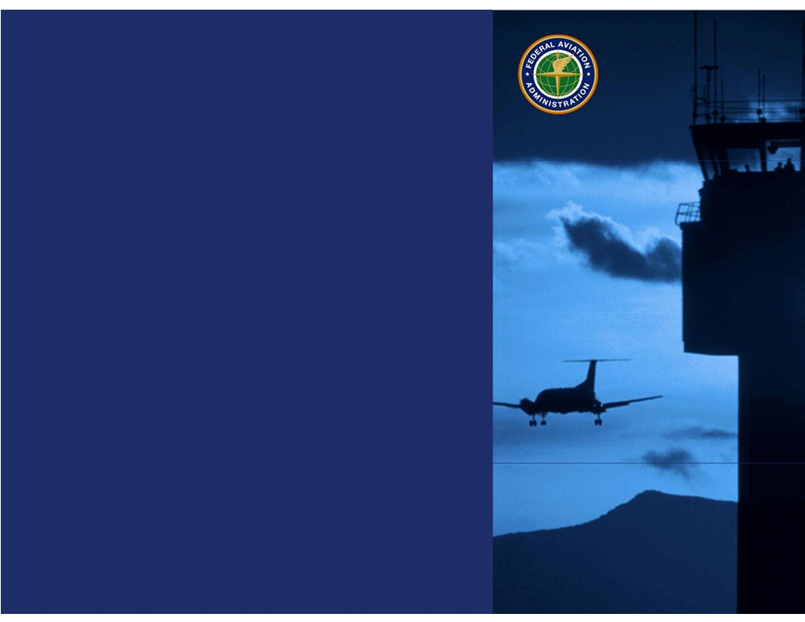
Technology
Development &
Prototyping Division
ANG-C5
Federal Aviation
Administration
RIRP Portfolio Update
Presented to: REDAC
Date: August , 2014

Slide 2
Runway Incursion Reduction Program (RIRP)
Why do we do what we do?
FAA Mission Needs Statement 323 (circa 1998):
  Runway Incursions (RIs) are a major problem affecting the safe operations of the nation’s airports.
Administrator’s Flight Plan 2006 – 2010
  Objective 3: Reduce the risk of runway incursions
Destination 2025 (2011)
  2018 Performance Metrics: Maintain the rate of serious runway incursions at or below 20 per 1000 events.
NTSB Recommendation A-91-30
  calls for the FAA to implement equipment aimed at reducing runway incursions
August 2014
Notes:
Runway Incursions have been recognized as a risk to aviation safety for at least twenty years. The Runway Incursion Reduction Program (RIRP) initiative is based on several recommendations and requirements.
The RIRP conducts research, development, and operational evaluation of technologies designed and developed to increase runway safety. Consistent with standing National Transportation Safety Board (NTSB) recommendations and initiatives identified in FAA Destination 2025, research emphasis will remain on technologies that provide for direct safety indications and alerts to pilots and air crews at large airports as well as those that can be applied cost effectively at small to medium airports.

Slide 3
Runway Incursion Reduction Program (RIRP)
Why do we do what we do?
  March 27, 1977: Fatal collision between two Boeing 747 passenger aircraft on the runway of Los Rodeos Airport on Tenerife, one of the Canary Islands. This crash killed 583 people, making it the deadliest accident in aviation history.
  August 27, 2006: Comair Flight 5191 Lexington, KY, to Atlanta, GA, crashed on takeoff, just past the end of the runway, killing all 47 passengers and two of the three crew. The aircraft was assigned Runway 22 for the takeoff, but used Runway 26 instead.
August 2014
Notes:
These two accidents illustrate the need for enhanced situational awareness, improved signage and markings, improved training for flight crews, and the development of runway incursion prevention technologies.

Slide 4
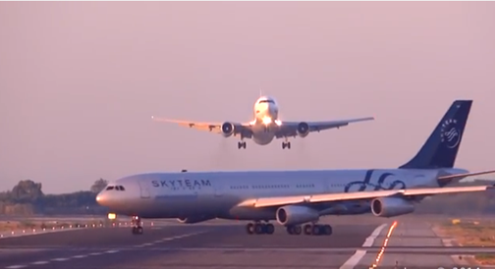
Runway Incursion Reduction Program (RIRP)
Why do we do what we do?
  April 24, 2014: Two planes nearly collided at Newark Liberty International Airport. United Express Flight 4100 was cleared to take off on runway 4R at the same time United Airlines Flight 1243 was landing on the intersecting Runway 29. The two aircraft passed within yards of each other.
  July 6, 2014: A passenger jetliner preparing to leave Barcelona’s El Prat airport taxied across a runway where another was about to land, forcing the arriving plane to abort its landing and climb sharply to avoid a possible disaster.
August 2014
Notes:
Here are two more recent incidents that could have been prevented through the implementation of conflict alerting systems.

Slide 5
Runway Incursion Reduction Program (RIRP) Projects
Runway Status Lights (RWSL) - transferred to PMO for implementation
Final Approach Runway Occupancy Signal (FAROS) - Discontinued
Low Cost Ground Surveillance (LCGS) - Cancelled by JRC
ADS-B Integration with LCGS - Cancelled by JRC
Enhanced FAROS (eFAROS) - June 2014 Flight Check at BOS
Runway Safety Assessment (RSA) – Market Survey Completed
August 2014
Notes:
RIRP portfolio of current projects.
Projects are owned by Runway Safety Office, and are funded through F&E dollars. These projects are actively managed by ANG-C5, the Technology Development and Prototyping Division.

Slide 6
Low Cost Ground Surveillance (LCGS)
RIRP Portfolio Update
Presented to: REDAC
Date: August , 2014

Slide 7
LCGS Pilot Program History and Status
In August 2007, Runway Safety Call to Action identified LCGS as potential technical solution to increase in Runway Incursions
Runway Incursion Reduction Program Office requested LCGS Investment Analysis Readiness Decision (IARD) from the Executive Council on May 26, 2009.
ATO EC delayed making a final decision; EC met again on July 7, 2009, and made the following decision:
    Directed team to continue with contract awards for the prototype systems
    Directed team to operate the prototype systems for two years
    Directed team to return to the EC with results of the operational evaluation
JRC meeting 6/19/2013 determined that LCGS not viable as a program
All 5 sites were powered down by 09/01/2013
All LCGS displays were removed from ATCT cabs as of 9/30/2013
All LCGS cameras were removed from ATCT and radar towers as of 9/30/2013
Final equipment and infrastructure inventory and bar coding was completed as of 11/01/2013
Schedule for LCGS infrastructure removal has been developed
August 2014

Slide 8
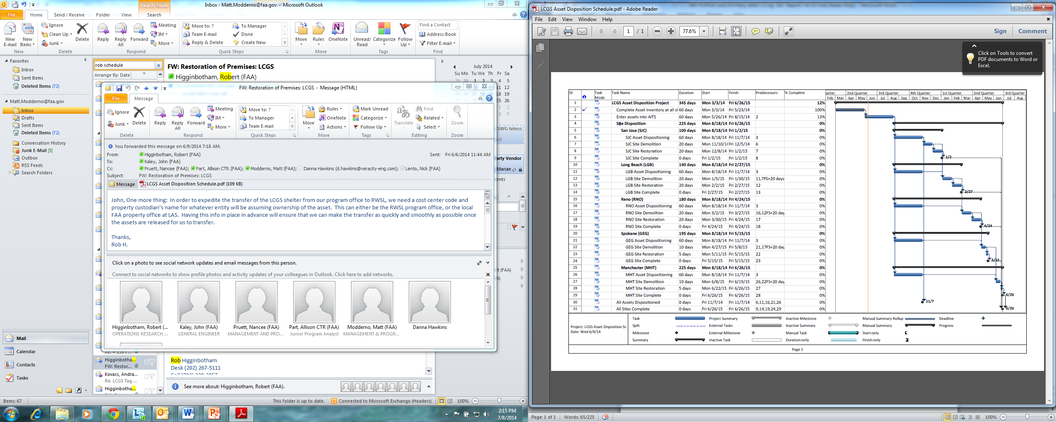
Notional Removal Schedule

Slide 9
Steps For Site Breakdown
1) Removal/Relocation of existing equipment racks located in shelter
2) Removal / crating of existing radar equipment located in shelter, including the disconnection of radar waveguide/transceiver/motor controller
3) Removal of electrical conduits between LCGS radar tower and shelter
4) Removal of copper ground leads to ground counterpoise
5) Removal of Ice Bridge connecting LCGS tower to shelter
6) Pull back of FAA single mode fiber from the shelter back to nearest pull box
7) Termination of existing power feed to FAA ATCT location (This will require support from the local Service Area)
8) Installation of Battery Operated Obstruction lights on LCGS radar tower until tower can be removed
August 2014

Slide 10

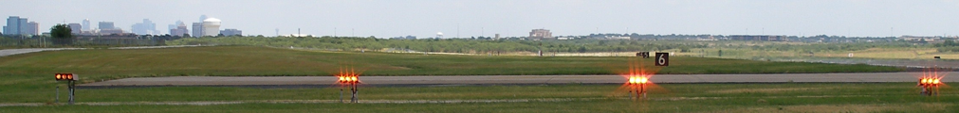
Enhanced Final Approach Runway Occupancy Signal (eFAROS)
RIRP Portfolio Update
Presented to: REDAC
Date: August , 2014
August 2014

Slide 11
Enhanced Final Approach Runway Occupancy Signal (eFAROS)
Enhanced-Final Approach Runway Occupancy Signal (eFAROS) uses surface surveillance with augmented safety logic to provide a visual warning to pilots on final approach that the runway is occupied and unsafe for landing. It does this by flashing the Precision Approach Path Indicator (PAPI) lights.
AJW-14 is providing design and engineering support for the development and implementation of eFAROS at RWSL test locations
Partners / Stakeholders
  Air Traffic Controllers
  AJW-14
  Airport Authorities (DFW, BOS)
  Local Tech-Ops personnel
August 2014
Notes:
11

Slide 12
Milestone Schedule
FY 14 Milestones
Q1
Q2
Q3
Q4
Develop quicklook report on shadow operations testing of the prototype eFAROS system at BOS. |  | Complete
Complete installation of the FPAPI units at BOS. |  | Complete | Complete
Conduct flight check of the FPAPI units installed at BOS, and commence 90-day Operational Evaluation of the prototype eFAROS system at BOS |  |  | Flight check Completed 06/22/2014
Develop a Preliminary Requirements Document (PRD) document, and commence the coordination of the Cost Benefits Analysis (CBA) document for eFAROS IARD.
August 2014
Notes:
12

Slide 13
FY14 eFAROS Activities
Completed to date:
Installed remaining FPAPI mod kits and COM at BOS – Apr/May 2014
Conducted ATC training and pilot outreach for eFAROS at BOS – May/Jun 2014
Conducted Flight Check and commence Operational Evaluation Testing (OET) of eFAROS at BOS – Jun 21-22, 2014
Planned:
Publish initial Preliminary Requirements Document (PRD) for eFAROS – Sep 2014
Publish updated Cost-Benefit Analysis (CBA) for eFAROS – Sep 2014
Commence “live” OpEval Oct 2014
August 2014

Slide 14
Surface Safety Initiatives Working Group
Runway Safety Assessment
Market Survey for RI Reduction Technologies
RIRP Portfolio Update
Presented to: REDAC
Date: August , 2014

Slide 15
ANG-C Market Survey - Overview
ANG-C5 issued a Market Survey on July 23, 2013 for Runway Incursion Reduction Technologies (Contract Opportunity ID: 14673).
The Market Survey solicits input on feasible technologies from industry partners and interested vendors. This survey is not a formal contract solicitation and is not intended to result in a contract award.
The intended outcome of the Market Survey is to evaluate one or more technologies which may be applied, or enhanced through additional research, to prevent runway incursions.
Market Survey closed on Aug 23, 2013; a total of 30 qualifying responses were received.
August 2014

Slide 16
ANG-C Market Survey - Assessment
Evaluation of the responses was conducted from 10/31/13 to 12/6/13.
The responses received were evaluated by a team of 8 FAA employees and contractors from ANG-C and AJI, consisting of SME’s in:
  ATC
  Engineering & Technology
  Program Management
  Runway Safety
The outcome of the evaluation process is focused on categorizing the responses by:
  the technical maturity of the proposal
  research viability within a 3-year timeframe
August 2014

Slide 17
Market Survey
Evaluation Team
Recommendations
August 2014

Slide 18
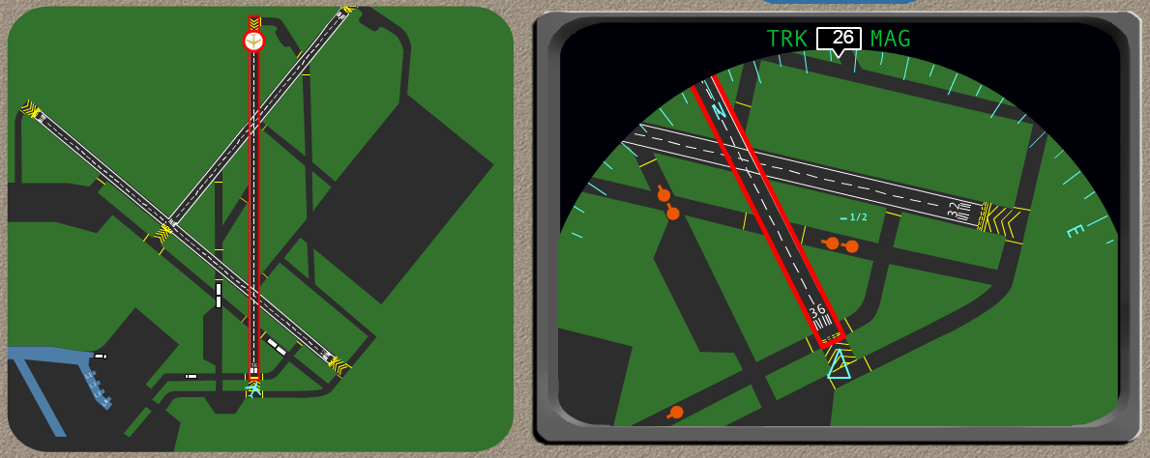
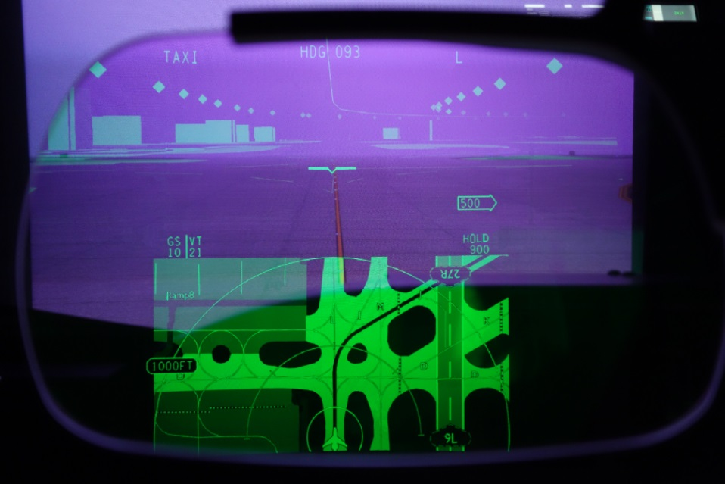
Rockwell Collins
Surface Guidance System/Digital Routing & EVS
  This proposal presented multiple technologies for DTPI including digital taxi routing and conformance, HUD and EVS. This system requires displays in the cockpit, and the vendor has already developed some of that technology. Some overlap exists with SURF IA, but it is far enough removed to warrant short term consideration.
August 2014
Notes:
DTPI = Direct to Pilot Indication

Slide 19
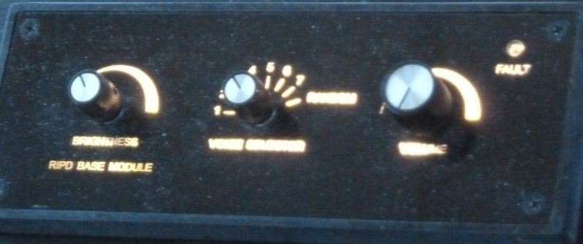
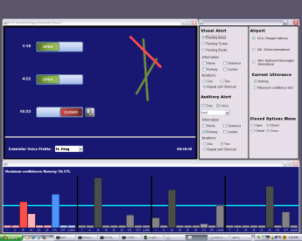
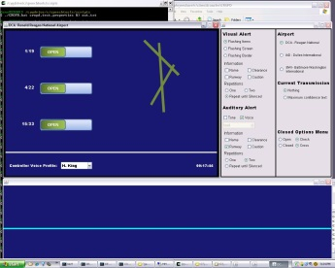
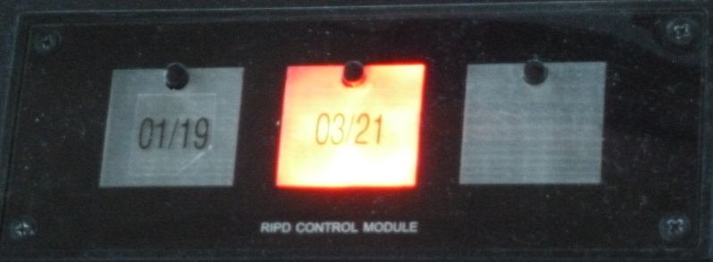

FAA Developed Controller Memory Aids
Runway Incursion Prevention Device
  The system is a memory aid for alerting controllers about locked-out runways that is being tested at MKC and MLI airports.
Closed Runway Operations Prevention Device
  Voice recognition system being developed by MITRE in collaboration with FAA Terminal Requirements.
August 2014

Slide 20
Northrop Grumman
Safety Decision Support Tool
  This system requires surveillance and voice recognition, technologies which already exist. It could be subjected, in the shorter term, to testing at ASDE-X equipped airports.
August 2014

Slide 21
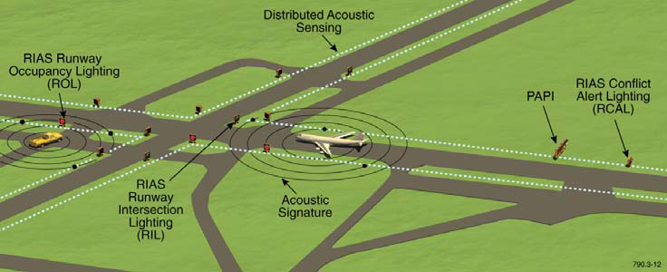
QinetiQ North America
Runway Incursion Alerting System
  RIAS is a layered approach using incremental surveillance sources such as DAS (Acoustic), Thermal cameras, and millimeter wave radar. The system is currently under testing by QinetiQ at PVD, and more recently at Potomac (VKX).
August 2014

Slide 22
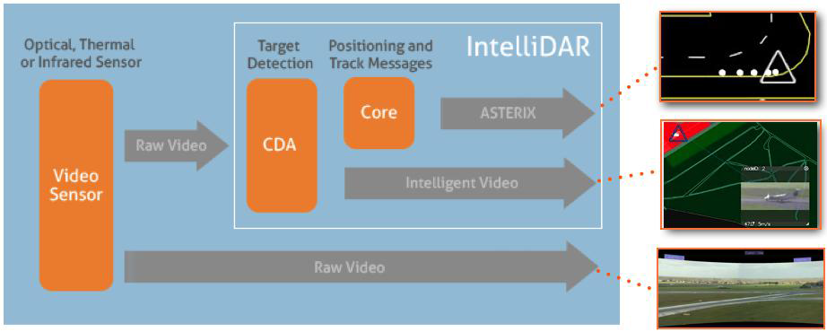
Searidge Technologies
IntelliDAR
  This system is based on real time video capture and processing for zone detection. It is primarily a surveillance tool with HMI capabilities for ATC, and is already being used in gate areas of airports in Canada. It is currently under evaluation for Non-Movement Area (NMA) application at WJHTC.
August 2014

Slide 23
Embry-Riddle Aeronautical University
Embry-Riddle Aeronautical University – INSPIRE
  Winner of FAA Design Competition 2013 that addressed Runway Safety/Incursions
  Provides navigational guidance by converting taxi instructions through the use of voice recognition software into a laser projection displayed directly on the windshield.
  Designed to increase pilot situation awareness (SA); targeted at GA aircraft.
August 2014

Slide 24
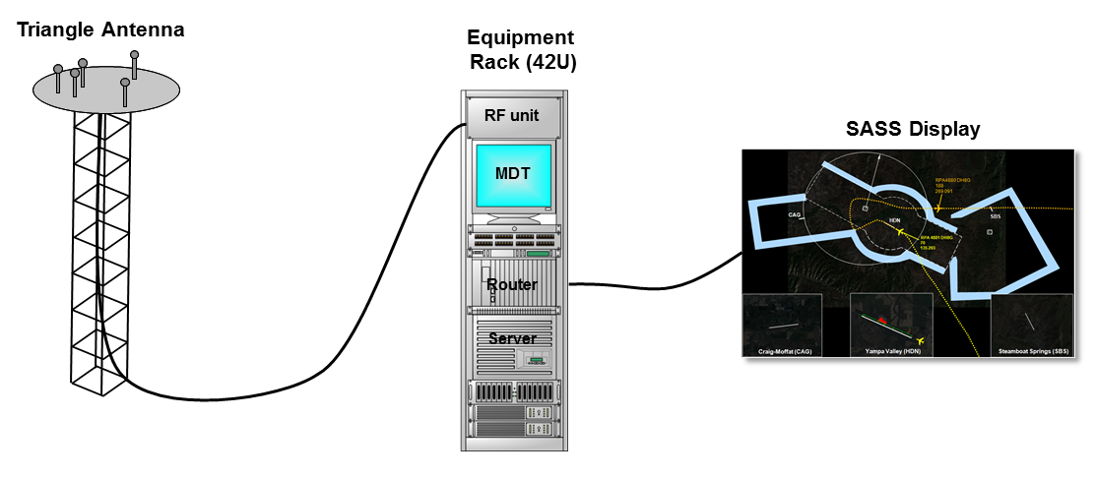
MIT Lincoln Labs
Small Airport Surveillance Sensor (SASS)
  Uses small, non-rotating antenna arrays and digital processing capabilities
  Provides secondary surveillance for non-ADS-B equipped aircraft
  Supports surveillance & validation for ADS-B equipped aircraft
  Supports Mode S data link capability (e.g., TIS-B) & UAT
  Team plans to investigate whether this technology could be adapted to provide surface safety benefits.
August 2014

Slide 25

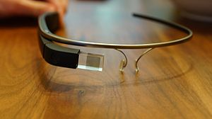
FAA - Advanced Concepts and Technology
HUD technology in the ATCT
  Study to re-evaluate the use of modern HUD technology in the ATCT.
  System could provide air traffic controllers with a real-time, user selectable source of meteorological, airport surface, and runway safety information displayed on the ATCT glass that is head-up and continually in their field of view (FOV) and scan.
August 2014

