Slide 1
Deep Dive Review of General Aviation (GA) Safety Projects
Weather Technology in the Cockpit (WTIC)
BLI A12.d
By: Gary Pokodner (WTIC Program Manager)
Date: August 5, 2014

Slide 2
Presentation Goals
WTIC Overview of General Aviation Research Tasks
Recap GA Accident Statistics
Summary of the Partnership to Enhance General Aviation Safety, Accessibility and Sustainability (PEGASAS) Projects
Deep Dive on the Four PEGASAS Projects
Discussions and Questions
2

Slide 3
WTIC Research Tasks - GA
Identify causal factors for GA Wx-related accident rate
Identify shortfalls in pilot understanding and proper use of MET information, and pilot training to resolve those shortfalls
Recommend minimum weather service for Part 91 aircraft to enable consistent and effective pilot decision making relative to adverse weather
  Minimum cockpit MET information needed
  Minimum accuracy, latency, and availability of cockpit MET information
  Minimum information rendering standards needed to enable correct and consistent interpretation
Determine GA willingness to spend on aircraft equipage and services to enable proper implementation and use of the minimum weather service
Notes:
3

Slide 4
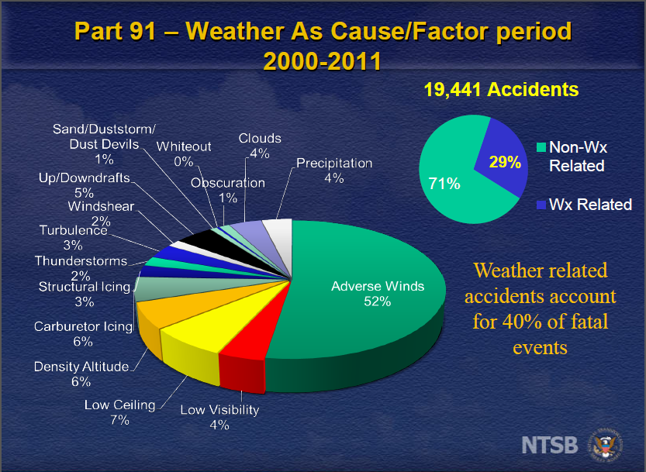
Identifying GA Safety Areas
29% of all GA accidents and 40% of fatalities are classified as being weather related between 2000-2011
WTIC and AWRP research is focused on identifying and addressing weather-related risks before they become accidents
To address these issues, research will address gaps in cockpit weather information, human factors associated with weather information displays, and enhanced pilot weather decision making
NTSB Briefing Slide – Summer 2013 FPAW
14CFR Part 830, Section 830.2, Definitions
"Aircraft Accident" means an occurrence associated with the operation of an aircraft that takes place between the time any person boards the aircraft with the intention of flight and all such persons have disembarked, and in which any person suffers death, or serious injury, or in which the aircraft receives substantial damage. *

Slide 5
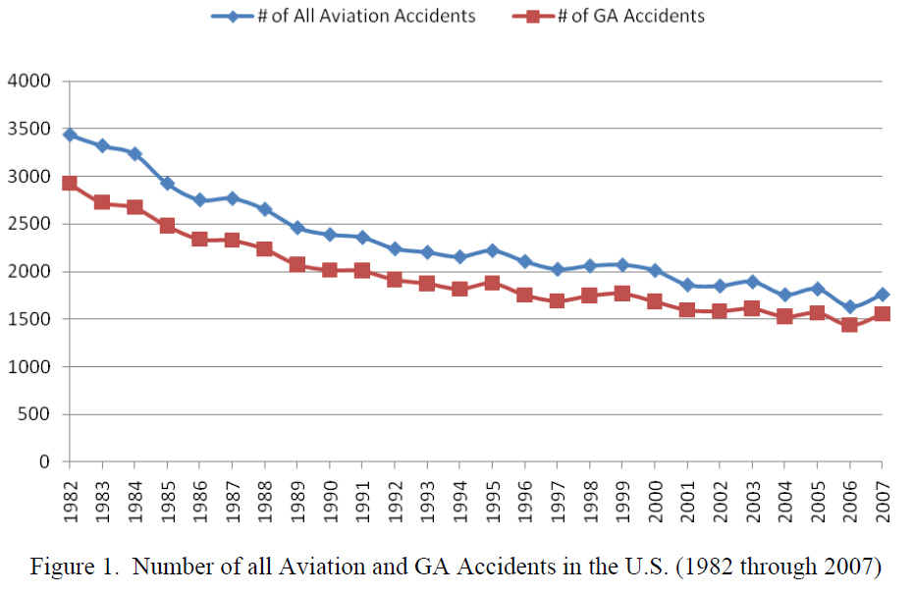
Identifying GA Safety Trends
GA accident rate has flattened out since 2001
Overall GA accident rate (per 100k hours) is not declining
WTIC research will focus on the weather-related factors
WTIC research is first identifying why the GA accident rate has not decreased in spite of the advances made in cockpit weather information and technology
* A Database Management System for General Aviation Safety, DOT/FAA/AR-xx/xx, December 2010
* https://www.aopa.org/About-AOPA/Statistical-Reference-Guide/General-Aviation-Safety-Record-Current-and-Historic.aspx#gaaccidents

Slide 6
PEGASAS – FAA Center of Excellence (COE) for GA
PEGASAS identified areas of research to enhance GA safety
As a COE, they operate under a grant
  Work and deliverables are less specific and intended to provide broader benefits
  COEs must provide cost matching providing better value
Research to support WTIC Part 91 minimum weather service development was grouped into four separate weather related projects
  Each project bid in two phases: (1) gap identification, (2) gap resolution development and verification
  Currently only phase 1 funded for each project

Slide 7






PEGASAS – Core Universities
Core universities serving as project leads
  Multiple affiliate universities supporting them

Slide 8
PEGASAS Projects Summary
Project A – Quantify Causality
  Expand accident/incident causal research
Project B – Inadvertent Flight from Visual Flight Rules (VFR) to Instrument Meteorological Conditions (IMC)
  Address unexpected transitions from VFR to IMC
Project C – GA Weather Alerting
  Assess feasibility and benefits of agile, low latency cockpit weather alerts
Project D – GA MET Information Optimization
  Evaluate utility of selected MET products to support pilot decision making

Slide 9
PEGASAS Projects - Overview
Deliverables are on schedule
Results presented are interim and were based on June deliverables
Deliverables to date include planning documents and preliminary research with a few initial findings
  Final reports due at the end of 2014

Slide 10
Project A – quantify GA accident Causality

Slide 11
Project A - Overview
Research Objectives
  Determine causal factors of why the weather-related accident rate for the GA segment has not decreased more in spite of commercial advances in MET cockpit technology and information
  Develop risk rating of various adverse weather conditions and scenarios based on accident and incident reporting
  Make recommendations for Part 91 minimum weather service attributes to resolve gaps/shortfalls

Slide 12
Project A Tasks
Product and services research
  Develop a data base that highlights MET technologies, their capabilities and their marketing features
Develop weather condition indexing tool
  Used to log weather conditions of accidents/incidents
  Determine weather contributing factors in GA accidents
Develop weather factor risk matrix
  Using index tool, develop objective risk assessment of adverse weather conditions
  Risk matrix to enable objective rating of pilot decision making to avoid adverse weather

Slide 13
Project A – Accomplishments to Date
Developed inventory of current weather technologies and information
Examined visual indications of weather information delays
Compiled a listing of vendor marketing points (samples in Backup)
Developed weather indexing tool (samples in Backup)
Numerous NTSB / ASRS reports analyzed

Slide 14
Project A – Interim Findings
In-cockpit weather products and information offerings are dynamic
Feature-based marketing of products versus use and benefits-based
No standards for how weather products are displayed
Varying delays in weather information
  Location of weather
  Age of information
Weather-related GA accidents primarily pilot decision errors
  Non-weather related GA accidents primarily skill based

Slide 15
Project B – Inadvertent flight from VFR into IMC

Slide 16
Project B – Overview
  Research Objectives
  Gain a deeper understanding of why GA pilots continue to be involved in incidents and accidents from continued flight under VFR into deteriorating weather
  Develop strategies for reducing the risk of this type of incident/accident
  Make recommendations for Part 91 minimum weather service attributes to resolve gaps

Slide 17
Project B – Tasks
Perform data collection and analysis of VFR flight into IMC accident/incident reports
  VFR into IMC Accidents occurring in the United States
  Part 91: General Aviation Operation
  Airplanes
  10-year period of study (2003 through 2012)
  Information/data source is the NTSB Aviation Accident Database

Slide 18
Project B – Accomplishments to Date
Reviewed AOPA Air Safety Institute (ASI) database and the NTSB database to identify accident reports associated with IMC
  Approximately 1100 IMC accidents were identified and reviewed.
  319 accident cases were identified as VFR Flight into IMC
Specific data associated with each case put into database

Slide 19
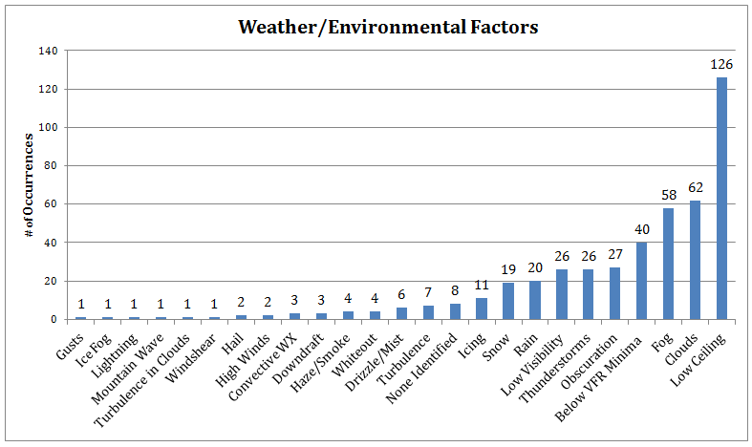
Project B – Interim Findings
“visibility” factors account for 74% of all weather and environmental accident factors from 2003 - 2012

Slide 20
Project B – Interim Findings
In analyzed reports pilot recognition of IMC below 20%
  Comparable to Tech Center HF Study which found lowest recognition in the 25% range in low stress scenario (coincidental?)

Slide 21
Project c – adverse weather alerting functions

Slide 22
Project C – Overview
Research Objectives
  Assess capability of agile, low latency cockpit weather alerts to identify adverse weather with minimal pilot analysis
  Increase understanding of the impacts of alert interfaces and assimilation factors on GA pilot decision making
    Improved situational awareness and risk reduction
  Make recommendations for Part 91 minimum weather service attributes for alerting functions to resolve/reduce identified gaps and shortfalls
Notes:
The “Bottom Line Up Front (BLUF)” slide
Provide a one-slide overview of the entire presentation
Why is this important to the FAA
Important findings / results
Important (first) next steps

Slide 23
Project C - Tasks
Develop Scenario Catalog of relevant use cases for low latency weather alert functions.
  Catalog will classify use cases for issuing a low latency weather alert according to weather event or condition
Develop Weather Alert Catalog of candidate graphical, audible, and/or multisensory alerts
Perform low fidelity simulation study to assess the benefits of the candidate weather alert functions
  Determine feasibility for evaluation in Phase II

Slide 24
Project C – Accomplishments to Date
Completed literature review to identify MET information gaps and shortfalls associated with safety risks that may be mitigated by an alert
Developed flight scenarios and use cases
Designed study methodology, simulation, evaluation tools, and inter-rater reliability to be used in feasibility study data collection
Notes:
The “Bottom Line Up Front (BLUF)” slide
Provide a one-slide overview of the entire presentation
Why is this important to the FAA
Important findings / results
Important (first) next steps

Slide 25
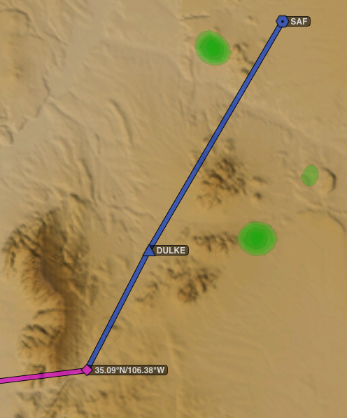
Project C – Accomplishments to Date
Sample Scenario
The route from Santa, Fe (KSAF) to Albuquerque, NM (KABQ).
Consists of gradually rising terrain during the first two-thirds of the flight, followed by a dramatic elevation change during the last third.
The flight includes two possible weather encounters, Mountain wave turbulence and mountain obscuration.
Notes:
The “Bottom Line Up Front (BLUF)” slide
Provide a one-slide overview of the entire presentation
Why is this important to the FAA
Important findings / results
Important (first) next steps

Slide 26
Project C – Interim Findings
Literature review identified key dimensions for investigation (final decisions pending pilot testing)
  Graphical vs. simple textual-based
    Textual-based with additional encoding (e.g., symbology, color-coding)
  Information access
    Call for more info
    Available via selectable menu
    Immediately displayed
  Attention-directing qualities
    Visual indication
    Auditory cue
  Alerts issued with low or high latency
    low: immediate “textual and symbology message”
    high: graphical data ~10 minutes old when arrives

Slide 27
Project C – Interim Findings
Review of recent research, accidents and incidents, suggests the following could contribute to gaps in the effective use of cockpit weather information
  Lack of formal training for new technology use
    No formal logbook endorsement/checkout required when transitioning to highly advanced avionics (similar to other logbook endorsements FAR 61.31(a), 61.31 (g) FAR 61.31
  A need to ‘call attention to’ and increase understanding of potential alerts; (e.g., AIRMET)
  Lack of understanding of actions necessary to obtain information through other sources, when failures occur with technology

Slide 28
Project C – Interim Findings
  Lack of understanding of Data Integrity/Limitations of use
  Overload of Information
  Over-reliance on technology
  Decision Making associated with the displayed information
  Personal minimums related to the displayed information
  Temptation to accept more risk with more information/automation
  Need to confirm information with visual conditions and other information when appropriate
  Strategic vs. Tactical use of information
  Recognizing/prioritizing conflicting information

Slide 29
Project d – GA met information optimization

Slide 30
Project D - Overview
Project D Research Objectives
  Assess current GA MET technology capabilities and processes to access information and support pilot decision making
    Identify “Human Factors” and “Human-System Integration” shortfalls
    Identify tasks and procedures associated with weather briefing in day-of, flight line, and en route weather information scenarios
    Determine variety of devices and associated challenges with processes for logging briefings
  Assess complexity and work load to accomplish tasks
  Make Part 91 Minimum Weather Service recommendations for cockpit MET technology optimization
Notes:
The “Bottom Line Up Front (BLUF)” slide
Provide a one-slide overview of the entire presentation
Why is this important to the FAA
Important findings / results
Important (first) next steps

Slide 31
Project D - Tasks
Catalog MET products / tools in use and provide a justification of products / tools selected for detailed evaluation
  Provide updates of research and advisory literature involving MET information issues using current products / tools
Assess procedures, following steps, challenges, and workload in selected products / tools
  Identify Human Factors issues with using selected MET products to complete basic GA pilot tasks
Analyze selected tasks (ie, obtain updated weather briefing on aircraft)

Slide 32
Project D – Accomplishments to Date
Identification of multiple hardware and software systems for obtaining aviation weather
Completed Pugh Matrix using 800-WX-BRIEF as baseline
  Compared multiple hardware and software systems
Completed analysis of process to “obtain updated (standard or abbreviated) weather brief” at aircraft
Notes:
The “Bottom Line Up Front (BLUF)” slide
Provide a one-slide overview of the entire presentation
Why is this important to the FAA
Important findings / results
Important (first) next steps

Slide 33
Project D – Interim Findings
Detected significant discrepancies in system capabilities for “obtain updated weather brief” task
New technologies have pros and cons
  Most popular tools may not have TAF, PIREP, AIRMET, etc.
  Technology integration (WiFi + Stratus example)
  Options for filing and logging?
Unexpected, Important Task and Procedure Distinctions
  Human Factors of getting information vs. Human-Systems Integration of flight activity logging
  Setup and proactive tasks to change / simplify / influence en route pilot workload and task performance

Slide 34
Project D – Interim Findings
Sample results based on assessment of “obtain updated weather briefing” task showing sample pros and cons of systems

Slide 35
Backup Slides

Slide 36
Project A - Sample Indexing Forms
Weather | ☐ Low IMC ☐ IMC ☐ Marginal VMC ☐ VMC
Wind | Direction _______° | Speed ______ kts | Runway used _____ If not runway in use, why not? | HW _______ kts XW _______ kts TW _______ kts
Visibility | Distance ______ SM | Obstructions reported: ☐ FG ☐ BR ☐ HZ ☐ FU ☐ DU ☐ SA ☐ VA ☐ BLPY
Precipitation type | ☐ None ☐ Non-convective ☐ Convective ☐ Unknown | Liquid: ☐ DZ ☐ RA ☐ UP | Freezing: ☐ FZDZ ☐ FZRA | Frozen: ☐ SN ☐ SG ☐ PL ☐ GR ☐ GS
Cloud layers | ☐ SKC/CLR ☐ FEW _____ ☐ SCT _____ ☐ BKN _____ ☐ OVC _____ ☐ VV _____ | ☐ SKC/CLR ☐ FEW _____ ☐ SCT _____ ☐ BKN _____ ☐ OVC _____ ☐ VV _____ | ☐ SKC/CLR ☐ FEW _____ ☐ SCT _____ ☐ BKN _____ ☐ OVC _____ ☐ VV _____ | ☐ SKC/CLR ☐ FEW _____ ☐ SCT _____ ☐ BKN _____ ☐ OVC _____ ☐ VV _____
Temp/DP | Temp _____°C | DP _____°C | Freezing level _______’
Altimeter setting | ________” Hg | Field elevation ________’ | PA ________’ | DA _______’
Pertinent WX remarks
Icing | Forecast? | Reported? | Conditions exist? | Frost?
Wind Shear | Forecast? | Reported?
Weather
Winds Aloft | Direction _______° | Speed ______ kts | HW _______ kts XW _______ kts TW _______ kts
Visibility | Distance ______ SM | Obstructions reported: ☐ FG ☐ BR ☐ HZ ☐ FU ☐ DU ☐ SA ☐ VA ☐ BLPY
Precipitation type | ☐ None ☐ Non-convective ☐ Convective ☐ Unknown | Liquid: ☐ DZ ☐ RA ☐ UP | Freezing: ☐ FZDZ ☐ FZRA | Frozen: ☐ SN ☐ SG ☐ PL ☐ GR ☐ GS
Cloud layers | ☐ SKC/CLR ☐ FEW _____ ☐ SCT _____ ☐ BKN _____ ☐ OVC _____ ☐ VV _____ | ☐ SKC/CLR ☐ FEW _____ ☐ SCT _____ ☐ BKN _____ ☐ OVC _____ ☐ VV _____ | ☐ SKC/CLR ☐ FEW _____ ☐ SCT _____ ☐ BKN _____ ☐ OVC _____ ☐ VV _____ | ☐ SKC/CLR ☐ FEW _____ ☐ SCT _____ ☐ BKN _____ ☐ OVC _____ ☐ VV _____
Temp/DP | Temp _____°C | DP _____°C | Freezing level _______’
Altimeter setting | ________” Hg | Cruise Altitude __________’ | PA ________’ | DA _______’
Pertinent WX remarks
Icing | ☐ None ☐ Trace ☐ Light ☐ Moderate ☐ Severe | ☐ NEG ☐Clear ☐ Rime ☐ Mixed | Conditions exist, as reported by other aircraft?
Turbulence | ☐ None ☐ Convective ☐ CAT | ☐ NEG ☐ Light ☐ Moderate ☐ Severe ☐ Extreme | Conditions exist, as reported by other aircraft?
Landing weather

Slide 37
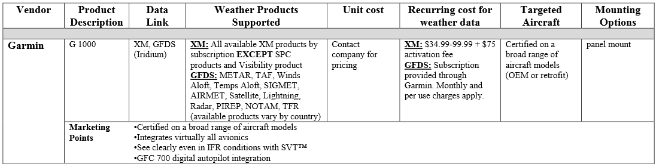
Project A – MET Technology Excerpt
Marketing aspects
  Majority DO NOT provide recommendations on use, limitations of use, or safety benefits

Slide 38
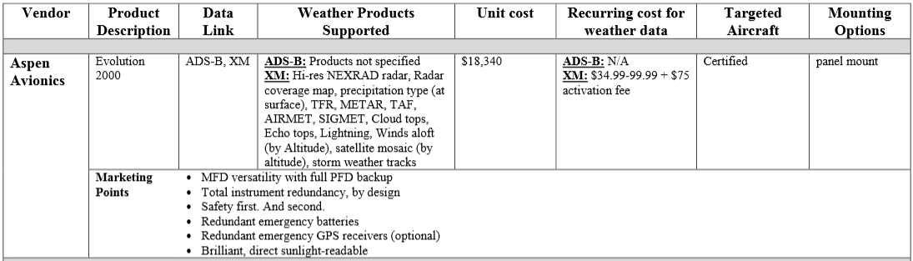
Project A – MET Technology Excerpt

