Slide 1
REDAC NASOps Spring 2014 Review
Operational Concept Development & Infrastructure
BLI Number: 1A01C
By: Rob Hunt, AJV-73
Date: March 2014

Slide 2
Mission Support Services (AJV) Organizational Chart
Senior Technical Advisor
AJV-0
Edie Parish
Vice President
AJV-0
Elizabeth Lynn Ray
Executive Assistant
AJV-0
Valentina Smith
Senior Advisor
AJV-0
Rodger Dean (A)
Deputy Vice President
AJV-0
Bill Davis
Special Projects
AJV-0
Wayne Eckenrode
Airspace Services
AJV-1
Director
Dennis Roberts
Aeronautical Information Management
AJV-2
Director
Joshua Gustin
AeroNav Products
AJV-3
Director
Abby Smith (A)
ATO Operational Concepts, Validation & Requirements
AJV-7
Director
Greg Burke
Air Traffic Procedures
AJV-8
Director
TBD
Eastern Service Center
AJV-E
Director
Mark Ward
Central Service Center
AJV-C
Director
Gus Nezer
Western Service Center
AJV-W
Director
Ron Beckerdite
Deputy Director
AJV-1
Frank Black
National Flight Data
Center Group
AJV-21
Dick Powell
En Route Products Group
AJV-31
George Davis
Process & Publications Group
AJV-81
Senior Advisor
AJV-E
(A) Debra Fay
Senior Advisor
AJV-C
Sharon Rushing
Senior Advisor
AJV-W
Kimberly Flanigan
Deputy Director
AJV-1
Richard Jehlen
Senior Advisor
AJV-1
Leslie Swann
Visual Charting & Airport
Mapping Group
AJV-32
Eric Freed
Air Traffic Control Procedures Group
AJV-82
Quality Control Group,
AJV-E1
(A) John Myles
Quality Control Group,
AJV-C1
Tony Roetzel
Quality Control Group,
AJV-W1
Chuck Chamberlain
Geographic Services
Group
AJV- 22
Dick Powell
Process Control
Services Group
AJV-71
Pamela Curry (A)
Airspace Regulations Group AJV-11
(Acting) Gary Norek
Data System Architecture
Group
AJV-23
Dan Gerecht
Product Support
Group
AJV-34
Karen Gonzalez
Operations Support Group,
AJV-E2
Kip Johns
Operations Support Group,
AJV-C2
David Medina
Operations Support Group,
AJV-W2
Clark Desing
Airspace Optimization Group
AJV-12
(A) Howie Callon
ATO Operational
Concepts Group
AJV-72
Sharon Kurywchak
AIM Operations Group AJV-24
(Acting) Glenn Sigley
Terminal Products
Group
AJV-35
Gregory Yamamoto
Planning and
Requirements Group,
AJV-E3
Ryan Almasy
Planning and
Requirements Group,
AJV-C3
Denise Knight
Planning and Requirements
Group
AJV-W3
James Valle
PBN Policy & Support Group
AJV-14
(A) Sharon Abhalter
Technical Analysis &
Operational
Requirements Group
AJV-73
Rob Hunt
Engineering Support Group
AJV-25
Jim Scott
Production Technology
& Air Traffic Products Group
AJV-36
Eric Secretan
Business Services Group,
AJV-E4
Larry Barts
Business Services Group,
AJV-C4
Jeff Tague
Business Services Group,
AJV-W4
Jay Egbert
Obstruction
Evaluation Group
AJV-15
John Page
AIM Systems Group
AJV-26
Glenn Sigley
AeroNav Products
Logistics Group
AJV-37
Patricia Banks
Administrative Services Group,
AJV-E5
Maria James
Administrative Services Group,
AJV-C5
Lyndon Dyer
Administrative Services Group,
AJV-W5
Julie Fidler
Business Support
Group
AJV-17
Steve Holliday
Terminal & En Route
Oceanic Airspace Group
AJV-18
Martin Adams

Slide 3
AJV-7 Organizational Relationships
ATO Ops
AJM
Program Execution
Expert Teams
NextGen
Organizational
Relationships
NextGen
AJR
AJT
AJW
AJI
AJM-2
AJM-3
Service Areas
Evals,
Alts,
Trades,
Opportunities
Needs & Shortfalls
Needs & Shortfalls
Needs & Shortfalls
Needs & Shortfalls
Needs & Shortfalls
Prioritized Requirements
Mission Support
AJV-7
Process Control (AJV-71)
Operational Concepts
(AJV-72)
Concept Dev, Shortfall Analysis, Maturity Assessment
Operational Requirements
(AJV-73)

Slide 4
AJV-7 Organizational Framework
Process Control AJV-71 | Process design, facilitation, and continuous improvement utilizing quality metrics Design, develop and execute quality assurance and control Defining monitoring and performance metrics of defined processes Manage and maintain (operations) PLA master database Provide business services (financial and contract management, etc)
Operational Concepts AJV-72 | Cross-ATO coordination and engagement of service units to create: Operational shortfalls, concept exploration and scenario development Prioritized needs for future development & releases Singular operational input (response) to documents describing the future environment, including NSIP, NGIP, NAS EA, etc. Day to day operations in the NAS Recommend improvements and establish criteria and standards for implementation of Terminal and EnRoute systems Determine operational suitability Validate equipment
Operational Requirements AJV-73 | Technical analysis & validation of operational concepts and scenarios, including: Generation of use cases derived from the concepts & scenarios Generation of prioritized operational requirements Identification and conduct of analyses, modeling, and simulations In collaboration with AJV-72, conduct/document shortfall analyses, concept development, and concept validation Development of operational & functional requirements Manage projects through Service Analysis and CRD Lead the development/progress of investments up to IARD Milestone in AMS (materiel/non-materiel) and develop required documentation (e.g. CONUSE, pPR, projected costs/benefits, EA artifacts, etc) Conduct requirements continuity analysis and implementation planning support as investments move further through AMS

Slide 5
Operations Concept Development & Infrastructure/ BLI Number: 1A01C
What are the benefits to the FAA
The activity supports the FAA’s Strategic Initiatives by delivering benefits through technology and infrastructure; Concept validation supports development, analysis, and simulation of new concepts to assess requirements and to evaluate the impact of the concept on system capacity, efficiency, safety and human performance. Evaluation criteria include the following:
• Impact/Improvement to Air Traffic Service Providers, airspace users, and automation that could increase capacity,
• Impact/Improvement on airspace structure which may increase productivity and hence capacity,
• Impact/Improvement on communication, navigation, and surveillance (CNS) requirements to support the FAA's efforts to reducing cost, increasing capacity and efficiency and;
• Impact/Improvement on automation, display, and facility configuration elements to increase productivity and hence capacity.
What determines program success
Success is measured by the completion of the goals identified in multi-year plans developed for each activity. Initiatives that successfully complete all the project goals identified are then presented as candidates for acquisition.

Slide 6
Anticipated Research in FY14-15 ATDP Operations Concept Validation & Infrastructure Evolution
Unmanned Aircraft Systems (UAS) Concept Maturation
Objective: Enable the future increased use of UASs in the NAS
Activities: Scenario development/execution, functional analysis, requirements development
Operational Integration Analysis
Objective: Identify possible operational integration issues amongst emerging concepts, and amongst emerging concepts and existing operational capabilities
Activities: Scenario development/execution, mitigation recommendations (e.g. further research, requirements)
Enterprise-Based Information Delivery and Dissemination
Objective: Create an enterprise-based perspective and delivery/dissemination platform for AT support information (existing information and new information planned to be available in the mid-term)
Activities: Shortfall analyses, conceptual solutions, requirements development
National Special Activity Airspace (SAA) Concept Maturation
Objective: Improve the scheduling and real-time use of SAA in the NAS
Activities: Concept validation, CONOPs revision, requirements development, requirements allocation
Advanced Interval Management Concept Exploration
Objective: Evaluate advanced interval management applications
Activities: Concept development, high-level CONOPs
RTCA Support
Continued support of international standards and public/private collaboration
6

Slide 7
Emerging FY16 Focus Areas ATDP Operations Concept Validation & Infrastructure Evolution
Unmanned Aircraft Systems (UAS)
Objective: Further validation of lower-level UAS concepts
Potential Activities: HITL exercises, Part Tasks, updated functional analysis and requirements
Operational Integration Analysis
Objective: Continued examination of possible operational integration issues as emerging concepts evolve and new concepts are planned for the mid-term
Potential Activities: Scenario development/update/execution, mitigation recommendations (e.g. further research, requirements)
PBN Optimization
Objective: Expand the efficient use of PBN procedures in the NAS
Potential Activities: Shortfall analyses, concept exploration, CONOPs development, procedural recommendations
Advanced Interval Management
Objective: Mature advanced interval management applications
Potential Activities: Concept validation through scenario development/execution, HITLs exercises, Part Tasks
RTCA Support
Continued support of international standards and public/private collaboration
7

Slide 8
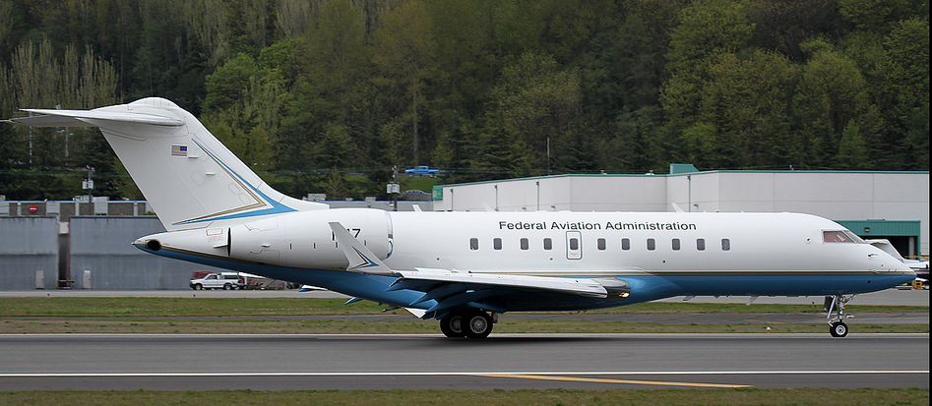
ATDP - Operations Concept Validation and Infrastructure Evolution –
Description:
Develop, mature, and validate near/mid-term emerging operational concepts to improve the capacity and efficiency of the NAS
Identify and mitigate operational integration concept challenges, focusing on optimizing the integration amongst emerging concepts, and amongst emerging concepts and existing NAS capabilities
Advance an enterprise-based perspective to the evolution of NAS capabilities, enabling a more integrated, synchronized, and sustainable NAS
Partnerships:
ANG/C4/C5
PMO
Volpe
NASA
Accomplishments / Plans:
Identify and mitigate operational integration issues through the development and execution of operational scenarios with SMEs (May 14)
Update existing, create new, and execute operational scenarios with SMEs to evaluate the use of UASs in the NAS (May 14)
Shortfall analyses of AT spt info (Sep 14)
Develop SAA-ATM integration requirements and identify enabling policies/procedures to improve the use of SAAs in the NAS (Sep 14)
RTCA: Analyses/documentation in support of standards and public/private collaboration
Funding:
FY11 | FY12 | FY13 | FY14 | FY15
$4,000,000 | $3,500,000 | $3,953,000 | $4,000,000 | TBD
AJV-7 controls funding from FY13 and beyond.

Slide 9
Questions?

