Slide 1
NAS Operations
Portfolio Review
FY16 Portfolio: NextGen Wake Turbulence (A12.b) and Wake Re-Cat (1A06B)
By: Paul Strande and Dr. Ed Johnson
Date: March 13, 2014
Notes:
The intent of the presentation is to provide the NasOps members with enough information to evaluate the content of the proposed FY15 NAS Ops R&D Portfolio for each BLI or BLI subsection. The presentation has two distinct parts.
Part One is a broader overview of the BLI, its overall purpose, how it supports the FAA Nextgen mission area(s), the overall benefits, and a general review of how the research gets done. The overview explains the why, what, and how for a particular area of research and should set a solid foundation for Part Two.
Part Two presents a quad chart for each of the requirements in the proposed FY15 portfolio. Parts one and two should work together to present a cohesive picture of the program to the NASOps members. The TAS presentation from the FY14 presentation to the SAS is used as an example.

Slide 2
Briefing Topics to be Covered
Overview of the FAA Wake Turbulence R&D Program (R,E&D and F&E)
NextGen - Wake Turbulence Research Project (A12.b)
NextGen – Wake Turbulence F&E Projects
    Wake Turbulence – Re-Categorization (1A06B)
    Wake Turbulence Mitigation for Departures (1A10A)
    Wake Turbulence Mitigation for Arrivals (1A10B)
Notes:
2
Describe the purpose and benefits of the program area. Section 2 of the Budget Narrative includes this information and is available for reference. This TAS slide from the FY14 presentation is provided as an example. Once again much of this information should already reside in the FY13.
This slide and the previous slide are very important. They should form the foundation for why the program area exists and how it supports aviation safety. If successful, they provide a strong segue to the quad charts and how each requirement is a critical element of the whole.

Slide 3
Overview of the FAA Wake Turbulence R&D Program
(R,E&D and F&E)
3

Slide 4
Wake Turbulence R&D Program Overview
What is this Program?
Program supports AOA Strategic Priority 2: Deliver Benefits through Technology and Infrastructure:
  2.2 – Maintain an average daily airport capacity for Core airports of 58,166 ,or higher, arrivals and departures
  2.3 – Achieve a NAS on-time arrival rate of 88 percent at Core airports
  2.6 – Improve throughput at Core airports during adverse weather by 14 percent by 2018
Two funding sources are used to achieve these goals:
  Wake Turbulence R, E&D (A12.b)
  F&E (1A06B, 1A10A, 1A10B) for wake turbulence solutions/standards requiring FAA automation support for implementation
Purpose of R,E&D funding:
  Supports the development of procedures-only wake avoidance solutions
    7110.308, Wake separation for new aircraft (A388, B748, B787, A350, A320-Neo, 737-Max)
  Supports procedure design for wake avoidance solutions that require automation
  Supports the data driven safety assessments for all solutions (procedure only or automation)
Purpose of F&E funding: Development/validation of requirements for NAS systems to support wake solutions
Notes:
4

Slide 5
Wake Turbulence (R&D) Program Overview
What is this Program?
Benefits (actual and expected) coming from the program:
  Gains in airport runway throughput capacity without adding concrete:
    Safe, capacity efficient CSPR procedures:
      7110.308 ATC dependent staggered procedure reduces capacity loss when CSPR operations change from visual separation (~60/hr) to IMC separation (~30/hr). IMC arrival throughput capacity with 7110.308 is increased by 8-10 or more arrivals per hour depending on traffic mix
      Wake Turbulence Mitigation for Departures – increases airport CSPR departure throughput capacity by 4 to 8 more departures per hour – when persistent crosswind is present
      Wake Turbulence Mitigation for Arrivals – extends the 7110.308 procedure to more aircraft types and airport CSPR configurations
    Safe, capacity efficient wake separation standards:
      Static for NextGen near and mid term
      Dynamic, weather and aircraft performance parameterized for NextGen far term – Wake Turbulence Mitigation Single Runway is the first step
      New Wake Re-Cat 6 Category standards implemented in MEM (11/2012) are allowing FedEx to increase its departure rate by 10+%, departure taxi queue to near zero, and time spent in terminal airspace reduced by 10%. (equates to savings in fuel, emissions and fewer delays). SDF (9/2013). Wake Re-Cat Phase II – another 4 to 6% increase depending on fleet mix (IOC – TBD)
  Safe, capacity efficient ATC wake separation standards for new aircraft series
  Gains in capacity in constricted en-route airspace:
    Wake safe en-route ATC maneuvers when aircraft en-route separations are less than 5 nm
    Wake safe capacity efficient sharing of airspace with UAS
Notes:
5

Slide 6
Wake Turbulence (R&D) Program Overview
Why is Wake RE&D Necessary ?
  Products from this R&D program provide cost effective airport throughput capacity benefits to NAS users without requiring new runways to be built
  NextGen mid to far term products (TBO, Flex Terminal) require wake solutions to deliver their full capacity benefit
  FAA, aircraft manufacturers, air carriers and airports require this program to set safe, throughput capacity efficient wake separations for new aircraft series

Slide 7
Wake Turbulence Program Overview
Direct Resources Being Applied
FAA – 4.0 FTEs
  Jeff Tittsworth – FAA Wake Turbulence Research Program Manager (AJV-8)
  Paul Strande –Wake Turbulence RE&D Lead (ANG-C2)
  AJM - 1, AFS – 1
External resources
  Volpe
  MIT/LL
  CAASD
  NWRA (partially funded by NASA)
  HS Inc.
  ATSI
  Engility Corp.
  TASC
  NIA
  CSSI
  NEXTOR II
  NASA
Application Development:
  Lockheed Martin, Raytheon & ASRC Research and Technology – implement wake technology solutions

Slide 8
NextGen – Wake Turbulence
R,E&D Project A12.b

Slide 9
National Rule Change 7110.308
Dependent Staggered Approaches to Parallel Runways Spaced Less Than 2500 ft
The procedure permits any aircraft type trailing on instrument approach to one runway to be diagonally separated by a minimum of 1.5 NM from a leading small or large aircraft on instrument approach to the parallel runway. Standard radar or wake turbulence separation is applied between the trailing aircraft and the lead aircraft of the next pair.

Slide 10
National Rule Change 7110.308
CSPRs at EWR and SFO were approved in FY13 to conduct 7110.308 procedures by Change 3
  SFO achieving 35 arrivals per hour, and increased called rate from 30 to 33 per hour due to .308
  Business plan goal to obtain approval for an additional two airports per year.
RE&D was critical in funding data collection and analysis
All airports currently approved:
  STL, BOS, CLE, PHL, SEA, EWR, MEM, SFO
FY14 Airports
  PHX and LAS (Change 4)
  Use of RNAV for Boston 4L (Change 5)
FY15 revision of 7110.308 to address Wake Re-Cat wake mitigation separations
FY16 – None, RTCA request completed in FY15

Slide 11
Wake Standards for New Aircraft Designs
NTSB 1994 recommendation to assess new large aircraft for wake turbulence prior to entry into the NAS
For aircraft larger than B744, data driven assessments are preferred
  A388 was first effort:
    2006 and again in 2008 using LIDAR data
    2009 and again in 2010 using wake encounter data from flight tests
    FAA final report to ICAO – should be completed April 2013
  B748 was completed in 2011 using LIDAR data, joint FAA/EASA/EURCONTROL/Boeing recommendation to ICAO 2012
For aircraft smaller than B744, a sensitivity analysis is sufficient (aircraft design not stable until high lift tests)
  B787 was completed in 2011
  A350 standards to be completed prior to entry into service (10/2014?)
  A320-Neo standards – est. entry into service (10/2015)
  737-Max proposed entry into service (8/2017)
Notes:
11

Slide 12
Develop NextGen Wake Procedure Concepts/DSTs
Wake Turbulence Mitigation Single Runway (WTMSR)
  Far term wake turbulence mitigation solution for single runways
    Concept is in the early stages of research and development – build on EUROCONTOL/SESAR Concept
    RE&D funded for now
    Will transition to F&E funding later in the requirements development/validation process
  Data collection and analysis will determine how the concept is developed, where and how it is implemented
    WTMD & WTMA – likely platforms for WTMSR implementation
Develop En-route Wake Mitigation Procedure Concepts
  Enhanced by aircraft observed wind data – Effort underway with RTCA to enable flow of data
  May initiate procedures with UAS
Dynamic Wake Mitigation – Concept/Benefit work delayed to FY17 due reduction in A12.b funding

Slide 13
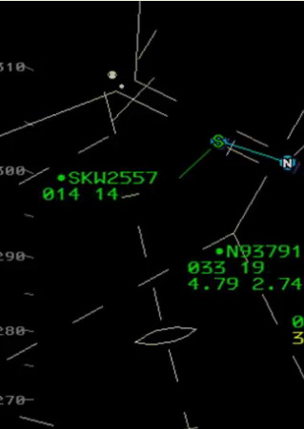
Placeholder WTMSR DST
Color determined by WFA
Envision use of ATPA Phase 1 with WFA determined separations for WTMSR - arrivals
Potential similar scheme for WTMSR – departures or use of Runway Status Lights – Logic again driven by WFA

Slide 14
Safety Risk Management
All safety assessments to date have been conducted using a relative risk assessment
  Today is safe
  Constrain wake severity and encounter likelihood for proposed change to be no greater than today
  Statistically significant wake transport and decay data sets needed for aircraft type - to - aircraft type wake separation standards.
    Ground based wake data collection for “near airport” wake separation standards
    Instrumented aircraft measurements for “en route” wake separation standards
  Statistical analysis tools for evaluating NextGen era airspace and procedures for potential risk of wake encounter
Absolute criteria will be necessary for NSIP C solutions (e.g., some dynamic separations)
RE&D funding supporting AFS development of ‘acceptable wake encounter’
  Aircraft simulators with line pilots encountering wakes of varying strength, height above ground and ceiling/visual conditions
  Flight data recorder data to establish frequency in the NAS
  Can invite AFS to brief at future NAS Ops as necessary

Slide 15
NextGen – Wake Turbulence – RE&D
AOA Strategic Priority Addressed
Priority 2: Deliver Benefits through Technology and Innovation
R,E&D is developing tools & concepts that when implemented will contribute to meeting or exceeding these metrics:
2.2 – Maintain an average daily airport capacity for Core Airports of 58,166, or higher arrivals and departures
2.3 – Maintain a NAS on-time arrival rate of 88% at Core airports
2.6 – Improve throughput at Core airports during adverse weather by 14 percent by 2018
Research Goals
FAA Improve Efficiency R&D Goal 2: Improved aircraft separation processes associated with current generalized and static air navigation service provider (ANSP) wake turbulence mitigation separation standards
National Aeronautics R&D Plan “Mobility” Principle Goals:
  Goal 1 – Develop Reduced Aircraft Separation in Trajectory and Performance-Based Operations
  Goal 4 – Maximize Arrivals and Departures at Airports and in Metroplex Areas.
Research Strategy
Develop and leverage new knowledge on aircraft wake transport and decay into safe, more capacity efficient ATC wake separation concepts, processes, procedures & technology
Need
Get more flights into and out of our airports and through congested airspace
Planned FY 2016 Accomplishments
Continued development of feasible application of dynamic wake separations in ATC (NextGen and SESAR)
Determination of required wake separations for new developed aircraft (737 Max), change FAA Orders for A320 Neo and Bombardier C series
Enhanced wake transport and decay analysis data extraction software applied to existing wake track databases
Continue large scale flight data recorder screenings for potential medium to low level wake encounter events
Probabilistic wake encounter model applied to proposed NextGen terminal and en-route airspace designs – wake risk assessments
Enhanced wind prediction capabilities for wake DST applications
Continued development of wake data collection sensor suite
Enhance WTMD and Wind Forecast Algorithm for WTMSR application
Out Year Contract Funding Requirements
 | FY 2014 | FY 2015 | FY 2016 | FY 2017 | FY 2018
Funding | $8,719K | $8,120K | $8,397K | TBD | TBD
Notes:
A12.b NextGen – Wake Turbulence – R,E&D

Slide 16
NextGen – Wake Turbulence
F&E Projects

Slide 17
Aircraft Assignments Under Current US Weight Classes and Under Recategorization
Current U.S. Classes
Wingspan (ft)
RECAT Classes
Wingspan (ft)
Aircraft Type (Decreasing Wingspan →)

Slide 18
RECAT Separation Matrix
Changes Relative to US
Separation was increased for some or all aircraft pairs
Separation was decreased for some or all aircraft pairs
Separation remained the same for some or all aircraft pairs
MRS
Minimum Radar Separation (3NM, or 2.5 NM when existing requirements are met)

Slide 19
Wake Turbulence Re-Categorization
Three Phases
  Phase I static 6 category system IOC in MEM in Nov 2012, SDF in Sep 2013
    Departure runway throughput capacity gains have been stated to be equal to adding another runway
    To be implemented at other Core Airports whose fleet mix is similar to MEM/SDF – funding permitting.
  Phase II static pairwise separation – Allows Phase I benefit for Core airports with differing fleet mixes (IOC potentially late CY15 – funding currently uncertain)
  Phase III pairwise dynamic separation (2020)
  All three use F&E funding for implementation, but require wake data collection and analysis for safety case
Phase I implemented with adaptation data and rule changes in MEM
  Software builds – including ATPA to replace rule changes – fielded for both CARTS and STARS. Implementation requires EFSTS at TRACON and Tower
Phase II will provide aircraft type to aircraft type pairwise separations that will allow any ANSP (ICAO wide) to optimize their standards based on local airport fleet mix demand to gain maximum runway throughput
  RE&D wake transport/decay data collection and analysis is providing the critical parameter information to determine the safe wake separations between aircraft types rather than the present standards for categories that are used for broad ranges of aircraft types
Notes:
19

Slide 20

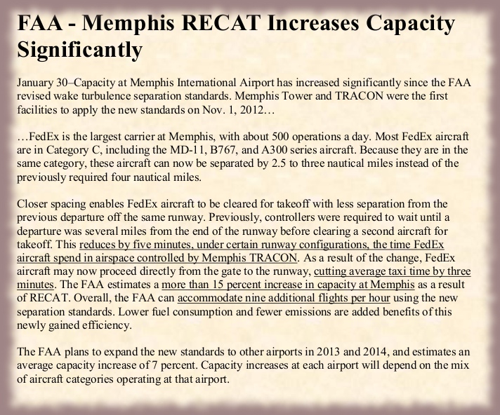
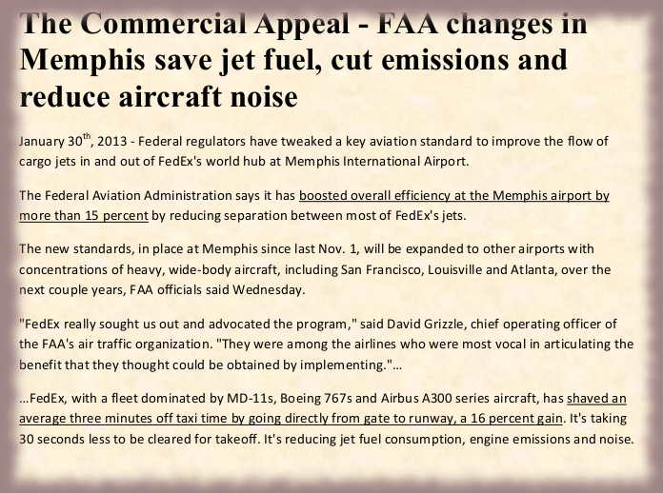
RECAT in the News
Notes:
20

Slide 21
Wake Turbulence Re-Cat – NextGen F&E
R&D Goals
FAA Improve Efficiency R&D Goal 2: Improved aircraft separation processes associated with current generalized and static air navigation service provider (ANSP) wake turbulence mitigation separation standards
National Aeronautics R&D Plan “Mobility” Principle Goals:
  Goal 4 – Maximize Arrivals and Departures at Airports and in Metroplex Areas.
  Goal 1 – Develop Reduced Aircraft Separation in Trajectory and Performance-Based Operations
R&D Strategy
Develop safe, more capacity efficient ATC wake separation standards and decision support tools based on results from the NextGen - Wake Turbulence research project
AOA Strategic Priority Addressed
Priority 2: Deliver Benefits through Technology and Infrastructure
2.2 – Maintain an average daily airport capacity for Core airports of 58,166 ,or higher, arrivals and departures
2.3 – Achieve a NAS on-time arrival rate of 88 percent at Core airports
2.6 – Improve throughput at Core airports during adverse weather by 14 percent by 2018
Need
Get more flights into and out of our airports and through congested airspace
Planned FY 2016 Accomplishments
TBD
Out Year Funding Requirements
 | FY 2014 | FY 2015 | FY 2016 | FY 2017 | FY 2018
Funding | $1,416K | TBD | TBD | TBD | TBD
21
Notes:
21
1A08E – Wake Turb. Re-Cat – NextGen F&E

Slide 22
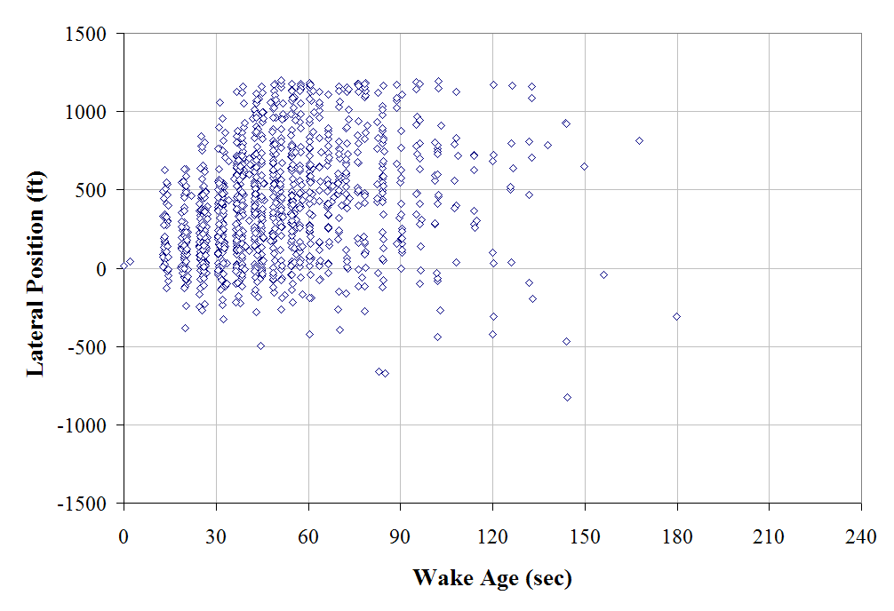
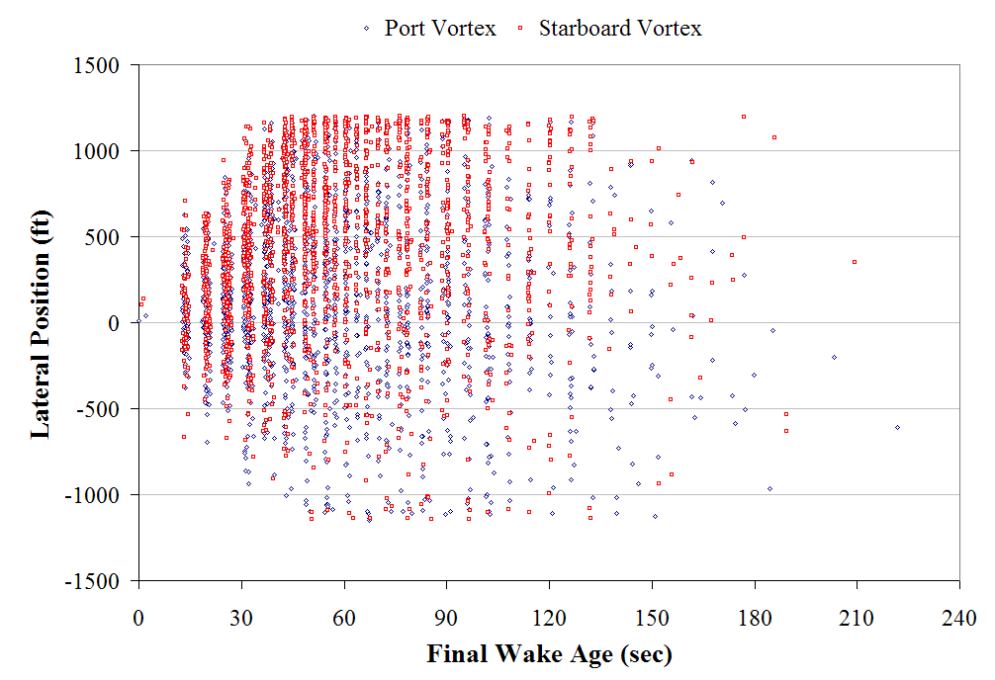
WTMD Overview: Wake Behavior – Data Collection
Edge of Measurement Region
CW: 3+ Kt Surface Wind Away
from Wake-Independent Runway
Edge of Measurement Region
Edge of Measurement Region
Comprehensive departure wake turbulence data collection required for safety case
Over 14,000 H and B757 departure wake tracks collected
Notes:
22

Slide 23
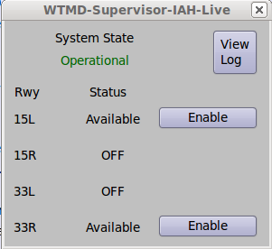
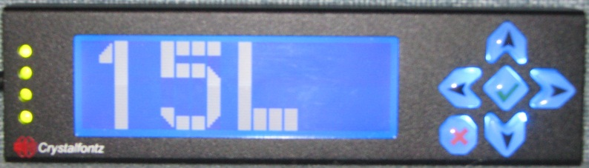
WTMD Elements
Supervisor Display Window (on stand alone display)
Local Controller Display (stand alone)
IAH Example
Two Stand Alone Processors (Tower Cab and Equipment Room) host the WTMD software
Passive tap of ASOS data
FTI line connecting processor to WJHTC for gridded winds and maintenance/monitoring functions
Notes:
23

Slide 24
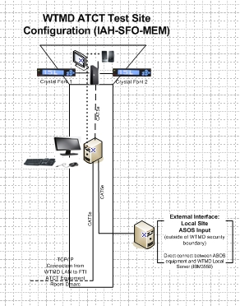

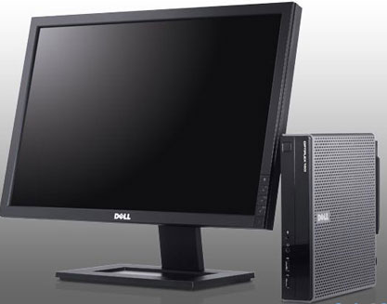
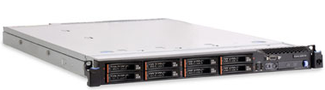
Operational Demonstration Site Major Components
The mini LCD display is a USB device that connects to the Supervisor Workstation in the tower to provide status info to controllers. (18L is available for wake independent departures)
Core Workstation accepts ASOS and gridded wind data and determines when it is appropriate to advise that WTMD procedures can be implemented.
Supervisor Workstation provides the user interface for ATC personnel.
AJM-24 WTMD Implementation Team Support, WakeNet Memphis Workshop, March 28, 2012

Slide 25
Wake Turbulence Mitigation for Departures (WTMD)
Allows controllers to skip the 2-3 minute wait behind B757 and Heavy aircraft on departure
  Monitors for sufficient crosswind to prevent wakes from drifting onto the adjacent runway.
  At least 10 airports have consistent crosswinds, CSPR, and the traffic demand to benefit from WTMD in the US
  Enables 2-8 more departures per hour at eligible constrained airports
  One Year Operational Demonstrations on going at SFO (5/2013), IAH (7/2013) and MEM (12/2013)
Started with RE&D funding
  Enabled data collection, analysis and safety case development
Operational Demonstration and implementation funded under F&E
  Table top prototype developed by NASA
  Entered into the AMS process
  Data indicating ways to improve WTMD runway throughput capacity benefit
25
Notes:
25

Slide 26
Wake Turbulence Mitigation for Arrivals (WTMA)
Safely permits dependent instrument approaches during less than visual conditions to Closely Spaced Parallel Runways
  Allows B757, Heavy, Large, and Small aircraft to lead, any aircraft may trail
Two Solutions
  WTMA-P: procedures only and similar to 7110.308 with some separation reduction
    DST optional
  WTMA-S: Similar to WTMD, wind dependent and separation reduction to 1.5 NM diagonal
    Requires the tactical DST for the controller
    Requires strategic wind forecast to get arrival demand to the airport when winds are conducive
Data collection and analysis funded under RE&D
  Need data on Heavy and B757 aircraft specifically which requires more time (only ~10% of ops). Minimum required amount of data completed in March 2013. Further data aiding refinement of procedure
  Data driven analysis will drive the safety case
F&E funds the development of decision support tools
  Tool for strategic wind forecast (next slide)
  Automated Terminal Proximity Alert (ATPA) Phase 2 for tactical DST
26
Notes:
26

Slide 27
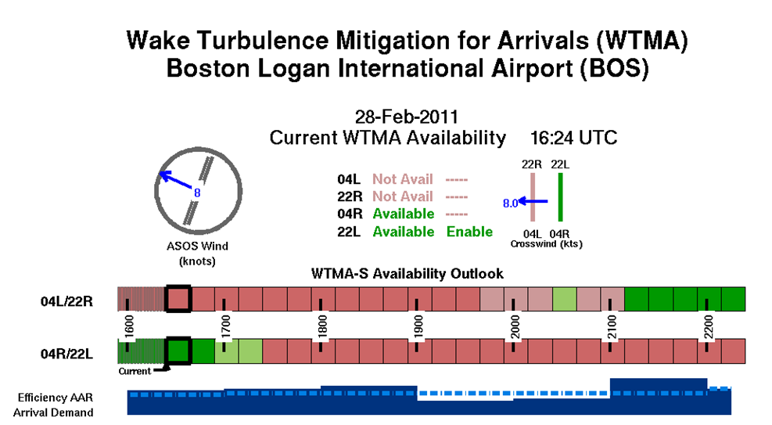
Sample Display for Strategic Wind Forecast
For WTMA-S

