Slide 1
REDAC NASOps
Spring 2014 Review
ATC/TechOps Human Factors
Part of BLI 1A12 System Development & Support
By: Rachel Seely
Date: March 2014
Notes:
Instructions:
1 Insert TCRG name and the name of the appropriate BLI. I used TAS as an example.
2 Insert name of requirement sponsor and research provider.
3 Insert exact date of your presentation – see agenda for more information.
4 The objective of the presentation is to provide the SAS members with enough information to evaluate the content of the proposed FY16 Aircraft Safety R&D Portfolio for each BLI or BLI subsection and provide recommendations. The presentation has two distinct parts.
Part One is a broader overview of the BLI, its overall purpose, how it supports the AVS mission area(s), the overall benefits, and a general review of how the research gets done. The overview explains the why, what, and how for a particular area of research. This information is usually drawn from the Budget Narratives. In some cases the story line has not changed much since the Spring 2013 meeting.
Part Two presents a quad chart for each requirement in the proposed FY16 portfolio. Parts one and two should work together to present a cohesive picture of the program to the SAS members. The TAS presentation from the FY14 presentation to the SAS is used as an example.
5 As a general rule please erase all instructions and template information. Insert your own notes as necessary.

Slide 2
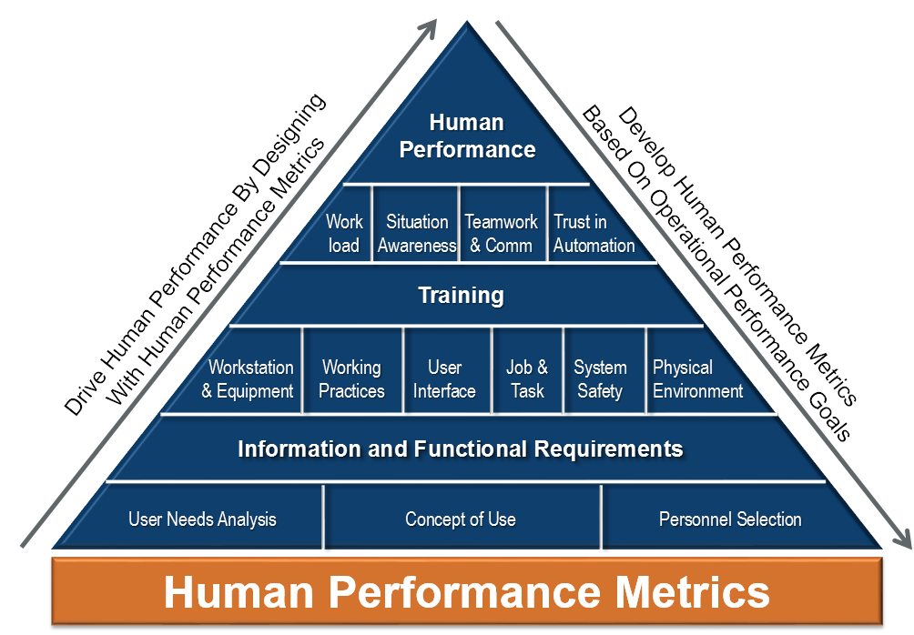
Human Performance Pyramid
*Adapted from NATS Human Performance Pyramid

Slide 3
Human Performance Buckets
Safety
Engineering
Training
Overarching Activities

Slide 4

Human Performance in Safety

Slide 5
Controller Human Performance Hazards
Develop NextGen Segment Bravo Safety Metrics
Conduct a NextGen Segment Bravo Benefits Assessment
Attempt to quantify human performance and safety as a result of NextGen implementations in the air traffic domain

Slide 6
TechOps Human Performance Hazards
Identify and assess human performance hazards in the TechOps domain
First step in multi-year effort to quantify human performance and safety benefits from NextGen implementations

Slide 7
Integrated Control Structure
Collaborative Air Traffic Management

Slide 8

Human Performance in Engineering

Slide 9
RNAV/RNP Non-Conformance Mitigation Validation
Conduct simulations assessing validity of previously developed mitigations
Develop recommendations for reduction of non-conformance for RNAV/RNP procedures

Slide 10
NextGen Alarms & Alerts
Update Alarms & Alerts Guidebook
Assess prioritization schema and taxonomy as new NextGen systems with alarms and alerts are implemented
Will take part in simulation studies to validate guidance

Slide 11
NextGen Controller Automation - Interaction
Update NextGen Automation Implementation Guidebook
What effects do DSTs and automation have on controllers during degraded modes of operation?
How do DSTs and automation affect adverse event recovery?
Perform low-fidelity simulations

Slide 12
EnRoute/TRACON Function Commonality Assessment
Identify “common” function across workstations
Work towards developing a common look and feel
Will lead to greater cost savings and flexibility

Slide 13
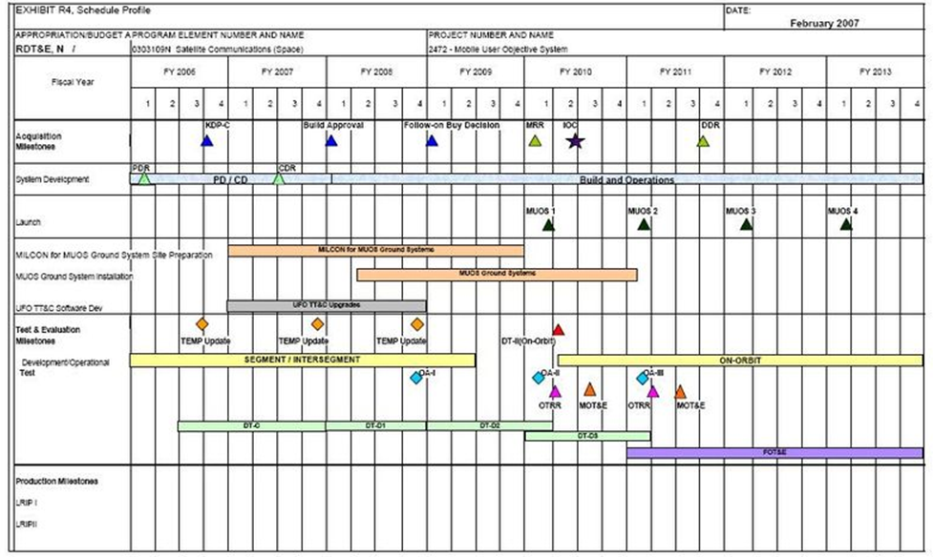
En Route and TRACON Common Information Requirements
En Route Functions
TRACON Functions
New NextGen Functions
Strategic Rollout Plan for:
New features
Porting a feature from one domain to the other
Harmonization of existing features
En Route
Program Schedule
TRACON
Program Schedule
Use planned program updates
to incrementally increase the commonality of the domains
with an order and pace that eases the transition for facilities
13
Notes:
1) New features that neither system has (e.g., Data Comm)
2) Features that exist in one domain or system but not the other (e.g., route functions in TRACON; fusion targets in en route)
3) Features that exist in both systems but are different (e.g., target symbols)

Slide 14
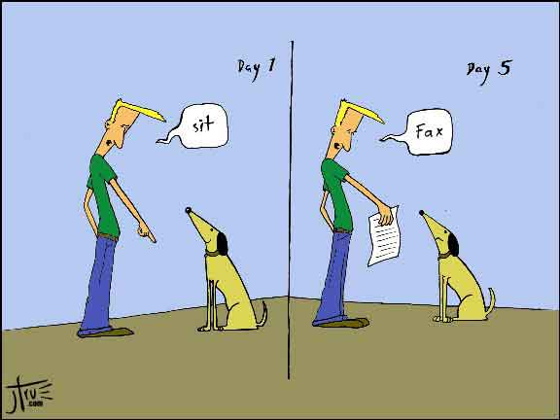
Human Performance in Training

Slide 15
TMC: NextGen Segment Bravo Job Task Analysis
Identify and assess NextGen Drivers
First step in multi-year effort to define the job of TMC’s for Segment Bravo
Further outputs include Training Needs Assessment

Slide 16
TechOps: Finalize Mid-Term Strategic Training Needs
The TechOps community will be prepared for training personnel to Segment Bravo technology implementations
Follow on work to begin on Far-term assessment of TechOps Strategic Job Analysis and Training Needs

Slide 17

Overarching Activities

Slide 18
HSI Roadmap
Become a single source planning tool for FAA human factors
Better depict the evolution of NAS actors
Improve alignment of systems, technologies, procedures, and users
Facilitate a system of systems approach
Promote the development of external HF dependencies

Slide 19
Human Systems Integration Roadmap (CY 2014 DRAFT)
En Route / Oceanic Sector Controller
579
HF
01
267
FID
304
Separation Manager
572
IID
57
HF
02
FID
122
FID
121
HF
03
Interval Management – Spacing (IM-S)
Interactive Flight Planning Using 4D Trajectory Information in the Oceanic Environment
On-Demand NAS Information
Improved Management of SAA
Point-In-Space Metering
Automation Support for Separation Management
En Route / Oceanic (ARTCC)
Time-Based Metering in the Terminal Environment
Air Traffic Control
Initial Conflict Resolution Advisory
Expanded Radar-like-Services to Secondary Airports
Integrated Arrival/Departure Airspace Management
Remotely Staffed Tower Services
Reduced Horizontal Separation Standards, En Route-3 Miles
Automated Support for Conflict Resolution
Reduced Oceanic Separation and Enhanced Procedures
Flow Corridors – Level 1 Static
Methods/Techniques
Methods/Techniques
Notes:
Use nail gun vs hammer – no change in job
Modular housing fundamental change
CY2014 Roadmap Redesign Benefits
Facilitates:
Achievement of Destination 2025 goals and metrics
Efficient, integrated decision-making by programs
Infrastructure development of a single source for human-system engineering need identification / NextGen program driver
Improved usability of NAS products / Air-Ground Integration (AGI)
Programmatic risk reduction
Definition of technical relationships from the user perspective (Operational Views)
Achievement of critical path objectives and timelines
Each block represents a single OI. They are comprised of increments. The data (each increment is laid out by segment, the description is used to map to all the impacted NAS actor, determine the change on each specific actor, ID the application of the tool (how they will use it), analyze the impact that each increment has on each of the NAS actors and then further detail the nature and level of change, identify the roll up of cumulative change from all the increments that make up the OI) on each increment is captured on a spreadsheet that is under development.
The FID decision points link to a program. That includes a roll up of systems and capabilities.
As is – defined by SMEs and FAA documentation
To be – JPDO CONOPS
Back in the May/June time frame, ANG-C4 conducted a Service Roadmap revalidation effort. The source data was NSIP 5.0. The sample roadmap I provided you is a representation of the Service Roadmap revalidation effort. However when this is presented it needs to be made clear that a Portfolio Revalidation effort (facilitated by ANG-D21) is currently underway. The roll-up of both efforts will be reflected in the next publication of the NSIP in mid-November.
Eddie will provide definition of all diamonds

Slide 20
Human Factors in Service Analysis and Strategic Planning
HF Participation
  operational concepts
  reduction of risk
  definition of requirements
  development of NAS architecture products
Brings the perspective of the human role in the operational improvements or sustainments that are being defined and evaluated

Slide 21









Partnerships and Labs

Slide 22
Questions?
24 Hour NAS Flight Visualization

