Slide 1
Operational Weather Needs Analysis (OWNA) Briefing to REDAC NAS Operations Subcommittee
CAASD
Richard Heuwinkel
Matt Fronzak, Mark Huberdeau
March 12, 2014

Slide 2
What is OWNA?
Operational Weather Needs Analysis (OWNA)
Formalized, operationally-based analysis process
Repeatable for different scenarios and air traffic management (ATM) capabilities and processes
Output is traceable
Goal – identify weather information needs based on operational decision-making by members of the ATM community

Slide 3
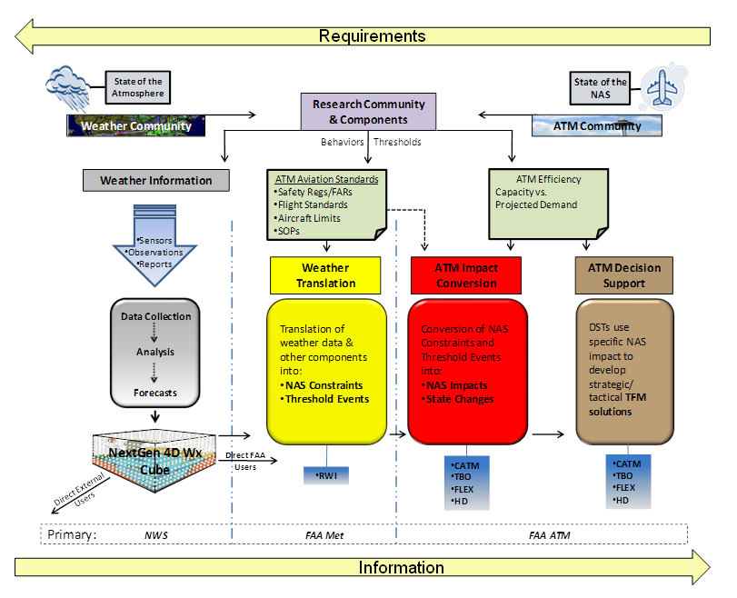
Why OWNA?
FAA weather performance requirements IOU to NWS
“…you don’t know what you don’t know…”
Responsibility – FAA
Aviation Weather Division
(ANG-C6)
NextGen Web Services
Direct External Users

Slide 4



Weather Requirements Process
Objective → To develop validated operational performance requirements that address user needs and achieve the successful implementation of mid-term service capabilities.
NextGen Mid-term CONOPS Services
NSIP 5.0 Alpha & Bravo Portfolios
Allocate validated requirements to FAA & NWS.
NAS
Strategic TFM
Flight Planning
Airport Operations
CATM
ISO
TBFM
Validate performance requirements through appropriate methods, such as modeling, simulation, or human-in-the-loop exercises.
Arrival & Departure Operations
Cruise Operations
Oceanic Operations
IMRO
IALVO
Others
Approve requirements.
Decomposition of capabilities through CONOPS functional analysis and NSIP operational analysis to derive weather functions and interfaces with ATM operations.
Convert operational requirements to performance requirements.
Assess user needs from an ”as-is” and “to-be” operational context to determine weather information needs in the “to-be” state.
Conduct operational validation of user needs, operational requirements, and weather information needs through use of scenarios with subject matter experts.
Analysis
Validation & Approval

Slide 5
Why OWNA?
FAA weather performance requirements IOU to NWS
“…you don’t know what you don’t know…”
Process Owner – FAA
Aviation Weather Division
(ANG-C6)
Progress to date
  FAA ANG-C6
    Systems engineering-
    centric analysis
    Based on mid-term NextGen
    CONOPS
  TRWG
    TFM-centric analysis
    CDM WET input
NextGen Web Services
Direct External Users

Slide 6
Progress to Date – ANG-C6
Objective → To develop validated operational performance requirements that address user needs and achieve the successful implementation of mid-term service capabilities.
NextGen Mid-term CONOPS Services
NSIP 5.0 Alpha & Bravo Portfolios
Allocate validated requirements to FAA & NWS.
NAS
Strategic TFM
Flight Planning
Airport Operations
CATM
ISO
TBFM
Validate performance requirements through appropriate methods, such as modeling, simulation, or human-in-the-loop exercises.
Arrival & Departure Operations
Cruise Operations
Oceanic Operations
IMRO
IALVO
Others
ANG-C6
Approve requirements.
Decomposition of capabilities through CONOPS functional analysis and NSIP operational analysis to derive weather functions and interfaces with ATM operations.
Convert operational requirements to performance requirements.
Assess user needs from an ”as-is” and “to-be” operational context to determine weather information needs in the “to-be” state.
Conduct operational validation of user needs, operational requirements, and weather information needs through use of scenarios with subject matter experts.
Analysis
Validation & Approval

Slide 7
Progress to Date – ANG-C6 and TRWG
Objective → To develop validated operational performance requirements that address user needs and achieve the successful implementation of mid-term service capabilities.
NextGen Mid-term CONOPS Services
NSIP 5.0 Alpha & Bravo Portfolios
Allocate validated requirements to FAA & NWS.
NAS
Strategic TFM
Flight Planning
Airport Operations
CATM
ISO
TBFM
Validate performance requirements through appropriate methods, such as modeling, simulation, or human-in-the-loop exercises.
Arrival & Departure Operations
Cruise Operations
Oceanic Operations
IMRO
IALVO
Others
ANG-C6
Approve requirements.
Decomposition of capabilities through CONOPS functional analysis and NSIP operational analysis to derive weather functions and interfaces with ATM operations.
TRWG
Convert operational requirements to performance requirements.
Assess user needs from an ”as-is” and “to-be” operational context to determine weather information needs in the “to-be” state.
Conduct operational validation of user needs, operational requirements, and weather information needs through use of scenarios with subject matter experts.
Analysis
Validation & Approval

Slide 8
Why OWNA?
FAA weather performance requirements IOU to NWS
“…you don’t know what you don’t know…”
Process Owner – FAA
Aviation Weather Division
(ANG-C6)
Progress to date
  FAA ANG-C6
    Systems engineering-
    centric analysis
    Based on mid-term NextGen
    CONOPS
  TRWG
    TFM-centric analysis
    CDM WET input
OWNA Scope
NextGen Web Services
Direct External Users

Slide 9
OWNA Scope
Objective → To develop validated operational performance requirements that address user needs and achieve the successful implementation of mid-term service capabilities.
NextGen Mid-term CONOPS Services
NSIP 5.0 Alpha & Bravo Portfolios
Allocate validated requirements to FAA & NWS.
NAS
Strategic TFM
Flight Planning
Airport Operations
CATM
ISO
TBFM
Validate performance requirements through appropriate methods, such as modeling, simulation, or human-in-the-loop exercises.
Arrival & Departure Operations
Cruise Operations
Oceanic Operations
IMRO
IALVO
Others
ANG-C6
Approve requirements.
Decomposition of capabilities through CONOPS functional analysis and NSIP operational analysis to derive weather functions and interfaces with ATM operations.
TRWG
Convert operational requirements to performance requirements.
Assess user needs from an ”as-is” and “to-be” operational context to determine weather information needs in the “to-be” state.
Conduct operational validation of user needs, operational requirements, and weather information needs through use of scenarios with subject matter experts.
Analysis
Validation & Approval

Slide 10
How Does OWNA Work?
Discussions with a group of ATM experts, focused on domain-specific capabilities and processes that involve weather-impacted operational decision-making, are used to identify both
“as-is” and “to-be” weather information attributes, which are recorded, interpreted, compared and reported out

Slide 11
ATM Experts
Discussions with a group of ATM experts, focused on domain-specific capabilities and processes that involve weather-impacted operational decision-making, are used to identify both
“as-is” and “to-be” weather information attributes, which are recorded, interpreted, compared and reported out
  Broad definition of ATM
    CDM-centric, includes both providers and operators
    Consistent with ICAO definition regarding collaboration
  Persons whose decisions may affect the trajectory of a flight
    FAA traffic managers (TFM) and operator ATC coordinators (AOC) in the planning domain
    FAA air traffic controllers (ATC) and operator aircraft dispatchers (DSP) and pilots (PIC) in the execution domain
  SMEs used in the OWNA sessions were current MITRE employees
  Total of 15 individuals with approximately 300 years of practical ATM decision-making experience

Slide 12
Domains
Discussions with a group of ATM experts, focused on domain-specific capabilities and processes that involve weather-impacted operational decision-making, are used to identify both
“as-is” and “to-be” weather information attributes, which are recorded, interpreted, compared and reported out
  Two domains
    Planning
    Execution (Flight Operation)
  Each domain is divided into five chronologically-ordered phases
  The two domains are strongly linked when an expected demand/capacity imbalance, usually constraint-driven,
  takes place

Slide 13

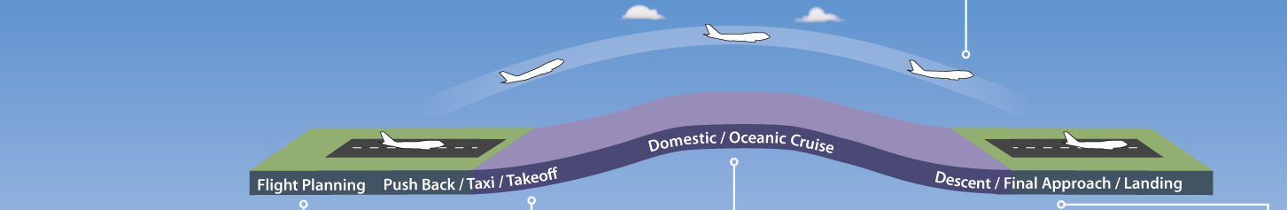

Planning and Execution Domains – Linked by Weather and Flight Operations
Pilot (PIC) Dispatcher (DSP)
Execution
Domain
(Linked to the Flight Event)
Controller (ATC)
Flight
Planning
Surface
(Pushback/
Taxi)
Departure
(Takeoff/
Climb)
Cruise
(Domestic/ Oceanic)
Arrival
(Descent/Approach/ Landing/Taxi)
ATM Timeline
Flow Contingency Management Traffic Management Separation Management
Next Day+ before the Weather Event
8+ to 4 hours before the Weather Event
4 to 2 hours before the Weather Event
2 to 1 hour before the Weather Event
1 hour before onset through cessation of the Weather Event
Planning
Domain
(Linked to the Weather Event)
ATC Coordinator (AOC)
Traffic Manager (TFM)

Slide 14
Capabilities and Processes
Discussions with a group of ATM experts, focused on domain-specific capabilities and processes that involve weather-impacted operational decision-making, are used to identify both
“as-is” and “to-be” weather information attributes, which are recorded, interpreted, compared and reported out
  Any procedure or decision support system that is intended to assist the ATM decision maker in resolving a weather-related demand/capacity imbalance
  For purposes of this task, the target capabilities and processes came from the NSIP V5.0

Slide 15
Source of Capabilities and Processes
Objective → To develop validated operational performance requirements that address user needs and achieve the successful implementation of mid-term service capabilities.
NextGen Mid-term CONOPS Services
NSIP 5.0 Alpha & Bravo Portfolios
Allocate validated requirements to FAA & NWS.
NAS
Strategic TFM
Flight Planning
Airport Operations
CATM
ISO
TBFM
Validate performance requirements through appropriate methods, such as modeling, simulation, or human-in-the-loop exercises.
Arrival & Departure Operations
Cruise Operations
Oceanic Operations
IMRO
IALVO
Others
ANG-C6
Approve requirements.
Decomposition of capabilities through CONOPS functional analysis and NSIP operational analysis to derive weather functions and interfaces with ATM operations.
TRWG
Convert operational requirements to performance requirements.
Assess user needs from an ”as-is” and “to-be” operational context to determine weather information needs in the “to-be” state.
Conduct operational validation of user needs, operational requirements, and weather information needs through use of scenarios with subject matter experts.
Analysis
Validation & Approval

Slide 16
OWNA Capabilities and Processes Scope
What are the NSIP Portfolios? How many Increments (including stand-alone OIs) are in each?
  Collaborative Air Traffic Management (CATM) [6A, 8B]
  Improved Surface Operations [7A, 6B]
  Time-Based Flow Management (TBFM) [6A, 9B]
  Improved Multiple Runway Operations (IMRO) [8A, 1B]
  Improved Approaches and Low-Visibility Operations
  [6A, 5B]
  Performance-Based Navigation (PBN) [8A, 2B]
  On-Demand NAS Information [4A, 6B]
  Separation Management [5A, 28B]
  NAS Infrastructure
  Environment & Energy
  System Safety Management
  Policy Issues
8 Operational Portfolios,
115 Increments [50A, 65B]
4 Non-Operational Portfolios

Slide 17
Weather-Impacted
Discussions with a group of ATM experts, focused on domain-specific capabilities and processes that involve weather-impacted operational decision-making, are used to identify both
“as-is” and “to-be” weather information attributes, which are recorded, interpreted, compared and reported out
  Weather-impacted
    For each NSIP increment, determine if the increment has a direct weather dependency

Slide 18
Direct Weather Dependency
Direct weather dependency – Systems and capabilities associated with the increment require raw and/or translated weather information in order to successfully function
Raw weather is directly sensed or measured
  Examples – temperature, wind, radar imagery
Translated weather is comprised of one or more raw weather elements that have been transformed into a parameter that is not directly sensed or measured
  Examples – wind chill, heat index, ITWS microburst alert, weather avoidance field (WAF)
So…of the 115 operational increments in the NSIP V5.0, how many have a direct weather dependency?

Slide 19
OWNA Scope – NSIP Increments with Direct Weather Dependency
Of the 115 Increments found in the 8 Operational NSIP portfolios, 7 were determined to have direct weather dependencies:
  CATM Portfolio (5)
    CACR (A)
    RAPT (A)
    A-RAPT [ARAP] (B)
    IDRP (B)
    AARDS (B)
  IMRO Portfolio (2)
    WTMD (A)
    WTMA-S (B)

Slide 20
Operational Decision-Making
Discussions with a group of ATM experts, focused on domain-specific capabilities and processes that involve weather-impacted operational decision-making, are used to identify both
“as-is” and “to-be” weather information attributes, which are recorded, interpreted, compared and reported out
  Operational Decision-Making
    Examine the problem(s) that each increment is supposed to resolve in the context of an appropriate decision model

Slide 21
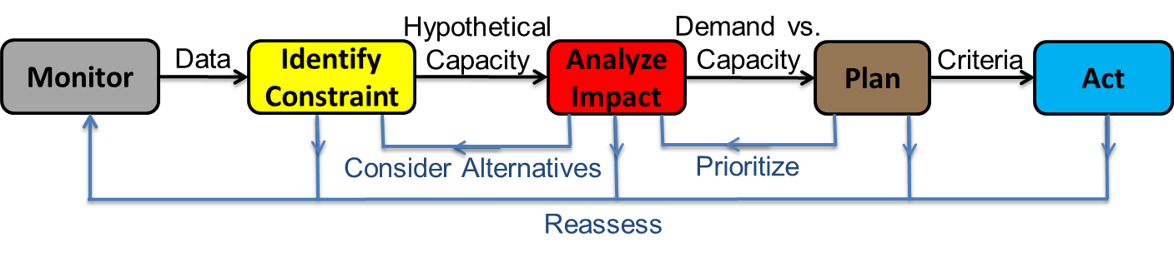
Weather-Impacted Operational
Decision Model
Iterative process, five phases
Monitor (M) and Identify Constraint (IC) directly involve and require weather information
Analyze Impact (AI) uses weather and air traffic information to quantify the extent of the demand/capacity problem
Plan (P) and Act (A) do not necessarily require the same weather information

Slide 22
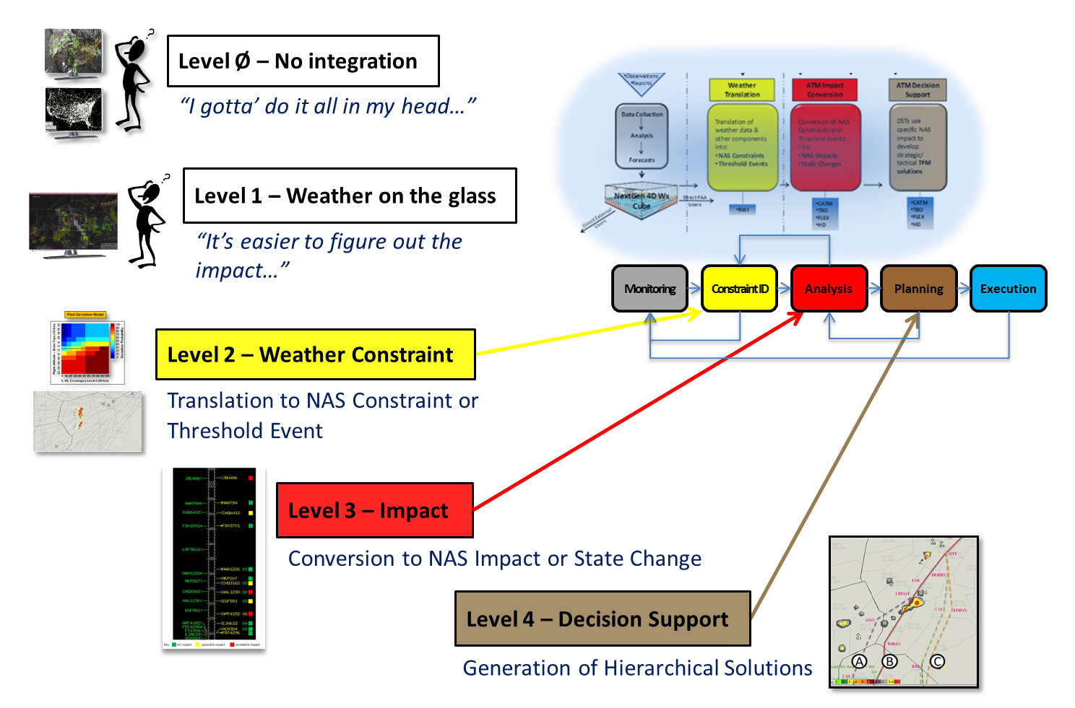
The Big Picture (or What do ATM-Weather Integration and OWNA have to do with each other?)

Slide 23
“As-Is” and “To-Be” Weather Information Attributes
Discussions with a group of ATM experts, focused on domain-specific capabilities and processes that involve weather-impacted operational decision-making, are used to identify both
“as-is” and “to-be” weather information attributes, which are recorded, interpreted, compared and reported out
  Weather Information Attributes
    Primarily qualitative (“…you don’t know what you don’t know…”)
    Categorized for both observations and forecasts

Slide 24
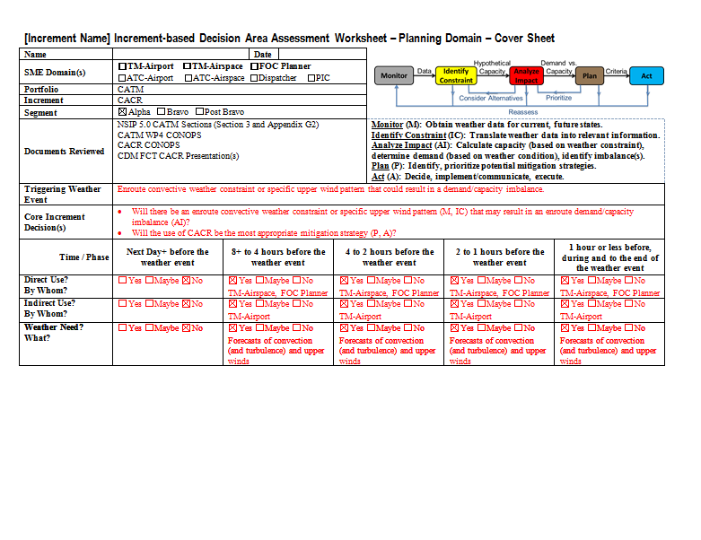
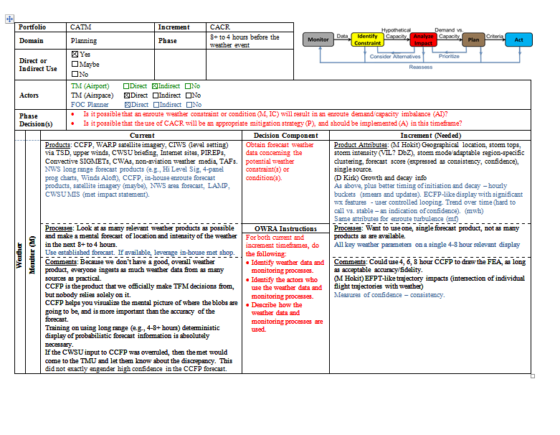
Recording Results
Discussions with a group of ATM experts, focused on domain-specific capabilities and processes that involve weather-impacted operational decision-making, are used to identify both
“as-is” and “to-be” weather information attributes, which are recorded, interpreted, compared and reported out
  Provides traceability

Slide 25
Interpreting Results
Discussions with a group of ATM experts, focused on domain-specific capabilities and processes that involve weather-impacted operational decision-making, are used to identify both
“as-is” and “to-be” weather information attributes, which are recorded, interpreted, compared and reported out
  If the ATM decision makers “don’t know what they don’t know,” then how do you know what they are REALLY saying?

Slide 26

Reading Between the Lines
NOTHING
READ
IS EVER
BETWEEN
WHAT IT
THE LINES.
SEEMS.
“…SMEs look at METARs
from nearby airports while
in the 8+ to 4 hour planning
phase for enroute
convection…”
MIGHT MEAN
…SMEs don’t “trust” the
current enroute convective
forecast…
MIGHT MEAN
…the current convective
forecast product is not as
effective as it could be…
…SMEs do not understand how to cognitively process probabilistic forecast information…

Slide 27
OWNA
Discussions with a group of ATM experts, focused on domain-specific capabilities and processes that involve weather-impacted operational decision-making, are used to identify both
“as-is” and “to-be” weather information attributes, which are recorded, interpreted, compared and reported out

Slide 28
OWNA – CACR

Slide 29


Collaborative Airspace Constraint Resolution (CACR) Description and Use
Description | “…combination of new and existing systems and processes, intended to enable the seamless integration of enroute airspace traffic flow management (TFM) six or more hours to approximately 30 minutes prior to a constraint.” “…directly incorporating NAS user preferences in traffic management solutions and providing tools for collaboration throughout the management of an event.”
Portfolio | CATM
Segment | Bravo (2015-2020)
Level of Integration | Level 2 – Automatic translation of convective weather forecasts into NAS constraints Level 3? – Automatic calculation of operational impacts
Direct Use | Planning (Flow) | Next Day+ | 8+-4 | 4-2 | 2-1 | 1-Cessation
 | Execution (Flight) | Flt Planning | Surface | Departure | Enroute | Arrival

Slide 30
Collaborative Airspace Constraint Resolution (CACR) Weather and Core Decision Information
Explicit Weather Needs | “…certain weather information improvements could greatly increase CACR's effectiveness. The improvements should include more reliable weather forecasts, the translation of weather information into aviation constraints and operational impacts, as well as data regarding the uncertainty of the weather-related information.” “CACR will translate tactical weather forecasts into weather impact forecasts for sector capacities.”
Weather Constraint(s) | Enroute Convection (potentially enroute turbulence)
Core Decisions (Planning Domain) | (M) Will there be convective weather in enroute airspace within my area of interest? (IC) Will the convective weather reduce the capacity of the enroute airspace? (AI) Will the capacity reduction lead to a demand/capacity imbalance? (P) Is the use of CACR an appropriate mitigation strategy? (A) Use CACR?

Slide 31
Shortfall Analysis – Content
Attribute | Current | Needed | Gap | WET Comments
Automated Alerting | Few products feature automatic alerting when specific hazardous weather phenomena are observed or forecast to occur in the AOR. | Automated alerting when thunderstorms are observed or forecast in key enroute airspace regions. | Y | Agree. RAPT provides translated alerting. What % of time does the alert have to be right?
Data Type (raw vs. translated) | Little translated weather information is available via current weather products, and none is available for direct use by ATM decision-makers. | The CACR CONOPS calls for the availability and use of translated convective weather information. There are no translated graphical products for direct use by ATM decision-makers in the development pipeline. | Y | Did not agree or disagree. Decision-makers need to get comfortable with the automation. HF – need transition time (learning curve/trust factor).
Weather Elements | Current raw weather observation and forecast products cover all major weather elements. However, translated weather products are only available for convective weather constraints. | Translated weather products will eventually be needed for turbulence and icing constraints. | M | Agree. Possibly space weather and volcanic ash, too.

Slide 32
Shortfall Analysis – Level of Detail
Attribute | Current | Needed | Gap | WET Comments
Spatial (area of forecast coverage and resolution) | The level of spatial detail of current weather observation and forecast products varies from product to product, but is generally perceived as adequate. | There were no specific spatial detail requirements that came out of the CACR OWRA discussions. | N | Agree. No comments.
Temporal (update rate, valid time, standard forecast time) | The level of temporal detail of current weather observation and forecast products varies from product to product, as do the perceptions of adequacy. | For enroute convective constraints, better temporal resolution than is currently available via CCFP (1-hour forecasts vs. 2-hour forecasts) was seen as being important. | Y | Agree. No comments.

Slide 33
Shortfall Analysis – Production
Attribute | Current | Needed | Gap | WET Comments
Method (manual, HITL, HOTL, automated) | Current weather observation and forecast products are mostly produced via manual and automated processes. | There were no new explicit requirements that more products be produced via one method or another in support of CACR. However, to provide some of the described products, it is clear that more and more will come from automated and HITL/HOTL methods, while fewer are produced manually. | N | No comments.

Slide 34
Shortfall Analysis – Properties
Attribute | Current | Needed | Gap | WET Comments
Onset/ Cessation | Few if any current convective weather forecast products included explicit onset and cessation information. | The inclusion of explicit onset and cessation information was seen as critical in support of CACR. | Y | Agree. CIWS/CoSPA have implicit onset/cessation information as returns appear/disappear.
Scoring | Few (CIWS, ITWS) current weather forecast products provide real-time forecast scoring information. | The inclusion of explicit weather forecast scoring information was seen as important to the manual, cognitive use of convective weather forecasts in support of the CACR process. | M | Agree. No comments.
Trend | No current weather forecast products provide real-time trend information. | The inclusion of forecast trend information was seen as important to the manual and automated use of convective weather forecasts in support of CACR. | Y | Agree. No comments.

Slide 35
Shortfall Analysis – Other (1/3)
Attribute | Current | Needed | Gap | WET Comments
Numbers of Displays | Search out and cognitively assimilate numerous, stand-alone weather products. | Access all necessary weather information from a single, map-based graphical interface, | Y | Agree. No comment.
Convective Forecast Content | Many convective forecast products contain some storm top, intensity and mode information, historical and real-time forecast scoring, explicit convective initiation and cessation times, and enhanced growth and decay information. None contain all. | A single convective forecast product with all the necessary information. | Y | Agree. No comment.

Slide 36
Shortfall Analysis – Other (2/3)
Attribute | Current | Needed | Gap | WET Comments
Official Convection Forecast | CCFP – updated every two hours, probabilistic, single view, hand drawn | The official TFM convective forecast product (evolution of CCFP) should be a hybrid product that transitions from an ECFP-like form at the longer forecast periods to a CIWS-like display close to the event, updates more frequently than CCFP and has improved latency vs. SREF. | Y | Agree (after rewording).
Translation | With few exceptions, any translation of raw weather information into NAS constraint and conversion to impact is done cognitively by the ATM decision-maker. | Translated weather information should be combined with historical traffic information to identify projected NAS impact areas, available in graphic form to the ATM decision-maker and in digital form to planning and problem resolution services. | Y | No comment.

Slide 37
Shortfall Analysis – Other (3/3)
Attribute | Current | Needed | Gap | WET Comments
Available Weather Sources | Only officially approved information and traditional sources. | Information from non-traditional sources (e.g., CWOP, MADIS, MDCRS, TAMDAR) should be made available to ATM decision-makers. | Y | No comment.
Alerting Functionality | With few exceptions, weather systems do not contain any viable alerting functionality. | Alerting functionality should be a part of any future weather or weather-related decision support system whose information is manually retrieved and cognitively processed. | Y | No comment.

Slide 38
Preliminary WTIC-Related Findings from CACR OWNA (1/2)
Direct Use | Planning (Flow) | Next Day+ | 8+-4 | 4-2 | 2-1 | 1-Cessation
 | Execution (Flight) | Flt Planning | Surface | Departure | Enroute | Arrival
Direct Use
What if the PIC is also functioning as his own AOC? Or DSP?
  Communication (non-verbal) with the cockpit is essential
Downstream Linkage
All Execution (Flight Operation) domain phases except Flight Planning are downstream of the CACR process
CACR-driven trajectory changes could take place during the Surface, Departure and Cruise phases
Execution of CACR-driven trajectory changes – new capabilities, information or products required?

Slide 39
Preliminary WTIC-Related Findings from CACR OWNA (2/2)
Problem – number of CACR-driven reroutes = ?
Problem – cockpit level of shared situation awareness?
Problem – high volume of post-reroute radio traffic?
Solution – leverage WTIC-type functionality.
  Provide a pictorial representation of the revised trajectory, along with accompanying weather graphics, to the cockpit
  Need not be the sole responsibility of FAA
  Operator may be responsible to create and transmit the trajectory-change graphic, based on some kind of electronic trigger sent by FAA once the reroute has been issued
Benefit – Mitigate the need for the flight crew to pick up the radio and ask questions of clearance delivery, or fire up the ACARS to find out, alongside the dispatcher’s other affected flights, why they have been rerouted, or delayed, or both

Slide 40


Slide 41
Backup Slides

