Slide 1
Quantifying Benefits to General Aviation (GA) Safety
Weather Technology in the Cockpit (WTIC)
BLI A12.d
By: Gary Pokodner (WTIC Program Manager)
Date: March 5, 2014

Slide 2
Presentation Goals
Review REDAC recommendations being addressed
Describe interaction with other RE&D agencies, organizations, and/or groups
Response to NAS Ops Recommendation to Quantify Potential Benefits to GA Safety
Identify wx-related GA safety factors
Results of early gap analyses
Benefits quantification
Discussions and Questions
2

Slide 3
REDAC Recommendations
Aircraft Safety
Finding (1) Recommendation Fall 2013– The Subcommittee recommends that the sponsors of this research interface with other Research, Engineering, and Development (R,E&D) areas to explore COTS possibilities and with the appropriate areas in FAA to facilitate dissemination of tools and information to industry.
NAS Operations Subcommittee
Recommendation Spring 2013: The FAA should provide quantitative estimates of the NextGen safety and operational benefits achievable with the research results when applied to operations. Where the justification for the research requirement comes from NSIP, the FAA should define specific requirements for weather technology improvement, based upon the safety and operational requirements of NextGen. If these requirements have not been defined and quantified, the FAA should orient the Weather PPT research portfolio to define these requirements. The FAA should also provide specific quantitative estimates of the safety benefit for those research investments targeted for GA safety.

Slide 4
Response to SAS Recommendation: Collaboration with Stakeholder and Industry
4

Slide 5
Government / Industry GA Safety Collaboration
National Transportation Safety Board (NTSB)
Focus is not on solving a specific type of weather-related accident / incident unless a trend is identified
Granted access to and have utilized NTSB resources
Internal FAA (Small A/C Directorate, Aircraft Cert, Flight Standards, Accident Investigation / Prevention, Aviation Wx Division)
Focus primarily on ground aspects of weather
GA Joint Steering Committee (JSC)
Focus on high level accident types
Reference GA JSC Accident Pareto
WTIC invited to participate in GA JSC activities
AOPA
Member of GA JSC
No responsibility for accident investigation
AFS-820, Flight Standards Services
AVP-200, Aviation Safety Information Analysis and Sharing Division
ANG-C62, AWD Aviation Weather Division
ANG-E272, System Safety Section
AFS-801, Flight Standards Service - General Aviation and Commercial Division,
ACE-114, Small Airplane Directorate, Standards Office - Programs and Procedures Branch
AFR-300, Office of Financial Reporting and Accountability
AFS-800, Flight Standards Service - General Aviation and Commercial Division
AFS-820, Flight Standards Service - Operations & FAAST Support Branch

Slide 6
GA Safety Collaboration Summary
Obtained consensus on WTIC research
No overlaps in efforts
Commitment to continue collaboration and support of WTIC research
AWRP and WTIC focus on areas that NTSB, other FAA programs, and GA JSC do not
Recommendation for a Minimum Weather Service
Display of weather information in the cockpit
Human Factors issues associated with cockpit weather displays
Training issues associated with cockpit weather displays and MET information
Regulatory test standards for MET information in the cockpit
Collaboration Benefit
Stakeholder participation in WTIC working groups increases likelihood of WTIC research acceptance for standards and guidance

Slide 7
Response to NAS Ops Recommendation: Quantifying Benefits to GA Safety
7

Slide 8
GA Safety Area Quantification
8

Slide 9
Identifying GA Safety Areas
29% of all GA accidents and 40% of fatalities are classified as being weather related between 2000-2011
WTIC and AWRP research is focused on identifying and addressing weather-related risks before they become accidents
To address these issues, research will address gaps in cockpit weather information, human factors associated with weather information displays, and enhanced pilot weather decision making
NTSB Briefing Slide – Summer 2013 FPAW
14CFR Part 830, Section 830.2, Definitions
"Aircraft Accident" means an occurrence associated with the operation of an aircraft that takes place between the time any person boards the aircraft with the intention of flight and all such persons have disembarked, and in which any person suffers death, or serious injury, or in which the aircraft receives substantial damage. *

Slide 10
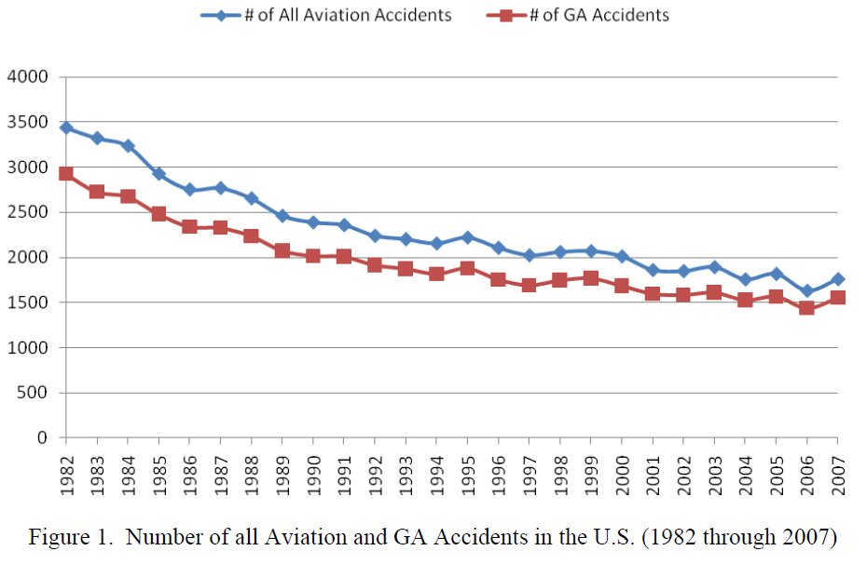
Identifying GA Safety Trends
GA accident rate has flattened out since 2001
Overall GA accident rate (per 100k hours) is not declining
WTIC research will focus on the weather-related factors
WTIC research is first identifying why the GA accident rate has not decreased as a function of advances in cockpit weather information / technology
* A Database Management System for General Aviation Safety, DOT/FAA/AR-xx/xx, December 2010
* https://www.aopa.org/About-AOPA/Statistical-Reference-Guide/General-Aviation-Safety-Record-Current-and-Historic.aspx#gaaccidents

Slide 11
Part 91: VFR into IMC Operation
FAA Region | #1 Cause of Fatal GA Accidents | #2 Cause of Fatal GA Accidents | #3 Cause of Fatal GA Accidents
Alaska | VFR into IMC | Airspeed | In-flight Planning
Central | Aircraft Control | Airspeed | VFR into IMC
Eastern | Airspeed | VFR into IMC | Aircraft Control
Great Lakes | Aircraft Control | Airspeed | VFR into IMC
New England | Aircraft Control | Airspeed | VFR into IMC
Northwest Mountain | In-flight Planning | VFR into IMC | Aircraft Control
Southern | Airspeed | VFR into IMC | Aircraft Control
Southwest | Aircraft Control | Airspeed | VFR into IMC
Western Pacific | VFR into IMC | Airspeed | In-flight Planning
Between 1982 and 2009, VFR into IMC was one of the top 3 initiating causes of fatal GA accidents in all FAA regions*
Transition from VFR to IMC is a pilot based operational decision (or lack of)
Not an ATC primary responsibility to separate a pilot from weather
Responsibility of a VFR-only qualified pilot to maintain VFR flight
Responsibility of IFR qualified pilot to assess adverse weather conditions to file for an IFR flight plan or maintain VFR
* Comprehensive Analysis of General Aviation Accidents Volume 1: Trends, Distributions, and Causes, DOT/FAA/AR-12/2, V1, May 2012

Slide 12
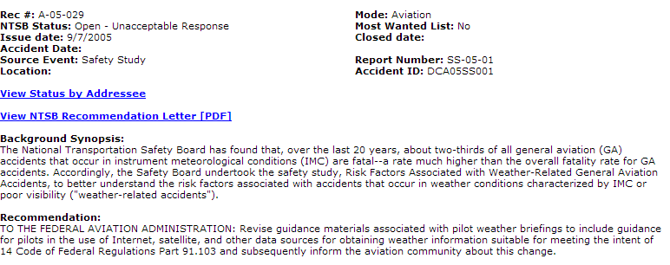
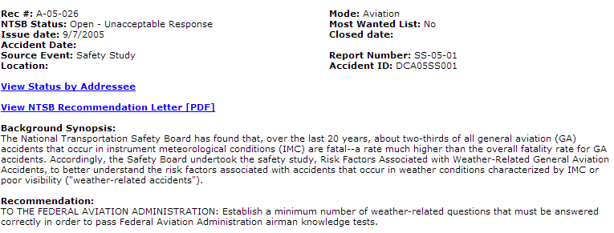
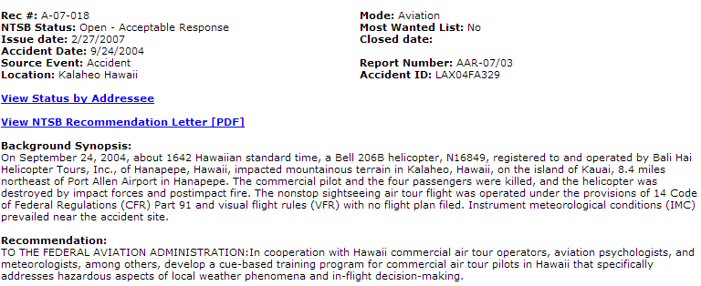
Quantifying Benefits Addressing NTSB Recommendations
As of March 2014, there are currently 38 “Open” NTSB Safety Recommendations related to “weather”
NTSB Safety Alerts associated with NEXRAD Mosaic Imagery latency and Reduced Visual References
WTIC and AWRP supports FAA efforts to address “Open” NTSB Safety Recommendations
NTSB Safety Recommendations also offer insight into possible WTIC/AWRP research
Background Synopsis (A-05-029):
“…2/3 of all GA accidents that occur in IMC are fatal…”
Recommendation (A-05-029):
“…guidance for pilots…in obtaining weather information…”
Recommendation (A-05-026)
“…minimum number of weather-related questions…”
Recommendation (A-07-018):
“…cue based training program…”
March 2013
12

Slide 13
Sample Gap Analyses Research and Results
13

Slide 14
WTIC Research Tasks - GA
Identify causal factors for the high weather-related accident rate for GA aircraft
Identify the shortfalls in pilot understanding and proper use of MET information, and the pilot training to resolve those shortfalls
Recommend a minimum weather service for Parts 91 aircraft to enable consistent and effective pilot decision making relative to adverse weather
What is the minimum information needed in the cockpit?
What is the minimum accuracy, latency, and availability of the minimum information?
What are the minimum rendering standards needed to enable correct and consistent interpretation of the information?
Determine GA willingness to spend on aircraft equipage and services to enable proper implementation and use of the minimum weather service
Notes:
14

Slide 15
Project Overview: GA MET Presentation Gaps Research
15

Slide 16
GA MET Presentations - Project Overview
Part 1 –
Flight simulation of GA aircraft flying in VFR conditions
Destination airport and diversion airports change to IFR conditions during flight
Observed pilot recognition of changing conditions
3 pilot groups each using a different commercial-based presentation
Measured recognition, workload, variations between groups
16

Slide 17
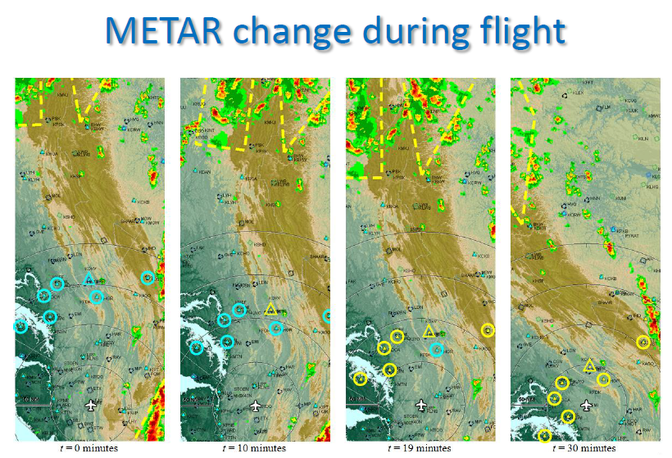
GA MET Presentations – Project Overview
METAR status change observation study
t=0 min: destination and alternate airports VFR
t=10 min: destination airport IFR. All others remain VFR
t=19 min: destination and majority of alternate airports IFR
t=30 min: final alternate airport goes IFR
Alternate airport – id with circle
Destination airport – id with triangle
Blue - VFR
Yellow - IFR
17

Slide 18
GA MET Presentations – Results Overview
3 independent commercial displays recreated in simulator
Pilots with display 1 showed lowest recognition (25% overall)
Pilots with display 3 showed highest recognition (62% overall)
Research goal to identify presentation that achieves consistent recognition to enhance pilot decision making
Low recognition of change in METAR status (VFR to IMC)
Presentation significantly impacted recognition
18

Slide 19
GA MET Presentations - Project Overview
Part 2 – Part Task experiment using One Shot Technique
Present screen shot, take it away, present revised screen, and measure pilot recognition of change
Used same 3 pilot groups and presentations
Post demonstration questions / pilot responses
19

Slide 20
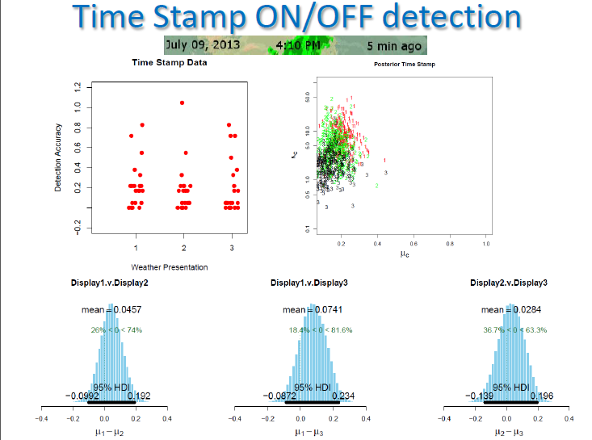
WTIC Program Identified Gaps
Commercial display of Time Stamp recreated in Part-Task simulation
Low observance of Time Stamp depiction (<20% overall)
Consistent with NTSB Safety Alert regarding NEXRAD Data Latency
Time Stamp is not successfully communicating information currency
NOTE: There are 2 additional tasks that were conducted as part of this study and are included in the “backup” slides. Time permitting, we will provide short explanation of those findings as well.
20

Slide 21
Project Overview: Impacts of Uncertainty Information on GA Pilot Decision Making
21

Slide 22
Uncertainty Information- Project Overview
Flight simulation of GA aircraft flying towards red cell
One pilot group used current deterministic MET information (current commercial rendering) and one pilot group was given uncertainty information in prototype rendering in addition to current commercial rendering
Observed impacts of uncertainty information on decision making
22

Slide 23
Uncertainty Information Project Results and Identified Gaps
Uncertainty Study
No pilots complied with the recommended 20nm separation distance from a thunderstorm (red cell)
65% of GA pilots in “deterministic” group came within 5nm of a red cell
Pilots in the “probabilistic” group performed significantly better with only 34% of pilots coming within 5nm of a red cell
Providing probabilistic weather information influenced pilot behavior to increase distance from red cells
*
*Reference US DOT/FAA Aeronautical Information Manual, August 22, 2013, Section 7-1-29, Thunderstorm Flying, http://www.faa.gov/air_traffic/publications/ATPubs/AIM/aim.pdf
23

Slide 24
Uncertainty Information Project Results and Identified Gaps
Uncertainty Study
Flightpaths depicted in Blue were routes taken by those with “deterministic” forecast display
Flightpaths depicted in Red were routes taken by those with “probabilistic” uncertainty forecast display
Pilot simulation group with probabilistic display made safer decisions for red cell avoidance
Providing probabilistic weather information influenced pilot behavior to increase distance from red cells
24

Slide 25
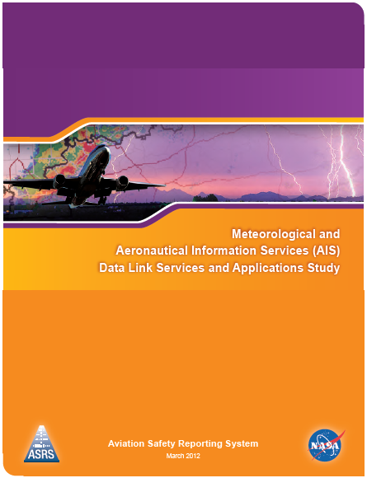
NASA ASRS Wx Event CallBack Study
ASRS CallBack Study
Pilot excerpts to explain incident causes
“…failure to accept the information as "advisory" and actually use it as a "tactical" tool.”
“…failed to properly interpret and recognize the age of the data…”
“…Pilot error in judgment when flying VFR…”
“…ATIS broadcast from class C airport that was 7 miles from destination that broadcasted a significantly different (better) weather conditions than existed at destination…”
25

Slide 26
NEXT STEPS
Perform research to identify and verify “minimum weather service” for GA operations
Perform research to identify weather-related factors associated with weather related GA accidents / incidents
Perform research to develop specific display design parameters
Provide information to support guidance material and standards
Enhanced training recommendations to be provided to AFS-820 for posting to FAASafety.gov
26

Slide 27
Possible Backup Slides
27

Slide 28
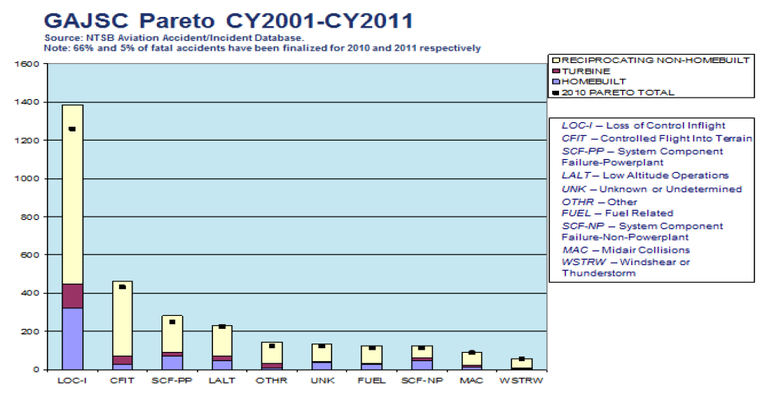
GA JSC Pareto
GA JSC Loss of Control Working Group
Approach and Landing Report September 1, 2012

Slide 29
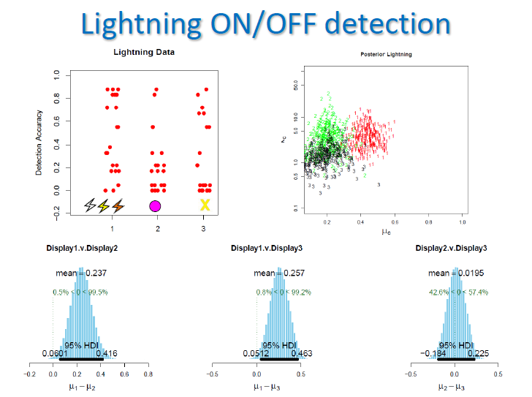
WTIC Program Identified Gaps
3 independent commercial displays recreated in Part-Task simulation
Pilots with “circle” or “X” display showed lowest recognition (20% average)
Pilots with lightning symbol showed statistically higher recognition (40% average)
Low recognition of change in lightning display
Statistically significant variations between pilot groups
29

Slide 30
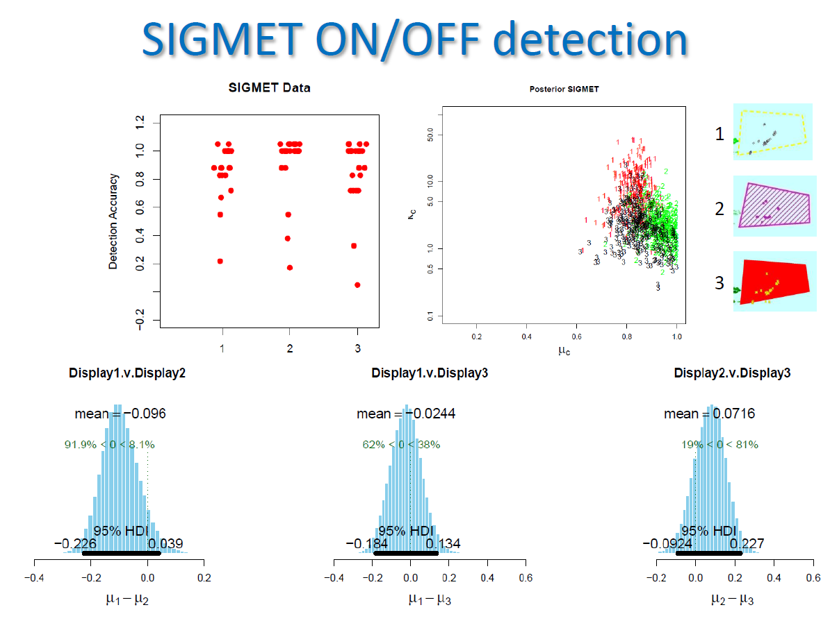
WTIC Program Identified Gaps
Commercial display of SIGMET recreated in Part-Task simulation
No gaps identified
High recognition of SIGMET areas across all 3 pilot groups
Part-Task identified consistent and positive recognition of a particular rendering

