Slide 1
REDAC NAS Ops Fall 2013 Review
NAS Operations PPT
Presented by: John Marksteiner
Date: March 12-13, 2014

Slide 2
PPT Portfolio Overview
NAS Ops PPT for the FY2015 FAA budget process includes the following areas:
Status of REDAC Recommendations (Fall 2012)
NextGen – Operations Concept Validation – Validation Modeling (OCVM)
2

Slide 3
Fall_2012_02 Subcommittee: NAS Operations REDAC Recommendation
Recommendation:
FAA should enable and support a longer-term activity in developing a understandable plan or roadmap for these activities, specifically supported by facilities and equipment (F&E) budget line, to facilitate shortfall areas and define needed research areas.
FAA Response:
Develop multi-year (5 year) Research Plan
Plan developed to be updated in FY14 to identify research gaps identified through multiple sources (NAS Enterprise Architecture, NextGen Segment Implementation Plan 4.0 and 5.0, NextGen Implementation Plan, Internal Reviews of FAA ConOps)
3

Slide 4
Fall_2012_03 Subcommittee: NAS Operations
REDAC Recommendation
Recommendation:
More intense cross-cutting human factors research and development efforts are necessary to ensure that the linkages among different ConOps that have been developed are carefully defined and addressed in order to ensure effective integration. All nodes of collaboration, including Airline Operations Centers.
FAA Response:
The following research proposals were included in the Multiyear plan to address this recommendation
NextGen Trajectory Negotiation (NTN) (approved)
Special Activities Airspace (SAA) (not approved)
Unmanned Aircraft Systems (UAS) integration (approved)
4

Slide 5
Fall_2012_05 Subcommittee: NAS Operations REDAC Recommendation
Recommendation:
FAA research activities (e.g., ConOps development, validation, etc.) involving NextGen equipage need to explore the following:
Critical mass thresholds for delivery of benefits to equipped users
Potential automation mitigations to enable controllers to handle mixed capabilities
Trade space of performance requirements, benefits, costs, aircraft equipage levels, and ground capabilities with respect to overall system performance gains, system benefits, and net benefits to equipped operators
Performance and equipage levels in different timeframes and operational environments (2018 vs. the 2025 timeframe and later)
Methods to ensure that aircraft with NextGen equipage gain differential benefits over non-equipped aircraft
FAA Response:
The following research proposals were included in the Multiyear plan to address this recommendation
Performance Based Navigation (PBN) ConOps (not approved)
Performance Based Navigation Flexible Route System (not approved)
Level 2 Data Comm ConOps (not approved)
Mixed Equipage Research for Operational Concepts Validation (not approved)
5

Slide 6
Fall_2012_05(Continued) Subcommittee: NAS Operations REDAC Recommendation
FAA Response:
The Life Cycle Integration Office (ANG-D3) prepared a draft paper, dated May 25, 2011, addressing “NextGen equipage strategy” and various mixed performance environments. The paper describes a systematic pathway for identifying and validating NextGen services and benefits to be accrued based on a set of user-defined operations. It lays out the foundation for the next level of detail supporting the development of NextGen Implementation Plan to evolve enabling technologies. The strategy will help facilitate improved performance for all stakeholders (i.e., mainline, regional business, General Aviation, military) for the Mid-Term. Part of the strategy is to address the challenges and dynamics of aircraft mixed equipage, airspace design and procedures, airport configuration and operations, variations in business case analysis practices and other critical success factors. The paper also proposes a simplistic means of providing air traffic controllers with additional aircraft capability information and scenarios to support traffic flow and operational management of aircraft.
Notes:
NextGen Equipage Insertion Strategy Paper Final May 25, 2011, was provided to Gloria Dunderman on December 19, 2013 in pdf.

Slide 7
Fall_2012_06 Subcommittee: NAS Operations REDAC Recommendation
Recommendation:
The FAA research supporting validation of a TBO concept of operations should include the following activities: Differentiation of midterm and post midterm operations and benefits; integrate TFM, CDM with Data Comm to the aircraft regarding reroutes (pre-flight and during flight); address mixed capability operations; quantify marginal benefits of differing performance requirements and capabilities from both a system perspective and the perspective of investing operators
FAA Response:
The following research proposals were included in the Multiyear plan to address this recommendation
Trajectory Operations (TOps) Concept of Operations (approved)
Complex Clearances (approved)
Vertical Ascent and Decent Rate (VADR) (approved)
7

Slide 8
PPT Financial Summary
 | FY 12 Enacted |  | FY 13 Enacted |  | FY 14 Enacted
Program Title | In-House | Contracts | In-House | Contracts | In-House | Contracts
Base Program (RE&D)
Base Program (RE&D)
Base Program (F&E)
NextGen Program (F&E)
NextGen Ops Concept Validation |  | 8,122,000 |  | 3,873,000 |  | 4,722,000
F&E Subtotal |  | 8,122,000 |  | 3,873,000 |  | 4,722,000
PPT Total |  | 8,122,000 |  | 3,873,000 |  | 4,722,000
8

Slide 9
PPT 5-Year Financial Plan
Program | Out-Year Contract Dollars (For Planning Purposes Only)
 | FY 2014 | FY 2015 | FY 2016 | FY 2017 | FY 2018
Base Program (RE&D)
NextGen Program (RE&D)
RE&D Subtotal
Base Program (F&E)
NextGen Program (F&E)
NextGen Ops Concept Validation | 4,722,000
F&E Subtotal | 4,722,000
PPT Total | 4,722,000
TBD
9
Notes:
Provide a five-year projection of contract spending for FY 2012 through FY 2016. These figures will be provided by the RST Financial Manager, and are to be considered only as a target amount. The projected budget levels should be labeled “For Planning Purposes Only” and will only include contract dollars.
Confirm ATDP numbers
Include SNT and Ops Concept Validation; no numbers for 1a12a

Slide 10
FY14 Plans – Operations Concept Validation / Modeling (OCVM)
Unmanned Aircraft Systems (UAS) Scenario Development (Oct 2013)
Analyze improved departure predictability on demand predictions (EDPT) (Nov 2013)
Optimized Route Coordinator (ORC) Functional Research Assessment (Dec 2013)
Dynamic Network Analysis (DNA) Model (Dec 2013)
Concept Development for Datalink of Complex PBN Clearances in Support of 4D TBO (PBN) (April 2014) – Project has been refocused without change in scope to develop the Dynamic RNP concept in support of AJV-7 and RTCA SC-214 (TBD)
Statistical Methods for Departure Predictability (SMDP) BBN Model (Jan 2014)
TMI Attribute Standardization for Tracking and Simulation (TAS) (June 2014)
NextGen Trajectory Negotiation (NTN) Concept Development (Dec 2013)
Remote Tower (RT) Research – project refocused to support SBS Program’s Blended Airspace project (FY14 Activities TBD)
Space Vehicle Operations (SVO) Concept Development/Initial Validation (Oct 2014)
10
Notes:
TMI deliverable is Taxonomy for June 2014 (PLA date)

Slide 11
FY15 Planned Activities – OCVM
Specific Ops Concept Validation Modeling project outcomes for FY15 include:
Optimized Route Coordinator (ORC): Develop procedures and automation ability to generate optimal airspace, routing configuration, and other traffic management initiatives for consideration.
NextGen Trajectory Negotiation (NTN): Provide the methodology for performing real-time trajectory negotiation for trial planning, coordinating, issuing, and accepting or rejecting trajectory changes (reroutes) in real time
Remote Towers (RT) Research: Define and validate a concept to provide remote operations at non-towered airports in support of Blended Airspace Project
Space Vehicle Operations (SVO): Analyze space vehicle operations to include launch patterns, trajectory characteristics, safety data, locations, expected launch quantities, and impact to airborne and ground aircraft to mature ConOps
Complex Clearances/ Dynamic RNP (DRNP) using Data Communications: Concept validation
Unmanned Aircraft Systems (UAS): Functional Analysis / Operational requirements development based on scenarios
Vertical Conformance Verification (VCV was VADR): Provides ATC with aircraft climb and descent rate for conformance monitoring.
TMI Attribute Standardization for Tracking and Simulation (TAS): Develop TMI System Model
11

Slide 12
Emerging FY16 Focal Areas
NextGen Ops Concept Validation – Validation Modeling
Develop updates for end-to-end and lower level ConOps
Validate high priority 2nd and 3rd level operational concepts, possible areas of research include:
Optimized Route Coordinator (ORC)
Space Vehicle Operations (SVO)
Remote Towers (RT) Research (Blended Airspace)
Complex PBN Clearances (PBN) / Dynamic RNP (DRNP)
Derive inputs for future modeling of the NextGen benefits for 2025 timeframe
Modeling and simulation activities to support risk reduction activities
Supports implementation of operational capabilities including those associated with ATC decision support tools procedures
Development of concept level requirements will incrementally be handed off to implementation organizations
Requirements for future Data Comm applications, Collaborative traffic management, and SVO may be generated
12

Slide 13
FY13 Projects
Integrated Arrival/Departure Control Services (IADCS)
Optimized Route Coordinator (ORC)
Trajectory Operations (TOps) ConUse
NextGen Trajectory Negotiation (NTN)
Dynamic RNP(DRNP)
Enhanced Departure Predictability for TFM (EDPT)
Statistical Methods for Departure Predictability (SMDP)
TMI Attribute Standardization for Tracking and Simulation (TAS)
Space Vehicle Operations (SVO)
Remote Towers (RT) Research
Unmanned Aircraft Systems (UAS) Integration into the NAS
Vertical Conformance Verification (VCV)
13

Slide 14
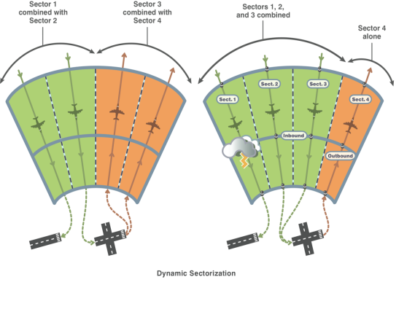
Integrated Arrival / Departure Control Services (IADCS)
Description:
To improve operational efficiencies in major metropolitan areas by:
Using dynamic route options to enhance metroplex throughput
Using dynamic airspace reconfiguration of bi-directional ARR/DEP routes
Improved utilization of ATC assigned routes and emerging NextGen trajectories
Current activities focus on what can be done with current automation platforms and existing airspace design / surveillance capabilities
Partnerships:
ANG-E25
NATCA
Accomplishments / Plans:
Selected Atlanta area facilities (A80 and ZTL) as test model (Nov 2011)
Cognitive Walkthrough (Feb 2012)
Validated IADCS alternatives using fast-time simulations (Nov-Dec 2012)
Human-in-the-loop simulation completed (Aug-Sep 2013)
Will brief HITL results (due Spring 2014) to AJV-7 to ascertain next steps
Funding:
FY11 | FY12 | FY13 | FY14 | FY15
$0 | $0 | $0 | $0 | $0
Project is supported with funding allocations prior to FY11
14

Slide 15
Optimized Route Capability (ORC)
Description:
Additional IADCS and PBN route options/ playbooks make optimal route selection and coordination more complicated
ORC will research tools and procedures needed to assist ATM with assessment, coordination, and implementation of these new options in order to optimize the benefits
Partnerships:
MITRE
Accomplishments / Plans:
Preliminary ORC Functional Analysis (Oct 2012)
Initial ConOps completed (Jun 2013)
Cognitive walkthrough identified specific traffic management issues, and gathered input from the facilities (Nov 2013)
Optimized Route Capability Functional Research Assessment Report (Dec 2013)
Current research focusing on ORC decision tree and preliminary algorithm development
Funding:
FY11 | FY12 | FY13 | FY14 | FY15
$1,550,000 | $510,152 | $1,229,062 | * | *
* Proposed follow-on funding identified in Research Plan
15

Slide 16
Trajectory Operations (TOps) ConUse
Description:
Supported AVS/RTCA/ANG/ATO in defining an overall TOps Concept and requirements for NextGen avionics automation and collaborative capabilities
Ensured domain specific concepts work end-to-end
Identified concepts and technologies within the FAA that may enable NextGen trajectory operations in the mid-term
Identified shortfalls in concepts and technologies for the mid-term
Partnerships:
ATO
AVS
Accomplishments / Plans:
COMPLETED
TOps ConOps information mapping, FAA and RTCA version (Oct 2012)
TOps ConOps document is in the process of being completed (Jun 2013)
Final TOps Document was sent to the Senior Management for general distribution (Jul 2013)
Funding:
FY11 | FY12 | FY13 | FY14 | FY15
$0 | $90,000 | $0 | * | *
* Proposed follow-on funding identified in Research Plan
16

Slide 17
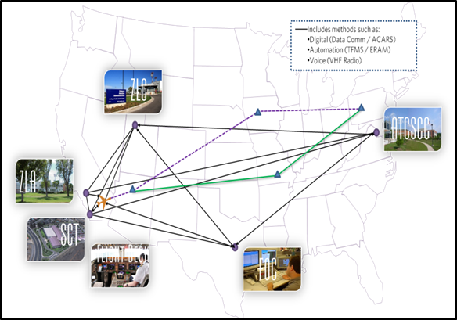
NextGen Trajectory Negotiation (NTN)
Description:
NTN will provide the methodology for performing real-time trajectory negotiation for trial planning, coordinating, issuing, and accepting or rejecting trajectory changes (reroutes) in real –time
Existing trajectory negotiation tools will be modified or developed as appropriate, utilizing defined research activities, to implement the NTN concept
Partnerships:
Boeing Airline Operations Experience (AOE)
Accomplishments / Plans:
Conducted NTN Cognitive Walkthrough #1 (Sep 2012)
Developed NTN Cognitive Walkthrough Final Report (Dec 2012)
NTN Cognitive Walkthrough #2 (Dec 2013)
NTN Cognitive Walkthrough #2 Final Report (Jan 2014)
NTN Concept of Operations (Feb 2014)
Funding:
FY11 | FY12 | FY13 | FY14 | FY15
$0 | $450,000 | $0 | *$1.3M | *$1.5M
* Proposed follow-on funding identified in Research Plan
17

Slide 18
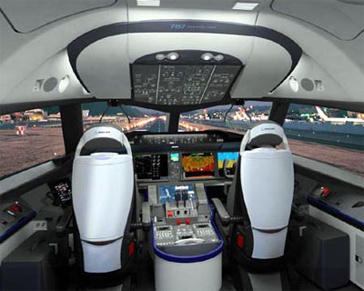
Dynamic RNP (DRNP)
Description:
Identify candidate Complex PBN Clearances (CPCs) that are operationally and technically viable and that yield the highest benefits
Emphasis on Dynamic Required Navigation Performance (DRNP)
CPC (DRNP) applications will be mapped in support of arrival / departure and high altitude en route operations.
Focus: Further-term requirements (ATN avionics)
Accomplishments / Plans:
Partnerships:
AIR, AJV-7
Boeing, Saab Sensis
United Airlines
Completed
Annotated outline of ConOps (Oct 2013)
Successful Focus Group #1 (Nov 2013)
DRNP Applications defined (Dec 2013)
Successful Focus Group #2 (Jan 2014)
Planned
FINAL ConOps (DRNP) (Mar 2014)
ROM Benefits Case (DRNP) (Apr 2014)
Whitepaper summarizing findings / recommendations (May 2014)
Funding:
FY11 | FY12 | FY13 | FY14 | FY15
$0 | $800,000 | $0 | * | *
* Proposed follow-on funding identified in Research Plan
18

Slide 19
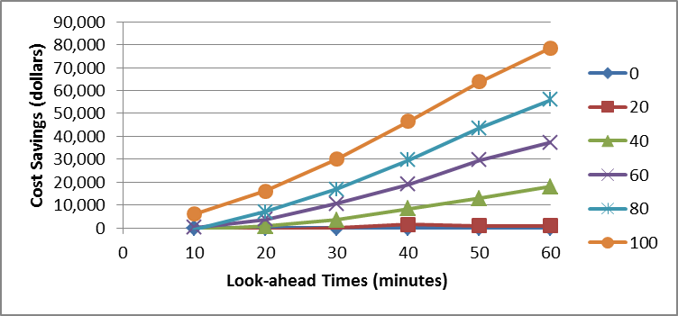
Enhanced Departure Predictability for TFM (EDPT)
Description:
Analyzed the amount of improvement in off-time predictions from enhanced NAS user tools, the ability to provide such improved data to TFM, and the resulting improvements in demand predictions
Accomplishments / Plans:
COMPLETED
Improved departure prediction benefits analysis (Sep 2013)
Analysis of improved departure predictability on demand predictions (Nov 2013)
Proposed to demonstrate the ability and benefits of better off-time predictions through collaboration with airlines and industry to conduct an operational demonstration of such a tool
Partnerships:
Volpe
Funding:
FY11 | FY12 | FY13 | FY14 | FY15
$300,000 | $300,000 | $0 | * | *
* Proposed follow-on funding identified in Research Plan
19

Slide 20
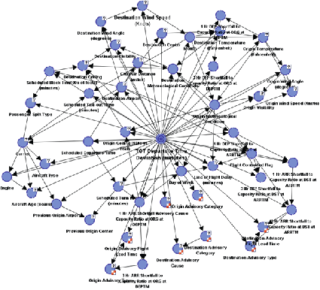
Statistical Methods for Departure Predictability (SMDP)
Description:
SMDP research will develop a probabilistic directed acyclic graphical model for improving departure time predictions by developing a Bayesian Belief Network (BBN) model
BBN model will utilize historical data to improve the reliability of departure time predictions for real-time traffic flow management
Partnerships:
TBD
Accomplishments / Plans:
BBN Model Approach (Aug 2013)
SMDP Model Briefing (Jan 2014)
SMDP Final Model and Report (Feb 2014)
SMDP Future Model Plan (Feb 2014)
Funding:
FY11 | FY12 | FY13 | FY14 | FY15
$0 | $700,000 | $0 | *$600,000 | *$450,000
* Proposed follow-on funding identified in Research Plan
20

Slide 21
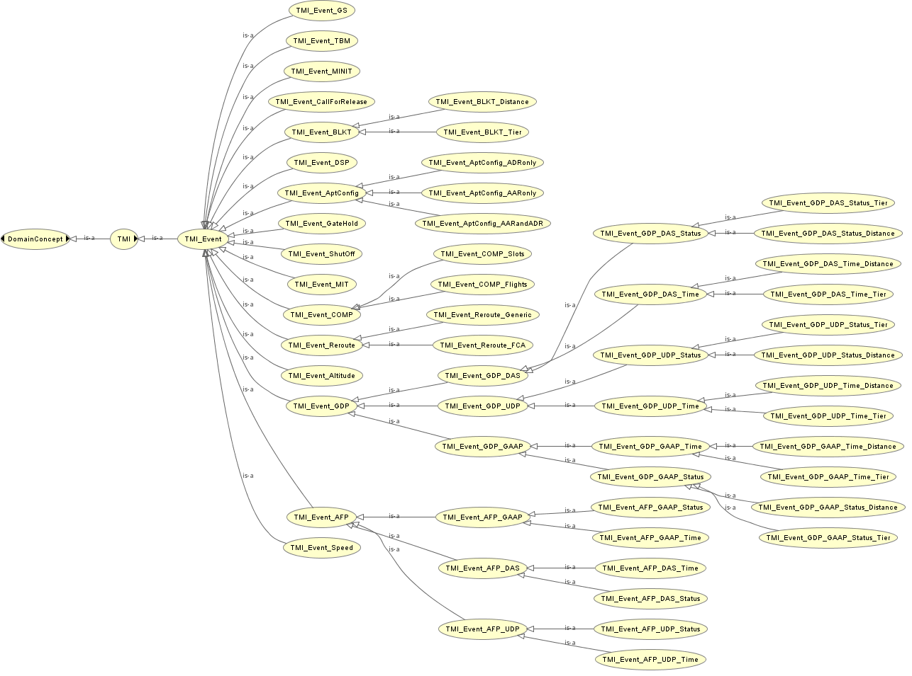
TMI Attribute Standardization (TAS)
Description:
This research will utilize historical and current TMI data to define a system model in which TMI attributes are categorized in a manner that will facilitate real-time TMI information and feedback to NAS users, unified TMI modeling, post-event analysis, and continuous flight day evaluation
This research will also result in standardized TMI entry, parsing, and tracking, by enhancing functionality currently provided by NTML
Partnerships:
TBD
Accomplishments / Plans:
TMI Analysis Report (Oct 2013)
TMI Workshop (Nov 2013)
TAS Site Visits (Feb-Jul 2014)
TMI Final Taxonomy Report (May 2014)
Funding:
FY11 | FY12 | FY13 | FY14 | FY15
$0 | $700,000 | $0 | *$250,000 | *$150,000
* Proposed follow-on funding identified in Research Plan
21

Slide 22
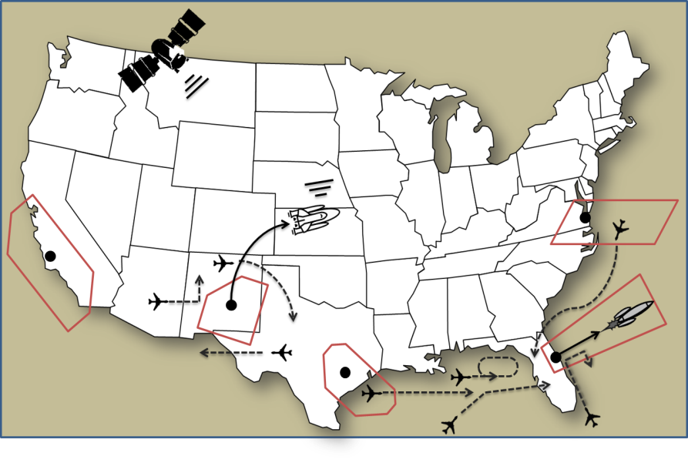
Space Vehicle Operations (SVO)
Description:
This research will analyze space vehicle operations to include launch patterns, trajectory characteristics, safety data, locations, expected launch quantities, and impact to airborne and ground aircraft
Activities include development of a SVO Concept of Operations, a NAS/safety impact assessment, and conduct of human-in-the-loop experiments to validate concept
This research will result develop advanced tools and procedures for integrated space traffic management in the NAS
Partnerships:
FAA Commercial Space Transportation (AST)
Air Traffic Organization Space Operations Stanford University
William J. Hughes Technical Center
ACTA
Accomplishments / Plans:
SVO Focus Group #1 (Dec 2012)
SVO Shortfall Analysis (Apr 2013)
SVO Focus Group #2 (Sep 2013)
SVO Cognitive Walkthrough (Jan 2014)
SVO Concept of Operations (Jun 2014)
SVO Debris Mitigation Prototype (Aug 2014)
Integrated NAS/SVO Simulation Model (Oct 2014)
SVO Debris Mitigation HITL (Oct 2014)
Funding:
FY11 | FY12 | FY13 | FY14 | FY15
$300,000 | $1,390,700 | $900,000 | *$1.85M | *$2.25M
* Proposed follow-on funding identified in Research Plan
22
Notes:
Kevin Hatton

Slide 23
Remote Tower (RT) Research
Description:
Develop operational concept to remotely operate currently non-towered airports
Support the SBS Office in the development of the Blended Airspace concept
Remote Facility
Fully Remote Ops
Additional Services
Advanced Automation
Partnerships:
SBS MITRE
MIT/LL CSSI
BAH/MCR State of CO
WJHTC Human Factors Lab
NATCA
Accomplishments / Plans:
Draft Shortfall Analysis (Mar 2013)
Draft ConOps (Jun 2013)
Conduct Part-Task Simulation (Jul 2014)
Support SBS HITL (Aug 2014)
Develop CHI for Blended Airspace Concept (Mar 2015)
Funding:
FY11 | FY12 | FY13 | FY14 | FY15
$1,050,000 | $350,000 | $500,000 | *TBD | *TBD
* Proposed follow-on funding identified in Research Plan
23
Notes:
Kristina Carr

Slide 24
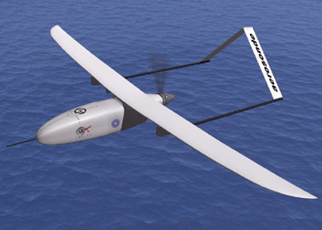
UAS Integration into the NAS
Description:
Mature concept of operations for UAS integration into the NAS:
Identify gaps in ConOps 2.0 in need of maturation and elements ready for validation
Generate operational scenarios for mature state and mid-term UAS operations
Document concept-level operational requirements, for both NAS and UAS operators, for mature state and mid-term UAS operations in the NAS
Accomplishments / Plans:
Partnerships:
Flight Standards Service: AFS-80 & AFS-400
Air Traffic Organization: AJV-7
Aircraft Certification Service: AIR-130
Deliver initial set of operational requirements for mature state UAS operations based on ConOps 2.0 (Nov 2013) (FY12 PLA milestone)
Requirements Decomposition (NAS/UAS) (Jan 2014)
UAS Integration Concept Development (Level 2) (Jun 2015)
Funding:
FY11 | FY12 | FY13 | FY14 | FY15
$0 | $445,000 | $500,000 | * | $0
* Proposed follow-on funding identified in Research Plan
24
Notes:
Sherri Magyarits

Slide 25
Vertical Conformance Verification (VCV)
Description:
The objective of the VCV concept is to develop a means for obtaining and monitoring real-time vertical rate (climb and descent) from top of descent to touchdown and from departure to top of climb.
Benefits: Addition of vertical rate information will improve controllers’ ability to monitor aircraft conformance. This enhances opportunities to utilize evolving NextGen trajectory design, increasing efficiency and capacity in transition airspace.
Partnerships:
Boeing
Accomplishments / Plans:
VCV Operational Improvement Assessment (Sep 2014)
Funding:
FY11 | FY12 | FY13 | FY14 | FY15
$0 | $700,000 | $0 | * | *
* Proposed follow-on funding identified in Research Plan
25
Notes:
Phil Bassett

