Slide 1
UAS Strategic Plans and Near Term Opportunities
Presented to:
REDAC NAS Operations Subcommittee
Presented by:
Maureen Keegan – ATO Operational Concepts, Validation & Requirements Directorate (AJV-7)
Date: August 9, 2016

Slide 2
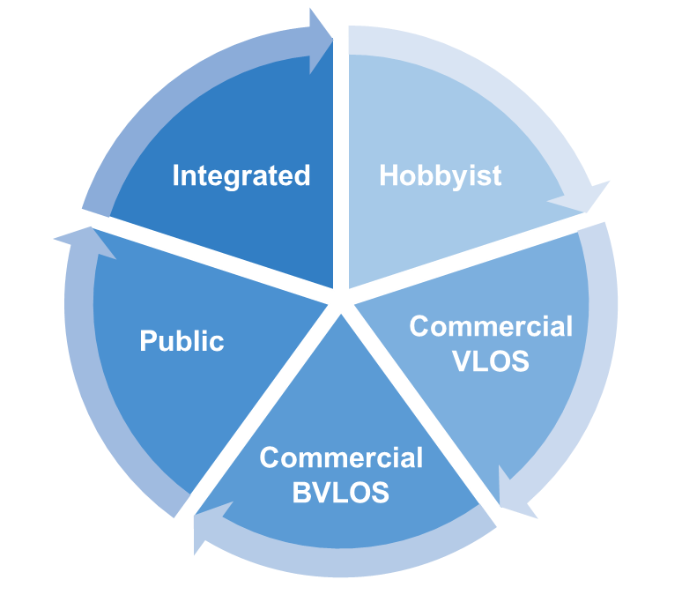
Program Overview
UAS operations are on the rise and the FAA must be ready to meet the growing demand
Model Aircraft Operations
Low Altitude VLOS sUAS Operations
Low Altitude BVLOS sUAS Operations
Public UAS Operations (All Sizes and Airspace)
Integrated UAS Operations
In support of these operations, program will:
Execute concept maturation efforts to address existing FAA shortfalls associated with the provision of air traffic services to UAS operators
Develop AMS artifacts to support required changes/enhancements to FAA automation systems
3

Slide 3
Applicability to FAA UAS Sectors Framework
FAA defined a “UAS Sectors Framework” to facilitate greater understanding, productive discourse, and consensus for action associated with UAS integration
Work completed to date supports all UAS sectors
UAS Work Elements | Hobbyist | Commercial VLOS | Commercial BVLOS | Public | Integrated
UAS Operational Requirements |  |  | ✓ | ✓ | ✓
Mid-Term UAS Scenarios |  | ✓ | ✓ | ✓
Mid-Term UAS Scenario Allocation Tables |  | ✓ | ✓ | ✓
Mature State UAS Scenarios |  |  |  | ✓ | ✓
Mature State UAS Scenario Allocation Tables |  |  |  | ✓ | ✓
UAS Concept Maturation Plan |  |  | ✓ | ✓ | ✓
UAS Operations Evolution Strategy (OES) |  | ✓ | ✓ | ✓ | ✓
ATC Notification/Authorization Requirements (Interim Capability) | ✓ | ✓
ATO UAS FY18-20 Vision | ✓ | ✓ | ✓ | ✓

Slide 4
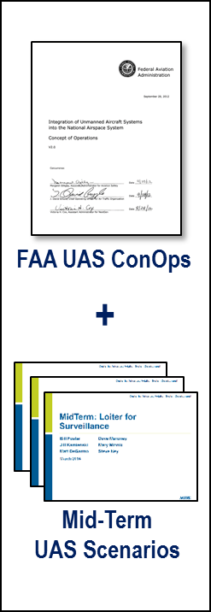
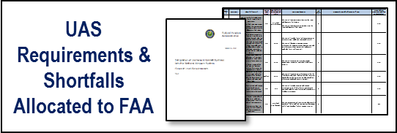
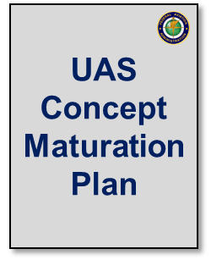
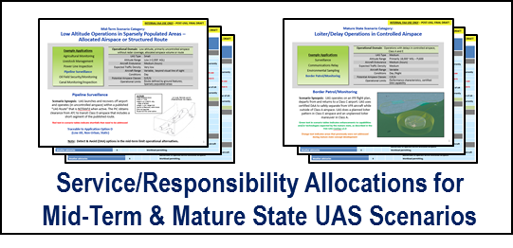
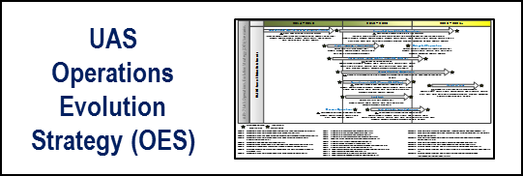
From Concepts to Operational Focus Areas
Notes:
Developed AJV-7 UAS Concept Maturation Plan to address air traffic–related challenges to support the evolution of UAS operations in the NAS
Plan identifies concept maturation activities AJV-7 proposes to lead (i.e., sponsor) or support (i.e., consult or participate in), subject to availability of funding/resources
Activities are identified in the form of concept maturation questions that need to be answered through supporting concept exploration, development, and validation efforts
Foundational inputs include the FAA UAS ConOps and the Mid-Term UAS Scenarios:
UAS ConOps – describes integrated UAS operations in the future NAS and contains mature state (integration) scenarios designed to demonstrate a variety of operations
Mid-Term UAS Scenarios – describes how UAS are envisioned to operate in the NAS when certain policies and procedures have not yet been established and certain capabilities, such as airborne DAA, have not been certified for operational use
These two products informed subsequent artifacts:
UAS concept-level requirements were derived for services, automation systems, capabilities, procedures, training, and policies, and were allocated to either the FAA or the UAS operator community
UAS requirements allocated to the FAA were then aligned and grouped by their relevant shortfalls
Service/Responsibility Allocation Tables were developed for each Mid-Term and Mature State UAS scenario and vetted with the UAS Steering Group (USG)
ATO UAS Operations Evolution Strategy (OES) was developed based on the vision established in ConOps and scenarios
AJV-7 UAS Concept Maturation Plan supports the OES milestones and addresses FAA shortfalls required to enable a number of UAS mid-term and mature state (i.e., far-term) operations.
Note: Completed, ongoing, and planned UAS concept development/research efforts will serve as an input for further scoping and detailing the work that AJV-7 will lead or support. This will be addressed during the development of supporting concept maturation proposals

Slide 5
Multi-Year Plan
First year of funding for this program is FY16 (received 03/24/16)
FY16-18 will focus on maturing requirements by executing UAS concept maturation efforts
FY19-22 will focus on developing AMS artifacts (for CRDRD, IARD, IID, FID) to support changes/enhancements to automation systems
FY16 | FY17 | FY18 | FY19 | FY20 | FY21 | FY22
Stakeholder Outreach
Scenario Impact Analysis and HITL Demonstrations
CM Priorities
AMS Artifact Development for CRDRD
Stakeholder Outreach
UAS Scenario Vetting with CPCs
Scenario Impact Analysis and HITL Demonstrations (cont.)
Update and Vetting of Operational Requirements
CM Priorities
AMS Artifact Development for IARD
AMS Artifact Development for IID
Update of UAS CM Products, Shortfalls, and Requirements
CM Priorities
Finalization of UAS requirements
AMS Artifact Development for FID
* UAS Program will take advantage of windows of opportunity, where available, to affect system changes earlier (if certain requirements mature before others and may be allocated to specific systems prior to FY19).

Slide 6
FY16 Program Status
Recommendations for ATC Notification/Authorization for Model Aircraft and sUAS Operations
Developed requirements for an automated system to support model aircraft operations that require ATC notification, and sUAS operations require ATC authorization prior to operating near airports
WG consisted of representatives from: AJV-7, AJV-1, AJV-8, AJV-C, AJT, AJI, ANG-C54, and NATCA
Requirements are levied on the system, the operator (Part 101-E, Part 107), and ATC
Requirements were provided to PMO for implementation

Slide 7
FY16 Program Status (cont)
ATC Receipt and Display of Contingency Information [When an IFR Flight Plan is Filed]
Objective: Determine initial contingency information and high-level display requirements for terminal and en route ATC systems
Performer: ANG-C35 (UAS Engineering Branch)
Collaborating with ANG-C1 and AJV-8 on this work
Literature Review completed 07/31/16
Tentative Schedule:
Terminal Cognitive Walkthrough (08/01/16 – 12/31/16)
En Route Cognitive Walkthrough (01/01/17 – 03/31/17)

Slide 8
FY16 Program Status (cont)
Scenario Human-in-the-Loop Demonstrations
Objective: Explore feasibility and operational impacts of selected low-altitude operational scenarios on NAS operations and ATC through HITL demonstrations.
Performer: ANG-C35 (UAS Engineering Branch)
Pipeline scenario was selected for the first HITL demonstration
Tentative Schedule:
Project Plan Development (06/01/16 – 08/31/16)
HITL Demo: Scenario #1 (08/01/16 – 11/30/16)
HITL Demo: Scenario #2 (11/01/16 – 02/28/17)
HITL Demo: Scenario #3 (02/01/17 – 05/31/17)

Slide 9
FY16 Program Status – Others
Finalizing contracts for four additional FY16 efforts:
ATC Receipt and Display of Contingency Information [When a Notification is Submitted]
Risk Assessment – No Radar Detection, Differentiation, and Tracking Capability of Non-Cooperative UAS with Small Radar Cross Sections
Scenario Impact Analysis (Modeling & Fast-Time Simulations)
UAS Waivers Trend Analysis
Updating UAS Scenario Allocation Tables
Updating UAS Shortfalls and Requirements Database

