Slide 1
UAS Flight Information Management System
FY18 Proposal
Presented to: REDAC NAS Ops Subcommittee
Presented by: Sherri Magyarits
Advanced Concepts Branch, ANG-C54
Date: August 9, 2016

Slide 2
The Need for Notification
With the proliferation of small UAS (sUAS) in the NAS, the FAA, as the purveyor of aviation-related information, including known and potential hazards, has a need to know at some level when and where these operations are occurring. Of particular concern is sUAS operating at low altitudes, where the largest growth in demand is expected.
From a regulatory and safety perspective, notification of UAS operations provides a means of traceability to (1) inform other NAS users, if needed, of sUAS activity in the vicinity of the airspace in which they are operating; (2) ensure operators are complying and conforming to regulatory standards; and (3) identify and hold accountable those who are responsible during accident/incident investigations.*
From an Air Traffic Control (ATC) /Air Traffic Management (ATM) perspective, notification of UAS activity enables the ANSP to provide safe and efficient flight services to manned and unmanned aircraft in the NAS.
  *UAS registration provides a means of traceability/accountability post-flight/incident, but a UAS Flight Information Management System for sUAS is needed to manage and generate awareness of sUAS operations before and during flight.

Slide 3
The Need for Notification (cont’d)
While an IFR flight plan provides sufficient notification of UAS flight and requisite data to the FAA, applying this requirement* is not always practical, doable, or necessary given the (1) location, nature, and/or dynamics of UAS operations; and (2) existing regulations and associated requirements for operating under IFR (14 CFR (Code of Federal Regulations) Part 91, Subpart B).
The current NOTAM system cannot effectively satisfy the need for informing other airspace users of UAS operations, given that exponential increases in sUAS activity are expected.
Notification of sUAS activity to other airspace users is necessary to ensure safety of flight. This is particularly the case for sUAS operations in low altitude, uncontrolled airspace, where there is no positive ATC.
  *IFR flight plan required for integrated operations conducted beyond visual line of sight (BVLOS) of the operator, as per the FAA’s UAS Concept of Operations 2.0.

Slide 4
Proposed UAS Flight Information Management System
A UAS Flight Information Management System, independent of the flight planning system, will provide a means to essentially manage unmanaged airspace, and for sUAS to gain access to the NAS.
The UAS Flight Information Management System will be an FAA-approved system for UAS operators, operating primarily below 400 ft, to notify of/submit their flight intent to the FAA, and for other airspace users to access that information.
Where notification in lieu of a flight plan extends to controlled airspace, the system will provide ATC with essential sUAS flight information so they can assess the risk of the proposed operation, provide feedback electronically via the mechanism to the sUAS operator, maintain awareness of the sUAS activity, and provide separation and advisory services, as required, to safely manage sUAS and manned traffic.
The system may be linked to the UAS registration database for operator/aircraft traceability purposes.

Slide 5
Notification Requirements
The FAA’s notification needs with respect to sUAS operations depend on a number of factors, including the type of sUAS operation being conducted, where it is conducted, what services (if any) are required, what the sUAS capabilities are, and more.
Identifying notification requirements appropriate to specific sUAS operations allows the FAA, safety organizations, and regulators to process and access flight data in accordance with their organizational needs and responsibilities.
Notification requirements development has been underway to support model aircraft operations (Part 101-E) and sUAS operations (Part 107) and will be leveraged for the UAS Flight Information Management System.
Identified and vetted UAS operational scenarios and concepts, with associated characteristics (e.g., type, location), where notification in lieu of an IFR flight plan is practical and necessary

Slide 6
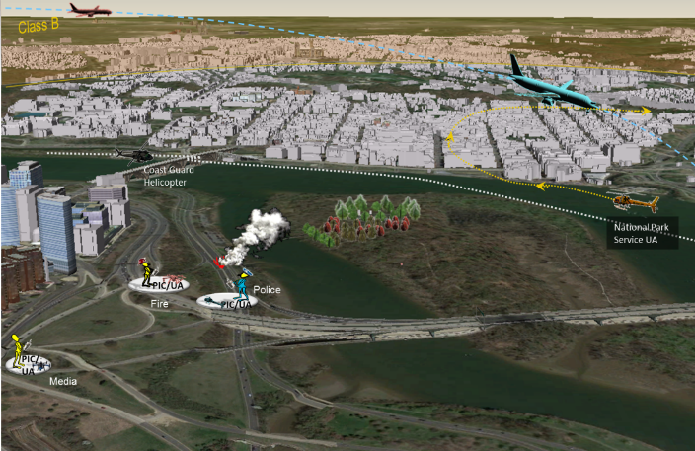
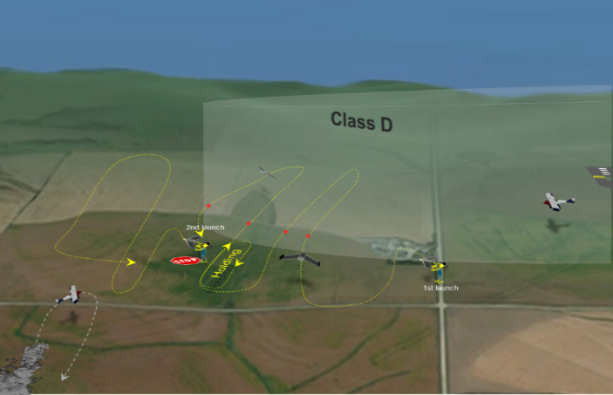
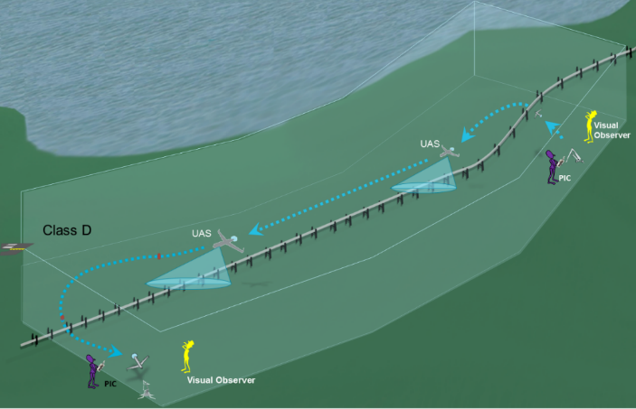
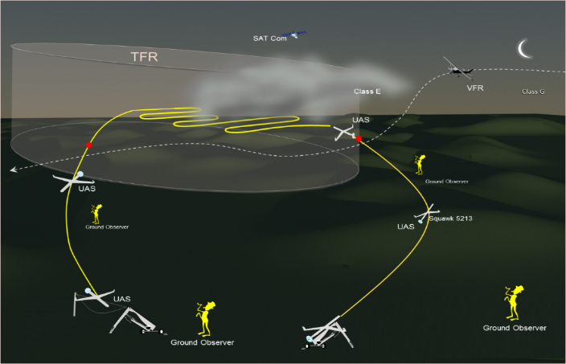
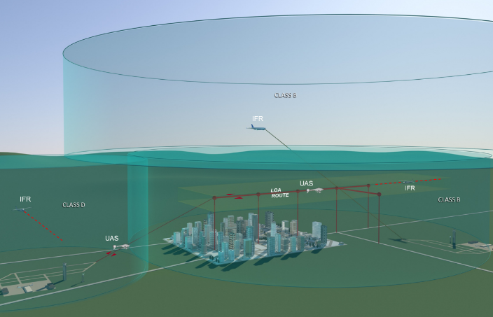
Low Altitude Scenarios involving Notification
Dynamic Allocated Airspace over Populated Areas (VLOS)
Extended Visual over Low Populated Areas
Structured/Designated Route over Low Populated Areas (BVLOS)
Ex: Accident Scene Investigation
Ex: Agricultural Monitoring
Ex: Pipeline Surveillance
Dynamic Allocated Airspace over Low Populated Areas (BVLOS)
Below 400ft AGL in Authorized Areas of Operation
Integrated Operations (BVLOS)
Ex: Search and Rescue
UTM Operations
Ex: Highway Traffic Reporting

Slide 7
Notification – Concept & Requirements Development Efforts
Resulting from need to develop an automated system to support model aircraft operators that must notify ATC (Part 101-E) & sUAS operators who must obtain ATC authorization prior to operating near airports (Part 107)
Developed functional and information requirements for an interim capability
Levied requirements on the system (“mechanism”), the operator, and ATC
Provided requirements to PMO for implementation
II. Resulting from need to develop alternative means for UAS to submit flight intent when an IFR flight plan is not feasible or practical
  Identified the need, based on concept maturation efforts, for a notification system to support:
    Flight intent submission for various VLOS, EVLOS, and BVLOS operations, and
    Distribution of notification information to other airspace users
  Developed high-level information requirements and a notional process for notification (documented in Low Altitude UAS Operating Concepts Paper)
7

Slide 8
FAA Concept Products: Mapping to UAS Operations
Products | Hobbyist | Commercial VLOS | Commercial BVLOS | Public | Integrated
Concept Documents
FAA UAS ConOps, Version 2.0 |  |  |  | ✓ | ✓
Low Altitude UAS Operating Concepts Paper (not formally vetted) |  | ✓ | ✓ | ✓ | ✓
Derived Artifacts
Mid-Term UAS Scenarios & Responsibility Allocation Tables |  | ✓ | ✓ | ✓
Mature State UAS Scenarios & Responsibility Allocation Tables |  |  |  | ✓ | ✓
UAS & FAA Operational Requirements |  |  | ✓ | ✓ | ✓
Strategic Plans
UAS Concept Maturation Plan |  |  | ✓ | ✓ | ✓
UAS Operations Evolution Strategy |  | ✓ | ✓ | ✓ | ✓
ATC Notification/Authorization Requirements for Interim Capability - In progress | ✓ | ✓
Proposed Effort
Low Altitude UAS Flight Information Management System | ✓ | ✓ | ✓ | ✓ | ✓

Slide 9


UTM Research Transition Team (RTT)
Notification a major element of UTM
FAA/NASA RTT will address collaboratively
Subgroups established to address
  Concepts and Use Cases (Overarching)
  Data and Information Exchange
  Information Architecture
  Performance (Communications & Navigation)
  Sense and Avoid (Surveillance & Control)

Slide 10
Benefits
FAA Benefits
  Increased numbers and expanded access of UAS operations in the NAS while maintaining safety and efficiency
  Improved situational awareness for FAA and ANSPs
  Reduction in number of Certificates of Waiver or Authorization (COAs) and exemptions processed and amount of time spent processing COAs and exemptions, even as number of UAS operations increases
User Benefits
  Increased access to NAS for UAS users
  Improved situational awareness for UAS operators and other airspace users, particularly in uncontrolled airspace

Slide 11
Questions?

